Slide 1

Measuring Information in very Large Data Sets
Pieter Adriaans
Universiteit van Amsterdam
www.pieter-adriaans.com
ILLC
January 2017

Slide 2
Information and Computation
Models of Computation
Turing machines
Lambda Calculus
Cellular Automata
Recursive functions
…
Information Measures
Shannon Information
Kolmogorov Complexity
Sophistication
Two-part code
Facticity
Semantic Information
….
?
Primitive Recursive Functions

Slide 3
Entropy as a unifying notion
Energy in Systems
Thermodynamics
Statistical Mechanics
Entropy
Information in messages
Complexity of strings
Information Theory
Shannon Information
Kolmogorov Complexity
Algorithmic Complexity

Slide 4
A system of messages A with a probability distribution P
The sun will rise tomorrow
John passed his exam
Julius Ceasar was Jesus Christ

Slide 5
A system of messages A with a probability distribution P
x is a message
I(x) is the amount of information contained in x
p_{x} is the probability that x will occur (0 ≤ p_{x} ≤ 1)
Observations:
If p_{x} = 1 then I(x) = 0
I(x and y) = I(x) + I(y)
Thus: I(x) = log₂ 1/ p_{x} = - log₂ p_{x}
(Shannon & Weaver 1949)
The communication entropy of A is:

Slide 6
A system of messages A with a probability distribution P
The average entropy per message is the rate:
The absolute rate is:
The absolute redundancy is:

Slide 7


Shannon paradigm
Data Set A
Code Table
Optimal code
for A
Code table
Code table
Optimal code
for A

Slide 8
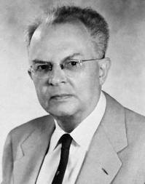
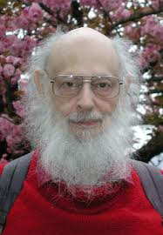
Another approach
Two notions of probability:
Frequency
Degree of Confirmation
R. Carnap, 1945, The Two Concepts of Probability: The Problem of Probability. Philosophy and Phenomenological Research 5 (4):513-532.
Rudolf Carnap
Ray Solomonoff

Slide 9

Betting sequences based on coin tossing
S1:011011100000011011100011011111011011011010
S2:111111111111111111111111111111111111111111
S3:001001001001001001001001001001001001001001
Probability of sequence of length k is 2^{-k}
Notions of randomness and typicality

Slide 10
Betting sequences
Wanted: a theory about the a priori probability of (binary) objects.
Idea: Strings with short program’s have higher probability
Questions: what is a program? what is a computer?

Slide 11
What is a computer?
The mathematician Alan Turing developed the notion of a Turing machine.
The Turing machine manipulates symbols the same way a mathematician
would do behind his desk.
Mathematician
In tray, manipulating data Out tray
IN
OUT
Computer
The Turing machine
Is an abstract model of a mathematician
INPUT
OUTPUT

Slide 12
Principles of a Turing machine
The tape has squares,
Containing symbols that can be read by
The Turing machine
Read/write head
example:
(b=blank)
. . . . . . . b 1 0 1 0 0 b . . . . . . Etc. . . . . . .

Slide 13
Schematic representation of a Turing machine
read./write head
State
Program

Slide 14
An example state (read 0) (read 1) (read b)
of a simple
DTM programm q₀ q₀,0,+1 q₀,1,+1 q₁,b,-1
is in the matrix
q₁ q₂,b,-1 q₃,b,-1 q_{N},b,-1
q₂ q_{y},b,-1 q_{N},b,-1 q_{N},b,-1
q₃ q_{N},b,-1 q_{N},b,-1 q_{N},b,-1
The
machine is
In state q₀
The read/
write head
reads 0
Writes a
0
moves (+1)
one place
to the right
State
changes
To q₀
+1
(state q₀)
b b 1 0 1 0 0 b b b
q₀
program
This program accepts strings that end with ’00’

Slide 15
q (lees) 0 (lees) 1 (lees) b
q₀ q₀,0,+1 q₀,1,+1 q₁,b,-1
q₁ q₂,b,-1 q₃,b,-1 q_{N},b,-1
q₂ q_{y},b,-1 q_{N},b,-1 q_{N},b,-1
q₃ q_{N},b,-1 q_{N},b,-1 q_{N},b,-1
Change status to.....
Write a ......
go (+1) one place right
go (-1) one place left
+1
Step 1
state q₀
b 1 0 1 0 0 b
Step 5
state q₀
b 1 0 1 0 0 b
q₀
program
q₀
program
b 1 0 1 0 0 b
Change status
To q₁ write b
And go left
Step 2
state q₀
Step 6
state q₀
b 1 0 1 0 0 b
q₀
program
q₁
program
b 1 0 1 0 0 b
Change status
To q₂ write b
And go left
b 1 0 1 0 0 b
Step 3
state q₀
Step 7
state q₁
b
q₀
program
q₂
program
b 1 0 1 0 0 b
Change status
To q_{yes} write b
And go left
b 1 0 1 0 b b
Step 4
state q₀
Step 8
state q₂
b
q₀
program
q_{y}
program
yes!
The program starts in q₀ and is ready when state q_{y} or q_{N} is reached.

Slide 16
Counting Turing Machines
q (read) 0 (read) 1 (read) b
q₀ q₀,0,+1 q₀,1,+1 q₁,b,-1
q₁ q₂,b,-1 q₃,b,-1 q_{N},b,-1
q₂ q_{y},b,-1 q_{N},b,-1 q_{N},b,-1
q₃ q_{N},b,-1 q_{N},b,-1 q_{N},b,-1
Changes the status to....
Writes a......
goes(+1) place to the right
or(-1) place to the left
# States =S
# Symbols = 3
# Turing machines with S states ≈
Enumerating all Turing machines: is machine with index i
Measuring the amount of information:
i.e. the length of the index represented as a bit string.

Slide 17
Storing tape information in the Turing machine itself is inefficient!
We need a Turing machine with at least k states to encode a binary string of length k.
The index of such a machine will contain at least 3k bits.

Slide 18
Self delimiting code
11111111111111111
0
01110010101001

Slide 19
Self delimiting split of a string
Data set AB
Data set A
Data set B
log(|A|)=n
1111
0
n
Data set A
Data set B
2 log(|A|)+1+|A|+|B|

Slide 20
Universal Turing Machine
T_{x}(y) Turing machine x with input y
Universal Turing machine
1111
0
n
Index of Tx
Input y
Program
U
State
Input y
Program
State

Slide 21
Turing machines
An enumeration of Turing machines
T_{x}(y) Turing machine x with input y
Universal Turing machine U_{i}(yx)
T_{x}(y) is defined if x stops on input y in an accepting state after a finite number of steps.
Minsky: there is a universal Turing machine with 7 states and 4 tape symbols

Slide 22
Uncomputable numbers
Define a recursive function g
g(x,y)=1 if T_{x}(y) is defined, and 0 otherwise
Since g is recursive there will be a Turing machine r such that T_{r}(y)=1 if g(y,y)=0 and T_{r}(y)=0 if g(y,y)=1
But then we have T_{r}(r)=1 if g(r,r)=0 and since T_{r}(r) is defined g(r,r)=1
Paradox: ergo g(x,y) can not be recursive

Slide 23
Some important notions
Halting set: K_{o} = {<x,y>: T_{x}(y)< ∞}
Diagonalization (Cantor)
Dovetailing computations: A universal search/learning algorithm
Church-Turing thesis: the class of algorithmically computable numerical functions coincides with the class of partial recursive functions

Slide 24
Entropy in binary strings
Intuition: a random string has maximal entropy
Shannon’s estimate: A binary string of length k is a sequence of messages from a collection A = {0,1} with maximal entropy i.e. p₁ = p₀ =2⁻¹.The probability of k messages is 2^{-k}. So the entropy of a random string of length k is H_{max}= - log 2^{-k}= k which is the optimal code length.

Slide 25
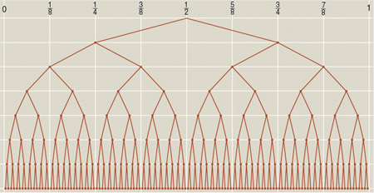
Entropy in binary strings
Intuition: a string of length k is random if it cannot be ‘recoded’ as a significantly shorter string of length < k- log k.
The number of binary strings of length k is 2^{k} , of length < k – log k is 2^{k – log k} .
The density of compressible strings in the limit :
Almost all strings are random!

Slide 26
Kolmogorov complexity
The Kolmogorov complexity of a binary object is the length of the shortest program that generates this object on a universal Turing machine
Random strings are not compressible
A message with low Kolmogorov complexity is compressible
Problem: Kolmogorov complexity is non constructive!
But it can be approximated.

Slide 27
Popular objections against Kolmogorov complexity
Nonsense!!!
It is uncomputable, so:
We cannot use it.
We cannot really learn anything.
Define time bounded Kolmogorov complexity:

Slide 28
Uncomputablity is almost never a problem!
Suppose the following strategy:
Select a data set/string D from {0,1}^{n}
Try to compress it for some time t >|D|
If you cannot compress D label D as random
How many compressible strings do you miss?

Slide 29
A nice theorem (Antunes, Souto, Adriaans, jan 2012)
The size of the domain {0,1}^{n} is 2^{n}
For any t > |D| the density of the bastards that are more than a logarithmic term removed from optimal compression is:
i.e. Neglectable!
n
ᴓ
C(x)
Good Guys
Bastards
0
0
C^{t}(x)
n

Slide 30
Randomness deficiency
Randomness deficiency is maximal complexity minus real complexity
For binary strings:
A good theory has minimal randomness deficiency
A good theory makes the data look random conditional to the theory
Data
Universe

Slide 31
The Power and Perils of MDL
MDL Code Length
Randomness Deficiency
Stop computation
Adriaans, P. Vitanyi, P., Approximation of the Two-Part MDL Code, Comput. Sci. Dept., Univ. of Amsterdam, Amsterdam; Information Theory, IEEE Transactions on, Volume: 55, Issue: 1, On page(s): 444-457. 2009
Size
Optimal code
Optimal randomness deficiency
Time
In the course of the learning process the quality of the model can vary independently of the MDL code. The effect is non computable, although the smallest code still gives the best model

Slide 32
Dove tailing computations of Turing machine U_{x} on all inputs
Computation steps
T_{x} | 1 | 2 | 3 | 4 | 5 | 6 | 7 | 8 | 9
0
1
00
01
10
11
000
001
010
binary inputstrings

Slide 33
Situation at time t_{k}
input | U_{x} | output
0 | ⇒ | ?
1 | ⇒ | p
00 | ⇒ | ?
01 | ⇒ | q
10 | ⇒ | ?
11 | ⇒ | ?
000 | ⇒ | r
001 | ⇒ | ?
010 | ⇒ | ?

Slide 34
Updating your best guess for the shortest program for s
Situation at time tk
Situation at time tk+c
input | U_{x} | output
… |  | …
… |  | …
x | ⇒ | ?
… |  | …
… |  | …
y | ⇒ | s
… |  | …
Z | ⇒ | s
… |  | ..
input | U_{x} | output
… |  | …
… |  | …
x | ⇒ | s
… |  | …
… |  | …
y | ⇒ | s
… |  | …
z | ⇒ | s
… |  | ..

Slide 35
Meta-computational Space
Start
Start
Yes
Yes

Slide 36
Going back (in time): Deterministic processes discard information
Log k bits
Yes

Slide 37
Going back (in time): Reversible processes do not discard information
Yes

Slide 38
Going back (in time): Finding the shortest program
S
S
Data D
S
Index
Y

Slide 39
Balancing Index versus Code length
All possible histories of
Turing machine i producing
the data
All possible histories of
Turing machine j producing
the data
S
S
S
i
S
j
Data D
Data D
S
Y
Y
S
Length of two-part code for j
Length of two-part code for j: Shorter i is better model

Slide 40
Turing two-part code optimal compression
Data D
Model Code
11
0
n
Data to Model Code
Randomness Deficiency
Facticity
Residual Entropy
Kolmogorov complexity

Slide 41
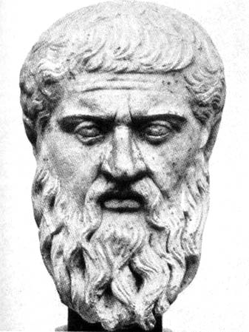
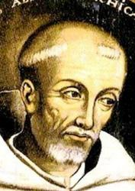

Two-part code optimization
The best theory to explain a set of data D is the one which minimizes such that:

Slide 42
Some conventions
Universe
U = Universe
M = Model
D = Data Set
For the moment M and D are finite
|M| = m
|D| = d
Model
Data

Slide 43
Selecting the best model according to Bayes
Universe
Model
Data
Model Code
Data to Model Code
Optimal Shannon Code

Slide 44
Intuition
Data
System
Physical Reality
Time
Computational Space =
Universal Process Model
Best model
= smallest region
with high entropy
Data

Slide 45
Going back (in time): From less information to more
More information
S
Log k bits
Less information
Data D
Index
Yes
Y

Slide 46
Going back (in time): Reversible processes are information neutral
S
Equal
information
Equal information
Data D
Index
Yes
Y

Slide 47
Intuition
Time
Negative Time
Computational Space
= Universal Process Model
Model
+ Code
Data
Minimizing two-part code length
= Minimizing information loss during computation
= Maximizing probability of reversible
(i.e. time invariant) process model

Slide 48
Energy in System of particles | Information in system of messages | Complexity of a string (i.e. a system of bits)
Boltzmann
Entropy
Maximal
Entopy
Random
string
Free
Energy
Absolute
Redundancy
Randomness
Deficiency

Slide 49
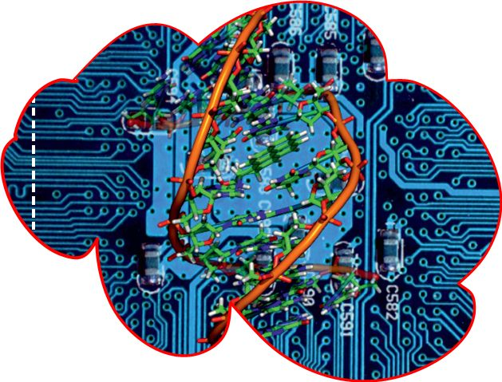
Kolmogorov paradigm
Data Set A
11
0
n
i
Program for A
Universal
Turing
Machine +
infinite time
Universal
Turing
Machine
Code table
Code table
11
0
n
i
Program for A

Slide 50
Integer complexity function I(x)=K(x)
Log i
K(i)
Random number
Compressible number
i = 0
i = k

Slide 51
log t (upperbound of conditional complexity given ID₀ and M at t=0)
- log (a – t) (upperbound of conditional complexity at t=a)
C(t|ID₀ , M) (actual Kolmogorov complexity given the total computation )
log (t – i) (upperbound of conditional complexity given ID₀ and M at t=i)
C(t|ID_{i} , M) (actual Kolmogorov complexity given the computation from i)
C(ID_{t}) (Kolmogorov complexity of the tape configuration over time)
t = 0
t = i
t = a

Slide 52
Complexity versus length for the class of finite binary strings
∞
Random numbers
Randomness
deficiency
K(x) Complexity
l(x) Length
∞

Slide 53
Complexity versus length for the class of finite binary strings
∞
Random numbers
Bit Flipping
Randomness
deficiency
Add Bits using
Coin flips
Compression
K(x) Complexity
Recursive
Computation
l(x) Length
∞

Slide 54
Kolmogorov complexity
Some problems with C(x):
No concatenation of programs: C(xy) < C(x) + C(y)
No associated probability distribution
Solution: shift to self-delimiting code or prefix code (Prefix free Kolmogorov complexity):

Slide 55
Self delimiting code
11111111111111111
0
01110010101001

Slide 56
Self delimiting split of a string
Data set AB
Data set A
Data set B
log(|A|)=n
1111
0
n
Data set A
Data set B
2 log(|A|)+1+|A|+|B|

Slide 57
Two part code optimization in Kolmogorov complexity
Index
Program
11
0
n
i
p
(Vereshchagin & Vitanyi, 2004)

Slide 58
Need for new measure(s) of information
Esthetic Measure (Birkhoff, Bense)
Sophistication (Koppel)
Logical Depth (Bennet)
Statistical complexity (Crutchfield, Young)
Effective complexity (Gell-Mann and Lloyd)
Meaningful Information (Vitanyi)
Self-dissimilarity (Wolpert and McReady)
Computational Depth (Antunes et al.)

Slide 59
Definition of facticity: the amount of self-descriptive information in a dataset
The facticity φ(x) of a string x is the amount of self descriptive information in x.
Facticity is definite!
11
0
n
i
p
facticity
Residual entropy

Slide 60
Complexity versus length for the class of finite binary strings
∞
Random numbers
Randomness
deficiency
K(x) Complexity
Residual entropy
Facticity
l(x) Length
∞

Slide 61

Shannon versus Kolmogorov
Code table
Code table
Optimal code
for A
X is entropic iff H(x)=K(x)
Universal
Turing
Machine
Universal
Turing
Machine
Code table
Code table
11
0
n
i
Program for A

Slide 62
A thought experiment
Suppose a system of 2^{k} binary messages of length k with maximal entropy: 0 0 0 0 1 0 0 1 1 1 0 0 1 0 1 1 1 0 1 1 1
Select k log k messages randomly, we get a random binary string of length k (log k)²

Slide 63
A thought experiment
Code table
Program
code

Slide 64
A thought experiment
Shannon coding is non-selfdescriptive, works better for high entropy strings
Kolmogorov coding is selfdescriptive, works better for low entropy strings
Entropic strings (K(x)=H(x)) are extremely rare!!
Code table
Program
code

Slide 65
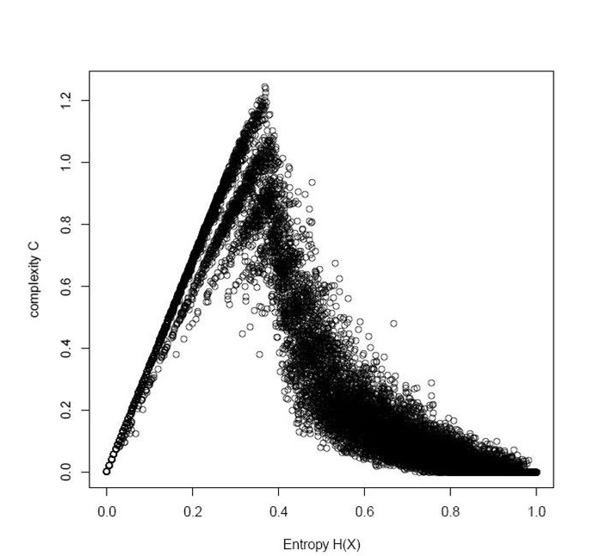
Estimate of model information in binary strings (Schultes, Hermans)

Slide 66
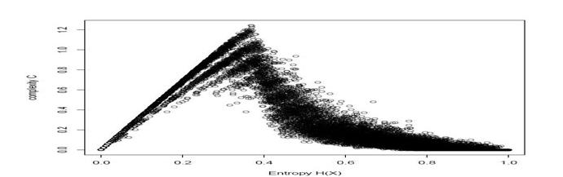
Zero probability
Optimal Facticity
=
Edge of Chaos
=
Maximal instability
Max φ(x) = δ(x)
Max K₂ (x) = φ(x)
Zero probability
φ(x)
Zero probability
Absolutely non-stochastic strings
Low density
Low probability
Non-stochastic models
mixed
Low density
High probability
stochastic models
High density
Low probability
K₂ (x)=0
K₂(x)=|x|

Slide 67
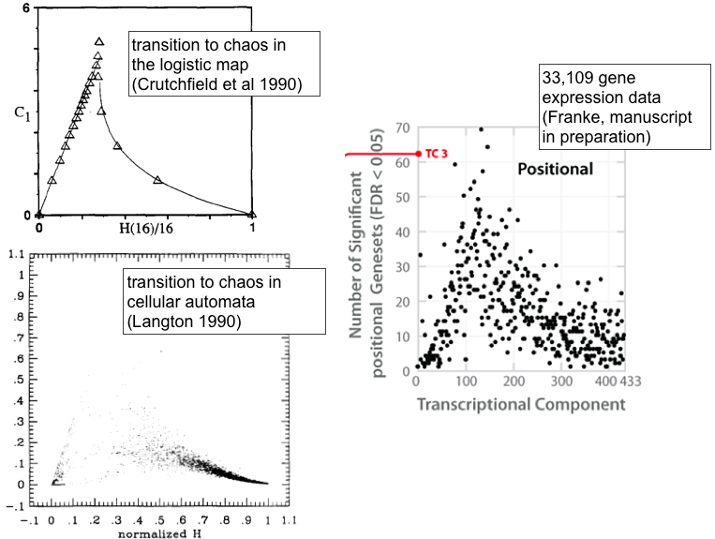

Slide 68
Information diffusion rate (bits per second)
Dynamic internal distribution of information in a system = information destruction
A dynamic process: Information diffusion rate of k bits per second.

Slide 69
Information growth rate (bits per second)
Dynamic internal creation of information in a system by means of random bit flipping
A dynamic process: Information growth rate of k bits per second.

Slide 70
Some insights
A system with maximal factity is on ‘the edge of chaos’
It has a balance between information creation and destruction: information growth = information diffusion
Kolmogorov Sinai Entropy: Entropy rate = information growth + information diffusion

Slide 71
Factic processes
Are the only processes that create meaningful information (random processes and deterministic processes do not create meaningful information)
Have no sufficient statistic
Are characterized by:
Randomness aversion: A factic process that appears to be random will structure itself.
Model aversion: A factic process is maximally unstable when it appears to have a regular model.
Are abundant in nature: game playing, learning, genetic algorithms, stock exchange, evolution,etc.

Slide 72
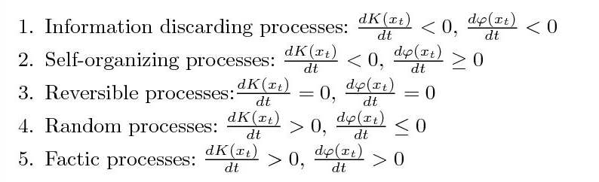
Classification of processes
Random process
Recursive process
Factic Process

Slide 73
Simple overview
Data set D
|D| = K(D) + δ(D)
K(D) = φ(D) + ρ(D)

Slide 74
References
Adriaans, Van Benthem eds. “Handbook of philosophy of information”. (2008)
Adriaans, “Between order and Chaos: the quest for meaningful information”, Theory of computing systems. (2009)
Adriaans, P. Vitanyi, P. ”Approximation of the Two-Part MDL Code, IEEE transactions on Information Theory, 2009
Computation, Information, and the Arrow of Time (P. W. Adriaans & P. E. van Emde Boas), in COMPUTABILITY IN CONTEXT: Computation and Logic in the Real World (ed. S Barry Cooper and Andrea Sorbi) World Scientific, Feb. 2011
P.W. Adriaans, On facticity, (in preparation)
http://staff.science.uva.nl/~pietera/
www.pieter-adriaans.com
Thanks to: Duncan Fowley, David Oliver, Amos Golan, Ariel Caticha, Peter van Emde Boas, Erik Schultes, Harry Buhrman, Luis Antunes and André Souto

Slide 75

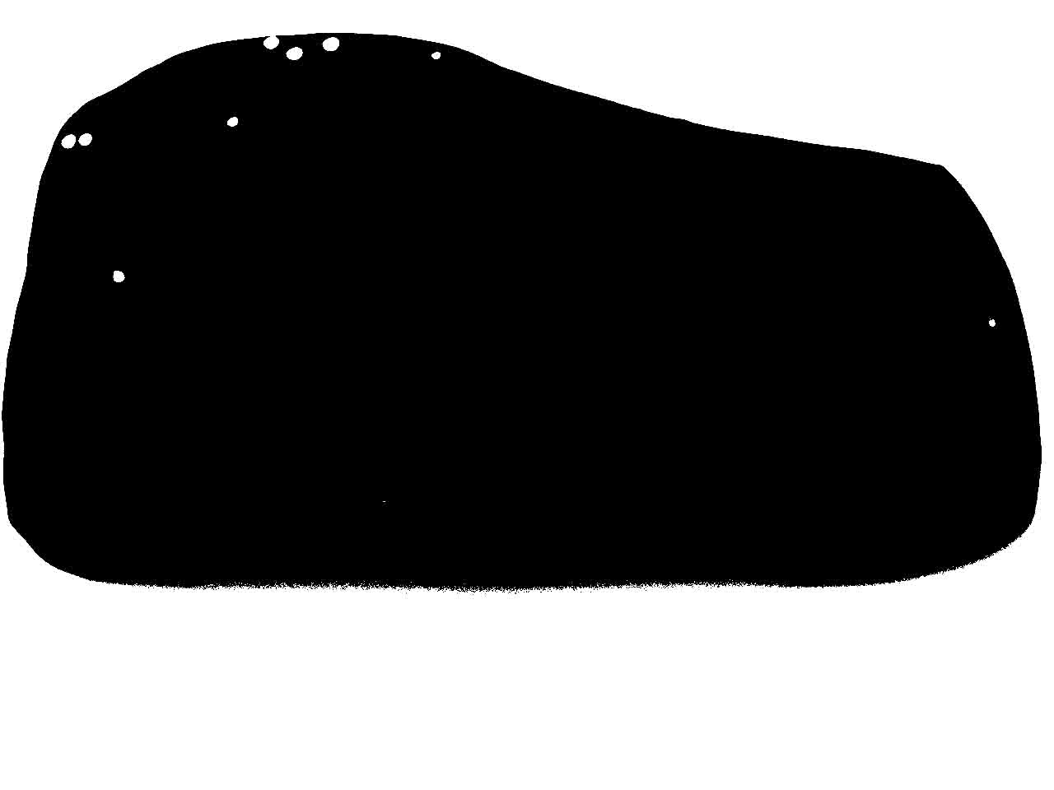
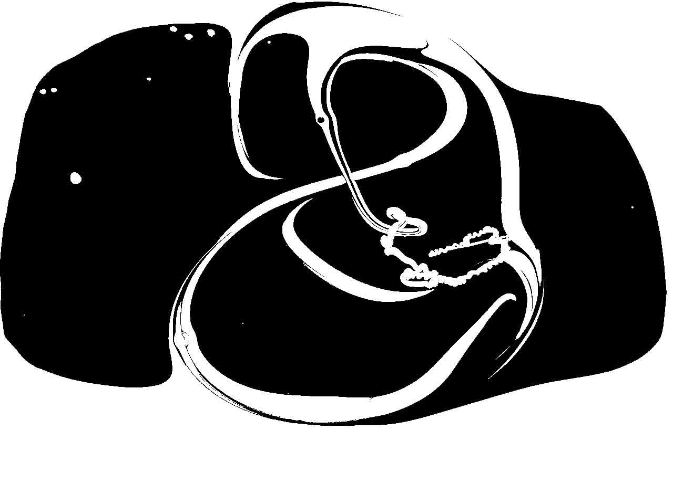



1
2
3
4
5
6

Slide 76
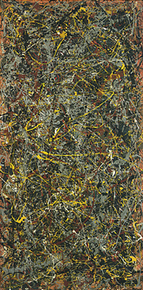
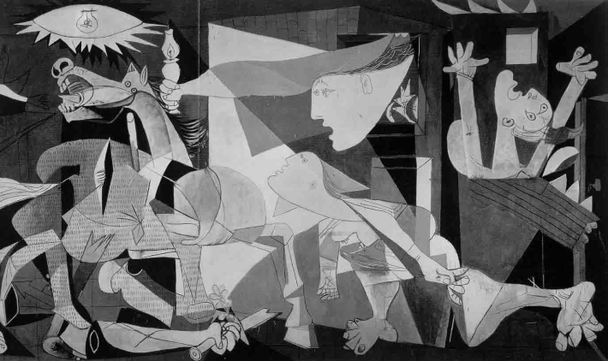


Slide 77






Slide 78
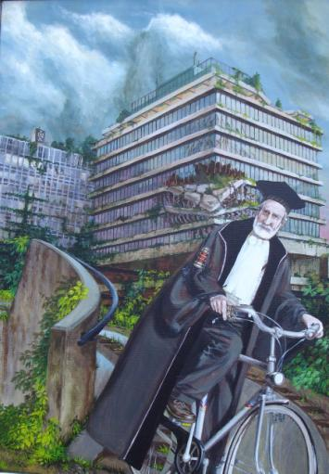
New proof technique: Meta-computational spaces
P.W. Adriaans , P.E. Van Emde Boas, Information, Computation and the Arrow of time, in COMPUTABILITY IN CONTEXT, Computation and Logic in the Real World, edited by S. Barry Cooper (University of Leeds, UK) & Andrea Sorbi (Universita degli Studi di Siena, Italy), 2011.
Computing in negative time

Slide 79
The minimum description length (MDL) principle: J.Rissanen
The best theory to explain a set of data is the one which minimizes the sum of: - the length, in bits, of the description of the theory and - the length, in bits, of the data when encoded with the help of the theory
Why?

Slide 80
Shannon information
The entropy, H, of a discrete random variable X is a measure of the amount of uncertainty associated with the value of X (Shannon 1948, Shannon & Weaver 1949).
The less we expect it the more value it has. Scarcity as a source of value.

Slide 81
Some conventions
Universe
U = Universe
M = Model
D = Data Set
For the moment M and D are finite
|M| = m
|D| = d
Model
Data

Slide 82
Selecting the best model according to Bayes
Universe
Model
Data
Model Code
Data to Model Code
Optimal Shannon Code

