Slide 1
Product recommendation
Capgemini Tech Challenge –Round 2
Submitted by:
JOSWIN V JAISON
Karunya institute of technology
Batch :2018-22

Slide 2
Brief Synopsis
The challenge is to build an appropriate product recommendation system using Modcloth dataset
The approach used was collaborative filtering. Collaborative filtering (CF) is a technique used by recommender systems. In the newer, narrower sense, collaborative filtering is a method of making automatic predictions (filtering) about the interests of a user by collecting preferences or taste information from many users (collaborating).It filter out items that a user might like on the basis of reactions by similar users. It works by searching a large group of people and finding a smaller set of users with tastes similar to a particular user.
In this model the user will input the product name and rating then the model predicts the similar items to be purchased

Slide 3
Problem Statement and implementation approaches used
Built a product recommendation system based on modcloth dataset.
The dataset includes 12 columns and 99893 rows.
The values of rating range from 1 to 5 including null values
There are 2 major approaches used in product recommendation . They are content based and collaborative filtering based recommendation.
Here the approach used is collaborative filtering.
Then a cross tab is created which display the cross tabulation between model attribute and user attribute column.
The columns model_attr and category is concatenated into a single column modcat for effective recommendation.
Then a pivot table is constructed where user_id is displayed in rows, modcat is displayed in columns and ratings in values. Then the null rating values are replaced with zero.
2 methods can be used as the next step. Either cosine similarity or Pearson correlation .In this model I have used Pearson correlation.
An inbuilt method called corr is used to display the correlation matrix.
.

Slide 4
Tools and technologies used
Python is the programming language that I have used for the implementation of product recommendation system.
The python libraries like pandas,numpy, matplotlib, scipy, statsmodels.api, seaborn is used . The main library used here is pandas which helped in the data manipulation and analysis
Numpy is an array-processing-package where matplotlib is used for performing effective visualizations.
The program execution and testing of model was done with the help of Google colab. It allows to write and execute arbitrary python code through the browser. It can also be replaced by Jupyter notebook Spyder Ide or Pycharm

Slide 5
Collaborative filtering approach : Architecture
This algorithm at first tries to find similar users based on their activities and preferences .For example, consider 2 users A and B and both of them purchased the same product
And if A have bought a product that B didn’t purchased yet then the product will be recommended to B.
In other words, the recommendations get filtered based on the collaboration between similar user’s preferences[thus the name collaborative filtering]
One typical application of this algorithm can be seen in the Amazon e-commerce platform, where you get to see the “Customers who viewed this item also viewed” and “Customers who bought this item also bought” list.

Slide 6
Collaborative filtering approach : Architecture
Different types of algorithms used in collaborative filtering are Memory based, Model based ,matrix factorization, clustering and deep learning.
Memory based collaborative filtering can be divided into 2 main sections :
User-item filtering and Item-item filtering. A user-item filtering takes a particular user, find users that are similar to that user based on similarity of ratings, and recommend items that those similar users liked. In contrast, item-item filtering will take an item, find users who liked that item, and find other items that those users or similar users also liked. It takes items and outputs other items as recommendations.

Slide 7
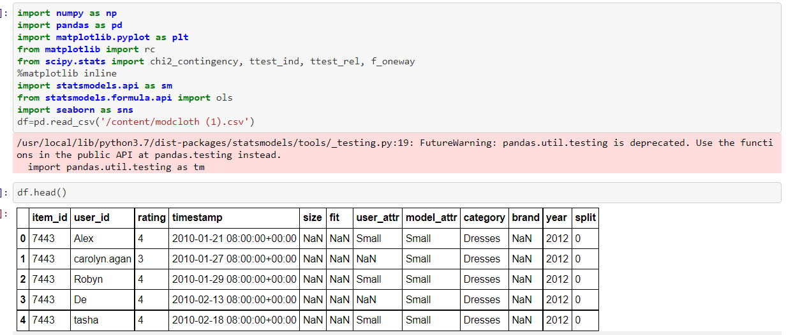
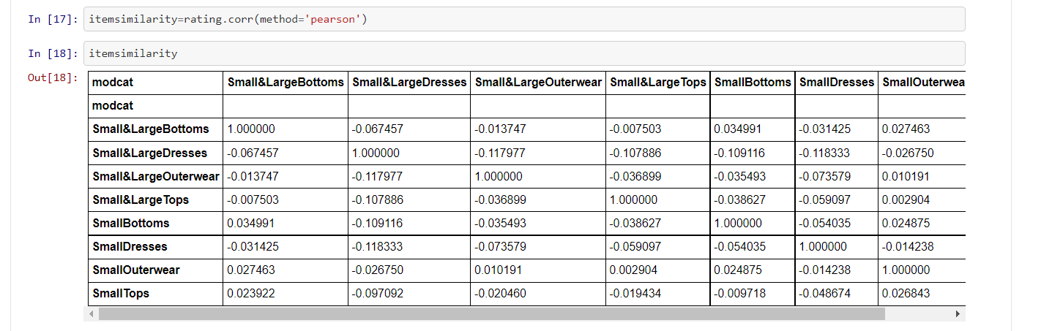
Screenshots of implementation
Libraries imported and dataframe view.
Pearson Correlation

Slide 8
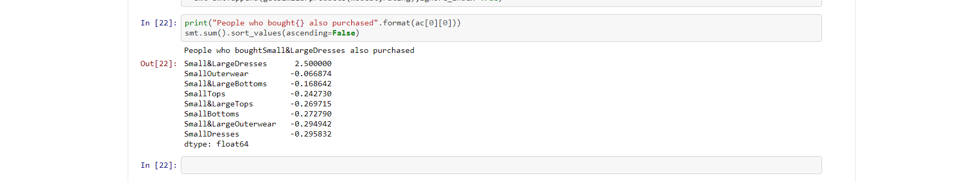
Screenshots of implementation
Output

Slide 9
Challenges in recommendation engines and future improvements
Challenges
Future improvements
Lack of data
Changing data
Changing User Preferences
Unpredictable items
*Boost algorithm using model size
*Build a web based application for recommendation

