Slide 1
Master Project
1
2
3
4
5
6
7
8
Design Guidelines and Usability of Mobile Games that Benefit Cognitive Abilities of People with Dementia
Elisabeth Hackner
Project Coach: FH-Prof. DI (FH) Michael Lankes

Slide 2


sharing – easy and fast

Slide 3
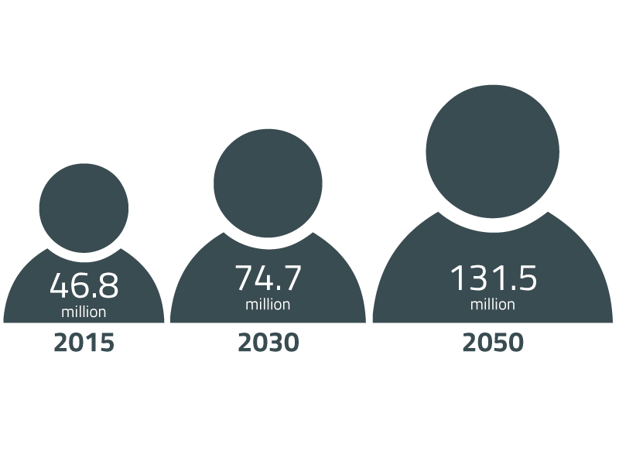
Motivation
1
2
3
4
5
6
7
8
Target group for master project
People with dementia
Restrictions with disease:
Short-term memory loss
Impairment to thinking, orientation, comprehension, learning, capacity, language and judgement
People dependent on caregivers
Focus of project on early- and middle-stage dementia patients with age 65+
Number of people worldwide living with dementia¹
¹ Source: World Alzheimer Report 2015: The Global Impact of Dementia

Slide 4

Motivation
1
2
3
4
5
6
7
8
Role of technology in the dementia context
Activating therapy with tablets apps
Facilitates cognitive abilities
Supports biographical work therapy
Trains communication and social interaction
Enhances a person’s well-being, self-esteem, mood and behaviour
Problems
Conventional apps/games are not fitted for target group
Individuals have different needs
E.g. loss in visual or auditory acuity

Slide 5
Research Question
1
2
3
4
5
6
7
8
The focus of my master project
Game Design Guidelines
How can design guidelines for mobile games look like to benefit the cognitive abilities of people suffering from dementia?
Challenges
Interaction design of mobile games for target group
Dynamic adjustment of the game, to consider individuals

Slide 6
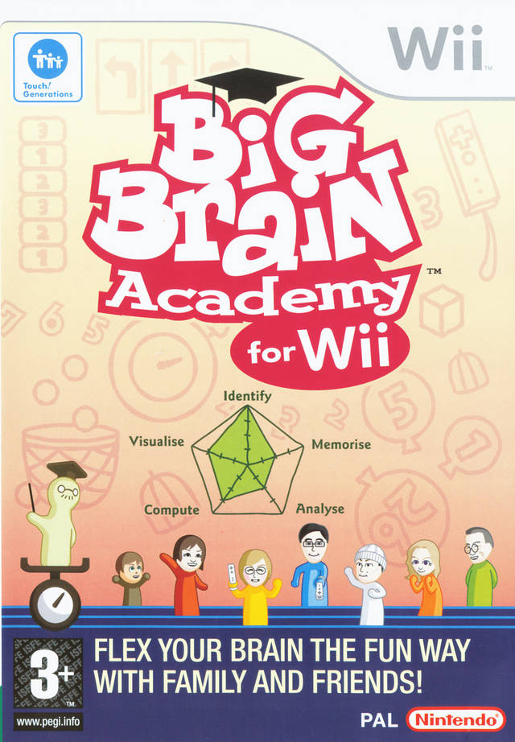
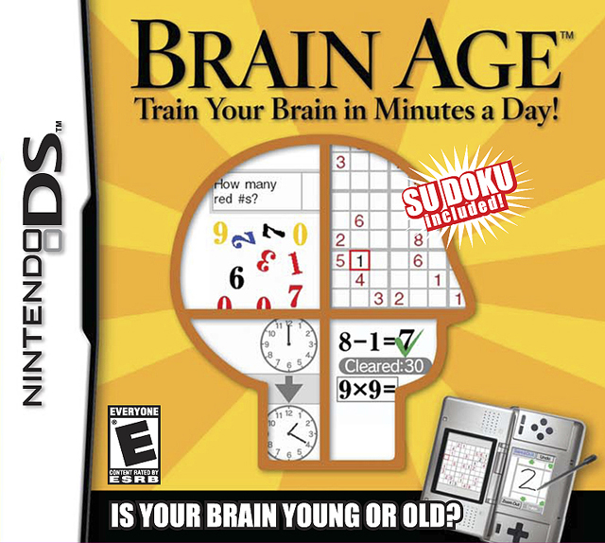
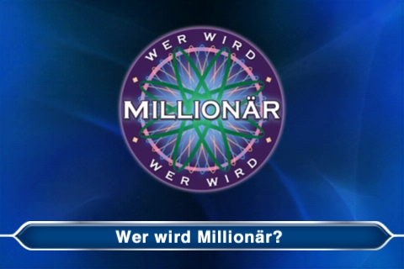
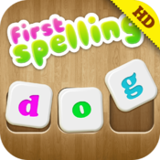
State of the Art
1
2
3
4
5
6
7
8
Research projects & commercial products
Games for dementia is a big topic in the research fields Serious Games and Games for Health.
Many commercial games were evaluated and tested within research projects (medium: PC, game console, mobile app).

Slide 7
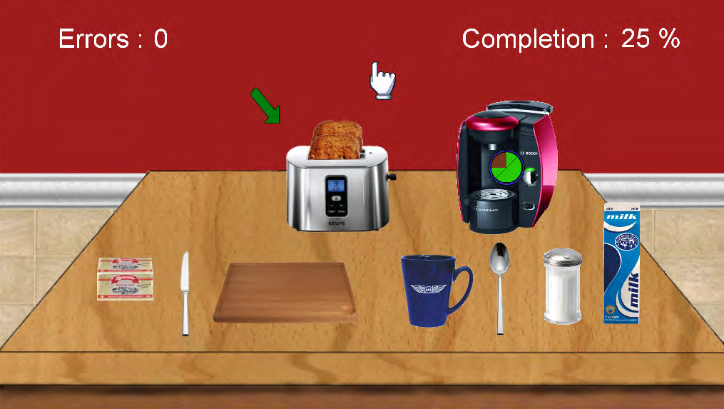
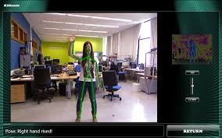
State of the Art
1
2
3
4
5
6
7
8
Research projects & commercial products
Games for dementia is a big topic in the research fields Serious Games and Games for Health.
Some dementia games evolved from research projects and have been evaluated (medium: PC, game console).

Slide 8

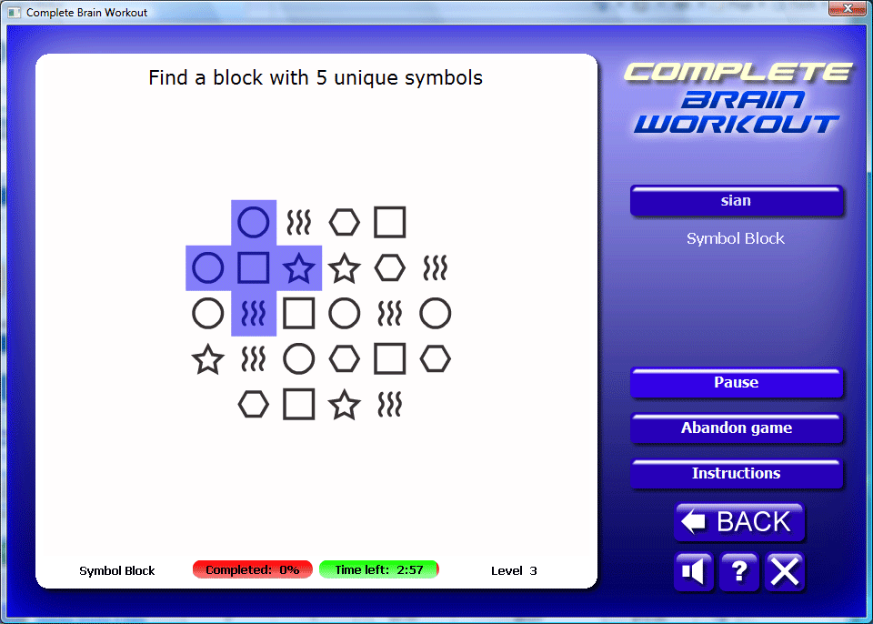
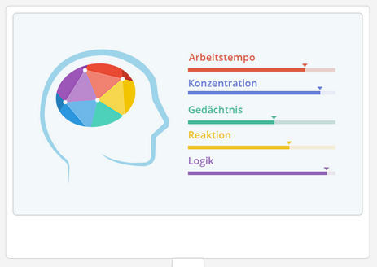
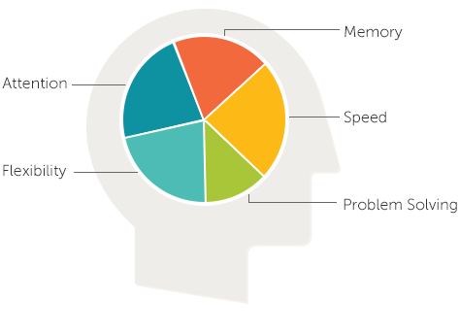

State of the Art
1
2
3
4
5
6
7
8
Research projects & commercial products
Games for dementia is a big topic in the research fields Serious Games and Games for Health.
Some commercial games are available which are described as “suitable for people with dementia” or as “preventing dementia” (medium: PC, game console, mobile app).

Slide 9
Planned Implementation
1
2
3
4
5
6
7
8
Develop a mobile game for tablets
Tablet-App for target group with the following characteristics:
Integrate different interaction methods (swipe, press, fling, …)
Benefit cognitive abilities
Adaptable to the needs of one individual
Support biographical work therapy
Result
Mobile game which follows specific design guidelines for people with dementia

