Slide 1


sharing – fast and easy
Notes:
Sp1 Hi. We are Team Apricot ….
Sp2 …. and we like to introduce you to our mobile App “ourWallet”.
“ourWallet” is the instant & virtual joint account.
10sec

Slide 2
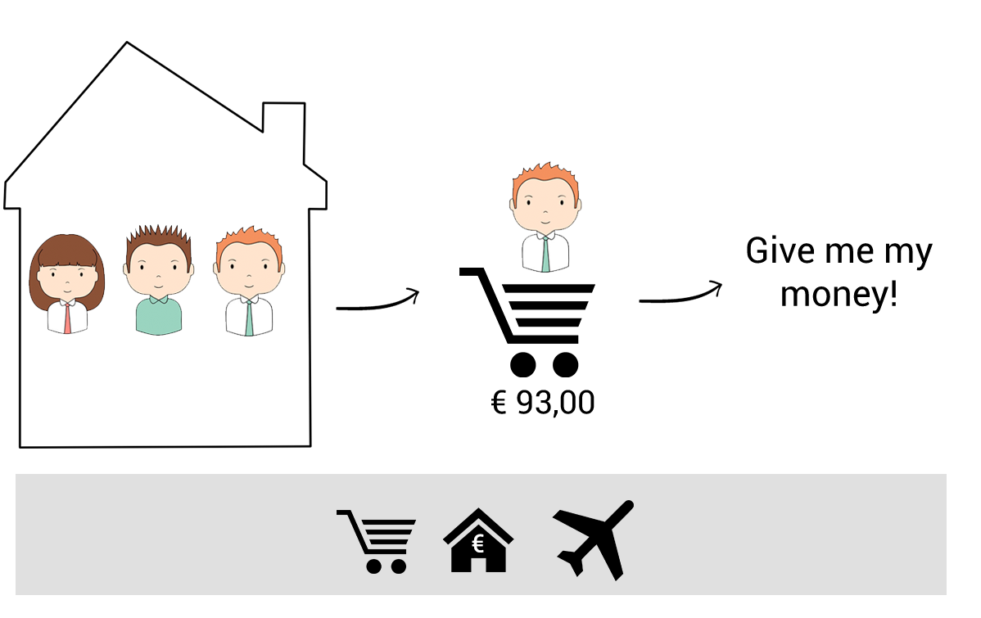
Current Problem
Notes:
SP1:
What it does? Well let’s talk first about the current problem.
SP2:
We all know that splitting or sharing bills sucks.
Let’s take Chris for example. He lives together with his friends. Every Tuesday Chris goes to the supermarket and buys stuff for the shared flat. Usually they split the bill. The problem is that he often has to wait for like 2 weeks until he gets his money back.
SP1:
The same problem also occurs when they have to pay the rent or they go travelling together.
The current solutions for these problems include Excel and some mobile apps to keep track of your expenses. But both are neither convenient, nor do they prevent you from simply forgetting your debts.
45sec

Slide 3
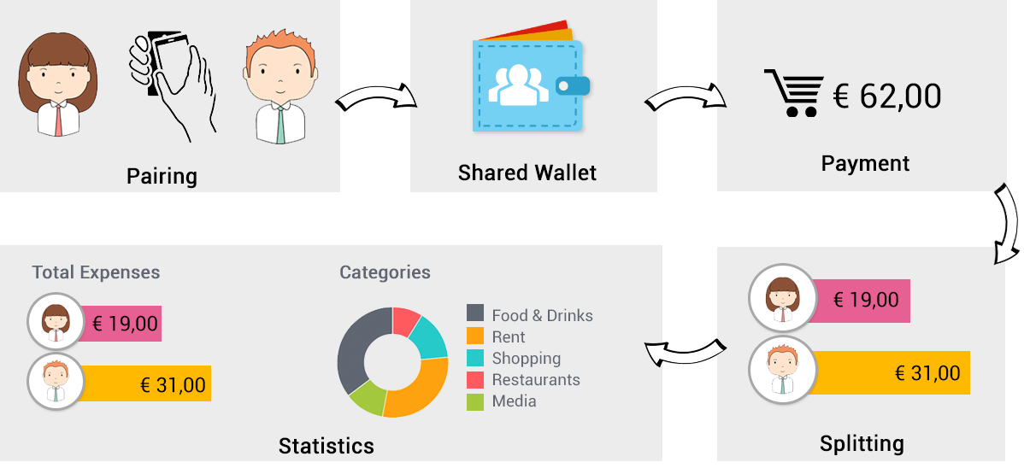
Notes:
SP2
Our solution is unique.
You start our app and simply stick together your smartphone with your friends. That’s all you have to do to create your shared wallet.
And the next time you have to pay a shared bill, you simply use your smartphone and our app and pay contactless.
After the payment you can decide whether you want to spilt the bill equally.
The expenses are categorized for you, which enable statistics of your shared wallet. So you can see who spends the most money.
45sec

Slide 4
Demonstration
…video…
Notes:
SP2:
Ned vergessen API erwähnen! He logged in with his bank austria credentials, we used the API for that.
90sec

Slide 5


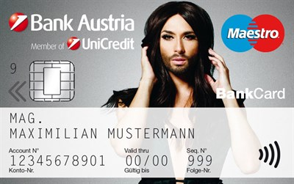
Benefits & Future
As secure as current mobile banking solutions
Shared wallet members just need a BA account
Future
Notes:
SP1:
Benefits of our app are that it’s easy to use without compromising security.
And all members of an bank austria account are ready to go!
SP2:
In the future the app will Integrate with other services like BlueCode or your debit card.
The possibilities are endless: In the future kids can also be part of this app. You can organize their pocket money and set limits for it.
30sec

Slide 6
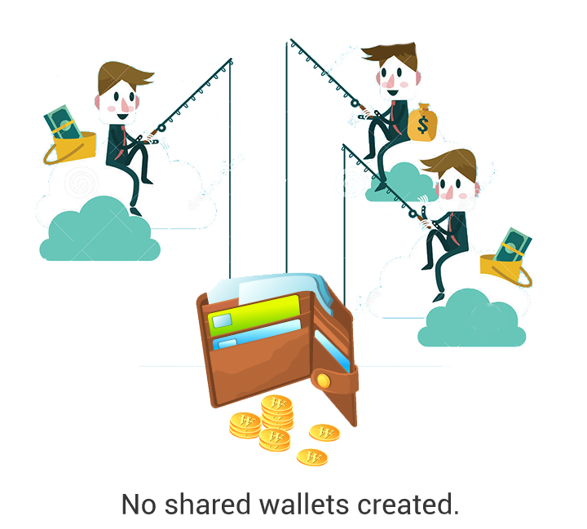
Notes:
SP1:
The future of social banking is here. Will you be there too?

