Slide 1

Finding the minimum k-weighted dominating set in weighted graphs
José Antonio Zamudio Amaya
Eva Barrena Algara
Sergio Bermudo Navarrete
Alfredo García Hernández-Díaz
Ana Dolores López Sánchez

Slide 2
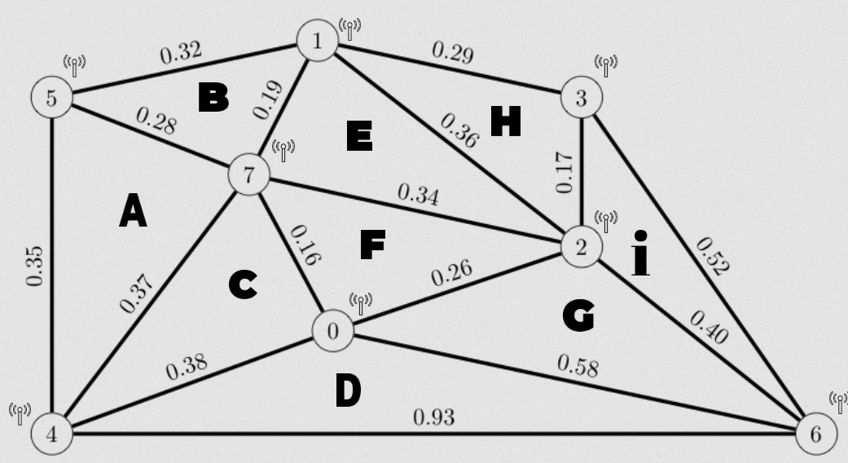
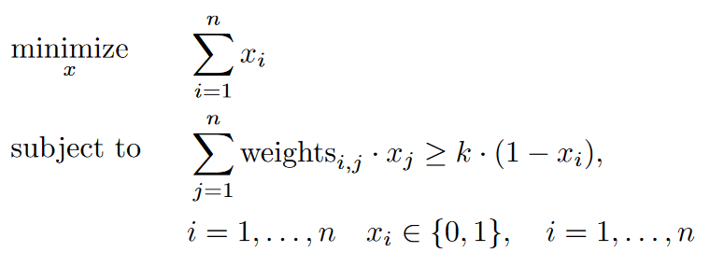
Finding the minimum k-weighted dominating set in weighted graphs
About the problem

Slide 3
Finding the minimum k-weighted dominating set in weighted graphs
About our proposal
Heuristic resolution with Wheel Selection Mechanism
Heuristic resolution with IG*
Insertion {R, E, C}
Destruction {R, E, C}
Reconstruction {R, E, C}
*We are currently testing different strategies for further optimization

Slide 4
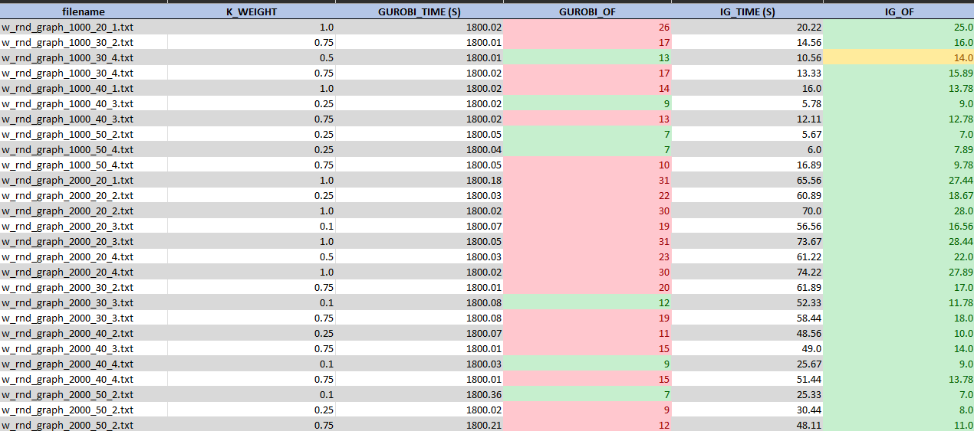
Finding the minimum k-weighted dominating set in weighted graphs
About our results

Slide 5
Finding the minimum k-weighted dominating set in weighted graphs
[1] - Pedro Pinacho Davidson, Christian Blum, Jose A. Lozano: The weighted independent domination problem: Integer linear programming models and metaheuristic approaches.
[2] - Feng Zou, Yuexuan Wang, Xiao-Hua Xu, Xianyue Li, Hongwei Du, Pengjun Wan, Weili Wu: New approximations for minimum-weighted dominating sets and minimum-weighted connected dominating sets on unit disk graphs.
[3] - Wang Cai, Yin: Local search for minimum weight dominating set with two-level configuration checking and frequency based scoring function.
[4] - Salim Bouamama, Christian Blum: A hybrid algorithmic model for the minimum weight dominating set problem.
[5] - A. Casado, S. Bermudo, A.D. López-Sánchez, J. Sánchez-Oro: An iterated greedy algorithm for finding the minimum dominating set in graphs.
References

