Slide 1
infOsmos
“Osmosis of Knowledge”
Amulya, Woong, Sanket, Joseph, Humphrey

Slide 2

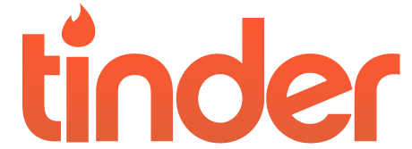
What?
A web platform that matches people for mutual enlightenment and knowledge sharing.
For
non-mating needs

Slide 3
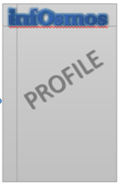





How?

Slide 4

Use cases
Cantonese….
English….

Slide 5


Why?
“Knowledge is real only when shared”

