Slide 1
3. Interrupt Management

Slide 2
Events
Embedded RTSs have to take actions in response to events that originate from the environment.
A packet arriving on an Ethernet peripheral (event) requires
A TCP/IP stack for processing (the action)
Different events have different processing overhead and response time requirements.

Slide 3
Make the best event processing implementation strategy
How should the event be detected?
Interrupts are normally used, but inputs can also be polled.
When interrupts are use, how much processing should be performed inside ISR, and how much outside?
Normally desirable to keep each ISR as short as possible.
How can events be communicated to the main code, and how can this code be structured to best accommodate processing of potentially asynchronous occurrences?

Slide 4
Introduction
FreeRTOS provides features that allow the chosen strategy to be implemented in a simple and maintainable way.
But does not impose any specific event processing strategy on the application designer.
Note: only API functions and macros ending in ‘FromISR’ of ‘FROM_ISR’ should be used within an ISR.

Slide 5
Scope
Understand API functions that can be used within an ISR.
Implement a deferred interrupt scheme.
Use binary semaphore and counting semaphore, and identify their differences
Use a queue to pass data into/out of an ISR

Slide 6
3.2 Deferred interrupt processing
Use binary semaphore to unblock a task each time a particular interrupt occurs
Effectively synchronizing the task with the interrupt
This allows the majority of the interrupt processing to be implemented within the synchronized task.
Only a very fast and short portion remaining directly in the ISR.
So the interrupt processing is said to have been ‘deferred’ to a ‘handler’ task.

Slide 7
If the interrupt processing is particularly time critical.
Can set the handler task’s priority to ensure that it always pre-empts other tasks in the system.
Then can implement ISR to include a context switch to ensure that it returns directly to the handler task when ISR itself has completed executing.
This can ensure that the entire event processing executes contiguously in time, just as if it had all been implemented within the ISR itself.

Slide 8
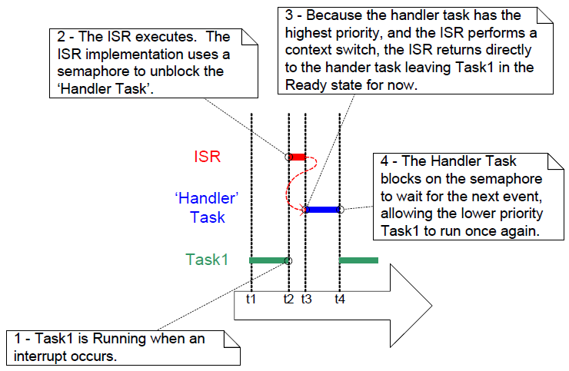
The interrupt interrupts one task but returns to another

Slide 9
The handler task uses a blocking ‘take’ call to a semaphore so as to enter the Blocked state to wait for the event to occur.
When the event occurs, the ISR uses a ‘give’ operation on the same semaphore to unblock the handler task so that the required event processing can proceed.

Slide 10
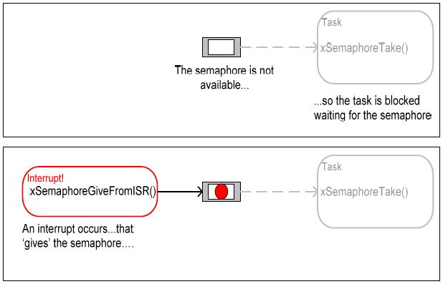

Slide 11
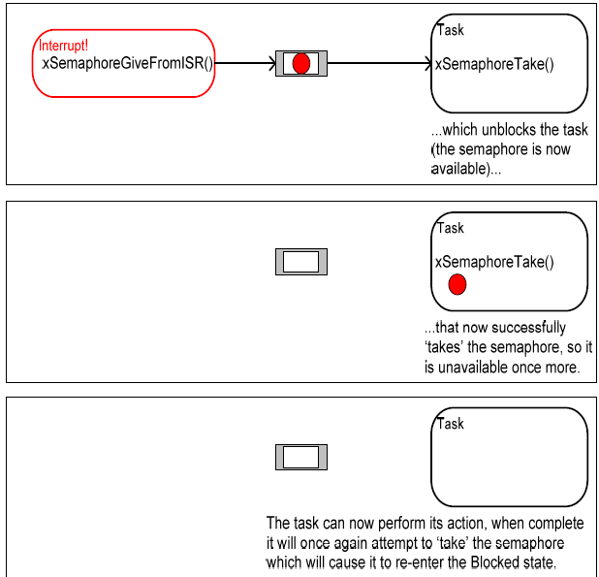

Slide 12
In this interrupt synchronization scenario
The binary S can be considered conceptually as a queue with a length of one.
Can contain a maximum of one item at any time
By calling xSemaphoreTake(), the handler task effectively attempts to read from the queue with a block time, causing the task to enter the Blocked state if the queue is empty.
When the event occurs, the ISR uses the xSemaphoreGiveFromISR() function to place a token into the queue, making the queue full.

Slide 13
In this interrupt synchronization scenario
This causes the handler task to exit the Blocked state and remove the token, leaving the queue empty once more.
When the handler task has completed its processing, it once more attempts to read from the queue and, finding the queue empty, re-enters the Blocked state to wait for the next event.

Slide 14
The interrupt ‘giving’ the S even though it has not first ‘taken’ it, and the task ‘taking’ the semaphore but never giving it back.

Slide 15
Writing FreeRTOS Interrupt Handler
Cortex-M3 architecture and FreeRTOS port both permit ISRs to be written entirely in C, even when the ISR wants to cause a context switch. The following examples demonstrate ISR implementation.

Slide 16
vSemaphoreCreateBinary() API Function
Handles to all the various types of FreeRTOS semaphores are stored in a variable of type xSemaphoreHandle.
Prototype
void vSemaphoreCreateBinary (
xSemaphoreHandle xSemaphore);
xSemaphore:

Slide 17
xSemaphoreTake() API
‘Taking’ a semaphore means to ‘obtain’ or ‘receive’ the semaphore.
S can be taken only if it is available.
Must not be used from an ISR
All various types of FreeRTOS semaphore can be ‘taken’ using this API function.
Except recursive semaphores.

Slide 18
Prototype
portBASE_TYPE XSemaphoreTake(
xSemaphoreHandle xSemaphore,
portTickType xTicksToWait);
xSemaphore: S being ‘taken’
xTicksToWait: Maximum amount of time the task should remain in the Blocked state to wait for the semaphore, if it is not already available.
Two possible return values
pdPass: successfully obtain S,
pdFALSE: S is not available.

Slide 19
xSemaphoreGiveFromISR() API Function
All the various types of FreeRTOS semaphore, except recursive semaphores, can be ‘given’ using the xSemaphoreGiveFromISR().
A special form of xSemaphoreGive() that is specially for use within an ISR.

Slide 20
Prototype
portBASE_TYPE xSemaphoreGiveFromISR(
xSemaphoreHandle xSemaphore,
portBase_TYPE *pxHigherPriorityTaskWoken);
xSemaphore: S being ‘given’
pxHigherPriorityTaskWoken: set to pdTRUE if a context switch should be performed before the interrupt is exited, which ensure that the interrupt returns directly to the highest priority Ready state task.
Two possible return values
pdPass: successfully give S,
pdFALSE: S is not given.

Slide 21
Example 12 Using a binary semaphore to synchronize a task with an interrupt
Demonstrate using a binary S to unblock a task within an ISR
synchronizing the task with the interrupt
Use a simple periodic task to generate an interrupt every 500ms.
Software generated interrupt is used as
it allows the time at which the interrupt occurs to be controlled.
It allows the sequence of execution to be observed more easily.

Slide 22
Static void vPeriodicTask(void *pvParameters) {
for(;;) {
vTaskDelay(500/portTICK_RATE_MS);
vPrintString(“About to generate an interrupt\n”);
// simply sets a bit in the interrupt controller’s
// Set Pending register.
mainTRIGGER_INTERRUPT();
vPrintString(“Interrupt generated\n”);
}
}

Slide 23
Handler task synchronized with the software interrupt through the use of a binary S
static void vHandlerTask(void *pvParameters) {
xSemaphoreTake(xBinarySemaphore, 0);
for(;;) {
xSemaphoreTake(xBinarySemaphore,
portMAX_DELAY);
vPrintString(“Interrupt generated\n”);
}
}

Slide 24
ISR simply clears the interrupt and ‘give’ the S to unblock the handler task.
void vSoftwareInterruptHandler (void) {
portBASE_TYPE xHigherPriorityTaskWoken = pdFALSE;
xSemaphoreGiveFromISR (xBinarySemaphore,
&xHigherPriorityTaskWoken);
mainCLEAR_INTERRUPT();
// ISR safe equivalent of taskYIELD(), performs a context // switch only if xHigherPriorityTaskWoken equals pdTRUE
portEND_SWITCHING_ISR (xHigherPriorityTaskWoken);
}

Slide 25
int main(void) {
vSetupEnvironment();
vSemaphoreCreateBinary(xBinarySemaphore);
if(xBinarySemaphore != NULL) {
prvSetupSoftwareInterrupt();
xTaskCreate(vHandleTask,“Handler”,240,NULL,3,NULL);
xTaskCreate(vPeriodicTask,“Periodic”,240, NULL,1,NULL);
vTaskStartScheduler();
}
for(;;);
}

Slide 26
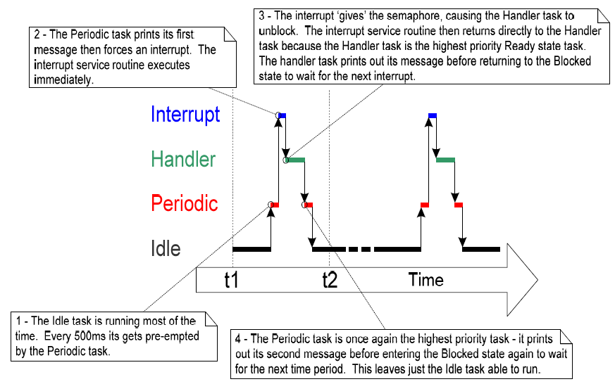
Example 12 execution sequence

Slide 27
3.3 Counting Semaphores
Problem of binary S
A binary S can latch, at most, one interrupt event.
Any subsequent events occurring before the latched event has been processed, will be lost.
Use counting semaphores to solve
Like queues having a length of more than one
Each time a counting S is ‘given’, another space in its queue is used.
# of items in the queue equals the ‘count’ value of S.
Tasks are interested in whether a queue is empty or not, not the data stored in the queue.

Slide 28
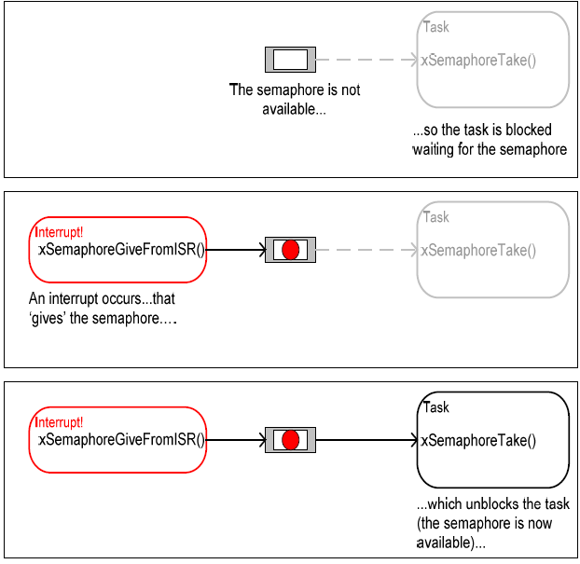
A binary S can latch at most one event.

Slide 29
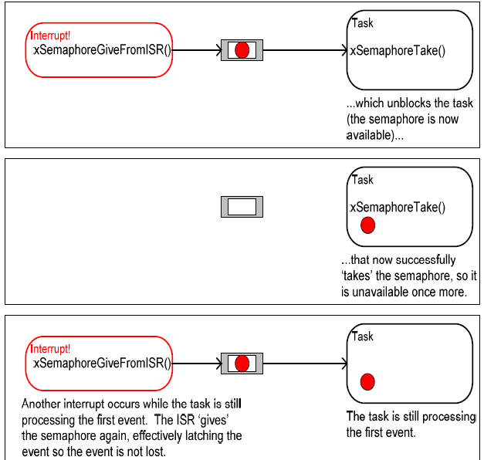

Slide 30
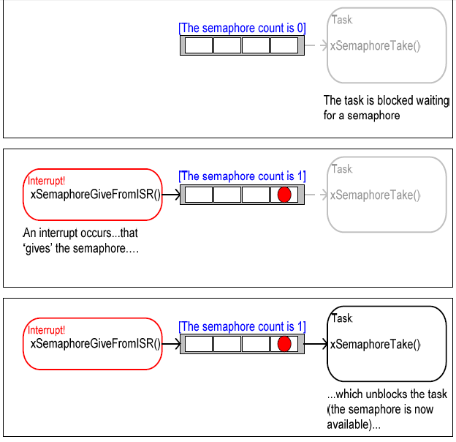
Using a counting S to ‘count’ events

Slide 31
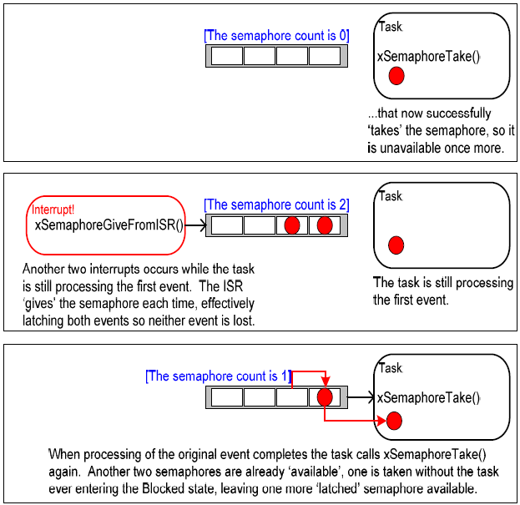

Slide 32
Counting S is typically used for two things
Counting events
An event handler will ‘give’ a S each time an event occurs
Increment the count value of S on each ‘give’
A handler task will ‘take’ a S each time it processes an event
Decrement the count value of S on each ‘take’
The count value is the difference between # of events that have occurred and # of events that have been processed.

Slide 33
Counting S is typically used for two things
Resource management
The initial count value of S equals the # of resources that are available.
A task must first ‘take’ a S to obtain control of a resource
Decrement the count value of S
the count value reaches zero -> no free resources
A task ‘give’ a S back when a task finishes with the resource
Increment the count value of S

Slide 34
xSemaphoreCreateCounting() API Function
Prototype
xSemaphoreHandle xSemaphoreCreateCounting (
unsigned portBASE_TYPE uxMaxCount,
unsigned portBASE_TYPE uxInitialCount);
uxMaxCount: the maximum value S will count to, which is effectively the length of the queue.
To count or latch events: the max # of events that can be latched,
To manage access to a collection of resources: the total # of resources that are available

Slide 35
uxInitialCount: the initial count value of S after it has been created.
To count or latch events: set to zero, presumably, when S is created, no events have yet occurred.
To manage access to a collection of resources: set to equal uxMaxCount, preseumably, when S is created, all resources are available.
Returned value
If NULL, S cannot be created due to insufficient heap memory available for FreeRTOS to allocate the S data structures.
If non-NULL, S has been created successfully. The returned value should be stored as the handle to S.

Slide 36
Example 13 Using a counting S to synchronize a task with an interrupt
Use a counting S in place of the binary S in Example 12.

Slide 37
int main(void) {
vSetupEnvironment();
xCountingSemaphore = vSemaphoreCreateCounting(10, 0);
if(xBinarySemaphore != NULL) {
prvSetupSoftwareInterrupt();
xTaskCreate(vHandleTask,“Handler”,240,NULL,3,NULL);
xTaskCreate(vPeriodicTask,“Periodic”,240, NULL,1,NULL);
vTaskStartScheduler();
}
for(;;);
}

Slide 38
void vSoftwareInterruptHandler (void) {
portBASE_TYPE xHigherPriorityTaskWoken = pdFALSE;
xSemaphoreGiveFromISR (xCountingSemaphore,
&xHigherPriorityTaskWoken);
xSemaphoreGiveFromISR (xCountingSemaphore,
&xHigherPriorityTaskWoken);
xSemaphoreGiveFromISR (xCountingSemaphore,
&xHigherPriorityTaskWoken);
mainCLEAR_INTERRUPT();
portEND_SWITCHING_ISR (xHigherPriorityTaskWoken);
}

Slide 39
3.4 Using Queues within an ISR
Semaphores are used to communicate events.
Queues are used to communicate events and to transfer data.

Slide 40
xQueueSendToFrontFromISR() and xQueueSendToBackFromISR()
xQueueSendToBackFromISR() is equivalent to xQueueSendFromISR().
xQueueSendToBackFromISR (xQueueHandle xQueue,
void *pvItemToQueue,
portBASE_TYPE *pxHigherPriorityTaskWoken);
xQueueSendToFrontFromISR( xQueueHandle xQueue,
void *pvItemToQueue,
portBASE_TYPE *pxHigherPriorityTaskWoken);

Slide 41
xQueue: The handle of the queue to which the data is being sent. It will have been returned from the call to xQueueCreate().
pvItemToQueue: a pointer to the data to be copied into the queue.
The size of each item that the queue can hold is set when it is created, so this # of bytes will be copied from pvItemToQueue into the queue storage area.

Slide 42
pxHigherPriorityTaskWoken:
A single queue may have one or more tasks blocked on it waiting for data to be available.
Calling these two APIs can make data available, so cause such a task to leave the Blocked state. If the unblocked task has a priority equal to or higher than the currently executing task, internally, the API function will set it to pdTRUE.
Then, a context switch should be performed before the interrupt is exited.
This ensures that interrupt returns directly to the highest priority Ready state task.
Returned value
pdPASS : data has been sent successfully
errQUEUE_FULL: data cannot be sent to the queue as the queue is already full.

Slide 43
Efficient Queue Usage
Most demo applications include a simple UART driver
use queues to pass characters into the transmit interrupt handler and out of the receive interrupt handler.
Every character gets passed individually through a queue.
Implementing UART drives in this way easily demonstrates queues being used within interrupts, but is extremely inefficient.

Slide 44
Efficient technique 1
Place each received character in a simple RAM buffer.
Use a S to unblock a task to process the buffer, after a complete message has been received, or a break in transmission has been detected.

Slide 45
Efficient technique 2
Interpret the received characters directly within the ISR.
Use a queue to send the interpreted and decoded commands to a task for processing.
It is suitable only if interpreting the data stream is quick enough to be performed entirely within an interrupt.

Slide 46
Example 14 Sending and receiving on a queue within an interrupt
Demonstrate xQueueSendToBackFromISR() and xQueueReceiveFromISR() being used within the same interrupt.
A periodic task is created to send five numbers to queue every 200ms.
It generates a software interrupt only after all 5 values have been sent.

Slide 47
static void vIntegerGenerator (void *pvParameters) {
portTickType xLastExecutionTime;
unsigned long ulValueToSend = 0;
int i;
xLastExecutionTime = xTaskGetTickCount();
for (;;) {
vTaskDelayUntil(&xLastExecutionTime, 200/portTICK_RATE_MS);
for (I = 0; I < 5; i++) {
xQueueSendToBack(xIntegerQueue,
&ulValueToSend,0);
ulValueToSend++;
}
mainTRIGGER_INTERRUPT();
} }

Slide 48
ISR calls xQueueReceiveFromISR() repeatedly, until all values written to the queue by the periodic task have been removed, and the queue is left empty.
The last two bits of each received value are used as an index into an array of strings, with a pointer to the string at the corresponding index position.
and send the string to a different queue using a call to xQueueSendFromISR().

Slide 49
static void vsoftwareInterruptHandler(void) {
portBASE_TYPE xHigherPriorityTaskWoken = pdFALSE;
static unsigned long ulReceivedNumber;
portBASE_TYPE xStatus;
static const char *pcStrings[] =
{“String 0\n”, “String 1\n”, “String 2\n”, “String 3\n”};
xStatus = xQueueReceiveFromISR(xIntegerQueue, &ulReceivedNumber, & xHigherPriorityTaskWoken);
while (xStatus != errQUEUE_EMPTY) {
ulReceivedNumber &= 0x03; // Truncate value 0 to 3
xQueueSendToBackFromISR(xStringQueue, &pcStrings[ulReceiveNumber],
& xHigherPriorityTaskWoken); }
mainCLEAR_INTERRUPT();
portEND_SWITCHING_ISR(xHigherPriorityTaskWoken);
} }

Slide 50
The task that receives the character pointers from the ISR blocks on the queue until a message arrives, printing out each string as it is received.
static void vStringPrinter(void *pvParameters) {
char *pcString;
for(;;) {
xQueueReceive (xStringQueue,
&pcString, portMAX_DELAY);
vPrintString(pcString);
}
}}

Slide 51
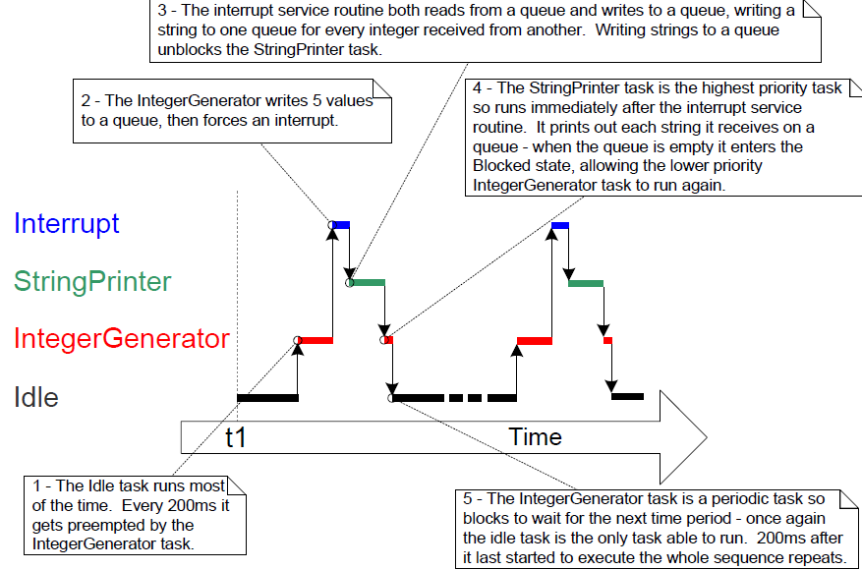

Slide 52
3.5 Interrupt Nesting- Constants that affect interrupt nesting
configKERNEL_INTERRUPT_PRIORITY
Set the priority of interrupts used by the kernel.
The timer interrupt used to generate the tick and PendSV (Pend Service Call) interrupt used within the API.
Will almost always be set to the lowest possible interrupt priority.
configMAX_SYSCALL_INTERRUPT_PRIORITY
Define the highest interrupt priority from which FreeRTOS API functions can be called.

Slide 53
Cortex-M3 core can use up to 8 bits to specify an interrupt priority
Allowing a maximum of 256 different priorities
High numeric values denote low interrupt priorities.
Highest interrupt priority is 0, the lowest one is 255.
Two ways to simplify the specification of interrupt priority values
Think priority implemented by LSB, then shift the priority left by the # of unimplemented priority bits.
Use the functions provided by the CMSIS to access the interrupt controller.
NVIC_SetPriority(WDT_IRQn, 5);

Slide 54
Achieve full interrupt nesting functionality by setting configMAX_SYSCALL_INTERRUPT_PRIORITY to a higher priority (lower numeric value) than configKERNEL_INTERRUPT_PRIORITY
The default priority of all interrupts is zero.
If an interrupt uses a FreeRTOS API function, its priority must never be left uninitialized, unless configMAX_SYSCALL_INTERRUPT_PRIORITY is also set to zero.

