Slide 1
FreeRTOS

Slide 2
Queue Management
FreeRTOS applications are structured as a set of independent tasks
Each task is effectively a mini program in its own right.
It will have to communicate with each other to collectively provide useful system functionality.
Queue is the underlying primitive
Be used for communication and synchronization mechanisms in FreeRTOS.

Slide 3
Queue: Task-to-task communication
Scope
How to create a queue
How a queue manages the data it contains
How to send data to a queue
How to receive data from a queue
What it means to block on a queue
The effect of task priorities when writing to and reading from a queue

Slide 4
2.2 Queue Characteristics – data storage
A queue can hold a finite number of fixed size data items.
Normally, used as FIFO buffers where data is written to the end of the queue and removed from the front.
Also possible to write to the front of a queue.
Writing data to a queue causes a byte-for-byte copy of the data to be stored in the queue itself.
Reading data from a queue causes the copy of the data to be removed from the queue.

Slide 5
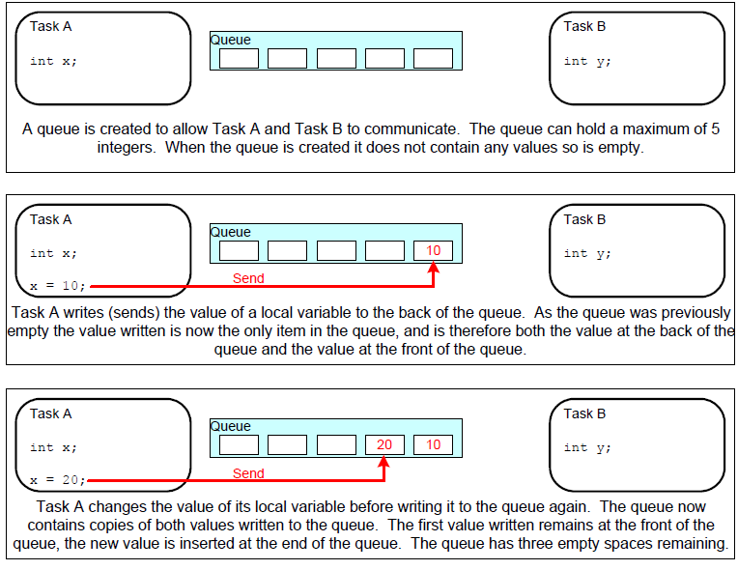

Slide 6
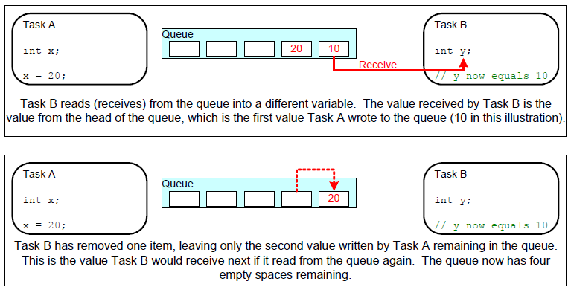
Queues are objects in their own right
Not owned by or assigned to any particular task
Any number of tasks can write to the same queue and any number of tasks can read from the same queue.
Very common to have multiple writers, but very rare to have multiple readers.

Slide 7
Blocking on Queue Reads
A task can optionally specify a ‘block’ time
The maximum time that the task should be kept in the Blocked state to wait for data to be available from the queue.
It is automatically moved to the Ready state when another task or interrupt places data into the queue.
It will also be moved automatically from the Blocked state to the Ready state if the specified block time expires before data becomes available.

Slide 8
Blocking on Queue Reads
Only one task will be unblocked when data becomes available.
Queue can have multiple readers.
So, it is possible for a single queue to have more than one task blocked on it waiting for data.
The task that is unblocked will always be the highest priority task that is waiting for data.
If the blocked tasks have equal priority, the task that has been waiting for data the longest will be unblocked.

Slide 9
Blocking on Queue Writes
A task can optionally specify a ‘block’ time when writing to a queue.
The maximum time that task should be held in the Blocked state to wait for space to be available on the queue.

Slide 10
Blocking on Queue Writes
Queue can have multiple writers.
It is possible for a full queue to have more than one task blocked on it waiting to complete a send operation.
Only one task will be unblocked when space on the queue becomes available.
The task that is unblocked will always be the highest priority task that is waiting for space.
If the blocked tasks have equal priority, the task that has been waiting for space the longest will be unblocked.

Slide 11
2.3 Using a Queue
A queue must be explicitly created before it can be used.
FreeRTOS allocates RAM from the heap when a queue is created.
RAM holds both the queue data structure and the items that are contained in the queue.
xQueueCreate() API Function
Be used to create a queue and returns an xQueueHandle to reference the queue it creates.

Slide 12
Function Prototype
xQueueHandle xQueueCreate(
unsigned portBASE_TYPE uxQueueLength, unsigned portBASE_TYPE uxItemSize);
xQueueLength: The maximum number of items that the queue being created can hold at any one time.
uxItemSize: the size in bytes of each data item that can be stored in the queue.
Return Value:
if NULL is returned, the queue cannot be created as there is insufficient heap memory available for FreeRTOS to allocate the queue data structures and storage.
A non-NULL value returned indicates that the queue has been created successfully. It should be stored as the handle to the created queue.

Slide 13
xQueueSendToBack() and xQueueSendToFront() API Functions
xQueueSendToBack()
Be equivalent to xQueueSend()
Be used to send data to the back(tail) of a queue
xQueueSendToFront()
Be used to send data to the front (head) of a queue
Please note, never call these two API functions from an interrupt service routine (ISR).
Interrupt-safe versions will be used in their place and described in next chapter.

Slide 14
Function prototypes
portBASE_TYPE xQueueSendToBack (
xQueueHandle xQueue,
const void * pvItemToQueue,
portTickType xTicksToWait);
portBASE_TYPE xQueueSendToFront(
xQueueHandle xQueue,
const void * pvItemToQueue,
portTickType xTicksToWait);
xQueue: The handle of the queue to which the data is being send (written). It will have been returned from the call to xQueueCreate() used to create the queue.

Slide 15
pvItemToQueue: a pointer to the data to be copied into the queue.
The size of each item that the queue can hold is set when the queue is created, so the data will be copied from pvItemQueue into the queue storage area.
xTicksToWait: the maximum amount of time the task should remain in the Blocked state to wait for the space to become available on the queue, should the queue already be full.
if xTicksToWait is zero, both APIs will return immediately in case the queue is already full.
The block time is specified in tick periods, so the absolute time it represents is dependent on the tick frequency. The constant portTICK_RATE_MS can be used to convert tickes into a time specified in MS.

Slide 16
Returned value: two possible return values.
pdPASS will be returned if data was successfully sent to the queue.
If a block time was specified, it is possible that the calling task was placed in the Blocked state to wait for another task or interrupt to make room in the queue, before the function returned,
Data was successfully written to the queue before the block time expired.
errQUEUE_FULL will be returned if data could not be written to the queue as the queue was already full.
In a similar scenario that a block time was specified, but it expired before space becomes available in the queue.

Slide 17
xQueueReceive() and xQueuePeek() API Function
xQueueReceive()
Be used to receive (consume) an item from a queue. The item received is removed from the queue.
xQueuePeek()
Be used receive an item from the queue without the item being removed from the queue.
Receives the item from the head of the queue.
Please note, never call these two API functions from an interrupt service routine (ISR).

Slide 18
Function prototypes
portBASE_TYPE xQueueReceive (
xQueueHandle xQueue,
const void *pvBuffer,
portTickType xTicksToWait);
portBASE_TYPE xQueuePeek(
xQueueHandle xQueue,
const void * pvBuffer,
portTickType xTicksToWait);
xQueue: The handle of the queue from which the data is being received (read). It will have been returned from the call to xQueueCreate().

Slide 19
pvBuffer: a pointer to the memory into which the received data will be copied.
The memory pointed to by pvBuffer must be at least large enough to hold the data item held by the queue.
xTicksToWait: the maximum amount of time the task should remain in the Blocked state to wait for the data to become available on the queue, should the queue already be empty.
if xTicksToWait is zero, both APIs will return immediately in case the queue is already empty.
The block time is specified in tick periods, so the absolute time it represents is dependent on the tick frequency. The constant portTICK_RATE_MS can be used to convert a time specified in MS into ticks.

Slide 20
Returned value: two possible return values.
pdPASS will be returned if data was successfully read from the queue.
If a block time was not zero, it is possible that the calling task was placed in the Blocked state to wait for another task or interrupt to send the data to the queue before the function is returned,
data was successfully read from the queue before the block time expired.
errQUEUE_EMPTY will be returned if data could not be read from the queue as the queue was already empty.
In a similar scenario that a block time was not zero, but it expired before data was sent.

Slide 21
uxQueueMessageWaiting() API Function
Be used to query the number of items that are currently in a queue.
Prototype
unsigned portBASE_TYPE uxQueueMEssagesWaiting (
xQueueHandle xQueue);
Returned value: the number of items that the queue being queried is currently holding. If zero is returned, the queue is empty.

Slide 22
Example 10. Blocking when receiving from a queue
To demonstrate
a queue being created,
Hold data items of type long
data being sent to the queue from multiple tasks,
Sending tasks do not specify a block time, lower priority than receiving task.
And data being received from the queue
Receiving task specifies a block time 100ms
So, queue never contains more than one item
Once data is sent to the queue, the receiving task will unblock, pre-empt the sending tasks, and remove the data – leaving the queue empty once again.

Slide 23
vSenderTask() does not specify a block time.
continuously writing to the queue
xStatus = xQueueSendToBack(xQueue, pvParameters, 0);
If (xStatus != pdPASS) {
vPrintString(“Could not send to the queue.\n”); }
taskYIELD();
vReceiverTask() specifies a block time 100ms.
Enter the Blocked state to wait for data to be available, leaves it when either data is available on the queue, or 100ms expires, which should never occur.
xStatus = xQueueReceive(xQueue, &xReceivedValue, 100/portTICK_RATE_MS);
if (xStatus == pdPASS) {
// print the data received
}

Slide 24
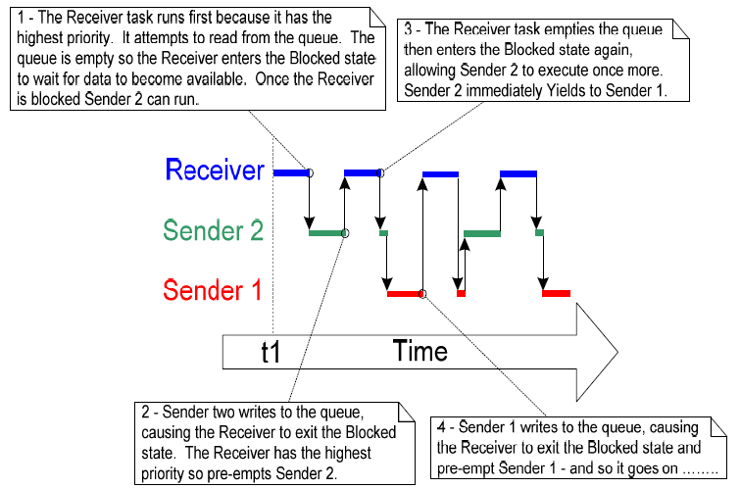
Execution sequence

Slide 25
Using Queues to transfer compound types
It is common for a task to receive data from multiple sources on a single queue.
Receiver needs to know the data source to allow it to determine how to process the data.
Use the queue to transfer structures which contain both data value and data source, like
typedef struct {
int iValue; // a data value
int iMeaning; // a code indicating data source
} xData;

Slide 26
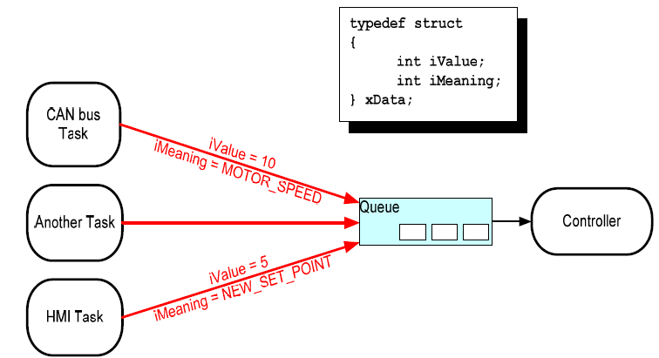
Controller task performs the primary system function.
React to inputs and changes to the system state communicated to it on the queue.
A CAN bus task encapsulates the CAN bus interfacing functionality, like the actual motor speed value.
A HMI task encapsulates all the HMI functionality, like the actual new set point value.

Slide 27
Example 11
Two differences from Example 10
Receiving task has a lower priority than the sending tasks.
The queue is used to pass structures, rather than simple long integers between the tasks.
The Queue will normally be full because
Once the receiving task removes an item from the queue, it is pre-empted by one of the sending tasks which then immediately refills the queue.
Then sending tasks re-enters the Blocked state to wait for space to become available on the queue again.

Slide 28
In vSenderTask(), the sending task specifies a block time of 100ms.
So, it enters the Blocked state to wait for space to become available each time the queue becomes full.
It leaves the Blocked state when either the space is available on the queue or 100ms expires without space be available (should never expire as receiving task is continuously removing items from the queue).
xStatus = xQueueSendToBack(xQueue, pvParameters, 100/portTICK_RATE_MS);
If (xStatus != pdPASS) {
vPrintString(“Could not send to the queue.\n”);
}
taskYIELD();

Slide 29
vReceiverTask() will run only when both sending tasks are in the Blocked state.
Sending tasks will enter the Blocked state only when the queue is full as they have higher priorities.
The receiving task will execute only when the queue is already full. -> it always expects to receive data even without a ‘block’ time.
xStatus = xQueueReceive(xQueue, &xReceivedStructure, 0);
if (xStatus == pdPASS) {
// print the data received
}

Slide 30
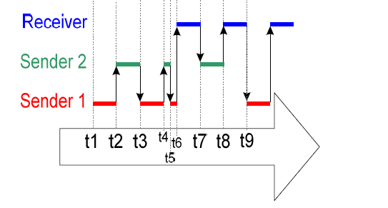
Execution sequence – Sender 1 and 2 have higher priorities than Receiver

Slide 31
2.4 Working with large data
It is not efficient to copy the data itself into and out of the queue byte by byte, when the size of the data being stored in the queue is large.
It is preferable to use the queue to transfer points to the data.
More efficient in both processing time and the amount of RAM required to create the queue.
But, when queuing pointers, extreme care must be taken.

Slide 32
The owner of the RAM being pointed to is clearly defined.
When multiple tasks share memory via a pointer, they do not modify its contents simultaneously, or take any other action that cause the memory contents invalid or inconsistent.
Ideally, only the sending task is permitted to access the memory until a pointer to the memory has been queued, and only the receiving task is permitted to access the memory after the pointer has been
The RAM being pointed to remains valid.
If the memory being pointed to was allocated dynamically, exactly one task be responsible for freeing the memory.
No task should attempt to access the memory after it has been freed.
A pointer should never be used to access data that has been allocated on a task stack. The data will not be valid after the stack frame has changed.
Notes:
What data are allocated on a task stack.

