Slide 1
4. Resource Management

Slide 2
Introduction
Potential conflict in a multitasking system
If one task starts to access a resource, but does not complete its access before being transitioned out of the Running state,
If the task leaves the resource in an inconsistent state,
Then, access to the same resource by any other task or interrupt could result in data corruption or other similar error.

Slide 3
Example – Accessing peripherals
Consider the following scenario where two tasks attempt to write to an LCD
Task A executes and starts to write the string “Hello world” to the LCD.
Task A is pre-empted by Task B after outputting just the beginning of the string – “Hello W”.
Task B writes “Abort, Retry, Fail?” to the LCD before entering the Blocked state.
Task A continues from the point at which it was pre-empted and completes outputting the remaining characters – “orld”.
LCD displays the corrupted string
“Hello wAbort, Retry, Fail?orld”.

Slide 4
Example –Function Reentrancy
A function is reentrant if it is safe to call the function from more than one task, or from both tasks and interrupts.
Each task maintains its own stack and its own set of core register values.
So, the function is reentrant as long as a function does not access any data other than data stored on the stack or held in a register.

Slide 5
A non-reentrant function
long lVarl;
long lnonRentrantFunc (void) {
// not allocated on the stack
static long lState = 0;
long lReturn;
switch (lState) {
case 0 : lReturn = lVarl + 10;
lState = 1; break;
case 1 : lReturn = lVarl + 20;
lState = 0; break;
}
return lReturn;
}
A reentrant function
long lAddOne (long lVarl)
{
long lVar2;
lVar2 = lVar1 + 1;
return lVar2;
}

Slide 6
Mutual Exclusion
Data consistency must be maintained at all times, if the access to a resource is shared between tasks or between tasks and interrupts
Once a task starts to access a shared resource, the same task has exclusive access until the resource has been returned to a consistent state.(一旦任务开始访问共享资源，相同的任务将具有独占访问权限，直到资源返回到一致状态。)

Slide 7
4.2 Critical sections and suspending the scheduler
Basic critical sections (regions)
Regions of code that are surrounded by calls to the macros taskENTER_CRITICAL() and taskEXIT_CRITICAL(), respectively.
taskENTER_CRITICAL();
GlobalVar |= 0x01;
taskEXIT_CRITICAL();

Slide 8
void vPrintString(const char *pcString) {
static char cBuffer[ ioMAX_MSG_LEN];
taskENTER_CRITICAL();
{
sprintf(cBuffer, “%s”, pcString);
consoleprint(cBuffer);
}
taskEXIT_CRITICAL();
}
A crude method of providing mutual exclusion.
It works by disabling interrupts up to the interrupt priority set by configMAX_SYSCALL_INTERRUPT_PRIORITY.

Slide 9
Critical section must be kept very short; otherwise, they will adversely affect interrupt response time.
So standard out should not be protected using a critical section because writing to the terminal can be a relatively long operation.
Need to explore alternative solutions!
It is safe for critical sections to become nested, as the kernel keeps a count of the nesting depth.
Exit the critical section only when the nesting depth returns to zero,
That is, one call to taskEXIT_CRITICAL() has been executed for every preceding call to taskENTER_CRITICAL().

Slide 10
Suspending (or Locking) the Scheduler
Create critical sections by suspending the scheduler.
Can protect a region of code only from access by other tasks as interrupts remain enabled.
A critical section that is too long to be implemented by simply disabling interrupts can be implemented by suspending the scheduler.
But, resuming the scheduler can be a relatively long operation.

Slide 11
vTaskSuspendAll() API Functions
Prototype
void vTaskSuspendAll(void);
Suspending the scheduler prevents a context switch from occurring but leaves interrupts enabled.(可防止上下文切换发生)
If an interrupt requests a context switch while the scheduler is suspended, the request is held pending and is performed only when the scheduler is resumed.

Slide 12
vTaskResumeAll() API Function
Prototype
portBASE_TYPE vTaskResumeAll(void);
Returned value
pdTRUE: a previously pending context switch being performed before xTaskResumeAll() returns;
pdFALSE: in all other cases.
Notes:
Context switches, which are requested while the scheduler is suspended, are held pending and performed only as the scheduler is being resumed.

Slide 13
Actual implementation of vPrintString()
void vPrintString(const char *pcString) {
static char cBuffer[ ioMAX_MSG_LEN];
vTaskSuspendAll();
{
sprintf(cBuffer, “%s”, pcString);
consoleprint(cBuffer);
}
vTaskResumeAll();
}

Slide 14
4.3 Mutexes (MUTual EXclusion)
In mutual exclusion scenario, mutex is considered as a token associated with the resource being shared.
For a task to access the resource legitimately, it must first successfully ‘take’ the token.
No task is allowed to access the shared resources unless it holds the token
When the token holder task has finished with the resource, it must ‘give‘ the token back.
Only when the token has been returned, another task can successfully take the token and then safely access the same shared resource.

Slide 15
Mutexes vs. Binary Semaphores
A mutex is a special type of Semaphore.
But, their usage scenarios are different.
Mutex for mutual exclusion
Binary semaphore for synchronization
And differ after obtaining the semaphore
Mutex must always be returned.
A binary semaphore is normally discarded and not returned.

Slide 16
A bit more
The mechanism works purely through the discipline of the application writer.
There is no reason why a task cannot access the resource at any time, but
Each task ‘agrees’ not to do so, unless it is able to become the mutex holder

Slide 17
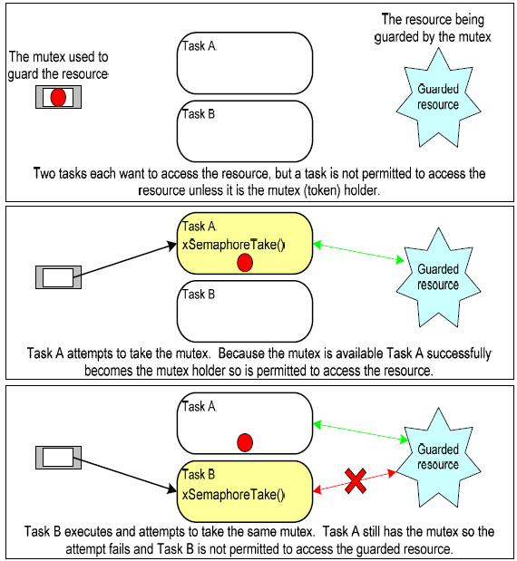

Slide 18
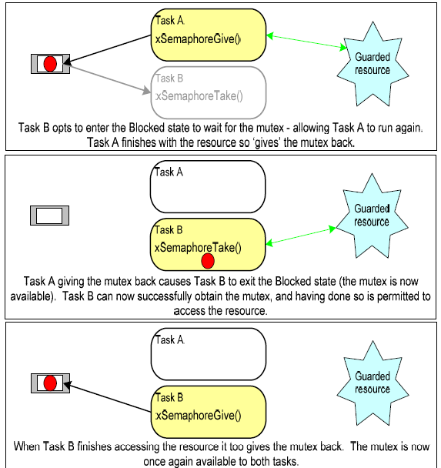

Slide 19
xSemaphoreCreateMutex() API
Prototype
xSemaphoreHandle xSemaphoreCreateMutex(void);
Retuned value
If NULL is returned, the mutex could not be created as there is insufficient heap memory available for FreeRTOS to allocate the mutex data structure.
A non-NULL return value indicates that the mutex has been created successfully. It should be stored as the handle to the created mutex.

Slide 20
Example 15 Rewriting vPrintString() to use a semaphore
Create a new version of prvNewPrintString()
Use a mutex to control access to standard out in place of the basic critical section.
Then, call this new function from multiple tasks.

Slide 21
static void prvNewPrintString(const char *pcString) {
static char cBuffer[ ioMAX_MSG_LEN];
/* Block indefinitely to wait for the mutex if it is not
available straight away. */
xSemaphoreTake(xMutex, portMAX_DELAY);
{
sprintf(cBuffer, “%s”, pcString);
consoleprint(cBuffer);
}
xSemaphoreGive(xMutex);
}
It is called repeatedly by two instances of a task implemented by prvPrintTask().

Slide 22
static void prvPrintTask(void *pvParameters) {
char *pcStringToPrint;
pcStringToPrint = (char *) pvParameters;
for(;;)
{
prvNewPrintString(pcStringToPrint);
/* Use a random delay time between each call. */
vTaskDelay((rand() & 0x1FF));
}
}

Slide 23
int main (void) {
xMutex = xSemaphoreCreateMutex();
/* seed the random number for a pseudo random delay */
srand(567);
if(xMutex != NULL) {
xTaskCreate( prvPrintTask, “Print1”, 240, “Task 1 *******************”, 1, NULL);
xTaskCreate( prvPrintTask, “Print2”, 240, “Task 2 *******************”, 2, NULL);
vTaskStartScheduler();
}
for( ; ; );
}
Use a mutex to ensure each task gets mutually exclusive access to the terminal, even when pre-emption occurs, the strings that are displayed will be correct and in no way corrupted.

Slide 24
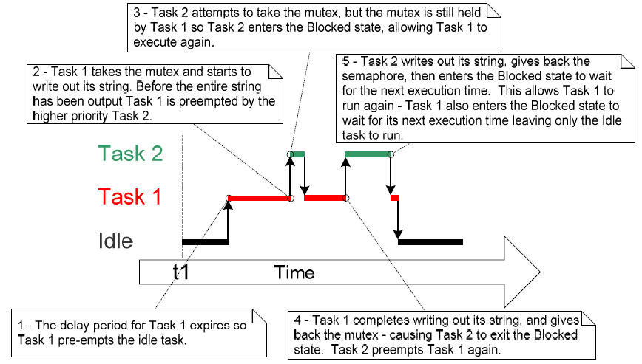

Slide 25
A potential pitfall of using mutex to provide mutual exclusion – priority inversion
Priority inversion is a higher priority task being delayed by a low priority task.
In previous sequence, the higher priority Task 2 has to wait for the lower priority Task 1 to give up control of the mutex, as shown in the previous execution sequence.
This undesirable behavior would be exaggerated if a medium priority task started to execute while the high priority task was waiting for S
A high priority task waiting for a low priority task without the low priority task even being able to execute.

Slide 26
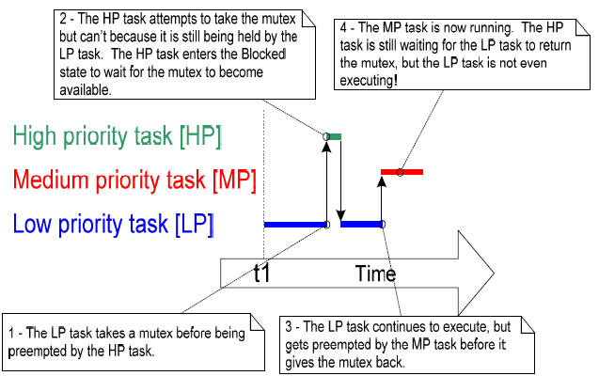
A worst case scenario
Can avoid priority inversion
at system design time for
small embedded systems
Consider how to access
resources.

Slide 27
Priority Inheritance
A scheme ensures the priority inversion is always time bounded.
Temporarily raise the priority of the mutex holder to that of the highest priority task which is attempting to obtain the same mutex.
The low priority task that holds the mutex ‘inherits’ the priority of the task waiting for the mutex.
Reset the priority of the mutex holder automatically to its original value when it gives the mutex back.

Slide 28
Pros and Cons
Pros
Minimize the negative effects of priority inversion
Cons
cannot fix priority inversion problem
Complicate system timing analysis, not a good practice for correct system operation
Mutex and binary S are very similar, but
mutex includes a basic ‘priority inheritance’ mechanism
binary S does not.

Slide 29
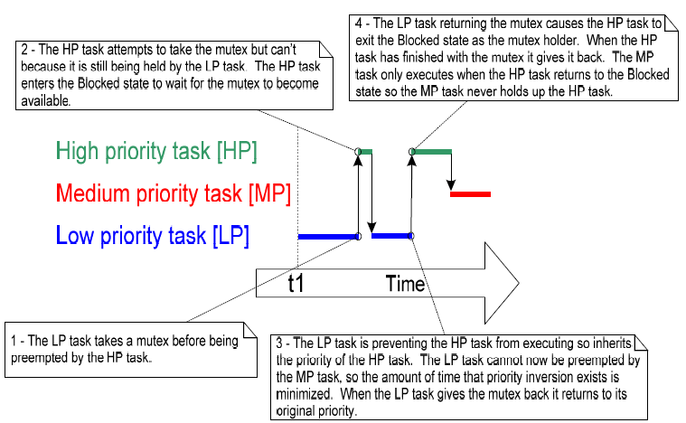
The priority inheritance mechanism implemented by mutexes is
only a basic form
Assume a task will hold only a single mutex at any one time.

Slide 30
Another potential pitfall of using mutex for mutual exclusion – Deadlock
Deadlock occurs when two tasks cannot proceed because they are both waiting for a resource held by the other.
Best method of avoiding deadlock is to consider its potential at design time
Design the system to ensure it cannot occur.
Not a big in small embedded systems
Can have a good understanding of the entire application, and identify and remove the areas where it could occur.

Slide 31
A scenario where Task A and B both need to acquire mutex X and mutex Y
Task A executes and successfully takes mutex X.
Task A is pre-empted by Task B.
Task B successfully takes mutex Y before attempting to also take mutex X
but mutex X is held by Task A, so is not available to Task B. Task B opts to enter the Blocked state to wait for mutex X to be released.
Task A continues executing. It attempts to take mutex Y.
But mutex Y is held by Task B, so is not available to Task A. Task A opts to enter the Blocked state to wait for mutex Y to be released.

Slide 32
4.4 Gatekeeper tasks
A gatekeeper task has sole ownership of a resource.
Only it is allowed to access the resource directly
Any other tasks requiring access to the resource must do so indirectly by using the services of the gatekeeper.
Provide a clean method of avoiding mutual exclusion without the risk of priority inversion or deadlock.

Slide 33
Example 16 Rewriting vPrintString() to use a gatekeeper task
Use a gatekeeper task to manage access to standard out as an alternative implementation for vPrintString().
When a task writes a message to the terminal, it does not call a print function directly but sends the message to the gatekeeper.
Internal implementation of the task needs not to consider mutual exclusion as it is the only task permitted to access the terminal directly
The gatekeeper task uses a queue to serialize access to the terminal.

Slide 34
A gatekeeper task spends most of its time in the Blocked state, waiting for messages to arrive on the queue.
When a message arrives, the gatekeeper writes it to standard out, before returning to the Blocked state to wait for the next one.
ISR can also safely use a gatekeeper to write messages to the terminal.
As interrupt can send to queues

Slide 35
The gatekeeper task
static void prvStdioGateKeeperTask(void *pvParameters)
{
char *pcMessageToPrint;
static char cBuffer[mainMAX_MSG_LEN];
for (;;) {
xQueueReceive(xPrintQueue, &pcMessageToPrint, portMAX_DELAY);
sprintf(cBuffer, “%s”, pcMessageToPrint);
consoleprint(cBuffer);
}
}

Slide 36
static void prvPrintTask(void *pvParameters) {
int iIndexToString;
iIndexToString = (int) pvParameters;
for(;;)
{
/*Send the string on the queue to the gatekeeper
task, rather than written out directly.*/
xQueueSendToBack(xPrintQueue, &pcMessageToPrint, portMAX_DELAY);
vTaskDelay((rand() & 0x1FF));
}
}

Slide 37
A tick hook function for writing out a message every 200 ticks.
It is a function that is called by the kernel during each tick interrupt.
Execute within the context of the tick interrupt, so
Must be kept very short and use only a moderate amount of stack space
Must not call any FreeRTOS API functions whose name does not end with ‘FromISR()’
To use a tick hook function
Set configUSE_TICK_HOOK to 1
Provide the implementation of the hook function, using the exact function name and prototype as
void vApplicationTickHook(void);

Slide 38
/* It counts the number of times it is called, sending its message
to the gatekeeper each time the count reaches 200.*/
void vApplicationTickHook(void) {
static int iCount = 0;
portBASE_TYPE xHigherPriorityTaskWoken = pdFALSE;
iCount++;
if(iCount >= 200)
{
xQueueSendToFrontFromISR( xPrintQueue,
&(pcStringsToPrint[2]),
& xHigherPriorityTaskWoken );
iCount = 0;
}
}

Slide 39
int main (void) {
xPrintQueue = xQueueCreate(5, sizeof(char *));
/* seed the random number for a pseudo random delay */
srand(567);
if(xPrintQueue != NULL) {
xTaskCreate( prvPrintTask, “Print1”, 240, (void *)0, 1, NULL);
xTaskCreate( prvPrintTask, “Print2”, 240, (void *)1, 2, NULL);
/* assign gate keeper task a lower priority than the print tasks,
so messages sent to the gate keeper remain in the queue until
both print tasks are in the Blocked state*/
xTaskCreate(prvStdioGateKeeperTask, “Gatekeeper”,
240, NULL, 0, NULL);
vTaskStartScheduler();
}
for( ; ; );
}

Slide 40
Chapter 5 memory Management

Slide 41
Introduction
FreeRTOS treats memory allocation as part of the portable layer (as opposed to part of the core code base)
Instead of calling malloc() / free() directly, the kernel calls pvPortMalloc() / vPortFree().
Pros: enable individual applications to provide their own specific implementation.
FreeRTOS provides three example implementations of both pvPortMalloc and vPortFree().
Notes:
The kernel allocates RAM dynamically each time to create a task, queue or semaphore.

Slide 42
Introduction
FreeRTOS’s three example implementations
Defined in heap_1.c, heap_2.c and heap_3.c
Users can use one of them, or provide their own.
For small embedded systems
Common to create tasks queues and semaphores before the scheduler starts.
So, memory gets dynamically allocated by the kernel before the application starts to perform any real-time functionality, and remains allocated for the lifetime of the application.

Slide 43
5.2 Example memory allocation schemes
Heap_1.c
Implement a very basic version of pvPortMalloc() and does not implement vPortFree().
Always be deterministic.
Applications that never delete a task, queue or semaphore have the potential to use it.
The allocation scheme subdivides a simple array into smaller blocks as calls to pvPortMalloc() are made.
The array is the FreeRTOS heap.

Slide 44
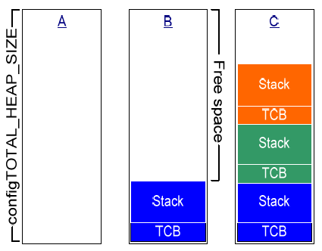
The total size of the array is set by the definition configTOTAl_HEAP_SIZE.
Each task requires a task control block (TCB) and a stack to be allocated from the heap.
A: the array before any tasks
have been created – the entire
array is free.
B: the array after one task has
been created.
C: the array after three tasks
Have been created.

Slide 45
Heap_2.c
Also use a simple array dimensioned by configTOTAL_HEAP_SIZE.
Declare array statically as well.
Does allow memory to be freed.
Use a best fit algorithm to allocate memory
Ensure that pvPortMalloc() uses the free block of memory that is closest in size to the number of bytes requested.

Slide 46
Example
Consider the scenario
The heap contains three blocks of free memory: 5 bytes, 25 bytes and 100 bytes, respectively.
pvPortMalloc() is called to request 20 bytes of RAM.
The smallest free block of RAM into which the requested number of bytes will fit is 25-byte block.
So, pvPortMalloc() splits the 25-byte block into one block of 20 bytes and one block of 5 bytes before returning a pointer to the 20-byte block.
The new 5-byte block remains available to future calls to pvPortMalloc().

Slide 47
Cons of heap_2.c
Not combine adjacent free blocks into a single larger block.
Suffer from fragmentation.
But fragmentation is not an issue if the blocks being allocated and subsequently freed are always the same size.
Not deterministic but is more efficient
Compared to most standard library implementations of malloc() and free().
Be suitable for an applications that create and delete tasks repeatedly,
provided the size of the stack allocated to the created tasks does not change.

Slide 48
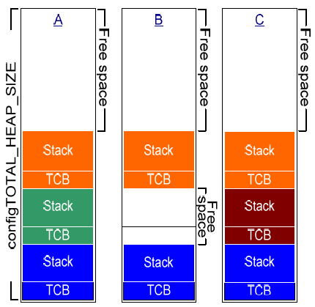
RAM being allocated from the array as tasks are created and deleted.
A: the array after three tasks have
been created.
A large free block remains at the
top of the array.
B: the array after one task has
been deleted.
The large free block at the top of
the array remains PLUS
Two smaller free blocks that were
previously allocated to the TCB
and stack of the deleted task

Slide 49
C: after another tasks has been created.
Results in two calls to pvPortMalloc(): one to allocate a new TCB, one to allocate the task stack. (The calls occur internally within the xTaskCreate() API.)
Every TCB is exactly the same size, so the algorithm ensures to reuse the block of RAM previously allocated to the TCB of the deleted task to allocate the TCB of the new task.
The size of the stack allocated to the newly created task is identical to that allocated to the deleted task, the algorithm ensures to reuse the block of RAM previously allocated to the stack of the deleted task to allocate the stack of the new stack. The larger unallocated block at the top of the array remains untouched.

Slide 50
Heap_3.c
Use the standard library malloc() and free() function, but
make the calls thread-safe by temporarily suspending the scheduler.
The size of the heap is NOT affected by configTOTAL_HEAP_SIZE; but is defined by the linker configuration.

Slide 51
void *pvPortMalloc(size_t xWantedSize) {
void *pvReturn;
vTaskSuspendAll();
{ pvReturn = malloc(xWantedSize); }
vTaskResumeAll();
return pvReturn;
}
void *pvPortFree(void *pv) {
if (pv != NULL) {
vTaskSuspendAll();
{ free(pv); }
xTaskResumeAll();
}
}

Slide 52
xPortGetFreeHeapSize() API
It returns the current number of unallocated bytes in the heap.
Be available only when heap_1.c or heap_2.c is being used.
Provide a simple method of optimizing heap size.
If it returns 2000 after all required tasks, queues and semaphores have been created, can reduce configTOTAL_HEAP_SIZE by 2000.
Prototype
size_t xPortGetFreeHeapSize(void);

