Slide 1
Digital Portfolio
STUDENT NAME: JOTHI MANI R
REGISTER NO AND NMID: 2422J1007 AND 08A27EC7BA57EAEAE0C4D333A36B08B8
DEPARTMENT: BCA
COLLEGE: Akshaya College of Arts and Science / Bharathiyar University

Slide 2
PROJECT TITLE
CloudFolio – A Light & Airy Portfolio

Slide 3


AGENDA
Problem Statement
Project Overview
End Users
Tools and Technologies
Portfolio design and Layout
Features and Functionality
Results and Screenshots
Conclusion
Github Link
3/21/2024 Annual Review

Slide 4

PROBLEM STATEMENT
Most online portfolios tend to look either too dark and serious or overly complicated. While these styles might work for some, they don’t always feel welcoming or easy to connect with. Many students and professionals want a portfolio that is simple, friendly, and approachable — something that feels fresh and easy to browse. A light, cloud-inspired design can solve this by creating a portfolio that’s both professional and pleasant to explore.

Slide 5

PROJECT OVERVIEW
CloudFolio is a digital portfolio designed with a soft, pastel, and airy theme. Instead of heavy colors or flashy designs, it uses gentle gradients, rounded shapes, and floating effects to give a calm, uplifting look. The portfolio is built using HTML, CSS, and JavaScript, making it responsive and interactive. CloudFolio is about presenting projects and skills in a way that feels professional, clean, and refreshing.

Slide 6

WHO ARE THE END USERS?
🎓 Students – who want to show their academic work in a friendly, polished way
💼 Educators & Trainers – showcasing teaching achievements and materials
🎨 Writers, Designers & Creatives – who prefer a softer and artistic presentation style
👨‍💻 Professionals – looking for a portfolio that is less corporate and more approachable

Slide 7

TOOLS AND TECHNIQUES
Frontend: HTML5, CSS3, JavaScript
Editor: Visual Studio Code
Hosting: GitHub Pages / Netlify
Design Style: Soft pastel colors, rounded cards, cloud shapes, floating animations

Slide 8
POTFOLIO DESIGN AND LAYOUT
☁️ Header – A soft gradient banner with floating cloud animation
🧭 Navigation Bar – Minimal buttons with pastel hover highlights
🏠 Home Section – A warm welcome with floating text animations
👤 About Section – A profile card with rounded corners and pastel icons
📂 Projects Section – Pastel-colored project cards with hover lift effects
📞 Contact Section – Clean contact links with soft glowing hover effects
📌 Footer – Simple footer with a pastel accent line
‹#›

Slide 9
FEATURES AND FUNCTIONALITY
☁️ Floating animations that make the site feel airy and light
🚀 Smooth navigation between sections with JavaScript
🖱️ Interactive hover effects on buttons and project cards
📂 Neat card-based project showcase
📱 Responsive design that works smoothly on phones, tablets, and desktops

Slide 10

RESULTS AND SCREENSHOTS
✅ A clean, pastel-themed portfolio successfully built
✅ Projects displayed in a simple and visually pleasant grid
✅ Smooth animations added for a floating, cloud-like feel
✅ Fully responsive across different screen sizes
3/21/2024 Annual Review
‹#›

Slide 11
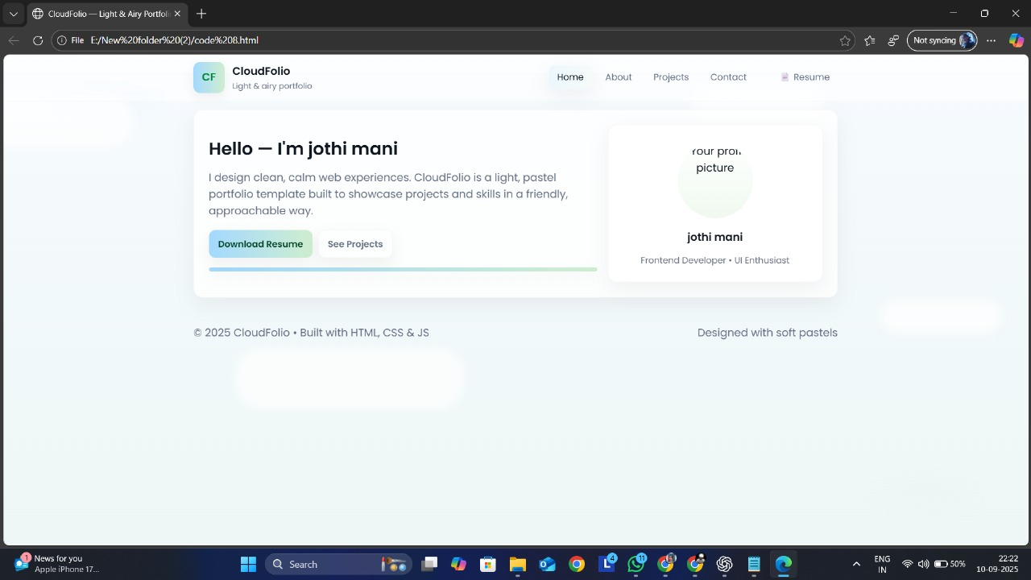

Slide 12
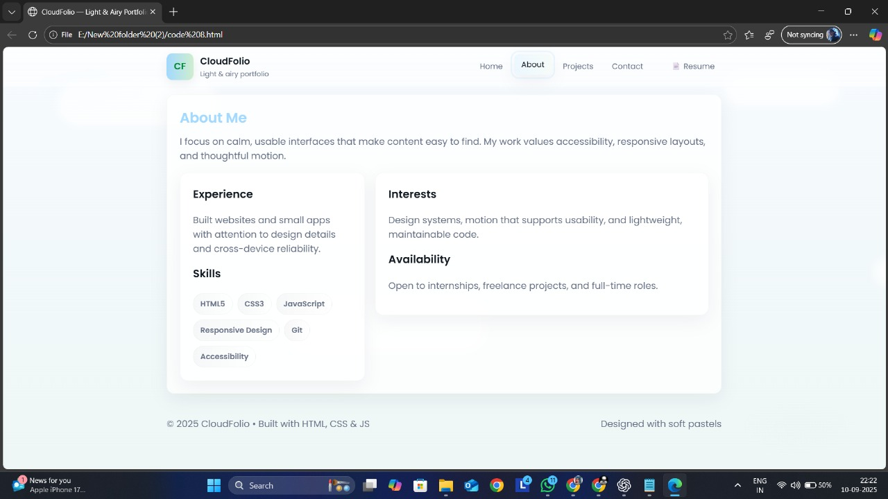

Slide 13
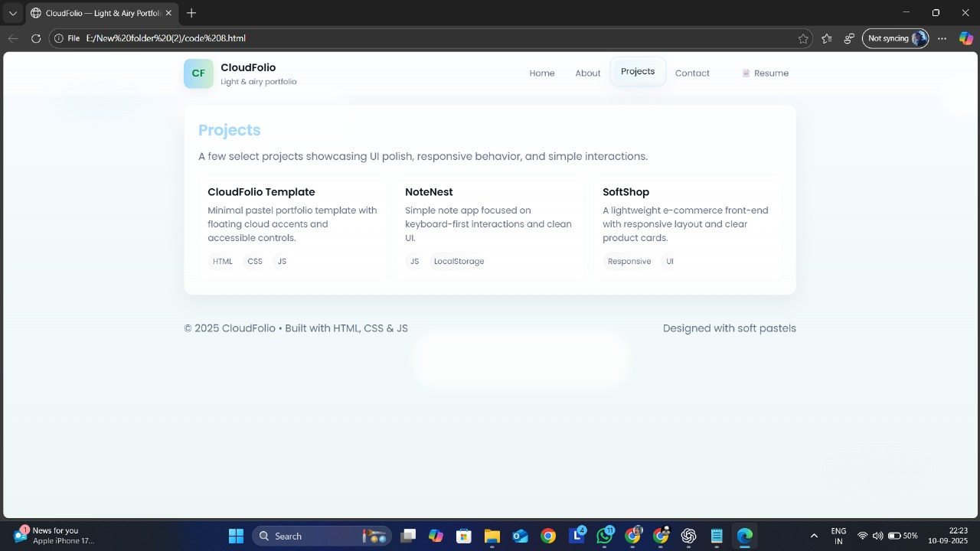

Slide 14
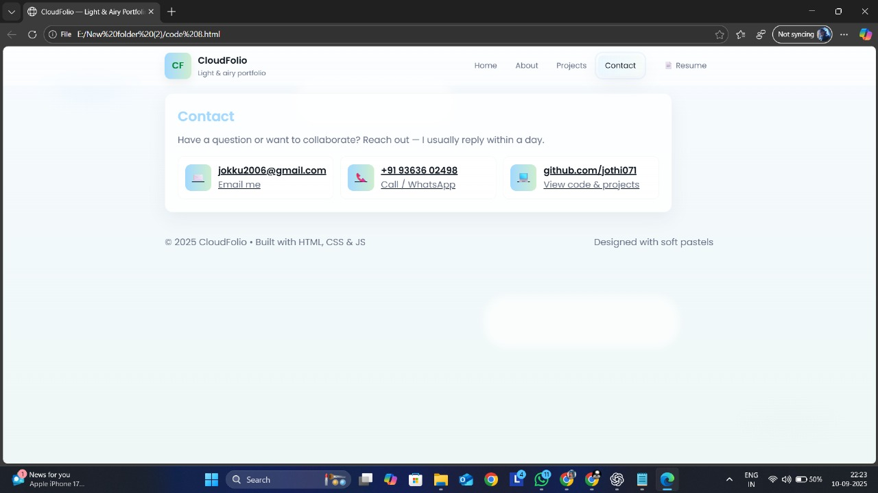

Slide 15
CONCLUSION
The CloudFolio project shows that portfolios don’t have to be bold or flashy to make an impact. With its light, airy, and nature-inspired design, CloudFolio creates a professional yet friendly way to present skills and achievements. It’s ideal for students, educators, and creatives who want a portfolio that feels approachable, unique, and refreshing.
‹#›

