Slide 1

Data Set : CDC Diabetes Health Indicators
Predicting Diabetes Risk Using Machine Learning to Support Early Healthcare Intervention
Objective:To develop and evaluate a machine learning classification model that predicts diabetes risk using demographic, lifestyle, and health-related indicators, and to identify key factors contributing to the predictions so that healthcare programme managers can prioritise high-risk individuals for screening and preventive interventions.
Prepared By:
Murugaiyan Nagajothi

Slide 2
Project Background:
Diabetes is one of the most prevalent chronic diseases worldwide and is associated with severe health complications and increasing healthcare costs. Early identification of individuals at high risk enables healthcare providers to implement preventive interventions, optimise screening programmes, and improve long-term patient outcomes.
Project Objectives:
Develop a machine learning model to predict diabetes risk using demographic, lifestyle, and health-related indicators.
Compare the performance of multiple machine learning algorithms and identify the most suitable prediction model.
Apply Explainable Artificial Intelligence to interpret model predictions and identify the most influential risk factors.
Recommend a practical deployment approach that supports data-driven decision-making for preventive healthcare programs.

Slide 3
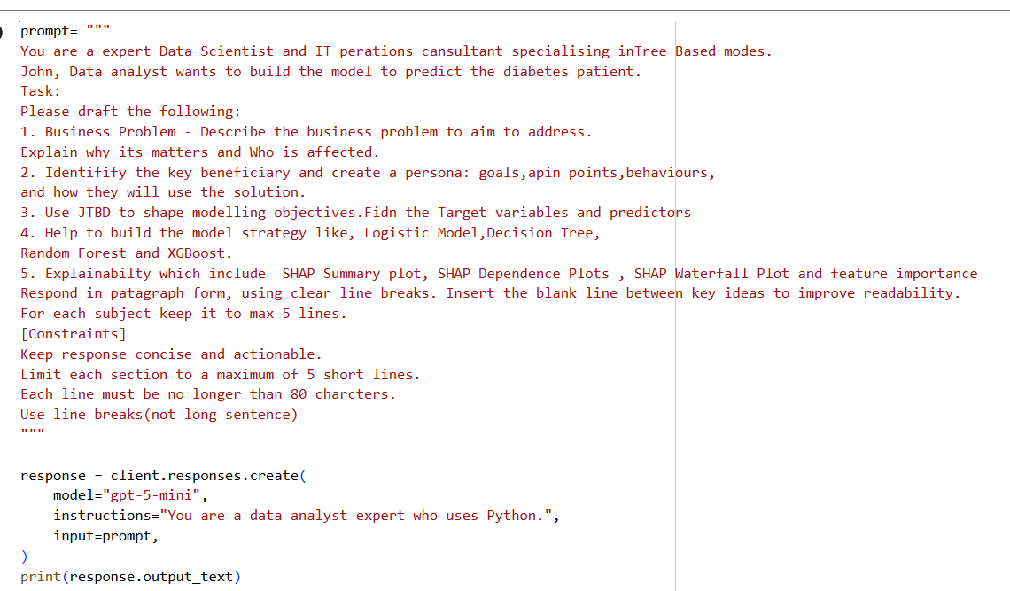
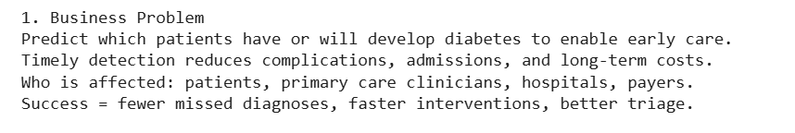
BUSINESS PROBLEM
Healthcare organisations are increasingly adopting data-driven technologies to improve disease prevention and optimise healthcare resource allocation. Diabetes is one of the most common chronic diseases worldwide, making the early identification of individuals at high risk of diabetes an important healthcare priority.
AI Prompt:
AI- Draft Prompt:
Comments / Review on AI Draft:
The AI draft correctly identifies diabetes prediction as an important healthcare problem and explains that early prediction can reduce complications and improve patient care. It also recognises the need for timely intervention.
However, the description is too broad and focuses mainly on clinical outcomes. It does not clearly explain the operational challenges faced by healthcare organisations, such as limited screening resources and the need to prioritise high-risk individuals. In addition, the business value of the predictive model should be emphasised by explaining how it supports healthcare planning, resource allocation, and preventive care. Therefore, the business problem should be refined to better align with the project objectives and the dataset.
Refined Business Problem:
Diabetes is one of the leading chronic diseases worldwide and is associated with significant healthcare costs, long-term complications, and reduced quality of life. Healthcare organisations often have limited resources for comprehensive diabetes screening. By using machine learning to analyse demographic, lifestyle, and health-related indicators, healthcare programmes can use predicted risk to prioritise individuals for further screening or preventive intervention.

Slide 4
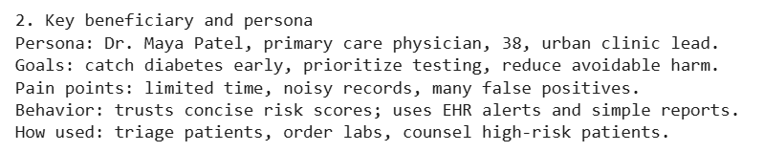
PERSONA
Identifying the key beneficiary is an important step in business understanding because it ensures the machine learning solution is developed to address genuine organisational needs. The persona captures the stakeholder’s responsibilities, objectives, pain points, and expected use of the predictive model, providing a clear connection between the business problem and the proposed analytical solution.
AI Draft Output:
Comments / Review on AI Draft:
The AI draft identifies a healthcare professional as the beneficiary and outlines several useful goals and pain points. However, the chosen persona, a primary care physician, is more focused on diagnosing and treating individual patients rather than planning preventive healthcare programmes.
Since this project aims to support population-level diabetes risk prediction, a Population Health Programme Manager is a more appropriate beneficiary. This role is responsible for organising screening programmes, allocating healthcare resources, and implementing preventive interventions.
Refined Persona:
Persona: Seng Guan
Role: Population Healthcare Programme Manager
Goals:
Improve early identification of individuals at high risk of diabetes.
Increase the effectiveness of community screening programmes.
Allocate preventive healthcare resources efficiently.
Reduce long-term diabetes complications.
Pain Points:
Limited healthcare resources.
Increasing prevalence of diabetes.
Difficulty identifying high-risk individuals before diagnosis.
Rising healthcare costs associated with chronic disease.
Behaviours:
Regularly reviews healthcare dashboards, analytical reports, and population health indicators to identify high-risk communities, monitor diabetes trends, and evaluate preventive healthcare programs.
How the solution will be used:
The predictive model generates an estimated diabetes risk score for each individual. Healthcare programme managers use these predictions to prioritise high-risk individuals for screening, lifestyle counselling, and prevention interventions, enabling more efficient allocation of healthcare resources.
Decision supported: Which individuals should be prioritised for screening or preventive intervention?

Slide 5
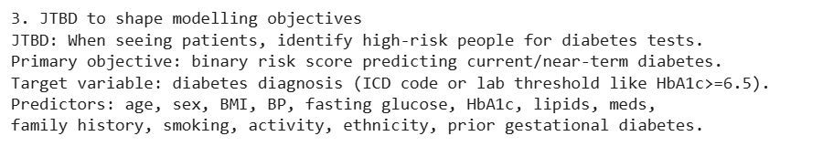
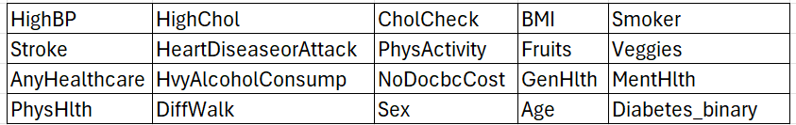
JOBS-TO-BE-DONE(JTBD) FRAMEWORK
The Jobs-To-Be-Done (JTBD) framework focuses on understanding what stakeholders need to accomplish rather than simply describing who they are. It translates business needs into a clear modelling objective by identifying the desired outcome that the machine learning solution should support. This ensures that the predictive model delivers practical value and aligns with the stakeholders’ decision-making process.
AI Draft Output:
Comments / Review on AI Draft:
The AI draft introduces the Job-To-Be-Done concept and proposes a suitable modelling objective. However, several recommended predictors, including HbA1c and ICD codes, are not available in the selected CDC Diabetes Health Indicators dataset. Including variables that are not present would make the model inconsistent.
The modelling objectives should therefore be revised using only the variables available in the dataset. This ensures that the project remains technically accurate and fully reproducible.
Refined JTBD and Modelling Objectives:
Jobs-To-Be-Done (JTBD)
When planning preventive healthcare programmes, I want to identify individuals who are at high risk of diabetes so that healthcare resources can be allocated efficiently, preventive interventions can be delivered earlier, and long-term diabetes complications can be reduced.
Predictive Modelling Objective:
Develop a binary classification model to predict whether an individual has diabetes using demographic, lifestyle, and health-related indicators.
Target Variable:
0 = No Diabetes
1 = Prediabetes or Diabetes
Predictor Variables:

Slide 6

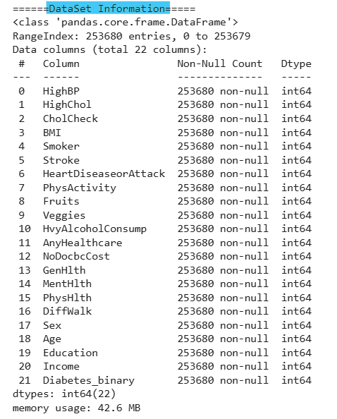
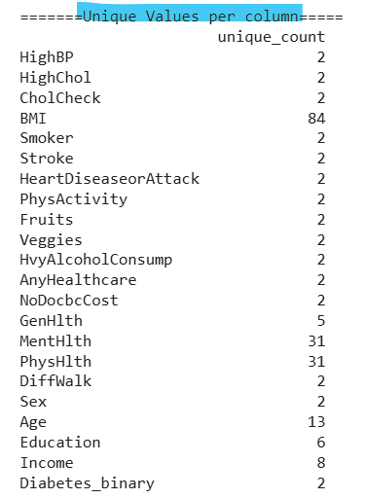
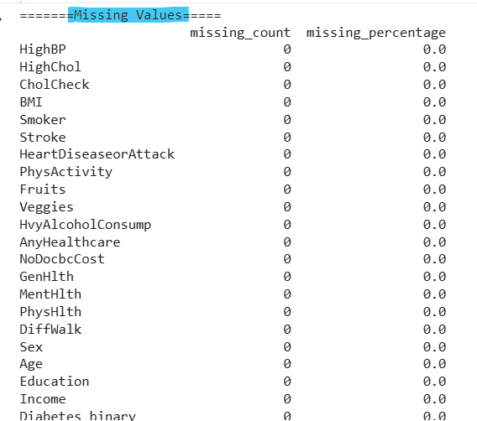
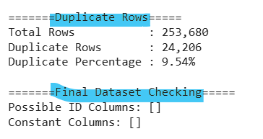
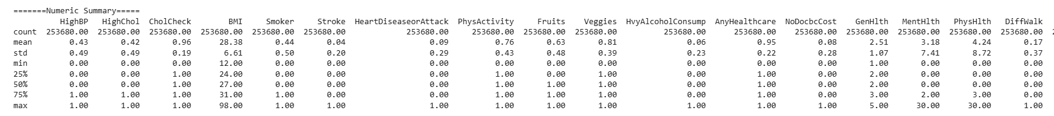
DATA SET – OVERVIEW
Source: CDC Diabetes Health Indicators
Total Records: 253,680
Duplicate Records: 24,206 (9.54%)
Features: 22 (21 Predictors +1 Target)
Target Variable: Diabetes Binary
Missing values: None
Original Data Type: All variables stored as int64
Although all variables were stored as integers, they were classified (Binary, Ordinal, Numerical) according to their meaning and measurement scale to guide data quality checks and modelling decisions.

Slide 7
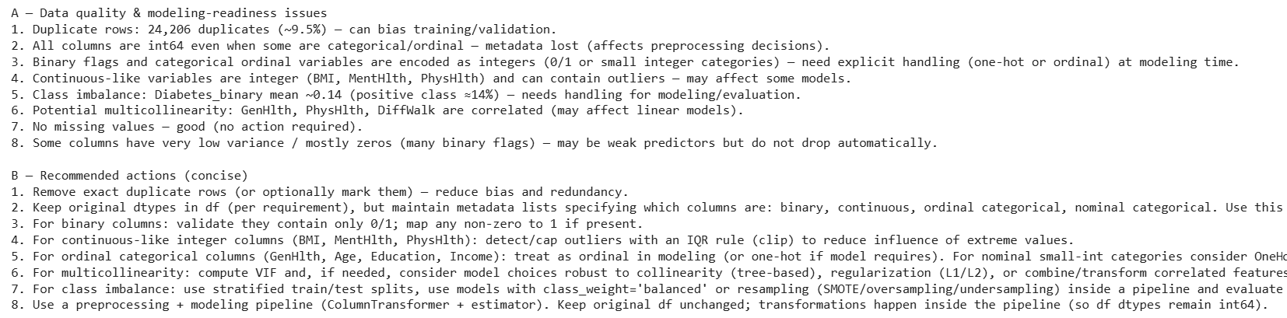
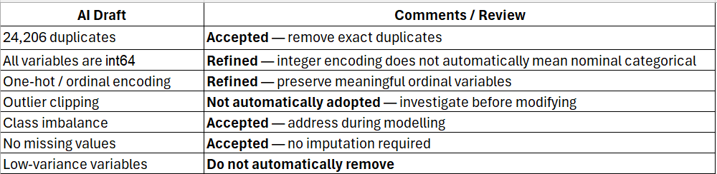
DATA QUALITY & DATA CLEANING
The Jobs-To-Be-Done (JTBD) framework focuses on Data quality assessment was performed before modelling to identify issues that could affect prediction reliability. The dataset was examined for missing values, duplicates, variable representation, and class distribution, followed by appropriate cleaning and preprocessing.
AI Draft Output:
Comments / Review on AI Draft:
AI provided a useful diagnostic checklist, but recommendations were refined based on
data characteristics and modelling requirements.

Slide 8
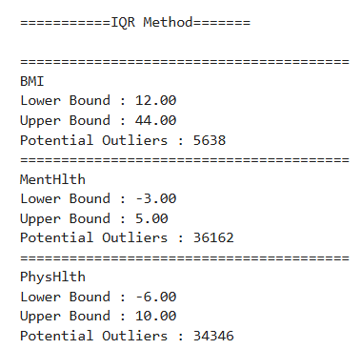
DATA CLEANING – REFINED OUTPUT
Duplicate Records:
24,206 duplicate rows identified (9.54%).
Removed exact duplicates.
Dataset reduced from 253,680 → 229,474 records.
Removing exact duplicates prevents repeated observations from disproportionately influencing model training.
Missing Values:
No missing values detected across the dataset.
No imputation required.
Feature Classification:
The 22 variables were classified into Binary, Ordinal and Numeric features based on their values and meaning.
Binary: 15 variables (HighBP, HighChol, Smoker, Stroke, Sex,…)
Ordinal: 4 variables (GenHlth, Age, Education, Income)
Numeric: 3 variables (BMI, MentHlth, PhysHlth)
This classification determines how the variables should be handled during preprocessing and modelling.
Outlier Detection:
Potential outliers were identified in BMI, MentHlth and PhysHlth
using the IQR method.
Potential outliers were identified for investigation rather than
automatically removed, as extreme values may represent
genuine patient observations.
AI provided a useful diagnostic checklist, but recommendations were refined based on
data characteristics and modelling requirements.

Slide 9
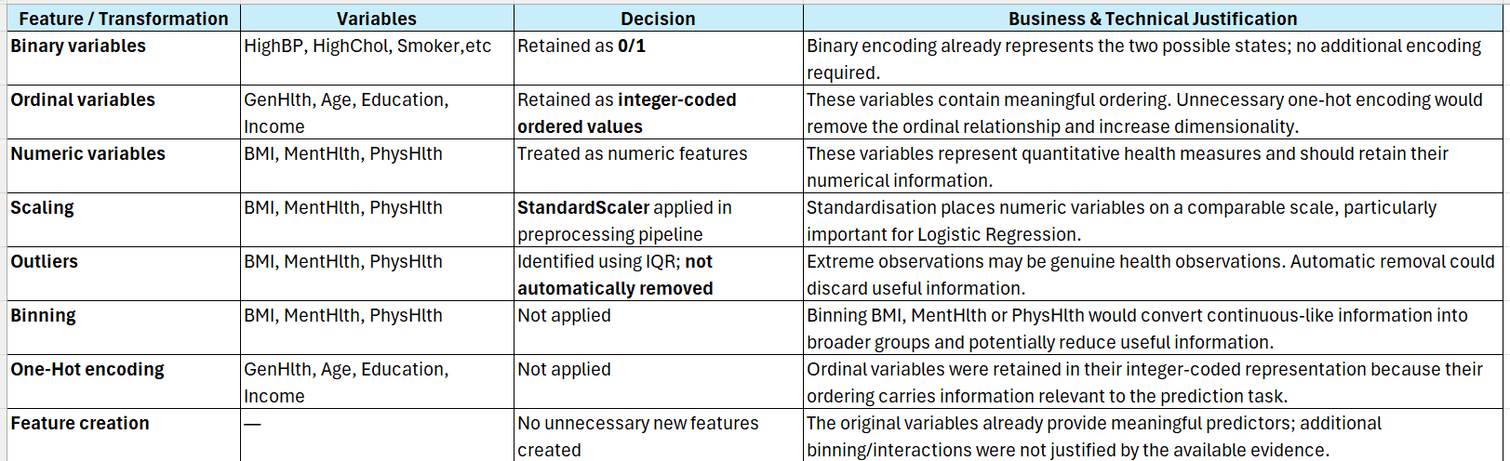
FEATURE ENGINEERING & TRANSFORMATIONS
Feature engineering was focused on preserving the information contained in the CDC health indicators while applying only the transformations required for reliable model training. Variables were classified according to their characteristics, and preprocessing was applied consistently within the modelling pipeline.
Decision:
Preserve the original feature information wherever possible and avoid unnecessary feature engineering. Transformations were applied only when they had a clear technical justification.

Slide 10
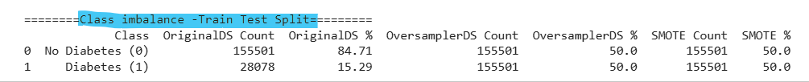
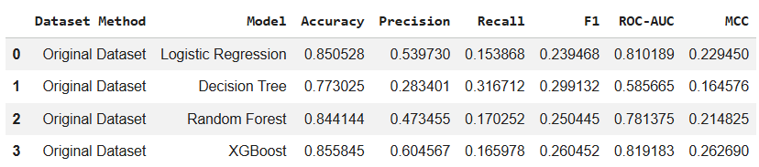
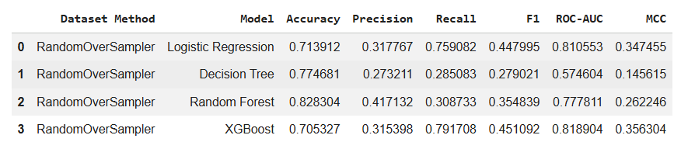
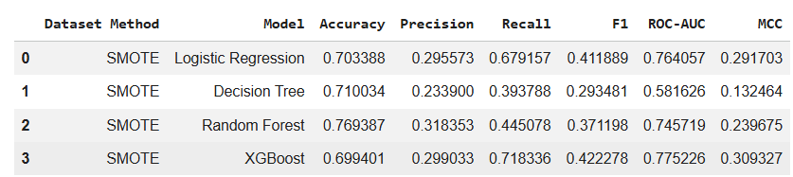
CLASS IMBALANCE HANDLING – COMPARING SAMPLING STRATEGIES
Original Data: Preserve the original class distribution. Provides a baseline for comparison. No synthetic or duplicated observations.
Random Oversampling: Randomly duplicates minority-class observations. Increases the number of diabetes-positive samples. Does not create new feature values.
Synthetic Minority Oversampling Technique(SMOTE):Generates synthetic minority-class observations. Uses neighbouring minority samples to create new examples. Increases minority-class representation without simply duplicating existing rows.
Key Evaluation Metrics:
Recall – ability to identify actual diabetes cases
F1-score – balance between Precision and Recall
ROC-AUC – ability to distinguish between the two classes
MCC – balanced measure for imbalanced classification
Accuracy – supporting metric, not used alone
Recall and F1-score were given greater importance because the project aims to identify potentially high-risk individuals for screening and preventive intervention.
Decision: Random Oversampling Selected
Random Oversampling was selected as the preferred class-imbalance strategy because it substantially improved detection of the minority class. Across the evaluated models, it produces strong Recall and F1 performance while maintaining competitive MCC values.

Slide 11
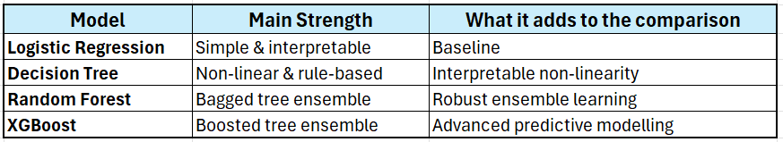
MODEL SELECTION – JUSTIFICATION FOR FOUR CLASSIFICATION MODELS
Logistic Regression:
Baseline Benchmark
Establishes a simple statistical benchmark before adding complexity.
Provides direct feature interpretability & rapid inference speed.
Decision Tree:
Rule-Based Logic
Captures non-linear relationships without complex scaling.
Offers intuitive, visual IF-THEN rules for non-technical stakeholders.
Random Forest:
Bagging Ensemble
Aggregates multiple decision trees to overcome single-tree overfitting.
Provides robust global feature importance and lower prediction variance.
XGBoost:
Boosting Ensemble
Sequentially minimizes residual errors for peak predictive accuracy.
Industry standard for high performance on complex tabular datasets.
The four models were selected to provide a balanced comparison between interpretability, non-linear modelling, ensemble learning, and advanced predictive performance.

Slide 12
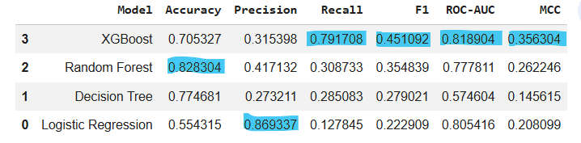
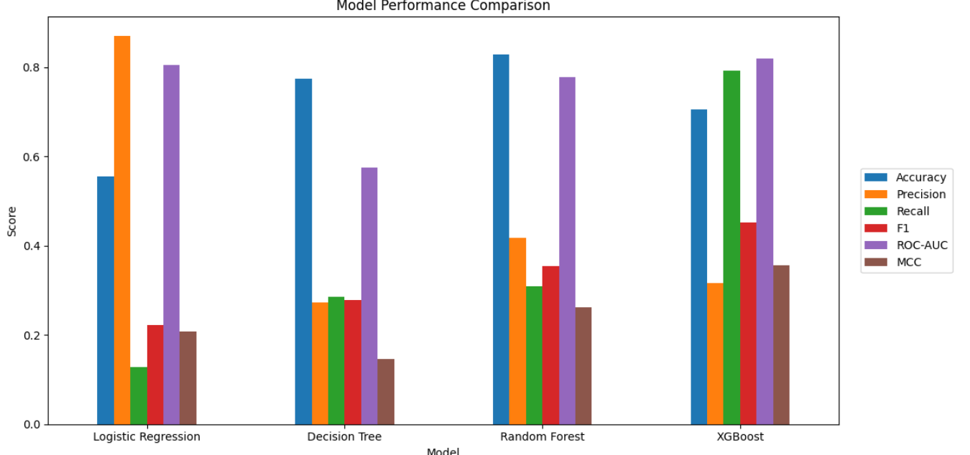
MODEL PERFORMANCE COMPARISON
The four classification models were evaluated using the selected Random Oversampling strategy and the same performance metrics.
Key Findings: Logistic Regression:
Highest Precision: 86.93%
However, Recall is only 12.78%
This means it identifies fewer actual diabetes cases despite its high precision.
Provides strong discrimination with 80.54% ROC-AUC, but week minortity-class detection.
Decision Tree:
Recall: 28.51%
ROC-AUC: 57.46%
F1: 27.90%
Weakest overall Performance among the four models.
Random Forest:
Highest Accuracy: 82.83%
Highest Precision after Logistic Regression:41.71%
How ever, Recall is only 30.87%
High accuracy but weaker diabetes-case detection
XGBoost:
Highest Recall after Random Forest: 79.17%
Highest F1:45.11%
Highest ROC-AUC:81.89%
Highest MCC:35.63%
Provides the strongest overall performance for identifying diabetes-positive cases.
CHAMPION MODEL: XGBOOST
XGBoost achieved the highest Recall, F1-score, ROC-AUC and MCC, making it the most suitable model for the project's primary objective of identifying potential diabetes cases. Although Random Forest achieved the highest Accuracy (82.83%) and Logistic Regression achieved the highest Precision (86.93%), both had substantially lower Recall than XGBoost.
Recall is prioritised because the project aims to identify as many potential diabetes cases as possible. A low Recall means that many actual diabetes cases may be missed.

Slide 13
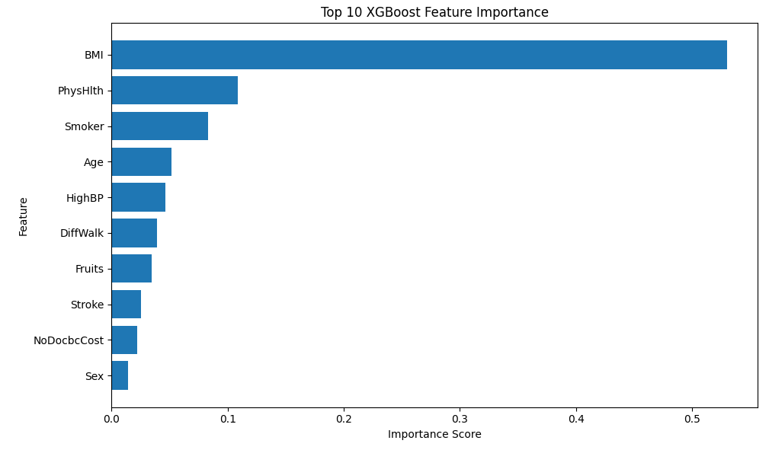
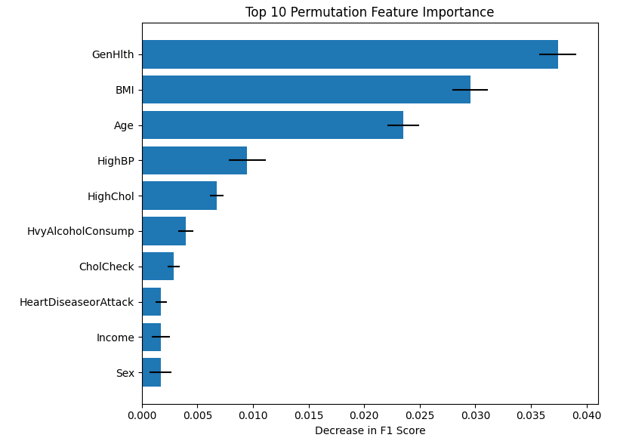
GLOBAL FEATURE IMPORTANCE
XGBoost Model Interpretation – Key Predictive Features
Feature-importance analysis identifies the variables that contribute most to the XGBoost model's predictions.
Key Finding:
BMI is the dominant feature, with an importance score of 0.5299.
PhysHlth is the second most important feature (0.1091).
Smoker, Age and HighBP are also among the leading predictors.
The remaining top features contribute smaller but measurable importance.
The model therefore relies on a combination of physical health, demographic, and behavioural factors.
Key Finding:
GenHlth had the highest permutation importance (0.0374).
BMI (0.0295) and Age (0.0235) were the next most influential features.
HighBP and HighChol also contributed to model performance.
Shuffling these features caused a greater reduction in predictive performance.
The ranking provides a complementary view of feature importance beyond the XGBoost built-in importance.
Feature importance indicates how strongly the model relies on a variable for prediction; it does not establish a causal relationship with diabetes.
Permutation importance confirms that health status, BMI, age, and HighBP are important for maintaining XGBoost predictive performance.

Slide 14
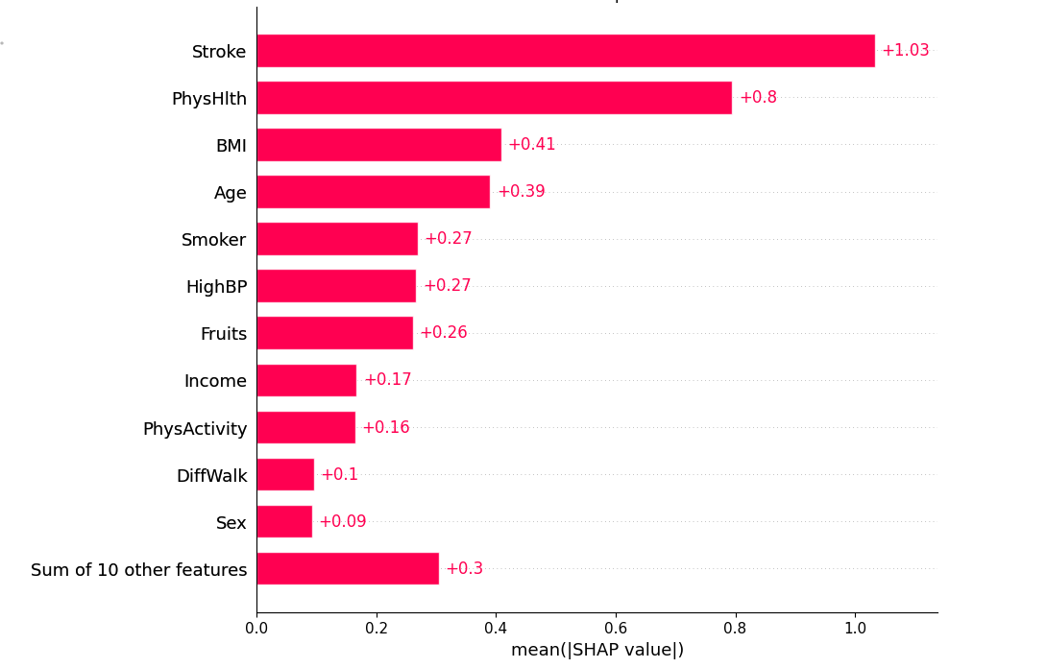
GLOBAL SHAP FEATURE IMPORTANCE– XGBoost
1. What the chart measures
2. What our model shows
• Mean |SHAP value| = average absolute contribution across observations.
• Larger value = greater average influence on XGBoost predictions.
• Answers: “Which features matter most overall?”
• It does NOT show whether a feature increases or decreases a prediction.
• Stroke: 1.03 — largest overall contribution.
• PhysHlth: 0.80 — second largest contribution.
• BMI: 0.41 and Age: 0.39 — substantial influence.
• Smoker and HighBP: about 0.27 each.
• These features have the greatest average impact.
3. Relationship with prediction
• High importance means a feature can strongly change model output.
• The same feature can contribute positively for some people and negatively for others.
• Direction must be interpreted using the Beeswarm plot.
• SHAP describes model behaviour, not clinical causation.
Importance ranking: Stroke 1.03 > PhysHlth 0.80 > BMI 0.41 > Age 0.39 > Smoker / HighBP ≈ 0.27
Feature → Prediction interpretation
What this means for the project
Stroke: strongest average contribution, so its value can substantially alter predicted probability.
PhysHlth: second strongest; variation in physical-health status contributes strongly to prediction.
BMI and Age: important signals that materially influence model output.
HighBP and Smoker: meaningful contributors; direction is interpreted from the Beeswarm.
The model uses a combination of health-status, demographic and lifestyle information rather than one variable alone.
The highest-ranked feature is NOT automatically the strongest clinical risk factor.
Global SHAP explains model reliance and supports transparent screening prioritisation.
Final healthcare decisions remain with qualified professionals.

Slide 15
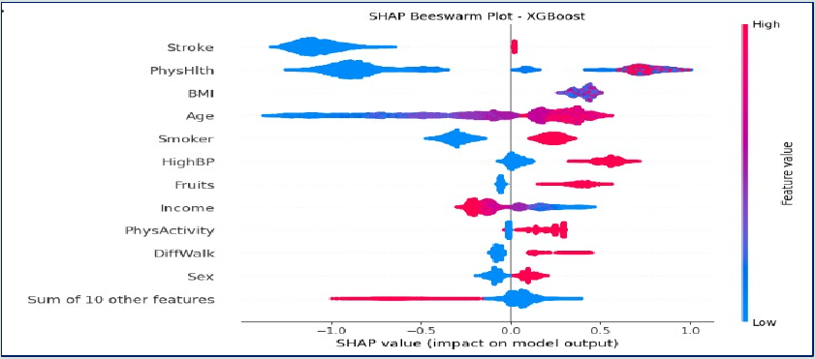
SHAP BEESWARM PLOT – XGBoost
How to read the plot
• Each dot = one observation.
• X-axis = SHAP value (model contribution).
• Right of 0 = pushes prediction toward the positive target class.
• Left of 0 = pushes prediction away from the positive target class.
• Red/Pink = higher feature value; Blue = lower feature value.
What the colour and spread tell us
• The colour distribution shows whether high or low feature values tend to occur on the positive or negative SHAP side.
• Wider horizontal spread = greater variation in a feature's contribution across individuals.
• The same feature can therefore have different effects for different individuals.
Key findings from our beeswarm
• Stroke, PhysHlth, BMI and Age have the largest overall effects.
• Higher PhysHlth values are predominantly on the positive side, while lower values appear more on the negative side.
• Higher BMI and Age values generally appear more toward the positive SHAP side.
• HighBP and Smoker also show noticeable positive contributions for higher feature values in this model.
Why this is more informative than the bar chart
Global SHAP answers: “What matters most overall?” | Beeswarm answers: “How do feature values affect individual predictions, and how much does the effect vary?”
Important: these are model associations/contributions, not proof of clinical causation.
Feature value → SHAP direction: right of 0 = toward Prediabetes/Diabetes; left of 0 = away. Global SHAP = importance; Beeswarm = direction + variation.

Slide 16
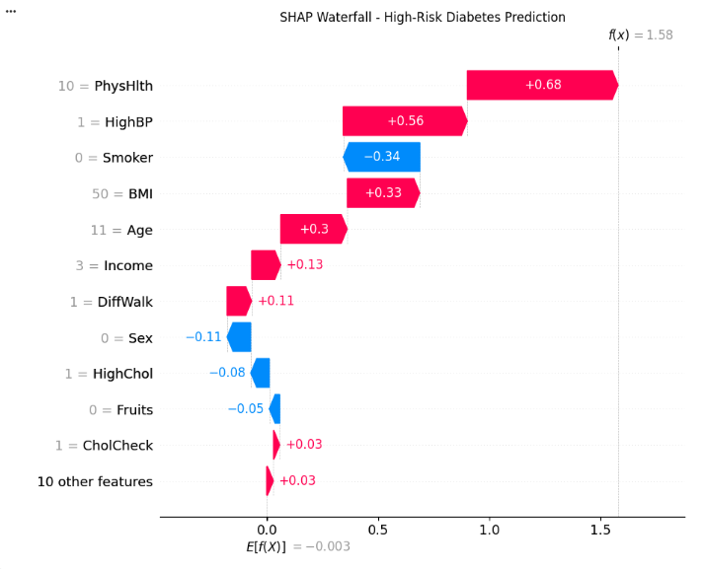
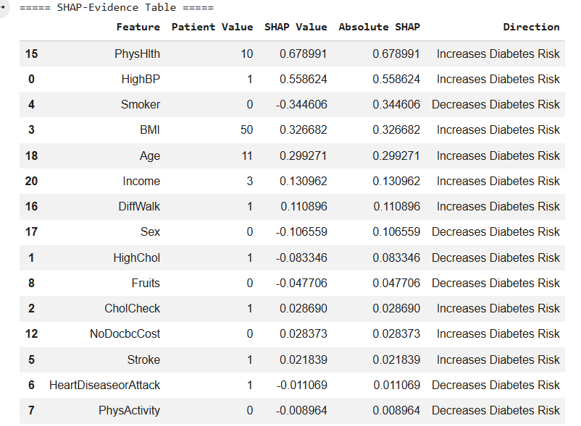
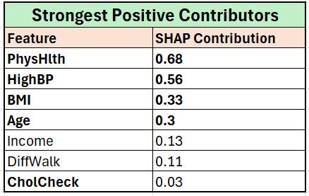
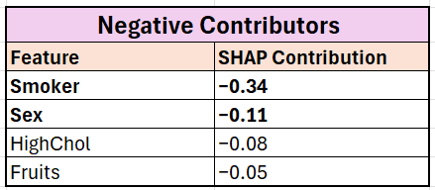
SHAP WATERFALL: High-Risk Prediabetes/Diabetes Prediction
Patient Index:
4519
Actual Target Class
1- Prediabetes or Diabetes
Predicted Probability:
95.04%
Predicted Class:
1- Prediabetes or Diabetes
The high-risk prediction was primarily driven by PhysHlth, HighBP, BMI and Age. Although several features pushed the prediction downward, the positive contributions resulted in a final predicted probability of 95.04% for the positive prediabetes/diabetes target class.

Slide 17
PRACTICAL USE CASE – FROM PREDICTION TO ACTION
Using XGBoost prediction and SHAP explanation to support preventive screening prioritisation
1. SCENARIO
2. MODEL SIGNAL
3. POTENTIAL ACTION
A population healthcare programme needs to identify individuals who may benefit from further screening or preventive assessment.
Selected individual: Test index 4519
Target class: 1 – Prediabetes or diabetes
XGBoost predicted a 95.04% probability of belonging to the positive target class.
SHAP provides an individual-level explanation of the prediction.
Major contributors include PhysHlth, HighBP, BMI and Age.
Prioritise the individual for further screening or preventive assessment.
A healthcare professional reviews the individual's information and determines appropriate follow-up.
Where appropriate, preventive support or lifestyle intervention may be considered.
PRACTICAL DECISION WORKFLOW
Health indicators
XGBoost prediction
95.04%
SHAP explanation
Screening prioritisation
Professional review
Business value: earlier identification • better screening-resource prioritisation • targeted preventive support
Important: Decision-support tool only — not a clinical diagnosis; final decisions remain with healthcare professionals.

Slide 18
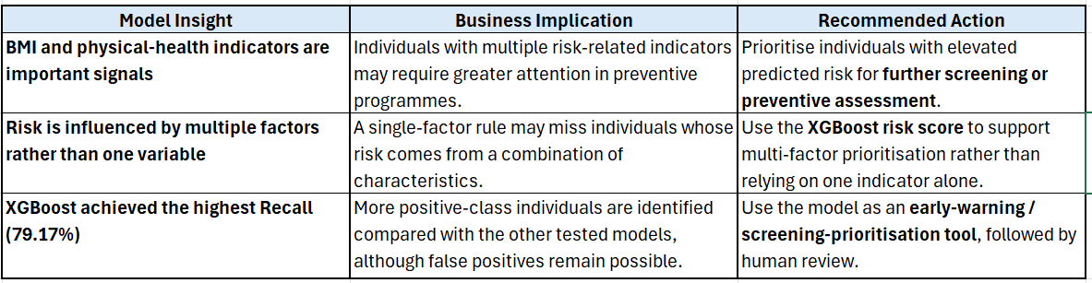
BUSINESS INSIGHTS, ACTIONS & RECOMMENDATIONS
XGBoost identifies a combination of health, lifestyle, and demographic indicators as important signals for the positive prediabetes/diabetes class.
BMI was the strongest feature in XGBoost built-in feature importance.
GenHlth, BMI, and Age were among the strongest features in permutation importance.
Stroke, PhysHlth, BMI and Age had the largest overall SHAP contributions.
Use XGBoost to prioritise individuals for further screening and preventive intervention, while keeping healthcare professionals involved in the final decision.
SHAP and feature importance indicate model associations/contributions, not clinical causation or diagnosis.
Combine data-driven screening prioritisation with preventive healthcare and professional clinical assessment rather than using the model as a standalone diagnostic tool.

Slide 19
Thank you

