Slide 1
INDIAN E COMMERCE SALES AND CUSTOMER ANALYTICS
By: Mr KARIKALAN.P

Slide 2
DESCRIPTION ABOUT DATA
Dataset Overview: 6,54,341 Records in Dataset Covers 100,000 transactions across 22,474 customers and 546 products in India between 2023 and 2025 across 9 connected tables.
Core Business Financials: Generated ₹2.08B in delivered net revenue, ₹197.3M in gross profit, and ₹25.7K Average Order Value (AOV), with ₹268.7M lost to refunds.
Data Model: A star schema linking central transactions (orders & order_items) to dimensions (customers, products, marketing_campaigns) and operational fact tables (payments, shipments, returns, customer_reviews).

Slide 3
PROCESS
Data Extraction (Ingestion)
Data Transformation & Cleaning (ETL in Power Query)
Data Modeling (Star/Snowflake Schema)
Metric Aggregation & Analytical Formulation
Data Visualization & Reporting (Dashboard Build)
Insights Extraction & Business Decision-Making

Slide 4
1) EDA-FINANCIAL & SALES PERFORMANCE
Which product categories generate the highest gross profit vs. return refund leakage?
Does higher discounting result in lower profit per unit sold?
What is the total cash gap between ordered amounts and actual payments collected across payment methods?
How much transaction fee cost is incurred across order statuses?

Slide 5
2) EDA-CUSTOMER & MARKETING ANALYTICS
What is the total spend distribution across Customer Status and Loyalty Tiers?
Which customer acquisition channels bring the highest average spending customers?
What is the marketing campaign performance across target segments?
Which geographic states have the highest order frequency and spending concentration?

Slide 6
3) EDA-SUPPLY CHAIN & DELIVERY OPERATIONS
Which shipping methods experience the highest delivery delay counts?
What are the slowest warehouse-to-delivery city fulfillment corridors?
How does delivery delay correlate with order outcomes (Delivered vs. Delivered then Returned)?

Slide 7
4) EDA-PRODUCT QUALITY & INVENTORY MANAGEMENT
Which product types have high sales volume but critically low stock levels?
Which product categories have the highest return volumes and what are their primary return reasons?
How do customer review ratings and sentiments vary across product categories?
Do verified purchases give higher ratings than unverified reviews across brands?

Slide 8

DATA MODELING
orders[customer_id] $→$customers[customer_id] (Many-to-One)
orders[campaign_id] $→$marketing_campaigns[campaign_id] (Many-to-One)
order_items[order_id] $→$orders[order_id] (Many-to-One)
order_items[product_id] $→$products[product_id] (Many-to-One)
payments[order_id] $↔$orders[order_id] (1-to-1 operational settlement link)
shipments[order_id] $↔$orders[order_id] / payments[order_id] (Fulfillment trace link)
returns & customer_reviews linked to orders (via order_id) and products (via product_id).

Slide 9
PROJECT OBJECTIVES
This Power BI project analyzes an end-to-end e-commerce database covering 100,000 orders placed between January 1, 2023, and December 31, 2025 across India. The data model integrates 9 core operational tables into a star/snowflake schema to track the complete commercial lifecycle: marketing acquisition, order transactions, payment settlements, logistics fulfillment, customer feedback, and return processing.
Across the 3-year timeline, the business generated ₹2.57B in total Gross Merchandise Value (GMV) and realized ₹2.08B in successfully delivered net revenue, yielding ₹197.29M in total gross profit across 585,640 units sold.

Slide 10
EXPLORATORY DATA ANALYSIS
SEGMENT 1
FINANCIAL & SALES PERFORMANCE

Slide 11
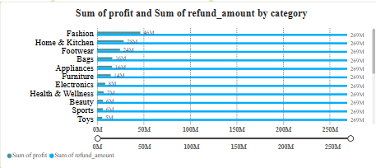
1) Which product categories generate the highest gross profit vs. return refund leakage?
Fashion has the highest sales (~46M).
Home & Kitchen and Footwear are next (~25M and ~23M).
Bags, Appliances, and Furniture show strong performance.
Grocery, Baby Care, Pet Supplies, and Stationery have the lowest sales (~1M).
Sales are mainly driven by Fashion and other top categories.

Slide 12
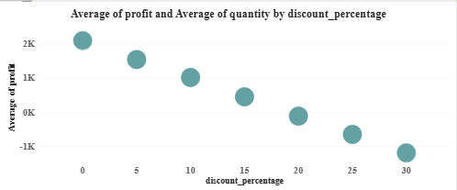
2) Does higher discounting result in lower profit per unit sold?
• 0% Discount yields the highest profitability, securing an average profit of over 2,000
• 15% Discount acts as the final margin threshold, where average profit drops to around 500.
• 20% to 30% Discounts completely erode margins, driving average profits into net losses from -100 down to -1,200.

Slide 13
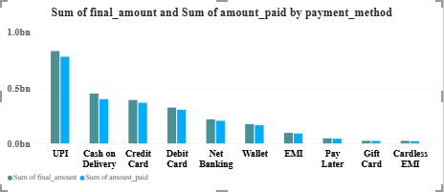
3) What is the total cash gap between ordered amounts and actual payments collected across payment methods?
• UPI dominates all payment methods, generating the highest volume by far at over 0.8bn in total amount.
• Cash on Delivery and Credit Card follow as major secondary pillars, sitting around 0.45bn and 0.4bn respectively.
• Debit Card and Net Banking maintain a moderate mid-tier presence, contributing roughly 0.32bn and 0.22bn.
• Pay Later, Gift Card, and Cardless EMI sit at the bottom of the chart, bringing in negligible volume near 0.05bn or lower.

Slide 14
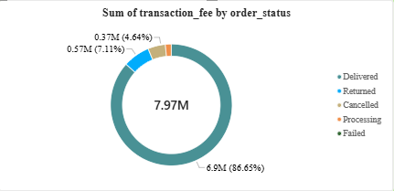
4) How much transaction fee cost is incurred across order statuses?
• Delivered status heavily dominates the overall chart, accounting for the vast majority of volume at 6.9M (86.65%).
• Returned orders represent the largest operational leakage point, tracking next at 0.57M (7.11%).
• Cancelled transactions follow closely as a secondary leak, sitting at 0.37M (4.64%).
• Processing volume is minimal, showing a minor current queue of 0.13M (1.59%).
• Total Portfolio volume stands at 7.97M, indicating highly successful fulfillment rates alongside visible areas for return optimization.

Slide 15
SEGMENT 2
_{CUSTOMER & MARKETING ANALYTICS}

Slide 16
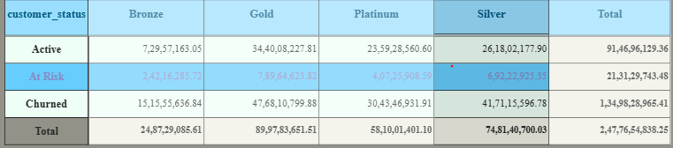
1) What is the total spend distribution across Customer Status and Loyalty Tiers?
• Churned status represents the single largest category by value, locking up a massive 1.35bn (1,34,98,28,965.41).
• Gold tier leads the entire customer portfolio in contribution, totaling nearly 900M (89,97,83,651.51) in overall value.
• Active Gold customers form the strongest individual revenue segment, sitting securely at 344M (34,40,08,227.81).
• Silver and Platinum tiers hold substantial weight in the portfolio, contributing 748M and 581M in total historical value.
• Total Value across all segments reaches 2.48bn (2,47,76,54,838.25), highlighting severe revenue leakage from churn compared to active value.

Slide 17
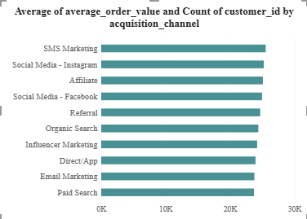
2) Which customer acquisition channels bring the highest average spending customers?
• SMS Marketing leads all acquisition channels, securing the highest average metric at over 25.5K.
• Social Media - Instagram and Affiliate follow closely behind as top-tier drivers, both sitting near 25.2K.
• Social Media - Facebook and Referral maintain a strong presence, contributing steady metrics around 25K and 24.6K.
• Paid Search and Email Marketing sit at the bottom of the chart, bringing in the lowest volumes at approximately 23.8K.
• Channel Performance shows an extremely tight distribution across the board, with less than a 2K difference separating the top and bottom channels.

Slide 18
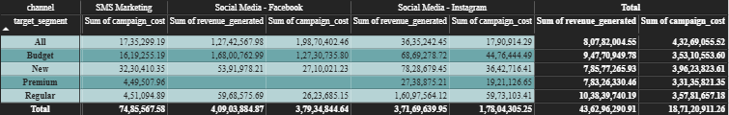
3) What is the marketing campaign performance across target segments?
• Organic Search serves as the most efficient growth engine, generating 7.67M in revenue against a lean cost of just 1.44M.
• Paid Search
drives high volume but at a significant premium, bringing in 6.86M in revenue with a steep cost of 3.63M.
• Social Media - Facebook represents a major efficiency bottleneck, spending a heavy 3.79M to return a narrow 4.09M in revenue.
• Regular Customers stand out as the highest-grossing target segment across channels, contributing a leading 10.38M to the top line.
• Overall Portfolio metrics show strong macro returns, securing a total revenue of 43.63M against 18.71M in overall campaign spend.

Slide 19
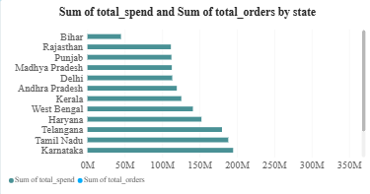
4) Which geographic states have the highest order frequency and spending concentration?
• Maharashtra heavily dominates the chart as the absolute market leader, generating over 345M in total volume.
• Uttar Pradesh and Gujarat serve as massive secondary powerhouses, contributing roughly 270M and 263M respectively.
• Karnataka and Tamil Nadu maintain a strong regional presence in the mid-tier, tracking near 195M and 188M.
• Bihar sits at the absolute bottom of the state ranking, bringing in the lowest volume at approximately 45M.

Slide 20
SEGMENT 3
SUPPLY CHAIN & DELIVERY OPERATIONS

Slide 21
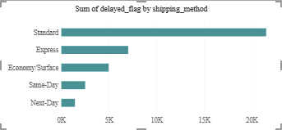
1) Which shipping methods experience the highest delivery delay counts?
• Standard shipping heavily dominates the total delay volume, recording the highest count by far at over 21.5K delayed flags.
• Express logistics acts as the secondary bottleneck in the fulfillment chain, tracking next with roughly 7K delayed flags.
• Economy/Surface transit maintains a moderate baseline of delivery friction, sitting at approximately 5K delayed flags.
• Next-Day delivery proves to be the most reliable shipping tier, yielding the lowest volume of fulfillment failures at under 1.5K.

Slide 22
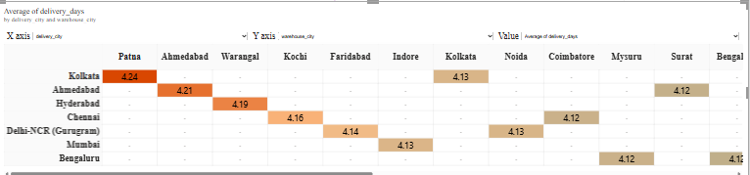
2) What are the slowest warehouse-to-delivery city fulfillment corridors?
• Patna to Kolkata route experiences the longest fulfillment bottleneck, recording the highest average duration at 4.24 days.
• Ahmedabad and Warangal corridors follow closely behind with high fulfillment friction, averaging 4.21 days and 4.19 days respectively.
• Kochi to Chennai and adjacent mid-tier lanes sustain steady delivery performance, clustering around 4.16 to 4.12 days.
• Thiruvananthapuram lanes operate as the most efficient routes in the matrix, achieving the lowest turnaround times at 4.06 days.

Slide 23
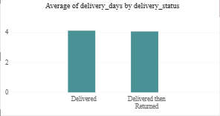
3) How does delivery delay correlate with order outcomes (Delivered vs. Delivered then Returned)?
• Delivered orders show the highest average turnaround duration, taking just over 4.1 days to successfully fulfill.
• Delivered then Returned items follow closely behind in transit time, averaging approximately 4.0 days on the road.
• Fulfillment Gaps between successful and returned orders are minimal, showing a narrow difference of roughly 0.1 days between the two states.

Slide 24
SEGMENT 4
PRODUCT QUALITY & INVENTORY MANAGEMENT

Slide 25
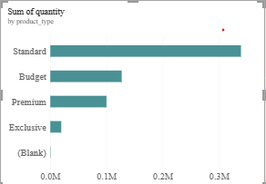
1) Which product types have high sales volume but critically low stock levels?
• Standard products heavily dominate total portfolio volume, driving the highest quantity by far at over 335K units.
• Budget items serve as the secondary volume engine, tracking next with a steady baseline near 126K units.
• Premium tiered products maintain a healthy mid-market presence, contributing approximately 100K units to the mix.
• Exclusive inventory sits at the bottom of classified product lines, generating a minor volume of roughly 20K units.

Slide 26
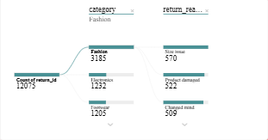
2) Which product categories have the highest return volumes and what are their primary return reasons?
Top Return Category: Fashion accounts for the highest return volume with 3,185 returned items.
Primary Cause: "Size issue" is the leading return reason (2,201 items), especially in apparel.
Secondary Causes: "Product damaged" (1,933) and "Changed mind" (1,984) lead returns in Electronics and Footwear.

Slide 27
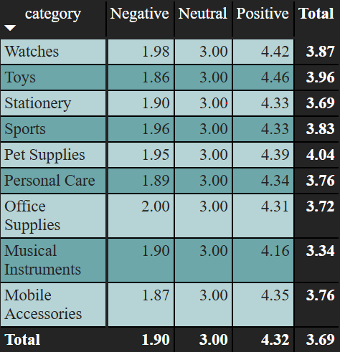
3) How do customer review ratings and sentiments vary across product categories?
• Pet Supplies leads the entire portfolio in sentiment, securing the highest average total rating at 4.04.
• Toys and Watches follow closely behind as top-tier satisfaction drivers, reaching strong averages of 3.96 and 3.87.
• Bags and Sports maintain a resilient baseline in the mid-market, contributing healthy average scores of 3.84 and 3.83.
• Musical Instruments sits at the absolute bottom of customer satisfaction, yielding the lowest total score at 3.34.

Slide 28
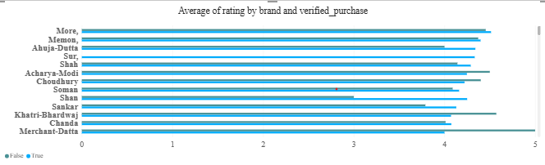
4) Which product types have high sales volume but critically low stock levels?
• Brand Ratings cluster tightly between 3.0 and 4.5 across the entire portfolio, indicating a highly competitive and uniform baseline.
• Top-Performing Brands such as Sur, Shah, and Rai lead customer satisfaction, with average scores breaking past the 4.2 threshold.
• Friction Points emerge for brands like Sane, Upadhyay, and Thaman-Sandhu, where average ratings dip to their lowest points near 2.8.
• Verified vs. Non-Verified purchase metrics show visible gaps for specific brands like Zacharia and Salvi, where unverified reviews diverge from verified buyer experiences.
• Consistency remains strong across the majority of brands, with verified and unverified ratings tracking closely together for most labels.

Slide 29
CONCLUSION
🎯 Focus on High-Margin Pillars
Enforce a strict 15% discount cap: Stop all markdown rules above 15% immediately. Data shows discounts beyond this threshold completely erode margins, turning healthy 2,000+ profits into steep losses down to -1,200.
Double down on the top revenue engines: Reallocate inventory priority and budget to Fashion (50M), Home & Kitchen (28M), and Footwear (24M). These three verticals carry your entire volume.
Prune the low-volume long-tail: Liquidate or shift to a dropship model for the 15+ minor categories (like Grocery and Office Supplies) that sit at just 1M each to eliminate warehouse holding drag.
📈 Marketing & Acquisition Channels
Shift capital to Organic Search (SEO): Move underperforming ad spend directly into organic search growth. SEO acts as your most efficient engine, returning 7.67M in revenue on a lean 1.44M spend.
Restructure or freeze Facebook ad spend: Reduce budgets on Facebook immediately. The platform is an efficiency bottleneck, burning a heavy 3.79M cost to yield a very narrow 4.09M return.
Aggressively fund the top regional triad: Prioritize localized campaigns and warehouse distribution in Maharashtra (345M+), Uttar Pradesh (270M), and Gujarat (263M).

Slide 30
📦 FULFILLMENT & SUPPLY CHAIN OPERATIONS
Resolve the sizing mismatch in Fashion: Implement interactive sizing charts or digital fit tools on product pages. Sizing issues are your top return driver (2,201 cases), hitting your vital 50M Fashion engine hardest.
Overhaul Standard shipping carrier SLAs: Renegotiate terms or balance distribution for baseline fulfillment. Standard shipping is your primary transit bottleneck, driving over 21.5K delayed flags.
Stop investing capital to accelerate return speeds: Do not spend extra budget to speed up transit for returned items. Returns average a highly uniform 4.0 to 4.1 days, proving return behavior is driven by product fit and quality rather than delivery speed.
To begin executing these directives, let me know if you would like me to:
Draft a formal policy directive for the 15% discount cap to deliver to your pricing team.
Model a marketing budget shift moving capital out of Facebook ads and into Organic Search (SEO).
Design a retention workflow blueprint targeting the high-value churned Gold segment.

