Slide 1
Title:IInnovative ideas for environmental monitoring in future with basic tools.
Incorporating data visualization techniques to showcase historical temperature and humidity trends.
1.DIY Weather Stations with Historical Data: Develop DIY weather stations equipped with basic temperature and humidity sensors. Create a web-based platform where users can view real-time data and historical trends in temperature and humidity. Visualizations could include line graphs, heatmaps, or calendar heat maps displaying daily variations over time.
2.
Community Climate Calendar:
Enable communities to collaboratively track and
visualize temperature and humidity variations throughout the year. Each member can record
daily observations using a basic tool like a thermometer and then contribute to a shared climate
calendar. The calendar can display monthly and yearly trends.
3. | Weather Photo Time-Lapse: Encourage individuals to capture photos of the same
outdoor location at the same time each day. Over time, these photos can be compiled into
time-lapse videos or image galleries to visually showcase seasonal changes in temperature,
humidity, and other environmental factors.
4. | DIY Garden Monitoring App: Create a mobile app for gardeners to record and
visualize temperature and humidity data in their gardens. Users can input data manually or use
basic sensors. The app can generate personalized garden climate reports with interactive charts
and recommendations for plant care.
Environmental Art Installations: Combine environmental monitoring with art by creating interactive installations that visualize temperature and humidity data. For instance, a large LED display can change colors or patterns in response to real-time weather conditions or historical trends.
Weather Wall Maps: Install weather maps on community walls or public spaces, updated with basic data like temperature and humidity. These maps can use color coding, thermochromic ink, or LEDs to display current conditions and historical trends, making weather information easily accessible to the public.

Slide 2
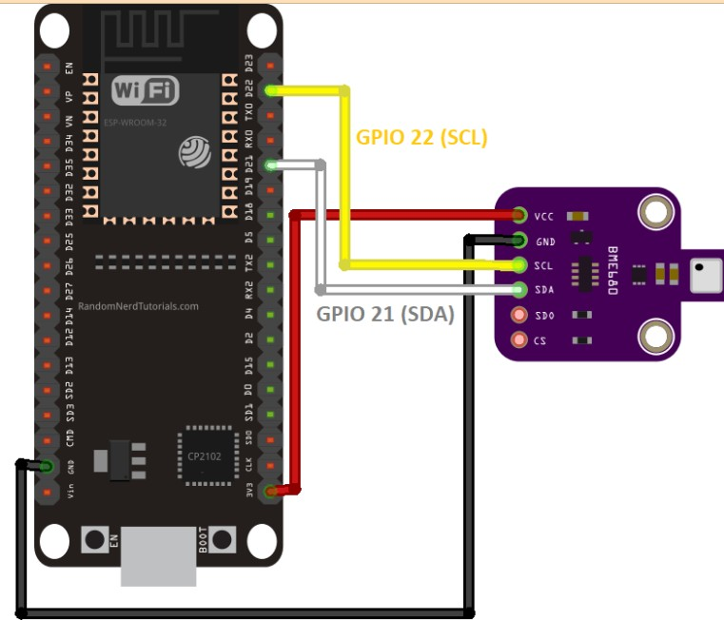
Weather Data Postcards: Design postcards with integrated temperature and humidity sensors. Travelers can send these postcards from different locations, and the recipients can view the weather conditions on the postcards and track how they change as the postcard travels.
Environmental Storytelling with Smart Bulbs: Integrate smart light bulbs into homes and public spaces that change color or brightness based on real-time environmental data. This creates an immersive experience that allows people to "feel" the weather.
Community Climate Murals: Collaborate with local artists to create climate murals that visually represent historical temperature and humidity trends. These murals can serve as educational tools and works of art that raise awareness about climate change.
Weather Wearables with Data Projection: Develop wearable devices (e.g., bracelets or necklaces) that project real-time weather data as visuals onto surfaces. Users can wear these devices and share their environmental data with others in an engaging and interactive way.
Farmers' Market Climate Dashboard: Create a digital dashboard at farmers' markets displaying temperature and humidity trends. This helps farmers and consumers make informed decisions about purchasing and selling fresh produce.
Microclimate Trails: Establish trails or routes in natural areas with basic weather stations along the way. Hikers and outdoor enthusiasts can check environmental conditions at different points, and the data can be visualized on trail maps and signs.
These ideas demonstrate how basic tools can be used to collect environmental data
and how creative data visualization techniques can make this information accessible and engaging to the public. By combining data monitoring with visualization, you can inspire community involvement and raise awareness about environmental issues.

Slide 3
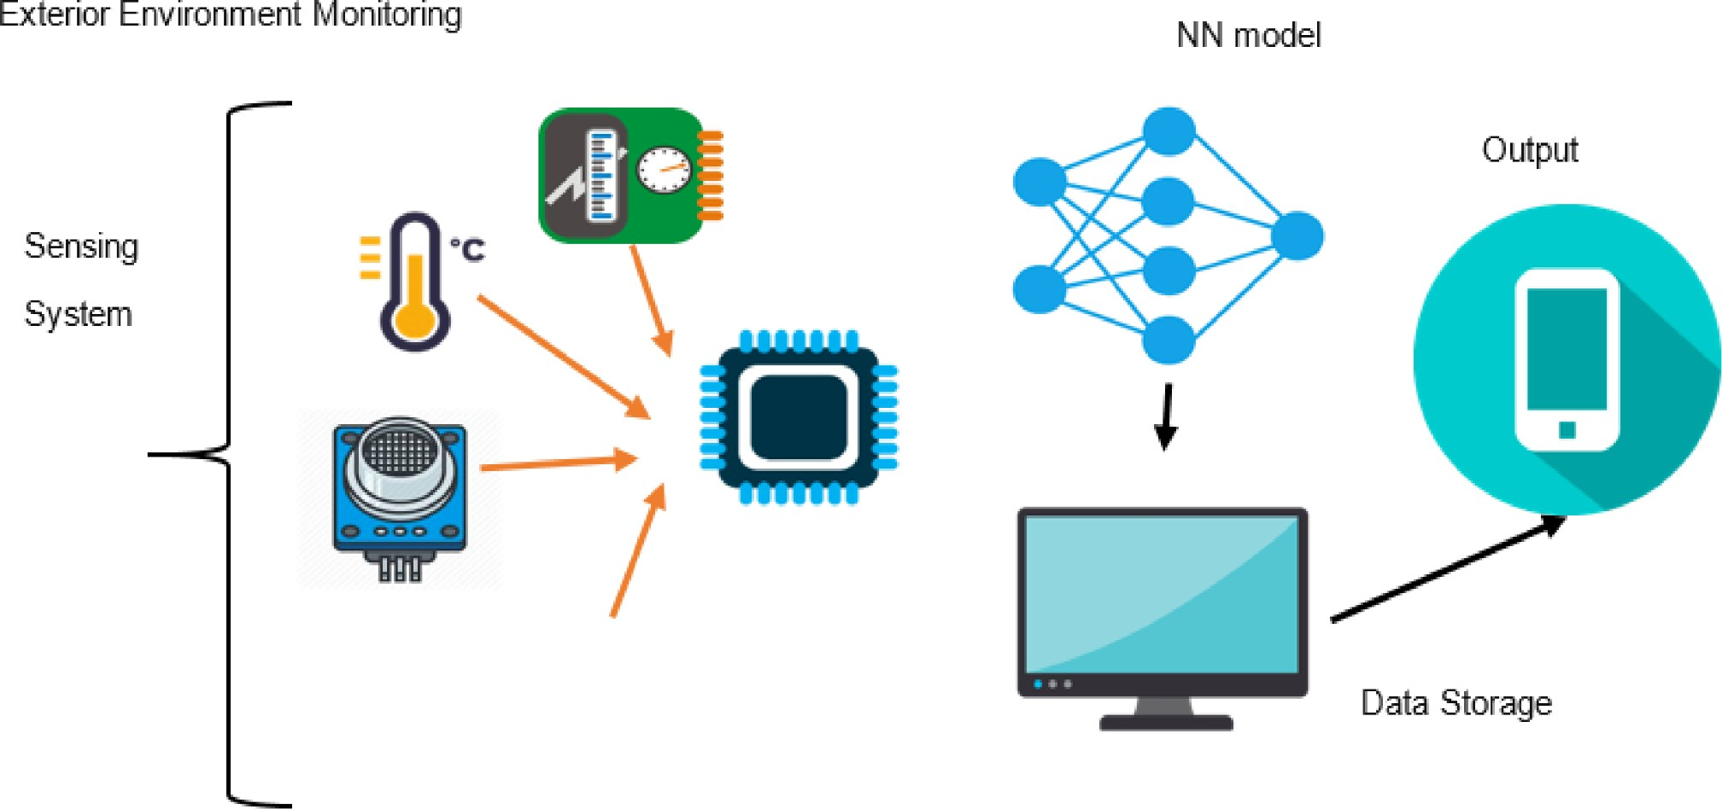
Conclusion: |  | The future of environmental monitoring holds promising possibilities,
even when utilizing basic tools and technologies. By incorporating data visualization
techniques to showcase historical temperature and humidity trends, we can make
environmental | data |  | more | accessible, engaging, and |  | actionable | for | individuals,
communities, and organizations.

