Slide 1
ENVIRONMENTAL MONITORING
WEBSITE

Slide 2
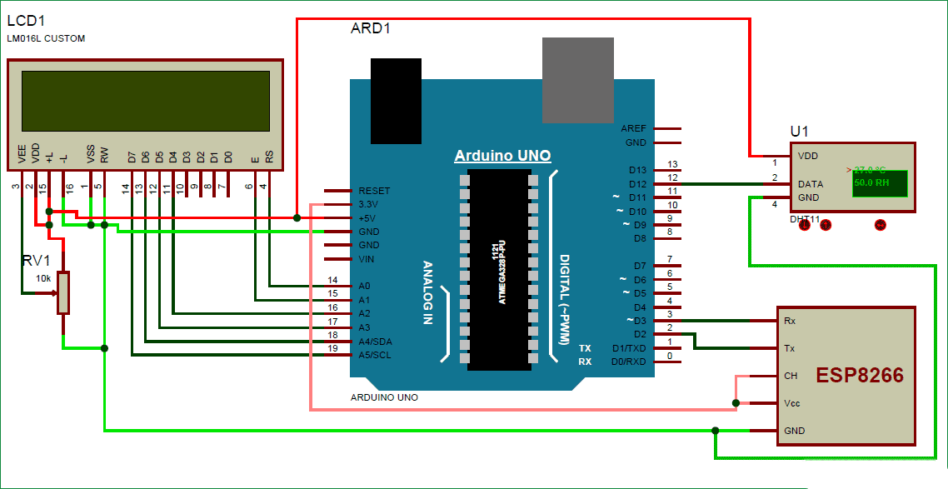
.
In this IoT project we are going to Monitor Humidity and Temperature over the Website. where we will show the current Humidity & Temperature data over using the website . It is accomplished by the data communications between Arduino, DHT11 Sensor Module, ESP8266 WIFI module and LCD. Celsius scale thermometer and percentage scale humidity meter displays the ambient temperature and humidity through a LCD display and also sends it to the website for live monitoring from anywhere in the park.

Slide 3
.
#include “WiFi.h”
#include”ESPAsyncWebServer.h”
#include<Sensor.h>
#include<DHT.h>
Const char* ssid=“REPLACE_WITH_YOUR_SSID”;
Const char* password=“REPLACE_WITH_YOUR_PASSWORD”;
#define DHTPIN 27
#define DHTTYPE DHT22
DHT dht(DHTPIN, DHTTYPE);
AsyncWebServer server(80);
String readDHTTemperature(){
Float t=dht.readTemperature();

Slide 4
.
If(isnan(t)){
Serial.println(“Failed to read from DHT sensor !”);
Return “_ _”;
}
Else{
Serial.println(t);
return String(t);
}
}
String readDHTHumidity(){
Float h=dht.readHumidity();
If(isnan(h)){
Serial.println(“Failed to read from DHT sensor!”);
return “_ _”;
}

Slide 5
.
else{
Serial.println(h);
return string(h);
}
}
Const char index_html[] PROGMEM=R”rawliteral(
<!DOCTYPE HTML><html>
<head>
<meta name=“viewport” content=“width=device-width , initial-scale=1”>
<link rel=“stylesheet href=“https://use.fontawesome.com/releases/v5.7.2/css/all.css “integrity=“sha384-fnmOCqbT1WI1j8LyTjo7mOUStjsKC4pOpQbqyi7RrhN7udi9R”>
<style>
html{
font-family:Arial;
display:inline-block;
margin:0px auto;
text-align:center;
}

Slide 6
.
H2{font-size:3.0rem;}
P{font-size: 3.0rem;}
.units{font-size:1.2rem;}
.dht-labels{
font-size:1.5rem;
vertical-align:middle;
padding-bottom:15px;
}
</style>
</head>
<body>
<h2>ESP32 DHT Server</h2>
<p>
<i class=“fas fa-thermometer-half” style=“color:#059e8a;”></i>
<span class=“dht-labels”>Temperature</span>
<span id=“temperature”>%TEMPERATURE%</span>
<sup class=“units”>&deg;C</sup>
</p>

Slide 7
.
<p>
< i class= ‘ fas fa-tint’ style=‘ color :#00add6;’></i>
<span class=‘dht-labels’><Humidity</span>
<span id=“humidity”>%HUMIDITY%</span>
<sup class=‘units’>%</sup>
</p>
</body>
<script>
setInterval(function()){
var xhttp=new XMLHttpRequest();
xhttp.onreadystatechange=function(){
if(this.readyState ==4&&this.status ==200){
document.getElementById(“temperature”).innerHTML=this.responseText;
}
};
Xhttp.open(“GET”,”/temperature”,true);
Xhttp.send();
},10000);
setInterval(function(){
var xhttp=new XMLHttpRequest();

Slide 8
.
Xhttp.onreadystatechange=function(){
if(this.readystate ==4&& this.status==200){
document.getElementById(“humidity”).innerHTML=this.responseText;
}
};
Xhttp.open(“GET”,”/humidity”,true);
Xhttp.send();
},10000);
</script>
</html>)rawliteral”;
String processor (const String &var){
if(var==“TEMPERATURE”){
return readDHTTemperature();
}
else if(var==“HUMIDITY”){
return readDHTHumidity();
}

Slide 9
.
Return String();
}
Void setup(){
Serial.begin();
WiFi.begin(ssid,password);
while(WiFi status()!=WL_CONNECTED){
delay(1000);
Serial.println(“connecting to WiFi..”);
}
Serial.println(WiFi.localIP());
Server.on(“/”,HTTP_GET,[](AsyncWebServerRequest *request){
request->send_p(200,”text/html”,index_html,processor);
});
Server.on(“/temperature”,HTTP_GET,[](AsyncWebServerRequest *request){
request->send_p(200,”text/plain”,readDHTTemperature().c_str());
});

Slide 10
.
Server.on(“/humidity”,HTTP_GET,[](AsyncWebServerRequest *request){
request->send_p(200,”text/plain”,readDHT Humidity().c_str());
});
Server.begin();
}
Void loop(){
}

