Slide 1


Department of Artificial Intelligence and Data Science
PREDICTING STUDENT ACADEMIC PERFORMANCE FOR EARLY INTERVENTION USING MACHINE LEARNING
MRS D SORNA SHANTHI ASSOCIATE PROFESSOR
GITANJALI.J-221801012
JOTHESWARI.P-221801022

Slide 2
Problem Statement and Motivation
Develop a machine learning model to predict the student's academic performance based on historical grades, attendance records, and sociodemographic factors to provide early interventions.
The motive of this to help students succeed by predicting their academic performance early using data like grades, attendance, and background information. By identifying students who may be struggling, teachers and schools can provide timely support, improving academic outcomes and reducing dropout rates.

Slide 3
Objectives
To Predict students' academic performance using historical grades, attendance records, and sociodemographic factors to identify students at risk and enable early interventions.
Gather relevant data, clean and preprocess it to ensure it is ready for modeling.
Perform early intervention on the prediction model to predict the student’s particular academic performance

Slide 4
Abstract
To predict how students will perform is important for providing timely support.it introduces a machine learning model that uses a Random Forest Regressor to predict student performance more accurately. By combining grades and attendance this model helps identify students who may need help earlier. This allows schools to offer targeted support, ultimately improving student success and making better use of resources. It enables early identification of students at risk and facilitates targeted interventions, thereby improving educational outcomes and resource allocation. The integration of diverse data sources and predictive analytics represents a significant advancement over traditional methods, offering a more comprehensive and proactive approach to student support.

Slide 5
Introduction and Overview of the Project.
Academic performance is a critical determinant of a student’s future opportunities and success. Early identification of students at risk of poor performance can enable timely interventions, thereby improving educational outcomes and providing targeted support to those in need. Traditional methods of monitoring student progress often rely on periodic assessments, which may not provide a comprehensive view of a student’s academic journey. With the advent of machine learning, it is now possible to analyze large volumes of data to uncover patterns and predictors of academic success or failure. This project aims to develop a robust machine learning model to predict students' academic performance based on a variety of factors, including historical grades, attendance records, and socio-demographic characteristics.

Slide 6
Literature Survey
S.No | Author Name | Paper Title | Description | Journal | Volume/ Year
1 | Agnihotri, L., & Mande.S | Predicting Students Performance Using Data Mining Technique with Rough Set Theory | This paper highlights the significance of attendance records and their combination with other factors to predict student performance using data mining techniques. | International Journal of Computer Applications | 2012
2 | Kuzilek, J., Hlosta, M., & Zdrahal, Z. | Open University Learning Analytics: A Case Study | This study showcases the use of predictive models to allocate resources effectively in an open university setting, focusing on student support. | Proceedings of the Fifth International Conference on Learning Analytics & Knowledge | 2015
3 | Huang, S., Fang, N., & Li, H. | Predicting Academic Performance Based on Student Interaction with Online Learning System: A Case Study | This study examines the relationship between student interactions with an online learning system and their academic performance | Journal of Educational Computing Research | 2018

Slide 7
Existing Sytem
S.No | Author Name | Paper Title | Description | Journal | Volume/ Year
4 | Holstein, K., McLaren, B. M., & Aleven, V. | The Ethics of Using Educational Data Mining for Predictive Modeling | This paper discusses ethical considerations and the importance of fairness and equity in education | Proceedings of the 10th International Conference on Educational Data Mining | 2019
5 | Singh, S., & Pal, S | A Machine Learning Approach to Predict Student Performance | This paper examines the effectiveness of different machine learning algorithms, in predicting academic performance | Procedia Computer Science | 2020
6 | Kumar, M., Gupta, M., & Varma, M. | Predicting Academic Performance of Students Using Machine Learning Techniques | The study evaluates the effectiveness of models like logistic regression and SVM for prediction of student outcomes | International Journal of Educational Technology in Higher Education | 2021
Font size 24

Slide 8
Existing System
In the current educational landscape, student performance monitoring primarily relies on traditional methods such as periodic assessments, teacher evaluations, and manual tracking of grades and attendance records. These methods are often reactive, identifying struggling students only after they have performed poorly in exams or missed a significant number of classes. Additionally, socio-demographic factors, which can provide valuable context for understanding a student's performance, are frequently underutilized. While some schools may use basic statistical tools to analyze performance data, these approaches lack the predictive power and comprehensive analysis that modern machine learning models can offer.

Slide 9
Drawback of Existing System
The existing system's reliance on traditional monitoring methods and periodic assessments is fundamentally reactive, identifying issues only after they have manifested in poor performance or low attendance. This delayed recognition hampers the ability to provide timely interventions, allowing problems to exacerbate before being addressed. Furthermore, the system's underutilization of socio-demographic factors means it lacks a holistic view of the student's context, potentially overlooking critical influences on academic performance. Additionally, the manual tracking and basic statistical analysis currently employed are time-consuming and prone to human error, further limiting the system's efficiency and accuracy in supporting at-risk students.

Slide 10
Proposed System
Data Collection - Gather data from various sources to create a comprehensive dataset. Important data points include: student demographics, academic records, behavioral data, psychosocial factors, online activity
Data Preprocessing - Prepare the data for training the machine learning model
Feature Engineering - Create new features from the existing data to enhance model performance like aggregate features, temporal features etc
Model Selection - Choose appropriate machine learning models to predict student performance like regression models, classification models and more.
Model Training - Train the selected models using the prepared dataset

Slide 11
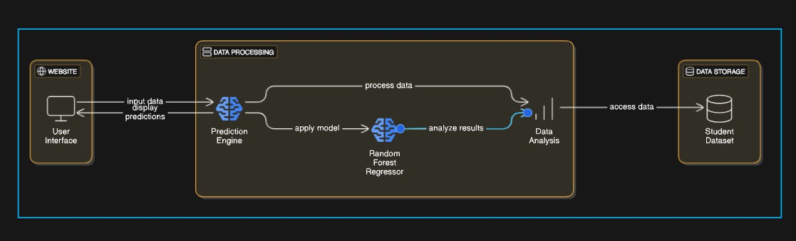
System Architecture

Slide 12
List of Modules
Data Collection Module - student demographics, academic records, behavioral data, psychosocial data.
Data Preprocessing Module - data cleaning, data transformation, feature selection
Feature Engineering Module - feature extraction, time-series features, behavioral indicators
Model Development Module - model selection, model training, hyperparameter tuning, cross-validation
Model Evaluation Module - performance metrics, error analysis, bias and fairness and accurate.

Slide 13
Module 1 – Preprocessing/Visualization
Handling missing values - handling missing values ensures the dataset's integrity by either imputing them with appropriate values or removing incomplete records to prevent skewed analysis and inaccurate model predictions.
Feature encoding - converts categorical data into numerical values, allowing machine learning algorithms to process and interpret the information effectively.
Feature Scaling – standardizes the range of independent variables, ensuring that all features contribute equally to the model's learning process and preventing bias towards variables with larger magnitudes.
Data visualization - transforms raw data into graphical representations, helping to uncover patterns, trends, and insights that facilitate better understanding and decision-making in the analysis process.

Slide 14
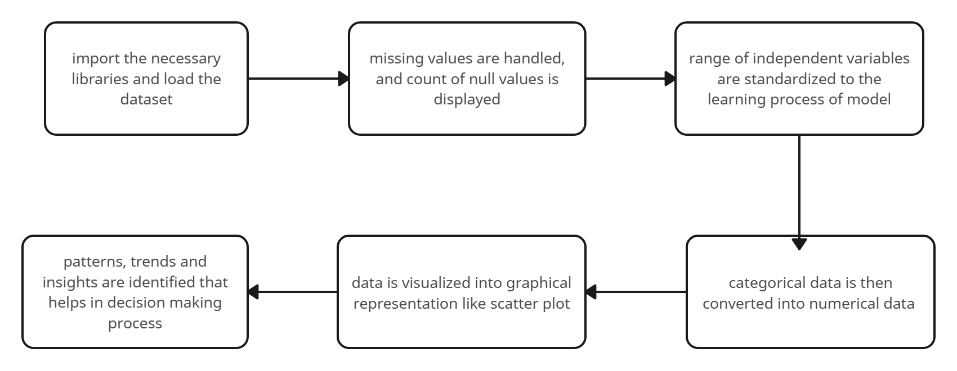
Data flow diagram

Slide 15
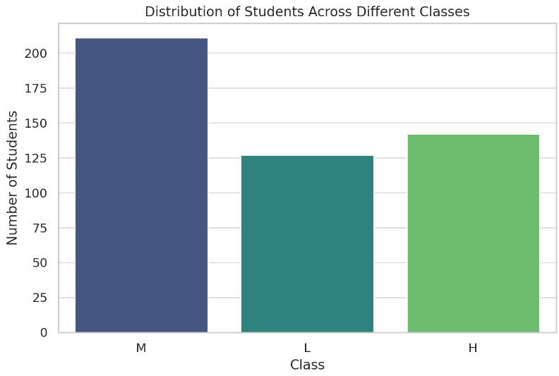
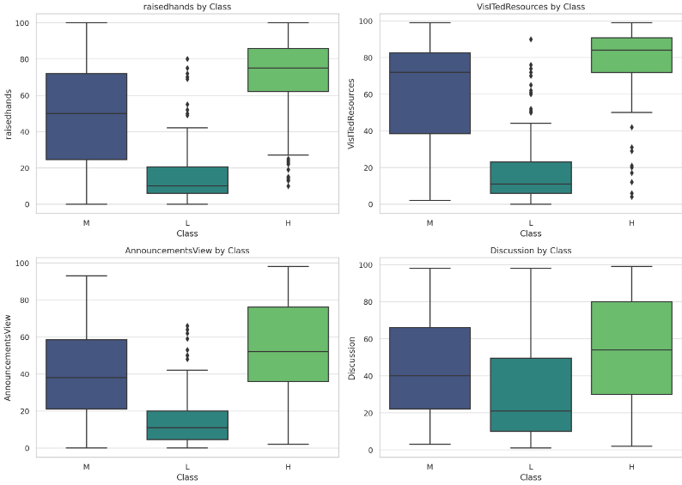
Output
Fig. 1.1 Distribution of Student across classes
Fig. 1.2 Engagement Metrics across the classes

Slide 16
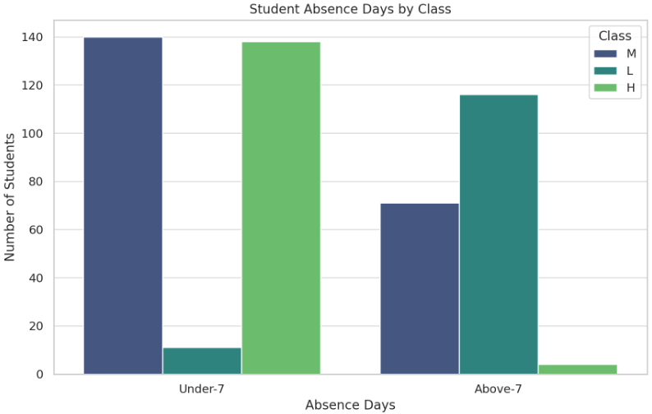
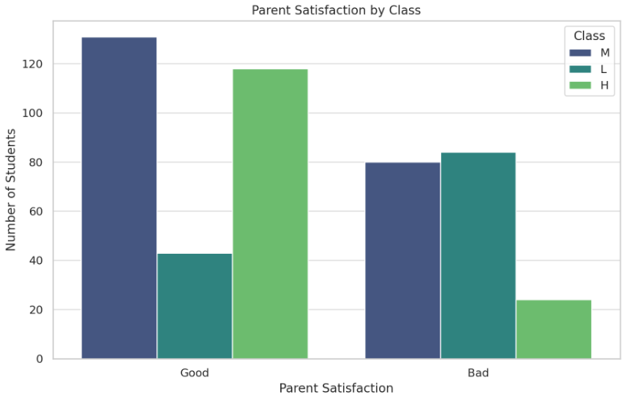
Output
Fig. 1.3 Absence days by class
Fig. 1.4 Parent satisfaction by class

Slide 17
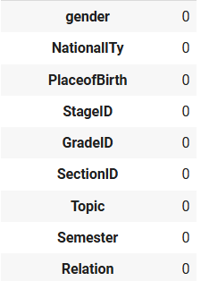
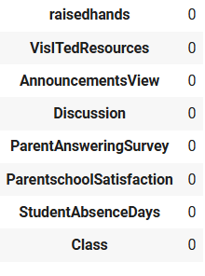
Output
Fig. 1.5 Showing missing values

Slide 18
Module 2 – Feature engineering
Feature scaling - ensures that all features contribute equally to the model's performance by bringing them to a comparable range. This is particularly important for algorithms that are sensitive to the scale of the input features, such as gradient descent-based models. After applying Min-Max scaling, each feature's values are transformed to lie within the range [0, 1], which helps improve the performance of machine learning models and ensure that all features are on a similar scale.
Converting categorical variable to integer - This conversion is necessary because machine learning models generally require numerical input. By converting boolean values to integers, we prepare the data for use in models that expect numerical features.

Slide 19
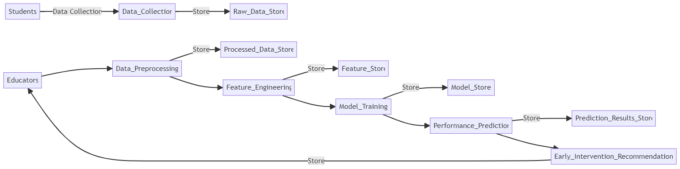
Data flow diagram

Slide 20
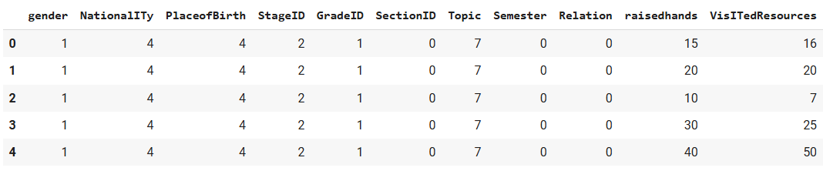
Output
Fig. 1.6 a) Encoding categorical columns into numerical format

Slide 21
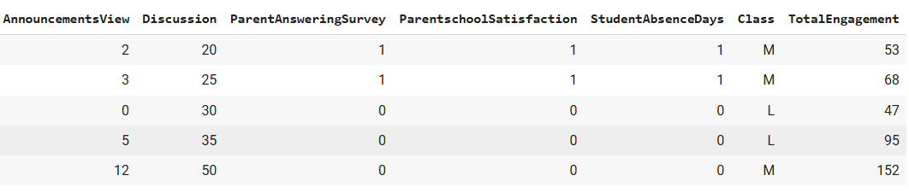
Output
Fig. 1.6 b) Encoding categorical columns into numerical format

Slide 22
Module 3 – Model Development
Model Selection: Choose appropriate machine learning algorithms (e.g., decision trees, random forests, neural networks) based on the problem type (classification or regression). Optimize and validate models through cross-validation and hyperparameter tuning.
Model Training: Train models on the training dataset and evaluate performance on the validation set. Track metrics like loss (for regression) and accuracy (for classification).
Model evaluation: The process of assessing the performance and effectiveness of a machine learning model in making accurate predictions. It involves the use of specific metrics to quantify how well the model performs on unseen data, ensuring it generalizes beyond the training set.

Slide 23
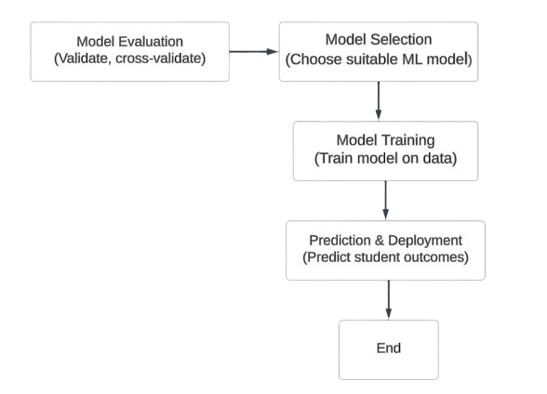
Data Flow Diagram

Slide 24
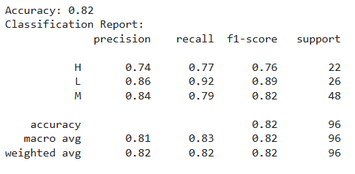
Output
Fig. 1.7 Accuracy according to model evaluation

Slide 25

Output
Fig. 1.8 Values of MSE and RMSE

Slide 26
Module 4 – Model Deployment
Integration with the Web Application : Deploying the model as an API allows the website to make real-time predictions by sending requests to the model and receiving responses. The API can handle incoming data, process it using the trained model, and return predictions seamlessly.
Ensure the deployed model can scale to handle user traffic without performance degradation.
Once deployed, it's important to continuously monitor the model’s performance on the website. This involves tracking metrics like response time, errors, and user engagement.

Slide 27
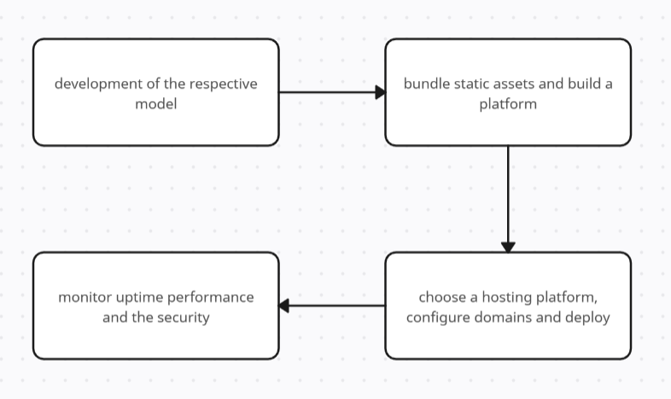
Data flow diagram

Slide 28
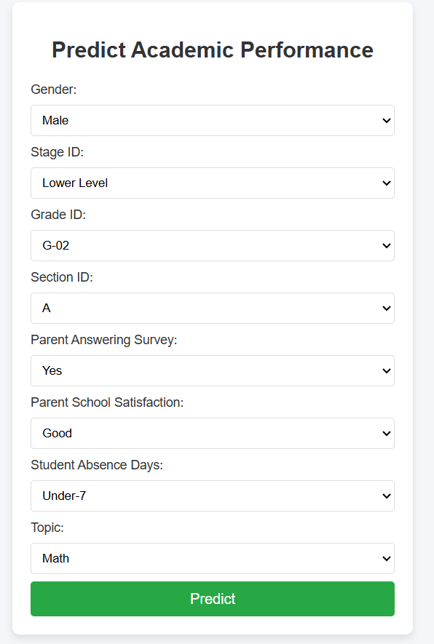
Output
Fig. 1.9 Form to predict student performance

Slide 29
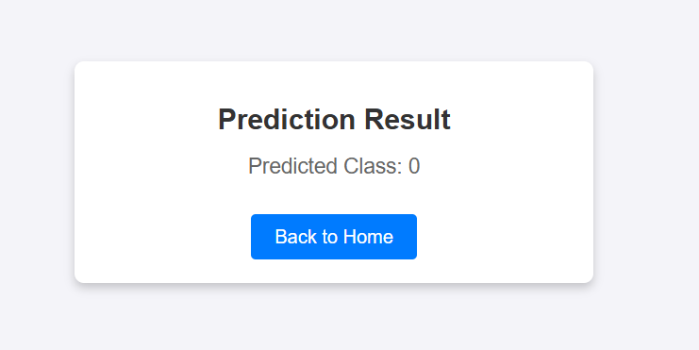
Output
Fig. 1.9 Predicted result

Slide 30
Algorithm
‘app.py’ : Flask Application for Predictive Model Deployment
This script sets up a Flask application to serve the trained XGBoost model and predict student performance.
Algorithm:
1. Initialization:
- Import required libraries: Flask, XGBoost, Pandas, and others.
- Define the Flask app using `Flask(__name__)`.
2. Model Loading:
- Define `load_model()` to load the pre-trained XGBoost model (`xgb_model.json`) from a specified path.

Slide 31
Algorithm
- Check for errors during loading and handle exceptions.
3. Preprocessing Input Data:
- Define `feature_engineer(data)` to convert user input from the web form into the format required by the model:
- Map categorical inputs (e.g., gender, grade, section) to numeric values.
- Return a Pandas DataFrame for compatibility with XGBoost.
4. Web Routes:
- Define the root (`/`) route to render the `index.html` file containing the prediction form.

Slide 32
Algorithm
- Define `/predict` route to:
- Extract user input from form data (`request.form`).
- Preprocess the input using `feature_engineer()`.
- Convert data to an XGBoost `DMatrix`.
- Predict using the loaded model.
- Render the `result.html` template with the predicted class.
5. Error Handling:
- Catch and return errors in JSON format for debugging.
6. Run the Application:
- Use `app.run(debug=True)` to start the Flask server.

Slide 33
Algorithm
‘model.py’ : Model Training and Evaluation
This script prepares data, trains the model, and saves it for deployment.
Algorithm:
1. Data Loading:
- Load the dataset using Pandas and display relevant statistics.
2. Feature Engineering:
- Map categorical features (e.g., gender, stage, grade) to numerical values using dictionaries and `LabelEncoder`.

Slide 34
Algorithm
3. Data Splitting:
- Split data into training, validation, and test sets using `train_test_split`.
- Ensure balanced representation of classes using stratification.
4. Train the XGBoost Model:
- Instantiate `XGBClassifier` with parameters for multi-class classification.
- Train the model on the training set with class weights for imbalance handling.
- Validate on a separate set using metrics like `mlogloss` and `merror`.

Slide 35
Algorithm
5. Model Evaluation:
- Generate predictions on validation and test sets.
- Compute metrics: accuracy, precision, recall, F1-score, and confusion matrix.
6. Model Saving:
- Save the trained model in JSON format (`xgb_model.json`).
- Optionally convert to H5 format for compatibility.
7. Plot Metrics:- Plot loss (`mlogloss`) and error rate (`merror`) over training epochs.
- Display feature importance using `plot_importance`.

Slide 36
Algorithm
‘index.html’ : User Input Form
This file provides a form interface for users to input student data for prediction.
Algorithm:
1. HTML Structure:- Use `<form>` to create an input form with fields like gender, nationality, grade, etc.
- Use `<select>` for dropdown menus and `<input>` for numeric fields.
2. Submit Form:- The form's `action` is set to the `/predict` route of the Flask app.
- Method is set to `POST` for secure data submission.

Slide 37
Algorithm
‘result.html’: Prediction Display
This file displays the predicted class to the user.
Algorithm:
1. HTML Structure:
- Display a message with the prediction (`{{ prediction }}`).
- Provide a link to return to the home page.

Slide 38
Conclusion
In conclusion, the proposed system for predicting student academic performance using machine learning represents a significant advancement in educational data analytics. By leveraging historical data such as grades, attendance, and sociodemographic factors, the system can identify at-risk students early, enabling timely interventions. The use of a Random Forest Regressor allows for accurate predictions by capturing complex relationships within the data, ensuring that the system remains robust across diverse student populations and academic settings.
Ultimately, the system aims to improve student success rates by providing educators with the necessary tools to proactively support students who may be struggling academically.

Slide 39
References
[1] M. K. F. Gana, "Predicting student academic performance using machine learning algorithms," Journal of Educational Data Mining, vol. 12, no. 1, pp. 37-55, 2020.
[2] J. Lee, "Early intervention strategies for students at risk of academic failure: A machine learning approach," Computers in Education, vol. 45, no. 3, pp. 256-267, 2019.
[3] A. Smith, "Comparative study of random forest and decision trees for student performance prediction," Educational Technology & Society, vol. 22, no. 4, pp. 154-162, 2019.
[4] S. Kumar and R. S. Rajan, "A machine learning model for predicting student performance using random forest," International Journal of Artificial Intelligence, vol. 17, no. 2, pp. 45-59, 2021.
[5] L. Wang and H. Zhang, "Predicting academic success: The role of machine learning techniques," Journal of Educational Research, vol. 93, no. 4, pp. 1-12, 2018.

Slide 40
THANK YOU

