Slide 1

Courier Management System
Gitanjali J - 221801012
Jotheswari P - 221801022

Slide 2
INTRODUCTION
A Courier Management System is a comprehensive solution designed to streamline and automate the end-to-end processes involved in courier and logistics operations. It enables the efficient handling of key activities such as order placement, tracking, dispatching, delivery, and payment processing. By managing information on customers, packages, delivery routes, and branch locations, the system ensures that couriers are processed quickly and accurately, enhancing customer satisfaction and operational efficiency. Additionally, it provides real-time tracking and reporting features, allowing both customers and administrators to monitor parcel status, delivery timelines, and logistics performance, which ultimately supports better resource management and improved service quality. By incorporating features such as notifications, automated billing, and delivery proof, the system enhances transparency for customers and allows businesses to build trust through reliable service and real-time updates.

Slide 3
EXISTING SYSTEM
1. Manual Operations and Data Entry
Physical Logs: Many traditional systems rely on paper logs to record shipment details, tracking numbers, and delivery updates, increasing the likelihood of errors.
Customer Inquiries: Manual responses to customer inquiries about shipment status can lead to delayed or inconsistent updates, impacting customer satisfaction.
Invoice Processing: Manual processing of invoices and receipts is time-consuming and often lacks accuracy, leading to potential billing errors.
2. Inefficiencies in Scheduling and Routing
Delivery Scheduling: Without automated scheduling, assigning deliveries to drivers can be slow and inefficient, leading to underutilization of resources.
Route Planning: Manual route planning is less efficient, often resulting in longer delivery times and higher fuel costs, especially for complex or high-volume routes.

Slide 4
ADVANTAGES
Improved Efficiency and Speed
Automates repetitive tasks like data entry, scheduling, and invoicing, reducing processing time and the likelihood of errors.
Streamlines operations by centralizing data, making it easy for employees to access and update parcel information in real-time.
Real-Time Tracking and Transparency
Provides real-time tracking, allowing customers and businesses to monitor the status of shipments at every stage.
Enhances customer satisfaction by offering tracking information and timely notifications, which improves transparency and builds trust.
Optimized Resource Management
Automates route planning and scheduling, helping reduce delivery times and fuel costs by selecting the most efficient routes.
Allows better allocation of resources, as deliveries can be assigned based on capacity and priority, improving operational efficiency

Slide 5
DISADVANTAGES
High Initial Implementation Costs
The setup and integration of a full-featured system can be costly, especially for smaller courier businesses with limited budgets.
Additional costs for software, hardware, training, and ongoing maintenance can be a barrier to entry.
Complexity in Integration
Integrating the system with existing tools and software may be complex, requiring technical expertise and custom solutions.
Poor integration with other logistics or ERP systems can limit the effectiveness of the Courier Management System.
Training Requirements
Employees need training to effectively use the new system, which may lead to temporary slowdowns and additional training expenses.
Continuous support is necessary to ensure all staff are updated on system features and changes.

Slide 6
PROPOSED SYSTEM
User Roles and Access
Admin: Manages system settings, staff, and operations.
Courier Staff: Updates delivery statuses and handles deliveries.
Customer: Places orders, tracks packages, and manages profile.
System Features
Mobile App for Couriers: Allows route and status updates on the go.
Customer Portal: Self-service for order management and support.
API Integration: Connects with payment, GPS, and other external services.
Security & Privacy: Secure data handling and role-based access controls.
Customer Relationship Management (CRM)
Customer Profiles: Stores customer contact information, preferences, and previous order history.
Support Tickets: Allows customers to open support tickets for issues and queries.
Feedback Collection: Collects feedback after deliveries for service improvement.

Slide 7
ADVANTAGES OF PROPOSED SYSTEM
Better Resource Management
Warehouse and Inventory Management optimizes storage space and speeds up package sorting and dispatching.
Scalability and Flexibility
API Integrations allow easy integration with third-party services (e.g., payment gateways, GPS services) and future technology expansions.
Cost Savings and Revenue Growth
Route Optimization reduces fuel consumption and labor costs.
Enhanced Security and Data Privacy
Role-Based Access Control ensures that sensitive data is accessible only to authorized users, reducing risks of data breaches.

Slide 8
DISADVANTAGES OF PROPOSED SYSTEM
1.High Initial Development Cost
Developing and implementing a comprehensive system with real-time tracking, route optimization, and database management can require a significant upfront investment in software development, infrastructure, and technology integration, making it a costly endeavor for businesses.
2. Complexity in Integration
Integrating the system with existing legacy systems, third-party services, and APIs can be complex and time-consuming, potentially leading to compatibility issues and operational disruptions during the transition period.
3. Dependence on Technology and Internet Connectivity
The system's reliance on real-time tracking and cloud-based services means it is dependent on stable internet connectivity and the availability of accurate GPS services. Network disruptions or GPS failures can result in tracking errors or delays in deliveries.

Slide 9
4. Security and Data Privacy Concerns
As the system stores sensitive customer and order information, it must comply with data protection regulations (such as GDPR). Any vulnerabilities or breaches in security could lead to data leaks, compromising customer trust and exposing the business to legal liabilities.
5. Maintenance and Continuous Upgrades
The system requires ongoing maintenance, bug fixes, and regular updates to ensure compatibility with new technologies and address emerging security threats. This can lead to additional operational costs and require dedicated IT resources.
6. Training and Adaptation
Staff and couriers will need to undergo training to effectively use the new system, which could temporarily reduce productivity during the learning curve. Resistance to change among employees could also hinder successful implementation.
7. Scalability Challenges
While the system is designed to be scalable, expanding operations into new regions or handling a large increase in volume may require significant adjustments to infrastructure, databases, and resources, which could pose challenges in maintaining performance and reliability.

Slide 10
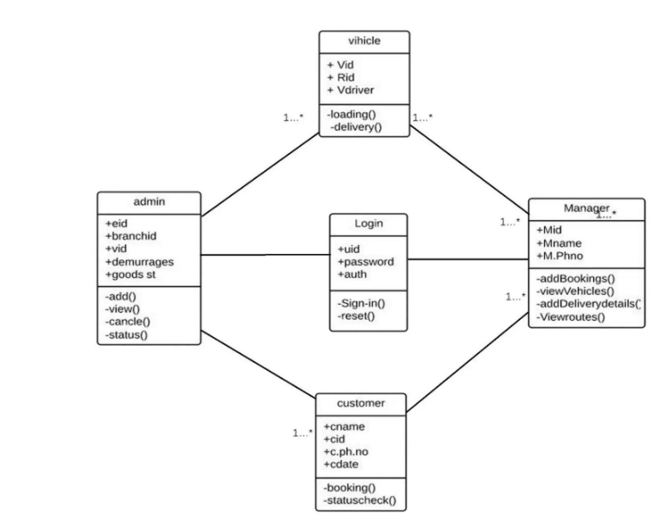
Class Diagram

Slide 11
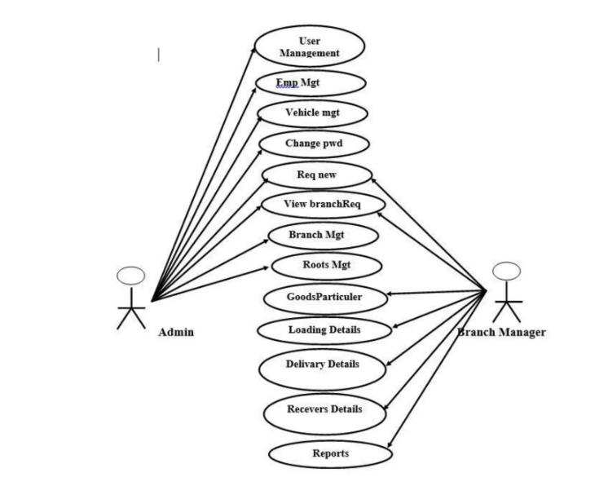
Use Case Diagram

Slide 12
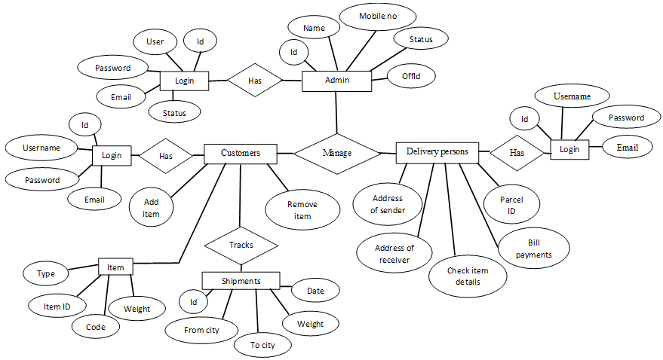
ER DIAGRAM

Slide 13
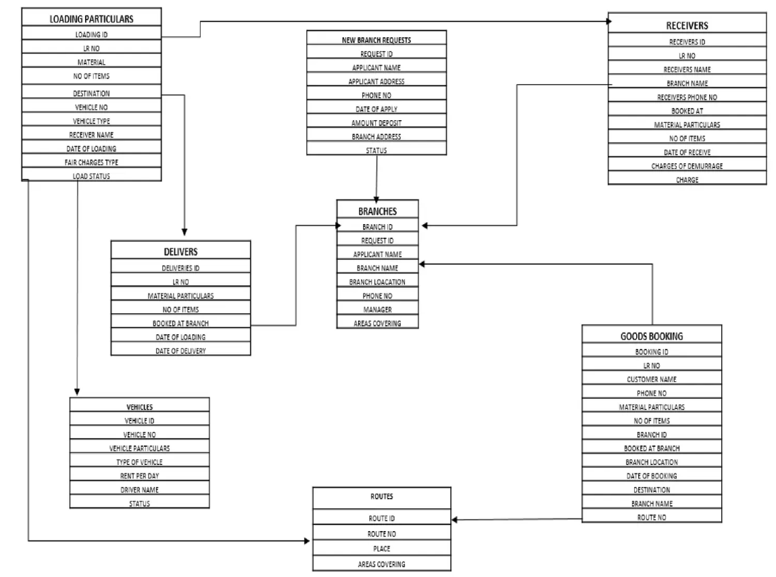
ER DIAGRAM

Slide 14
LITRATURE SURVEY
S.No | Author Name | Paper Title | Description | Jornal | Volume/ Year
01. | Chopra, S., Meindl, P. | Supply Chain Management: Strategy, Planning, and Operation | Discusses logistics and supply chain optimization, which is relevant for route planning and delivery management in courier systems. | Pearson Education | 2016
02. | Rodrigue, J.-P. | The Geography of Transport Systems | Explores transport systems, including logistics, routing, and the geography of transportation networks, which are crucial for optimizing courier routes. | Routledge | 2020

Slide 15
03. | Coronel, C., Morris, S. | Database Systems: Design, Implementation, & Management | Provides insights into database design and management for handling large volumes of order, customer, and inventory data in courier systems. | Cengage Learning | 2018
04. | Goodfellow, I., Bengio, Y., & Courville, A. Database Systems: Design, Implementation, & Management | Deep Learning | Discusses machine learning techniques, including their application in optimizing delivery routes and predictive analytics for courier systems. | MIT Press | 2016
05. | Stallings, W. | Computer Security: Principles and Practice | Covers fundamental principles of computer security and privacy, which are critical for protecting customer and order data in a Courier Management System. | Pearson | 2019

Slide 16
Software model – Agile Incremental
The Agile-Incremental Model is a hybrid approach that combines the flexibility of Agile methodologies with the structured, step-by-step approach of the Incremental model. This combination is particularly well-suited to projects with evolving requirements, like a Courier Management System (CMS), where continuous feedback and frequent updates are essential.
Benefits –
Faster Delivery and Early Value: By delivering incremental updates, users get early access to parts of the system, which adds immediate value. In CMS, basic features like tracking or notifications can be deployed while advanced functionalities are still being developed.
Risk Management: Smaller, incremental releases allow for early identification of issues and quick fixes, reducing the risk of large-scale errors in the final product.
Customer Satisfaction: The Agile component ensures that customer needs and feedback are incorporated frequently, leading to a final product that closely aligns with user expectations.

Slide 17
Testing – Unit & Automation
Unit Testing focuses on verifying individual components or "units" of code in isolation to ensure they work as expected. In CMS, unit testing is crucial for maintaining the integrity of core functionalities that are often updated or modified.
Automation Testing is essential for repetitive tasks, regression testing, and ensuring consistency in a CMS where features frequently evolve due to Agile development cycles. By automating tests, CMS can maintain reliability and performance with minimal manual intervention.
By combining unit and automation testing, a CMS project can achieve reliable and scalable results, minimizing manual testing effort while ensuring that core functionalities remain robust, even with frequent updates. This layered approach to testing supports both the immediate validation of individual components and the long-term reliability of the entire system.

Slide 18
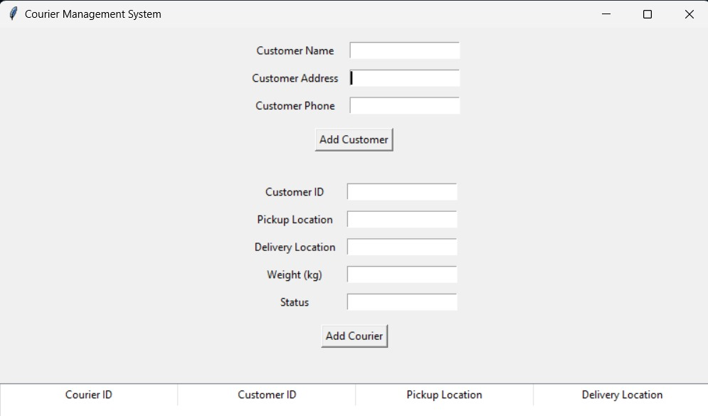
User Documentation:
Login page

Slide 19
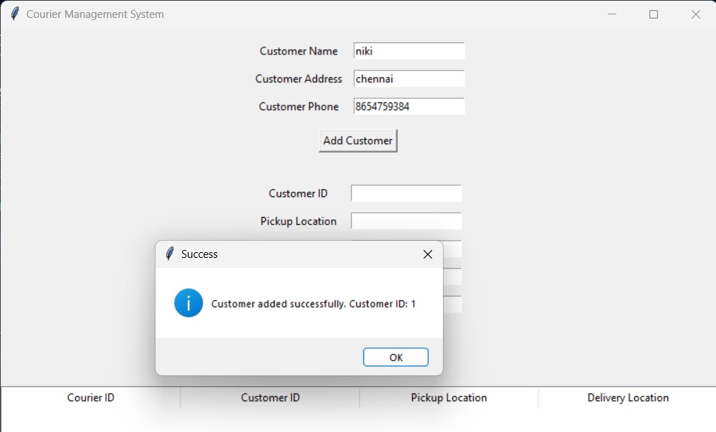
Register page

Slide 20
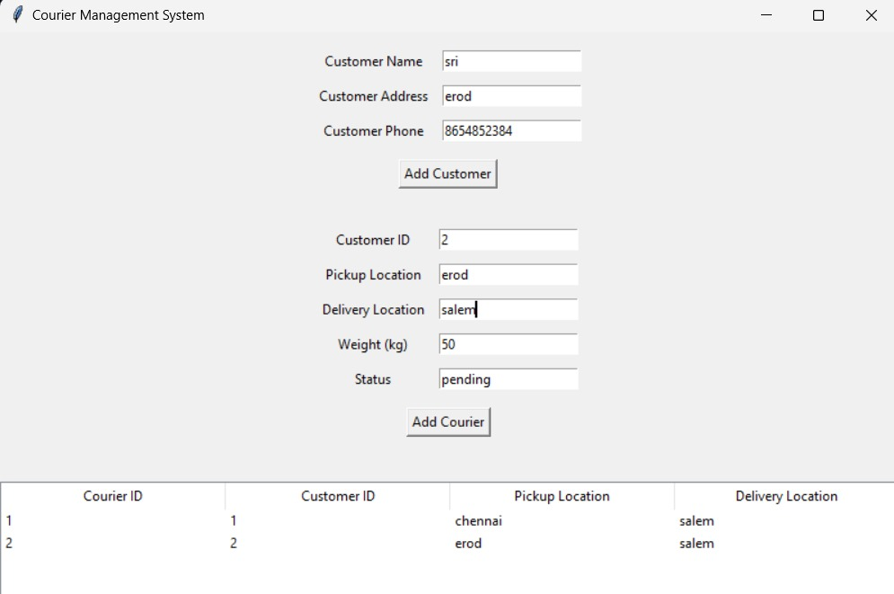
Register page

Slide 21
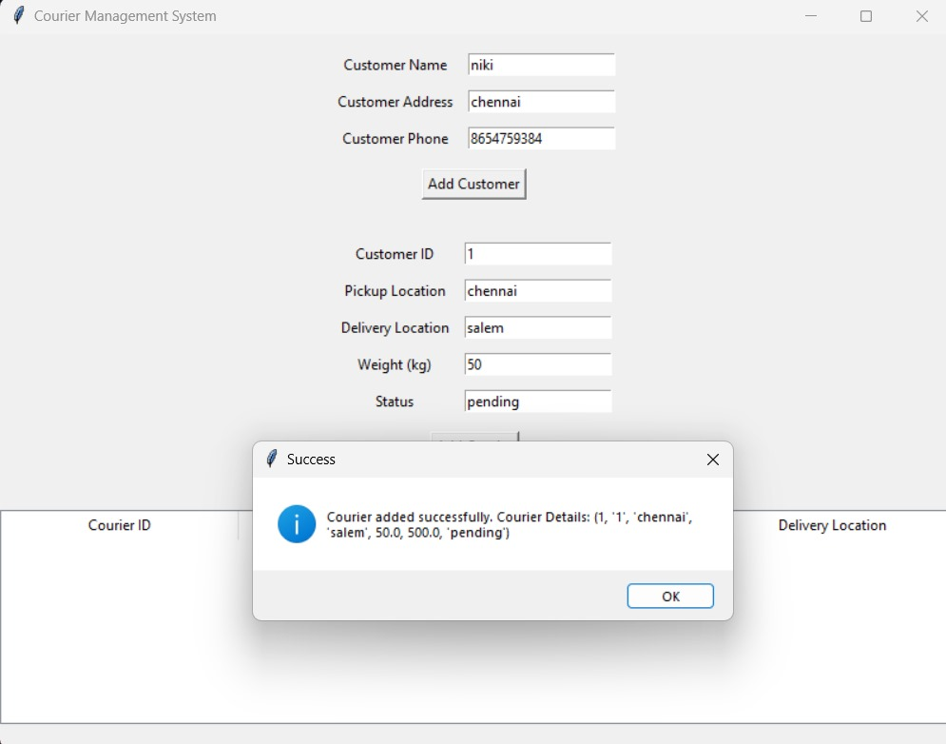
Customer courier details display page

Slide 22
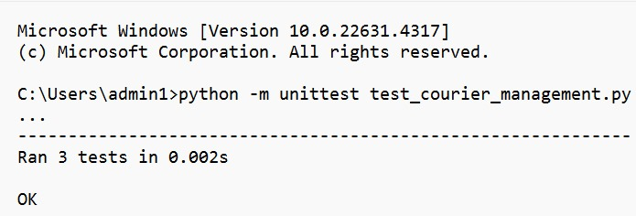
Unit testing

Slide 23
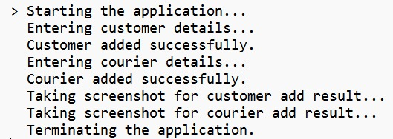
Automation testing

Slide 24
Result
The implementation of the proposed Courier Management System is expected to yield measurable results in both operational and customer service metrics. Key outcomes include faster delivery times due to optimized routing, reduced operational costs from efficient resource allocation, and increased customer satisfaction through improved tracking and real-time notifications. Enhanced data collection and analytics capabilities will provide actionable insights, leading to informed decision-making and continuous process improvements. Additionally, secure and efficient handling of orders will bolster trust, setting the stage for sustained growth, higher customer retention, and a stronger competitive position in the logistics industry. The scalable architecture also enables easy expansion into new regions or service types, supporting business growth without requiring significant reconfigurations. Over time, the Courier Management System will become an invaluable asset, driving operational excellence, maximizing profitability, and positioning the business as a leader in the fast-evolving logistics landscape.

Slide 25
Conclusion
The proposed Courier Management System is designed to streamline delivery operations, optimize resource management, and enhance customer satisfaction through features like real-time tracking, efficient route optimization, and an intuitive self-service portal. By integrating automation, data analytics, and secure data handling, the system boosts operational efficiency and adaptability, making it scalable for future growth. This solution not only reduces costs but also improves transparency and reliability, providing a competitive edge and fostering customer loyalty. The inclusion of CRM features enables personalized customer interactions and feedback collection, fostering continuous service improvements. Additionally, the data-driven insights from performance metrics and analytics allow for informed decision-making, enhancing operational agility and strategic planning. Overall, the proposed system provides a comprehensive solution that meets both current operational needs and positions the business for future scalability and enhanced profitability.

Slide 26
REFERENCES
1.Chopra, S., & Meindl, P. (2016). Supply Chain Management: Strategy, Planning, and Operation.
2.Rodrigue, J.-P. (2020). The Geography of Transport Systems.
3.Coronel, C., & Morris, S. (2018). Database Systems: Design, Implementation, & Management.
4.Goodfellow, I., Bengio, Y., & Courville, A. (2016). Deep Learning.
5.Stallings, W. (2019). Computer Security: Principles and Practice.
6. https://stackoverflow.com/
7. Geeks for Geeks
8. Android Developers Guide
https://developer.android.com/guide

Slide 27
THANK YOU

