Slide 1
BUILDING PRODUCTION-READY AI AGENTS
Microsoft Foundry
From Creation to Evaluation
Agent architectures · tools & knowledge · tracing · monitoring · evaluation · production feedback loops
Industry Expert Session
Jothsna Praveena Pendyala · Sep 5, 2026

Slide 2
What we will cover
A practical architecture-to-operations view of Microsoft Foundry
01
02
03
04
Build
Operate
Evaluate
Demo
Prompt agents, hosted agents, workflows, tools, knowledge
Tracing, monitoring, Application Insights, production metrics
System, process/tool, quality, safety, datasets & traces
Retail agent: OpenAPI tool → trace → evaluation → improvement

Slide 3
Why agents need a different production mindset
A good final sentence does not prove a good agent trajectory
Traditional GenAI app
Agentic system
Production question
Prompt → model → response
Primary questions:
• Is the answer relevant?
• Is it grounded?
• Is it safe?
• Is latency acceptable?
Intent → reasoning → tools → state → actions → response
New failure modes:
• Wrong tool
• Wrong arguments
• Ignored tool output
• Excessive calls
• Unsafe action
We must evaluate both:
1. OUTCOME
Did the task succeed?
2. PROCESS
Was the path correct, efficient, safe, and grounded?
Core principle
Observe the trajectory. Evaluate the trajectory. Improve the trajectory.

Slide 4
01
PART 1
Build agents in Microsoft Foundry
Microsoft Foundry

Slide 5
Microsoft Foundry as the agent platform
One control plane from model choice to production operations
Models
Agent Service
Tools & IQ
Observability
Evaluation
Governance
Model catalog
model deployments
Prompt agents
Hosted agents
Toolboxes · MCP
Foundry IQ · search
Traces · metrics
Application Insights
Agent · quality
safety · custom rubrics
Entra · RBAC
network · policy
Foundry Agent Service combines managed runtime, models, tools, identity, publishing, and observability so teams can move from prototype to governed production without stitching every layer themselves.

Slide 6
Choose the right build approach
Start declarative; move to code when orchestration requirements justify it
Approach
Who owns orchestration?
Best fit
Control
Single model call
No agent resource
Prompting / inference only
Lowest
Prompt agent
Instructions + model + tools
Managed agent without custom runtime
Low
Hosted agent
Bring your own code/container
Custom orchestration, framework, protocols
High
Workflow (preview)
Compose agent + logic nodes
Deterministic multi-step business flows
Medium
Rule of thumb: prompt agent first
Hosted agent when code is the product
Workflow for deterministic orchestration

Slide 7
Prompt agents: the fastest managed path
Declarative configuration; Foundry owns the runtime
Instructions
Model
Tools
Knowledge / memory
Role, policies, constraints, tool-use rules
Choose a Foundry model deployment
Built-in tools, custom functions, OpenAPI, MCP
Retrieval, project knowledge, memory where needed
FOUNDRY MANAGED AGENT RUNTIME
Why it matters
No application runtime to manage
Portal-first for rapid iteration; SDK/REST for repeatable CI/CD
Version, test, evaluate, monitor, and publish the same agent definition

Slide 8
Hosted agents: bring your own code, keep Foundry operations
For teams that need framework control without giving up managed hosting
Your agent code
Foundry Agent Service
Microsoft Agent Framework
Managed endpoint
Scaling / lifecycle
LangGraph
Semantic Kernel
Dedicated Entra identity
Session state / files
OpenAI Agents SDK
Anthropic Agent SDK
Foundry models & tools
Tracing / eval / monitoring
Custom code
Source: Microsoft Learn — Hosted agents in Foundry Agent Service

Slide 9
Multi-agent and workflow orchestration
Not every multi-step problem needs an autonomous multi-agent swarm
Use deterministic workflow structure where business control matters; delegate judgment to agents where language/reasoning helps.
User request
Routing / logic
Specialist agent
Business action
Input
if / else · for each
model + tools
API / system
Use workflow designer when
Use hosted-agent orchestration when
Avoid complexity when
You need visible sequence, branching, loops, transformations, and agent nodes.
You need custom state machines, code-based routing, or framework-specific multi-agent patterns.
A single prompt agent with the right tools can complete the task reliably.
Source: Microsoft Learn — Build a workflow in Microsoft Foundry (preview); Hosted agents

Slide 10
Tools, knowledge, memory, and guardrails
Give the agent access to the right capability — not every capability
Tools
Actions & structured data
OpenAPI, functions, MCP, web search, code interpreter
Use authoritative systems; least privilege
Knowledge
Unstructured enterprise context
Foundry IQ, search, files, policy documents
Ground facts and policies
Memory
Cross-turn / long-lived context
User preferences, session or persistent context
Store only what is useful and governed
Guardrails
Boundaries on behavior
Content filters, prompt rules, policy, identity
Prevent unsafe or unauthorized outcomes
Production design rule: structured product/inventory data belongs behind tools/APIs; policies, manuals, FAQs and guides belong in retrieval/knowledge.

Slide 11
Agent development lifecycle
Treat agent configuration like software: version it, test it, promote it
1
2
3
4
5
6
7
Design
Build
Test
Evaluate
Publish
Monitor
Improve
intent + policies
instructions + tools
playground + traces
datasets + evaluators
version + endpoint
production telemetry
failures → regression
Versioning matters because prompt, model, tool description, and tool set changes are all behavior changes. Compare versions against the same evaluation dataset before promotion.

Slide 12
02
PART 2
Observability: see what the agent actually did
Microsoft Foundry

Slide 13
Observability in Foundry
Tracing + monitoring + evaluation share the same operational story
Tracing
Monitoring
Evaluation
Execution flow
LLM calls · tools · dependencies · timing
Why did this run behave this way?
Operational health
tokens · latency · success rate · errors
Is the system healthy in production?
Quality & safety
task · tool · response · risk metrics
Was the behavior good enough?
Foundry integrates observability with Azure Monitor Application Insights and OpenTelemetry semantic conventions.

Slide 14
Tracing: reconstruct the execution path
The trace is the evidence behind an agent answer
User
Agent
Model
Tool
Tool
Model
request
planning
reasoning
search_products
check_inventory
final response
Trace answers
Performance answers
Production extension
Which tool was selected?
What arguments were passed?
What did the tool return?
Where did latency accumulate?
Which dependency failed?
How many model/tool calls occurred?
Server-side traces are automatic in portal-hosted agents; client-side OpenTelemetry adds your app code and custom logic.
Source: Microsoft Learn — Set up tracing / Add client-side tracing to Foundry agents

Slide 15
Monitoring: operate the agent as a service
Application Insights powers the Agent Monitoring Dashboard
Token usage
Cost / verbosity signal
Optimize prompts and responses
Latency
Responsiveness
Investigate model throttling, network, tools
Run success rate
Reliability
Find failed runs and dependencies
Evaluation metrics
Quality over traffic
Track sampled quality and safety
Red-team results
Security risk
Surface adversarial failures
Monitoring settings can drive recurring evaluations, red-team scans, and alerts (some capabilities are preview).

Slide 16
Production feedback loop
Turn traces and evaluation results into the next release, not just a dashboard.
PRE-PRODUCTION
Change
Evaluate
Gate
Deploy
Foundry view
Prompt, model, tools, policies
Golden datasets + simulated users
Quality thresholds before release
Published agent version
Traces
Monitor
Every production failure becomes a reusable regression case
Evaluations
Datasets
PRODUCTION
Compare runs
Regression
Curate
Score
Observe
Same test suite every release
Failed traces → dataset
Continuous / scheduled evals
Traces, metrics, failures
Source: Microsoft Learn — Foundry observability, evaluation, traces-to-dataset, monitor dashboard
16

Slide 17
03
PART 3
Evaluation: measure outcome, process, quality, and safety
Microsoft Foundry

Slide 18
Evaluation in Foundry: four lenses
No single metric can certify an agent
System / outcome
Process / tools
Did the agent accomplish the task?
Task Completion · Task Adherence · Intent Resolution · Customer Satisfaction
Did it take the right path?
Tool Selection · Input Accuracy · Output Utilization · Call Success · Call Accuracy
Response quality
Safety / risk
Is the answer useful and grounded?
Relevance · Groundedness · Coherence · Fluency · Quality Grader
Is behavior safe and policy-aligned?
Violence · Self-harm · Hate/unfairness · Indirect attack · custom rubrics
Source: Microsoft Learn — Agent evaluators / Run evaluations from the Foundry portal

Slide 19
System evaluators: did the agent achieve the goal?
Outcome metrics judge the whole task, not just the language quality
Task Completion
Task Adherence
Was a usable deliverable produced that satisfies the user’s requirements?
Did the agent follow instructions, policies, and explicit constraints?
Intent Resolution
Customer Satisfaction
Did the agent correctly identify and address what the user wanted?
Was the interaction helpful, clear, complete, and resolving?
Task Navigation Efficiency
Did the agent reach the result through an efficient trajectory?
Useful distinction: a run can be policy-compliant yet still fail Task Completion.

Slide 20
Process evaluators: did the agent use tools correctly?
Tool use should be inspected as a sequence of decisions
Tool Selection
Tool Input Accuracy
Tool Call Success
Tool Output Utilization
Tool Call Accuracy
Right tool?
Right arguments?
Did execution succeed?
Did response use result correctly?
Overall tool-use accuracy
Example failure: check_inventory returns available=false, but the final answer says “Yes, it is in stock.”
The API call succeeded — but Tool Output Utilization failed.
Source: Microsoft Learn — Agent evaluators

Slide 21
Quality, safety, and custom rubrics
Built-ins give broad coverage; rubrics encode your business definition of “good”
Quality evaluators
Safety evaluators
Rubric evaluator
Relevance
Groundedness
Coherence
Fluency
Quality Grader
Use when you care about answer usefulness, factual support, readability, and completeness.
Violence
Self-harm
Sexual
Hate & unfairness
Indirect attack
Protected material
Code vulnerability
Define weighted criteria specific to your agent:
• Inventory claims must be verified
• Never fabricate discounts
• Never relax budget silently
• Prefer enterprise tool over web search
Current Microsoft guidance recommends a rubric evaluator as a primary measure for agent-specific behavior, layered with built-in evaluators.
Source: Microsoft Learn — Evaluate your AI agents (updated Aug 31, 2026)

Slide 22
Choose target, scope, and data source
Foundry supports different evaluation modes for different questions
Target
Scope
Data source
Best for
Agent
Full conversations
Simulated data
Pre-deployment end-to-end behavior
Agent
Full conversations
Existing conversations
Production conversation quality
Agent
Individual turns
Existing dataset
Fine-grained debugging and tool testing
Agent
Individual turns
Existing traces
Historical interaction evaluation
Dataset
Individual turns
Preexisting outputs
Score outputs without re-running agent
Model
Individual turns
Dataset / synthetic
Model-level benchmark or Q&A
Microsoft tip: start with Agent → Full conversations → Simulated data for controlled predeployment testing.

Slide 23
Evaluation-driven agent development
Move from “prompt engineering” to measurable behavior engineering
Baseline
Evaluate
Inspect
Change
Re-run
Compare
Prompt V1
same dataset
failed rows
prompt / tool / model
same evaluator set
versions / score deltas
What changes can be evaluated?
What becomes a release gate?
Instructions · model · tool descriptions · tool set · retrieval configuration · policies · workflow shape
Critical policy failures = 0
Tool accuracy above target
Task completion above threshold
Latency/cost within SLO
The point is not to maximize every score — it is to define acceptable behavior for your use case.

Slide 24
04
PART 4
Demo: retail shopping agent in Foundry
Microsoft Foundry

Slide 25
Demo architecture: enterprise retail shopping assistant
A small use case that exposes the full agent lifecycle
search_products
Shopping-Assistant
OpenAPI tool
Customer
Prompt agent
GPT model
Retail policies
Tool-use rules
get_promotions
“Show me black running shoes under $120.”
OpenAPI tool
check_inventory
OpenAPI tool
Synthetic backend: product catalog + inventory + promotions
What the demo proves: build → tool call → trace → evaluate → inspect failure → improve prompt/version

Slide 26
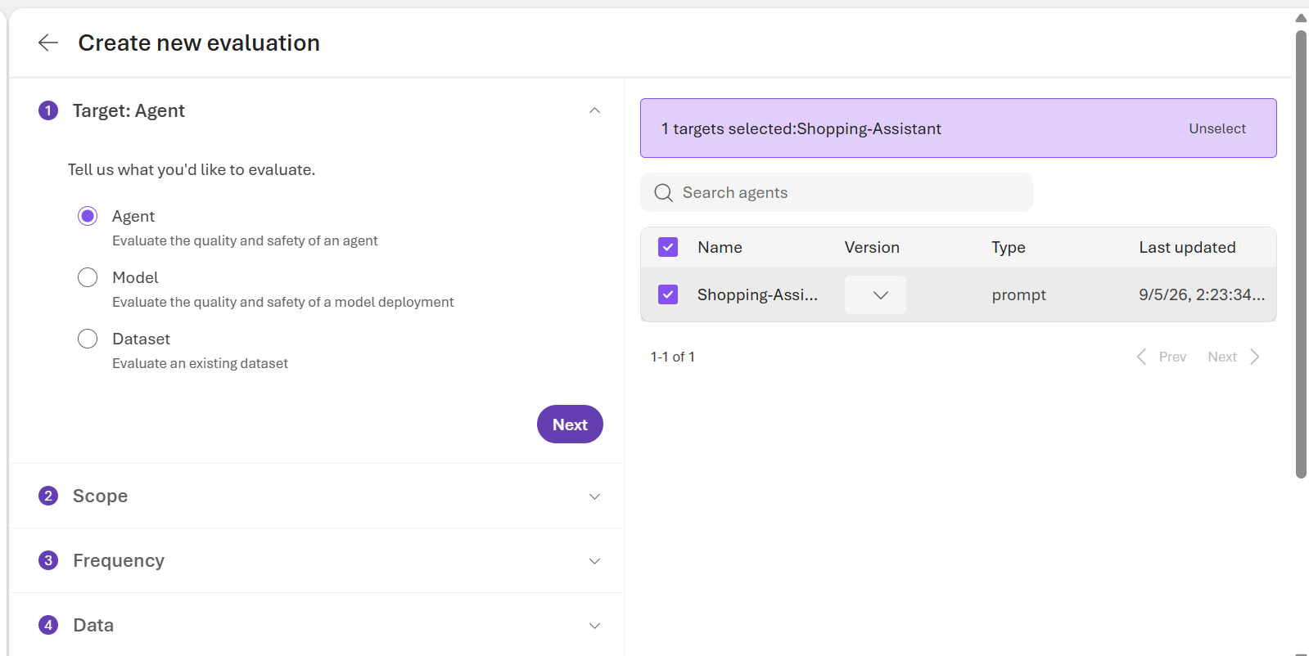
Demo 1 — Build & test the prompt agent
Keep the live build short; focus on the platform concepts
1. Agent
Prompt agent with retail instructions and a published version.
2. Tool
Attach custom OpenAPI retail tool using a connection.
3. Test
Use a realistic prompt: “Show me black running shoes under $120.”
Talking point: a prompt agent is declarative, versioned, and can be evaluated as a first-class Foundry asset.

Slide 27
Demo 2 — Observe the run before scoring it
Trace first: prove which tools were actually used
Prompt → model → search_products → candidate results → check_inventory → final answer
Tool selection
Inputs
Did it choose the retail API instead of web search?
Were color=black and max_price=120 passed correctly?
Outputs
Latency
Did the answer reflect actual product/inventory data?
Which model/tool step dominated response time?
Then open Monitor to connect the same agent behavior to tokens, latency, run success, evaluation metrics, and alerts.

Slide 28
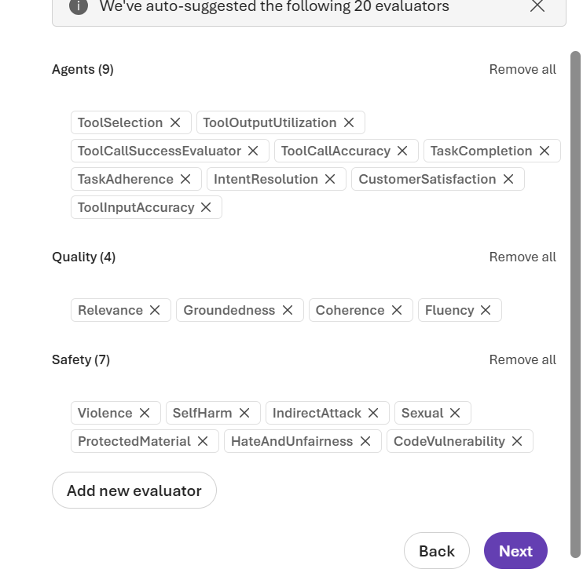
Demo 3 — Run a focused evaluation
Evaluate the agent, not just the underlying model
Target
Shopping-Assistant (Agent)
Scope + data
Individual turns + existing evaluation dataset
Criteria
System: Task Completion, Task Adherence, Intent Resolution
Quality: Relevance, Groundedness, Coherence, Fluency
Keep process/tool evaluators for a separate run so the result is easier to explain.

Slide 29
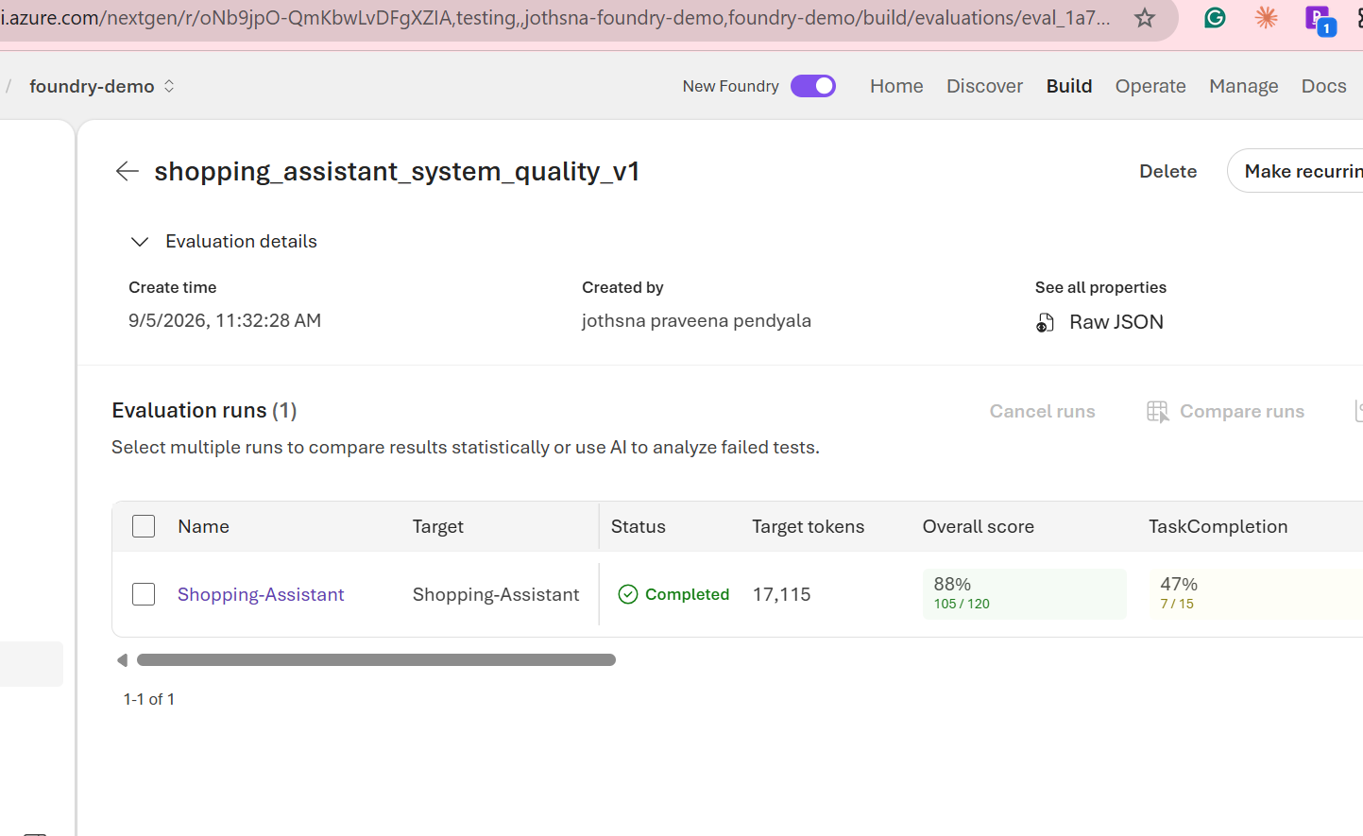
Demo 4 — Read the result, not just the headline score
A single aggregate can hide a critical production weakness
Overall
Task Completion
Task Adherence
88%
47%
80%
105 /120
7 /15
12 /15
Workshop insight
“88% looks healthy, but Task Completion is only 47%.”
Evaluation decomposes quality and points us to the exact behavior that needs improvement.
Next live step: open failed rows → inspect evaluator explanation → change prompt → save new version → Add run → Compare runs.

Slide 30
Production-ready Foundry checklist
What I want you to remember after the session
✓
Build
Choose prompt vs hosted intentionally; expose only necessary tools.
✓
Ground
Use authoritative tools for structured business data; retrieval for unstructured knowledge.
✓
Observe
Connect Application Insights; inspect traces before relying on final answers.
✓
Evaluate
Measure outcome + process + quality + safety with repeatable datasets.
✓
Version
Treat prompt/model/tool changes as releases; compare versions on the same suite.
✓
Operate
Use monitoring, recurring evaluation, alerts, and trace-derived regression cases.
Observe what the agent did. Evaluate whether it was acceptable. Feed failures back into the next version.

Slide 31
Microsoft Learn resources
Recommended follow-up reading after the workshop
Agent Service overview
Agent Monitoring Dashboard
learn.microsoft.com/en-us/azure/ai-foundry/agents/overview
learn.microsoft.com/en-us/azure/foundry/observability/how-to/how-to-monitor-agents-dashboard
Choose how to build
Run evaluations in the portal
learn.microsoft.com/en-us/azure/foundry/concepts/choose-build-approach
learn.microsoft.com/en-us/azure/foundry/how-to/evaluate-generative-ai-app
Agent development lifecycle
Agent evaluators
learn.microsoft.com/en-us/azure/foundry/agents/concepts/development-lifecycle
learn.microsoft.com/en-us/azure/foundry/concepts/evaluation-evaluators/agent-evaluators
Observability concepts
Evaluate deployed interactions
learn.microsoft.com/en-us/azure/foundry/concepts/observability
learn.microsoft.com/en-us/azure/foundry/observability/how-to/cloud-evaluation-deployed-interactions
Thank you · Questions?

Slide 32
