Slide 1


Agentic Platform Engineering
MCP and Agents Powering Autonomous Operations
Presented by
Jothsna, Senior Data Scientist
Dinah, Senior Data Scientist

Slide 2
The Reality of Modern Platform Operations
Modern enterprise platforms are
Distributed across microservices
Running on Kubernetes
Integrated with multiple APIs
Instrumented with metrics, logs, traces
Backed by multiple knowledge systems

Slide 3
But Incident Handling Still Looks Like This:
Alert fires
Engineer checks dashboard
Correlates metrics manually
Opens logs
The Core Issues
Signals are fragmented
Knowledge is scattered
Human cognitive load is high
MTTR depends on experience
Notes:
“Today’s platforms are incredibly sophisticated — distributed services, Kubernetes orchestration, API gateways, observability stacks.
But when something breaks, the process is still largely manual.
We move between dashboards, logs, and documentation.
The human becomes the correlation engine.”
Pause.
“Platform complexity has scaled.
Human reasoning capacity has not.”
That line is strong. Deliver it calmly.

Slide 4
The Shift: From Observability to Intelligence
Traditional model:
Alert → Human → Dashboard → Logs → Fix
Agentic model:
Alert → MCP → Agent → Decision → Action

Slide 5
MCP as a Universal Abstraction Layer
MCP Servers can connect to:
Operational Systems
Kubernetes
API Gateway
Metrics & Logs
Knowledge Systems
MongoDB
SharePoint
Confluence / Atlassian
Internal Wikis
Notes:
“Instead of humans stitching signals together,
we introduce an intelligence layer between telemetry and action.
MCP standardizes access to systems.
Agents reason across signals.
The platform becomes self-investigating.”
Pause.
“This is not replacing engineers.
It’s augmenting them.”

Slide 6
Use Case 1: Agentic Onboarding Buddy
Problem:
New joiners navigate fragmented systems.
Solution:
MCP-connected knowledge systems + AI agent.
Agent can:
Retrieve architecture docs
Explain deployment workflows
Summarize runbooks
Answer environment questions
Notes:
Instead of searching across Confluence, SharePoint, and databases,
a new joiner interacts with one intelligent interface.
The agent retrieves structured context via MCP
and provides guided assistance.”

Slide 7
Use Case 2: Agentic Platform Engineer
Scenario:
CPU spike
Pod restart loop
API latency surge
Agent flow:
Invoke MCP tools
Gather metrics & logs
Correlate signals
Explain root cause
Recommend remediation
Notes:
“The agent is not hallucinating.
It invokes MCP tools backed by real systems.
It correlates signals and produces explainable reasoning.”
Pause.
“This reduces MTTR dramatically.”

Slide 8
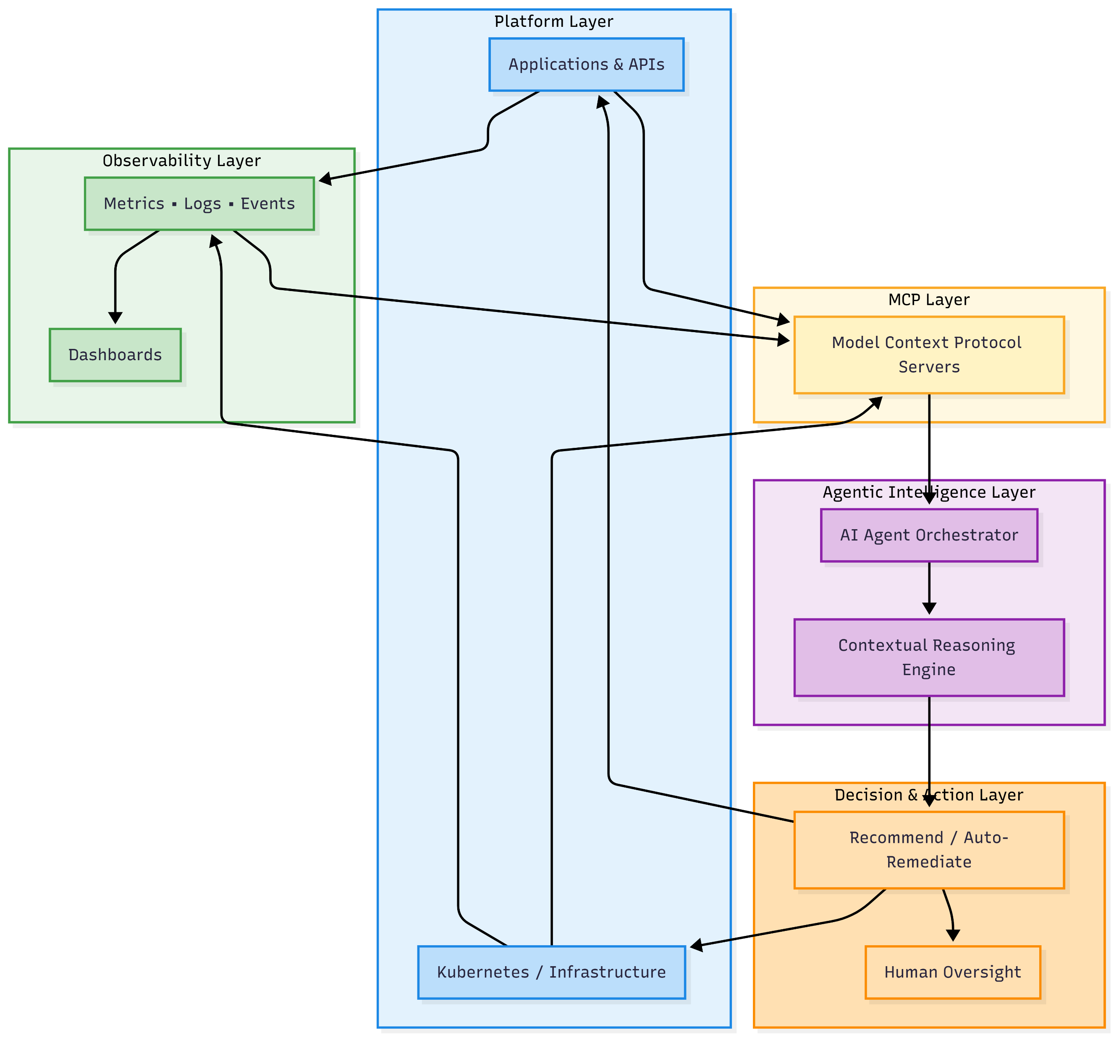

Slide 9
DEMO
https://techcohere-hbrv5z3trs9khdpuubpoya.streamlit.app/
https://techcohere-2gve77exrd26qr3du4wiyb.streamlit.app/

Slide 10
Operational Impact
Reduced MTTR
Lower cognitive load
Standardized incident handling
Faster onboarding
AI-augmented SRE

