Slide 1
Weekly Report 2020 CW 31
Hinweis
Um die Gestaltungsmöglichkeiten bei der Arbeit mit unseren IAV-Präsentationsvorlagen optimal auszuschöpfen und Designvorgaben einzuhalten, finden Sie im Intranet wichtige Gestaltungstipps und Beispielfolien:
https://intranet.iavgroup.local/c-cm1/de/leistungen/powerpoint/gestaltungsregeln.html
Internship:
„Localization Fusion Library“ / Supervisor: Robert Treiber & Ahmed Hussein
Mikel Zhobro, Dresden, 07/2020

Slide 2
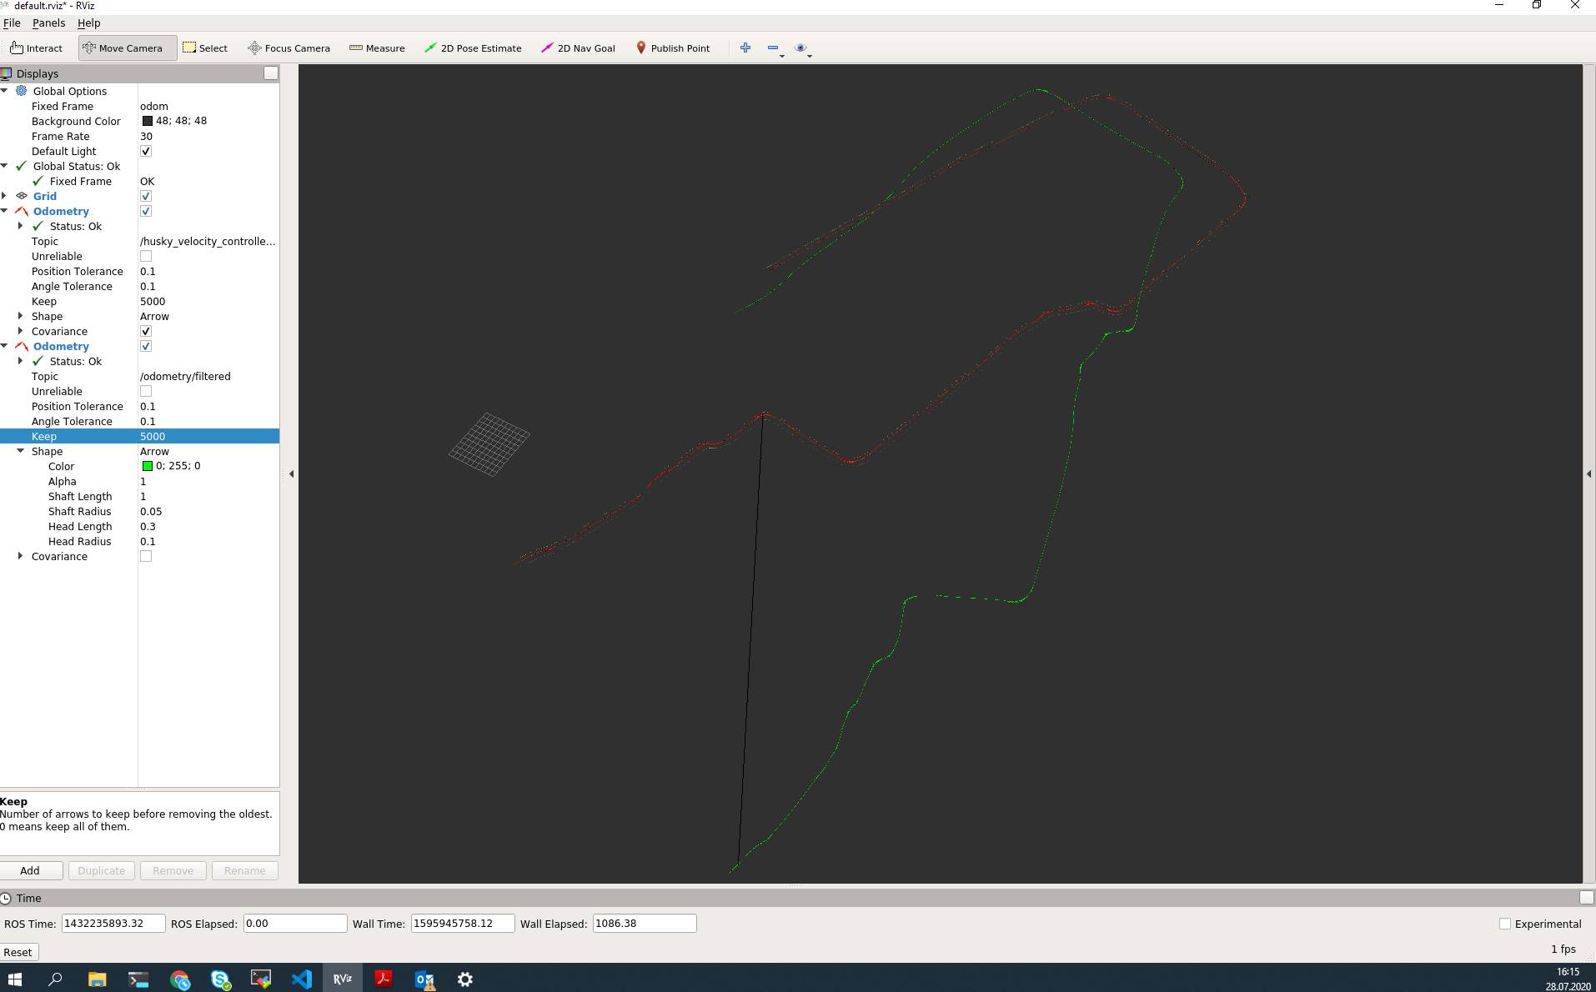
Main results
Organizational stuff, set up computer, WSL with Ubuntu, ROS
Looked into https://github.com/mherb/kalman for inspiration
EKF localization with robot_localization in ROS using a bag with a broken IMU + Encoder measurements

Slide 3
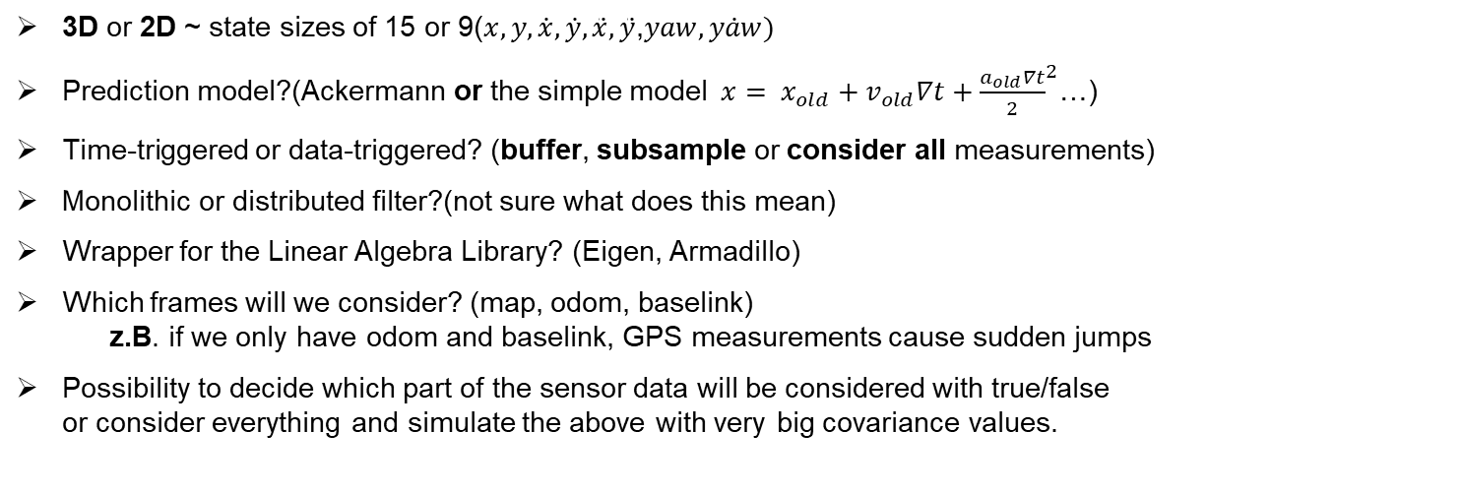
Open Points/Issues
3D or 2D ~ state sizes of 15 or 9($x,y,\dot{x},\dot{y},\ddot{x},\ddot{y}$,$yaw, \dot{yaw})$
Prediction model?(Ackermann or the simple model ${ x= x_{old}+v_{old}∇t+\frac{a_{old}∇t}{2}}^{2}$…)
Time-triggered or data-triggered? (buffer, subsample or consider all measurements)
Monolithic or distributed filter?(not sure what does this mean)
Wrapper for the Linear Algebra Library? (Eigen, Armadillo)
Which frames will we consider? (map, odom, baselink) z.B. if we only have odom and baselink, GPS measurements cause sudden jumps
Possibility to decide which part of the sensor data will be considered with true/false or consider everything and simulate the above with very big covariance values.

Slide 4
Time Plan
Create an UML describing the library
Write the library only for EKF and IMU first
Extend measurements with Wheel Encoder and GPS
Add UKF
Extend measurements with LIDAR
Enhanced EKF/UKF via Square Root Covariance (SQR-EKF/UKF)
Autodiff Library for the Jakobi-Matrixes?
IAV 07/2020 TI-F23

Slide 5
Next Week
Start building the UML for the library
Write a python script to create input-data for debugging

Slide 6
Mikel Zhobro
IAV GmbH
Kauffahrtei 25, 09120 Chemnitz mikel.zhobro@iav.de
www.iav.com

