Slide 1
Security Audit of OWASP Juice Shop
Major Project
Submitted By: Mehramjot Kaur
B.Tech Computer Science & Engineering
Cybersecurity Training and Internship Program
Tools Used
Kali Linux
Docker
Nmap
Burp Suite Community Edition
OWASP ZAP

Slide 2
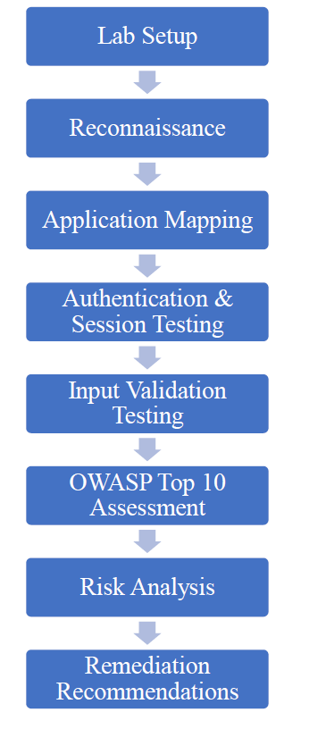
Project Overview & Objectives
Assessment Workflow
Scope
Practical security assessment of Juice Shop deployed via Docker on TCP port 3000. Testing performed locally from a Kali Linux VM.
Primary Objectives
Reconnaissance & application mapping
Authentication & session testing
Input validation and XSS/SQL checks
Assess selected OWASP Top 10 risks
Automated scanning and risk-based remediation recommendations

Slide 3
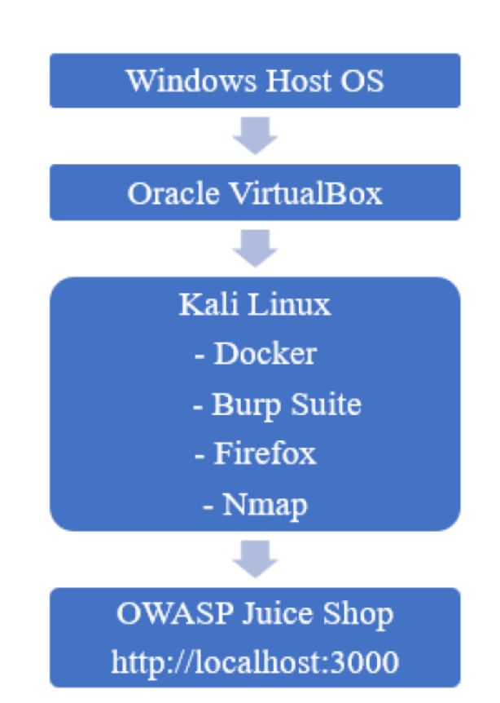
Lab Environment & Tools
Environment Architecture
Windows host → VirtualBox → Kali Linux VM hosting Docker. Juice Shop runs in a container exposed on localhost:3000. Testing performed with Burp Suite (proxy + manual interception), OWASP ZAP (automated passive scan), Nmap for network/service discovery, and Firefox for UI interaction.
Primary Tools & Purpose
Docker — Deploy Juice Shop container
Nmap — Port/service discovery and host fingerprinting
Burp Suite — Intercept, tamper, and manual testing
OWASP ZAP — Automated passive scanning and header analysis

Slide 4
Security Assessment Methodology
01
02
Phase 1 — Lab Setup
Phase 2 — Reconnaissance
Configure Kali, deploy Docker container, confirm application reachability.
Port scan, service enumeration, map application endpoints and pages.
03
04
Phase 3 — Authentication
Phase 4 — Input Validation
Registration, login, invalid credential behavior, session token review.
Test search, profile, address, registration inputs for injection and XSS.
05
06
Phase 5 — OWASP Top 10
Phase 6 — Findings & Remediation
Targeted manual tests supported by automated scans for configuration issues.
Risk analysis, prioritized recommendations, follow-up verification plan.

Slide 5
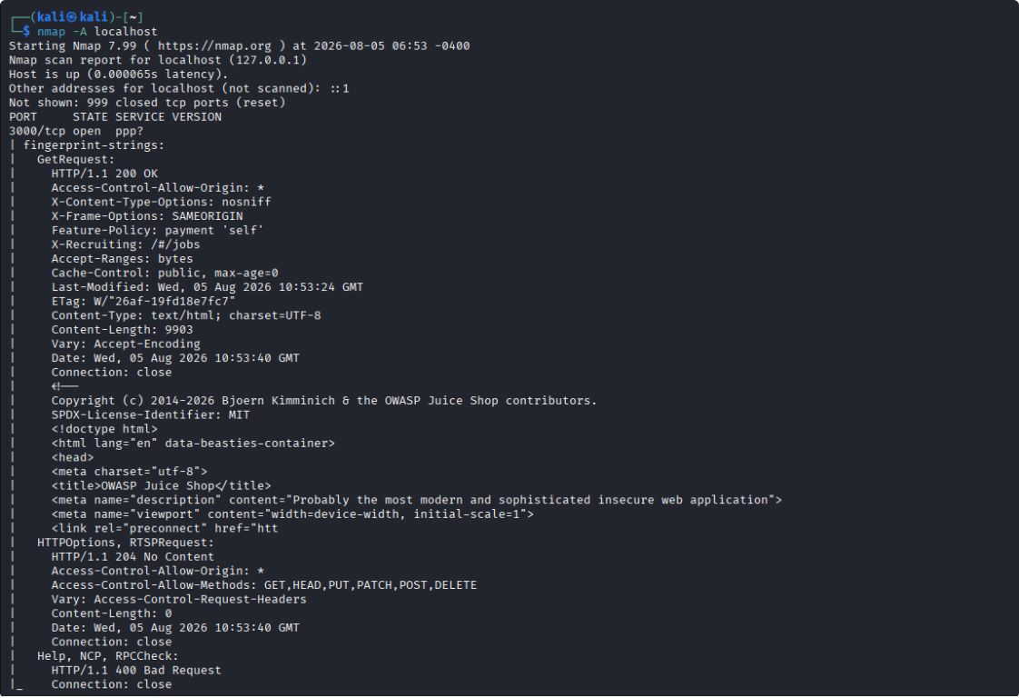
Reconnaissance & Application Mapping — Key Activities
Objective
Identify network services, ensure availability, enumerate accessible web endpoints prior to in‑depth testing.
Activities
Confirmed Juice Shop reachable at localhost:3000
Ran Nmap to discover open ports and HTTP service headers
Mapped primary pages (home, products, search, auth, profile, basket)
Notable Observations
HTTP headers present; security header review later in automated scan
Application fingerprinting consistent with Juice Shop deployment

Slide 6
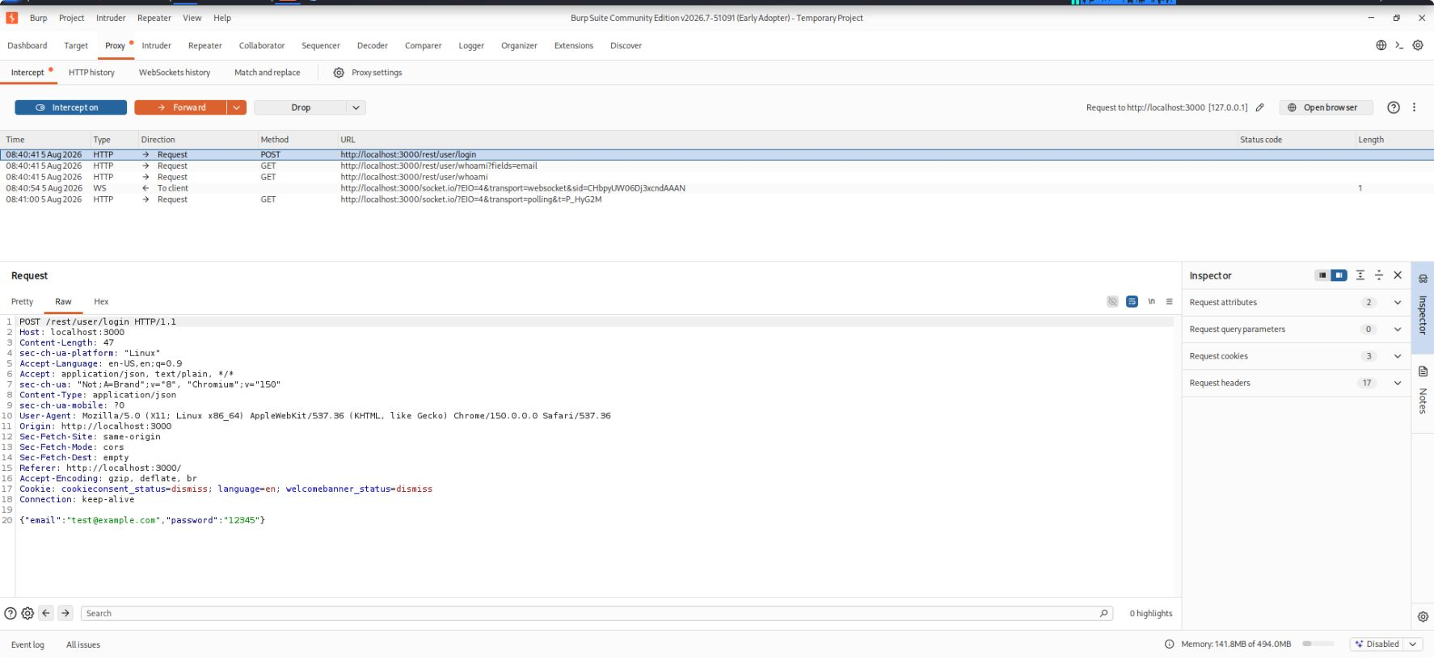
Authentication & Session Testing — Results
Registration & Login
Invalid Login Handling
Session Management
Registration and login flows succeed under normal inputs; controls for required fields enforced.
Generic authentication failure messages shown — reduces user enumeration risk.
Session tokens issued on login and invalidated on logout. Session persisted during normal operation.
Security observation: no obvious user enumeration. Recommend additional checks for token lifetimes, secure cookie flags (HttpOnly, Secure, SameSite), and session fixation protections.

Slide 7
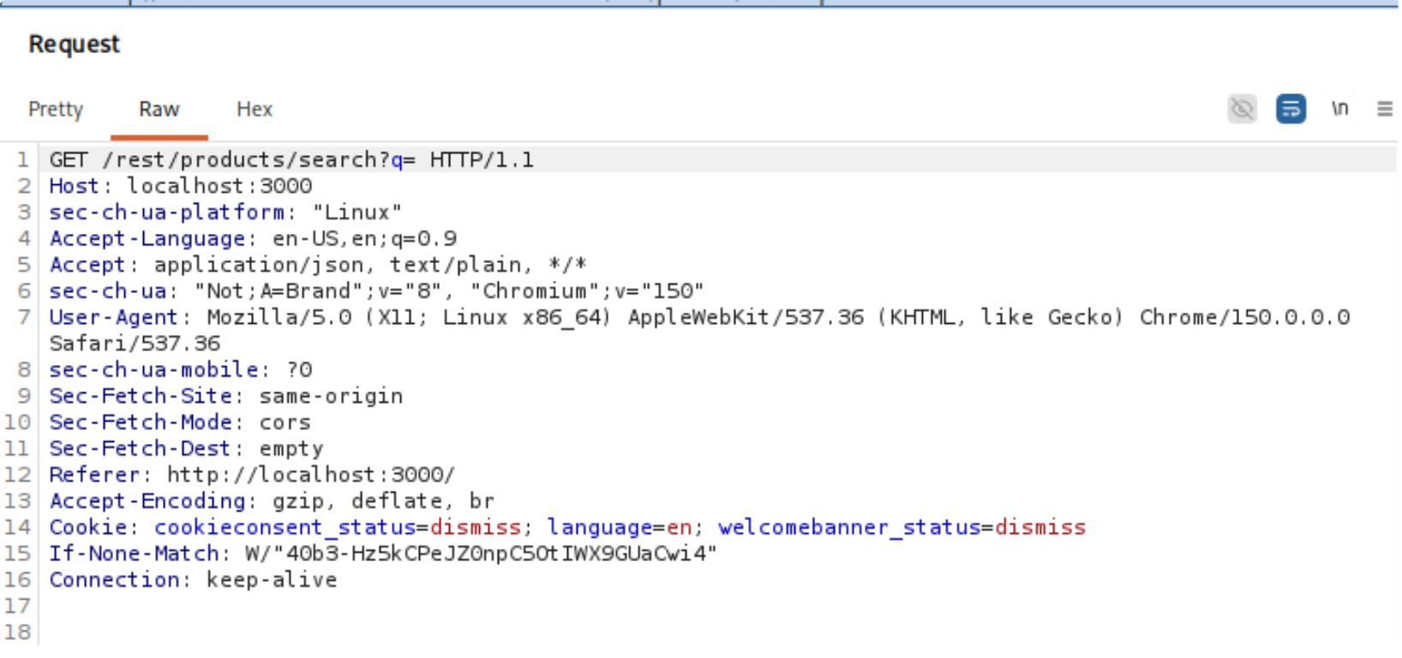
Input Validation Testing — Scope & Findings
Tested Components
Login and registration forms
Product search
Address management and profile update
Payloads Used
' OR 1=1 -- ; <script>alert(1)</script> ; special characters ; invalid email ; weak passwords
Results
No SQL injection observed with tested inputs
Stored/reflected XSS payloads did not execute in these tests
Email format and minimum password length validation enforce basic constraints
Application remained stable under tested inputs

Slide 8



OWASP Top 10 — Assessment Approach
Manual Testing
Automated Scanning
Coverage
Burp Suite used for targeted injection, logic, and session tampering tests.
OWASP ZAP passive scan for headers, configuration issues, and information disclosure.
Focus on authentication, session management, input validation, and security configuration (selected Top 10 categories).
Summary: Authentication and session handling validated; input validation controls observed. Automated scan highlighted header/configuration items for remediation review.

Slide 9
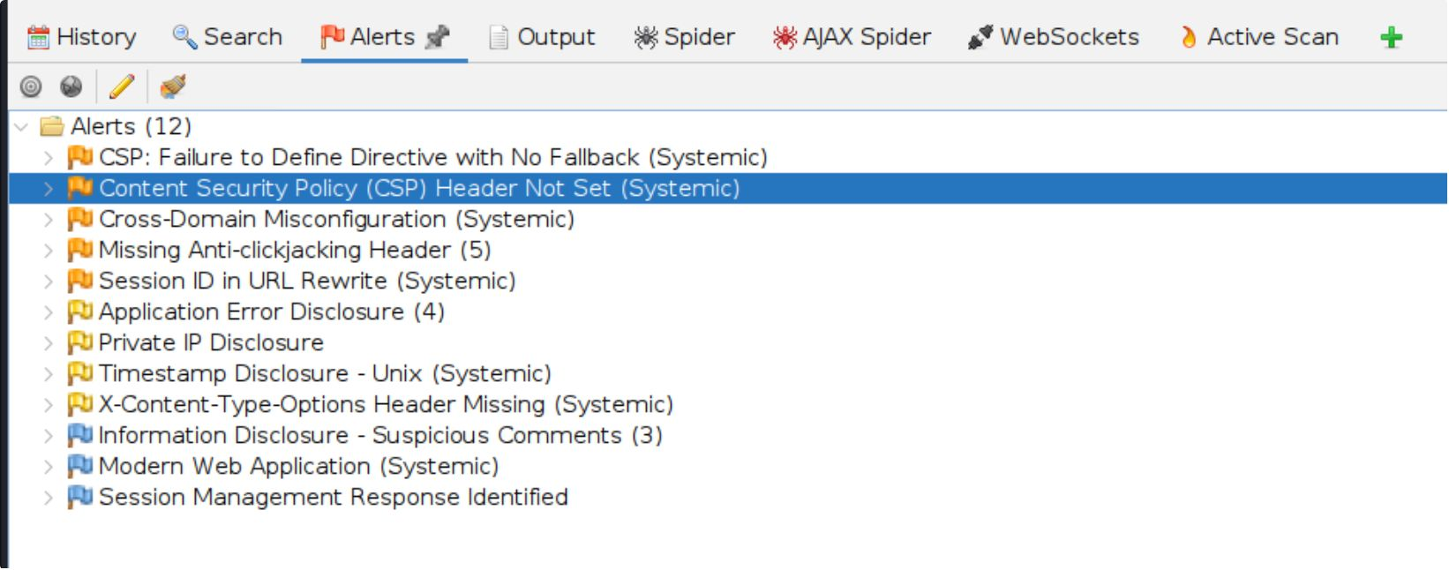
Automated Assessment — OWASP ZAP Findings
Scan Activities
Application crawling and passive scanning
HTTP security header analysis (CSP, HSTS, X-Frame-Options)
Configuration and information disclosure checks
Major Alerts
Missing or weak HTTP security headers (recommend CSP & HSTS)
Information disclosure in response headers or error pages
Configuration items marked as informational — review before production deployment

Slide 10
Findings & Vulnerability Matrix
Vulnerability Matrix
Risk Distribution
Finding
OWASP Category
Risk
Risk Level | Count
High | 0
Medium | 2
Low | 1
Informational | 2
Missing Content Security Policy Header
A05
Medium
Missing Anti-Clickjacking Protection
A05
Medium
Session Management Verification
A01
Low
Authentication Mechanism Verified
A07
Informational
Input Validation Assessment
A03
Informational

Slide 11


Recommended Security Improvements
High Priority
Medium Priority
Long-Term
Configure Content Security Policy (CSP)
Enable Anti-Clickjacking Protection
Strengthen server-side input validation
Improve session management
Review authentication policies
Reduce information disclosure
Conduct periodic penetration testing
Perform regular OWASP ZAP security scans
Keep dependencies updated
Integrate security into the SDLC (DevSecOps)
Follow OWASP Secure Coding Practices

Slide 12






Conclusion
Learning Outcomes
Project Summary
Successfully deployed OWASP Juice Shop.
Conducted manual security assessment using Burp Suite and Nmap.
Performed automated vulnerability scanning using OWASP ZAP.
Evaluated selected OWASP Top 10 categories.
Documented findings with supporting evidence.
Prepared remediation recommendations to improve application security.
Practical Web Application Security Testing
HTTP Traffic Analysis
Authentication & Session Testing
Input Validation Assessment
Automated Vulnerability Scanning
Professional Security Reporting

Slide 13
Thank You
Presented By
Mehramjot Kaur

