Slide 1
Normal Accidents
Living with High-Risk Technologies
... and why it matters to your company

Slide 2
Table of contents
Three Mile Island
Background
Chain of events
Prediction
Actual
Common language
Complexity & Coupling
Modularity
Mirroring Hypothesis
Conclusions

Slide 3
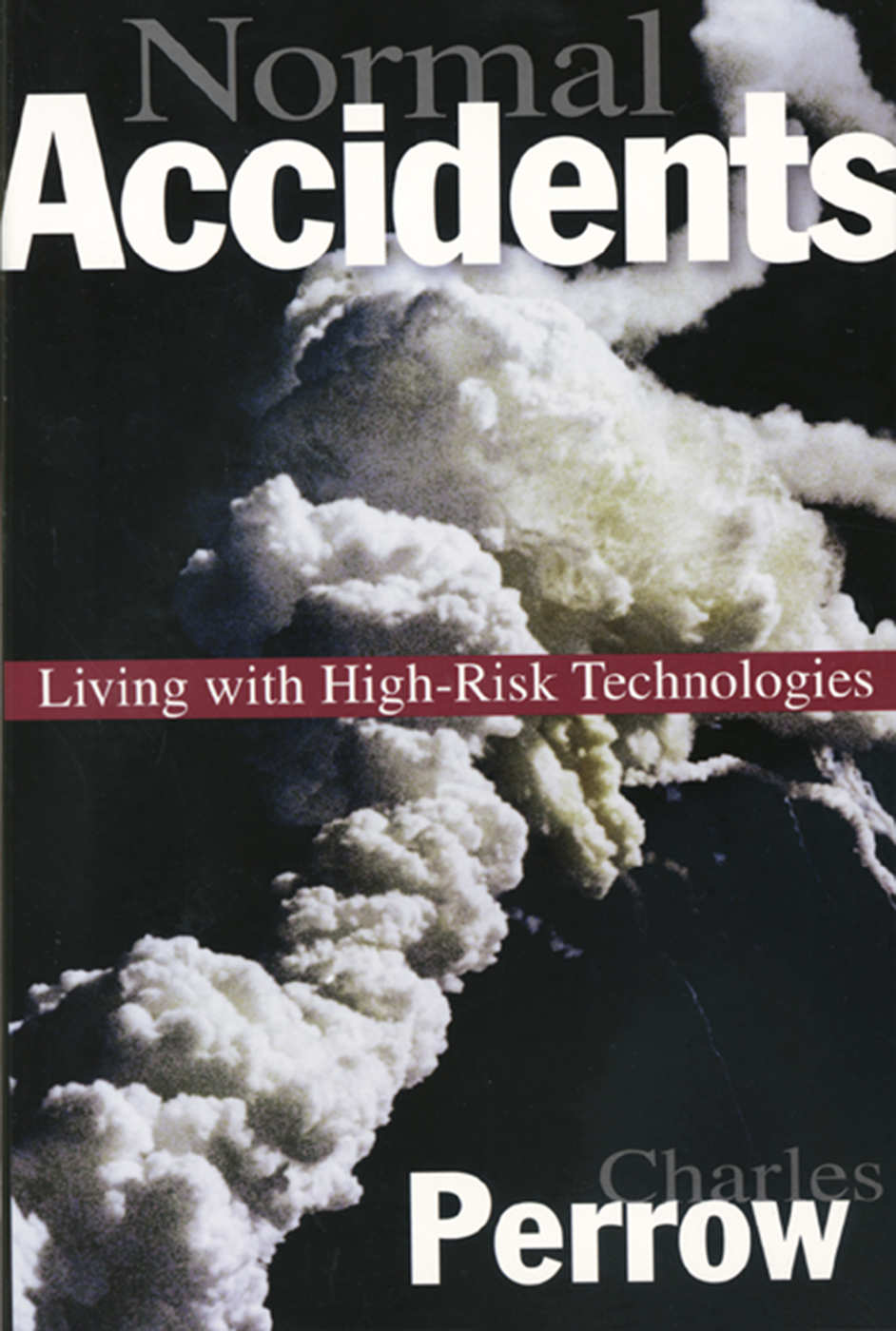
Normal Accidents
Living with High-Risk Technologies
Charles Perrow
Professor of Sociology at Yale
First published in 1984
ISBN 0-691-00412-9
It’s not light reading.
Heavily relies on anecdotes, which are interesting, but not the singular of data. However, there are a lot of them.
Covers
Nuclear
Air traffic control
Maritime navigation
Dams and mining

Slide 4
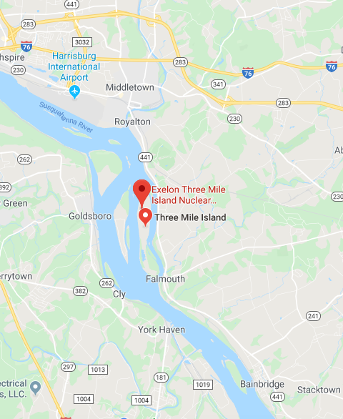
Three Mile Island
About
Two separate unites (TMI—1 & TMI-2) generating 852 MWe and 906MWe respectively
So named for being three miles downriver from Middletown, PA, a booming metropolis of 8,900 people as of 2010.
Populations of 211,000 within 10 miles and 2.8 million within 50 miles
History
Most infamous nuclear power generating station in the U.S.
TMI-2 began commercial operation on December 30, 1978.
March 28, 1979, partial meltdown of the reactor core
Released an estimated 43,000 curies (1.59 PBq) of radioactive krypton-85 gas.
Less than 20 curies (740 GBq) of the especially hazardous iodine-131
Notable
There is always a relevant XKCD.

Slide 5
Chain of events
Master Layout Slides
Root Cause Analysis
The conclusion of the President’s commission that investigated the Three Mile Island accident was that it was the result of human error, particularly on the part of the plant’s operators.
We can talk about the details, but honestly, it doesn’t matter because it will sound so familiar.
RESTR19790328
Bad news: Started with a blockage in what is called the plant’s polisher (a water filter). Polisher problems were not unusual or particularly serious.
Bad news: The blockage caused moisture to leak into the plant’s air system, inadvertently tripping two valves and shutting down the flow of cold water into the plant’s steam generator.
Good news: TMI had a backup cooling system for precisely this situation!
Bad news: But on that particular day the valves for the backup system weren’t open.
Bad news: They had been closed, and an indicator in the control room showing they were closed was blocked by a repair tag hanging from a switch above it.
Good news: The reactor had another backup system, a special sort of relief valve!
Bad news: The relief valve wasn’t working properly that day, either. It stuck open when it was supposed to be closed.
This box will not be visible in Slide Show mode or when printed.

Slide 6
Chain of events
Master Layout Slides
RESTR19790328 (cont’d)
Bad news: Despite the valve being stuck open, a light on the control panel ostensibly indicated that the valve was closed. In fact the light did not indicate the position of the valve, only the status of the solenoid being powered or not, thus giving false evidence of a closed valve..
Normal Accident
At 4:15 am radioactive material escaped containment.
We call these P0s
What caused the accident was the way minor events unexpectedly interacted to create a major problem.
... and there was no way the operators could have known about any of them!
No glaring errors or spectacularly bad decisions were made.
All the malfunctions were so trivial that individually they would have created no more than a nuisance.
This box will not be visible in Slide Show mode or when printed.

Slide 7
Does this sound familiar?
Master Layout Slides
All that is old is new again
“Large-break accidents require extremely fast reaction, which therefore must be automatically performed by the equipment. Lesser accidents may develop much more slowly and their control may be dependent on the action of human beings. This was the tragedy of Three Mile Island [...]”
Beating a...
“During the first few minutes of the accident more than 100 alarms went off and there was no system for suppressing the unimportant signals so that the operators could concentrate on the significant alarms. Information was not presented in a clear and sufficiently understandable form; [...]”
... dead horse
“But we have an overwhelming concern about some of the reports we have seen so far. While many of the proposed “fixes” seem totally appropriate, they do not come to grips with what we consider to be the basic problem. We have stated that fundamental changes must occur in organizations, procedures, and above all, in the attitudes of the people. No amount of technical “fixes” will cure this underlying problem.”
This box will not be visible in Slide Show mode or when printed.

Slide 8
“It suggests, for example, that the probability of a nuclear plant meltdown with dispersion of radioactive materials to the atmosphere is not one chance in a million a year, but more like one chance in the next decade.”
Charles Perrow, 1984

Slide 9
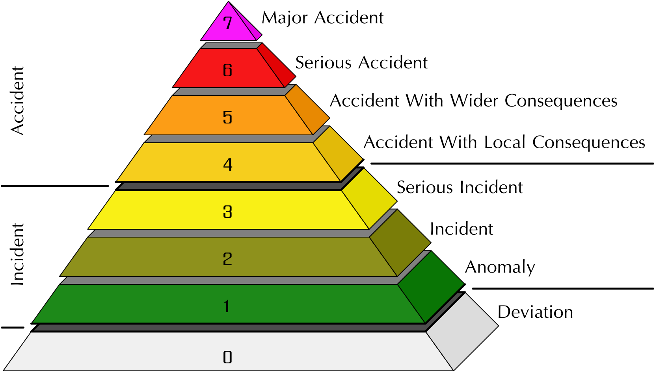
International Nuclear Event Scale
Scale is logarithmic
Prior to TMI in 1979 there were seven level 3 or above events with 5 dead and $2.4 billion in cleanup cost.
TMI cost $2.4 billion to cleanup.
1979 until 1986 a mere $2.9 billion in cleanup from a level 4, 2 and 0.
1986 – Big boom
Chernobyl is the first level 7.
$235-$500 billion in cleanup and at least 45 dead.
1987 until 2011 another $1.8 billion in cleanup from a straight flush of level 1,2,3 & 4
2011 – Fukushima – Nuclear tsunami flush
130-640 dead.
Estimated 1500 deaths due to evacuation.
Cleanup cost estimated at $180 billion.
Credit: By Silver Spoon (Own work) [CC BY-SA 3.0 (http://creativecommons.org/licenses/by-sa/3.0)], via Wikimedia Commons

Slide 10
Common Language
Master Layout Slides
Systems
The smallest element is a part
A unit is a collection of parts
A subsystem is a collection of units
Component and system are distinguished on the basis of whether or not interactions were expected or comprehensible to those who designed or operated the system
Accidents
Accident involves damage to a unit that disrupts the ongoing or future output of that system
If there is a problem, but no damage, then that is an incident
Accidents involve damage to systems or the system as a whole
Component failure accidents involve one or more component failure
System accidents involve the unanticipated interaction of multiple failures
Victims (we sometimes call these customers or employees)
First party victims are the operators of the system
Second party victims are associated with the system as suppliers or users but without influence over it
Third party victims are innocent bystanders (this is obviously management)
This box will not be visible in Slide Show mode or when printed.

Slide 11
Normal accidents
Master Layout Slides
There are three conditions that make a system likely to be susceptible to Normal Accidents.
The system is complex
Proximity of pieces that are not in a production sequence
Many common mode connections not in a production sequence
Unfamiliar or unintended feedback loops
Indirect or inferential information sources
Limited understanding of some processes
The system is tightly coupled
Tight coupling is a mechanical term meaning there is no slack or buffer or give between two items. What happens in one directly affects what happens in the other.
Loosely coupled systems tend to have ambiguous or flexible performance standards, and they may have little consumer monitoring, so the absence of the intended connection can remain unobserved.
The system has catastrophic potential
No one gets paid.
This box will not be visible in Slide Show mode or when printed.

Slide 12
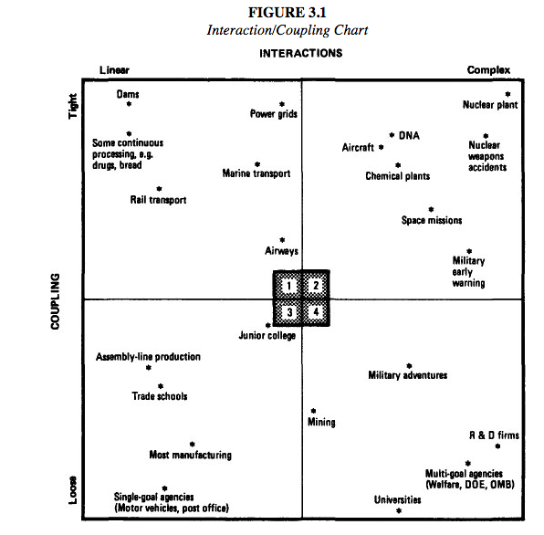
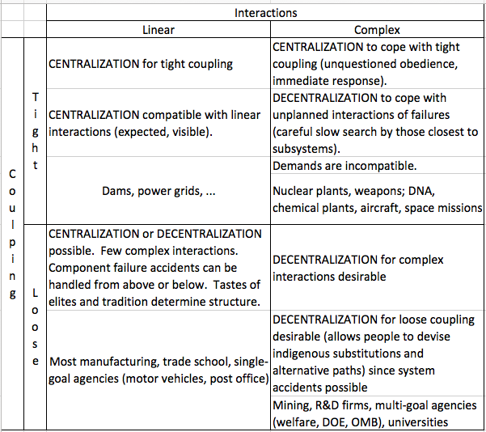
Linear & Complex vs Tight & Loose
Let’s play “spot the bias”

Slide 13
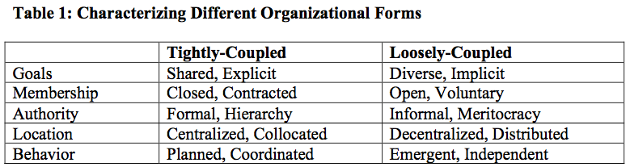
Product and Organizational Architectures
Master Layout Slides
“Any organization that designs a system will inevitably produce a design whose structure is a copy of the organization’s communication structure” (Conway, 1968).
Modular designs are loosely-coupled in that changes made to one module have little impact on the others.
Modularity promotes loose coupling, so that errors do not interact and cascade through the system.
This box will not be visible in Slide Show mode or when printed.

Slide 14
Exploring the Duality Between Product and Organizational Architectures: A Test of the Mirroring Hypothesis.
Master Layout Slides
A variety of studies have examined the link between a product’s architecture and the characteristics of the organization that develops it.
Software products can be processed automatically to identify the dependencies that exist between their component elements (something that cannot be done with physical products).
These dependencies, in turn, can be used to characterize a product’s architecture, by displaying the information visually and by calculating metrics that capture the overall level of coupling.
Design Structure Matrix (DSM).
A DSM highlights a design’s structure by examining the dependencies that exist between its constituent elements in a square matrix.
A key contribution of the DSM literature has been in showing that modularity depends not only on the number of dependencies between elements, but also on their pattern of distribution.
”Mirroring” Hypothesis
Loosely-coupled organizations will tend to develop products with more modular architectures than tightly-coupled organizations.
This box will not be visible in Slide Show mode or when printed.

Slide 15
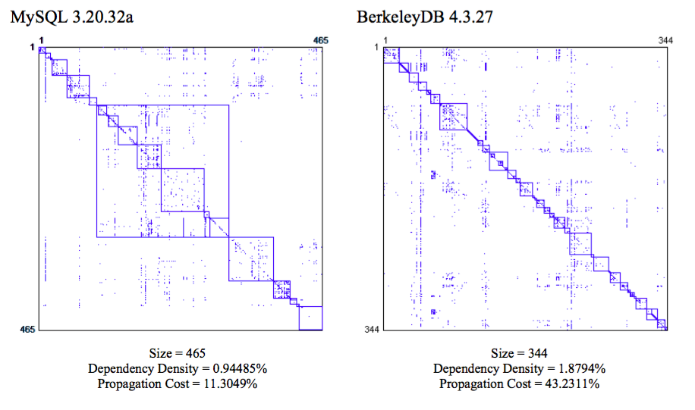
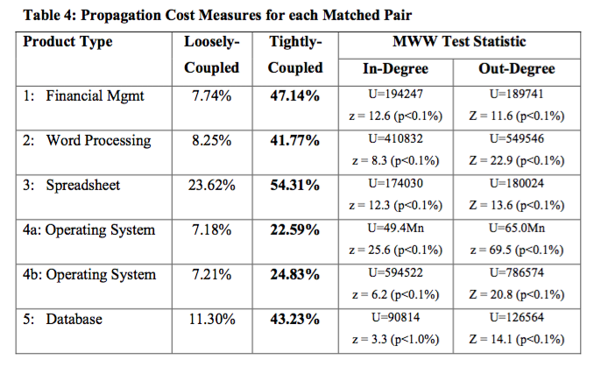
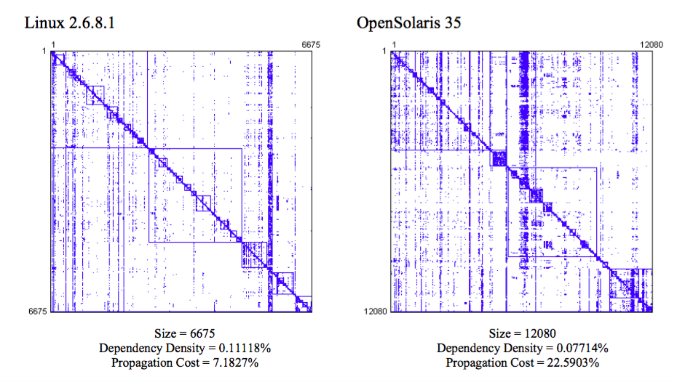
Propagation costs
Propagation Cost. Intuitively, this metric captures measures the percentage of system elements that can be affected, on average, when a change is made to a randomly chosen element.
Mann-Whitney-Wilcoxon (MWW) test of differences in means.
This box will not be visible in Slide Show mode or when printed.

Slide 16
The Duality Between Product and Organizational Architectures
Master Layout Slides
Results
The architectures of the products will differ significantly due to the form of the organization.
Open source software products are likely to be more modular than commercial software products.
Very high propagation cost suggests it is the pattern of dependencies, and not the number of them, that drives a high level of coupling between components.
Early design choices have a profound impact on a system, however, as the system grows, the organizational form during development plays an increasingly large role.
This highlights the impact of organizational design decisions on the structure of the software that will be developed.
This box will not be visible in Slide Show mode or when printed.

Slide 17
Conclusions
Master Layout Slides
Complexity is the enemy of reliability
Until we prioritize simplicity in design and implementation our System Accidents will all be Normal Accidents
Automation and process improvements only slow down the inevitable, they will never solve the problem
Become more loosely coupled (increased modularity)
Modularity decreases dependencies
Reduces propagation cost
Improves reliability
Our organizational structure causes bugs
Increasing co-location and hierarchy provably leads to
Tightly coupled systems
Reduced modularity
Inner source has to be a priority
Increases modularity
Leads to loose coupling
Reduce Complexity
There must be a sustained focus on creating linear relationships
Companies are terrible at doing things that are hard organizationally
This box will not be visible in Slide Show mode or when printed.

Slide 18
References
Nuclear and Radiation Accidents and Incidents (Wikipedia)
MacCormack, A.; Rusnak, J.; Baldwin, C.Y.; 2007b: The Impact of Component Modularity on Design Evolution: Evidence from the Software Industry. Working Paper 08-038, Harvard Business School; http://www.hbs.edu/research/pdf/08-038.pdf
MacCormack, A.; Rusnak, J.; Baldwin, C.Y.; 2007a: Exploring the Duality Between Product and Organizational Architectures: A Test of the Mirroring Hypothesis. Working Paper 08-039, Harvard Business School; http://www.hbs.edu/research/pdf/08-039.pdf
Software Failures, Security, and Cyberattacks. Charles Perrow 3/31/08
Three Mile Island Accident (Wikipedia)
The Guardian, Nuclear power plant accidents: listed and ranked since 1952
The Report Of The President’s Commission On The Accident At Three Mile Island
... and obviously the book
... and many more
This box will not be visible in Slide Show mode or when printed.

Slide 19
Appendices

Slide 20
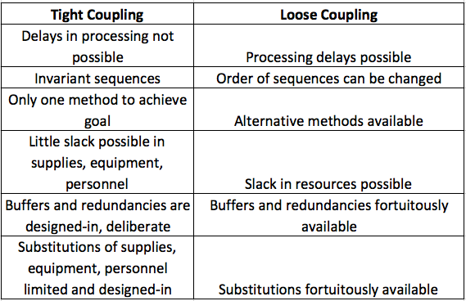
Coupling Explanation

