Slide 1

Help a Pokémon Trainer with a Deep Learning
Our Approach ?
Train a model to predict the outcome of battles.
Simulate all battles between available Pokémons at the enemy.
Use Dynamic Programming to determine the best team.
It’s clean and it works !
The entire model fits in one notebook.
Scikit-learn preprocessing pipeline makes modifications easy.
No complicated preprocessing needed.
Model is easily generalizable to other problems.
Fast to train, in comparison to sequential models.
Measured RMSE of 0.065 on test set !
Our prediction model?
Neural Network with 3 x 200 nodes.
Numerical data is normalized and categorical data is embedded.
Our selection Algorithm?
xxx

Slide 2
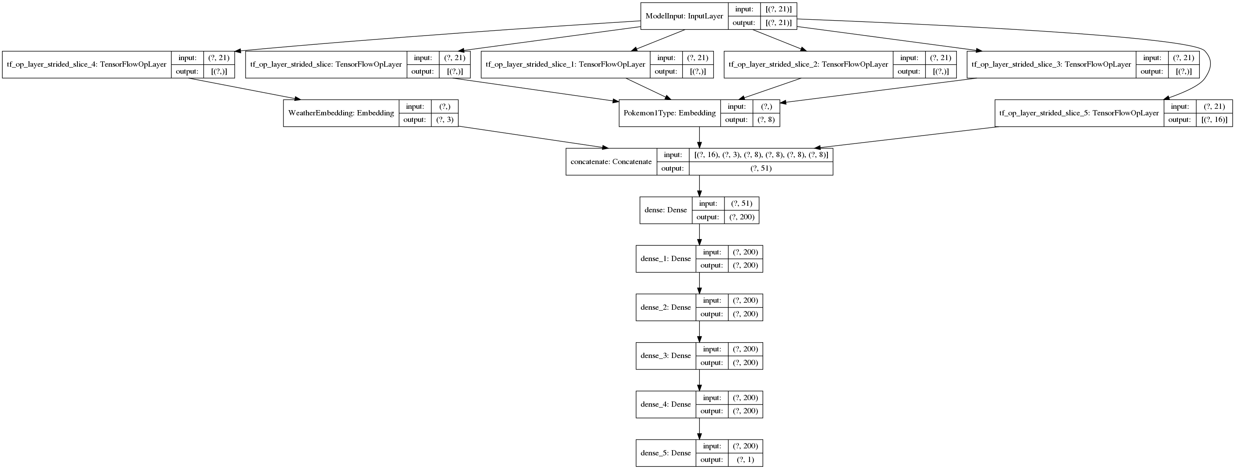
Details ?

