Slide 1
Case Study 2 Attrition at DDS Analytics SMU - DDS 6306
Jeremy Otsap

Slide 2
Intro
We are looking to understand the cause for attrition at DDS Analytics in hopes of retaining talent.
Additionally salary is hypothesized as one of the main factors in employee attrition, and as such DDS Analytics would like to
Validate or refute this hypothesis
See if salary can be predicted from the other employee attributes

Slide 3
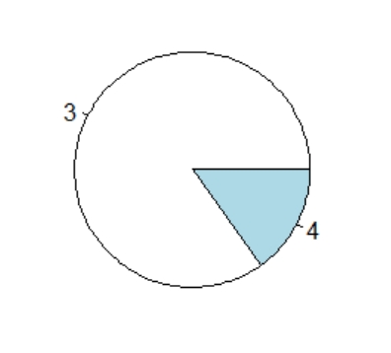
Immediate Issues with the Data Set
Repeating Values
Over18: every entry had “Y” for this category
EmployeeCount: every entry had 1
StandardHours: every entry had 80
Corrupt Values
PerformanceRating: only 3’s and 4’s
Unclear Meaning
HourlyRate
DailyRate
MonthlyRate

Slide 4
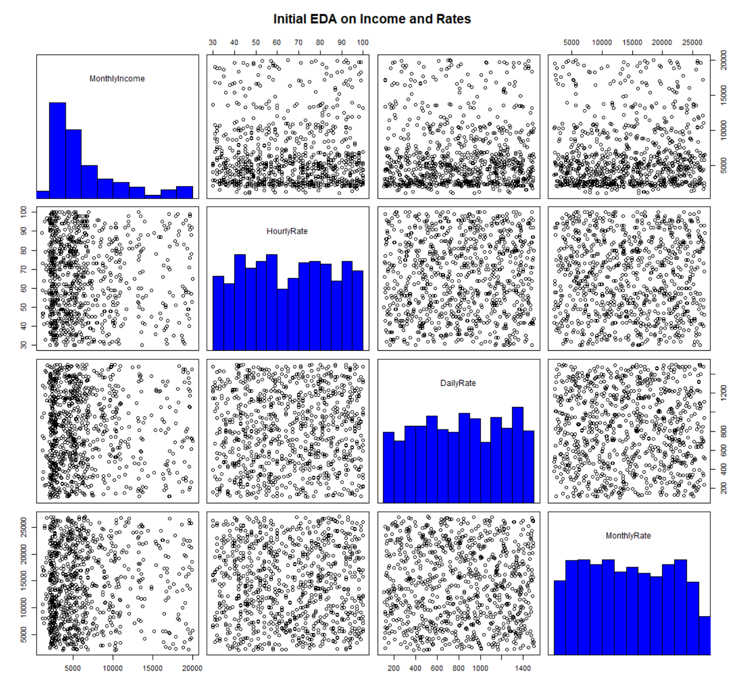
Hourly, Daily, Monthly Rates
No clear definition of these variables, how they relate to each other or the employee
As shown no relationship exists between each other, nor employee salary
Thus removed from analysis

Slide 5
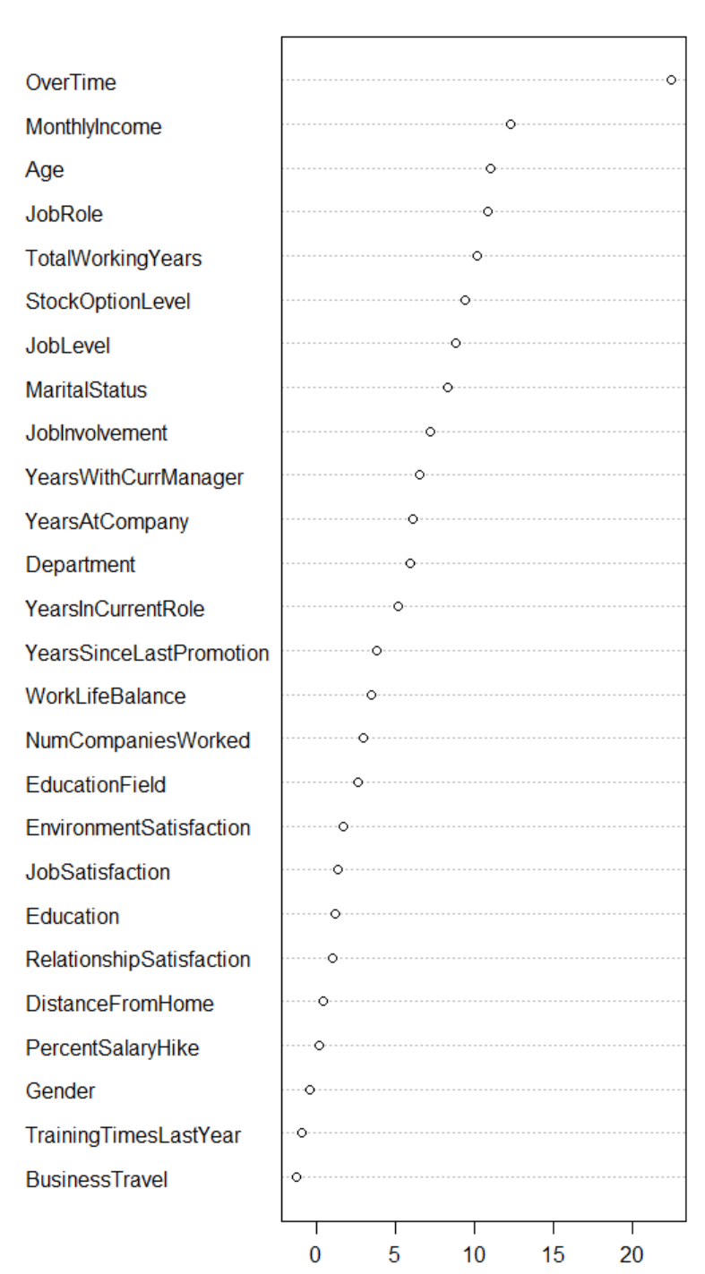
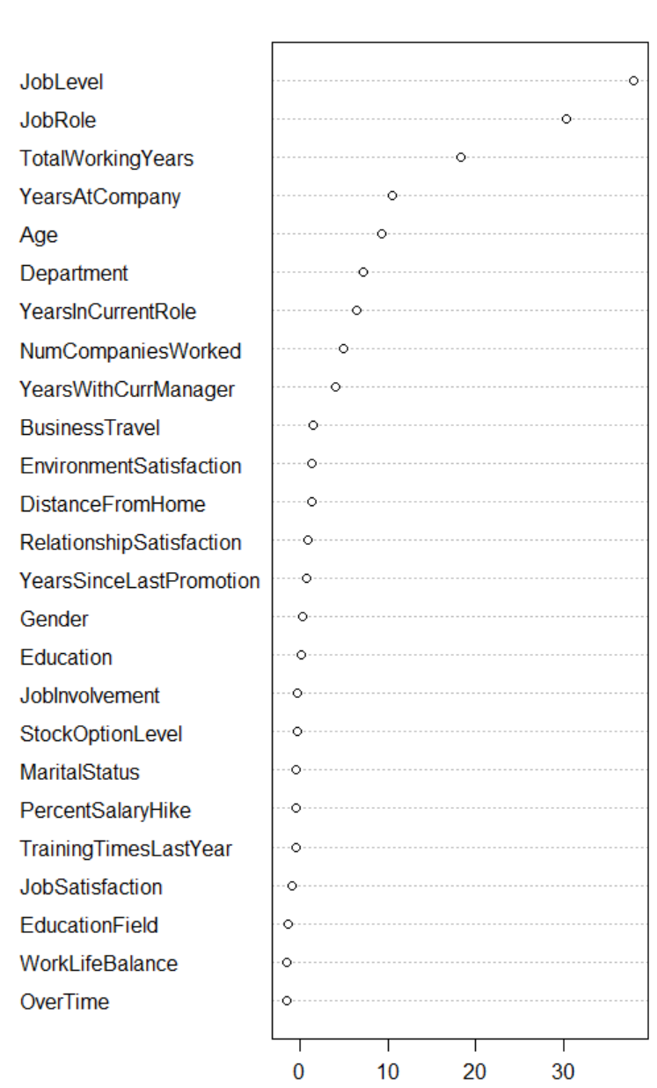
Random Forest: Feature Engineering
Attrition
Salary

Slide 6
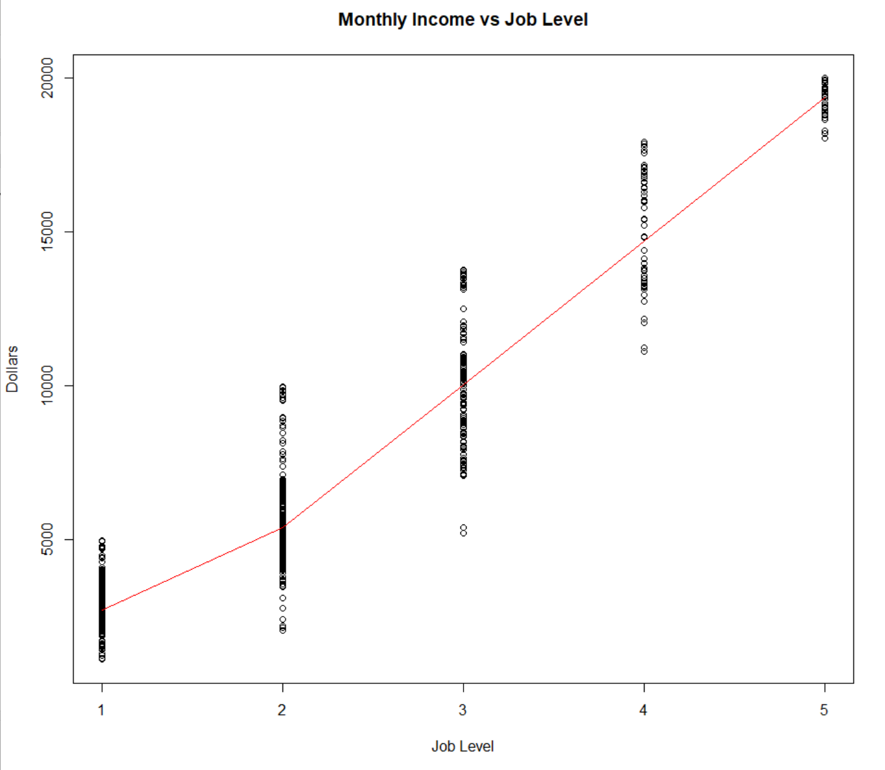
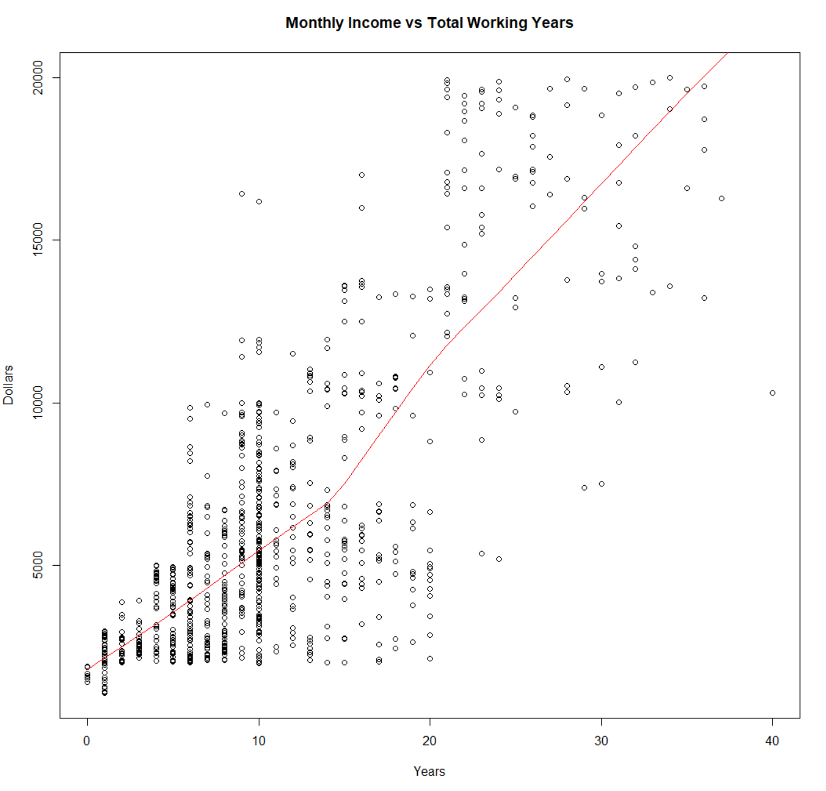
Monthly Income Numerical Factors
Job Level
Total Working Years

Slide 7
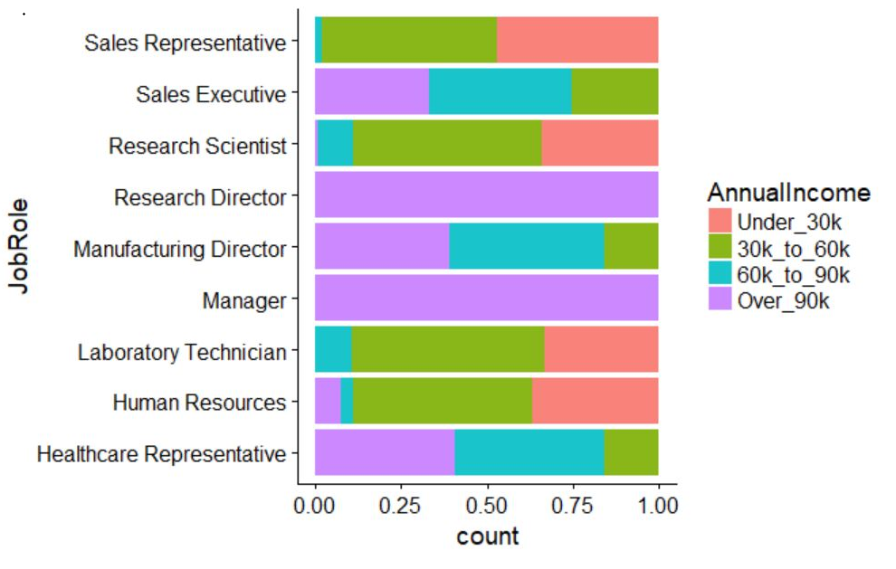
MonthlyIncome: Categoric Factor
JobRole
Low Income
Sales Rep
Research Scientist
Lab Tech
HR
High Income
Sales Exec
Research Dir
Manufacturing Dir
Manager
Healthcare Rep

Slide 8
Models for MonthlyIncome
Linear Regression
Random Forest
Metric | Score
RMSE | $1377.65
Adjusted R-squared | 0.9128
Prediction Error | 0.2112216
Metric | Score
RMSE | $1066.143
Adjusted R-squared | 0.9465
Prediction Error | 0.1651993
Important Features:
BusinessTravel: Travel_Rarely
DistanceFromHome
EducationField: Marketing
JobLevel
TotalWorkingYears
YearsWithCurrManager
Top 6 most influential were:
JobLevel
JobRole
TotalWorkingYears
YearsAtCompany
Age
Department

Slide 9
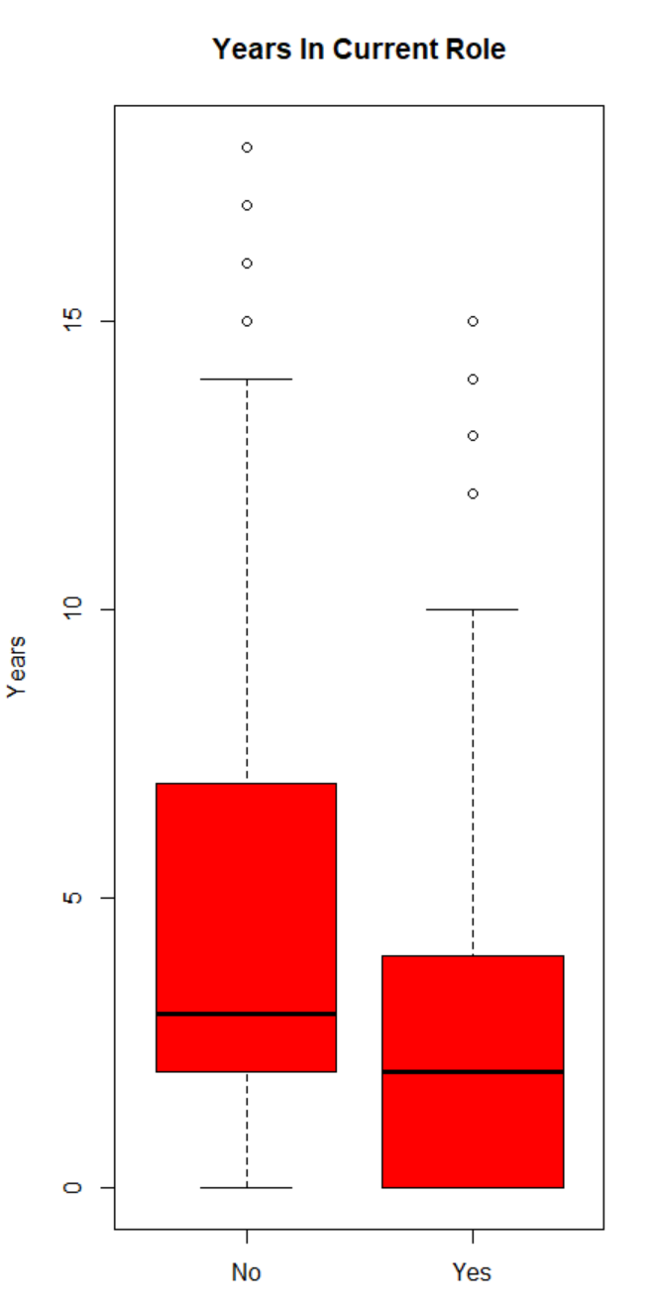
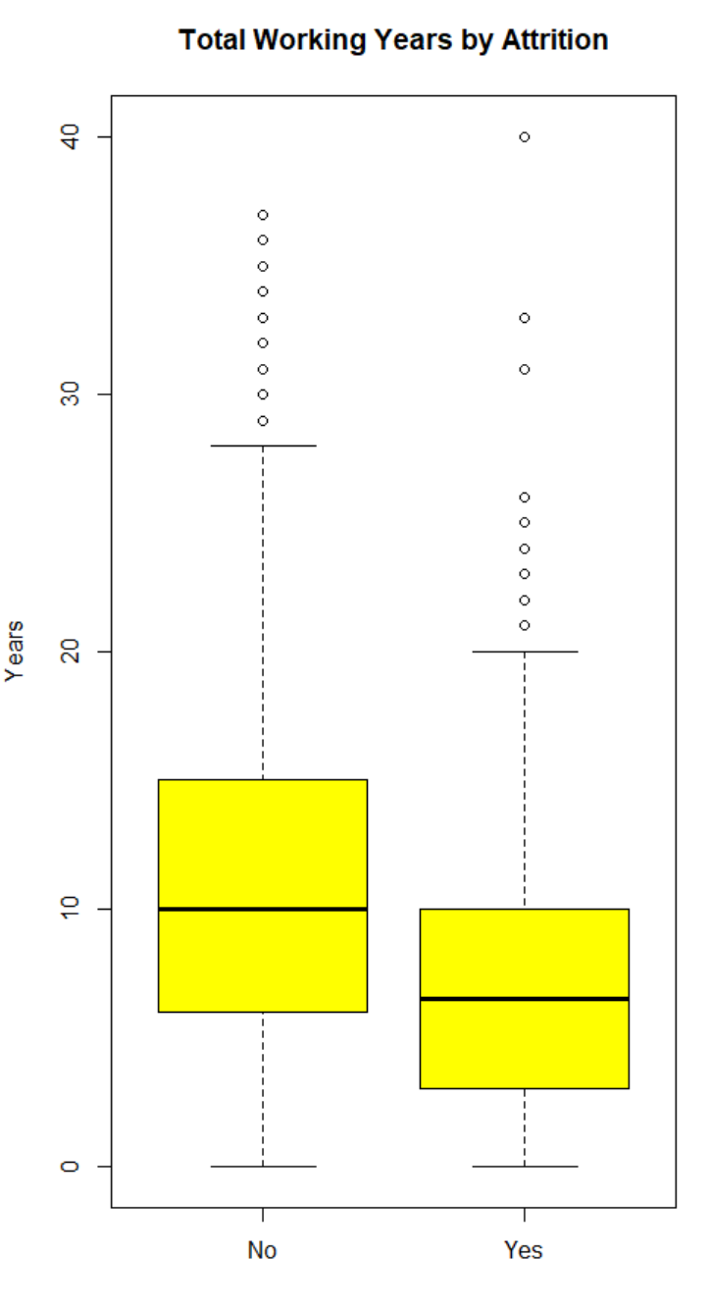
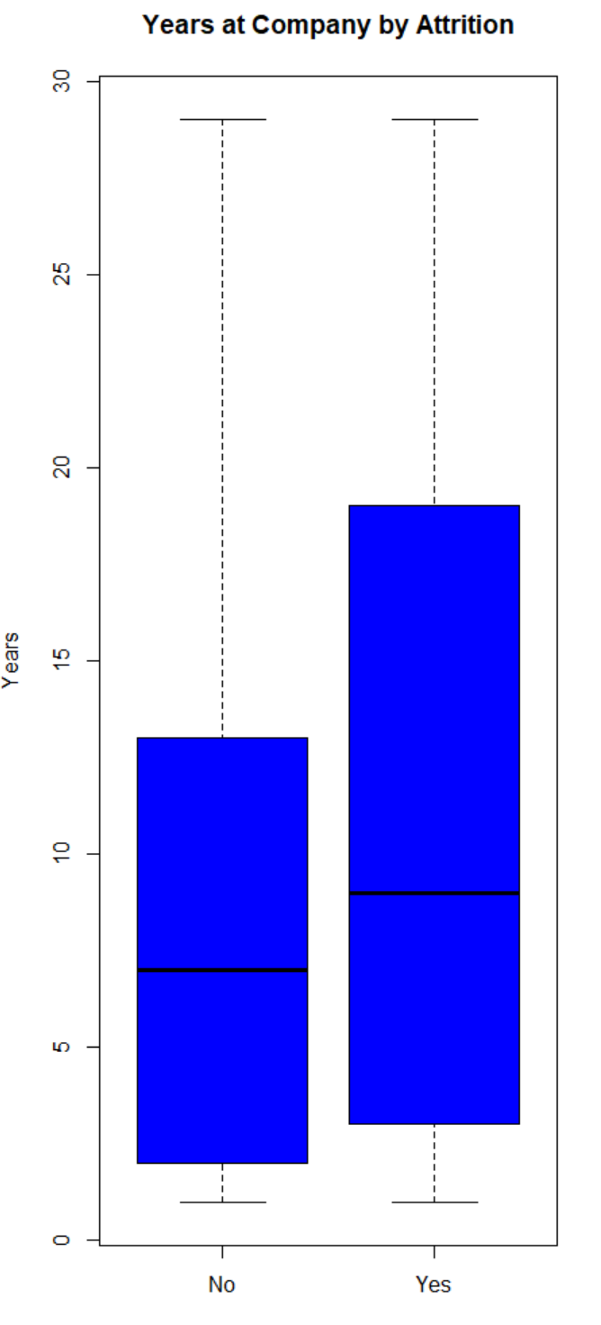
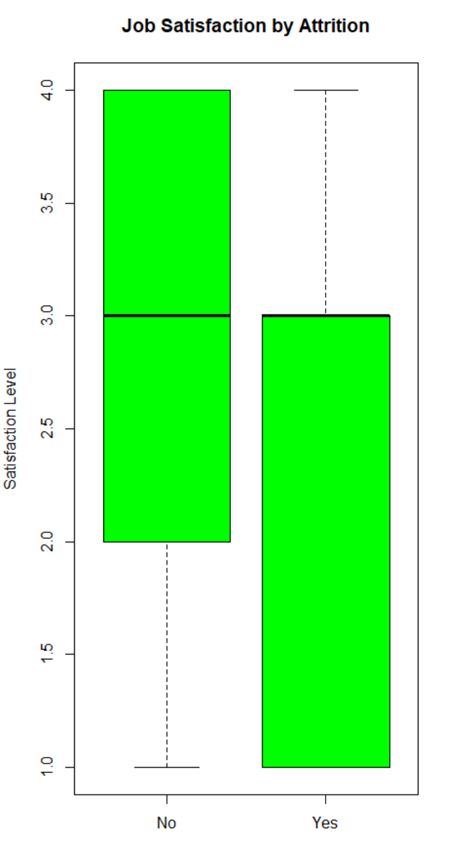
Numerical Factors For Attrition

Slide 10
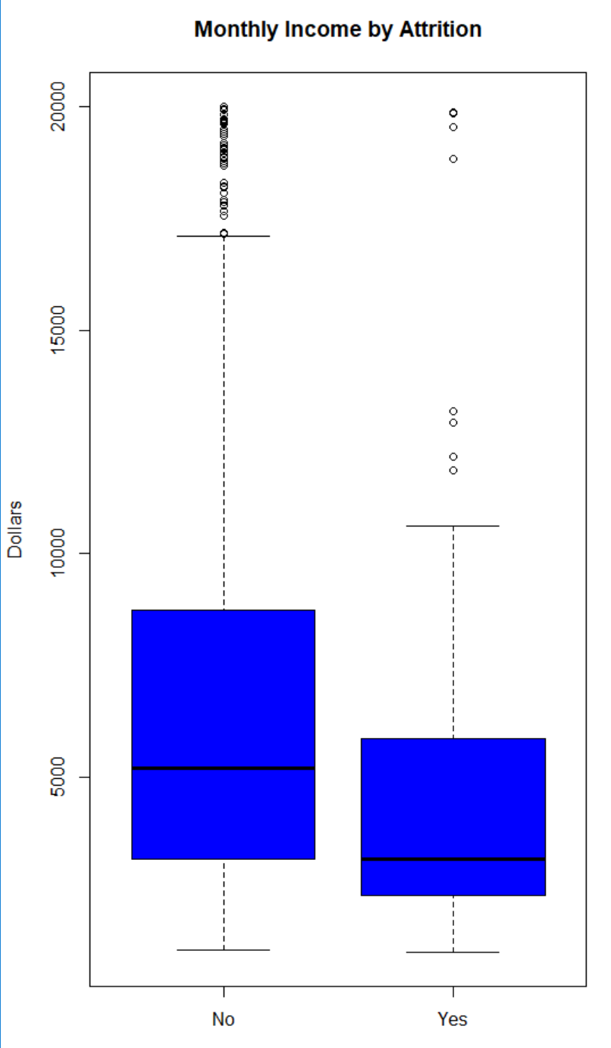
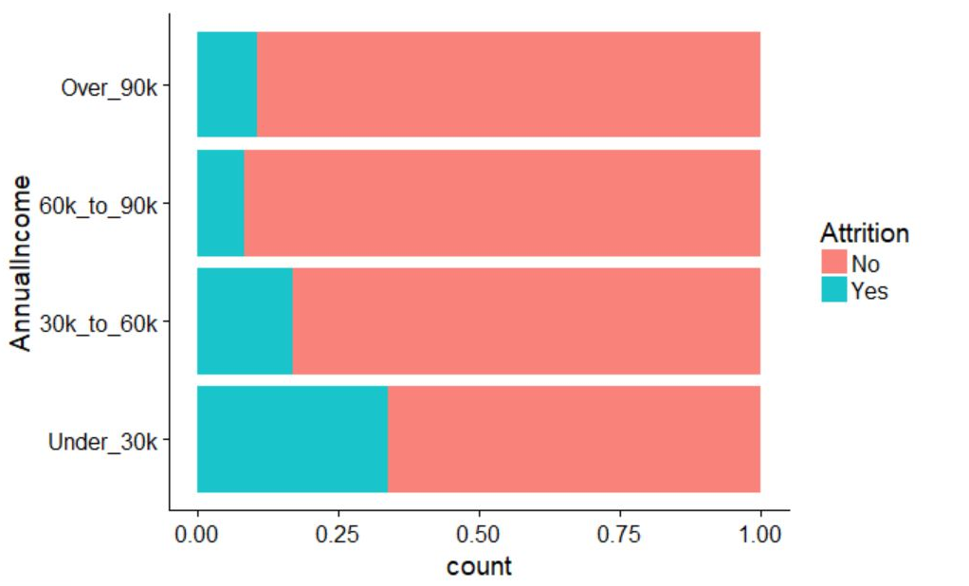
MonthlyIncome vs Attrition
T-Test shows significant difference p-value < 0.0001

Slide 11
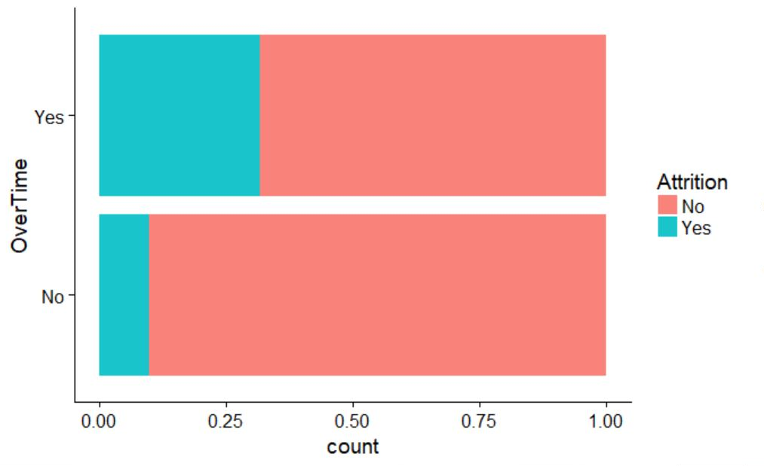
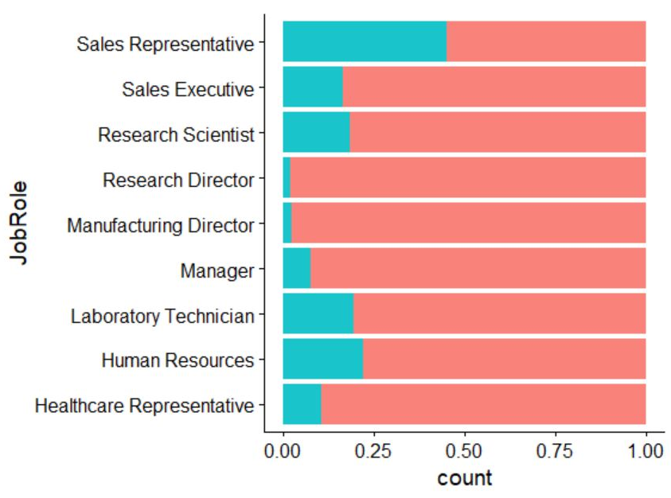
Categorical Factors For Attrition
OverTime
JobRole
OverTime
Yes: 172 stay vs 80 leave
No: 60 stay vs 558 leave

Slide 12
Models for Attrition
KNN
Random Forest
OBSERVED
OBSERVED
 | NO | YES
NO | 145 | 1
YES | 21 | 7
 | NO | YES
NO | 144 | 2
YES | 21 | 7
PREDICTED
PREDICTED
Accuracy : 0.8736
Sensitivity : 0.8735
Specificity : 0.8750
Accuracy : 0.8678
Sensitivity : 0.8727
Specificity : 0.7778

Slide 13
Conclusion
For determining Attrition, the most likely profile based on our analysis is the following.
Candidates with "Yes" in the OverTime field are more likely to leave. We are assuming these are non-exempt employees, however this is not explicitly stated for the data set
Candidates that make less than $30,000 per year are more likely to leave. There is evidence of a correlation between MonthlyIncome and Attrition
JobRoles can effect in both ways. Sales Reps are more likely to leave, while Research and Marketing Directors are more likely to stay
MaritalStatus can also effect in both ways. Single employees are more likely to leave, while Divorced employees are more likely to stay

