Slide 1
DS 6373 Time Series
Project A
Jeremy Otsap jotsap@mail.smu.edu
Spencer Fogelman sfogelman@mail.smu.edu

Slide 3
State | Data Points
AK | 260
AL | 259
AR | 260
AZ | 262
CA | 262
CO | 262
CT | 259
DC | 261
DE | 260
FL | 297
GA | 262
HI | 262
IA | 260
ID | 259
IL | 262
IN | 268
KS | 260
KY | 260
LA | 259
MA | 304
MD | 261
ME | 259
MI | 265
MN | 260
MO | 259
State | Data Points
MS | 259
MT | 259
NC | 262
ND | 259
NE | 280
NH | 262
NJ | 285
NM | 261
NV | 261
NY | 262
OH | 261
OK | 259
OR | 262
PA | 260
RI | 265
SC | 262
SD | 259
TN | 261
TX | 262
UT | 259
VA | 268
VT | 263
WA | 304
WI | 263
WV | 260
WY | 259

Slide 4
Initial Data Exploration

Slide 5
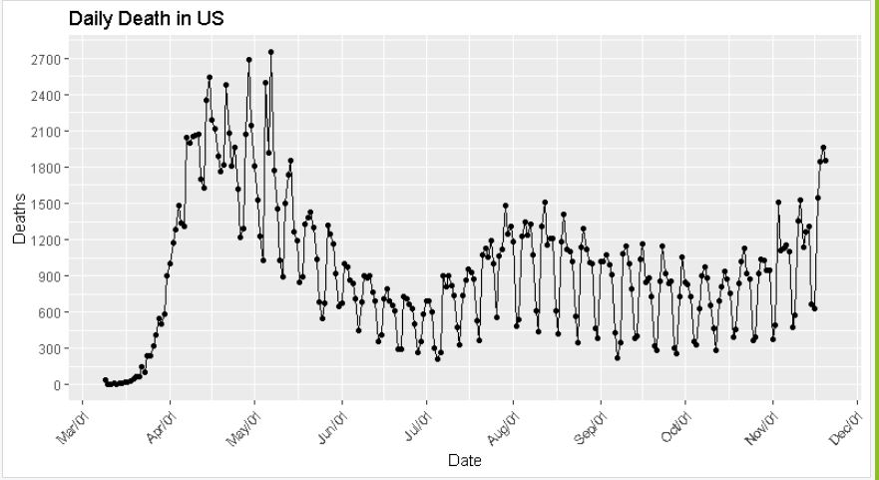
Filter out data before April 1, 2020

Slide 6
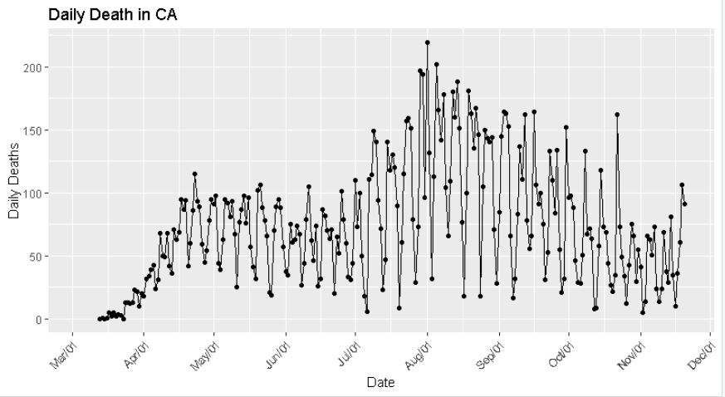
Filter out data before April 1, 2020

Slide 7
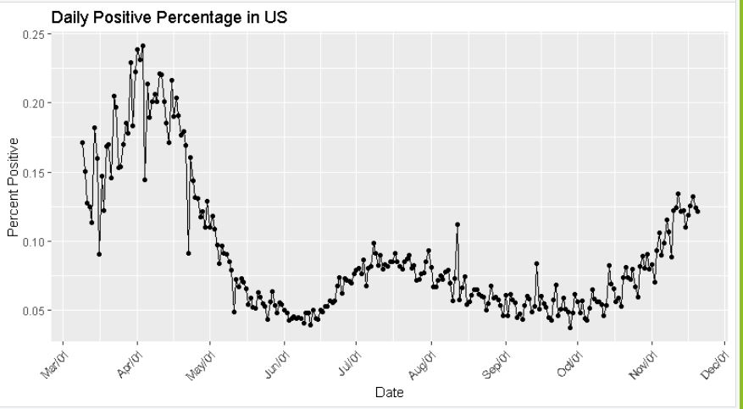
Filter out data before May 1, 2020

Slide 8
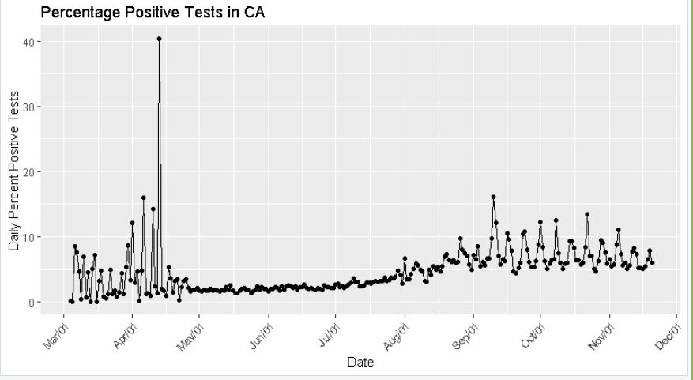
Filter out data before August 1, 2020

Slide 9
Univariate Time Series Models
All US: Total Deaths

Slide 10
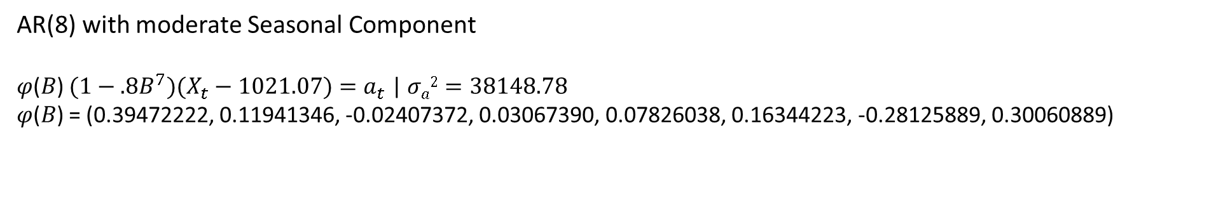
AR(8) with moderate Seasonal Component
𝜑(𝐵) $(1−.8B^{7})(X_{t}−1021.07)=a_{t}$ | $σa2=38148.78$
𝜑(𝐵) = (0.39472222, 0.11941346, -0.02407372, 0.03067390, 0.07826038, 0.16344223, -0.28125889, 0.30060889)

Slide 12
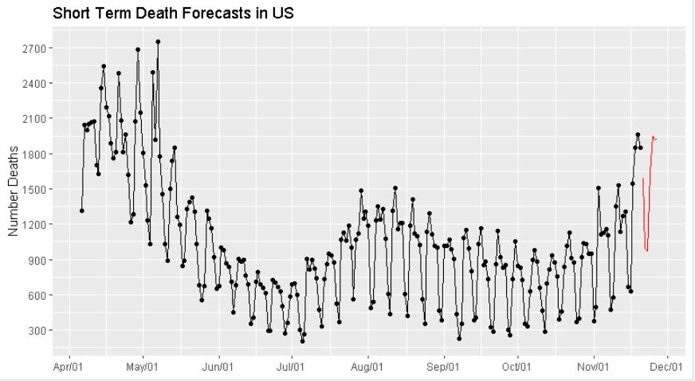

Slide 13
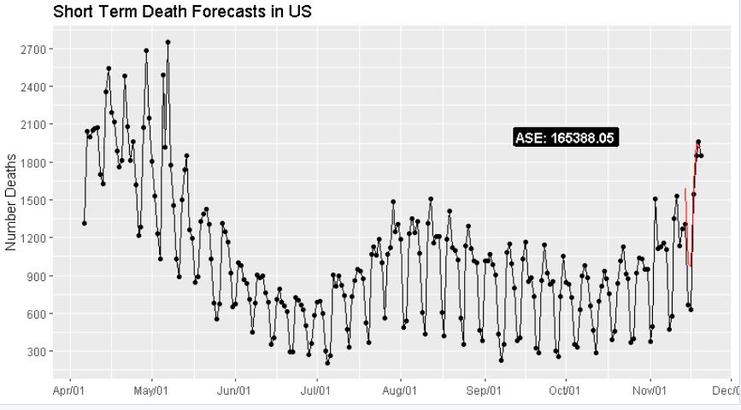

Slide 14
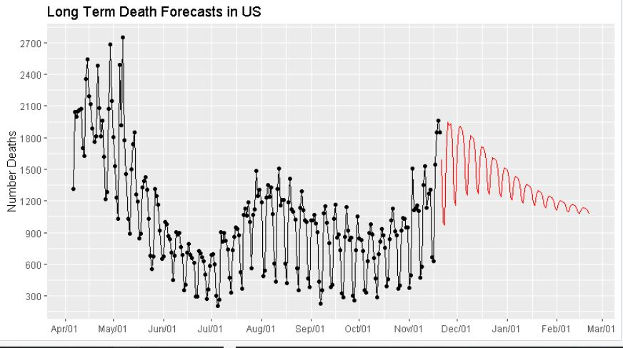

Slide 15
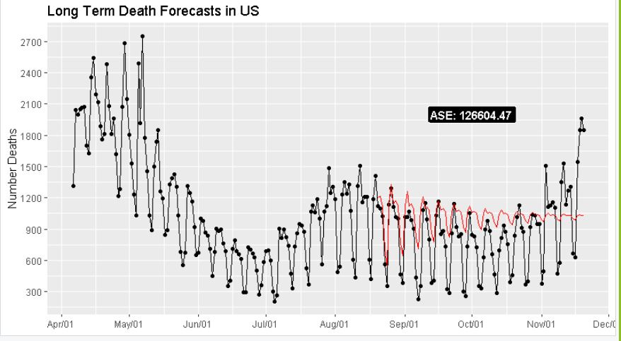

Slide 16
Univariate Time Series Models
CA: Total Deaths

Slide 17
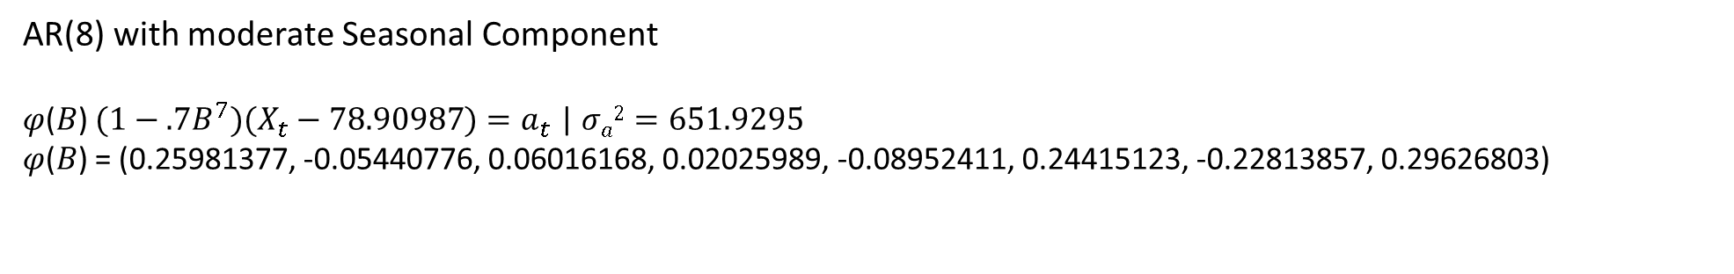
AR(8) with moderate Seasonal Component
𝜑(𝐵) $(1−.7B^{7})(X_{t}−78.90987)=a_{t}$ | $σa2=651.9295$
𝜑(𝐵) = (0.25981377, -0.05440776, 0.06016168, 0.02025989, -0.08952411, 0.24415123, -0.22813857, 0.29626803)

Slide 19
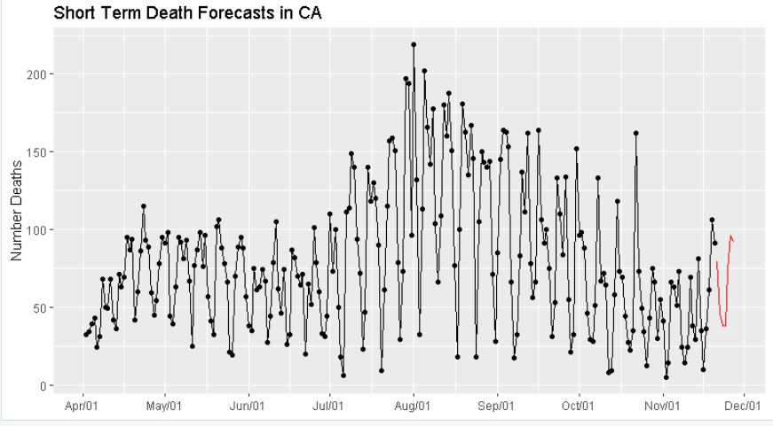

Slide 20
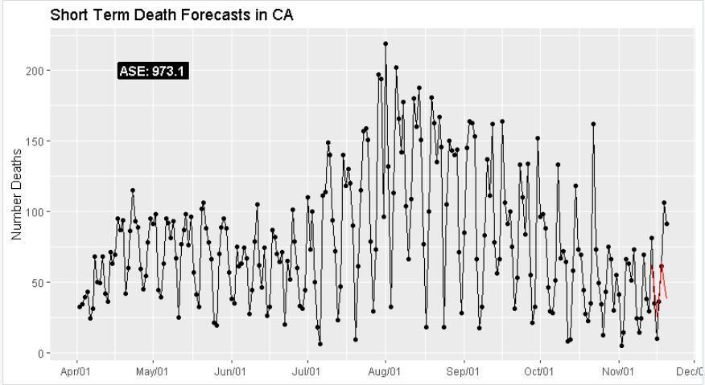

Slide 21
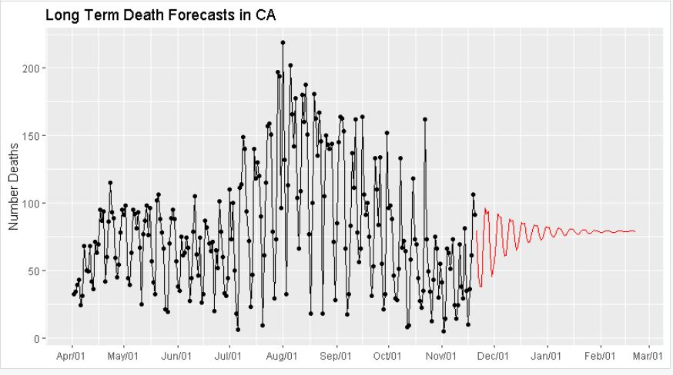

Slide 22
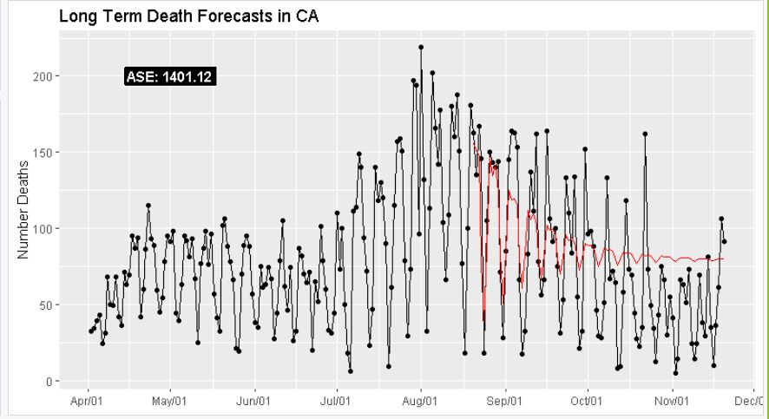

Slide 23
Univariate Time Series Models
All US: Percent of Positive Cases

Slide 24
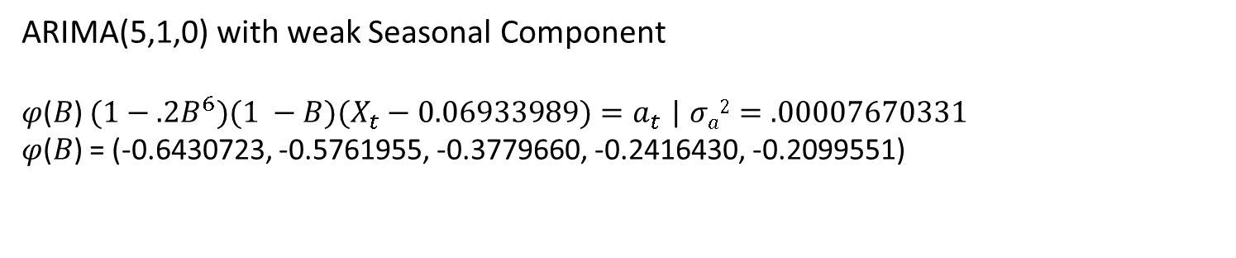
ARIMA(5,1,0) with weak Seasonal Component
𝜑(𝐵) $(1−.2B^{6})(1 −B)(X_{t}−0.06933989)=a_{t}$ | $σa2=.00007670331$
𝜑(𝐵) = (-0.6430723, -0.5761955, -0.3779660, -0.2416430, -0.2099551)

Slide 25
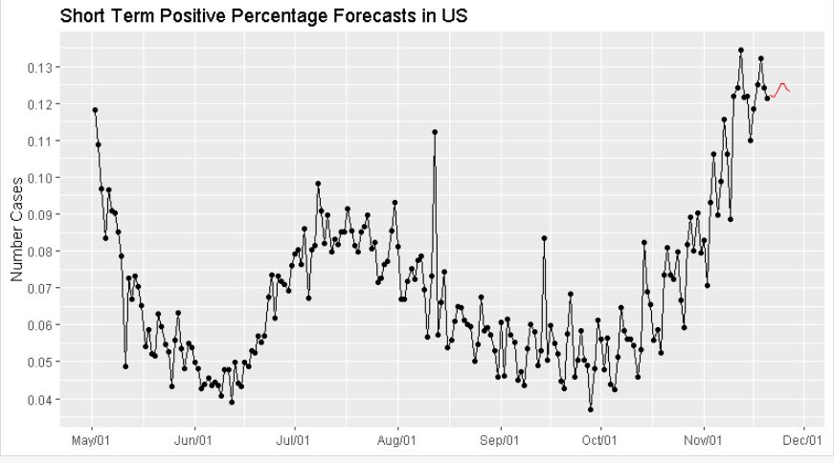

Slide 26
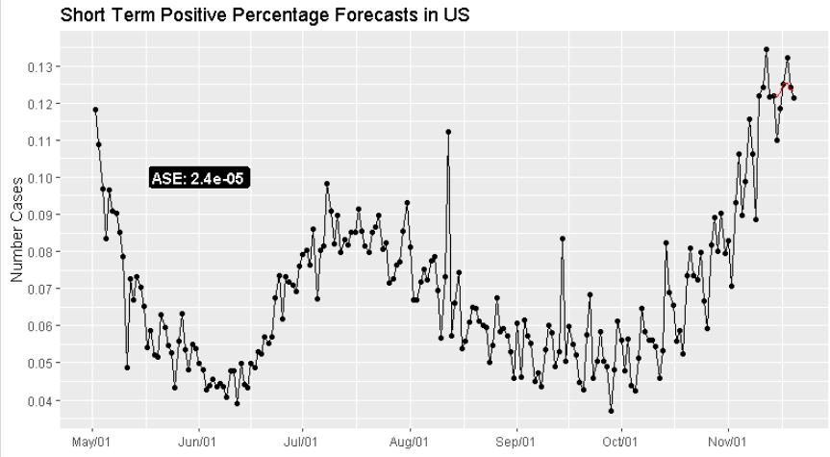

Slide 27
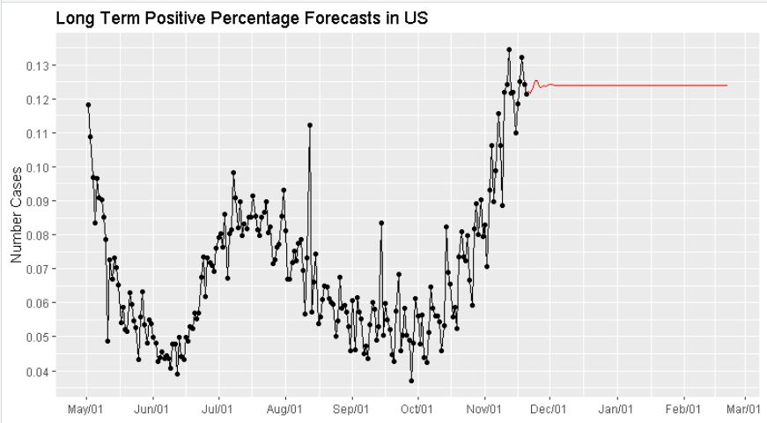

Slide 28
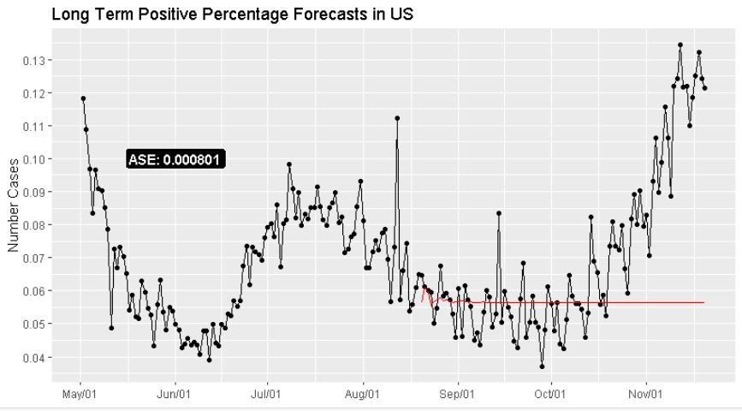

Slide 29
Univariate Time Series Models
CA: Percent of Positive Cases

Slide 30
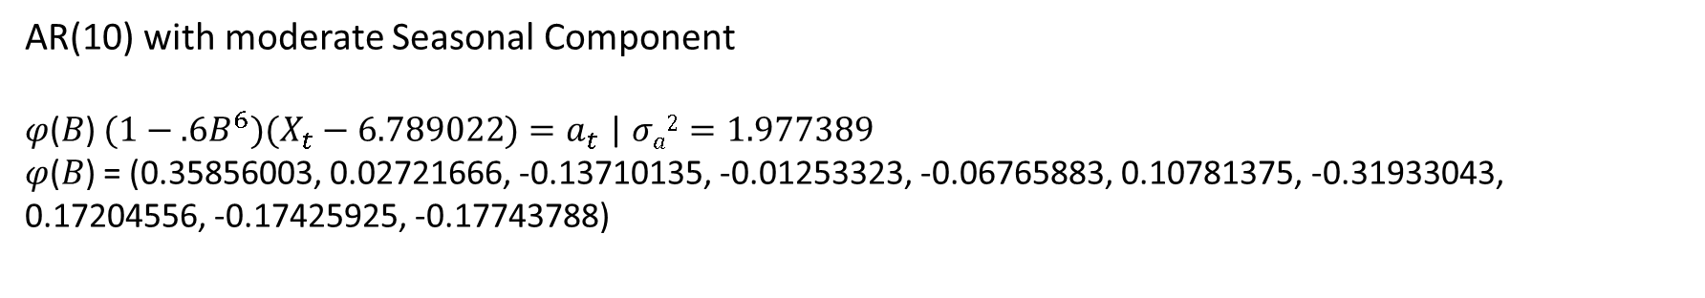
AR(10) with moderate Seasonal Component
𝜑(𝐵) $(1−.6B^{6})(X_{t}−6.789022)=a_{t}$ | $σa2=1.977389$
𝜑(𝐵) = (0.35856003, 0.02721666, -0.13710135, -0.01253323, -0.06765883, 0.10781375, -0.31933043, 0.17204556, -0.17425925, -0.17743788)

Slide 32
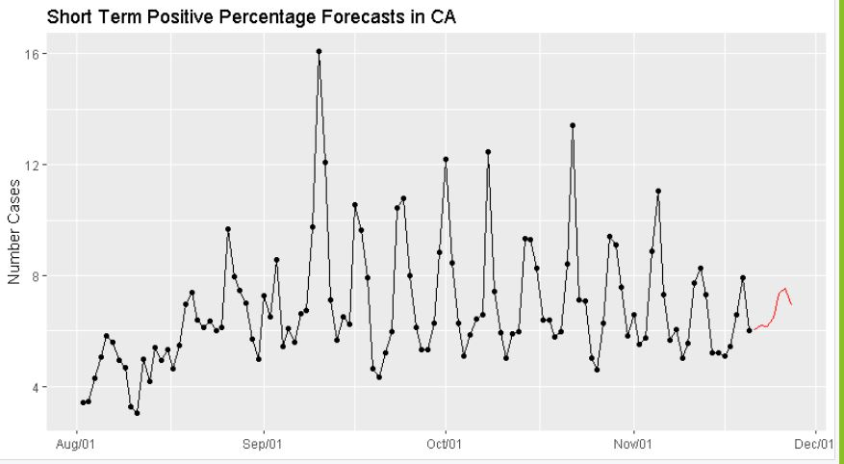

Slide 33
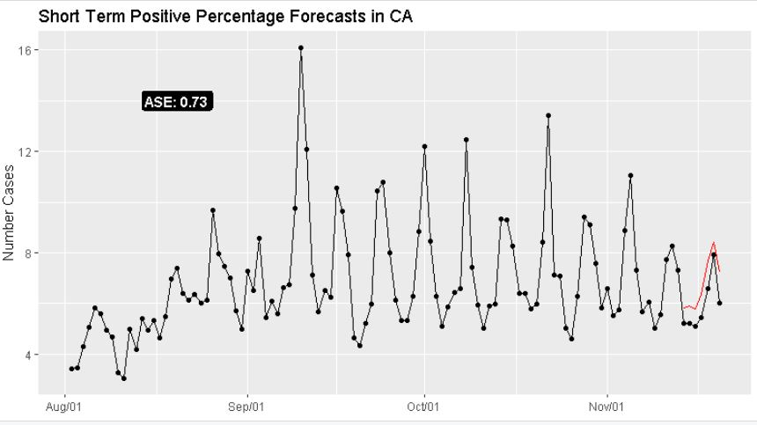

Slide 34
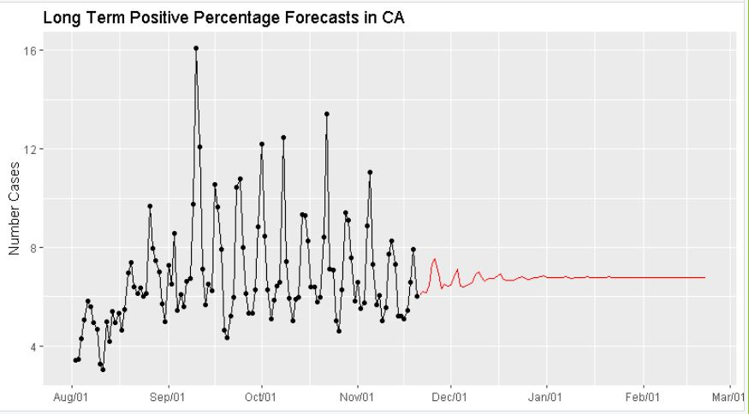

Slide 35
