Slide 1
DS 6373 Time Series
Project A
Jeremy Otsap jotsap@mail.smu.edu
Spencer Fogelman sfogelman@mail.smu.edu

Slide 2
Introductions: Style 1
Jeremy Otsap - Technical Director, Cloud & Data Architecture
Jeremy first got his start with computers when he was 13-years old with MS-DOS v5. Since then, he has spent the past 28 years on multiple aspects of technology from system engineering, network architecture, data center build-out, cloud migration, optimization & modernization, compliance audit & remediation, and big data deployments. He has worked as an IT Director at True Religion Jeans and BCBG, having deep industry expertise in Retail, Manufacturing, and Supply Chain Management. He has over a dozen IT certifications from Microsoft, VMware, Cisco, and NetApp, and additionally a Data Science Graduate Certificate from UC Irvine, while actively pursuing his Masters in Data Science.

Slide 3
Introductions: Style 2
Jeremy Otsap – Technical Director, Cloud & Data Architecture
Started as IT Support in 2000
Freelanced IT Admin & Troubleshooting 2004
System Admin & Network Engineer in 2005
Director of Network Services 2010
Principal Cloud Architect 2015
Global Cloud Architect & Transformation Strategist 2017
Technical Director & Principal Cloud & Data Architect 2019
10 units left in Masters of Data Science

Slide 4
Data Quality

Slide 5
Most data was not consistently collected/reported across all states until April 2020
State | Data Points
AK | 260
AL | 259
AR | 260
AZ | 262
CA | 262
CO | 262
CT | 259
DC | 261
DE | 260
FL | 297
GA | 262
HI | 262
IA | 260
ID | 259
IL | 262
IN | 268
KS | 260
KY | 260
LA | 259
MA | 304
MD | 261
ME | 259
MI | 265
MN | 260
MO | 259
State | Data Points
MS | 259
MT | 259
NC | 262
ND | 259
NE | 280
NH | 262
NJ | 285
NM | 261
NV | 261
NY | 262
OH | 261
OK | 259
OR | 262
PA | 260
RI | 265
SC | 262
SD | 259
TN | 261
TX | 262
UT | 259
VA | 268
VT | 263
WA | 304
WI | 263
WV | 260
WY | 259
Top 6 States by Deaths
state totalPos totalNeg totalDeath posRate
MA 25884027 287041539 1766411 8.271624
FL 91227715 651783814 1851698 12.278102
TX 95873309 758699360 1872876 11.218860
CA 107472315 1825143684 2173495 5.560976
NJ 41063857 469188028 3202329 8.047762
NY 93795107 1428861538 5390549 6.159964
Top 6 States by Total Positive Cases
state totalPos totalNeg totalDeath posRate
GA 41819872 345114394 986675 10.808004
IL 48244938 707154162 1595178 6.386682
FL 91227715 651783814 1851698 12.278102
NY 93795107 1428861538 5390549 6.159964
TX 95873309 758699360 1872876 11.218860
CA 107472315 1825143684 2173495 5.560976
Top 6 States by Positive Rate
state totalPos totalNeg totalDeath posRate
FL 91227715 651783814 1851698 12.27810
MS 13281633 90808654 402253 12.75972
AL 20310952 137608330 359044 12.86160
SD 3612740 24272122 38761 12.95592
ID 5654861 36870035 61212 13.29777
AZ 30670893 171360801 744989 15.18123

Slide 6
Initial Data Exploration

Slide 7
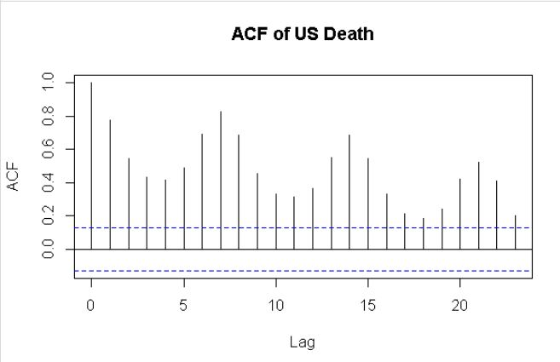
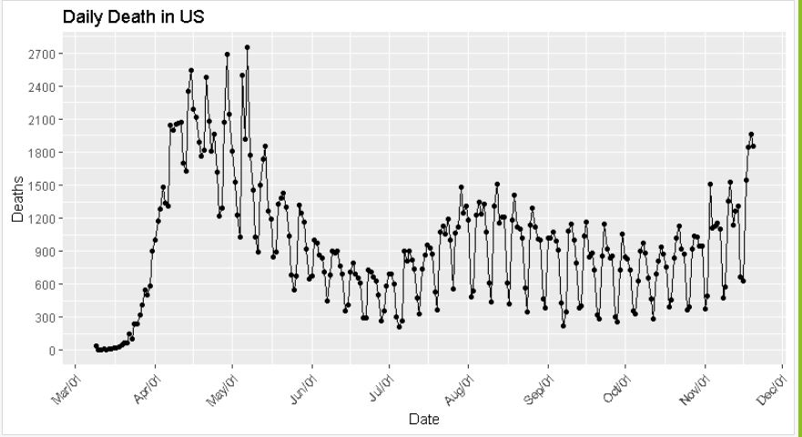
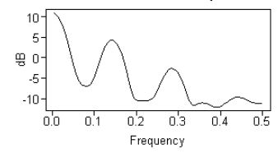
Daily Death for US
Filter out data before April 1, 2020

Slide 8
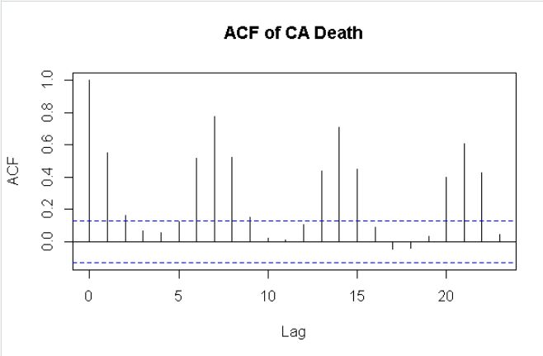
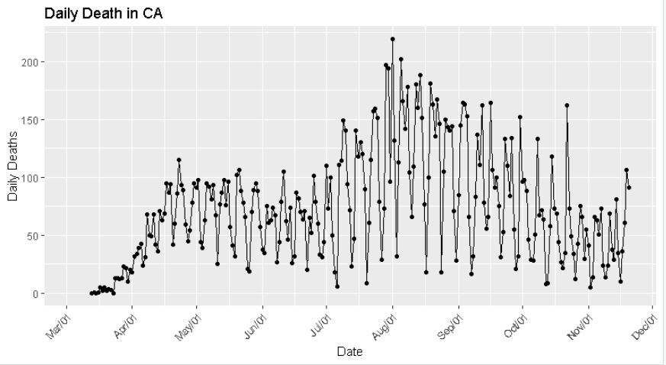
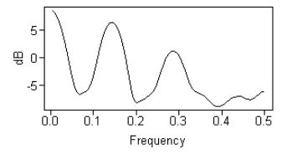
Daily Death for CA
Filter out data before April 1, 2020

Slide 9
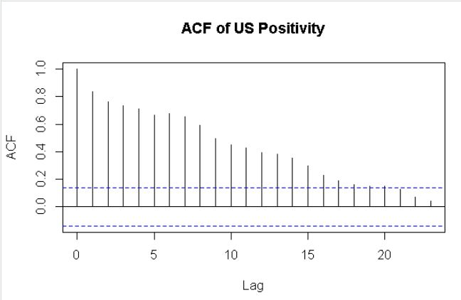
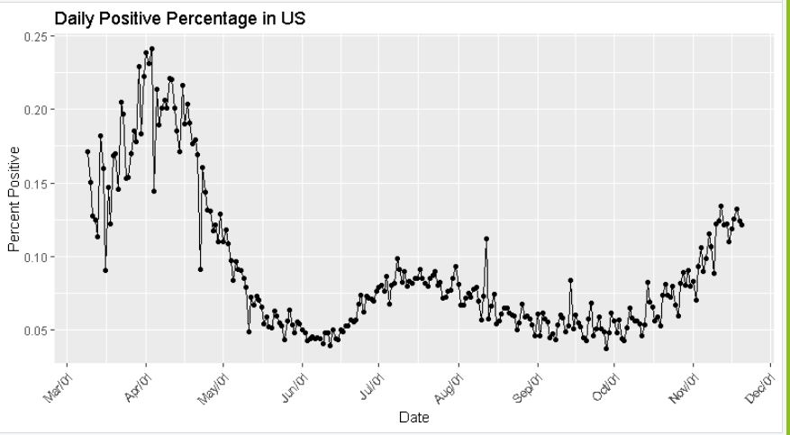
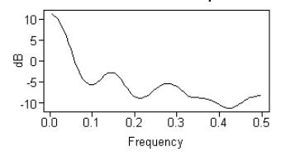
Daily Positivity Percentage for US
Filter out data before May 1, 2020

Slide 10
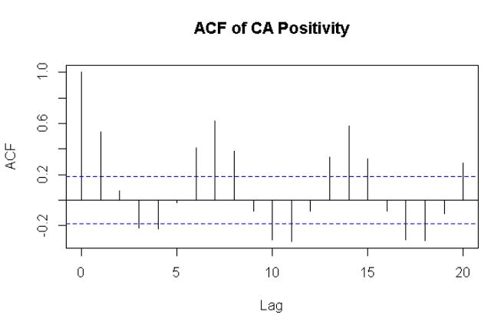
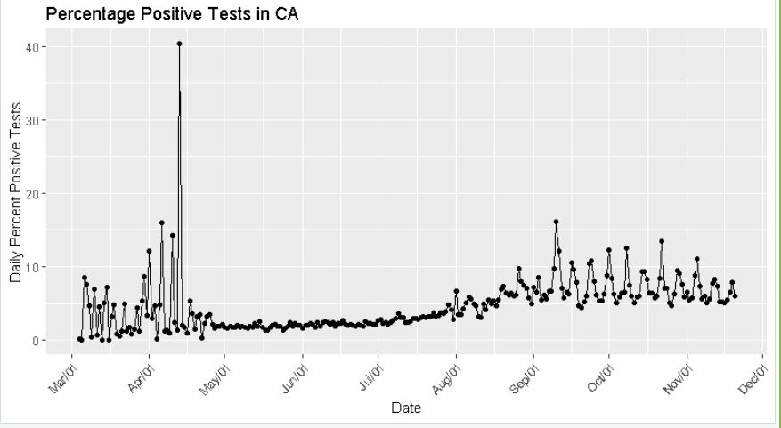
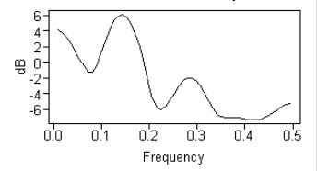
Daily Positivity Percentage for CA
Filter out data before August 1, 2020

Slide 11
Univariate Time Series Models
All US: Total Deaths

Slide 12
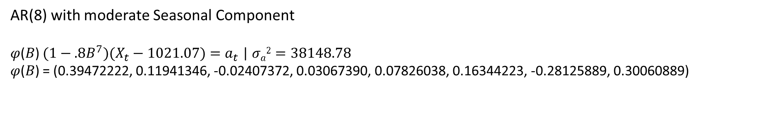
AR(8) with moderate Seasonal Component
𝜑(𝐵) $(1−.8B^{7})(X_{t}−1021.07)=a_{t}$ | $σa2=38148.78$
𝜑(𝐵) = (0.39472222, 0.11941346, -0.02407372, 0.03067390, 0.07826038, 0.16344223, -0.28125889, 0.30060889)

Slide 14
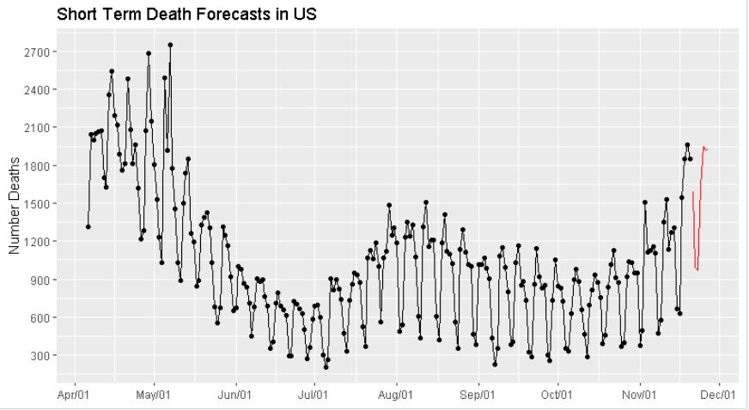

Slide 15
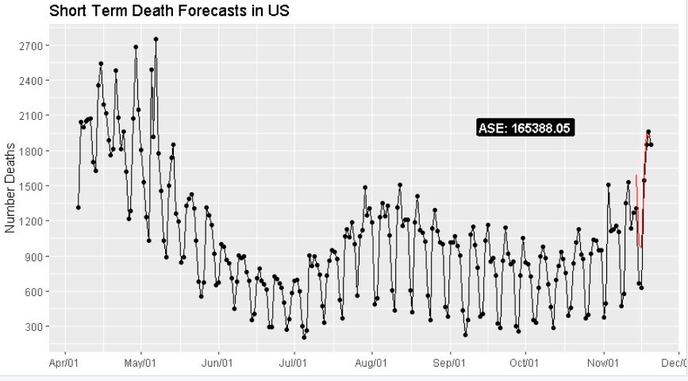

Slide 16
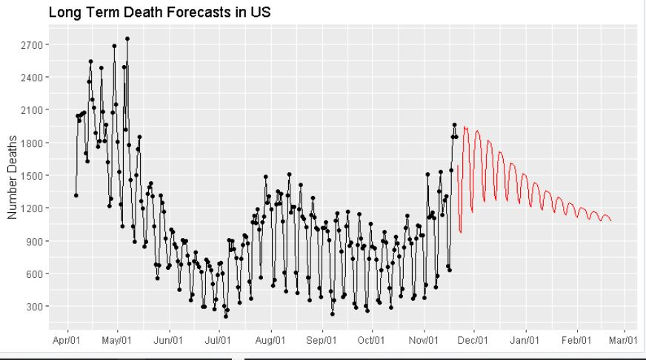

Slide 17
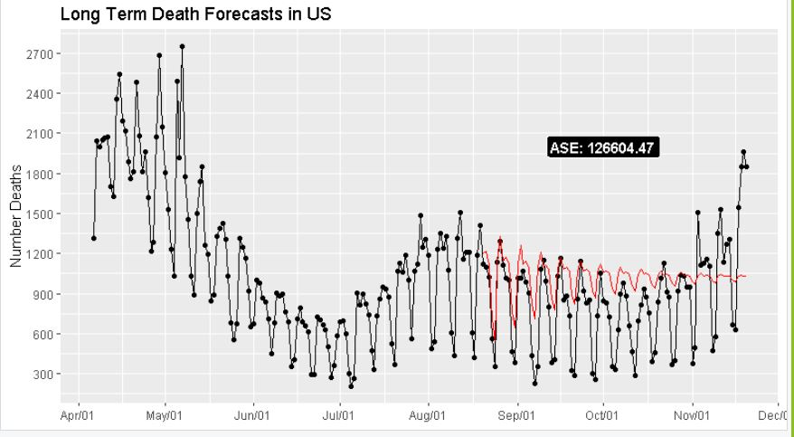

Slide 18
Univariate Time Series Models
CA: Total Deaths

Slide 19
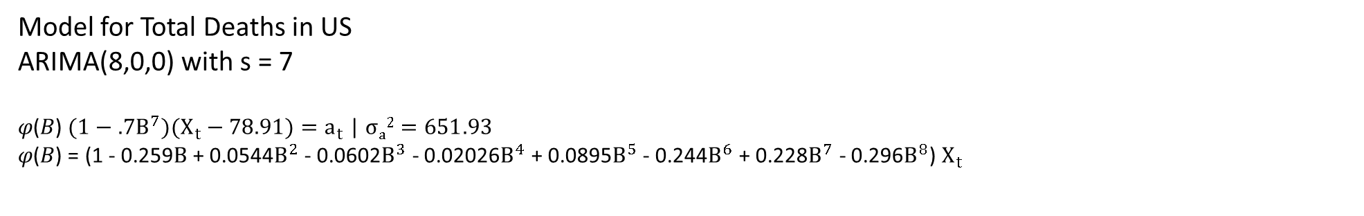
Model for Total Deaths in US
ARIMA(8,0,0) with s = 7
𝜑(𝐵) $(1−.7B^{7})(X_{t}−78.91)=a_{t}$ | $σa2=651.93$
𝜑(𝐵) = (1 - 0.259$B$ + 0.0544$B^{2}$ - 0.0602$B^{3}$ - 0.02026$B^{4}$ + 0.0895$B^{5}$ - 0.244$B^{6}$ + 0.228$B^{7}$ - 0.296$B^{8}$) $X_{t}$

Slide 21
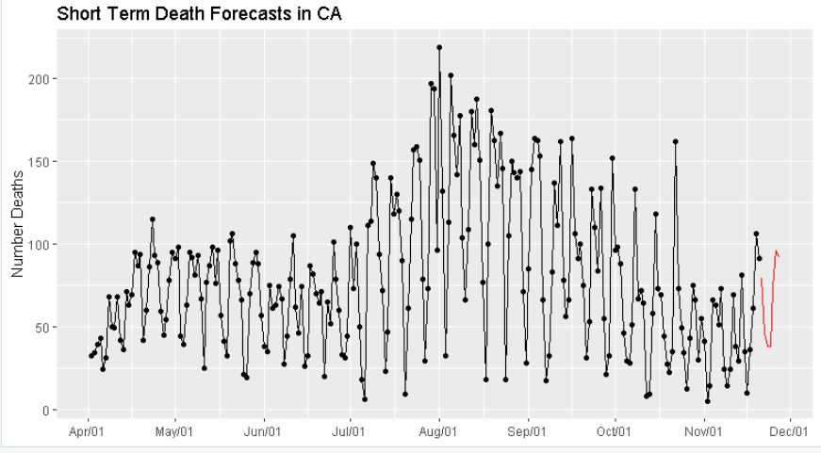

Slide 22
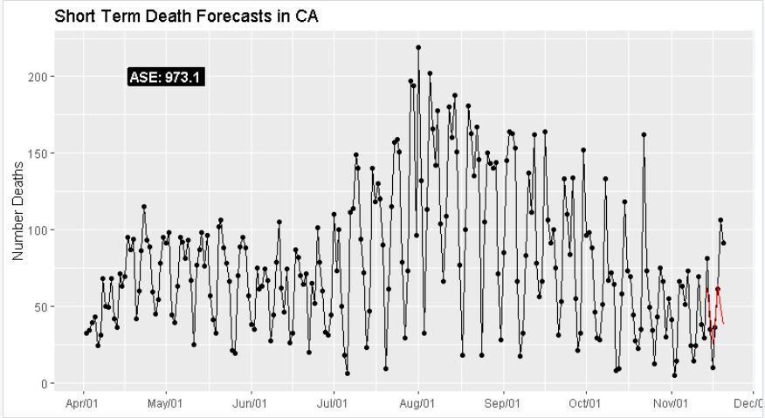

Slide 23
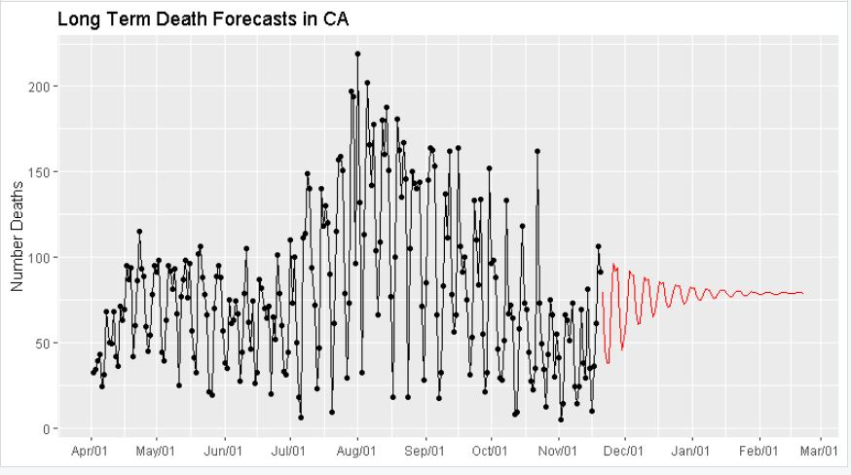

Slide 24
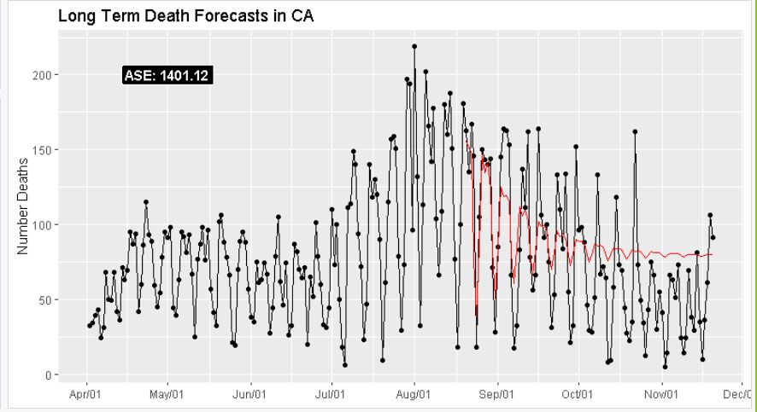

Slide 25
Univariate Time Series Models
All US: Percent of Positive Cases

Slide 26
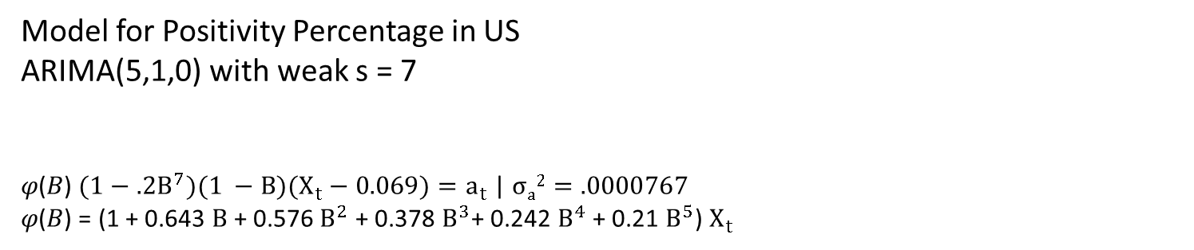
Model for Positivity Percentage in US
ARIMA(5,1,0) with weak s = 7
𝜑(𝐵) $(1−.2B^{7})(1 −B)(X_{t}−0.069)=a_{t}$ | $σa2=.0000767$
𝜑(𝐵) = (1 + 0.643 $B$ + 0.576 $B^{2}$ + 0.378 $B^{3}$+ 0.242 $B^{4}$ + 0.21 $B^{5}$) $X_{t}$

Slide 27
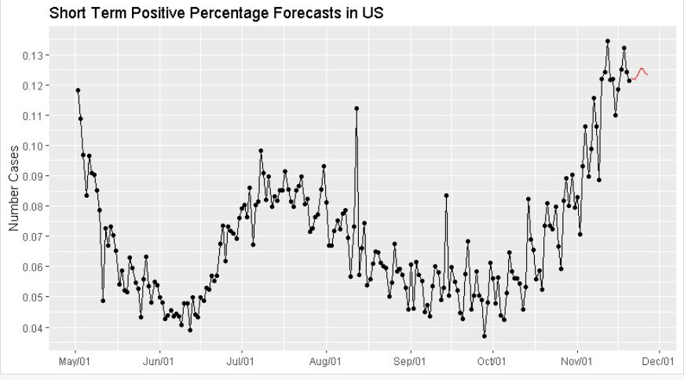

Slide 28
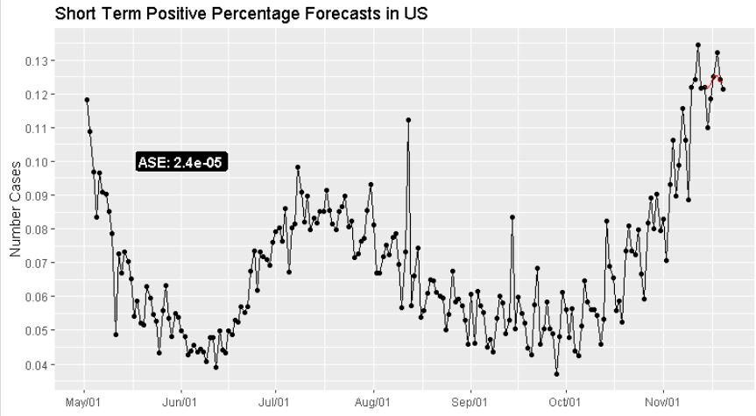

Slide 29
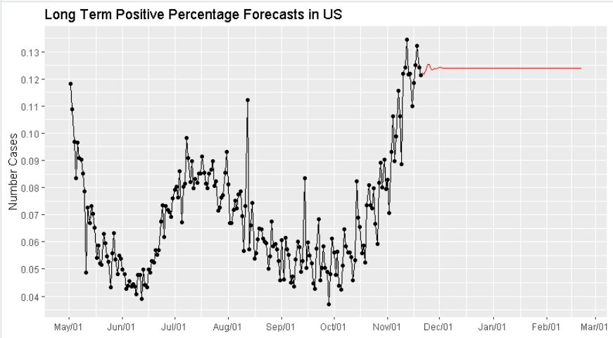

Slide 30
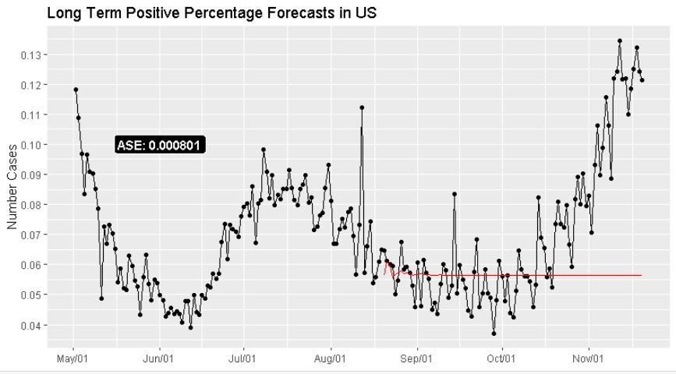

Slide 31
Univariate Time Series Models
CA: Percent of Positive Cases

Slide 32
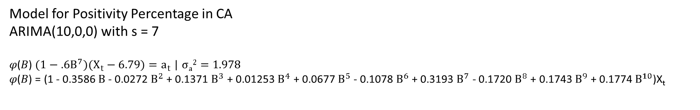
Model for Positivity Percentage in CA
ARIMA(10,0,0) with s = 7
𝜑(𝐵) $(1−.6B^{7})(X_{t}−6.79)=a_{t}$ | $σa2=1.978$
𝜑(𝐵) = (1 - 0.3586 $B$- 0.0272 $B^{2}$ + 0.1371 $B^{3}$ + 0.01253 $B^{4}$ + 0.0677 $B^{5}$- 0.1078 $B^{6}$ + 0.3193 $B^{7}$ - 0.1720 $B^{8}$ + 0.1743 $B^{9}$ + 0.1774 $B^{10}$)X_{t}

Slide 34
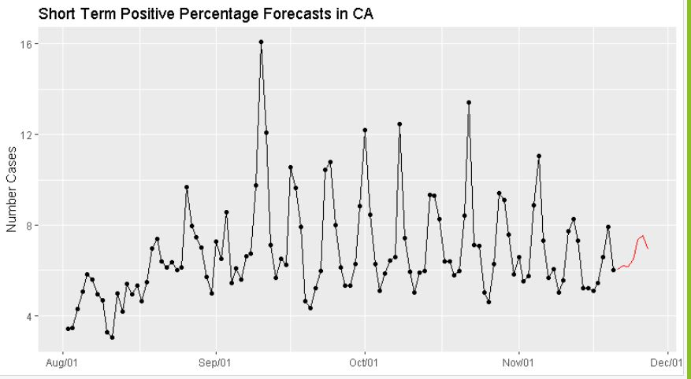

Slide 35
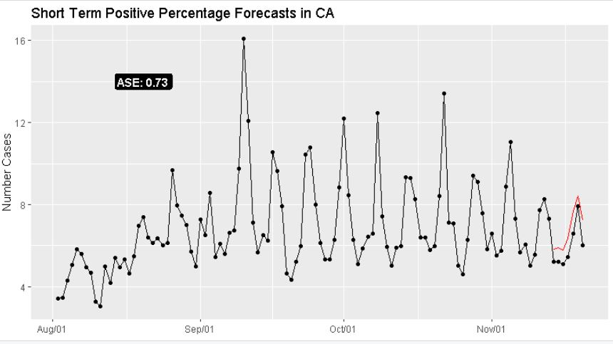

Slide 36
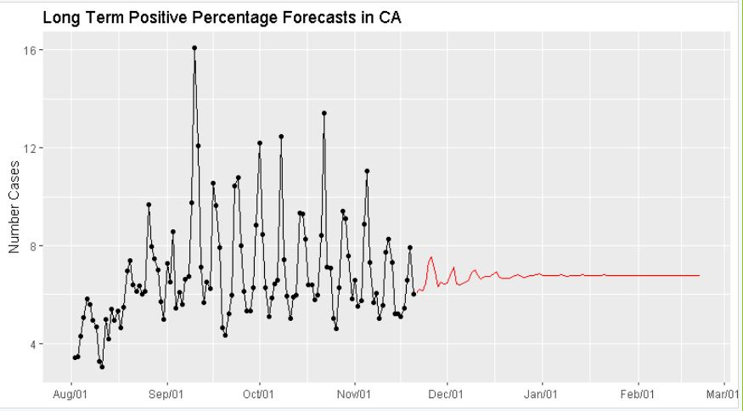

Slide 37
