Slide 1
Telco_Cluster_Analysis
File created on: 4/8/2020 1:22:48 PM

Slide 2
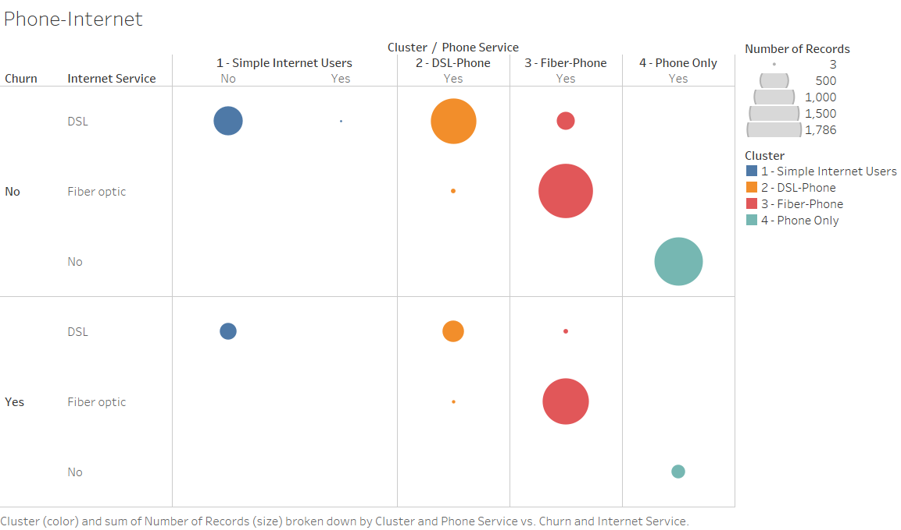
Avg Month Charge
$91.2
Avg Month Charge
$42.2
Avg Month Charge
$61.8
Avg Month Charge
$21.1
The distinction of Internet Only users, Phone Only users and Phone+Internet Bundle user group is apparent, even with days of clustering analysis from Machine Learning : The existing customer segmentation is still valid

Slide 3
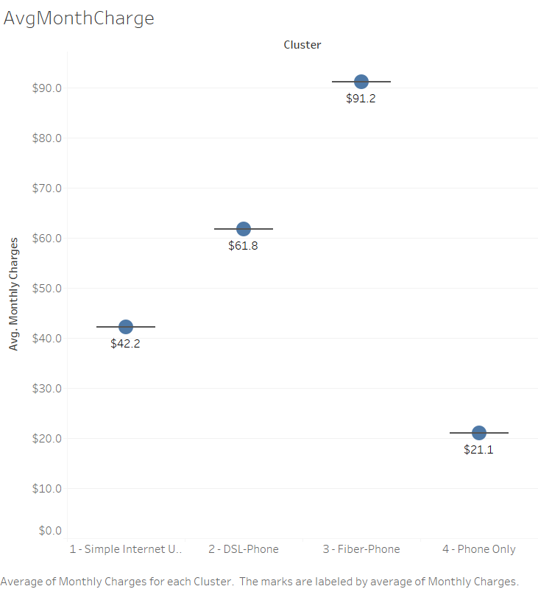
The customer segment is aligned with monthly charges from bundled service subscription – Cluster 3(Fiber + Phone) shows highest average charge

Slide 4
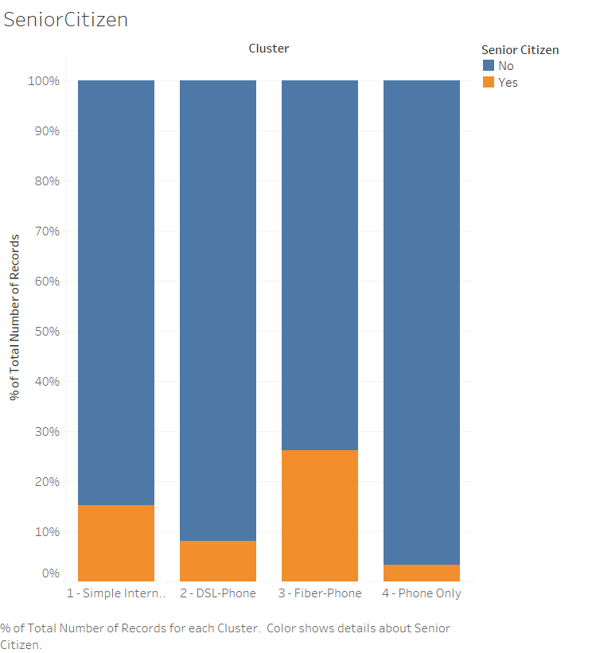
A bit of surprise – The percentage of ‘Senior Citizen’ is the lowest with ‘Phone Only’ group, and the highest with ‘Fiber Phone’ group.
Granpa also loves fast internet

Slide 5
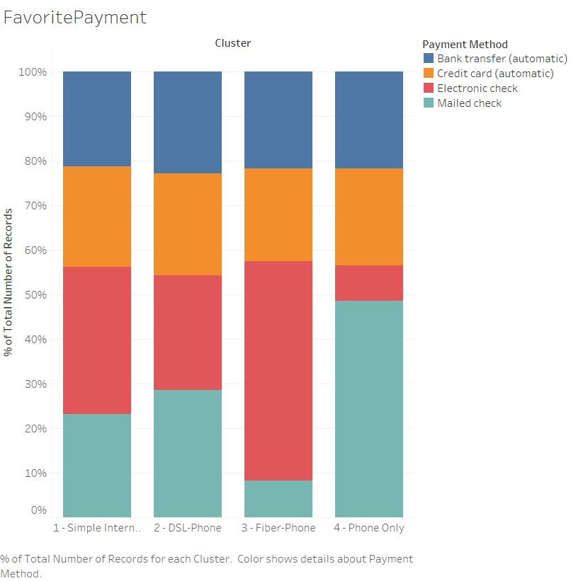
Electronic check is the favored payment method of the Cluster 3(Fiber – Phone)

Slide 6
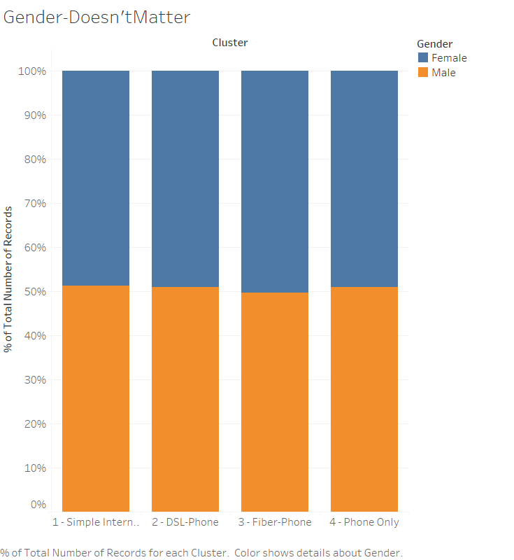
Gender of customers didn’t show any significant difference among these clusters(segments)
* We confirm with statistical significance - P value 0.72

