Slide 1

©
Spotify API

Slide 2
Questions:
What was behind the Spotify API?
Does popularity influence followers or does followers influence popularity?
How much does follower count change in short time frame?
How much does popularity change in short time frame?

Slide 3
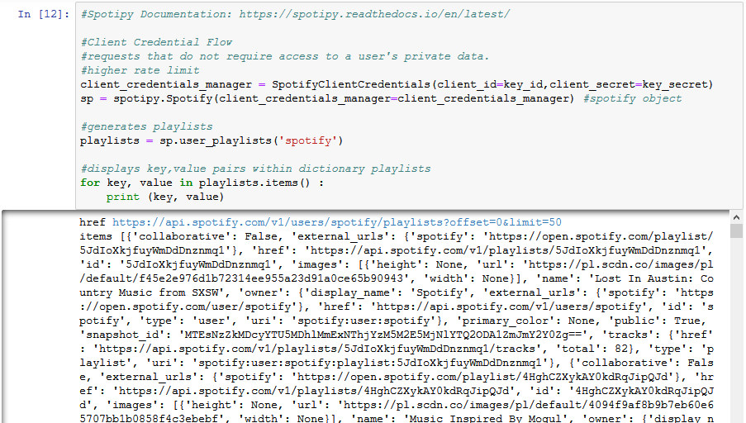
Creative Credential Flow

Slide 4
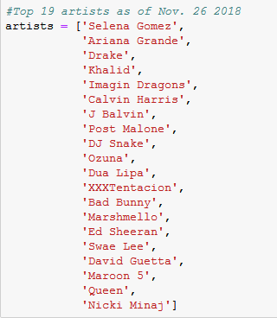
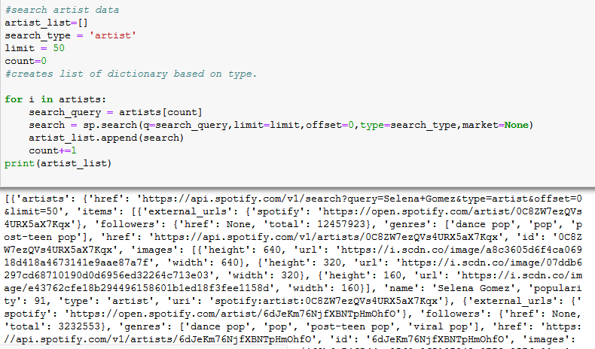
Criteria & Search Query

Slide 5
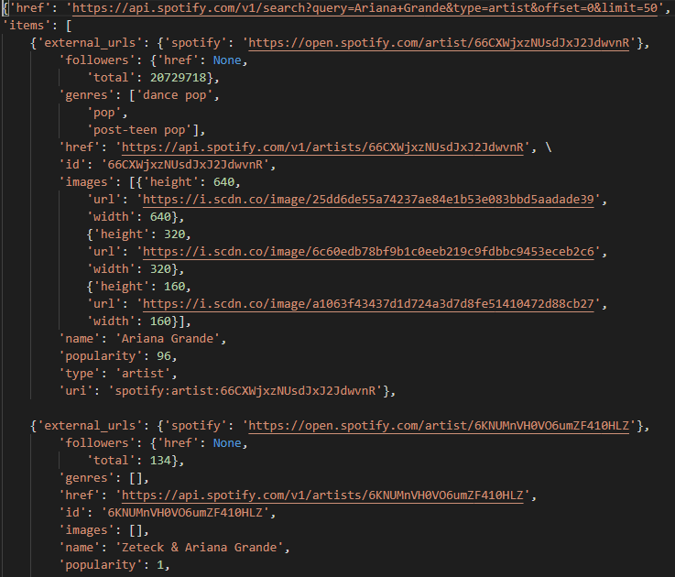
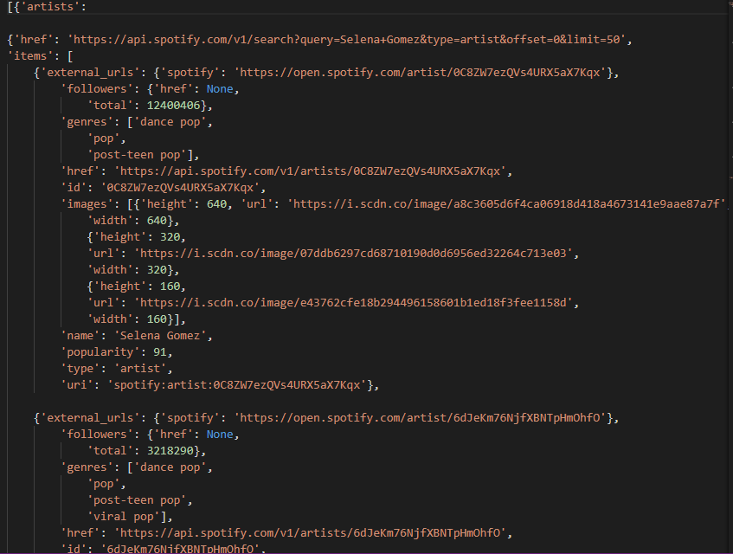
Traversing Spotify Object

Slide 6
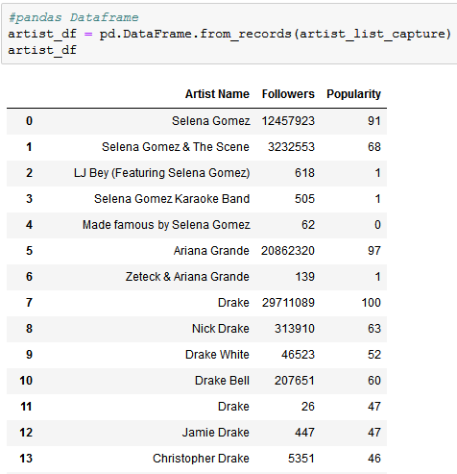
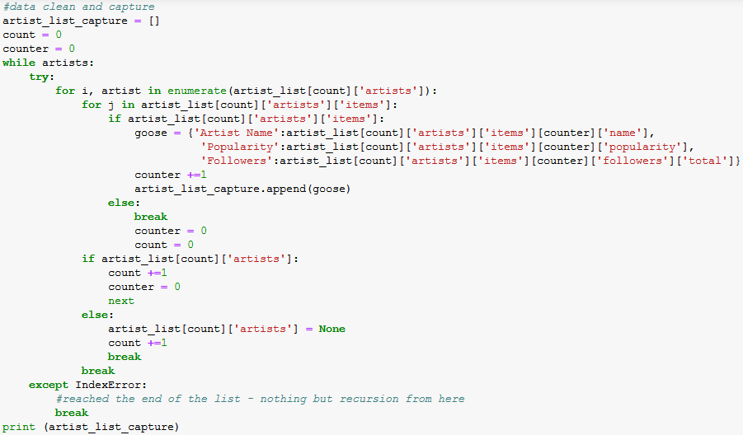
Traversing Data

Slide 7
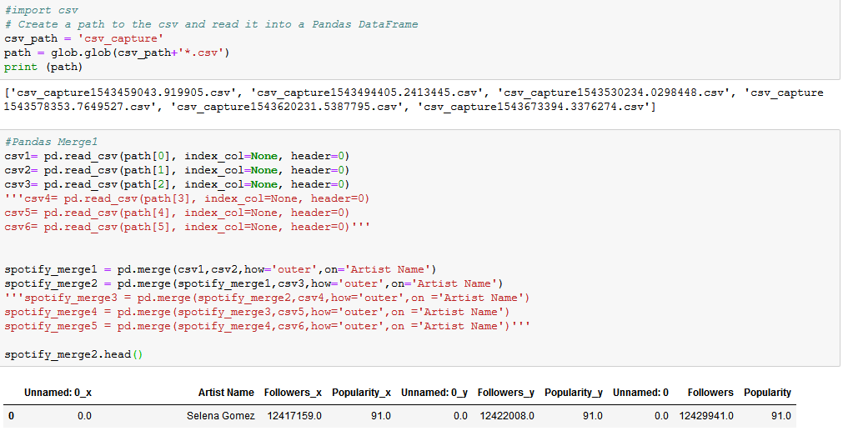
API Scrape -> Pandas Merge

Slide 8
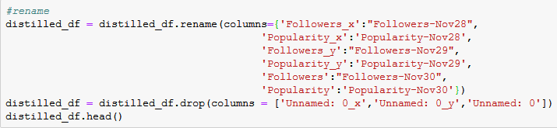
Parsing and Renaming

Slide 9
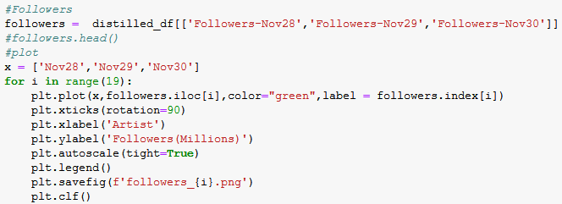
Saving Images – Followers & Popularity

Slide 10
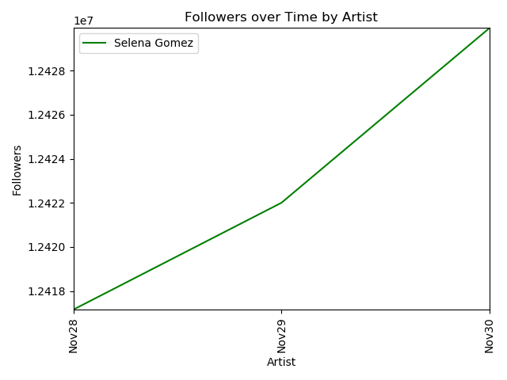
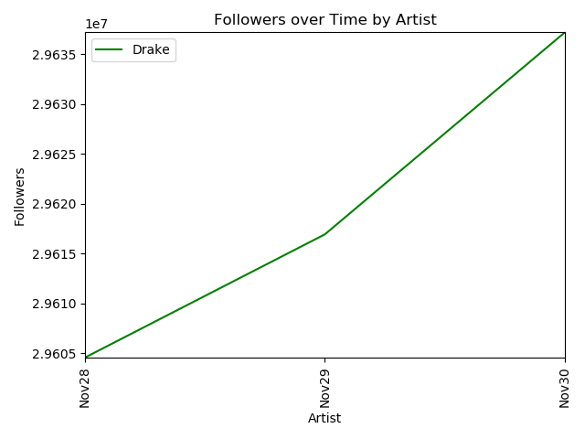
Follower Change by Artist

Slide 11
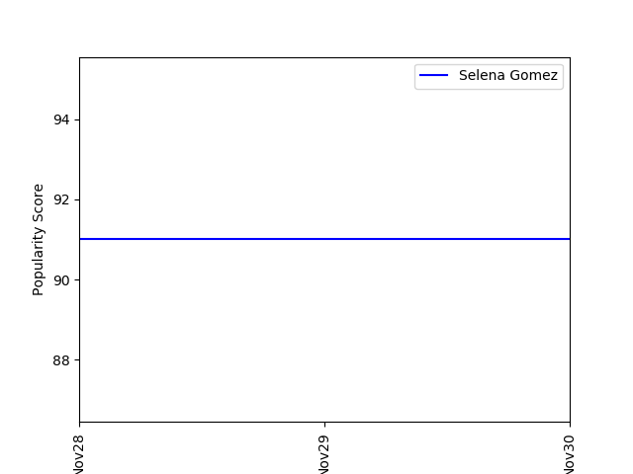
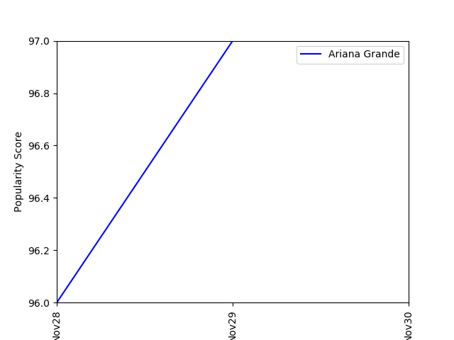
Popularity Change by Artist

Slide 12
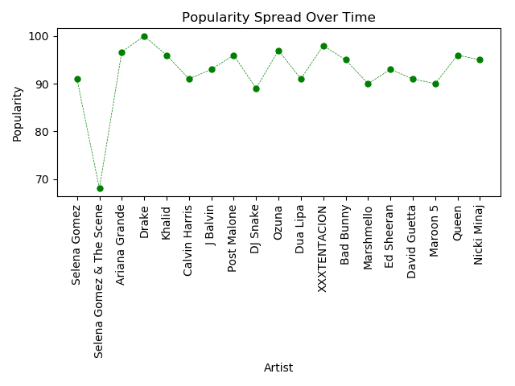
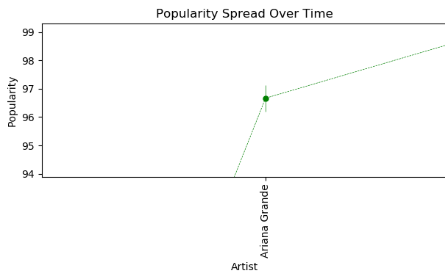
Data Spread of Popularity

Slide 13
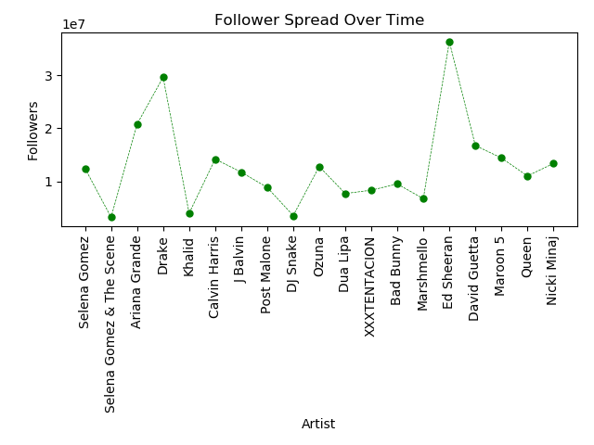
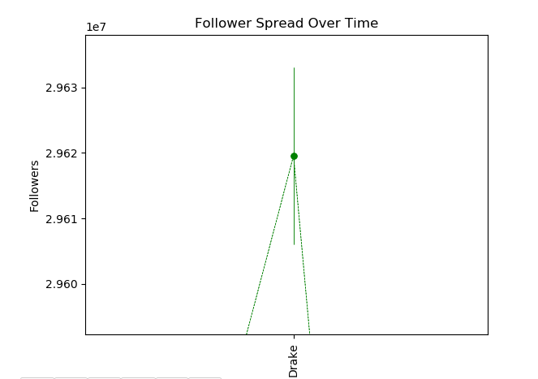
Data Spread of Followers

Slide 14
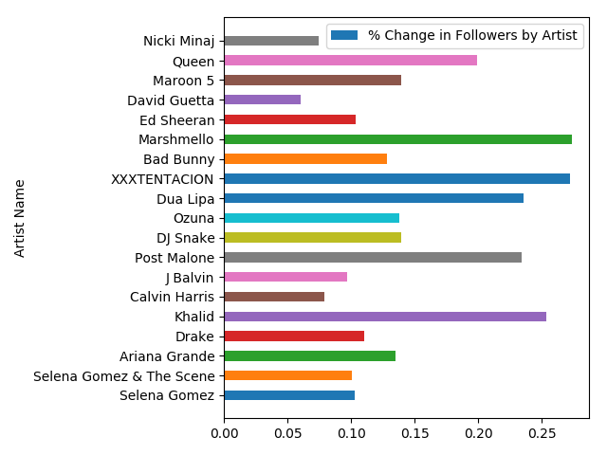
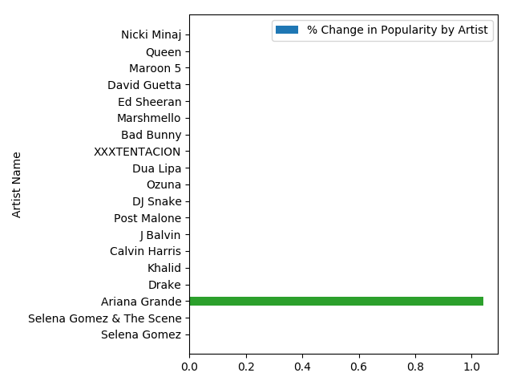
Percent Change in Followers vs. Popularity

Slide 15
Summary – Implications of Findings
What was behind the Spotify API?
Does popularity influence followers or does followers influence popularity?
How much does follower count change in short time frame?
How much does popularity change in short time frame?
Creative Credential Flow
Json objects specific to artist, track, playlists, etcs.
Based on my findings – a correlation could be drawn that there was no direct effect.
This is based on %change being largest for artists in follower count – but %change in popularity was unchanged.
Within our short time frame of 3 days:
Largest difference was Ed Sheeran with 37,541
And average was 17018 followers.
Short time frame only had one change recorded:
Largest difference was Ariana Grande as 1.0
Average was 0.53 popularity

Slide 16
What did we learn?
Python packages and Spotipy
Authentication tokens and Web APIs and how to use them.
Search query on extracted data – make sure you are specific.
Error handling is a VERY useful tool.
Glob and collecting csv all csv files.
Merging csv files – should have dropped the index.
Renaming
Matplotlib and Pandas for plotting DataFrames

Slide 17
What did we learn?
Python packages and Spotipy
Authentication tokens and Web APIs and how to use them.
Search query on extracted data – make sure you are specific.
Error handling is a VERY useful tool
Glob and collecting all csv files
Merging csv files – should have dropped the index
Renaming
Matplotlib and Pandas for plotting DataFrames
Various statistics that can be calculated

