Slide 1
OQaml A OCaml-based QASM
Johannes Otterbach

Slide 2
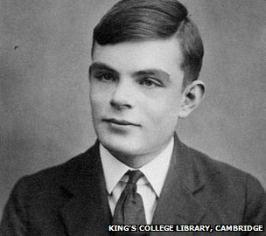
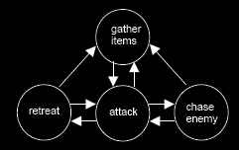
Turing Machine
Alan Turing (1936)
Led to the definition of Computability
A program is representable by
a finite set of states
a set of transitions
a set of instructions
an initial state
https://www.researchgate.net/publication/228920087_Evolutionary_neural_networks_applied_in_first_person_shooters

Slide 3
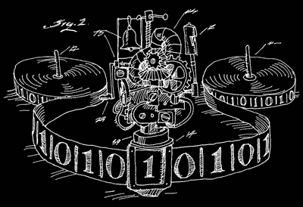
FSM Representations
Encode information in bits 0, 1
Boolean Logic: Operations on bits
NOT : bit -> bit
OR : bit -> bit -> bit
AND : bit -> bit -> bit
XOR : bit -> bit -> bit
…
Universal gate sets:
NOT and AND
NOT and OR
AND or XOR
...

Slide 4


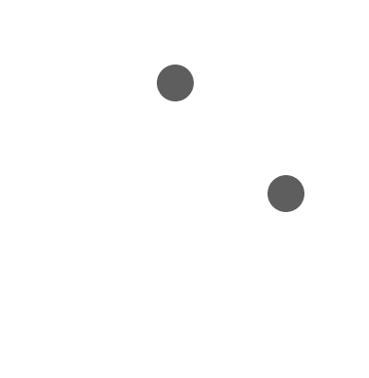
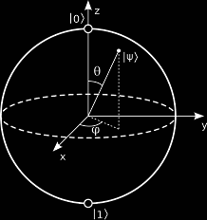
Classic to Quantum
Classical we can have only one state at a time:
Quantum Mechanics:
Real values
Complex values

Slide 5

State Transformation
QM states connected by gates
Computational basis
Series of gates is a circuit
“Time” flows from right to left

Slide 6
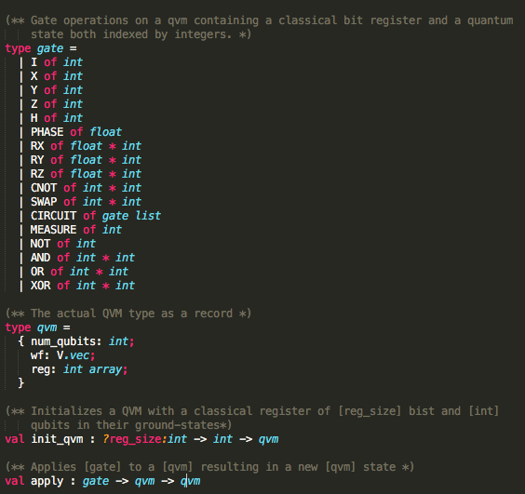
OQaml
OCaml based implementation of Quil
Statically typed, functional programming language
Let’s you program with “mathematical” notation

Slide 7



Evaluating small circuits
Structural similarity between CIRCUIT and GATE
OQaml: Circuits are Gates!
Example: 1 Qubit gates OQaml: let pg idx = Q.CIRCUIT [Q.PHASE (pi4); Q.RZ(pi4, idx); Q.RY (0.0, idx); Q.RZ (pi4, idx)];;

Slide 8
Demo

Slide 9
More examples
2 Qubit gate
OQaml: let swap i j = Q.CIRCUIT [Q.CNOT (i,j); Q.CNOT (j,i); Q.CNOT (i,j)];;
Assert we are correct: let tqvm = Q.apply (Q.X 0) (Q.init_qvm 2);; Q.apply (swap 0 1) tqvm = Q.apply (Q.SWAP (0,1)) tqvm;;

Slide 10
Demo

