Slide 1
OOP
Object-Oriented Programming.

Slide 2
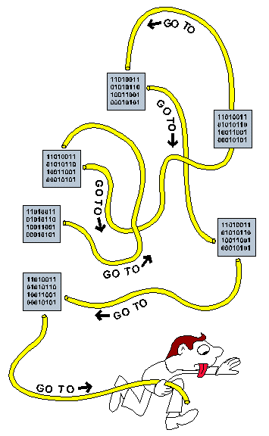

Slide 3
Concepts Of OOP
Class
Object
Encapsulation
Inheritance
Polymorphism
Abstraction

Slide 4

OOP In Dart
In OOP, an object can be anything, such as a person, a bank account, a car, or a house. Each object has its attributes and behavior .
For example, a person object may have the attributes name, age and height, and the behavior walk and talk.

Slide 5
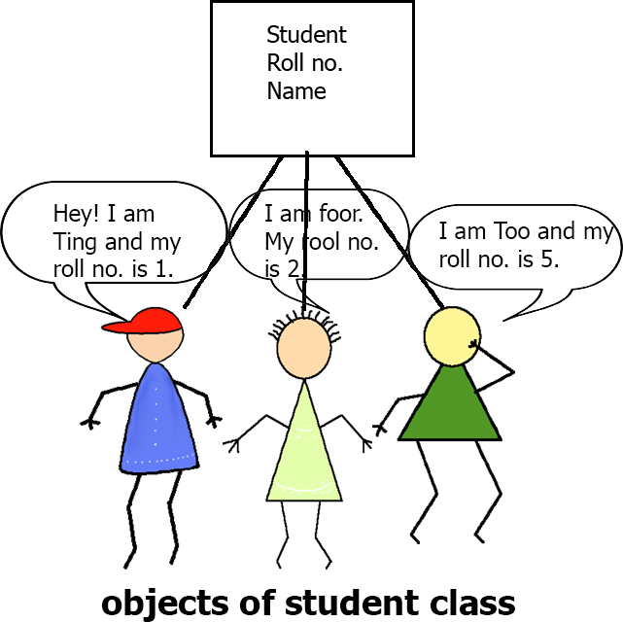
Class In Dart
In object-oriented programming, a class is a blueprint for creating objects. A class defines the properties and methods that an object will have.
For example, a class called Student might have properties like name, Roll no. and methods like register.

Slide 6
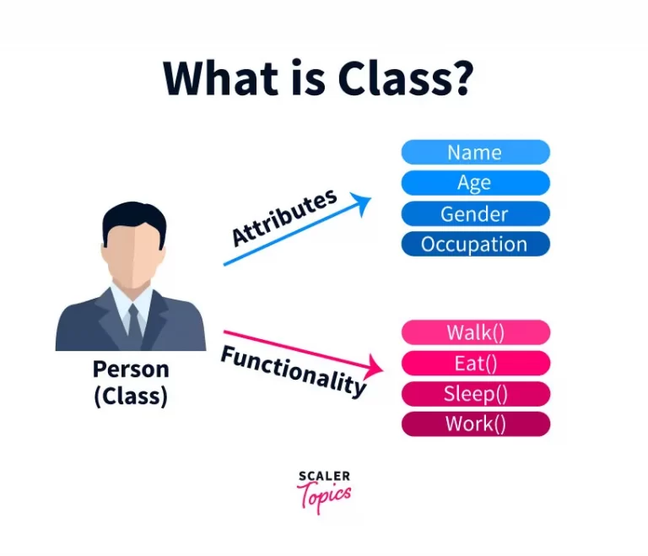

Slide 7
Object In Dart
In object-oriented programming, Objects are the instance of the class.
Objects are created from templates called classes.
An object is made up of properties(variables) and methods(functions).

Slide 8
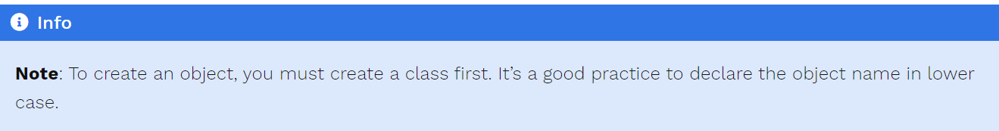

Slide 9
Declaring Class & Object In Dart

Slide 10
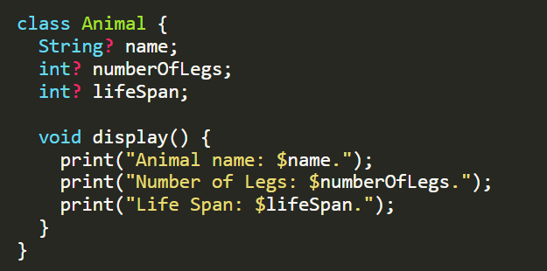
Declaring A Class In Dart
In this example below, there is class Animal with three properties: name, numberOfLegs, and lifeSpan. The class also has a method called display, which prints out the values of the three properties.

Slide 11

Declaring Object In Dart

Slide 12
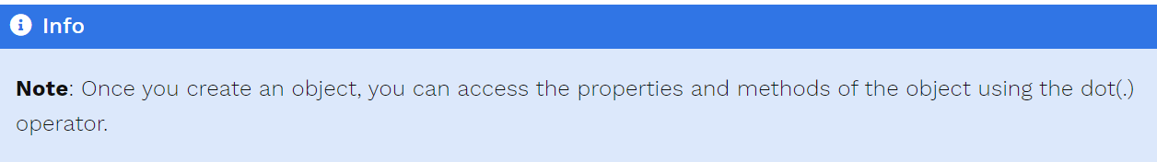

Slide 13

Challenge
Create a class Rectangle with two properties: length and breadth. The class also has a method called area, which calculates the area of the rectangle.

