Slide 1
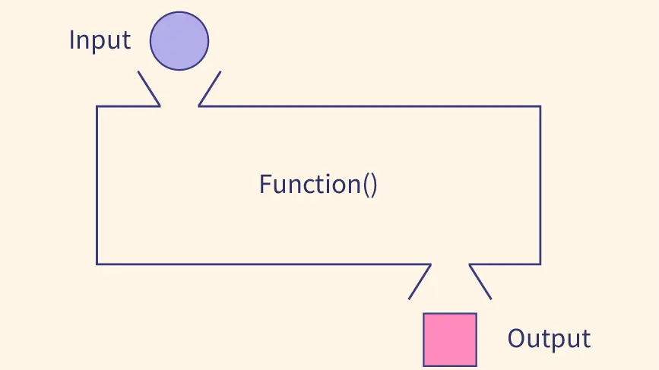
Functions in dart

Slide 2
Dart Function
Dart function is a set of codes that together perform a specific task. It is used to break the large code into smaller modules and reuse it when needed. Functions make the program more readable and easy to debug.

Slide 3
Advantages of Functions
It increases the module approach to solve the problems.
It enhances the re-usability of the program.
We can do the coupling of the programs.
It optimizes the code.
It makes debugging easier.
It makes development easy and creates less complexity.

Slide 4
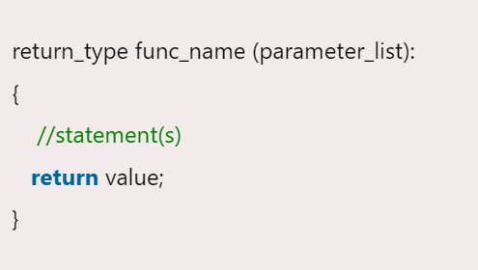
Defining a Function
A function can be defined by providing the name of the function with the appropriate parameter and return type. A function contains a set of statements which are called function body.

Slide 5
Defining a Function(Cont.)
Let's understand the general syntax of the defining function.
return_type - It can be any data type such as void, integer, float, etc. The return type must be matched with the returned value of the function.
void - It represents the function has no return type.
func_name - It should be an appropriate and valid identifier.
parameter_list - It denotes the list of the parameters, which is necessary when we called a function.
return value - A function returns a value after complete its execution.

Slide 6
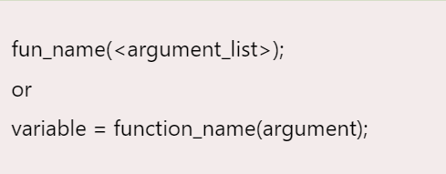

Defining a Function
When we call a function, the control is transferred to the called function. Then the called function executes all defined statements and returns the result to the calling function. The control returns to the main() function..

Slide 7
Passing Arguments to Function
When a function is called, it may have some information as per the function prototype is known as a parameter (argument). The number of parameters passed and data type while the function call must be matched with the number of parameters during function declaration. Otherwise, it will throw an error. Parameter passing is also optional, which means it is not compulsory to pass during function declaration. The parameter can be two types.
Actual Parameter - A parameter which is passed during a function definition is called the actual parameter.
Formal Parameter - A parameter which is passed during a function call is called the formal parameter.

Slide 8
What is Recursion?
Dart Recursion is the method where a function calls itself as its subroutine. It is used to solve the complex problem by dividing it into sub-part. A function which is called itself again and again or recursively, then this process is called recursion.
Recursive functions are quite similar to the other functions, but difference is to calling itself recursively. A recursive function repeats multiple times until it returns the final output. It allows programmers to solve complex problems with minimal code.

Slide 9
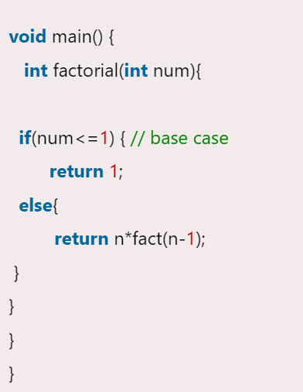
What is base condition in recursion?
Note - The base case or valid terminating condition is required in recursion function; otherwise, it will turn into an infinite loop.

Slide 10
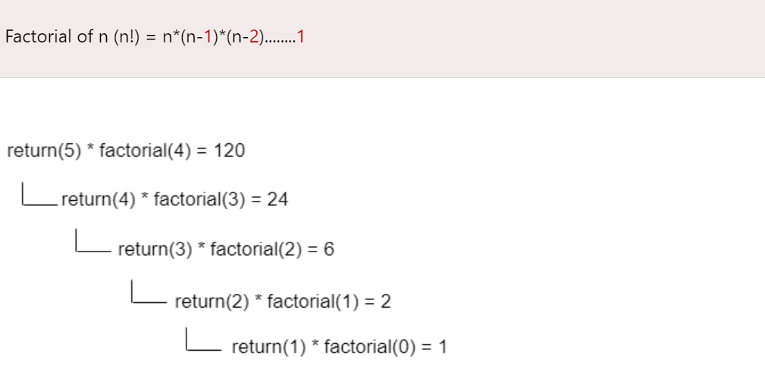
How does recursion works?
Let's understand the concept of the recursion of the example of a factorial of a given number. In the following example, we will evaluate the factorial of n numbers. It is the series of the multiplication as follows.

Slide 12
Characteristics of Recursive Function
A recursive function is a unique form of a function where function calls itself.
A valid base case is required to terminate the recursive function.
It is slower than the iteration because of stack overheads.

