Slide 1

Variables

Slide 2
What is a variable?
A Variables In Programming is a named storage location that holds a value or data.

Slide 3
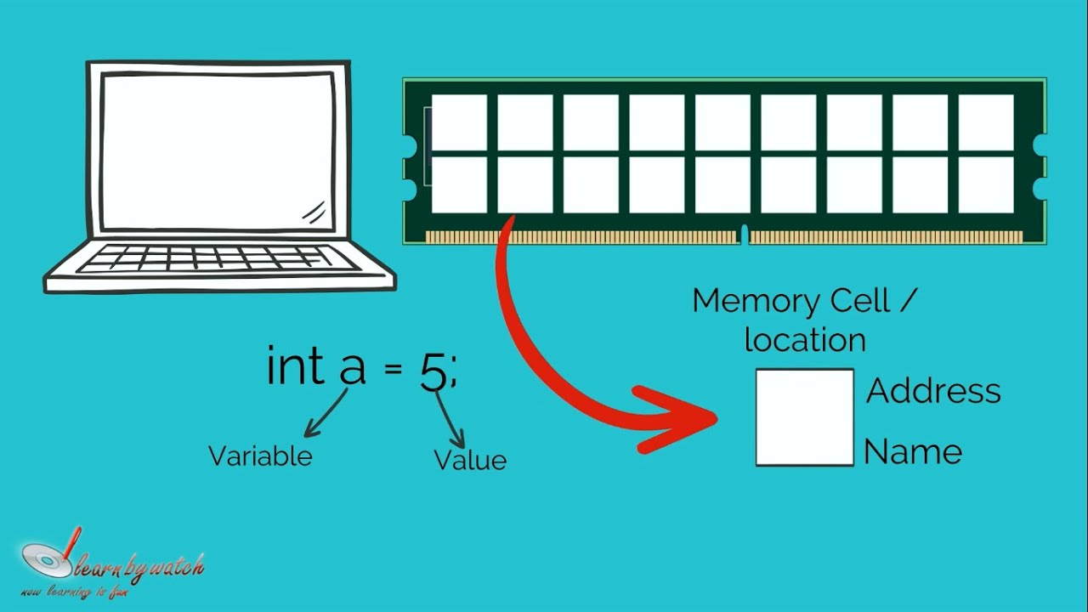

Slide 4

Dart Identifiers
Identifiers are the name which is used to define variables, methods, class, and function, etc.
An Identifier is a sequence of the letters
([A to Z],[a to z]), digits([0-9]) and underscore(_),
but remember that the first character should
not be a numeric.

Slide 5
Rules to define identifiers in dart
There are a few rules to define identifiers which are given below:
The first character should not be a digit.
Special characters are not allowed except underscore (_) or a dollar sign ($).
Two successive underscores (__) are not allowed.
The first character must be alphabet(uppercase or lowercase) or underscore.
Identifiers must be unique and cannot contain whitespace.
They are case sensitive. The variable name Jully and jully will be treated differently.
Cannot use Dart Keywords as Identifiers.

Slide 6

Dart Keywords
Dart Keywords are the reserve words that have special meaning for the compiler. It cannot be used as the variable name, class name, or function name.
Keywords are case sensitive; they must be written as they are defined.
There are 61 keywords in the Dart.

Slide 7

it's competition time

Slide 8
firstName

Slide 9
 | @var

Slide 10
 |  | String

Slide 11
 |  |  | first_name

Slide 12
__firstname

Slide 13
 | firstname

Slide 14
 |  | V5ar

Slide 15
 |  |  | &name

Slide 16
1ruslt

Slide 17
 | first-name

Slide 18
 |  | *star
 |  | V5ar | &name
1ruslt |  | var1 | name&
 |  | first name | name2

Slide 19
 | @var | *star
 |  | V5ar | &name
1ruslt | first-name | var1 | name&
 | $count | first name | name2

Slide 20
1ruslt
_firstname

Slide 21
 | $count

Slide 22
 |  | first name

Slide 23
 |  |  | name2

Slide 24
Naming Conventions in Programming
There are sets of standards that are generally accepted by the majority of developers, naming conventions are some of the most common. Because as programmers, we name a lot of things. Such as variables, functions, classes, methods, interfaces and so on.
And three of them have proved to be the most popular ones. They are:
Camel Case
Snake Case
Pascal Case

Slide 25
Declaration and Initialization of Variables
if you want to define the data type of variable explicitly you can follow this way:
datatType varName = value according dataType ;
Ex: int age =12;
if you want to declare variable without define data type you can use this keywords instead data types(var, object, dynamic).

Slide 26
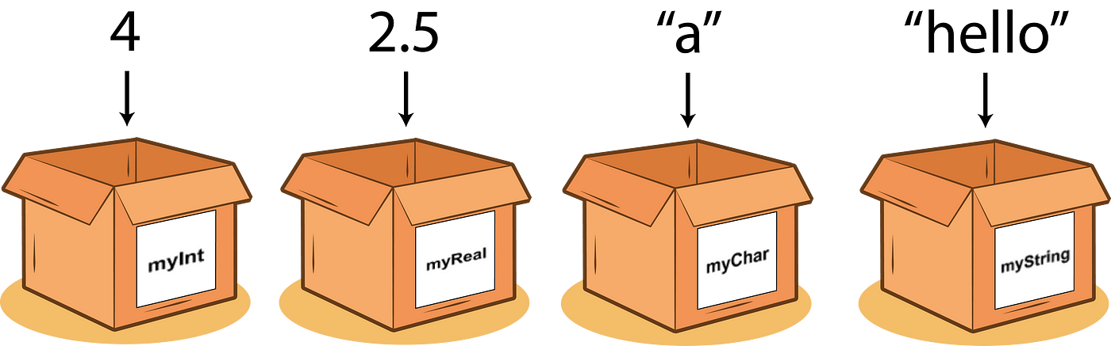
Define data type

Slide 27
Var… Object… dynamic
var is a keyword that represents a dynamically typed variable. This means that Dart will automatically infer the data type based on the assigned value.
dynamic is a type that tells the Dart compiler to skip type checking at compile time. This means that the type of a dynamic variable can be determined at runtime.
Object is the parent class of all classes in Dart and it can be used as a data type with type checking but cannot determined at runtime.

Slide 28
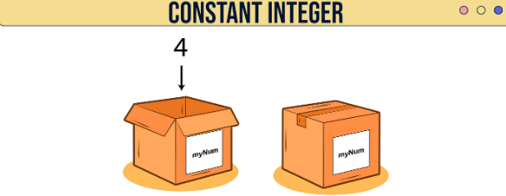
Dart Constants
Dart Constant is defined as an immutable object, which means it can't be changed or modified during the execution of the program. Once we initialize the value to the constant variable, it cannot be reassigned later.

Slide 29
Constant in Dart
The Dart constant can be defined in the following two ways:
Using the final keyword
Using the const keyword
It is beneficial when we want to keep the value unchanged in the whole program. The keywords final and const are used to create a constant variable. Both keywords final and const are used as a conjunction with the data-type. Dart will throw an exception if we try to modify the constant variable.

Slide 30
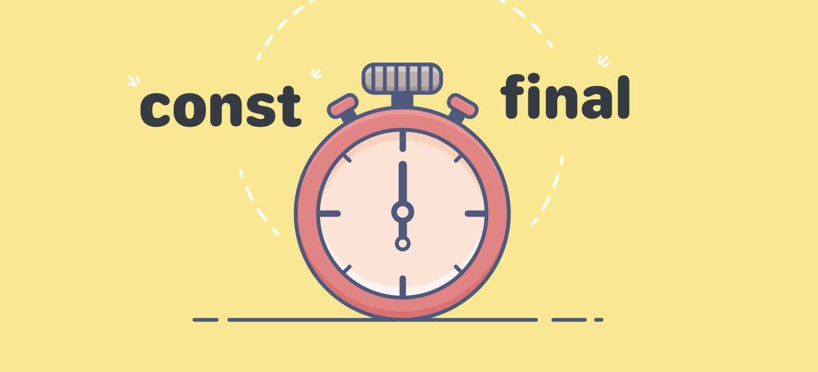
Final vs Const
A const keyword represents the compile-time constant, and the final variable can be set only once.

Slide 31
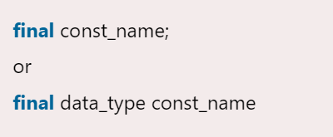
Define Constant Using final Keyword
We can define the constant by using the final keyword. The syntax is given below.

Slide 32
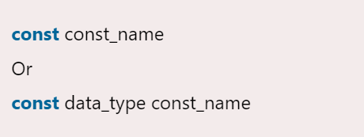
Define Constants Using const Keyword
We can define constant using the const keyword. The syntax is given below.

Slide 33
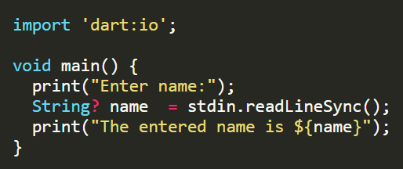
User Input in Dart

Slide 35
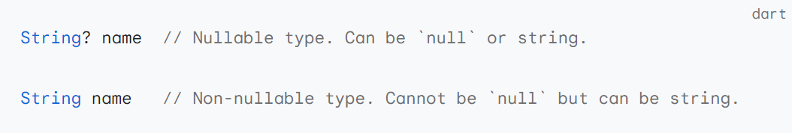
Null safety

Slide 36

Null-aware operators

Slide 37


