Slide 1

LOOPS

Slide 2
Dart loops
Dart Loop is used to run a block of code repetitively for a given number of times or until matches the specified condition. Loops are essential tools for any programming language. It is used to iterate the Dart iterable such as list, map, etc. and perform operations for multiple times. A loop can have two parts - a body of the loop and control statements. The main objective of the loop is to run the code multiple times.

Slide 3
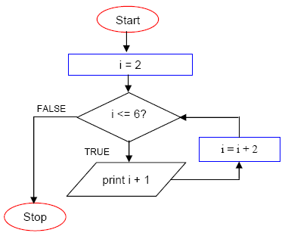

Slide 4

Type Of Loops
Dart supports the following type of loops:
Dart for loop
Dart while loop
Dart do-while loop

Slide 5
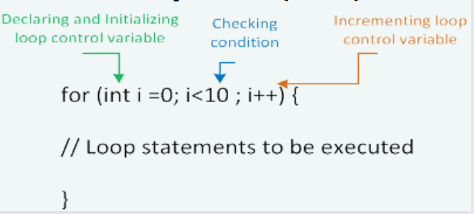
Dart for Loop Syntax

Slide 6
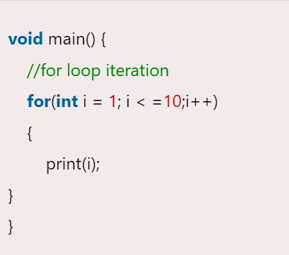
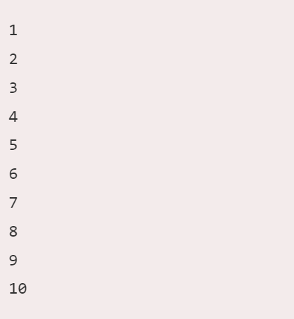
Example

Slide 7
Nested for Loop
The nested for loop means, "the for loop inside another for loop". A for inside another loop is called an inner loop and outside loop is called the outer loop. In each iteration of the outer loop, the inner loop will iterate to entire its cycle. Let's understand the following example of nested for loop.

Slide 8
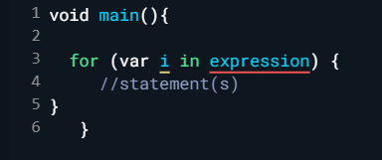
for..in Loop
The for..in loop is similar to for loop but different in its syntax.

Slide 9
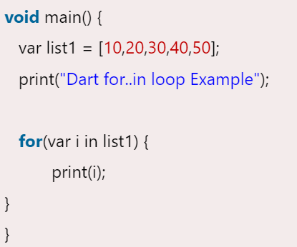
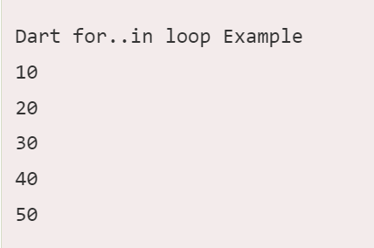
Example

Slide 10
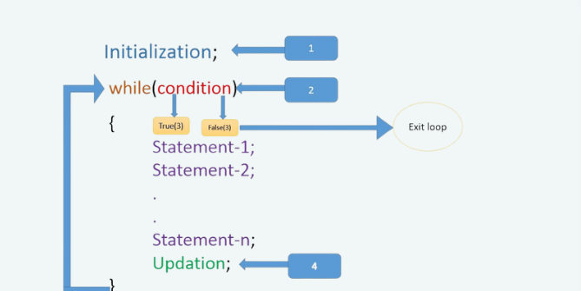
Dart while Loop Syntax

Slide 11
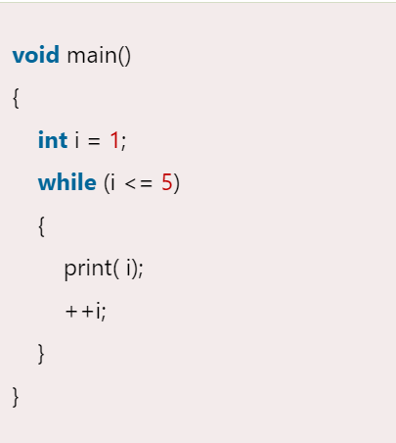

Example

Slide 12
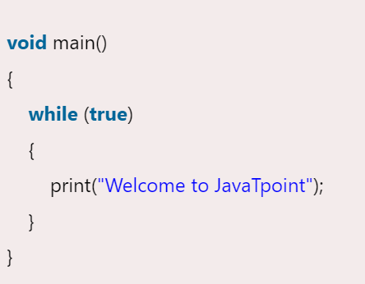
Infinite While Loop
When the while loop executes an endless time is called infinite while loop. Let's have a look at the infinite loop example.

Slide 13
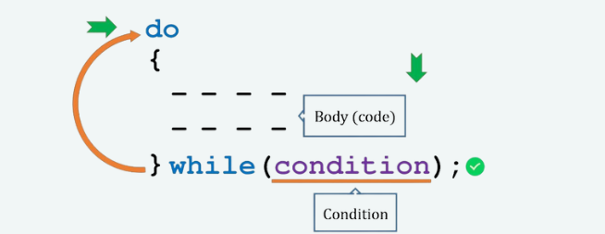
Dart Do-while Loop Syntax

Slide 14
Dart Do-while Loop Syntax (Cont.)
Dart do while loop executes a block of the statement first and then checks the condition. If the condition returns true, then the loop continues its iteration. It is similar to Dart while loop but the only difference is, in the do-while loop a block of statements inside the body of loop will execute at least once.

Slide 15
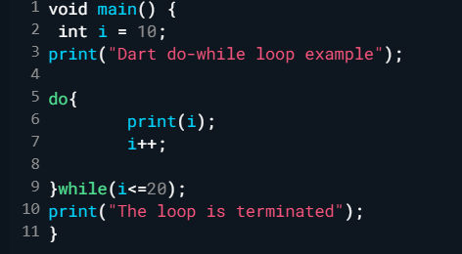
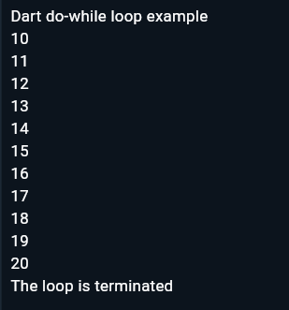
Example

