Slide 1
Unit Testing With ScalaCheck
Jouko Virtanen
Notes:
Thanks for coming to this talk on unit testing with ScalaCheck. I hope you enjoy this presentation and learn something useful.

Slide 2
Outline
Why unit testing?
Unit testing with JUnit example
Specification vs. tests
Tests as specification
Properties
Generators
ScalaCheck vs. Junit
Exercises
Notes:
I think everyone should be familiar with the concept of unit testing and why it should be done, but I will begin by talking about the importance of unit testing. I will then give an example of traditional unit testing with Junit. I will then talk about specifications of functions versus tests and writing tests that are more like specifications, which is one of the key ideas of ScalaCheck. ScalaCheck tests against properties of functions rather than a small number of predefined example runs of functions. To do this it generates random inputs using generators, along with common edge cases such as 0, large positing and negative numbers, and nulls. We will then go through some examples of ScalaCheck unit tests compared to junit tests. We will finish up by having you write some unit tests of your own using ScalaCheck. Feel free to interrupt with questions at any time.

Slide 3
Why unit testing
Make sure that program is working
Make sure that changes don’t break the program
Reduce time finding and fixing bugs
The development of software will not slow to a crawl as complexity increases
Notes:
Unit tests are used to help ensure that software is working. Of course you can never be 100% sure that your software is working as intended, but unit testing can dramatically improve the chances that it is working as intended. Unit testing helps you find bugs in code that you are writing and helps you fix them on the spot. Unit testing helps ensure that you will not break your code when you modify it. Fixing bugs with unit tests early on ensures that you won’t spend a lot of time searching for the cause of bugs later on. Without unit testing it takes longer and longer to find what is causing bugs when the size and complexity of the code increases.

Slide 4
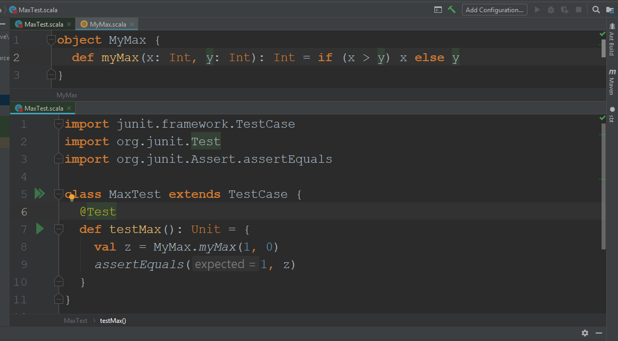
Unit testing with JUnit example
Notes:
Here is a simple unit test. Everyone should be familiar with this type of unit test. We have a simple function that finds the larger of two integers. Of course, Scala has a built in function for this, but I wrote my own for this presentation. We have one unit test for this function. In the unit test the function finds the larger of 1 and 0 and compares it to the expected value 1. I can run this unit test and indeed it passes.
sbt “testOnly MaxTest”

Slide 5
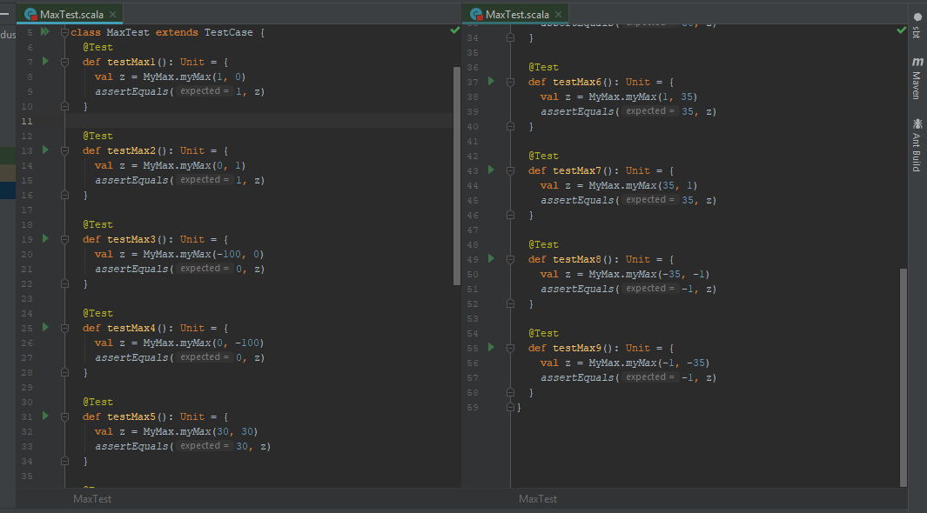
Unit testing with JUnit example
Notes:
We should have more than one unit test for each function as a function might work with some inputs and not others and we want confidence that our function works. Here we have 9 tests and they all pass. So we can be more confident that our function works. However, 9 unit tests might not be enough for a function and this can get tedious. We are also violating the don’t repeat yourself principle.
sbt “testOnly MaxMultipleTests”

Slide 6
Specification vs tests
Specification is the description of how the function should behave
Traditional unit tests only look at some number of examples
We would really like to test if the specifications are met
Specifications might be proven with logic in some cases
This can be difficult or impossible and mistakes can be made
ScalaCheck gets us close to testing specifications
Notes:
A specification is the definition of a program’s behavior. It is usually a description of the desired behavior in English or some other human language. Traditional unit tests don’t really test the specification but only some number of examples. We would really like to test if the program meets its specification. This can be proven in some cases but it is difficult and mistakes could be made in the proof. ScalaCheck gives us a way to get close to testing specifications.

Slide 7
Properties
ScalaCheck tests specifications by testing properties
A property gives a more general description of the behavior of some code
It is something that is always true of the code
For example if we have a function to square the number the output will always be positive
Notes:
ScalaCheck gets close to testing specifications by testing properties of code. A property gives a more general description of the behavior of code, compared to some finite number of unit tests. A property is something that is always true of the code. For example if we had code to calculate the square of a number a property of it would be that the output is always positive.

Slide 8
Generators
In order to test properties ScalaCheck generates random input
The unit tests check if the property holds for all random input
Input is not completely random, but also includes common edge cases
Notes:
In order to test properties ScalaCheck generates random input. ScalaCheck unit test check if the property holds for all generated random inputs. The input is not completely random. It includes common edge cases such as 0, negative numbers, large positive and negative numbers, nulls, and empty strings.

Slide 9
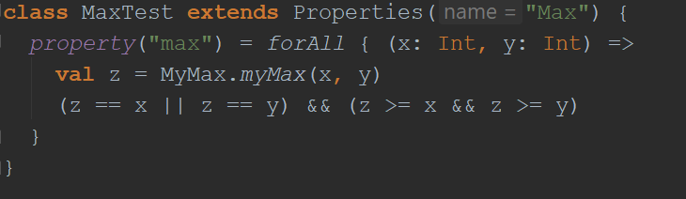
ScalaCheck example
The maximum of two numbers has to be equal to one of the two numbers
If the maximum of x and y is x then the maximum is equal to x. If the maximum is y than the maximum is greater than x.
If the maximum of x and y is y then the maximum is equal to y. If the maximum is x than the maximum is greater than y.
Notes:
In this ScalaCheck unit test the property that is tested for is (z == x || z == y) && (z >= x && z >=y), where z is the maximum of x and y. If we look at the first part here, the plain English meaning is that the maximum of two numbers must be one of the two numbers. If we ask the function which of 7 and 89 is greater and it tells us 112, something is wrong. If the output of the function is less than one of the two integers, something is wrong. If this property always holds than the function indeed returns the maximum of two numbers. Thus this property provides the specification. ScalaCheck cannot test all of the integers, but it does test for 100 random pairs of numbers by default.
sbt “testOnly MaxScalaCheckTest”

Slide 10
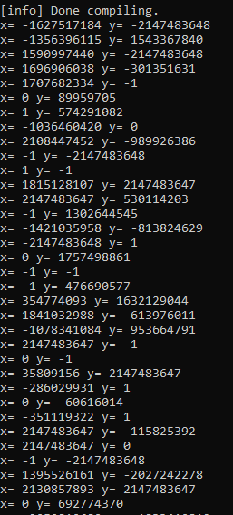
ScalaCheck example
Notes:
This displays the random pairs of x and y generated by ScalaCheck. As you can see it frequently generates 0, 1, -1, large positive numbers, and large negative numbers. Hopefully ScalaCheck will produce some input that a human writing unit tests would not use.

Slide 11
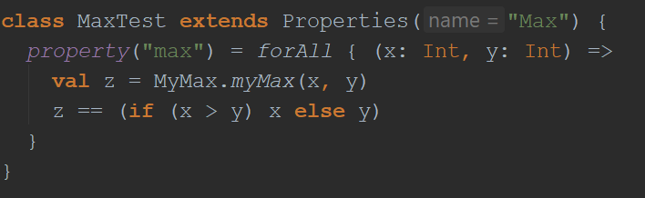
Bad ScalaCheck example
The property must be sufficiently different from the function itself
Notes:
If the property is a copy of the function. All your unit test will tell you is that a copy of the function gives the same output as the function. Put some thoughts into your properties.
sbt “testOnly MaxScalaCheckBadTest”

Slide 12
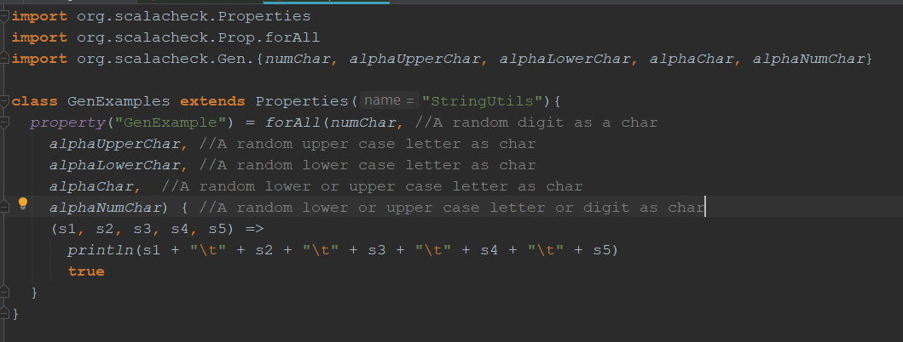
More on generators (Chars)
Notes:
ScalaCheck gives you a lot of control over the random input it generates. The next few slides are just a taste of what can be done. For example you can generate different types of random chars.

Slide 13
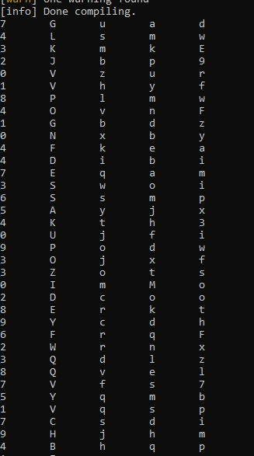
More on generators (Chars)
Notes:
Here is what the output of the previous test looks like.

Slide 14
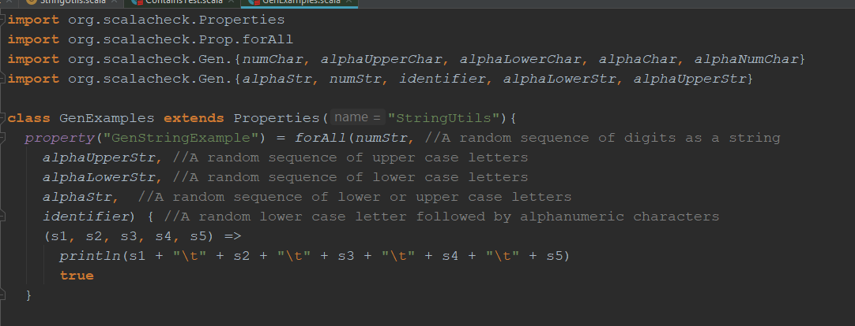
More on generators (Strings)
Notes:
Similarly there are generators for random strings.

Slide 15
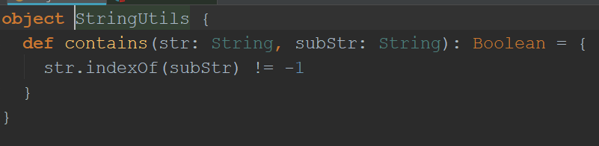
Exercise 1
Write two ScalaCheck unit tests for this function
If you think there is a bug in the code fix it
Notes:
Let’s spend some time doing an exercise. Write two ScalaCheck unit tests for this function. If you find a bug fix it.

Slide 16
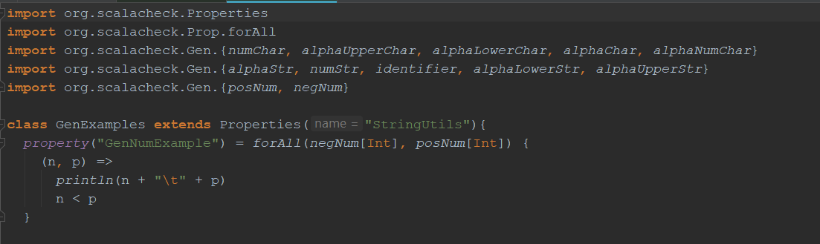
More on generators
Notes:
You can generate only negative numbers or only positive numbers.

Slide 17
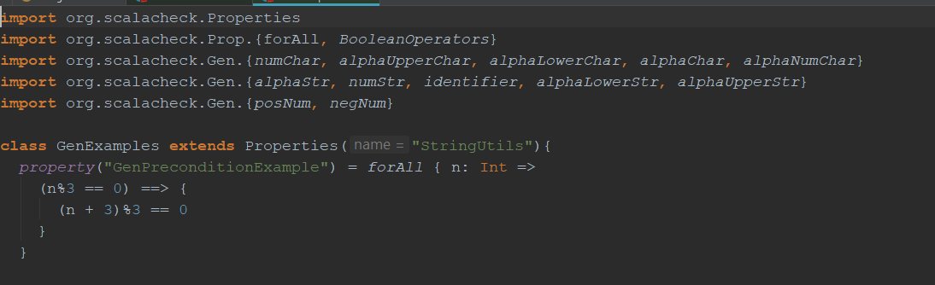
More on generators (Preconditions)
Notes:
We can use preconditions to filter out random input we don’t like. In this case only integers divisible by three are used. If the input is accepted too rarely the unit test will abort. So use this only if you have to. Alternatively I could have had ScalaCheck generate random integers and multiplied them by three to get numbers divisible by three.

Slide 18
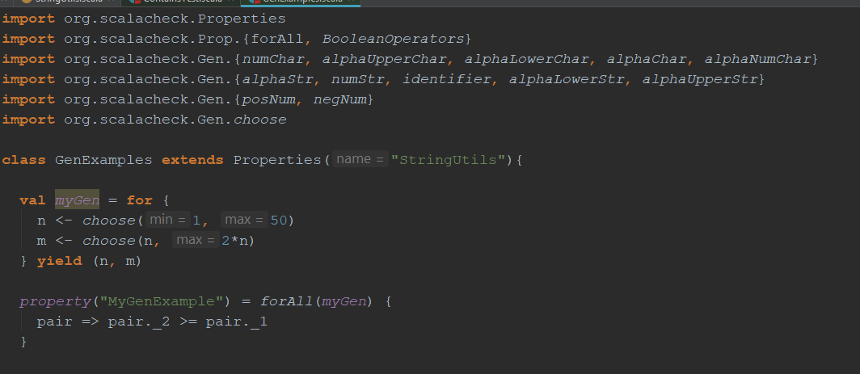
More on generators (Custom generators)
Notes:
You can write your own custom generators.

Slide 19
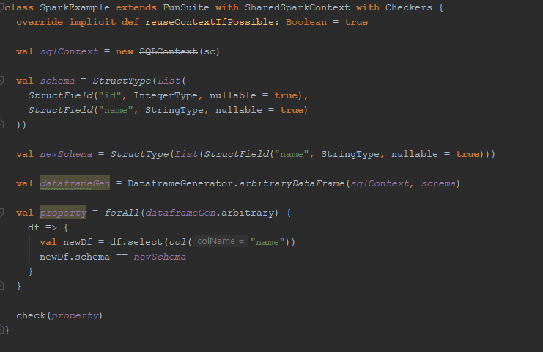
More on generators (Spark)
Notes:
You can use ScalaCheck to test Spark code.

Slide 20
Advice on coming up with unit tests
Properties don’t have to cover all behavior
If a function has an inverse, apply the inverse to the output and compare to input
Compare brute force methods with efficient methods
Relation properties
Notes:
If you can’t come up with a property that covers all behaviors of the code, come up with a property that covers some property of the code. Can the output of the function ever be negative? If a function has an inverse apply the inverse to the output of the function and you should get your original input. If not, something is wrong. If you are testing an efficient implementation of an algorithm for which you have brute force method you are confident works, compare them. They should agree. If they don’t, something is wrong. You might know that a function is continuously increasing when one parameter is increased, run the function on pairs of inputs and check if this hold. This is an example of a relation property.

Slide 21
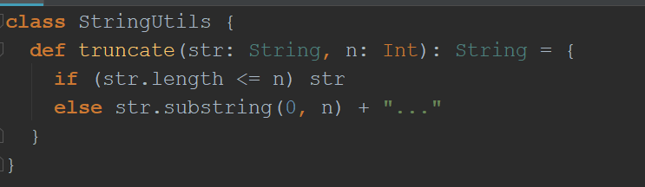
Exercise 2
Write a ScalaCheck unit tests for this function
If you think there is a bug in the code fix it
Notes:
Let’s spend some time doing an exercise. Write two ScalaCheck unit tests for this function. If you find a bug fix it.

