Slide 1
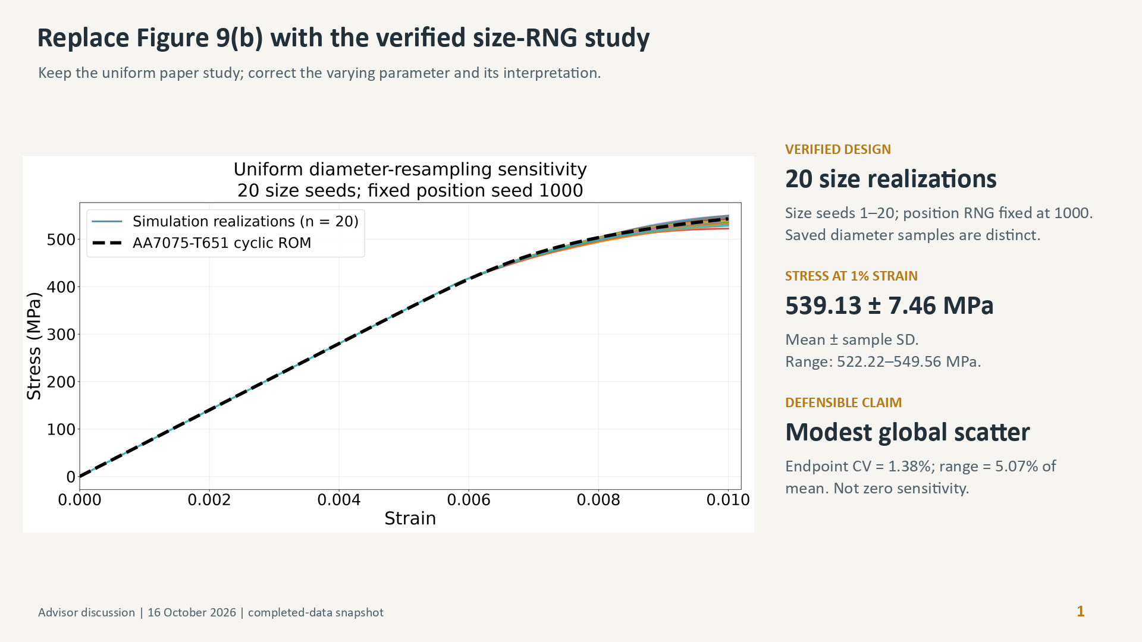
Notes:
Use set 3 as the replacement for Figure 9b, not the earlier mislabeled position ensemble. The stated uncertainty is sample standard deviation of 20 simulation endpoints, not a confidence interval. Keeping the position RNG fixed does not produce identical spatial geometries when the sampled seed inventory changes. The paper can retain the tested uniform family without claiming normal-family robustness.

Slide 2
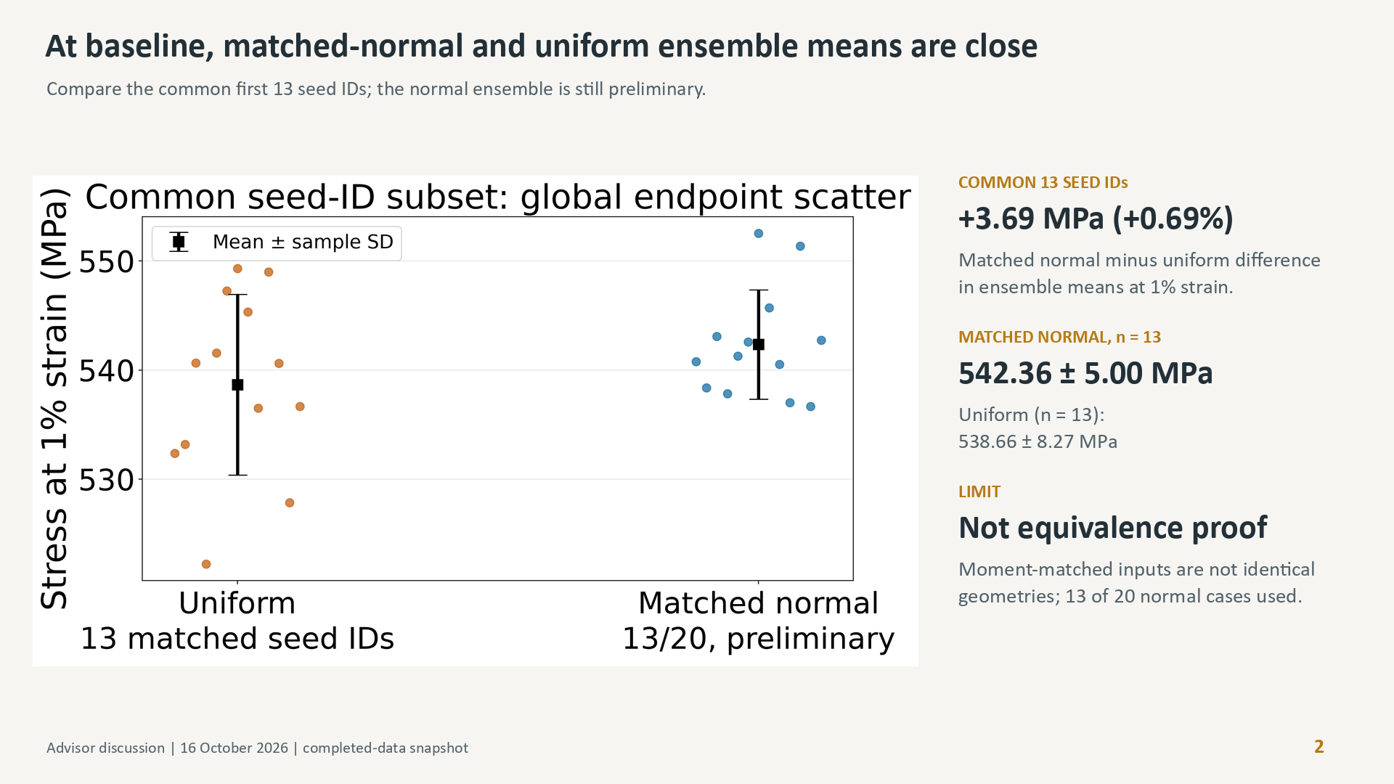
Notes:
Both theoretical size distributions have mean 0.055 mm and standard deviation 0.002886751 mm. The comparison uses size seed IDs 1–13 in both ensembles and position RNG 1000, but no identical-geometry or statistical-equivalence claim is justified. Full uniform n20 mean is539.126029 MPa, sample SD7.460961 MPa. The first13-only values make the displayed subsets comparable in count. Later arriving normal case14 was excluded from the frozen snapshot.

Slide 3
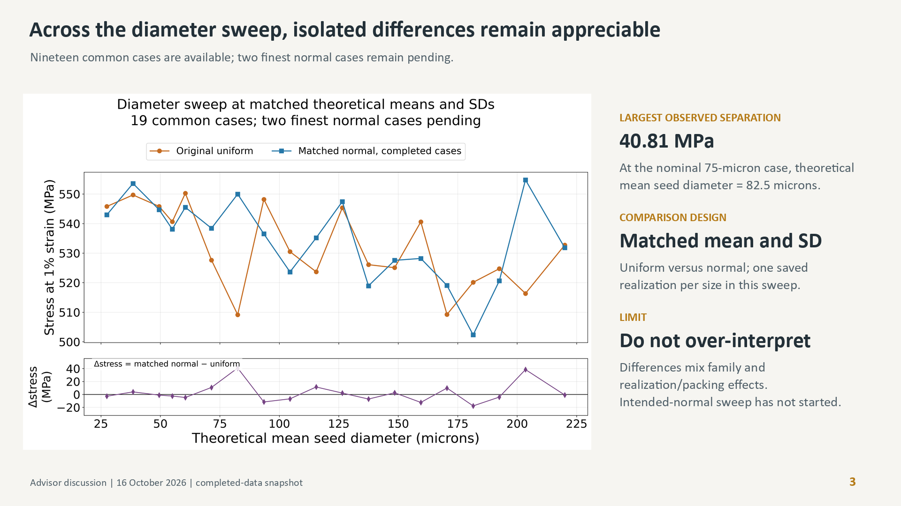
Notes:
Use for advisor discussion, not a rushed new paper claim. Maximum absolute endpoint difference across 19 matched cases is40.807528 MPa; signed differences range from-17.776935 to40.807528 MPa. Mean signed difference is2.507560 MPa but this is not a population-family estimate. No repeated ensemble at every size has been completed. Keep the original uniform sweep in the manuscript and avoid declaring family-insensitivity across sizes from a close baseline ensemble mean.

Slide 4
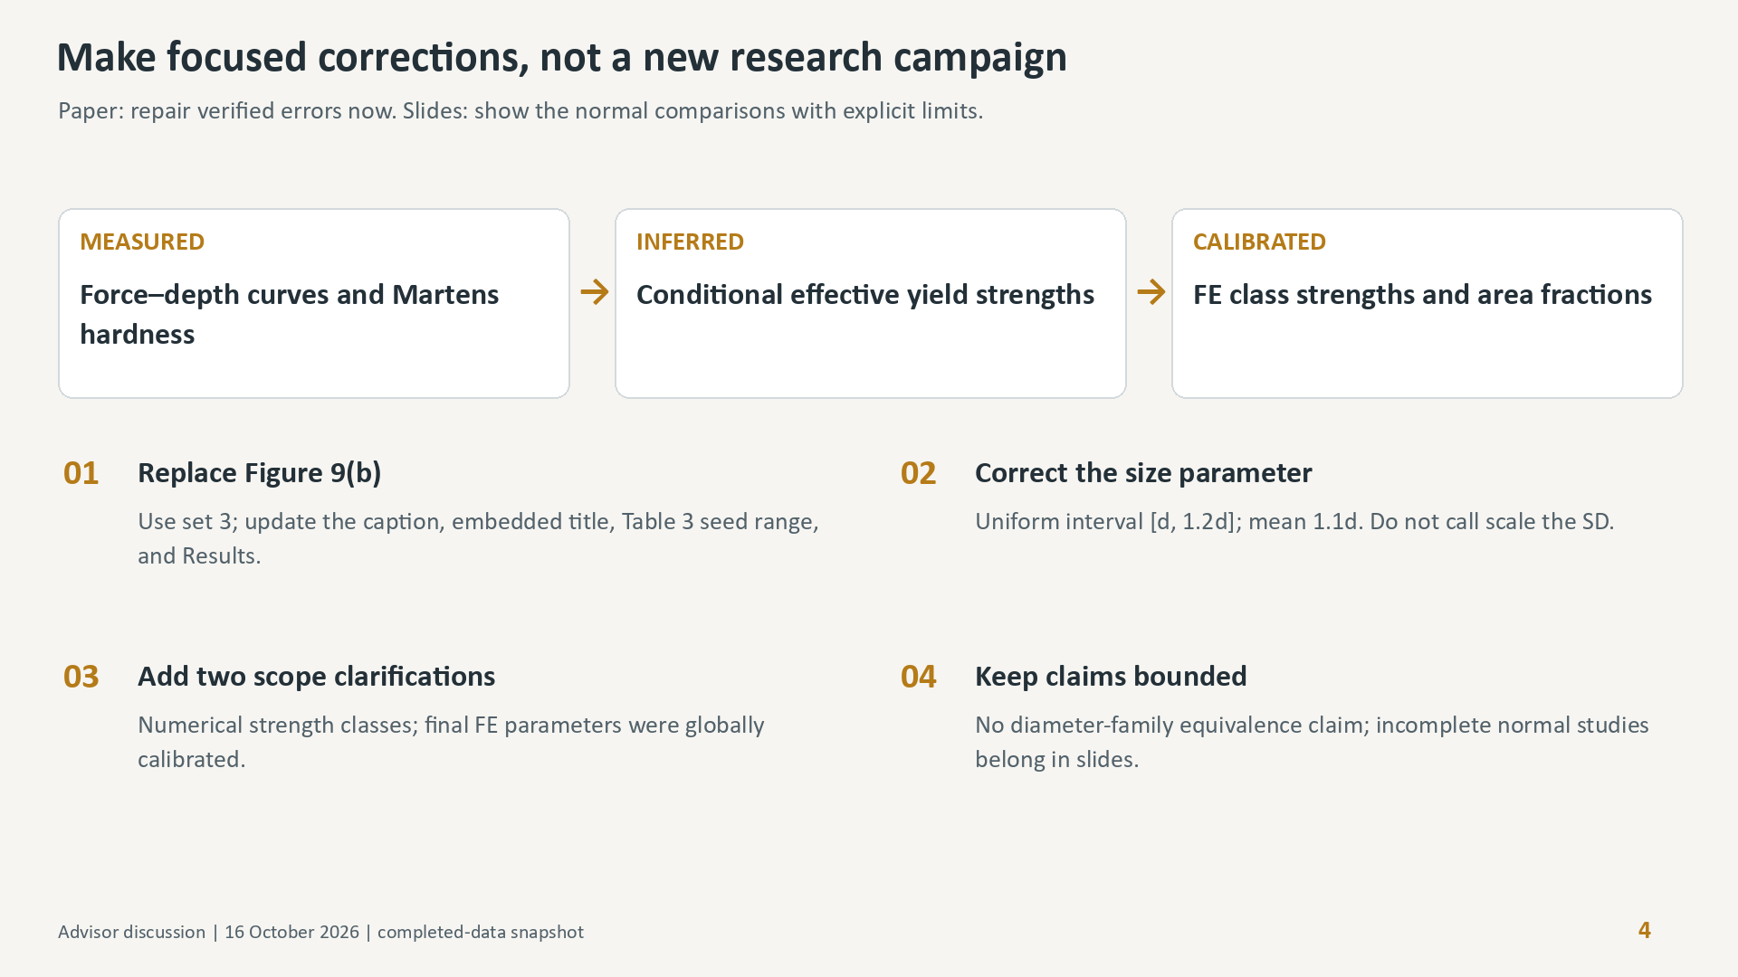
Notes:
This slide narrows the prior extensive review to necessary truth-preserving corrections. Avoid a wholesale title/structure rewrite, new microscopy, or an instrument troubleshooting campaign before the paper deadline. Correct the strongest accuracy/validation statement to a consistency or calibration description where appropriate. Exact minimal text patches are supplied separately. Final manuscript source remains untouched.

