Slide 1
The web development

Slide 2
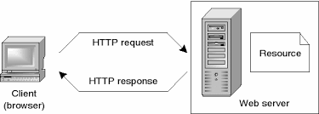
How does the web work
When http receive the browser messange.
The server receive the copy.

Slide 3
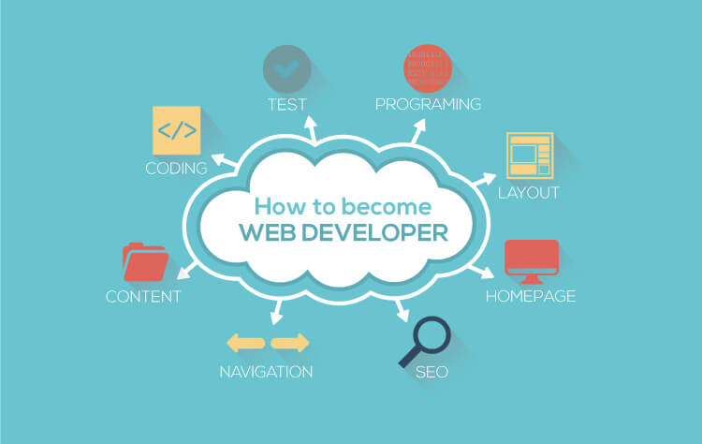
What do you need to be a web developer
You need to be a web developer is to learn the coding and langage programmation like html,cssand javascript...

Slide 4
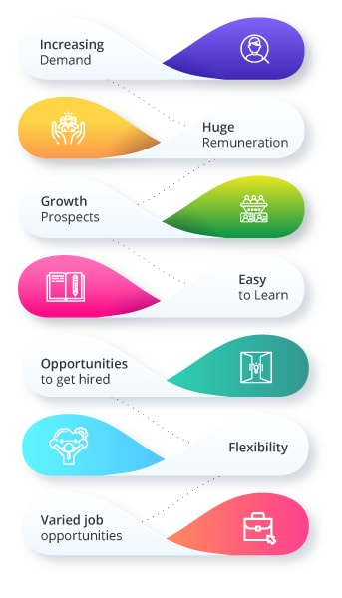
Why did you choose to learn web development
Choosing the web development is making a good career
Made innovantion and learn new thing...

Slide 5
Thanks for watching

