Slide 1
PROJECT CANARY · CAPSTONE MODEL PROOF
31
Evidence first.
Forecasts second.
Decisions always explainable.
independent
building outcomes
Refreshed EDA, leakage-safe validation, model comparisons, SHAP evidence, and an honest reliability boundary.
LATEST DATA REFRESH · 12 AUG 2026
Notes:
Set the expectation: this deck separates business evidence, model construction, model performance, and remaining limitations.
[Sources]
- /Users/jourdan.go/.codex/.chatgpt-projects/g-p-69390cd496c4819189246120c7ca0241/implementation/canary_app/data/FARM HARVEST DATA.xlsx
- /Users/jourdan.go/.codex/.chatgpt-projects/g-p-69390cd496c4819189246120c7ca0241/implementation/canary_app/outputs/model_ready/Project_Canary_Model_Ready_Data.xlsx
[/Sources]

Slide 2
PROJECT CANARY · EVIDENCE & MODEL PROOF
The business need is consistency—not another dashboard
Production outcomes vary by cycle and building. Management needs earlier evidence of drift while there is still time to investigate.
01
02
03
04
Earlier visibility
Earlier investigation
Earlier action
More consistency
Freeze the latest trustworthy records.
Prioritize the strongest recorded trigger.
Use Doc Raymond's approved inspection playbook.
Support recovery and Day 35 weight attainment.
Daily question: Which buildings are off-track, why, what outcomes are expected, and what should management check first?
02
Notes:
Canary supports decisions; it does not directly control mortality, diagnose disease, or guarantee growth.
[Sources]
- /Users/jourdan.go/.codex/.chatgpt-projects/g-p-69390cd496c4819189246120c7ca0241/implementation/canary_app/data/FARM HARVEST DATA.xlsx
[/Sources]

Slide 3
PROJECT CANARY · EVIDENCE & MODEL PROOF
The refreshed evidence base is small—but fully traceable
1,785
1,666
31
151 / 124
source workbook rows
canonical building-days after zone aggregation
eligible building outcomes across six cycles
recovery / weight training snapshots
01
02
03
04
05
Standardize
Aggregate zones
Create labels
Recreate decisions
Validate cycles
Unify cycle, building, date, age, units, and missingness.
Collapse Zone A/B to one building-day before feature creation.
Recovery proxy and recorded Day 35 weight.
Build as-of-date snapshots with future fields hidden.
Hold out every row from a complete unseen cycle.
03
Notes:
Repeated snapshots increase decision-time examples, but they do not create new independent flocks. Validation and weighting respect the building-cycle structure.
[Sources]
- /Users/jourdan.go/.codex/.chatgpt-projects/g-p-69390cd496c4819189246120c7ca0241/implementation/canary_app/data/FARM HARVEST DATA.xlsx
- /Users/jourdan.go/.codex/.chatgpt-projects/g-p-69390cd496c4819189246120c7ca0241/implementation/canary_app/outputs/model_ready/Project_Canary_Model_Ready_Data.xlsx
[/Sources]

Slide 4
PROJECT CANARY · EVIDENCE & MODEL PROOF
Seven EDA questions connect evidence to a decision
1. Is recovery consistently meeting 95%?
2. Is Day 35 weight consistently meeting 1,800 g?
3. Do outcomes differ by building?
4. Does Day 14 weight signal Day 35 weight?
5. Does Day 14 weight signal recovery?
6. How does target attainment evolve with age?
7. Which operational signals associate with recovery?
EDA shows association and patterns. It does not prove that changing a feature will cause a better outcome.
04
Notes:
Introduce the Evidence → Insight → Implication → Action structure used in the next seven slides.
[Sources]
- /Users/jourdan.go/.codex/.chatgpt-projects/g-p-69390cd496c4819189246120c7ca0241/implementation/canary_app/analysis/latest_eda/eda_summary.json
[/Sources]

Slide 5
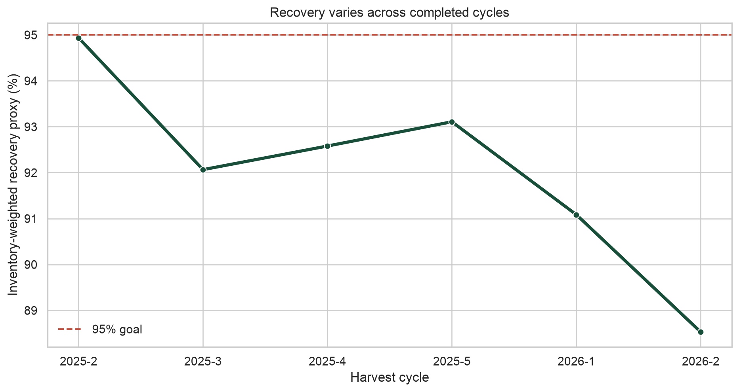
PROJECT CANARY · EDA
Q1 · Is harvest recovery consistently meeting 95%?
EVIDENCE
Six cycle proxies range from 88.5% to 94.9%; none reaches 95%.
INSIGHT
Recovery varies materially and remains below the desired level.
IMPLICATION
A single farm average hides cycle-specific deterioration.
ACTION
Track every cycle and investigate buildings before loss accumulates.
05
Notes:
Present this slide in four moves: state the evidence, interpret it, explain why it matters, then name the management or product action. Avoid causal wording.
[Sources]
- /Users/jourdan.go/.codex/.chatgpt-projects/g-p-69390cd496c4819189246120c7ca0241/implementation/canary_app/data/FARM HARVEST DATA.xlsx
- /Users/jourdan.go/.codex/.chatgpt-projects/g-p-69390cd496c4819189246120c7ca0241/implementation/canary_app/analysis/latest_eda/eda_summary.json
[/Sources]

Slide 6
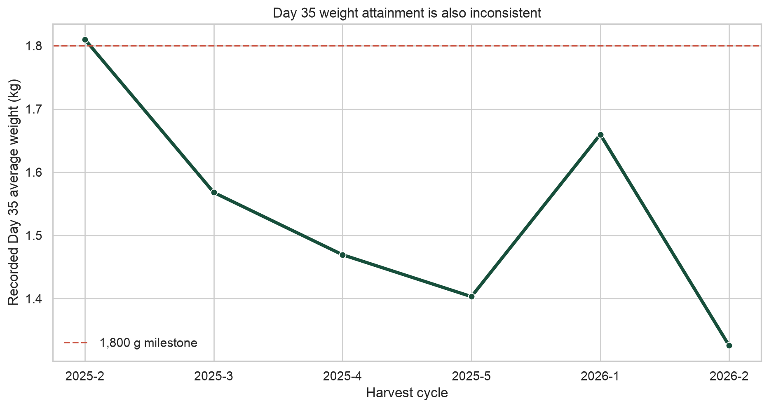
PROJECT CANARY · EDA
Q2 · Is Day 35 weight consistently meeting 1,800 g?
EVIDENCE
Cycle means range from 1.326 to 1.810 kg.
INSIGHT
Only the earliest cycle mean is near the 1,800 g milestone.
IMPLICATION
Growth shortfall is persistent, not an isolated building event.
ACTION
Use checkpoint weight gaps and measurement freshness as early evidence.
06
Notes:
Present this slide in four moves: state the evidence, interpret it, explain why it matters, then name the management or product action. Avoid causal wording.
[Sources]
- /Users/jourdan.go/.codex/.chatgpt-projects/g-p-69390cd496c4819189246120c7ca0241/implementation/canary_app/data/FARM HARVEST DATA.xlsx
- /Users/jourdan.go/.codex/.chatgpt-projects/g-p-69390cd496c4819189246120c7ca0241/implementation/canary_app/analysis/latest_eda/eda_summary.json
[/Sources]

Slide 7
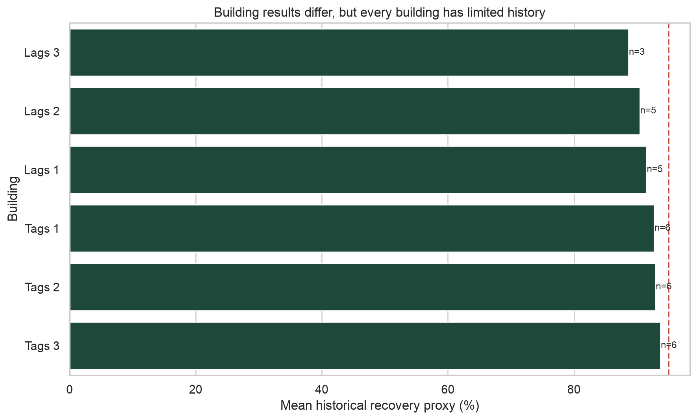
PROJECT CANARY · EDA
Q3 · Do recovery outcomes differ by building?
EVIDENCE
Building-level distributions overlap but vary in center and spread.
INSIGHT
Both building context and cycle conditions matter.
IMPLICATION
Ranking buildings within a cycle is useful, but building identity alone is not a cause.
ACTION
Compare each flagged unit with peers, then inspect direct operational triggers.
07
Notes:
Present this slide in four moves: state the evidence, interpret it, explain why it matters, then name the management or product action. Avoid causal wording.
[Sources]
- /Users/jourdan.go/.codex/.chatgpt-projects/g-p-69390cd496c4819189246120c7ca0241/implementation/canary_app/data/FARM HARVEST DATA.xlsx
- /Users/jourdan.go/.codex/.chatgpt-projects/g-p-69390cd496c4819189246120c7ca0241/implementation/canary_app/analysis/latest_eda/eda_summary.json
[/Sources]

Slide 8
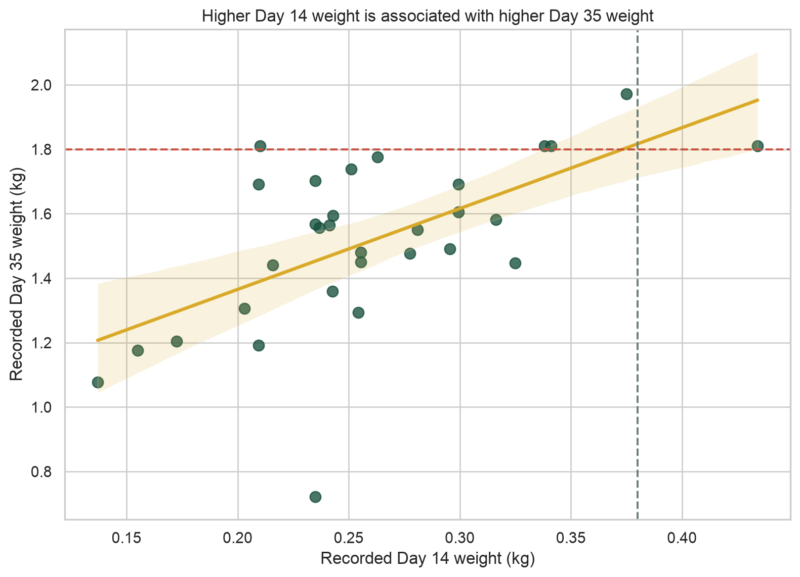
PROJECT CANARY · EDA
Q4 · Does Day 14 weight signal Day 35 weight?
EVIDENCE
Pooled Pearson r = 0.601; within-cycle r = 0.298 (not significant).
INSIGHT
Heavier Day 14 flocks tend to finish heavier, but cycle effects explain much of the pattern.
IMPLICATION
Day 14 is a useful checkpoint—not a deterministic guarantee.
ACTION
Keep Day 14 as the main early-warning review and continue updating forecasts.
08
Notes:
Present this slide in four moves: state the evidence, interpret it, explain why it matters, then name the management or product action. Avoid causal wording.
[Sources]
- /Users/jourdan.go/.codex/.chatgpt-projects/g-p-69390cd496c4819189246120c7ca0241/implementation/canary_app/data/FARM HARVEST DATA.xlsx
- /Users/jourdan.go/.codex/.chatgpt-projects/g-p-69390cd496c4819189246120c7ca0241/implementation/canary_app/analysis/latest_eda/eda_summary.json
[/Sources]

Slide 9
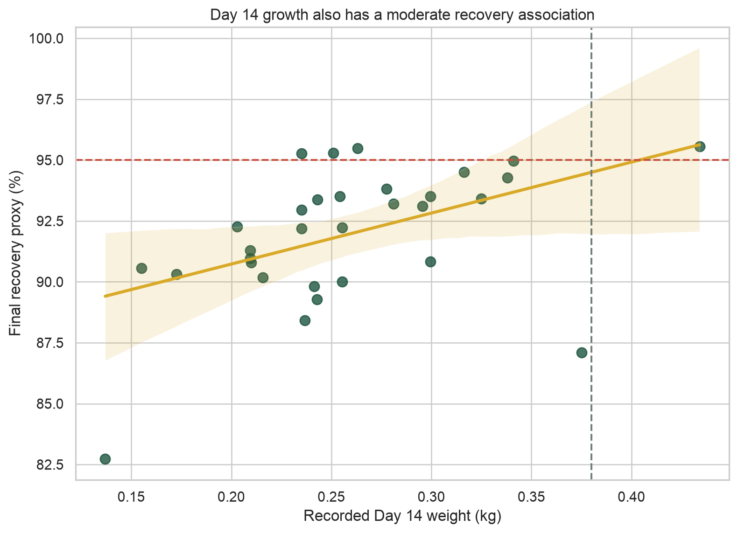
PROJECT CANARY · EDA
Q5 · Does Day 14 weight signal recovery?
EVIDENCE
Pooled r = 0.472; within-cycle r = 0.378 and borderline.
INSIGHT
Early growth and recovery move together moderately, but evidence is limited.
IMPLICATION
Weight alone cannot explain final recovery.
ACTION
Combine Day 14 weight with survival, mortality, freshness, and environment evidence.
09
Notes:
Present this slide in four moves: state the evidence, interpret it, explain why it matters, then name the management or product action. Avoid causal wording.
[Sources]
- /Users/jourdan.go/.codex/.chatgpt-projects/g-p-69390cd496c4819189246120c7ca0241/implementation/canary_app/data/FARM HARVEST DATA.xlsx
- /Users/jourdan.go/.codex/.chatgpt-projects/g-p-69390cd496c4819189246120c7ca0241/implementation/canary_app/analysis/latest_eda/eda_summary.json
[/Sources]

Slide 10
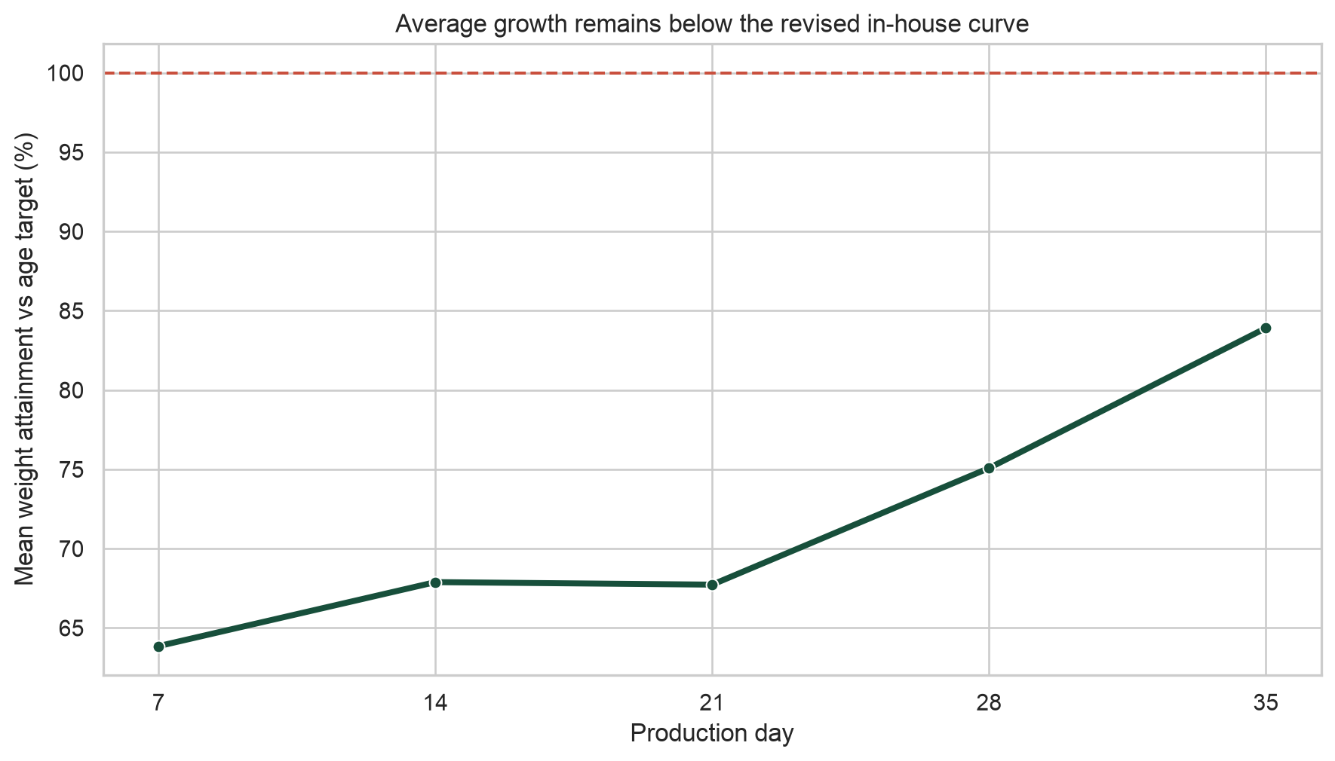
PROJECT CANARY · EDA
Q6 · How does weight target attainment evolve with age?
EVIDENCE
Mean attainment rises from 63.9% at Day 7 to 83.9% at Day 35.
INSIGHT
Flocks recover part of the early deficit but still finish below target on average.
IMPLICATION
Early deficits remain operationally meaningful even when catch-up occurs.
ACTION
Show both current gap and projected Day 35 gap; do not treat either alone as destiny.
10
Notes:
Present this slide in four moves: state the evidence, interpret it, explain why it matters, then name the management or product action. Avoid causal wording.
[Sources]
- /Users/jourdan.go/.codex/.chatgpt-projects/g-p-69390cd496c4819189246120c7ca0241/implementation/canary_app/data/FARM HARVEST DATA.xlsx
- /Users/jourdan.go/.codex/.chatgpt-projects/g-p-69390cd496c4819189246120c7ca0241/implementation/canary_app/analysis/latest_eda/eda_summary.json
[/Sources]

Slide 11
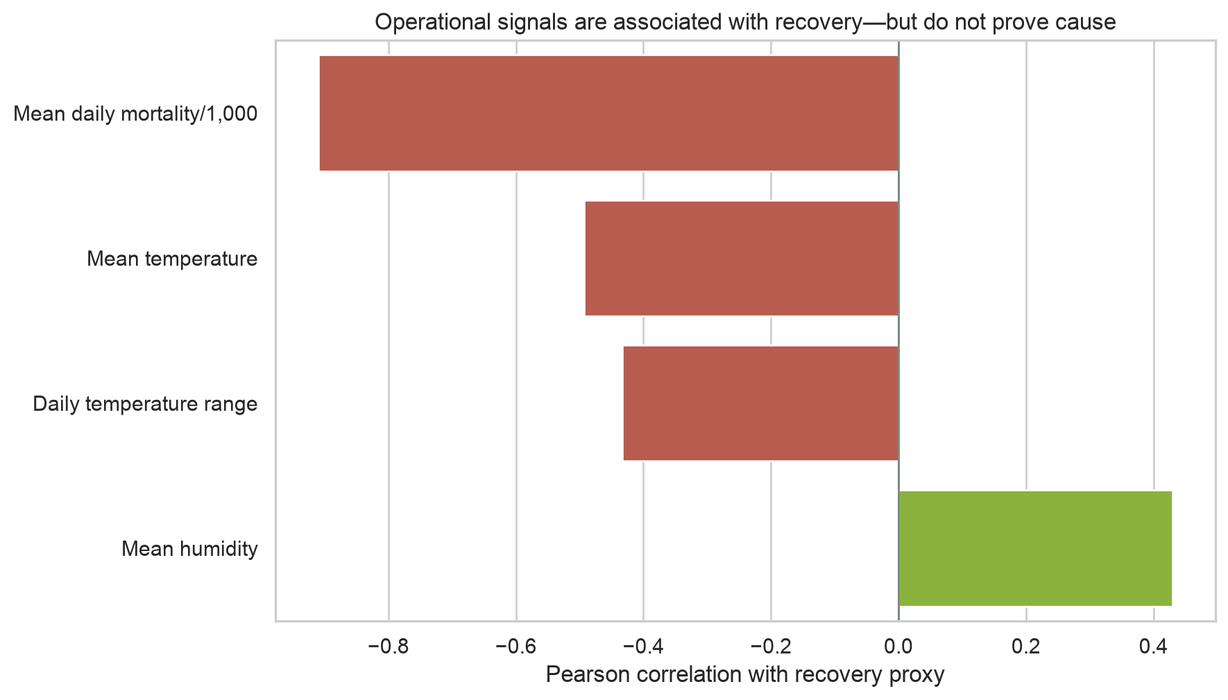
PROJECT CANARY · EDA
Q7 · Which signals associate with recovery?
EVIDENCE
Mean mortality/1,000 has the strongest descriptive correlation (−0.91).
INSIGHT
Mortality and environmental conditions carry useful signal, but signs can be confounded.
IMPLICATION
Feature importance cannot prescribe temperature or humidity changes causally.
ACTION
Use threshold breaches to trigger inspections; use model drivers as supporting context.
11
Notes:
Present this slide in four moves: state the evidence, interpret it, explain why it matters, then name the management or product action. Avoid causal wording.
[Sources]
- /Users/jourdan.go/.codex/.chatgpt-projects/g-p-69390cd496c4819189246120c7ca0241/implementation/canary_app/data/FARM HARVEST DATA.xlsx
- /Users/jourdan.go/.codex/.chatgpt-projects/g-p-69390cd496c4819189246120c7ca0241/implementation/canary_app/analysis/latest_eda/eda_summary.json
[/Sources]

Slide 12
PROJECT CANARY · EVIDENCE & MODEL PROOF
The product separates three business-logic engines
01
02
03
Rules-based risk
Predictive forecasts
Recommendation layer
Four auditable 0–3 checks: weight gap, population loss, daily mortality, environment.
Estimate final recovery proxy and Day 35 weight from what is known today.
Map the strongest observed trigger to Doc Raymond's inspection rule.
Important separation
Risk is operational concern—not a probability. Forecasts estimate outcomes. Recommendations respond to recorded evidence—not SHAP-based causal claims.
12
Notes:
This architecture keeps the system explainable and prevents a weak forecast from silently changing the deterministic risk score.
[Sources]
- /Users/jourdan.go/.codex/.chatgpt-projects/g-p-69390cd496c4819189246120c7ca0241/implementation/canary_app/models/recovery_manifest.json
- /Users/jourdan.go/.codex/.chatgpt-projects/g-p-69390cd496c4819189246120c7ca0241/implementation/canary_app/models/day35_weight_manifest.json
[/Sources]

Slide 13
PROJECT CANARY · EVIDENCE & MODEL PROOF
Recovery model · question, target, and inputs
BUSINESS QUESTION
CANDIDATE INPUTS (X)
Given survival today, how much additional population loss is likely before the recorded endpoint?
• Cycle day and forecast horizon
• Current percentage alive
• Recent mortality and mortality acceleration
• Weight gap and weight-measurement staleness
• Temperature and humidity deviation
• Days out of band and environmental staleness
TARGET (Y)
Additional loss after the review date
Final forecast = current % alive − predicted additional loss
Feed is withheld from the final compact feature set until its unit is confirmed.
13
Notes:
The remaining-loss target enforces a biologically coherent constraint: final recovery cannot exceed the percentage currently alive.
[Sources]
- /Users/jourdan.go/.codex/.chatgpt-projects/g-p-69390cd496c4819189246120c7ca0241/implementation/canary_app/outputs/model_ready/Project_Canary_Model_Ready_Data.xlsx
- /Users/jourdan.go/.codex/.chatgpt-projects/g-p-69390cd496c4819189246120c7ca0241/implementation/canary_app/models/recovery_manifest.json
[/Sources]

Slide 14
PROJECT CANARY · EVIDENCE & MODEL PROOF
Recovery model · preprocessing and feature engineering
01
02
03
04
05
Clean
Snapshot
Engineer
Guard leakage
Balance
Standardize IDs/dates; remove zone duplication; check impossible values.
Use Days 7/14/21/28 plus one labelled near-end training snapshot per building-cycle.
Survival, cumulative loss, mortality momentum, weight gap, environmental deviation/freshness.
Every X value is available on or before the as-of date; Y remains hidden.
Give each building-cycle equal total influence despite repeated snapshots.
Why some recovery rows are Day 48
Day 48 is often the last eligible row before the recovery-proxy label. It is not a fifth standard checkpoint. The workbook now separates and labels this near-end training-snapshot role.
14
Notes:
Explain that the exact standard checkpoints support comparable horizon testing, while the latest row tests near-end inference. The full daily audit remains available for lineage.
[Sources]
- /Users/jourdan.go/.codex/.chatgpt-projects/g-p-69390cd496c4819189246120c7ca0241/implementation/canary_app/outputs/model_ready/Project_Canary_Model_Ready_Data.xlsx
- /Users/jourdan.go/.codex/.chatgpt-projects/g-p-69390cd496c4819189246120c7ca0241/implementation/canary_app/models/recovery_manifest.json
[/Sources]

Slide 15
PROJECT CANARY · EVIDENCE & MODEL PROOF
Recovery model · nested whole-cycle validation
01
02
03
04
05
Outer fold
Inner folds
Preprocess inside fold
Predict unseen cycle
Aggregate evidence
Remove one complete cycle and all its building snapshots.
Tune only among the remaining cycles.
Fit imputation, scaling, filtering, and hyperparameters on training data only.
Create out-of-fold forecasts for every retained snapshot.
Primary: cycle-balanced MAE. Guardrails: RMSE, R², bias, stability, target-side accuracy.
Why no SMOTE or random row split?
This is small-sample regression. Synthetic snapshots do not create new independent cycles, and random rows would leak cycle conditions into both train and test.
15
Notes:
This protocol is stricter than leaving out one building while retaining other buildings from the same cycle. It approximates the real question: performance on a completely unseen future cycle.
[Sources]
- /Users/jourdan.go/.codex/.chatgpt-projects/g-p-69390cd496c4819189246120c7ca0241/implementation/canary_app/models/recovery_manifest.json
[/Sources]

Slide 16
PROJECT CANARY · EVIDENCE & MODEL PROOF
Recovery model · five candidates, one conservative champion
Model
Cycle MAE
RMSE
R²
Decision
Age-band baseline
2.092 pts
2.660 pts
−0.010
Baseline
Ordinary linear
1.756 pts
2.573 pts
0.054
Selected
Ridge
1.756 pts
2.572 pts
0.055
Near tie
Gradient Boosting
1.844 pts
2.469 pts
0.129
Compared
Constrained Extra Trees
1.802 pts
2.469 pts
0.129
SHAP challenger
Why ordinary linear?
It has the best cycle-balanced MAE by a negligible margin over Ridge and is easier to reproduce and explain. Extra Trees has better pooled R², but worse cycle-balanced MAE and higher complexity.
Selected forecast: MAE 1.74 percentage points · ±2.83-point 80% empirical half-width · R² 0.054
16
Notes:
Lower MAE/RMSE is better; higher R² is better. The selected model improves error versus baseline but explains little unseen-cycle variance, so the forecast remains experimental.
[Sources]
- /Users/jourdan.go/.codex/.chatgpt-projects/g-p-69390cd496c4819189246120c7ca0241/implementation/canary_app/models/recovery_manifest.json
[/Sources]

Slide 17
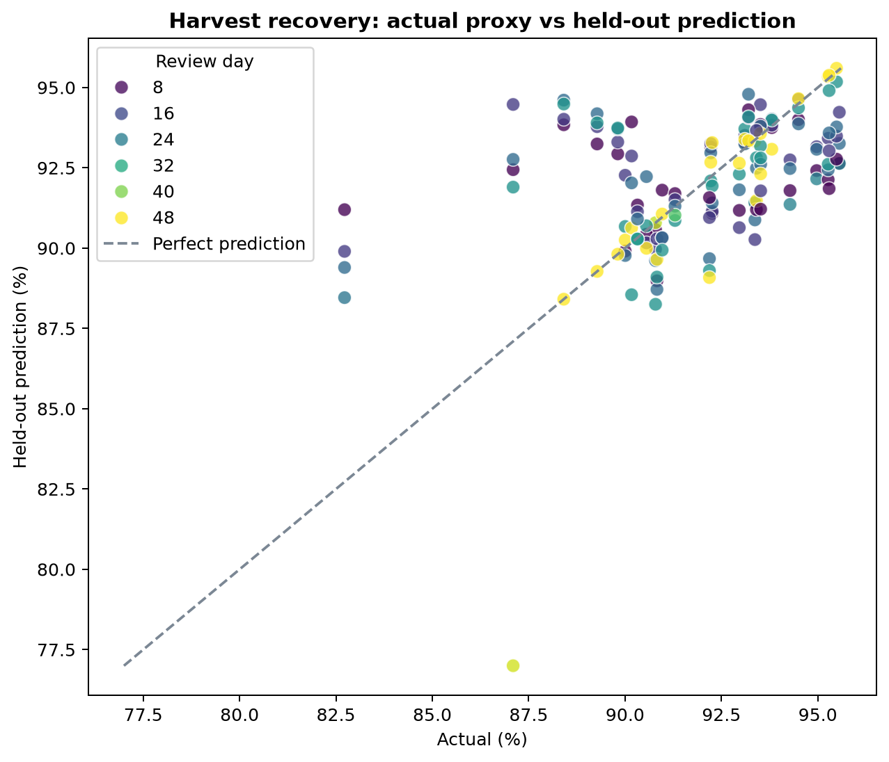
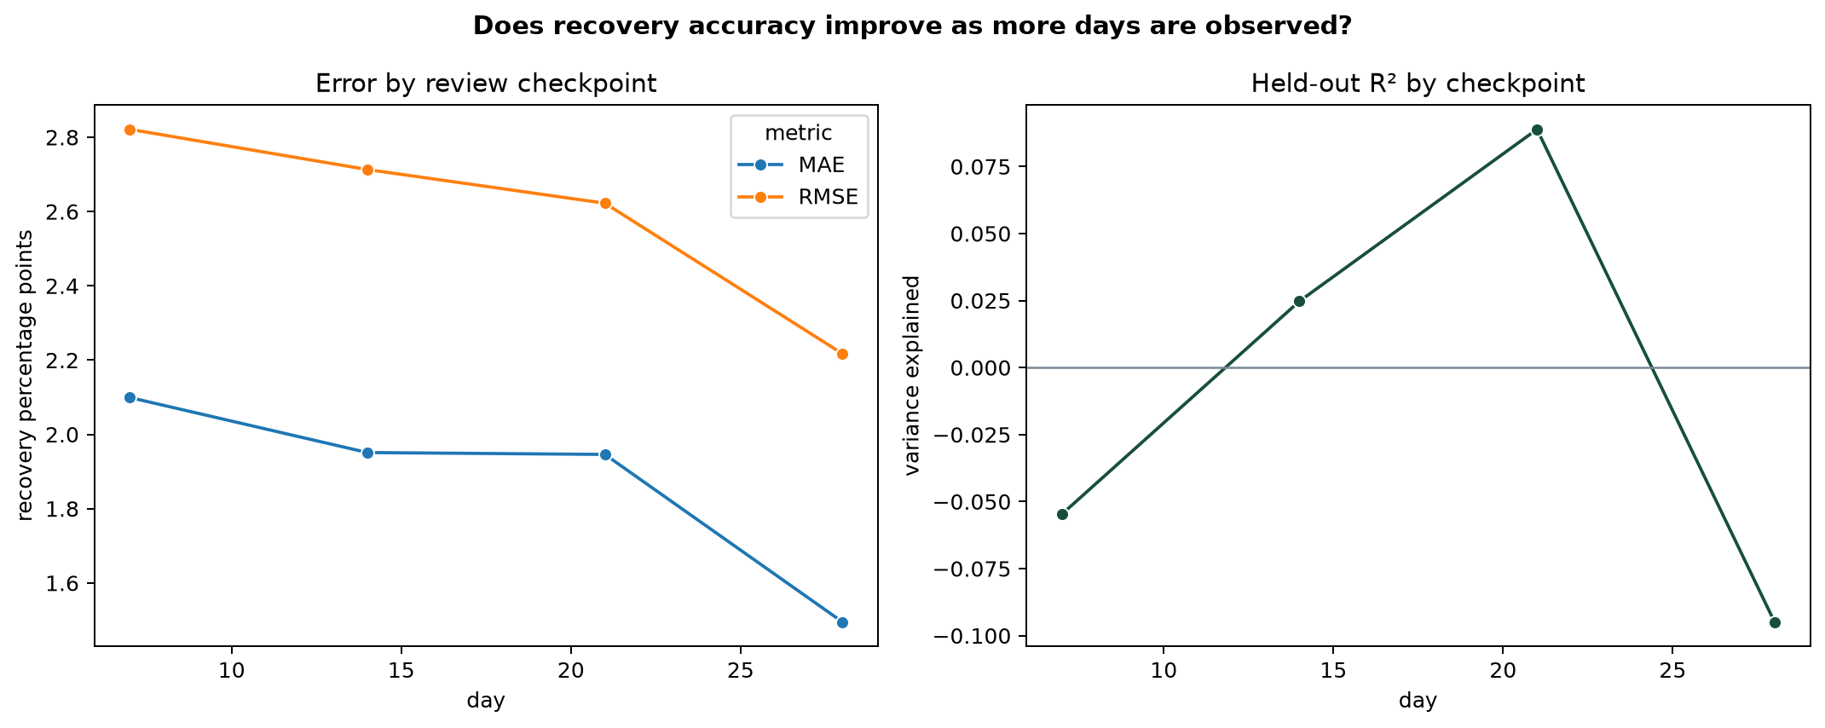
PROJECT CANARY · EVIDENCE & MODEL PROOF
Recovery model · actual versus predicted and performance by age
Accuracy improves with age: MAE is ~2.10 points on Days 1–7 and ~1.33 points from Day 22 onward. Day 14 MAE is 1.95 points.
17
Notes:
The scatter exposes regression error directly. The checkpoint chart answers the mentor question: forecasts generally become more accurate as more days of mortality and survival are observed.
[Sources]
- /Users/jourdan.go/.codex/.chatgpt-projects/g-p-69390cd496c4819189246120c7ca0241/implementation/canary_app/models/recovery_manifest.json
[/Sources]

Slide 18
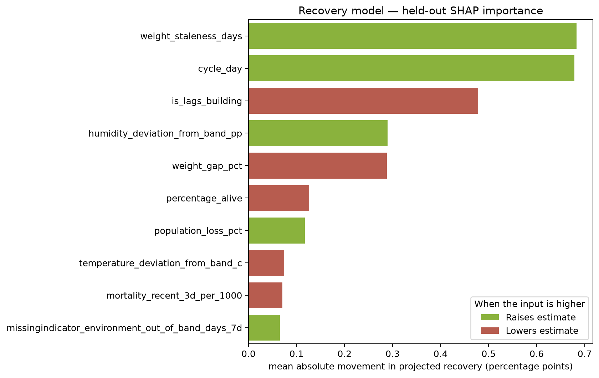
PROJECT CANARY · EVIDENCE & MODEL PROOF
Recovery model · SHAP adds sensitivity evidence—not causality
WHY A TREE CHALLENGER?
The live champion is linear. We use out-of-fold SHAP on the constrained Extra Trees challenger to test whether nonlinear patterns concentrate around sensible variables.
TOP SENSITIVITIES
Cycle day · weight staleness · building group · humidity deviation · weight gap
SHAP shows association within this fitted model. It does not prove that changing humidity or temperature will cause recovery to improve.
18
Notes:
Feature importance should support model understanding. Management actions continue to come from recorded threshold violations and the approved playbook.
[Sources]
- /Users/jourdan.go/.codex/.chatgpt-projects/g-p-69390cd496c4819189246120c7ca0241/implementation/canary_app/models/recovery_manifest.json
[/Sources]

Slide 19
PROJECT CANARY · EVIDENCE & MODEL PROOF
Recovery model · what the low R² means
1.74 pts
0.054
90.1%
typical held-out absolute error
variance explained in unseen cycles
target-side accuracy—but mostly below-target cases
THE HONEST INTERPRETATION
WHY R² IS LOW
The model improves continuous-error performance over the historical baseline, but most outcome variation remains unexplained. It is useful for a directional point estimate and range—not a probability of reaching 95%.
31 independent outcomes; strong cycle shifts; proxy endpoint; incomplete interventions, health events, feed units, and sensor histories.
Trust boundary: use forecast + uncertainty + operational evidence together. Do not present the estimate as a guarantee.
19
Notes:
Also state target-side weakness: Day 14 target-side accuracy equals the majority-below rule, and the model does not reliably identify the few ≥95% outcomes.
[Sources]
- /Users/jourdan.go/.codex/.chatgpt-projects/g-p-69390cd496c4819189246120c7ca0241/implementation/canary_app/models/recovery_manifest.json
[/Sources]

Slide 20
PROJECT CANARY · EVIDENCE & MODEL PROOF
Day 35 weight model · question, target, and inputs
BUSINESS QUESTION
CANDIDATE INPUTS (X)
Given the latest measured weight, how much additional growth is expected by Day 35?
• Latest observed weight and checkpoint day
• Weight-to-age-target ratio
• Day 7/14/21/28 weights known at that date
• Recent and cumulative average daily gain
• Current survival and recent mortality
• Environmental deviation and freshness
• Missingness indicators
TARGET (Y)
Recorded Day 35 average weight
Equivalent target: remaining gain from checkpoint to Day 35
Deaths were tested in learned challengers. They are not forced into the operational fallback because those challengers performed worse.
20
Notes:
Day 35 data is present on every training row as Y. It must not appear among earlier X features, or the model would be given the answer.
[Sources]
- /Users/jourdan.go/.codex/.chatgpt-projects/g-p-69390cd496c4819189246120c7ca0241/implementation/canary_app/outputs/model_ready/Project_Canary_Model_Ready_Data.xlsx
- /Users/jourdan.go/.codex/.chatgpt-projects/g-p-69390cd496c4819189246120c7ca0241/implementation/canary_app/models/day35_weight_manifest.json
[/Sources]

Slide 21
PROJECT CANARY · EVIDENCE & MODEL PROOF
Day 35 weight model · preprocessing and leakage controls
01
02
03
04
05
Observe checkpoints
Create as-of X
Engineer features
Set Y
Validate cycles
Use actual measured Days 7, 14, 21, and 28—not target interpolation as bodyweight.
Later checkpoint weights are blank in earlier snapshots.
Target ratio, recent/cumulative gain, survival, mortality, environment, freshness.
Attach the recorded Day 35 average weight and remaining gain.
Repeat nested whole-cycle testing and keep 2026-3 as prospective audit.
Why the training sheet ends at Day 28
The model predicts Day 35. A Day 35 row would contain zero remaining horizon and reveal the target. The Day 35 value is therefore the Y label attached to every earlier checkpoint row.
21
Notes:
This is standard supervised-learning structure: rows contain predictors at decision time and the later outcome label the model must learn to estimate.
[Sources]
- /Users/jourdan.go/.codex/.chatgpt-projects/g-p-69390cd496c4819189246120c7ca0241/implementation/canary_app/outputs/model_ready/Project_Canary_Model_Ready_Data.xlsx
- /Users/jourdan.go/.codex/.chatgpt-projects/g-p-69390cd496c4819189246120c7ca0241/implementation/canary_app/models/day35_weight_manifest.json
[/Sources]

Slide 22
PROJECT CANARY · EVIDENCE & MODEL PROOF
Day 35 weight · learned models do not beat the transparent fallback
Model
Cycle MAE
RMSE
R²
Decision
Historical remaining gain
182 g
242 g
0.126
Selected
Checkpoint linear
210 g
276 g
−0.136
Compared
Ridge
200 g
265 g
−0.049
Compared
Robust Huber
225 g
279 g
−0.164
Compared
Gradient Boosting
205 g
261 g
−0.019
Best learned
Champion gate
A learned model must improve cycle-balanced MAE by at least 10%, retain positive R², avoid severe cycle deterioration, and place at least 70% within 200 g. None passed.
Operational result: 178 g overall MAE · 65.3% within 200 g · R² 0.126 · experimental forecast
22
Notes:
The fallback is not 'no model.' It is an out-of-fold estimator of expected remaining growth by checkpoint, chosen because it generalized better than the fitted candidates.
[Sources]
- /Users/jourdan.go/.codex/.chatgpt-projects/g-p-69390cd496c4819189246120c7ca0241/implementation/canary_app/models/day35_weight_manifest.json
[/Sources]

Slide 23
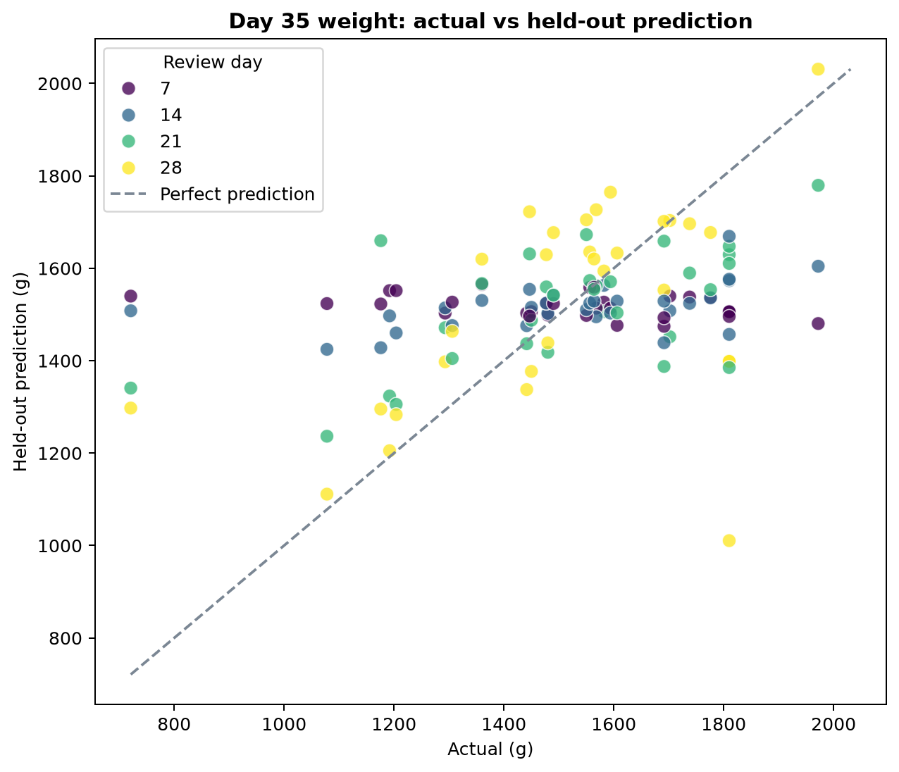
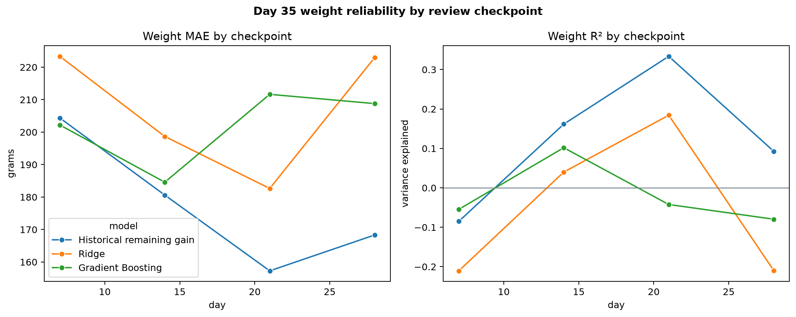
PROJECT CANARY · EVIDENCE & MODEL PROOF
Day 35 weight · actual versus predicted and checkpoint evidence
Day 21 is strongest historically: 157 g MAE, 77.4% within 200 g, R² 0.334. Day 14 MAE is 181 g and 58.1% fall within 200 g.
23
Notes:
Later does not improve monotonically in this small dataset; Day 28 is affected by strong cycle-specific remaining growth. That is evidence for a hierarchical biological growth-curve challenger.
[Sources]
- /Users/jourdan.go/.codex/.chatgpt-projects/g-p-69390cd496c4819189246120c7ca0241/implementation/canary_app/models/day35_weight_manifest.json
[/Sources]

Slide 24
PROJECT CANARY · EVIDENCE & MODEL PROOF
2026-3 gives a clean prospective weight audit
3
63 g
91.7%
1.446–1.517 kg
new building outcomes excluded from fitting
MAE across 12 checkpoint forecasts
forecasts within 200 g
recorded Day 35 outcomes
Checkpoint
MAE
Within 200 g
Do not overclaim
Day 7
54 g
100%
Only three closely clustered outcomes. Negative R² is mathematically expected when outcome variance is tiny, even with small gram errors.
Day 14
43 g
100%
Day 21
33 g
100%
Day 28
124 g
67%
24
Notes:
This audit was not used for champion selection. It is promising out-of-time evidence, but three buildings are too few to redefine reliability.
[Sources]
- /Users/jourdan.go/.codex/.chatgpt-projects/g-p-69390cd496c4819189246120c7ca0241/implementation/canary_app/models/day35_weight_manifest.json
[/Sources]

Slide 25
PROJECT CANARY · EVIDENCE & MODEL PROOF
Model governance keeps performance honest
01
02
03
04
05
Version inputs
Freeze model-ready data
Compare five families
Apply gates
Publish one release
Canonical workbook, target curve, environmental rules.
Export exact X/Y rows and leakage audit.
Baseline, linear, Ridge/Huber, constrained tree models.
MAE improvement plus R², stability, target and interval checks.
App, notebooks, manifests, PKLs, guide, and deck use identical evidence.
Current positioning
Validated experimental forecasts. Useful for directional planning with ranges; not production guarantees and not reliable probabilities of target attainment.
25
Notes:
The current operational methods stay in place until a challenger passes every predeclared gate under the same whole-cycle protocol.
[Sources]
- /Users/jourdan.go/.codex/.chatgpt-projects/g-p-69390cd496c4819189246120c7ca0241/implementation/canary_app/models/recovery_manifest.json
- /Users/jourdan.go/.codex/.chatgpt-projects/g-p-69390cd496c4819189246120c7ca0241/implementation/canary_app/models/day35_weight_manifest.json
- /Users/jourdan.go/.codex/.chatgpt-projects/g-p-69390cd496c4819189246120c7ca0241/implementation/canary_app/outputs/model_ready/Project_Canary_Model_Ready_Data.xlsx
[/Sources]

Slide 26
PROJECT CANARY · EVIDENCE & MODEL PROOF
The strongest next improvements are biological and data-centric
01
Verify outcomes
02
Standardize weights
Record actual harvest events, ending population, transfers/culls, and sale timing.
Record sampling method, sample size, zone, scale, and actual measurement date.
03
Recovery challenger
04
Growth challenger
Model future death counts with exposure-aware Poisson/negative-binomial or discrete-time hazard models.
Fit hierarchical Gompertz/Richards growth curves with partial pooling, then model residuals.
05
Add missing context
06
Accumulate cycles
Confirm feed/water units; capture strain, sex, density, disease, medication, and interventions.
Freeze 2026-3 and future cycles as prospective tests; recalibrate only after enough new outcomes.
26
Notes:
Complexity is not the main bottleneck. Better outcome labels, standardized measurements, biological curve structure, and more independent cycles will likely improve reliability more than adding a larger model zoo.
[Sources]
- /Users/jourdan.go/.codex/.chatgpt-projects/g-p-69390cd496c4819189246120c7ca0241/implementation/canary_app/models/recovery_manifest.json
- /Users/jourdan.go/.codex/.chatgpt-projects/g-p-69390cd496c4819189246120c7ca0241/implementation/canary_app/models/day35_weight_manifest.json
[/Sources]

Slide 27
THE DEFENSIBLE CAPSTONE POSITION
Canary creates earlier visibility—without hiding uncertainty.
The rules explain operational concern. The forecasts estimate likely recovery and Day 35 weight. The playbook turns recorded triggers into traceable inspections.
Evidence → Insight → Decision → Learning
Next milestone: verify labels, standardize measurements, and accumulate prospective cycles.
Notes:
Close with the honest proposition: the system is valuable because it organizes evidence and uncertainty into a repeatable management workflow—not because the present small-data forecasts are guarantees.
[Sources]
- /Users/jourdan.go/.codex/.chatgpt-projects/g-p-69390cd496c4819189246120c7ca0241/implementation/canary_app/data/FARM HARVEST DATA.xlsx
- /Users/jourdan.go/.codex/.chatgpt-projects/g-p-69390cd496c4819189246120c7ca0241/implementation/canary_app/models/recovery_manifest.json
- /Users/jourdan.go/.codex/.chatgpt-projects/g-p-69390cd496c4819189246120c7ca0241/implementation/canary_app/models/day35_weight_manifest.json
[/Sources]

