Slide 1
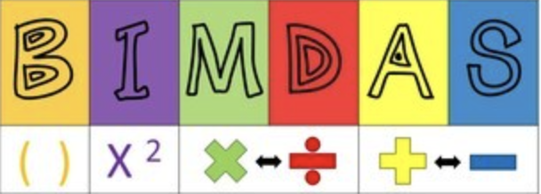




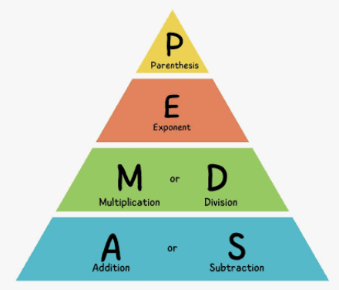

Order of operations review

Slide 2
How would you describe what you see?

Slide 3
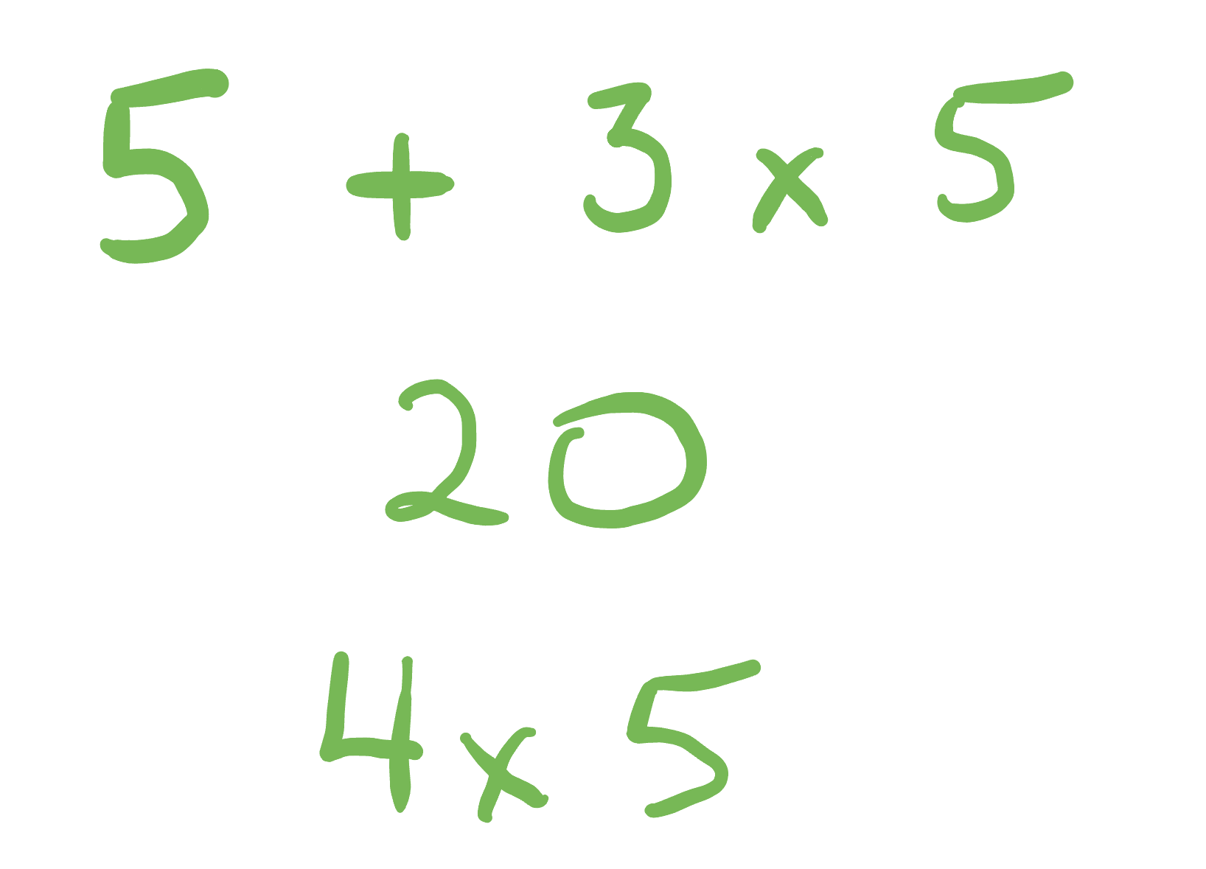
Maybe like this?

Slide 4
Or this?

Slide 5
Or even this??

Slide 6
Example 2
How would you describe what you see?

Slide 7
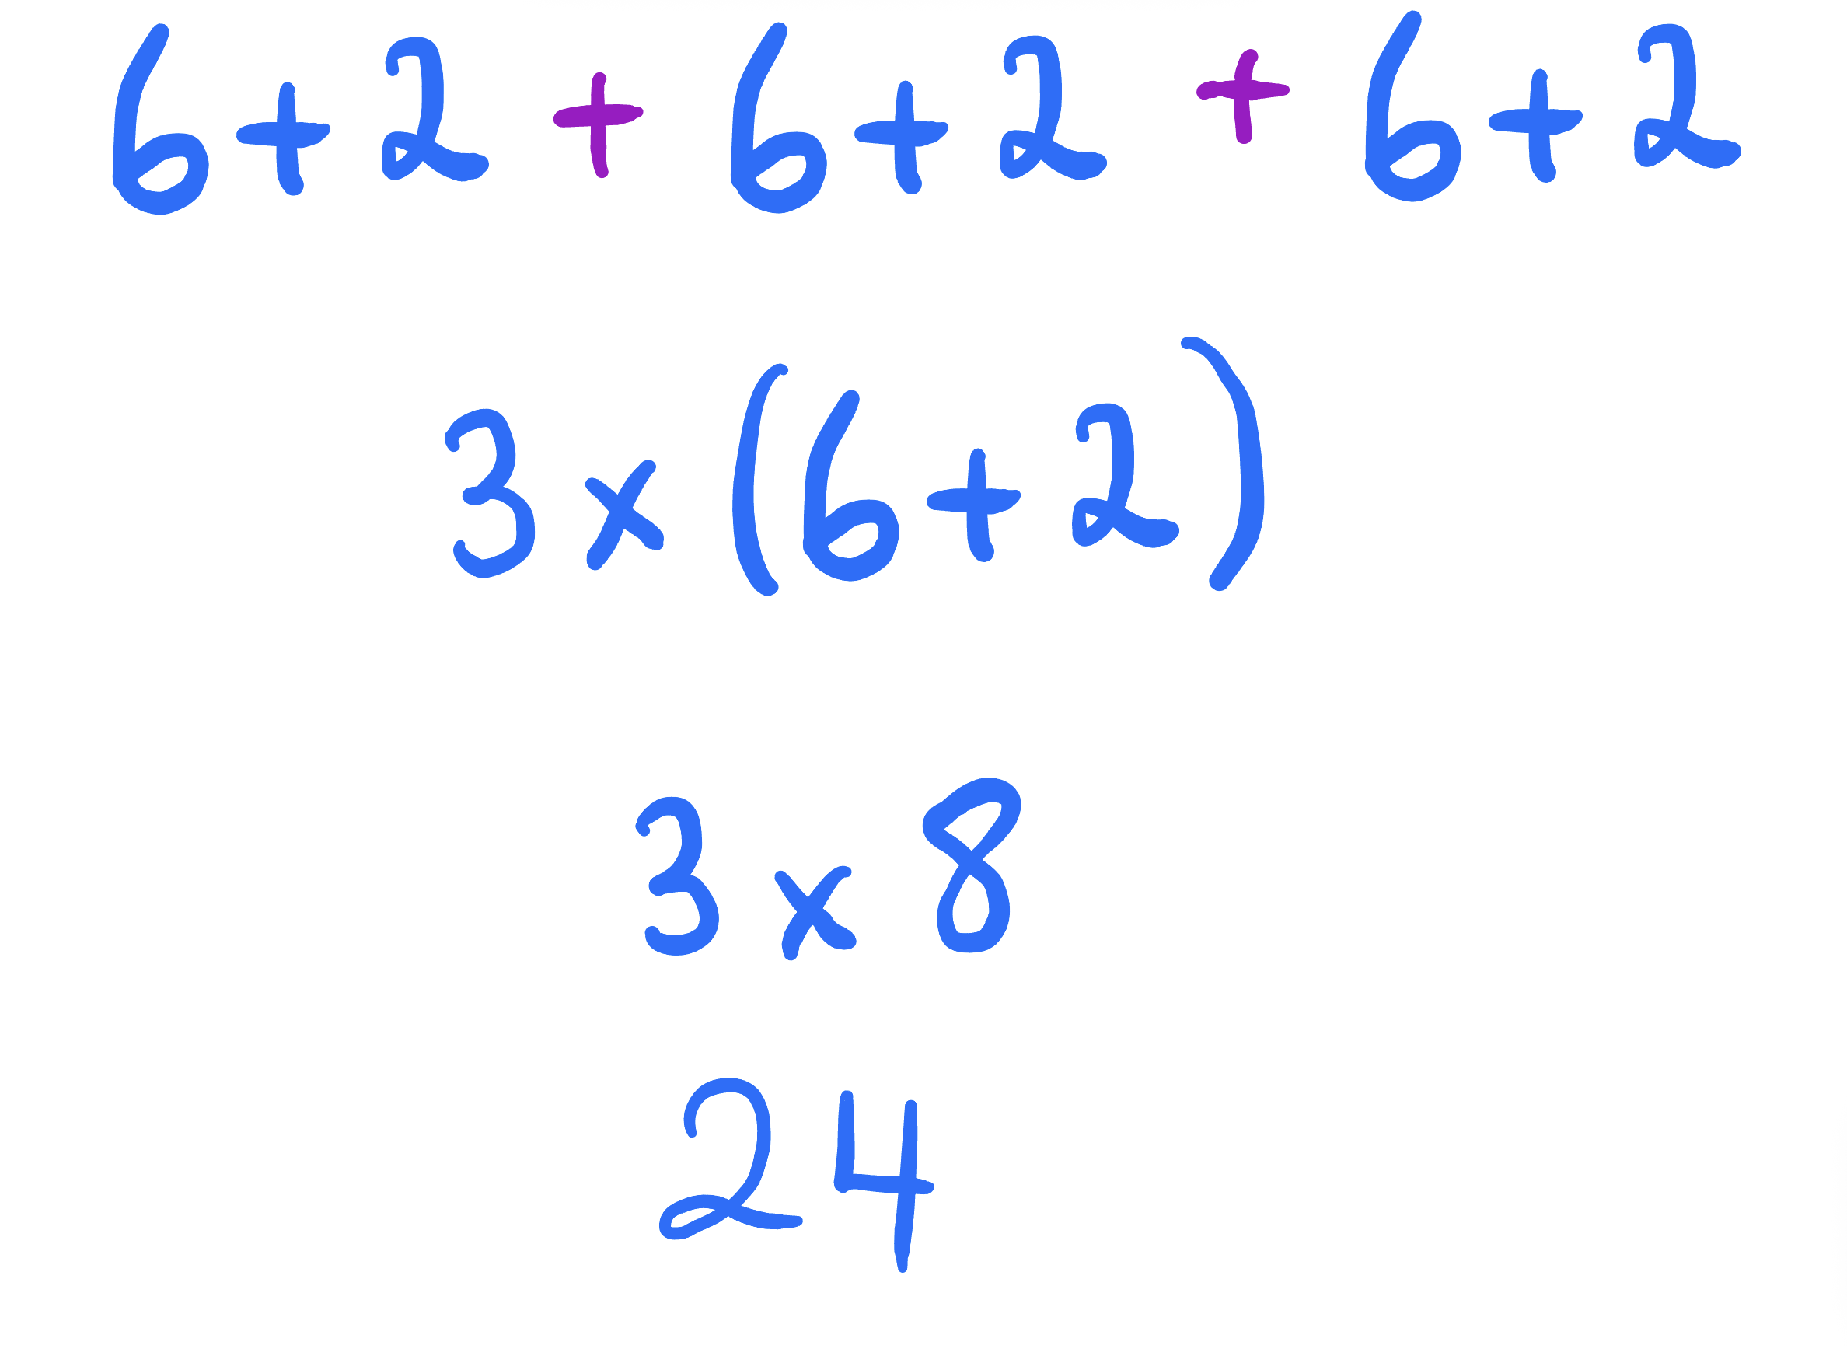
Example 2
Maybe like this?

Slide 8



Example 2
Maybe like this?

Slide 9



Example 2
Maybe like this?

Slide 10
Example 2
Maybe like this?

Slide 11
Example 3
How many tiles are there?

Slide 12
Example 3
What just happened?

Slide 13
Example 3
Now what happened??

Slide 14
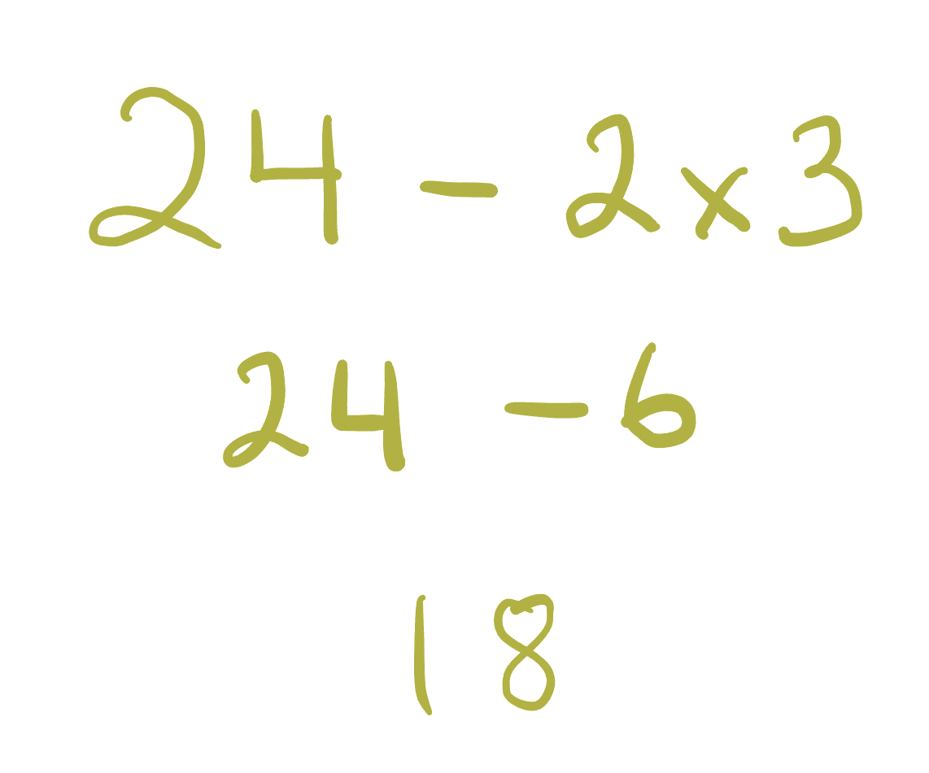
Example 3
Lets describe this in mathematics language

Slide 15
Example 3
Lets describe this in mathematics language

Slide 16
Example 3
Lets describe this in mathematics language

Slide 17
Example 3
Lets describe this in mathematics language

Slide 18
Example 3
Lets describe this in mathematics language

Slide 19
Example 4
What do you notice here?

Slide 20
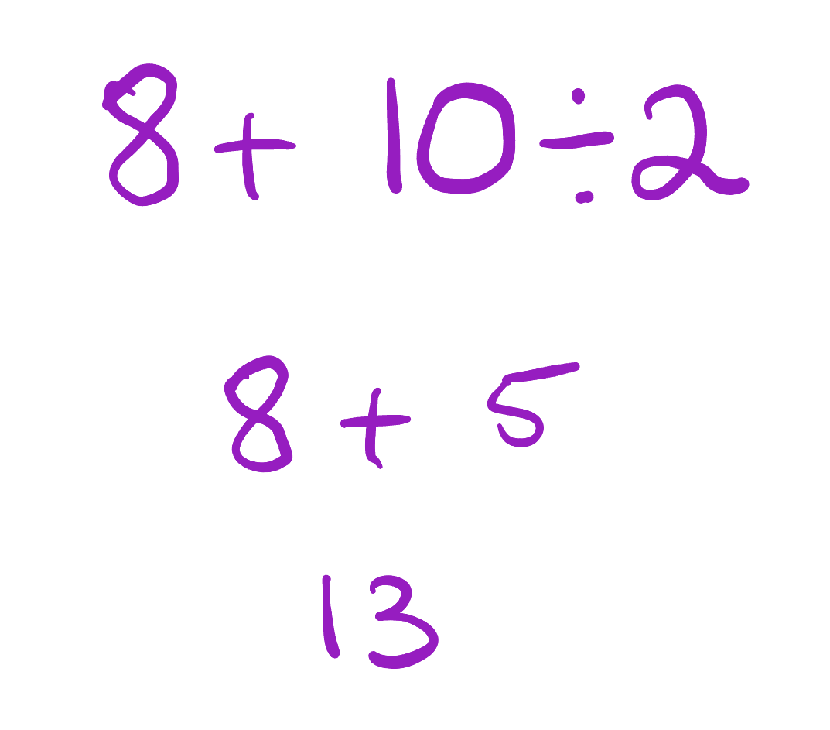
Example 4
How does this relate?

Slide 21
Example 4
And now this?

Slide 22
Example 4
Which is now

Slide 23
Example 4
And now

Slide 24
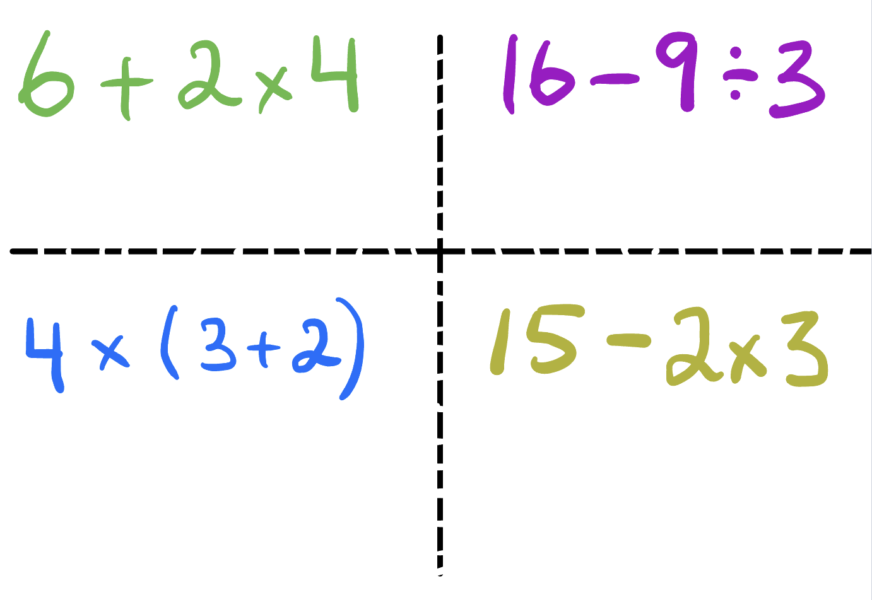
Your turn!
Visualise these to answer these using the correct order of operations

Slide 25

Close your eyes
Describe what you see in your imagination when I say

Slide 26


Option A
Option B

Slide 27
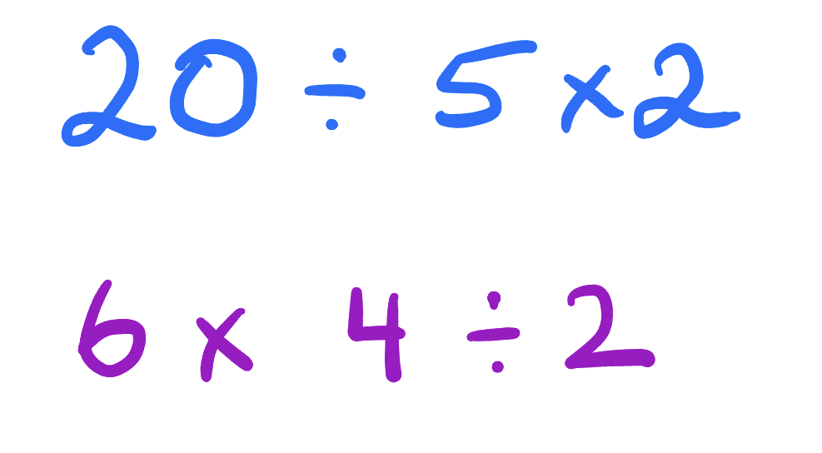
Which brings us to these cases

Slide 28
Which brings us to these cases

Slide 29
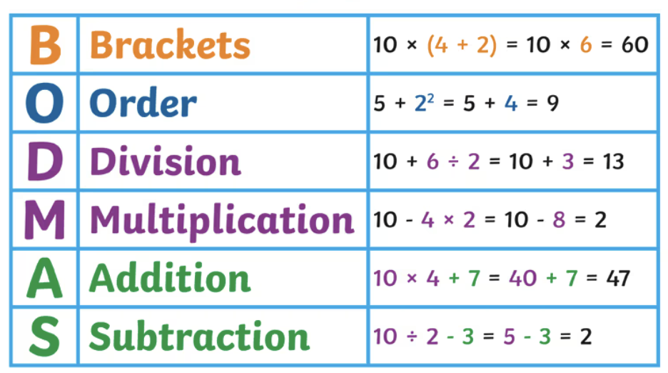
A shortcut to remember
If multiplication and division operations are together, just do them from left to right. These are our ‘boy with the telescope’ examples

Slide 30

A shortcut to remember
If multiplication and division operations are together, just do them from left to right. These are our ‘boy with the telescope’ examples

Slide 31
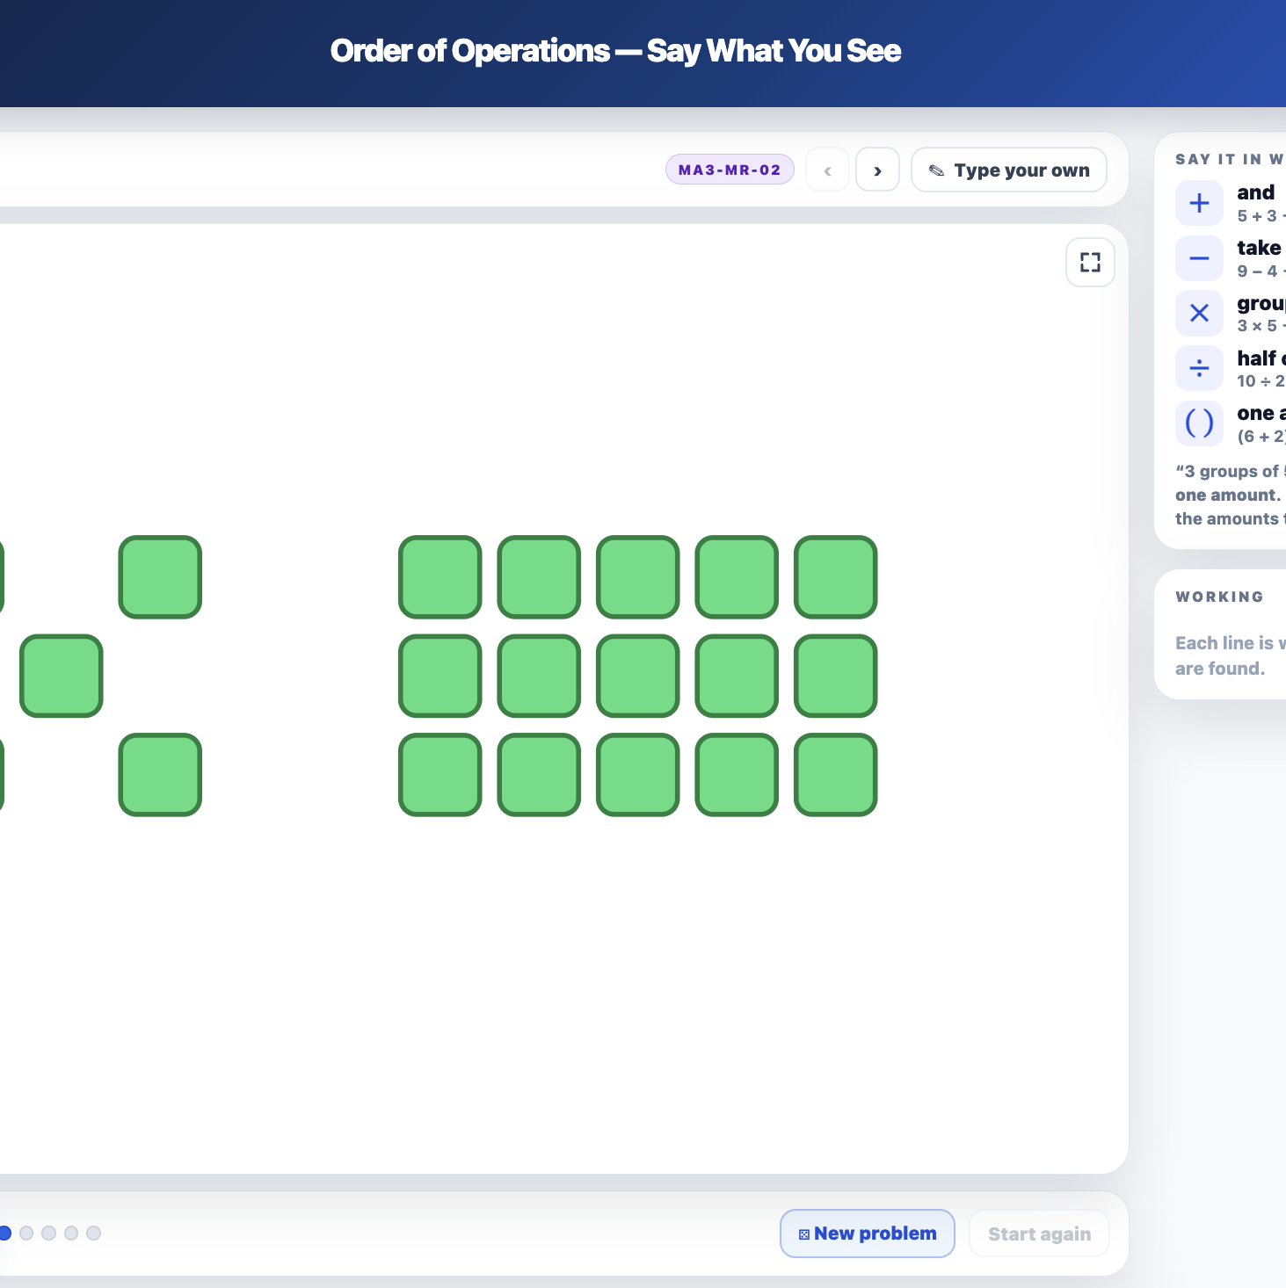
Another resource
https://millsmathstools.au/interactive-tools/stage-4/number/order-of-operations-in-words/index.html

Slide 32
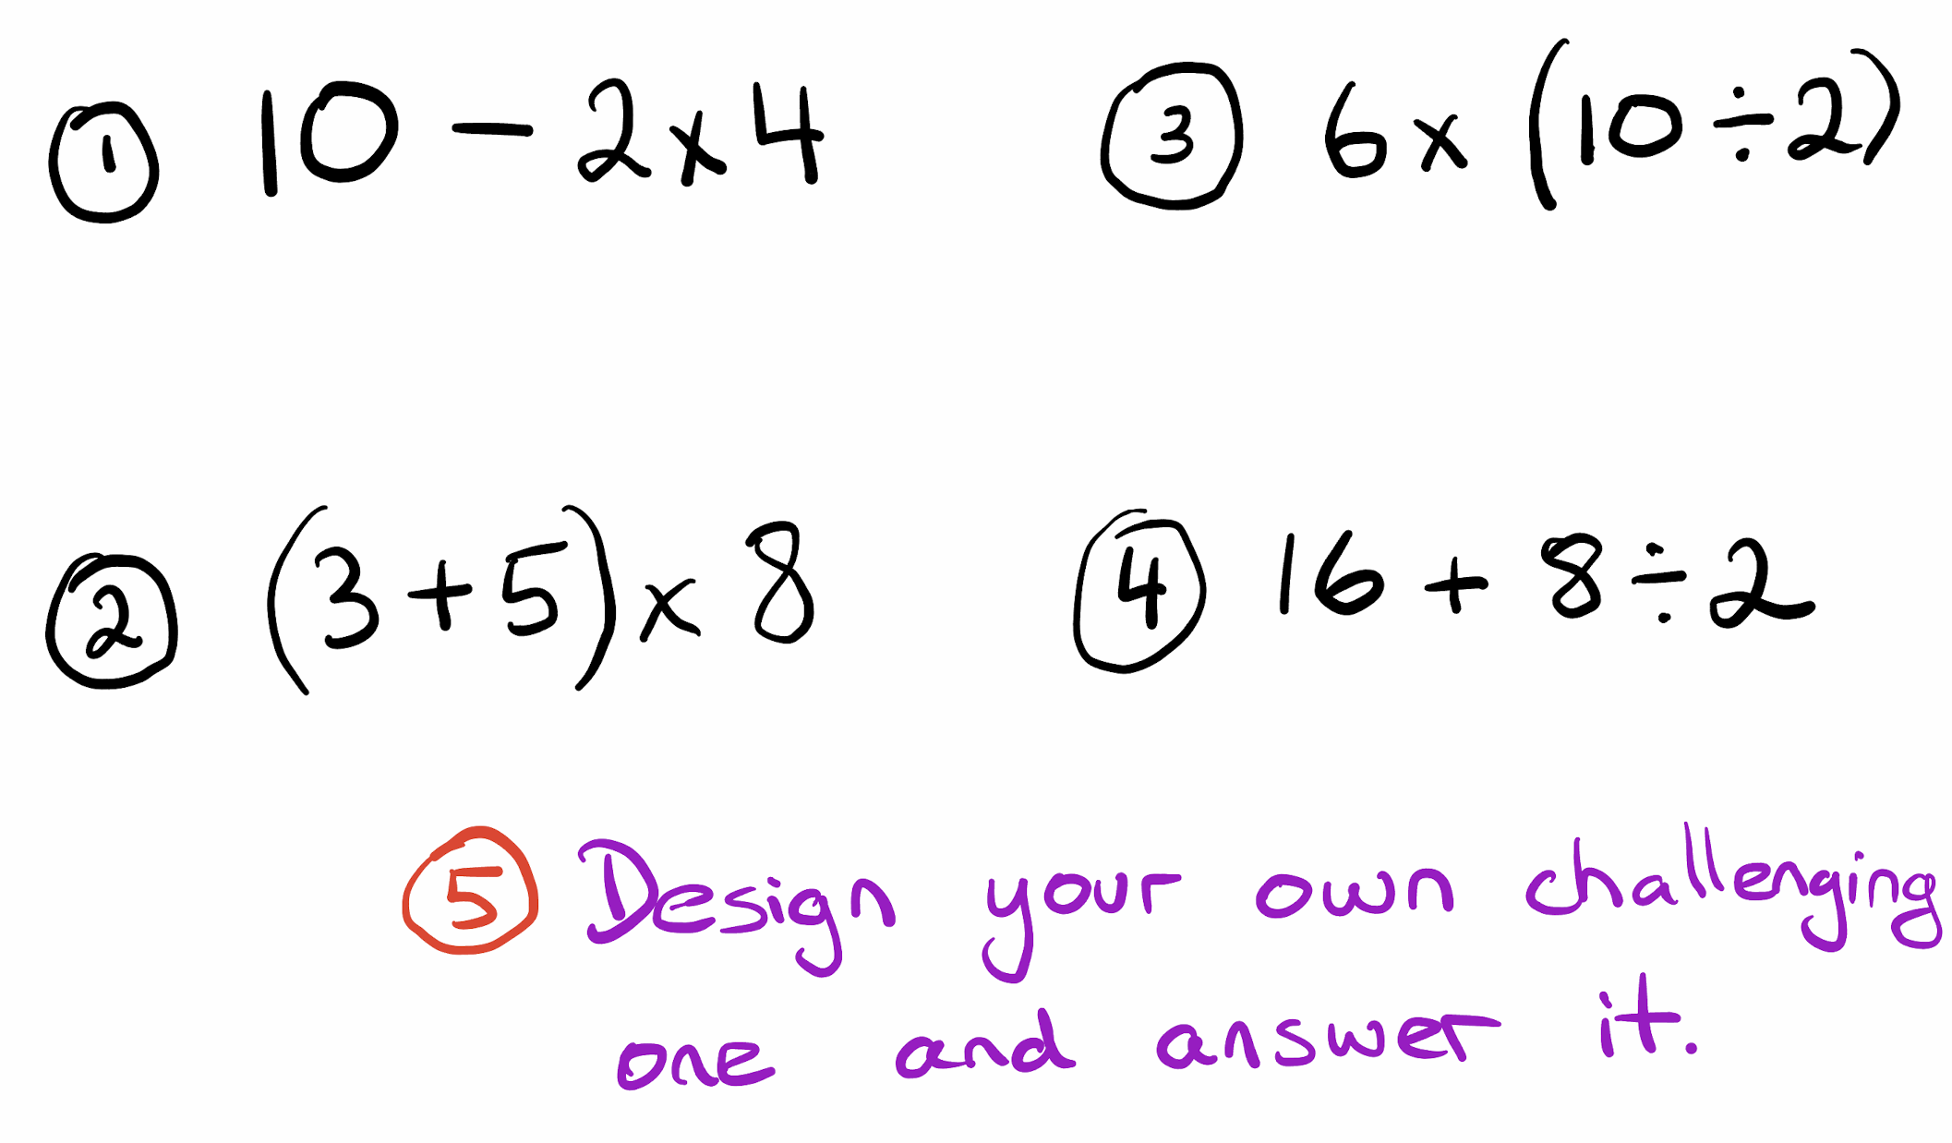
Exit ticket
Answer these on the slip of paper and hand in to me

