Slide 1
IT8401 Research in IT Assignment 1
Literature Review Presentation

Slide 2
Agenda
Introduction
Papers
3 Papers review sample
Discussion
Literature Map/Concept Matrix
Q&A

Slide 3
Introduction
Tom Dinh (Dinh Manh Hoang)
ID: 21500759
A Developer

Slide 4
Modern Web Development Technologies
The modern web development nowadays contains a massive of technologies.
What a programmer student should aware of ?
Client focus? Technology Stacks? Tooling? Eco-system?

Slide 5
Papers
Dirk Merkel, Docker: lightweight Linux containers for consistent development and deployment, Linux Journal, v.2014 n.239, p.2, March 2014
Ioannis K. Chaniotis , Kyriakos-Ioannis D. Kyriakou , Nikolaos D. Tselikas, Is Node.js a viable option for building modern web applications? A performance evaluation study, Computing, v.97 n.10, p.1023-1044, October 2015
K. Lei, Y. Ma, and Z. Tan. Performance Comparison and Evaluation of Web Development Technologies in PHP, Python, and Node.js. In Computational Science and Engineering (CSE), 2014 IEEE 17th International Conference on, pages 661–668, 2014.
Kento Goto , Motomichi Toyama, Mobile Web Application Generation Features for SuperSQL, Proceedings of the 20th International Database Engineering & Applications Symposium, July 11-13, 2016, Montreal, QC, Canada doi: 10.1145/2938503.2938524
Lorna Jane Mitchell. PHP Web Services. O’Reilly Media, 2013
Sam Chung , Soon Bang, Identifying knowledge, skills, and abilities (KSA) for devops-aware server side web application with the grounded theory, Journal of Computing Sciences in Colleges, v.32 n.1, p.110-116, October 2016
Yener Sönmez , Oğuz Bayat , Tuğce Ballı Altuğlu , Adil Deniz Duru, Performance Comparison of PHP-ASP Web Applications via Database Queries, Proceedings of the The International Conference on Engineering & MIS 2015, p.1-3, September 24-26, 2015, Istanbul, Turkey doi: 10.1145/2832987.2833054
Weidner O, Atkinson M, Barker A, Filgueira Vicente R (2016) Rethinking high performance computing platforms: challenges, opportunities and recommendations. In: Proceedings of the ACM international workshop on data-intensive distributed computing, DIDC’16. ACM, New York, pp 19–26. doi: 10.​1145/​2912152.​2912155

Slide 6
Papers Review

Slide 7
Harnessing modern web application technology to create intuitive and efficient data visualization and sharing tools
- Big data nowaday is the focus area of Neuroscientists. In order to collecting data Neuroscientists take advantage of Web application technologies to build up the data.
- Web application is a well-know, easy to use for users. It cheap, easy to gathering a large amout data and exchange data globally.
Strengths
- The COINS (Collaborative Informatics and Neuroimaging Suite) Data Exchange was built on open source stacks Linux-Apache-PostgreSQL-PHP (LAPP) and some are ussing NodeJS

Slide 8
Harnessing modern web application technology to create intuitive and efficient data visualization and sharing tools (cont)
- Weakness
Authors focus only on LAPP Stack
Authors not provide any referenced statistics
Research methodology
Quantitative Research

Slide 9
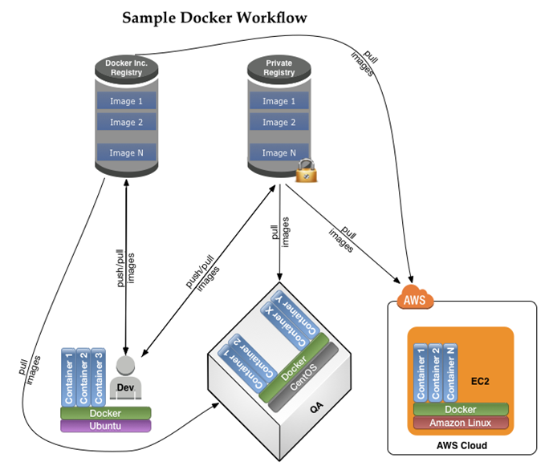
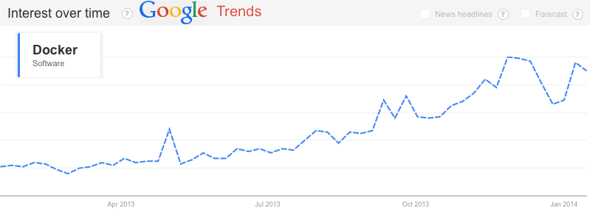
Docker: Lightweight Linux Containers for Consistent Development and Deployment
In this article the author using mix research to clarify Docker is a good solution for avoiding confliction of modern web development technologies.
This research was use Explanatory sequential design.
Figure 1. Google Trends Graph for “Docker Software” for Past 12 Months (Dirk Merkel, 2014)
Figure 2. Sample Software Development Workflow Using Docker (Dirk Merkel, 2014)

Slide 10
Docker: Lightweight Linux Containers for Consistent Development and Deployment (cont)
Pros and Cons Dirk Merkel point out clearly the point of using Docker to avoid “dependency hell” cause by too many instances run in the same environment.
However, author using Google trend, this is not good source for referencing, as well as Dirk Merkel depth dive in technique terms make the research look like a tutorial.

Slide 11
Performance Comparison of PHP-ASP Web Applications via Database Queries
This is a experimental to compare two widely use in web development nowadays.
By using Concurrent Triangulation Design, authors used a PC had an Intel i5 Processor, 8 GB of RAM and webservers and database servers were installed to run the test.
Overall, MySQL beat MSSQL

Slide 12
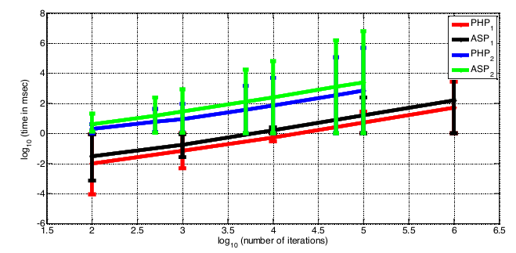
Performance Comparison of PHP-ASP Web Applications via Database Queries (cont)
Authors provide statistics and graphs of both test to illustrate the test result.
However, Authors not explain about the version of MySQL and MSSQL. Furthermore, this is a simulation on a non-server test machine.
Figure 3.Time spanned for the execution of the SQL scripts (Yener Sönmez , Oğuz Bayat , Tuğce Ballı Altuğlu , Adil Deniz Duru, 2015)

Slide 13
Discussion
It is very difficult for a student to learn and practice all of the modern wed development techniques
Students should focus and chose a stack/technologies that suitable with their skillsets

Slide 14
Literature Map

Slide 15
Concept Matrix
Concept Matrix | Concepts
Articles | Cloud | Stacks | Data | Performance
NodeJS (Ioannis K,2015) |  | ●
PHP web service (Lorna, 2013) |  | ● | ●
SqueakJS (Bert Freudenberg, 2014) |  | ●
Computing Platform (Weidner, 2016) | ● |  | ● | ●
SuperSQL (Kento Goto, 2016) |  |  | ● | ●
Database quires (Yener, 2015) | ● |  | ●
DevOps (Sam, 2016) | ●
Docker (Dirk Markel, 2013) | ●
PHP, Python... (K. Lei, 2014) |  | ● |  | ●

Slide 16
References
Ioannis K. Chaniotis , Kyriakos-Ioannis D. Kyriakou , Nikolaos D. Tselikas, Is Node.js a viable option for building modern web applications? A performance evaluation study, Computing, v.97 n.10, p.1023-1044, October 2015
K. Lei, Y. Ma, and Z. Tan. Performance Comparison and Evaluation of Web Development Technologies in PHP, Python, and Node.js. In Computational Science and Engineering (CSE), 2014 IEEE 17th International Conference on, pages 661–668, 2014.
Kento Goto , Motomichi Toyama, Mobile Web Application Generation Features for SuperSQL, Proceedings of the 20th International Database Engineering & Applications Symposium, July 11-13, 2016, Montreal, QC, Canada doi: 10.1145/2938503.2938524

Slide 17
Question
Thank you

