Slide 1
Driverless Cars
(Tom) Dinh Manh Hoang (21500759)
Supervisor: Dr Zawar Shah

Slide 2
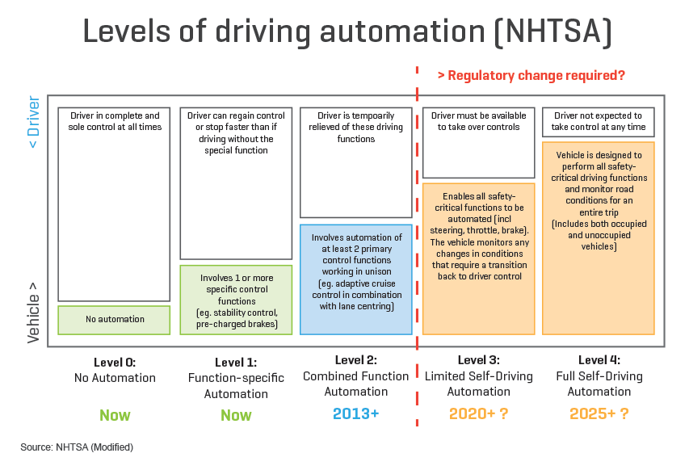
Introduction
Autonomous vehicle technology is a Thing
The fully autonomous Smart Shuttle for New Zealand's first on-road research trial in Christchurch Airport (Christchurch International Airport, 2017)
Autonomous and driverless vehicles developing and testing are belong to the New Zealand Intelligent Transport Systems Technology Action Plan 2014-18 (Ministry of Transport, 2014)
What is Autonomous Vehicles (AVs)
Notes:
National Highway Traffic Safety Administration

Slide 3
Introduction (cont.)
Why AVs technology ?
Human error cause more than 90 % of the traffic accidents, the use of autonomous vehicles can significantly reduce the number of crashes (Sanaullah, Hussain, Chaudhry, Case & Enoch, 2017).
Estimated congestion and parking cost reductions, energy savings and emission reductions are also uncertain due to interactive effects (Litman, 2017)
Many major automotive manufacturers such as Toyota, Nissan, and General Motors, and technology giants like Google, and Apple are actively involved in developing and testing their respective versions of autonomous vehicles (Smiechowski 2014).
Research Question
What are youths’ opinions on Autonomous Vehicles (AVs) advantages and their concern of adopting AVs technology?

Slide 4
Consumer Perception and Anticipated Adoption of Autonomous Vehicle Technology: Results from Multi-Population Surveys by Nikhil Menon (2015).
Strengths
This thesis author show the wide range of articles to point of the history and importance of develop AVs and how AVs will make the better future of transport.
Large amount of samples
Weaknesses
Consumers point of view on a theory of AVs
Research methodology
Sequential exploratory design
How it related
Provide an overview of AVs technology
Provide hypothesis of adoption and AVs factors for study

Slide 5
Autonomous Vehicles in Developing Countries: A Case Study on User’s View Point in Pakistan (Sanaullah, Hussain, Chaudhry, Case & Enoch, 2017)
Strengths
In this research authors present the technologies that impact to the development of AVs
The benefits that AVs will bring to developing countries
Weaknesses
Not has a well present of data
Not mention about deployment AVs in developing countries
Samples focus on Car owners
Research methodology
Quantitative design
How it related
Provide an overview of AVs benefits
Provide AVs technology factors for study

Slide 6
A Survey of Public Opinion about Autonomous and Self-Driving Vehicles in the U.S., the U.K., and Australia (Schoettle & Sivak, 2014)
Strengths
In this research authors present the technologies that impact to the development of AVs
Large amount of samples with high response rate 97%
Well present, analysis and explain of data
Weaknesses
This survey was designed to expand upon the existing survey data but not compare with previous survey data
Research methodology
Quantitative design
How it related
Provide consumers’ concerned factors for study and survey design

Slide 7
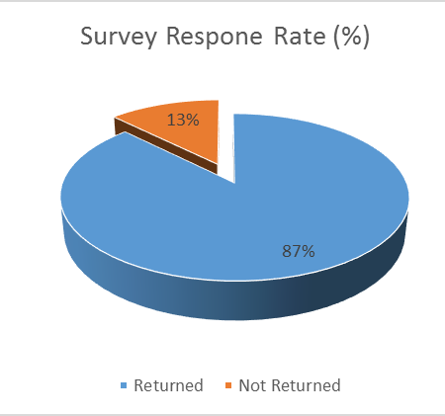
Research Methodology
Sequential exploratory design
Qualitative
I collected AVs factors and Ideas from 6 articles
Focusing on benefits and issues of driverless cars
Developing research questions
Quantitative
A survey of 10 questions to answer 2 research questions
7 responded participants out of 8 surveys

Slide 8
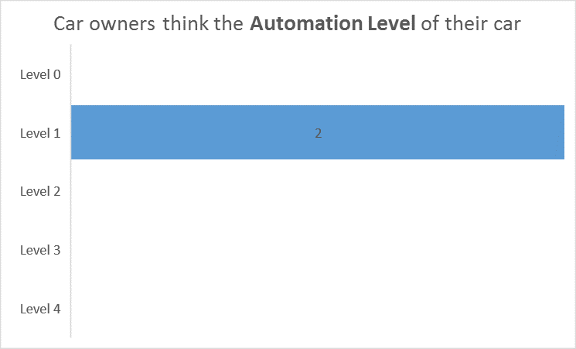
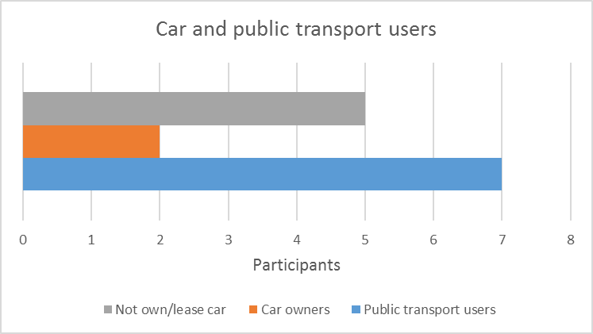
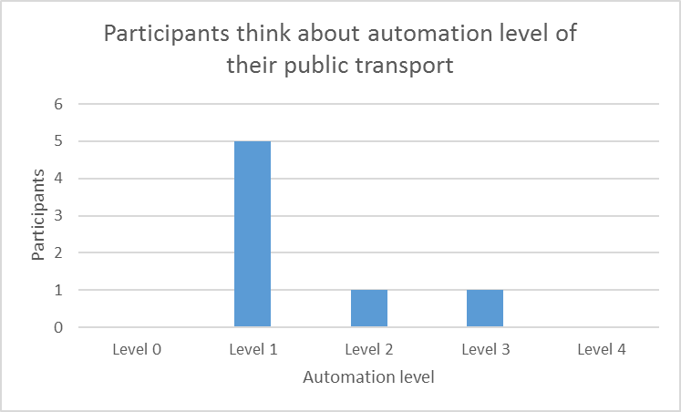
Results & Discussion
General information
The data show that most people till using public transport even they have car.
AVs technology is not popular, most participants are using level 1 AVs

Slide 9
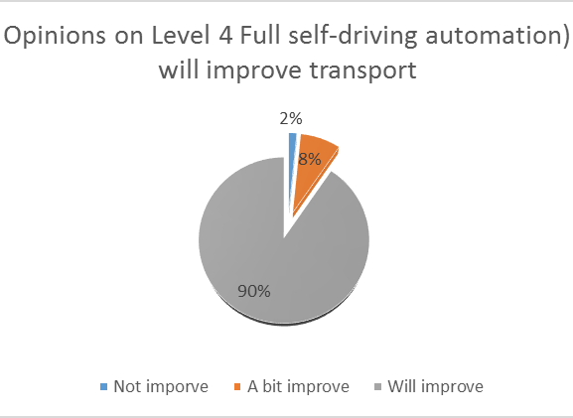
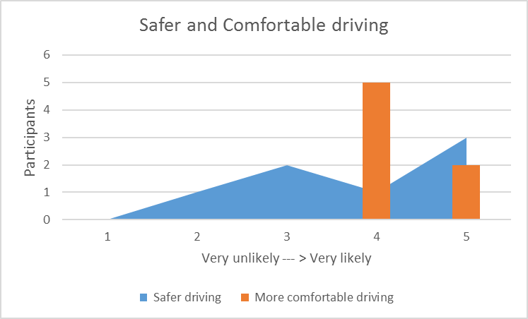
How likely would you think it is that AVs level 4 (Full self-driving automation) will improve transport in general?

Slide 10
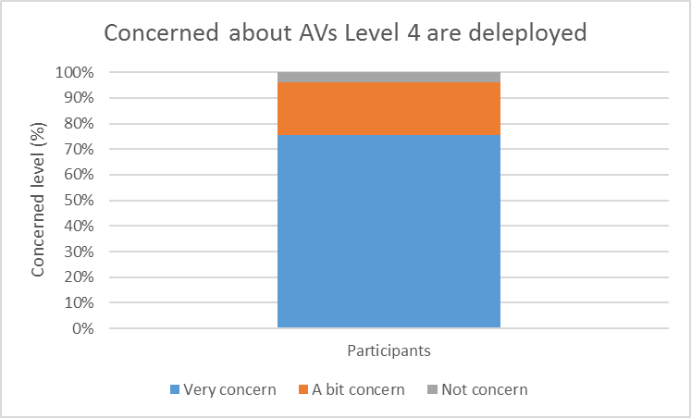
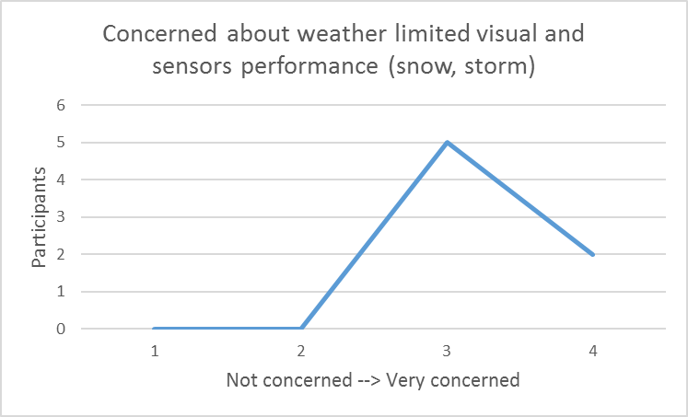
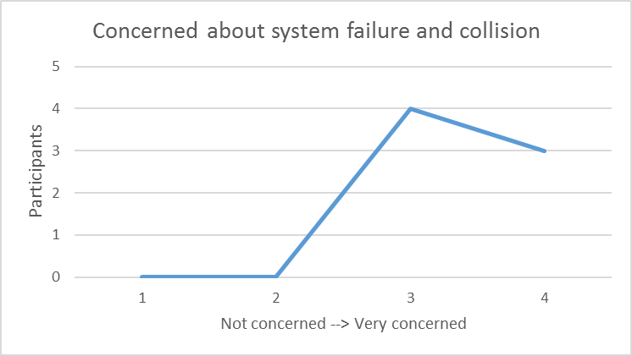
How concerned are you about the following when AVs level 4 (Full self-driving automation) is deployed?

Slide 11
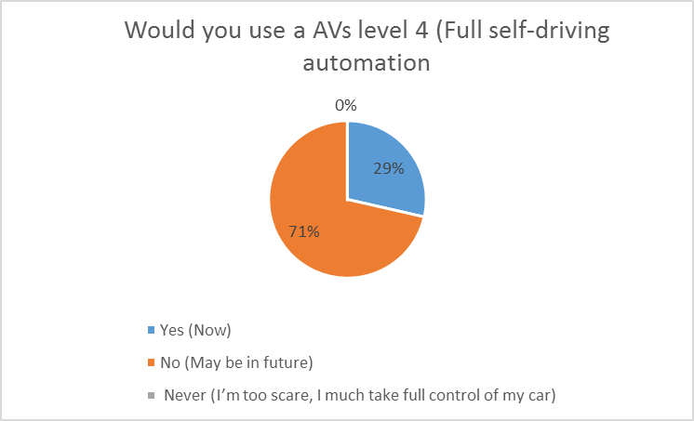
Would you use a AVs level 4 (Full self-driving automation)?

Slide 12
What are youths’ opinions on Autonomous Vehicles (AVs) advantages and their concern of adopting AVs technology?
What are youths’ opinions on Autonomous Vehicles (AVs) advantages ?
90% of responded participants are agree Level 4 Full self-driving automation) will improve transport
Most of participants think Level 4 AVs reducing accidents/crashes and traffic jams
78 % AVs safer and Comfortable driving
What youths concern of adopting AVs technology
AVs are not mature to use voted by 71% responded participants
43% participants are not trust the AVs system
71% participants want to manually control their car

Slide 13
Conclusion
Driverless car is the future and it already here, however, this technology need more time to prove and improve
AVs in testing and statistics are slowly changing road users’ mindset
In this survey, there are many gaps for AVs to come to the road that need to bridge by government and community.
The current transport system need to improve to adapt with AVs technologies
Further research is needed to improve the relationship between AVs and road system

Slide 14
References
Christchurch International Airport. (2017). New Zealand’s first Smart Shuttle unveiled in Christchurch. Retrieved from http://www.christchurchairport.co.nz/en/about-us/media-centre/media-releases/2017/new-zealand%E2%80%99s-first-smart-shuttle-unveiled-in-christchurch/
Menon, N. (2015). Consumer Perception and Anticipated Adoption of Autonomous Vehicle technology: Results from Multi-Population Surveys. Presented at the Transportation Research Board 95th Annual Meeting, 2016
Ministry of Transport. (2017). Intelligent Transport Systems. Retrieved from http://www.transport.govt.nz/ourwork/technology/intelligenttransportsystems/
Sanaullah, I. Hussain, A. ChaudhryKeith, A. Enoch, C. (2017). Autonomous Vehicles in Developing Countries: A Case Study on User’s View Point in Pakistan. Springer International Publishing Switzerland, Retrieved from https://www.researchgate.net/publication/304996162_Autonomous_Vehicles_in_Developing_Countries_A_Case_Study_on_User%27s_View_Point_in_Pakista

