Slide 1
GitHub Workflow Basics
Presentation by Daniel Perez
Graduate Fellow
Murty Sunak Quantitative Computing Lab

Slide 2
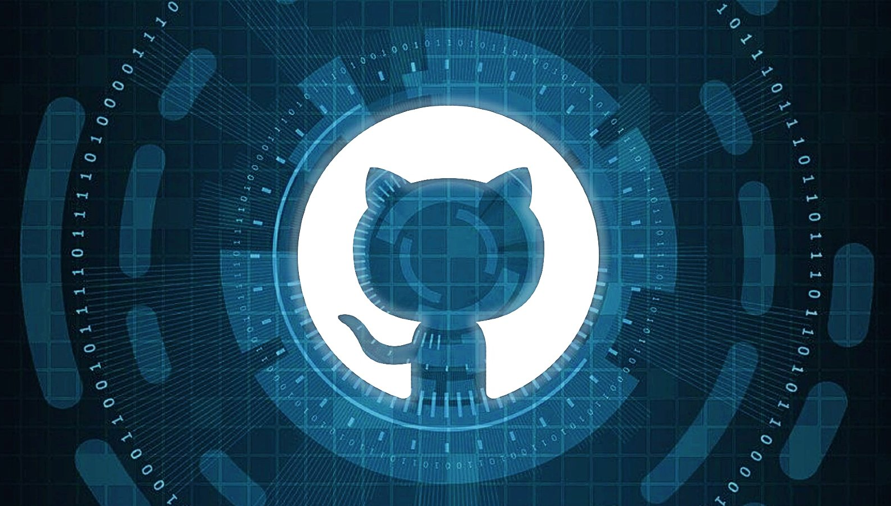
Requirements
GitHub desktop installed
Account and Logged into GitHub
Create a working directory in your computer

Slide 3

Learn basic concepts of version control systems
Learn how to setup a git repository and organization
Learn how to setup a project and prepare to contribute to it by cloning and branching
Learn how to create and assign issues
Learn about pull requests and code review

Slide 4

101
Version Control System:
Software tool that helps in recording changes made to files by keeping a track of modifications done in the code.
Why do we use a Version Control System (VCS)?
Keep a complete change history of every file; the change history contains essential information such as which change was made, who made the change, when the change happened, and why the change was made.
Let people work together independently at the same time
Make project management easier (traceability, reversibility, backup)

Slide 5
Types of VCS
Local Version Control Systems
Centralized Version Control Systems
Distributed Version Control Systems
Distributed VCS
Server
Centralized VCS
REPOSITORY
Server
REPOSITORY
Pull
Push
FORKED REPOSITORY
FORKED REPOSITORY
FORKED REPOSITORY
Update/ Pull
Push
WORKING CLONE
WORKING CLONE
WORKING CLONE
Update/ Pull
Push
Commit
Local computer #2
Local computer #3
WORKING CLONE
WORKING CLONE
WORKING CLONE
Local computer #1
Local Computer #1
Local computer #2
Local computer #3

Slide 6

What is GitHub?
GitHub is a web-based platform used for version control, collaboration, and code repository management. It allows developers to work together on projects, track changes, merge code, and manage issues.
Notes:
GitHub is significant in software development as it enables efficient collaboration among developers globally. It enhances project transparency, tracks code changes effectively, and streamlines the software development process.
GitHub provides version control functionality, allowing developers to keep track of code changes, revert to previous versions if needed, and maintain a comprehensive history of project updates.

Slide 7

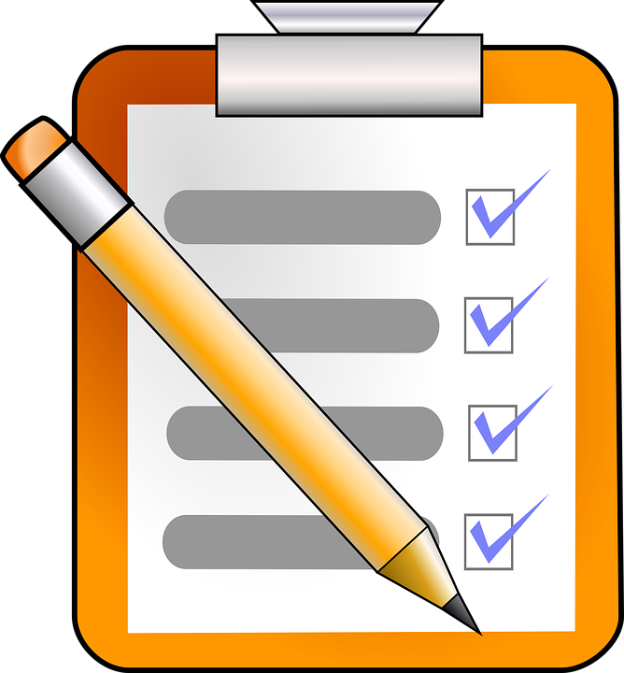
Key Components
Repositories in GitHub are where your project's files and revision history are stored. They can be public or private, and each repository contains documentation, code, and related resources.
Repositories
Issues in GitHub are used to track tasks, enhancements, and bugs for your projects. They facilitate communication among team members, assign tasks, and prioritize work.
Issues

Slide 8
Roles: Maintainer/Contributor
The Maintainer as the person who is owner and in charge of the main repository, manage a project's direction and improvement
The Contributor as the person who is accessing or helping modify the repository
Roles: Read, Triage, Write, Admin

Slide 9


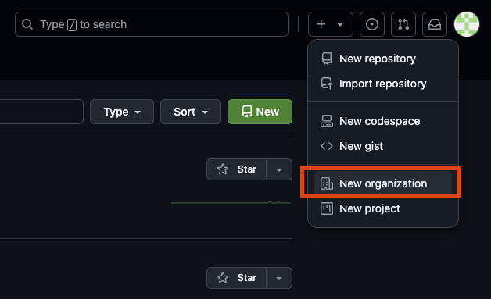

Prepare the project <Maintainer>
Creates an organization and a repository
Notes:
Go faster through this part in the Demo
On GitHub (you must be signed-in)
Click the plus + in the upper right corner and select New organization.
Set up your organization, name it what you like.
Use the email associated with your GitHub account as the billing address. (Since you chose the free plan you won't get billed.)
Select a free plan.
Finish the creation of the organization.
Invite each of your team members to be an organization member.
In your shared editor or chat, make a note of the URL of the organization's homepage.
Configure member privileges so that organization members can write to repositories. See Settings >> Member privileges >> Repository permissions .

Slide 10

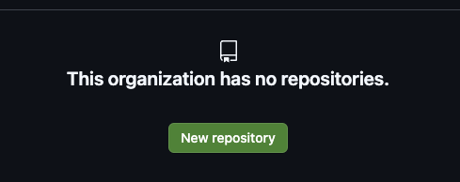
Prepare the project
<maintainer>
Update the readme file
Notes:
Click the Repository tab to view the repositories of the organization.
Click the big green Create a new repository button. (If you already have a repository in this organization, click the green New button.)
Name the repository our-food.
Optionally add a description.
Make it public.
Initialize it with a README
Add an open-source license (unless you have a strong opinion, for now choose GNU Public License v3.0).
Click the big green Create repository button
Update the README content.
In your shared editor, make a note of the URL of the repository's homepage.

Slide 11
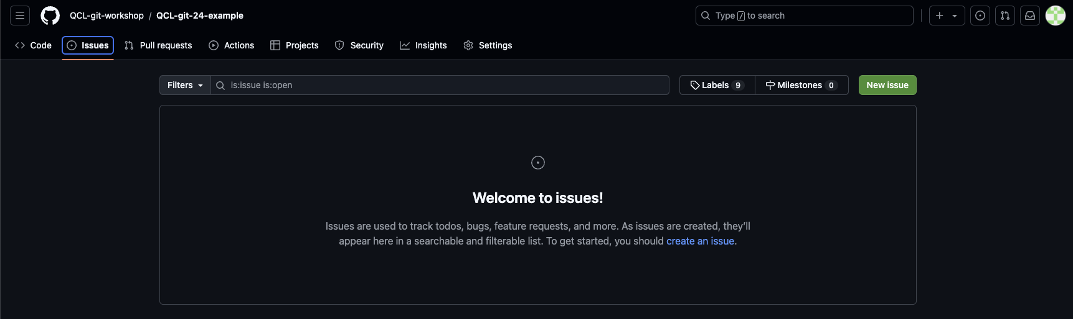
Issues and collaborations <Maintainer>
Creating and issue and then claiming it
Helps prevent developers from working on the same thing at the same time. Also, issue provides a place for the community to propose and ideas, prioritize issues, size issues, clarify requirements, and verify bugs
Notes:
Finding or creating and issue and then claiming it helps prevent developers from working on the same thing at the same time. Also issue provide a place for the community to propose and ideas, prioritize issues, size issues, clarify requirements, and verify bugs.
Add people to your repository
Protect the main branch

Slide 12
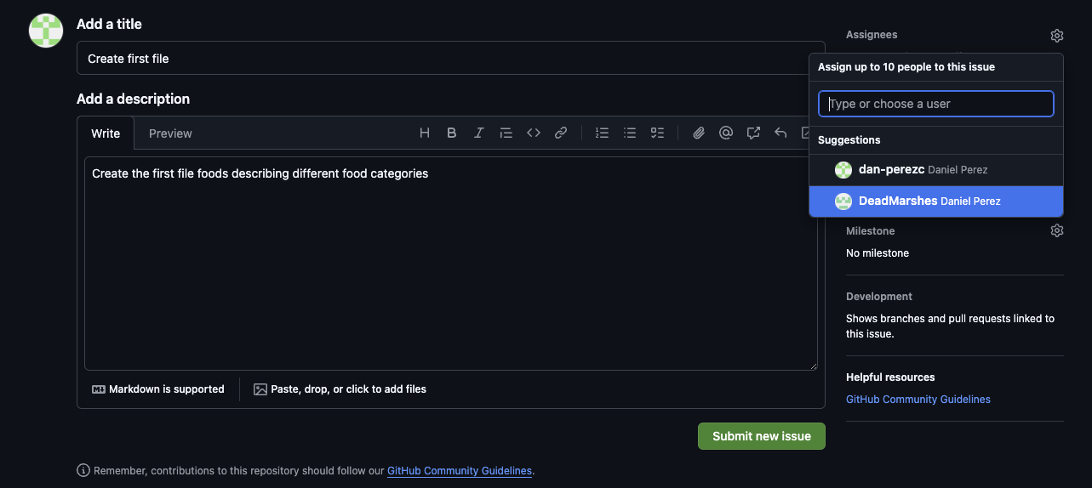
Issues and collaborations
Create and assign an issue to your Contributor
Notes:
So although this step may feel artificial during the activity, it's important to get in the habit of interacting with the community through the issue tracker before doing a significant amount of work.
Create a new issue for every collaborator

Slide 13
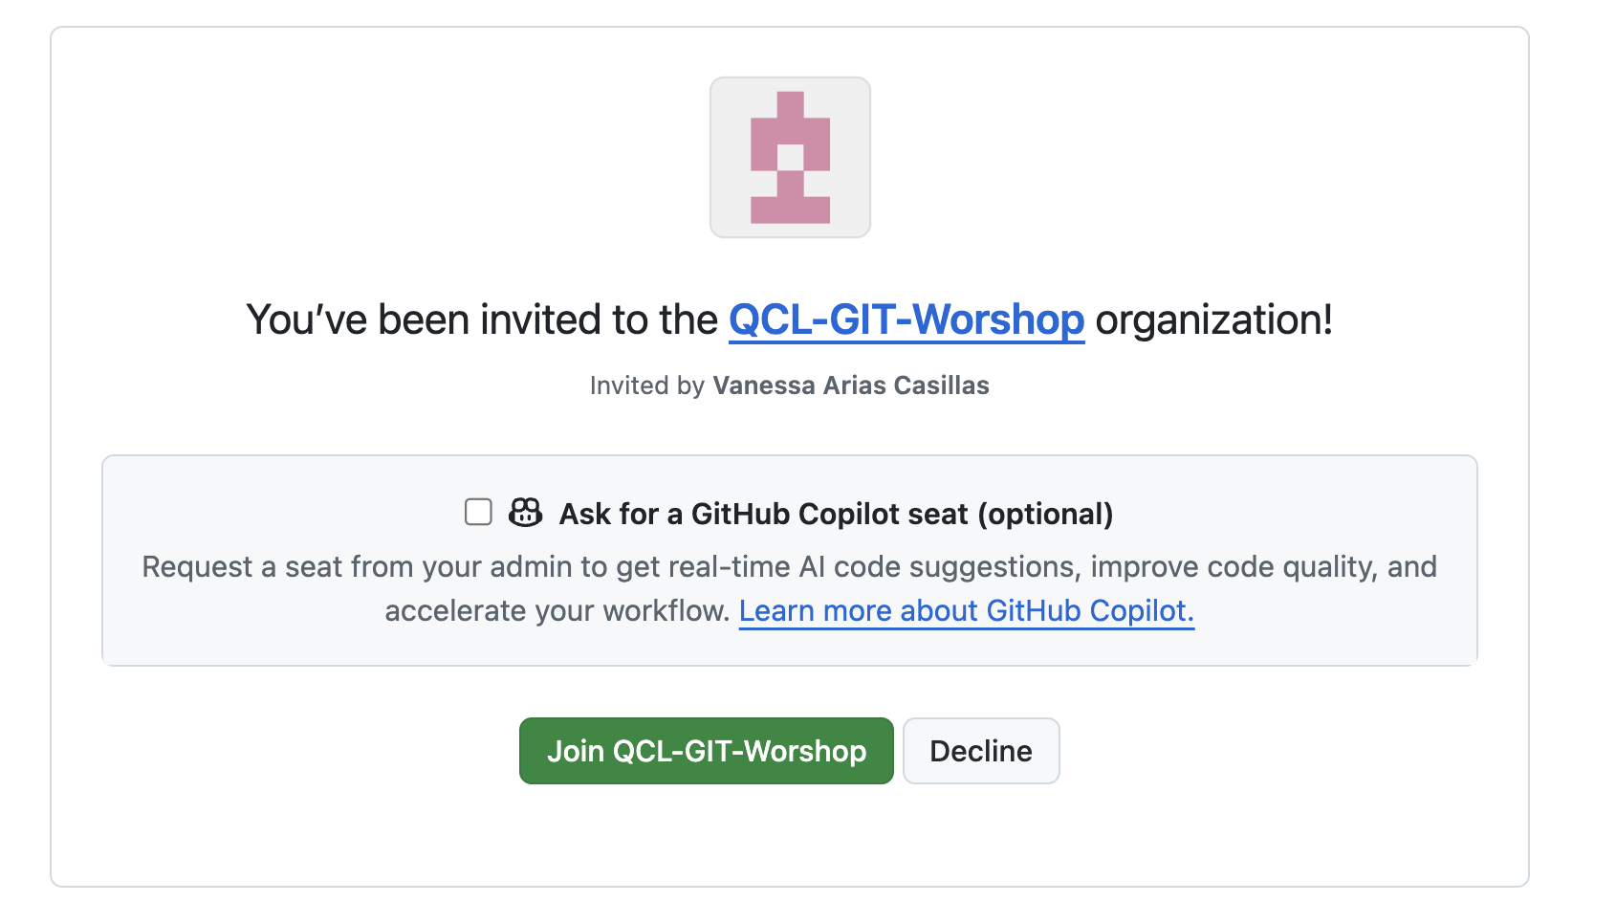
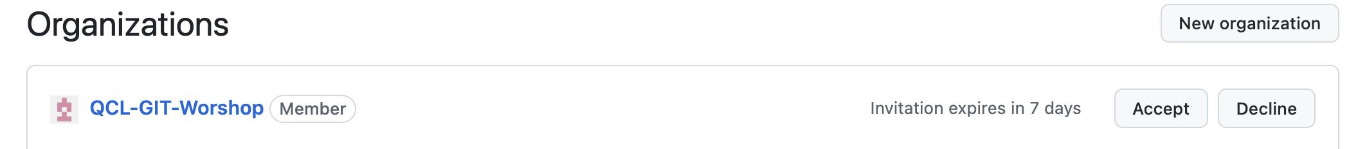
Join to the project < Contributor >
Receives invitation to the company or project
Either
Find the invitation in your email, view the invitation, and accept the invitation.
Or
Navigate to the team's organization, view the invitation, and accept the invitation.

Slide 14
Project tracker
Branch/TAG
GRAPH
COMMIT
USER
Main/master
Update on file Readme
Maintainer
Notes:
Modify the image

Slide 15
Prepare to work on a project
<Contributor>
Project
(Upstream)

Slide 16
Prepare to work on a project
Project
(Upstream)
Your fork
(Origin)
Fork
***File transfer***

Slide 17
Prepare to work on a project
Project
(Upstream)
Your fork
(Origin)

Slide 18
Prepare to work on a project
Project
(Upstream)
Your fork
(Origin)
Clone
Your local clone

Slide 19
Prepare to work on a project
Project
(Upstream)
Your fork
(Origin)
Your local clone

Slide 20

Prepare to work on a project
Project
(Upstream)
Your fork
(Origin)
Your local clone
Notes:
Introduce the idea of a hierarchy and permissions
Also fork and save projects in your personal repo

Slide 21
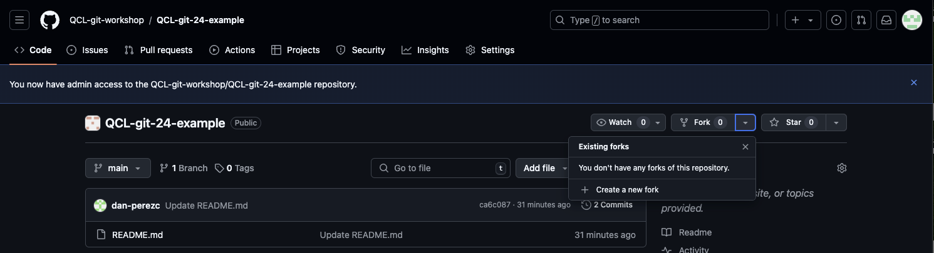
Activity! <Contributor>
Create new fork and clone the repo

Slide 22
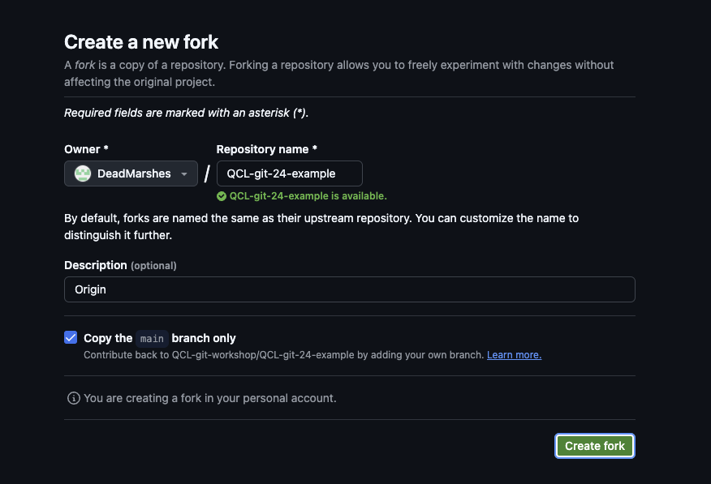
Activity!
<Contributor>

Slide 23
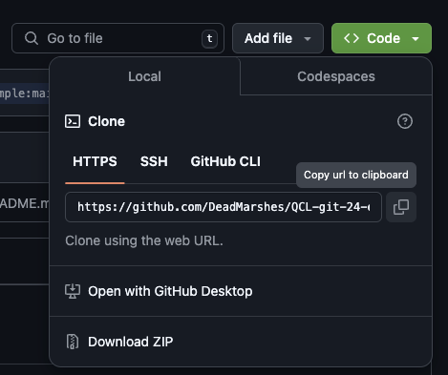
Activity!
<Contributor>
Make sure you are in your fork’s page
Notes:
Instructions
In the browser, click the green Clone or Download button.
If "HTTPS" is not selected, click Use HTTPS.
Click the clipboard to copy the URL in the box to your clipboard.
Tell them if this should be copied from their fork

Slide 24
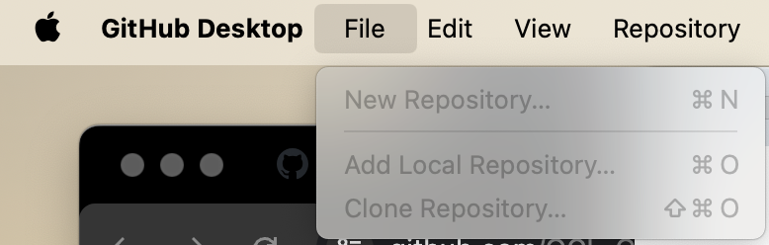
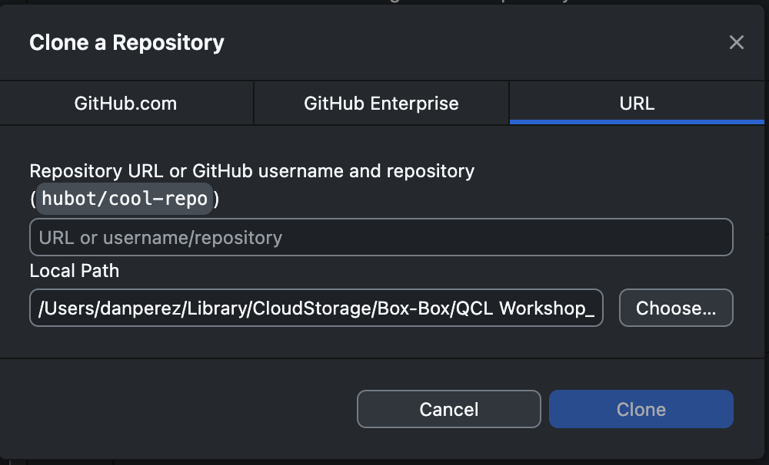
Activity!
Your local clone
Clone your repo

Slide 25
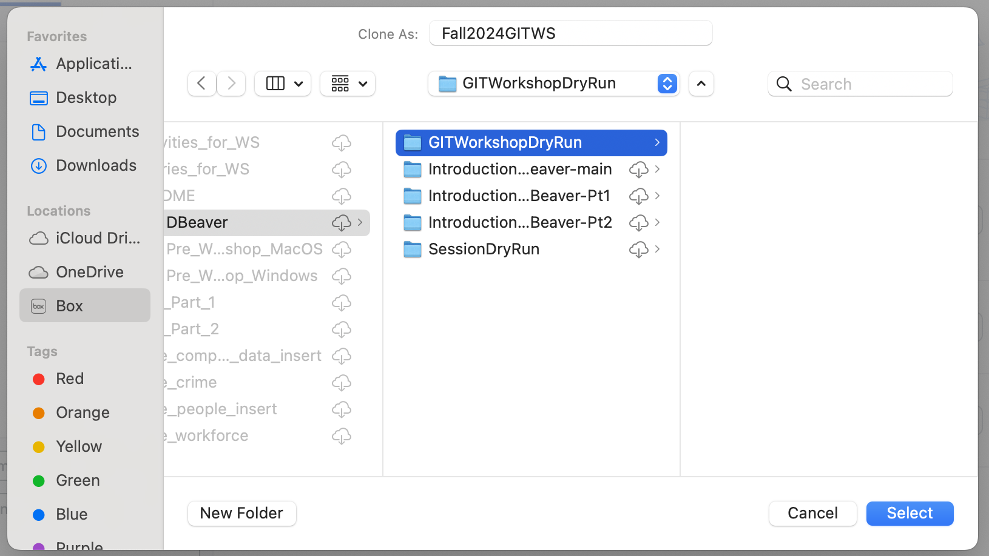
Activity!
Your local clone
Clone your repo

Slide 26
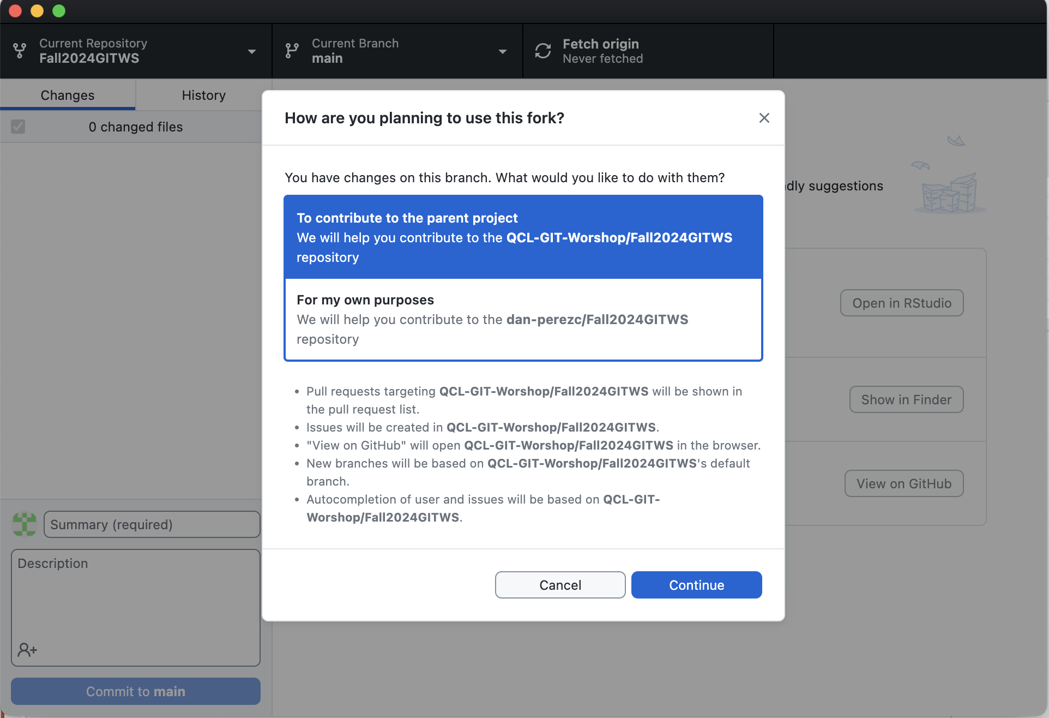
Activity!
Your local clone
Clone your repo

Slide 27
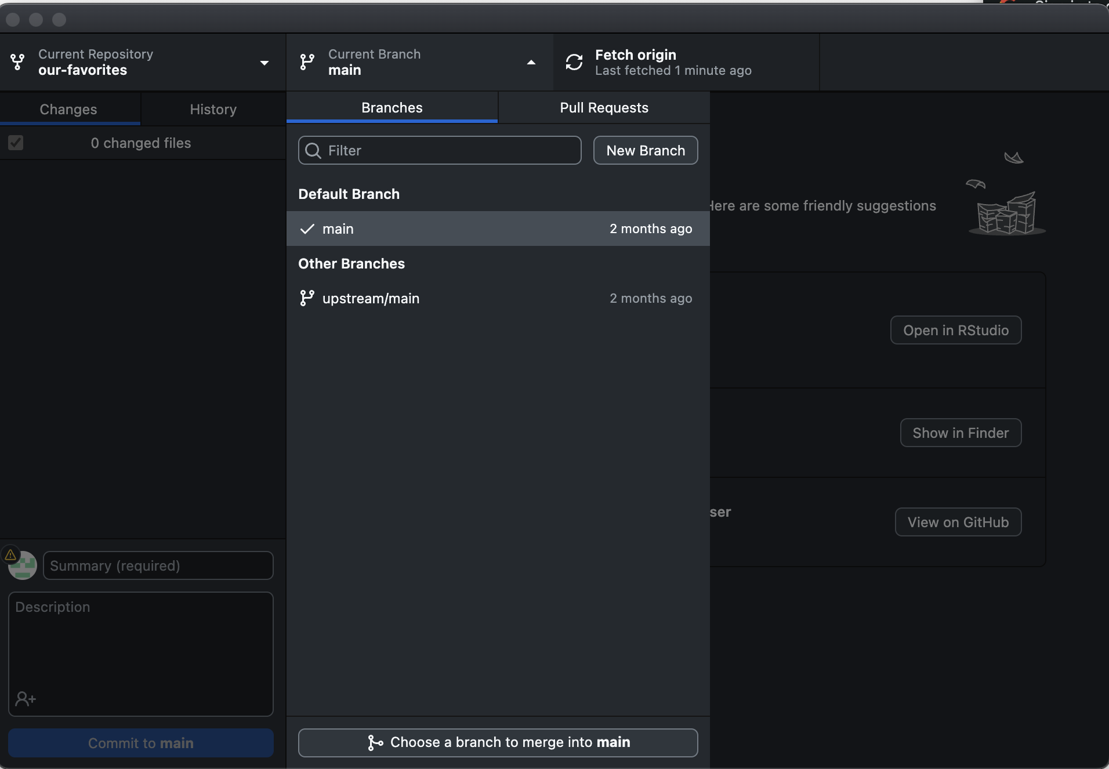
Activity!
upstream
Verify Branches, upstream remote
Notes:
Verify the files are being copied on you local computer
Add an upstream remote
Assumptions
You are viewing your fork of the team's repository on GitHub.
You have cloned your fork locally.
You have a terminal opened and positioned in the root of your local clone.

Slide 28
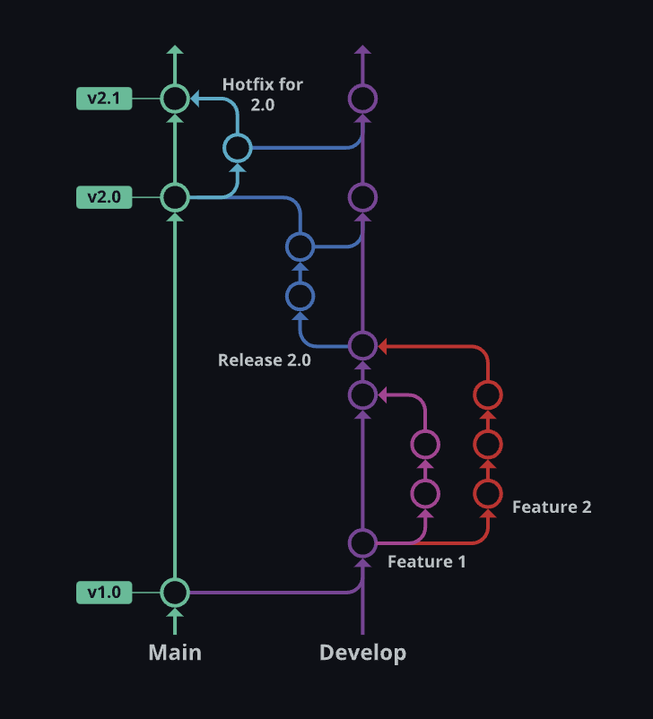
Branching Strategy
Branching allows developers to work on features or fixes in isolation without affecting the main codebase. It enables parallel development, experimentation, and the creation of feature branches.
Best Practices
Creating descriptive branch names, keeping branches short-lived
merging changes frequently to avoid conflicts
Having a branching strategy that aligns with the project's needs.
Notes:
A branch as a personal copy of the project within a repository. You will create a branch for every issue you work on. This will allow you to work on more than one feature at same time, allowing you to quickly switch between them, while keep their changes separate until you are ready to merge them.
This applies to the master branch as well. The master branch contains the official, current copy of the project. Using feature branches allows master to evolve while you work on your features without interfering with your development; and then, when you are ready, you can update your efforts with changes from master.
Again, in this activity you might feel branches are artificial and useless. However, when you are working on more significant issues and with more developers branches become invaluable. So we want to practice the full workflow with these more simplistic tasks so that we know what we are doing when things get more complicated.
Create DEVELOPMENT branch
Push the branch to remote

Slide 29
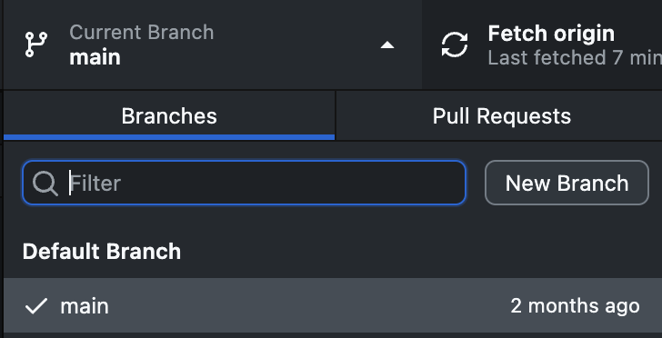
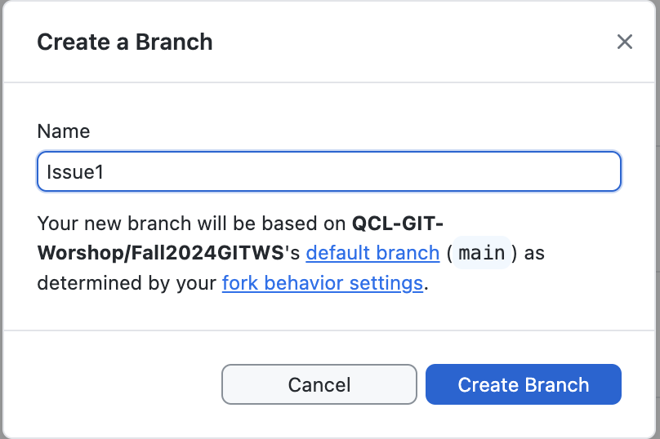
Check your assignment and Create a branch
Notes:
Check the assignment and create a branch
Git checkout –b <assigned issue>

Slide 30
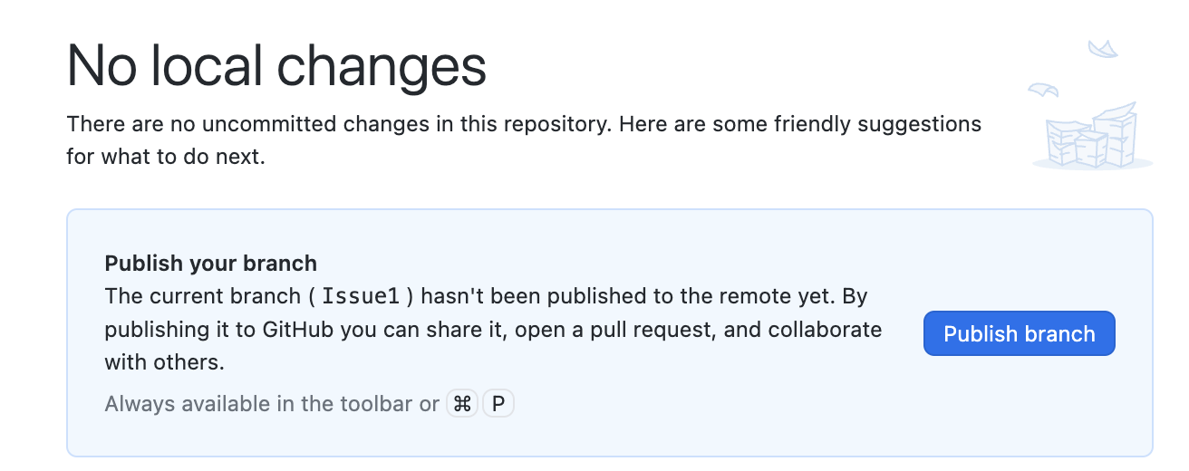
Create a branch
Notes:
Make the contributor create their new branch
Git push

Slide 31
Project tracker
Branch/TAG
GRAPH
COMMIT
USER
Issue #1
Contributor
Development
Maintainer
Main/master
Update on file Readme
Maintainer
Main
Development
Feature

Slide 32


Contribute a change
Project
(Upstream)
Your fork
(Origin)
Your local clone

Slide 33
Contribute a change
Project
(Upstream)
Your fork
(Origin)
Push
Your local clone

Slide 34
Contribute a change
Project
(Upstream)
Your fork
(Origin)
Pull request
Your local clone

Slide 35
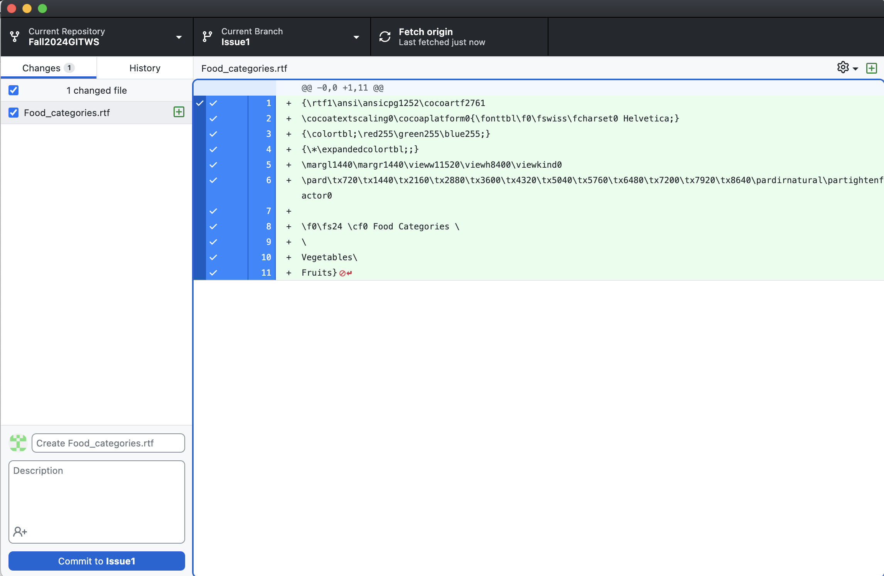
Activity! Work on your assigned issue

Slide 36
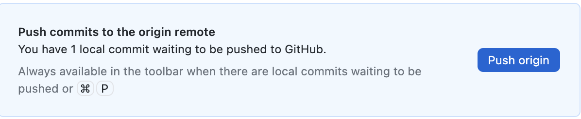
Activity! Push your changes to origin (Forked repo)

Slide 37
Project tracker
Branch/TAG
GRAPH
COMMIT
USER
Issue #1
Resolution Issue #1
Contributor
Issue #1
Contributor
Development
Main/master
Update on file Readme
Maintainer
Main
Development
Feature

Slide 38

Pull Requests
Purpose of Pull Requests
Pull requests are used to propose changes, discuss modifications, and review code before merging it into the main branch. They allow for collaboration, feedback, and ensuring code quality.
Creation Process
When creating a pull request, developers provide context about the changes, request reviews from team members, run automated tests, and ensure that the code meets the project's standards before merging.
Notes:
you will open an empty pull-request back to the organization's repository (upstream).
Pull-requests provide a place for developers to discuss their solution design and implementation. By opening a pull-request immediately, you make your efforts visible from the very beginning, allowing others to track progress and provide useful feedback. Getting feedback early may help you avoid pitfalls and will more likely lead to an acceptable solution sooner and with less effort than if you wait until you are "done" to get feedback.

Slide 39

Collaboration and Code Review
Facilitating Collaboration
GitHub facilitates collaboration by providing tools for code review, discussions, and pull request comments. It fosters teamwork, knowledge sharing, and error detection through code reviews.
Code Review Process
Code reviews in GitHub involve team members reviewing code changes, providing feedback, suggesting improvements, and ensuring code quality. They play a vital role in maintaining code consistency and quality standards.

Slide 40
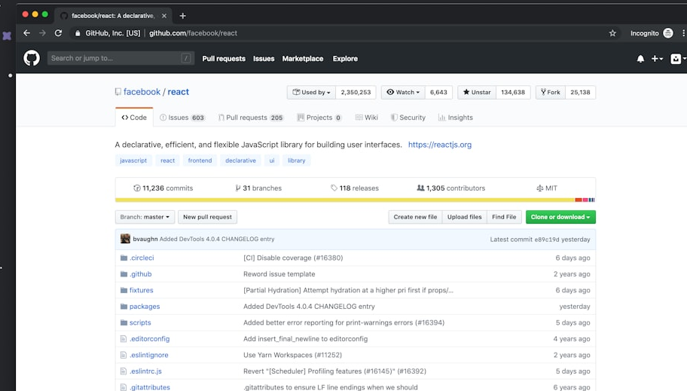
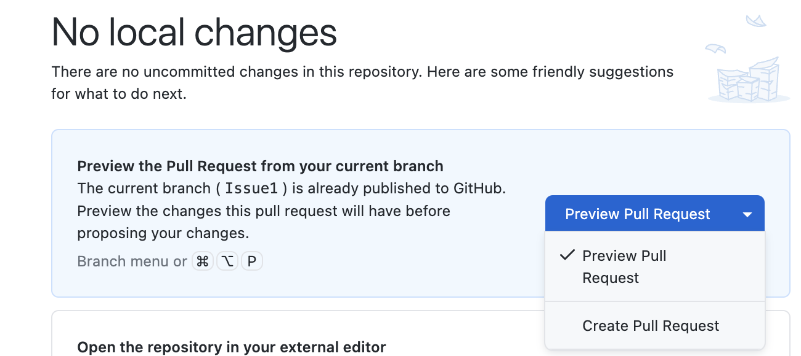
Activity! Create Pull Requests
Notes:
you will open an empty pull-request back to the organization's repository (upstream).
Pull-requests provide a place for developers to discuss their solution design and implementation. By opening a pull-request immediately, you make your efforts visible from the very beginning, allowing others to track progress and provide useful feedback. Getting feedback early may help you avoid pitfalls and will more likely lead to an acceptable solution sooner and with less effort than if you wait until you are "done" to get feedback.

Slide 41
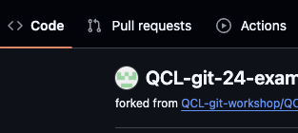
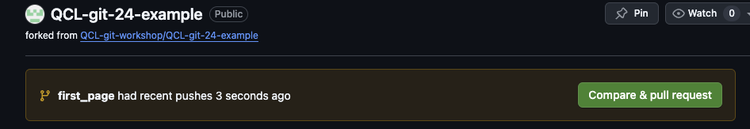
Activity! Pull Requests

Slide 42
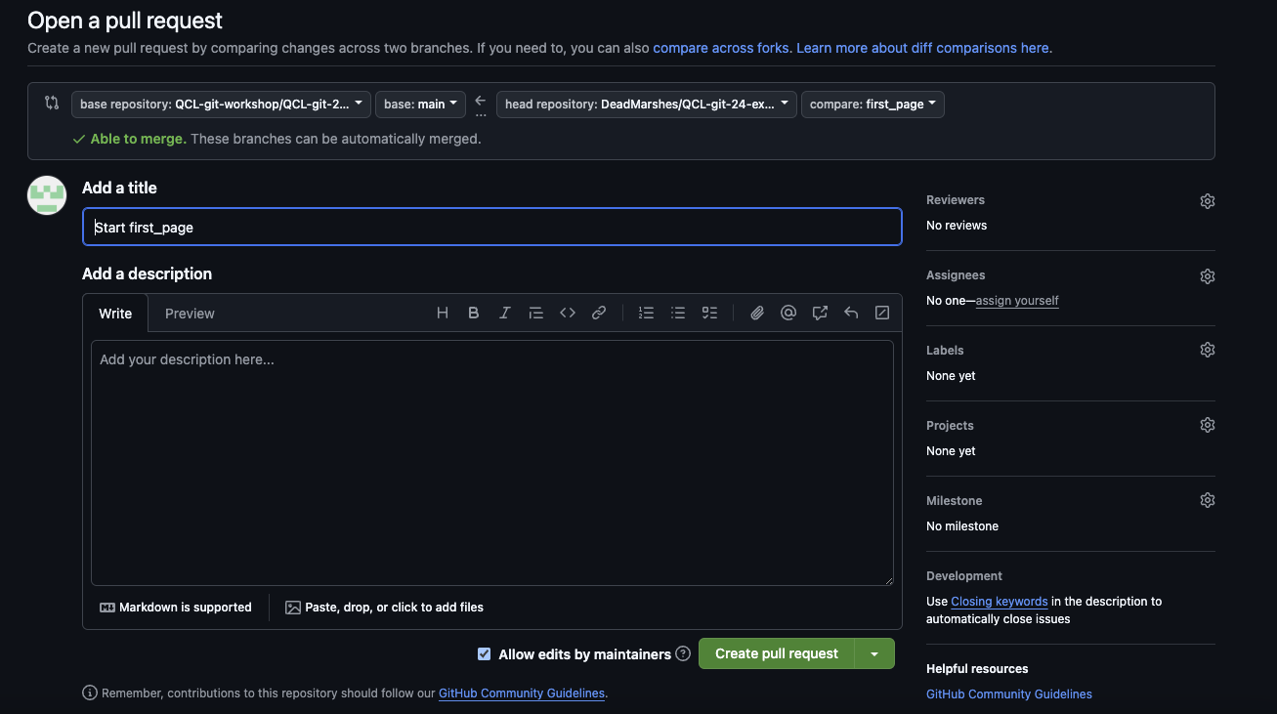
Pull Requests
Notes:
Congratulations! You have created a feature branch to hold the changes you will make while working on the issue. You have also opened a PR for this feature branch back to the upstream repository. This will allow others to follow your progress as you work. Also, the PR is a place where developers can discuss designs and implementations for solutions to issues.

Slide 43
Integrate a change
Merge
Project
(Upstream)
Pull Request
Your fork
(Origin)
Your local clone

Slide 44
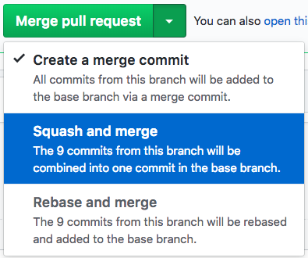


Maintainer reviews the PR
Accept the PR by merging it into master: choose "squash and merge" strategy for now and click Merge pull request and then Confirm.
Looks good!

Slide 45
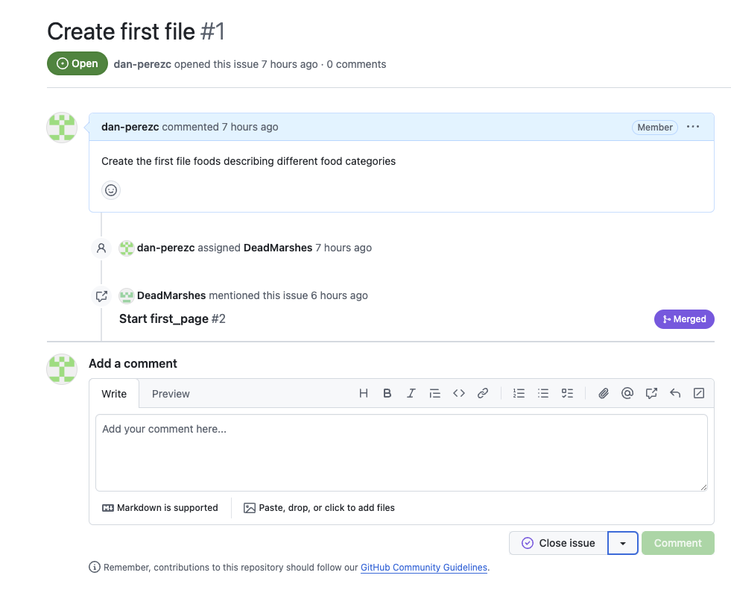

Maintainer close the issue

Slide 46
Project tracker
Branch/TAG
GRAPH
COMMIT
USER
Development
Merge Pull Request #1
Maintainer
Issue #1
Resolution Issue #1
Contributor
Issue #1
Work on issue #1
Contributor
Main/master
Update on file Readme
Maintainer
Main
Development
Feature
Notes:
Modify the image

Slide 47
Branching Strategy

Slide 48
Let’s cleanup!
Stand on main branch and pull upstream
Delete feature branch and push the change to origin

Slide 49
Workflow Best Practices
Best Practice | Description
Branch Protection | Enable branch protection rules to prevent direct commits to critical branches and ensure changes go through code review.
Continuous Integration | Integrate CI tools to automatically test and build code changes, ensuring the project's stability and quality.
Documentation | Maintain detailed documentation in repositories to enhance project accessibility, onboarding, and knowledge sharing.
Code Reviews | Encourage regular code reviews to catch bugs early, share knowledge, and maintain code quality standards.
Issue Tracking | Effectively use GitHub issues to track tasks, bugs, and enhancements, facilitating project management and collaboration.

Slide 50
Cheat sheet Git code
SETUP & INIT Configuring user information, initializing and cloning repositories
git init initialize an existing directory as a Git repository
git clone [url] retrieve an entire repository from a hosted location via URL
SHARE & UPDATE Retrieving updates from another repository and updating local repos
git remote add [alias] [url] add a git URL as an alias
git fetch [alias] fetch down all the branches from that Git remote
git merge [alias]/[branch] merge a remote branch into your current branch to bring it up to date
git push [alias] [branch] Transmit local branch commits to the remote repository branch
git pull fetch and merge any commits from the tracking remote branch
STAGE & SNAPSHOT Working with snapshots and the Git staging area
git status show modified files in working directory, staged for your next commit
git add [file] add a file as it looks now to your next commit (stage)
git reset [file] un-stage a file while retaining the changes in working directory
git diff diff of what is changed but not staged
git diff --staged diff of what is staged but not yet committed
git commit -m “[descriptive message]” commit your staged content as a new commit snapshot
USER
git config user.name
BRANCH
git branch list all branches
git branch my-feature create new branch
git checkout branch change branch
git merge my-feature (step on main and merge feature branch)
git branch -d my-feature Delete branch
Notes:
git push origin feature
https://github.com/settings/tokens

Slide 51
Additional Info
https://docs.github.com/en/pull-requests/collaborating-with-pull-requests/proposing-changes-to-your-work-with-pull-requests/creating-and-deleting-branches-within-your-repository
https://www.geeksforgeeks.org/version-control-systems/
https://www.geeksforgeeks.org/ultimate-guide-git-github/?ref=gcse_ind
https://www.gitkraken.com/learn/git/git-flow
https://www.atlassian.com/git/tutorials/comparing-workflows/gitflow-workflow

