Slide 1
Proxy Design Pattern
By: Houari ZEGAI

Slide 2
Our process is easy
first
second
third
last
Design Pattern
Proxy Design Pattern
Conception & Implementation
Bonus !

Slide 3
What is Design Pattern?
Are solutions to recurring problems and are formalized best practices that the programmer can use to solve common problems in software design

Slide 4
Type of Design Pattern
There are 24 Design Pattern devided into three types
Creational
Factory method
Abstract Factory
Builder
Prototype
Singleton,
Structural
Adapter (class)
Adapter (object)
Bridge
Proxy
Composite, Decorator, Façade, Flyweight,
Behavioral
Interepter
Template method
Chain of Responsibility
Command, Iterator, Mediator, Memento, Observer, State, Strategy, Visitor,

Slide 5
Proxy Design Pattern
Definition
An object representing another object!
Category
Structure

Slide 6
Proxy Design Pattern
Objectif
Provide an intermediary between the client and a object to control access to the latter
Motivation
Controlling access to an object is to defer the full cost of its creation and initialization until we actually need to use it.

Slide 7
Applicability
Remote Proxy
The remote proxy provides a local representation of the object which is present in the different address location.
Virtual Proxy
delaying the creation and initialization of expensive objects until needed, where the objects are created on demand.

Slide 8
Applicability
Protection Proxy
The protective proxy acts as an authorization layer to verify if the actual user has access to appropriate content
Smart Reference
provides additional actions whenever a subject is referenced, such as counting the number of references to an object

Slide 9

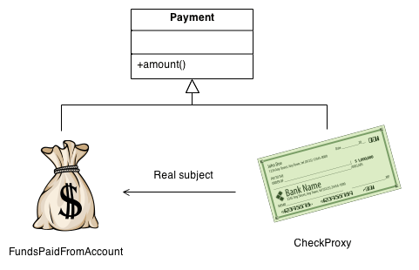
Examples
ATM Machine

Slide 10
Conception & Implementation
Let's see some of the UML Diagram which describe a proxy design pattern & how to build it in Java

Slide 11
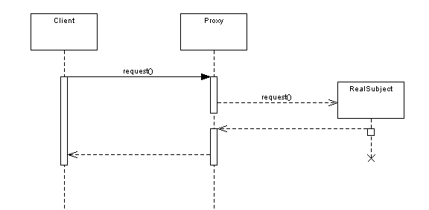
Structure – Sequence Diagram

Slide 12
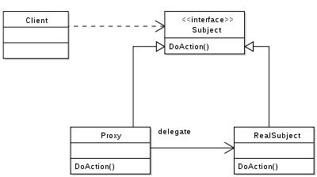
Structure – Class Diagram

Slide 13

Implementation in Java
Let’s write some code!

Slide 14
Thanks!
Any questions?
You can find me at: http://houarizegai.me

Slide 15

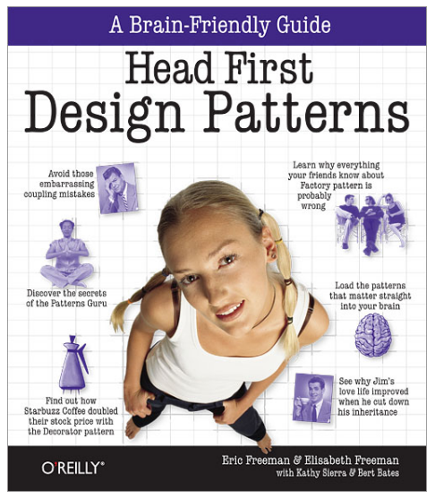

Where can I learn or find code of Design Patterns?
Bonus!
Book
Video Tutorial:
Channel: Derek Banas
Link:1https://www.youtube.com/playlist?list=PLF206E906175C7E07
Source Code:
Author: Houari ZEGAI
Link: https://github.com/HouariZegai/Design-Patterns-in-Java

