Slide 1
The Missing Middle
A statistical investigation of the exoplanet radius gap
Jovana Mickovikj
Faculty of Computer Science and Engineering (FINKI)
Ss. Cyril and Methodius University in Skopje
Notes:
The radius gap is a shortage of planets of one particular size. This talk asks how strong the statistical evidence for it is in public NASA archive data, and what properties decide which side of it a planet falls on. Three numbers to keep in mind: 2,587 planets, a density minimum at 1.76 Earth radii, and a period effect of 0.335.

Slide 2

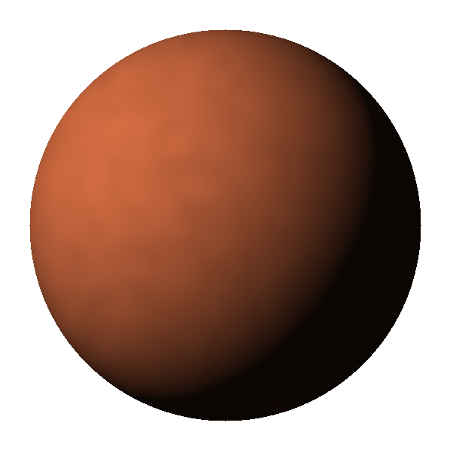
Planets don’t come in every size
THE PHENOMENON
CONTEXT
Super-Earths
THE RADIUS GAP
Sub-Neptunes
rocky, envelope stripped
1.5 – 2.0 R⊕
core + gas envelope
1
1.5
2
3
4
Planet radius [R⊕]
First resolved by Fulton et al. (2017), California-Kepler Survey
Notes:
One idea only: planet sizes are not uniformly distributed. Among small exoplanets, radii between roughly 1.5 and 2.0 Earth radii are conspicuously rare. Small planets split into rocky super-Earths, which have lost their primordial atmosphere, and sub-Neptunes, which kept a thick hydrogen–helium envelope. The gap marks the boundary between keeping and losing that envelope. First resolved by Fulton et al. (2017) in the California-Kepler Survey.

Slide 3

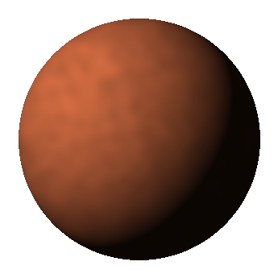
Two theories, one testable prediction
WHY IT MATTERS
CONTEXT
Photoevaporation
Core-powered mass loss
Starlight strips the envelope in the first ~100 million years.
The planet’s own heat drives it off over billions of years.
BOTH PREDICT
Short orbits → below the gap Long orbits → above the gap
Notes:
Photoevaporation: X-ray and UV radiation from the young host star strips the primordial envelope within roughly the first 100 million years, strongest close to the star. Core-powered mass loss: the planet's own cooling interior heats the envelope from below and drives it off, far more gradually, over billions of years. Different physics, but one identical prediction: orbital period should track a planet's final size. That shared prediction is what can be tested statistically without choosing between the mechanisms.

Slide 4
Four research questions
SCOPE
CONTEXT
Q4
Q1
Q2
Q3
Is there a gap?
Do the tests agree?
What predicts it?
Does period matter?
and where does it sit
formal tests of modality
without using radius
classical + Bayesian
Notes:
The roadmap. Q1: does a carefully filtered sample show two populations, and where does the boundary sit? (GMM, KDE, bootstrap). Q2: do formal tests of multimodality support the structure, or reveal their own limits? (Silverman, Hartigan dip, power simulation). Q3: leaving radius out, can orbital and stellar properties tell which side a planet falls on? (logistic regression, random forest). Q4: is the predicted period-dependence real, classically and under Bayesian estimation? (KS, Mann-Whitney, Beta-Binomial). The tracker in the top-right corner shows where we are.

Slide 5
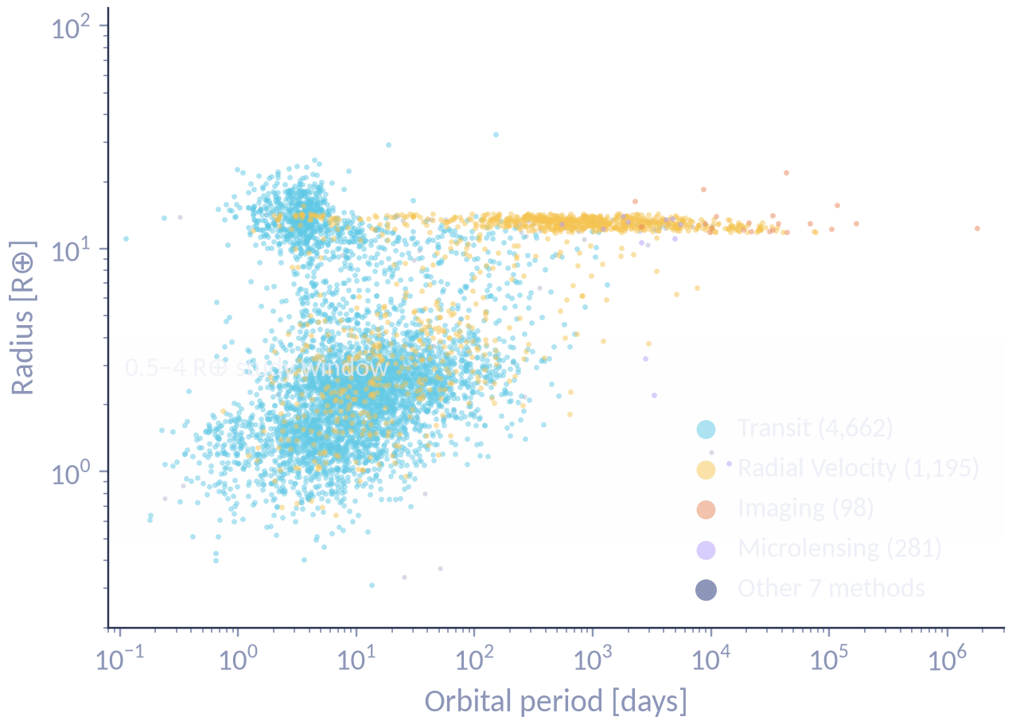
One archive, many ways of finding planets
THE SOURCE
DATA
6,319
confirmed planets · 84 parameters each
Transit 74% RV 19% Other 7%
Methods see different planets: median period 8 days by transit, 308 days by radial velocity.
NASA Exoplanet Archive · PSCompPars · 15 July 2026
Notes:
Source: NASA Exoplanet Archive, Planetary Systems Composite Parameters (PSCompPars), downloaded 15 July 2026 — 6,319 planets, 84 columns. Transit 74%, radial velocity 19%, nine other methods 7%. Transit median period 8.0 days vs radial velocity 307.9 days (Mann-Whitney p ≈ 4.4×10⁻³⁰⁰). The small-planet region relevant to the gap is populated almost entirely by transit detections. Caveat: this is a composite catalogue — each column comes from whichever study reported it most completely, so columns for one planet need not be mutually consistent.

Slide 6
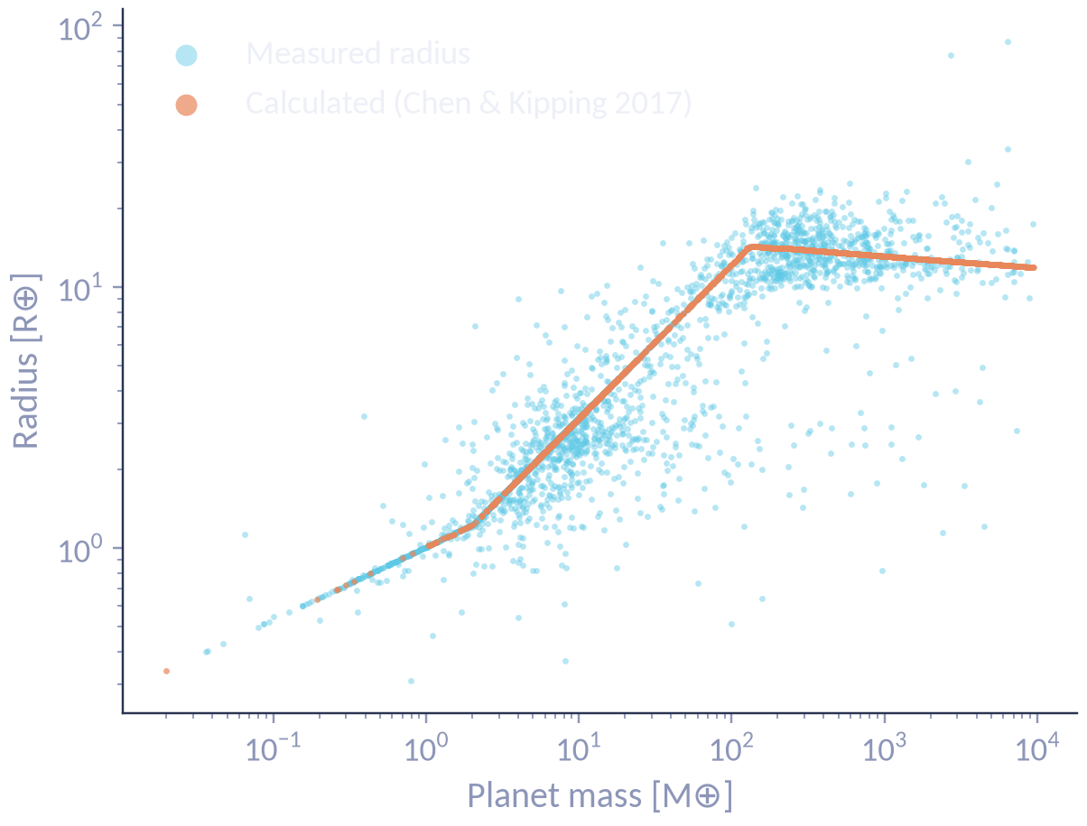
Not every radius was measured
THE DECISIVE FILTER
DATA
1,518
radii were calculated from a mass–radius formula, not measured (24%)
A formula can’t contain a gap — so these planets had to go.
Notes:
The key methodological decision. Where a radius wasn't measured, the archive fills it from the Chen & Kipping (2017) mass–radius relation. Plotting mass against radius makes this visible: the calculated values fall exactly on a piecewise curve, measured ones scatter around it. 1,518 planets (24%) carry a calculated radius, including 94.6% of radial-velocity (M sin i) masses — that horizontal band on the previous slide was a formula. A deterministic formula cannot reproduce fine structure, so leaving them in would smooth away the very gap under study.

Slide 7
From 6,319 to 2,587 planets
FILTERING PROTOCOL
DATA
Raw archive
6,319
Has radius and period
5,929
Not controversial
5,879
Radius measured
4,713
−1,166
Radius not a limit
4,710
Period not a limit
4,710
2,587
Radius 0.5–4 R⊕
3,512
−1,198
analysis sample
Radius error < 20%
2,587
−925
Notes:
Seven pre-specified cuts: 1) has radius and period (−390); 2) not controversial (−50); 3) radius measured, not calculated (−1,166); 4) radius not a limit value (−3); 5) period not a limit value (0); 6) radius in 0.5–4 Earth radii, following Fulton et al. (−1,198); 7) relative radius error under 20%, since noise that large can smear a 0.3–0.5 Earth-radius feature (−925). The orange bars are the three big cuts. Every step is printed in notebook 01. A transit-only variant gives 2,562 planets, only 25 fewer, and is used for sensitivity tests.

Slide 8
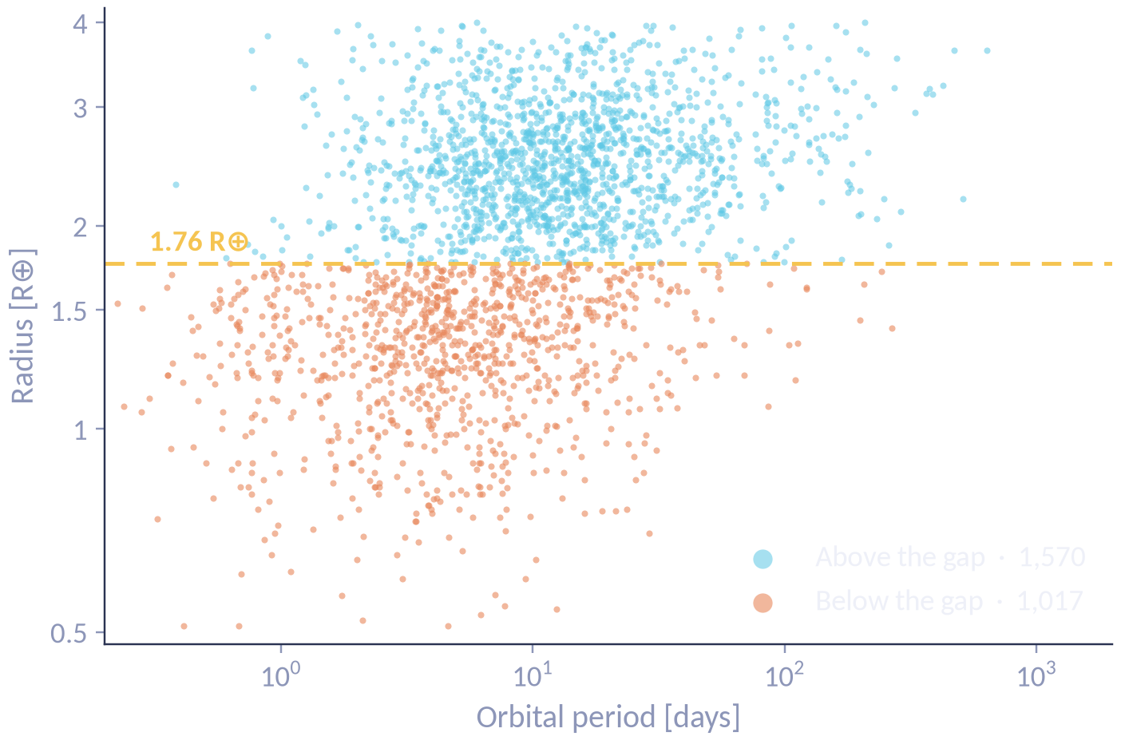
2,587 planets in one picture
THE ANALYSIS SAMPLE
DATA
60.7%
above the gap
39.3%
below the gap
Note the lower edge rising with period — we return to it at the end.
Notes:
Each dot is a planet: period on a log scale across, radius up. The gold line marks the gap at 1.76 Earth radii — the location estimated in Q1 and used for every label downstream. 1,570 planets (60.7%) sit above it, 1,017 (39.3%) below. Point at the lower edge of the cloud rising to the right — it returns on the limitations slide.

Slide 9
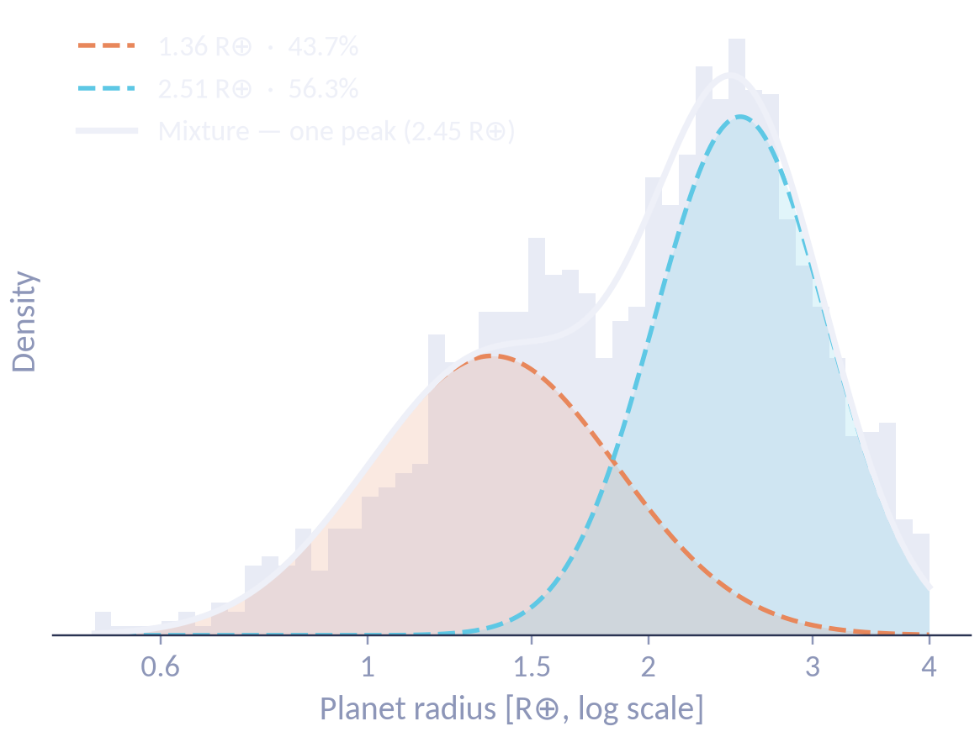
Two components beat one — but that isn’t two peaks
Q1 · MODEL COMPARISON
Q1 · THE GAP
ΔAIC −242
one → two components: decisive
The trap
The fitted mixture has a single peak. Two components ≠ two modes.
Notes:
Gaussian mixtures with one, two and three components on log radius. AIC: −1724.37, −1965.93, −1985.55; BIC: −1712.65, −1936.63, −1938.68. One → two: ΔAIC ≈ −241.6, ΔBIC ≈ −224.0, decisive. Two → three: ΔBIC ≈ −2, negligible. Components at 1.36 (43.7%) and 2.51 Earth radii (56.3%). But the white curve — the mixture — has a single maximum at 2.45 and no interior minimum. Model comparison shows one Gaussian is inadequate; it does not show bimodality. The evidence for a gap has to come from a non-parametric estimate.

Slide 10
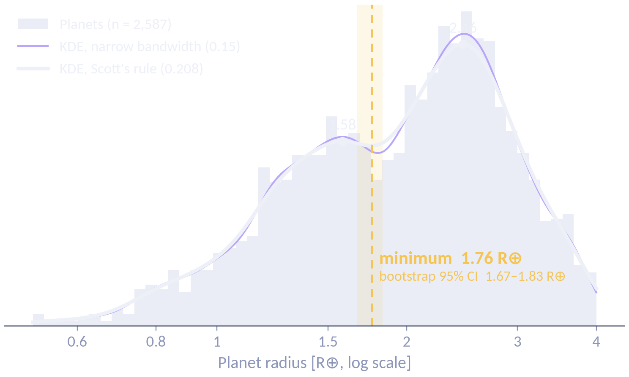
A density minimum at 1.76 R⊕
Q1 · LOCATING THE GAP
Q1 · THE GAP
1.76 R⊕
kernel density minimum
1.76–1.80
across smoothing bandwidths
Notes:
The central figure. Bars are the raw planets, the white curve is the kernel density estimate with Scott's-rule bandwidth (factor 0.208). It finds a local minimum at 1.76 Earth radii, between peaks at 1.58 and 2.46 — inside the 1.5–2.0 range in the literature. Bandwidth-stable: 1.76 → 1.78 → 1.80 at factors 0.208, 0.18 and 0.15 (violet curve). The KDE is non-parametric, so it isn't forced into a two-Gaussian shape — mirroring the structure of Fulton et al.'s method. The gold band is the bootstrap interval on the next slide.

Slide 11
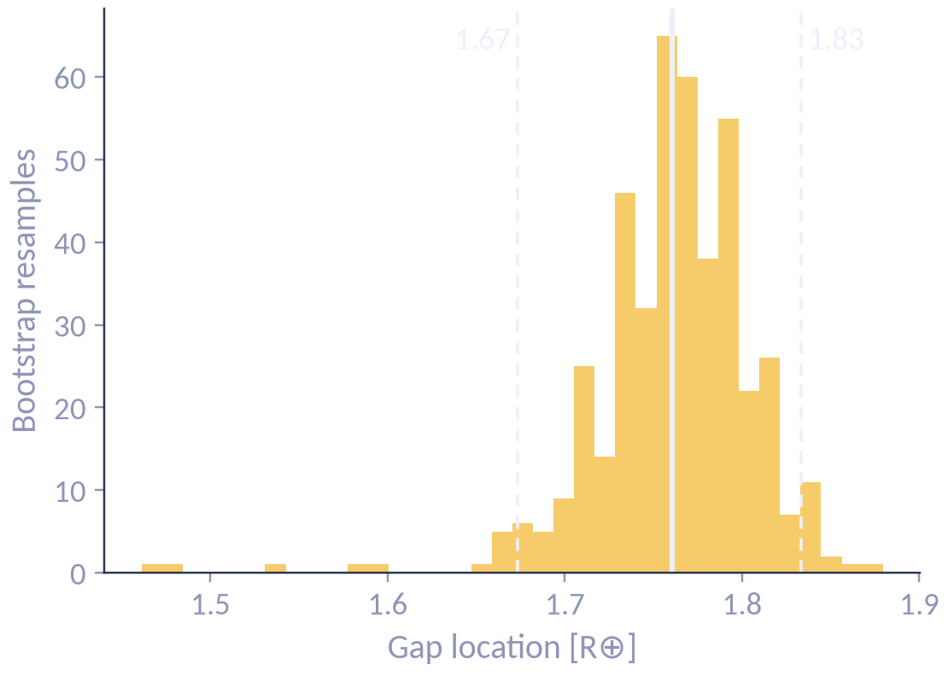
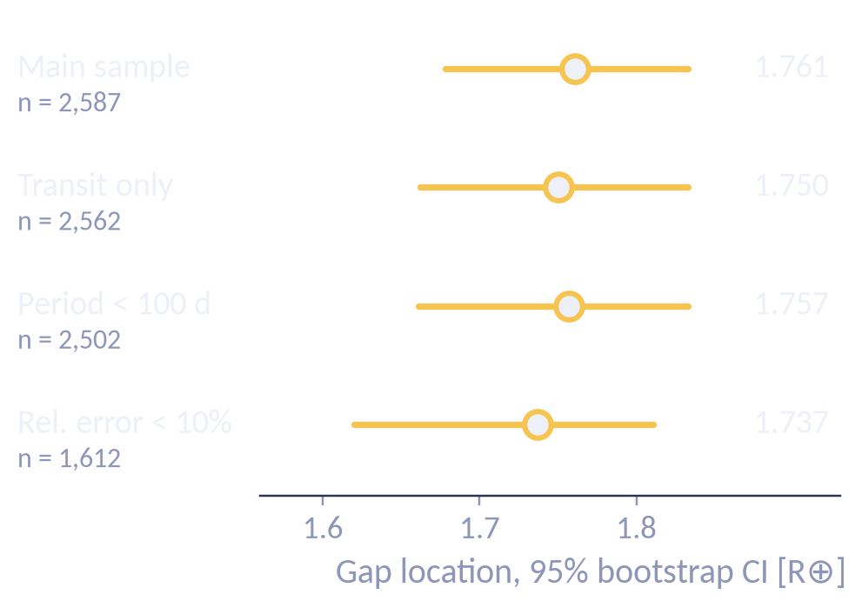
The location holds up
Q1 · ROBUSTNESS
Q1 · THE GAP
Resampled 500 times 95% CI 1.67–1.83 R⊕
Rebuilt four ways all within 0.03 R⊕
Notes:
Two checks on position. Left: 500 bootstrap resamples; a minimum is recovered in 436 (87.2%), mean 1.76, 95% CI [1.67, 1.83]. Right: four independently filtered samples (300 resamples each) — main 1.761, transit only 1.750, period < 100 d 1.757, relative error < 10% 1.737 — all within 0.03 Earth radii. Where the gap sits is not an artefact of how the sample was built.

Slide 12
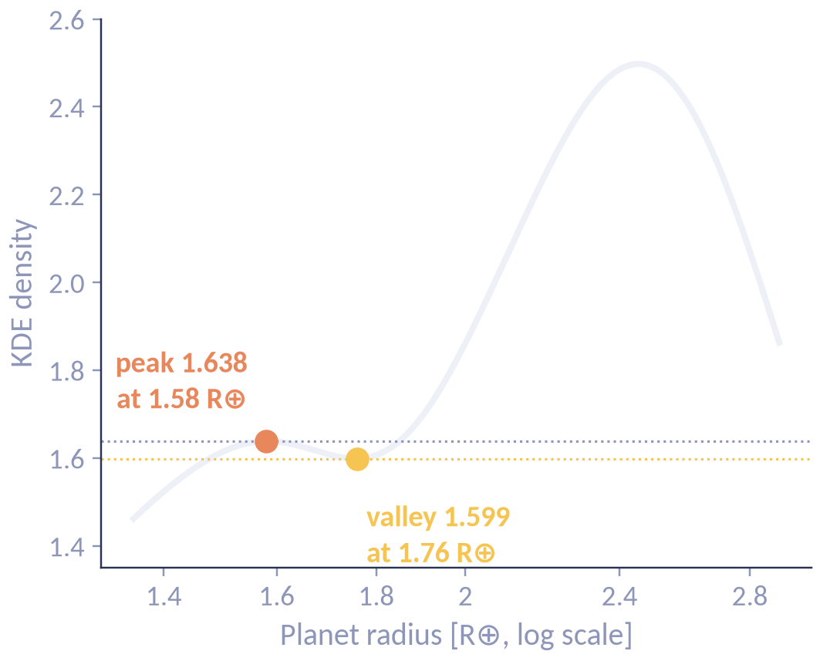
Robust in position — shallow in depth
Q1 · THE HONEST CAVEAT
Q1 · THE GAP
2.4%
≈ 2×
deep, in this sample
deficit in Fulton et al.
Pooled archive data, with no completeness correction, blurs the valley.
Notes:
Stated plainly: the density at the minimum is 1.599 against 1.638 at the neighbouring peak — 2.4% lower. Fulton et al. report roughly a factor of two. Why shallower: the archive pools heterogeneous literature sources of differing precision; a composite catalogue admits no survey-completeness correction; Fulton et al. worked from one homogeneous sample with uniformly precise radii. Stable in location, weak in amplitude — which the modality tests are about to expose.

Slide 13
Same data, opposite verdicts
Q2 · FORMAL TESTS
Q2 · MODALITY
Silverman’s test
Hartigan’s dip test
p = 0.028
p = 0.52
rejects unimodality
does not reject
Sensitive to whether a second mode exists
Sensitive to how deep the valley is
A shallow but genuine second mode is exactly where these two tests part company.
Notes:
Same data, same null hypothesis, opposite verdicts. Pause here. Silverman's critical bandwidth test: h_crit = 0.0445, 1,000 smoothed bootstraps, p = 0.028 — it measures how much smoothing is needed before the second mode disappears, so it responds to whether a mode exists. Hartigan's dip: dip = 0.0073, p = 0.52 — the largest distance between the empirical CDF and the closest unimodal CDF, so it is governed by how deep the valley is. At 2.4% depth, the dip barely registers.

Slide 14
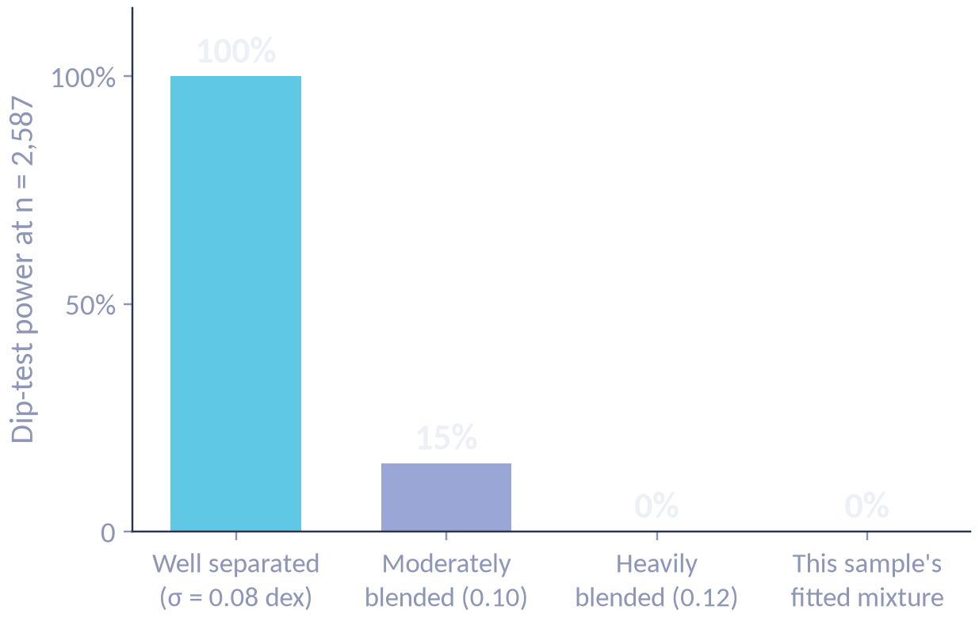
The dip test isn’t weak — the valley is shallow
Q2 · VERIFYING THE CLAIM
Q2 · MODALITY
At n = 2,587 the dip test finds a pronounced gap every time — and this sample’s shape never.
Silverman, done right
naive bootstrap p = 0.54 → smoothed bootstrap p = 0.028
Notes:
The dip test's null could mean absence or insensitivity — testable. Two-component populations simulated at n = 2,587, 200 draws per scenario, α = 0.05: a well-separated (0.08 dex) gap is detected 100% of the time; 0.10 dex, 15%; 0.12 dex, 0%; and the configuration fitted to this sample, 0%. Its null result is about the feature, not the test. Method integrity: my first Silverman implementation resampled the raw values, which manufactures spurious modes and gave p = 0.54. The smoothed bootstrap of Silverman (1981) gives p = 0.028, and was validated on known data: p = 0.505 for a simulated unimodal sample, p = 0.000 for a bimodal one.

Slide 15
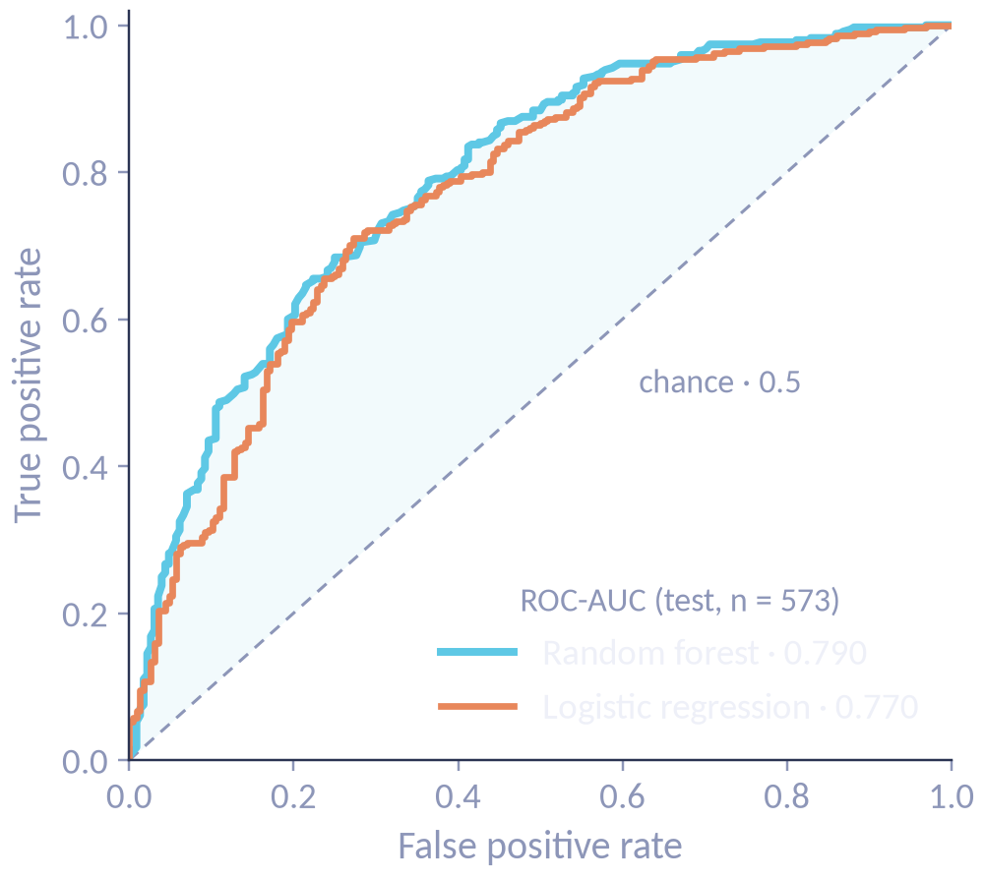
Predicting the side of the gap — without radius
Q3 · CLASSIFICATION
Q3 · PREDICTORS
1
Label each planet above / below 1.76 R⊕
0.77–0.79
ROC-AUC on held-out planets
2
Use 8 orbital & stellar features — no radius
Moderate — but real.
3
Train on 1,716, test on 573
Notes:
Planets are labelled above or below 1.76 Earth radii, then every radius-derived quantity is removed. Eight predictors: period, insolation, stellar temperature, radius, mass, metallicity, distance, number of planets (eccentricity dropped for 20% missingness). 2,289 complete cases, stratified 1,716 / 573 split; log-transform and scaler fitted on train only; balanced class weights. Test ROC-AUC: logistic regression 0.770, random forest 0.790. 5-fold CV: 0.761 ± 0.018 and 0.811 ± 0.009. Excluding the ambiguous zone 1.62–1.83: 0.772 and 0.810. RF under-gap recall is only 0.57. Excluding radius means a result above chance cannot be circular.

Slide 16
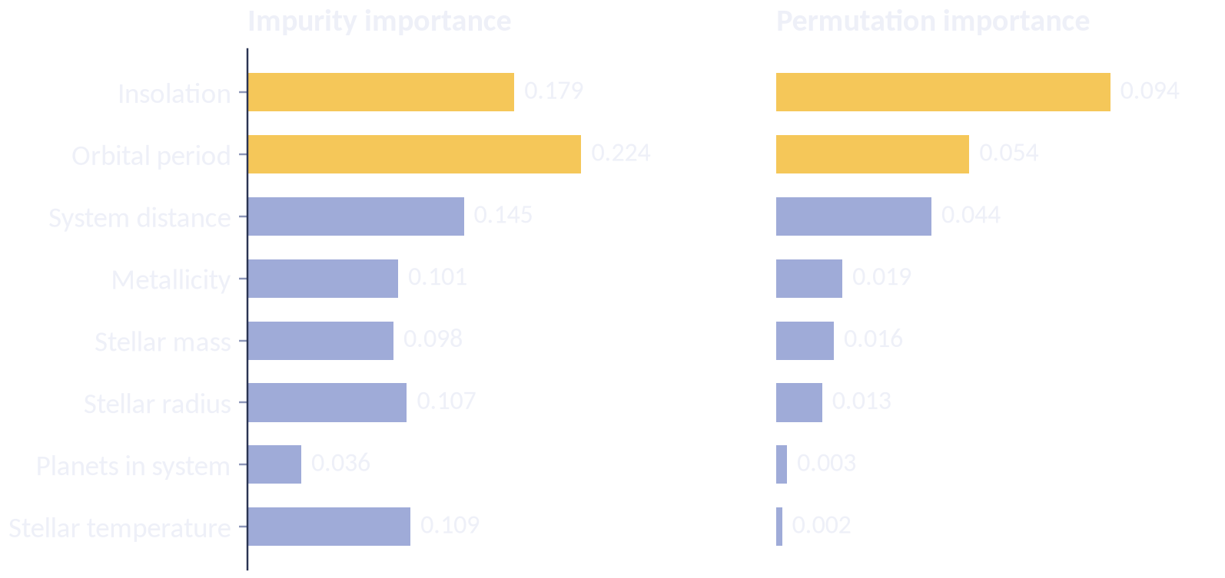
The period–insolation axis carries the signal
Q3 · WHAT DRIVES IT
Q3 · PREDICTORS
r = −0.74
period vs insolation · VIF > 20
Rank them jointly — swap the measure and the top two swap places.
Notes:
Both models put orbital period and insolation (gold) at the top: close-in, highly irradiated planets tend to sit below the gap. But they are near-redundant by construction (S ∝ L⋆/a², a ∝ P^2/3): correlation −0.74, VIF 21.5 and 26.9 (threshold 10). Impurity importance ranks period first; permutation importance on the held-out set ranks insolation first (0.094 vs 0.054). The defensible claim is that the period–insolation axis jointly dominates. System distance is read as a detection-bias artefact.

Slide 17
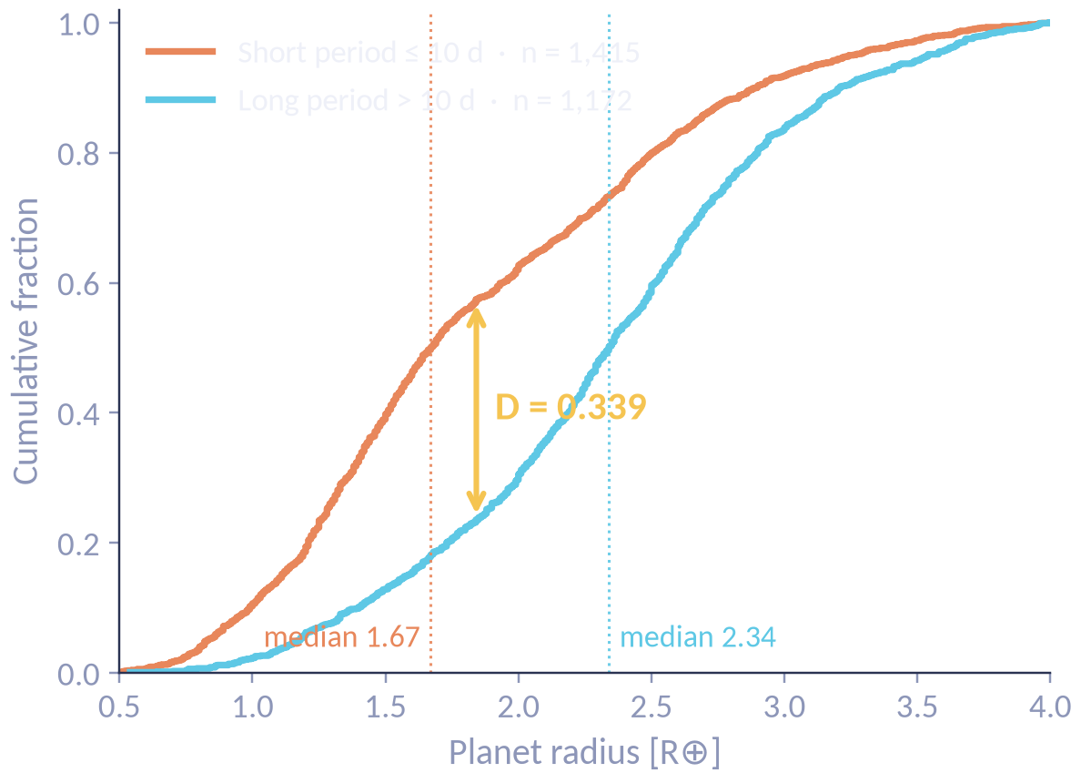
Long-period planets are larger
Q4 · CLASSICAL TESTS
Q4 · PERIOD
1.67 → 2.34
median radius (R⊕), ≤ 10 d vs > 10 d
KS p = 7.8×10⁻⁶⁶
Mann–Whitney and Kruskal–Wallis agree.
Notes:
Splitting at 10 days: the cumulative curves separate by D = 0.339 and the medians are 1.67 vs 2.34 Earth radii. KS p = 7.8×10⁻⁶⁶; Mann-Whitney U = 509,419.5, p = 3.9×10⁻⁶⁴; Kruskal-Wallis over three period groups H = 381.8, p = 1.2×10⁻⁸³ — one finding confirmed three ways. Also: multi-planet membership is associated with gap position (χ² = 13.18, p = 2.8×10⁻⁴, peas in a pod); discovery method is not (Fisher OR 1.22, p = 0.68), but with only 25 non-transit planets that is inconclusive.

Slide 18
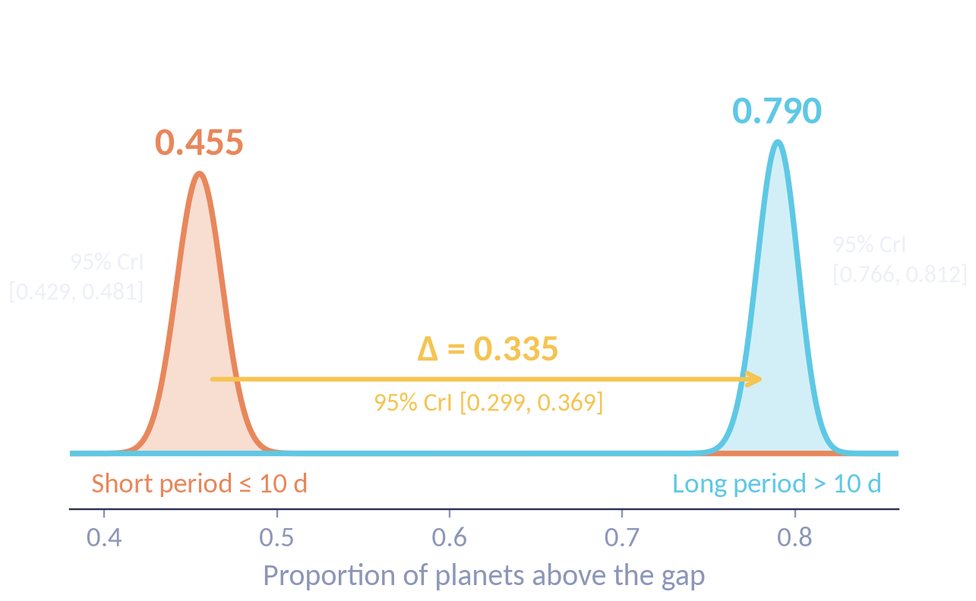
The posteriors don’t even touch
Q4 · BAYESIAN ESTIMATION
Q4 · PERIOD
STILL HOLDS WHEN WE CHANGE
the prior
0.335 → 0.324
the period cut
0.276 – 0.414
host clustering
CI × 1.02
Notes:
Beta-Binomial with a flat Beta(1,1) prior. Short period: 644 of 1,415 above the gap → Beta(645, 772), mean 0.455 [0.429, 0.481]. Long period: 926 of 1,172 → Beta(927, 247), mean 0.790 [0.766, 0.812]. Δ = 0.335, 95% CrI [0.299, 0.369], P(p_long > p_short) > 0.9999. Robustness: sceptical Beta(20,20) prior moves Δ only to 0.324; 5/10/20-day cuts give 0.414 / 0.334 / 0.276; a cluster bootstrap over 1,932 host systems (42% of planets share a host) widens the interval by just 1.02× to [0.299, 0.370]. The posterior predictive check passes but cannot fail by construction, so it's reported as weak evidence.

Slide 19
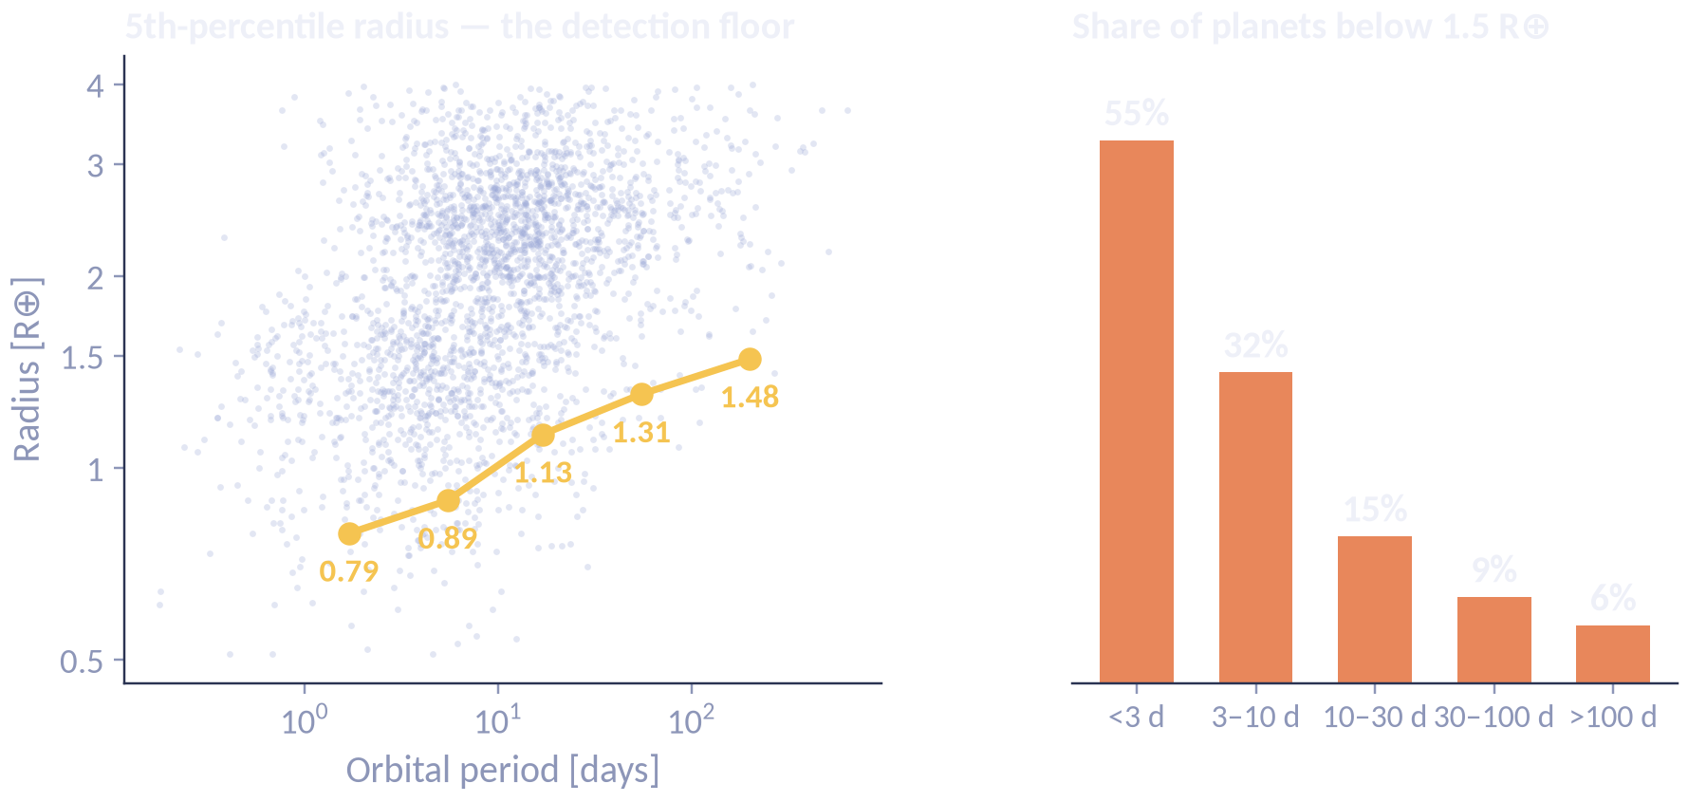
Detection bias predicts the same signature
THE PRINCIPAL LIMITATION
LIMITS
55% → 6%
planets < 1.5 R⊕, short to long period
Consistent with mass loss — not proof of it.
Notes:
The strongest counter-argument to the headline result. Transit signal-to-noise scales with planet size and with the number of transits in the observing window, so small planets on long orbits are systematically missed. The 5th-percentile radius climbs from 0.79 to 1.48 Earth radii across period bins, and the share of planets below 1.5 falls from 55% to 6%. A survey that fails to see small, distant planets produces exactly the reported pattern with no mass loss at all. Fulton et al. could correct for this within a homogeneous Kepler sample; a composite archive cannot.

Slide 20
What the data supports
CONCLUSION
✓
A gap at 1.76 R⊕
~
But a shallow one
stable across samples and bandwidths
2.4% deep vs ≈ 2× in Fulton et al.
✓
A real period effect
✗
Mechanism not proven
Δ = 0.335, robust to every check
detection bias predicts the same
Next a homogeneous, completeness-corrected sample.
Fulton et al. 2017, AJ 154, 109 · Weiss et al. 2018, AJ 155, 48 · Chen & Kipping 2017, ApJ 834, 17 · Silverman 1981, JRSS B 43, 97
Notes:
Close on the distinction between what is established and what is not. A second mode near 1.76 Earth radii: bandwidth-stable, filter-robust (95% CI 1.67–1.83), supported by Silverman's test. But shallow: 2.4% below the adjacent peak, far weaker than the California-Kepler feature. A real period-dependence: Δ = 0.335, robust to prior, threshold and host clustering. Not a proven mechanism: transit detection bias predicts the same pattern and this sample cannot separate them. The next step is a homogeneous, completeness-corrected sample like the one Fulton et al. used — the only way to separate physics from selection.

