Slide 1
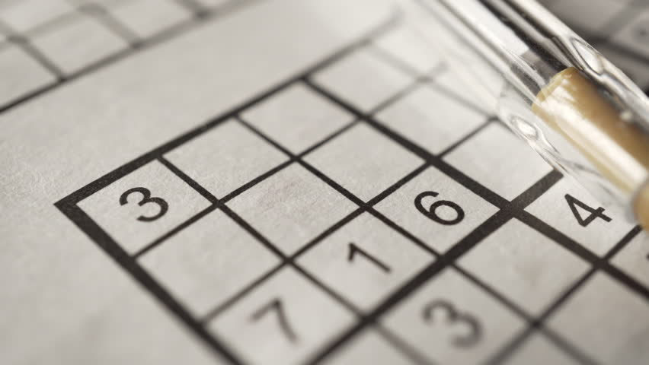

Rešavanje sudoku slagalice
Backtracking algoritmom
Kandidat: Jovanoski Bojan
Mentor: Pot Mikloš

Slide 2
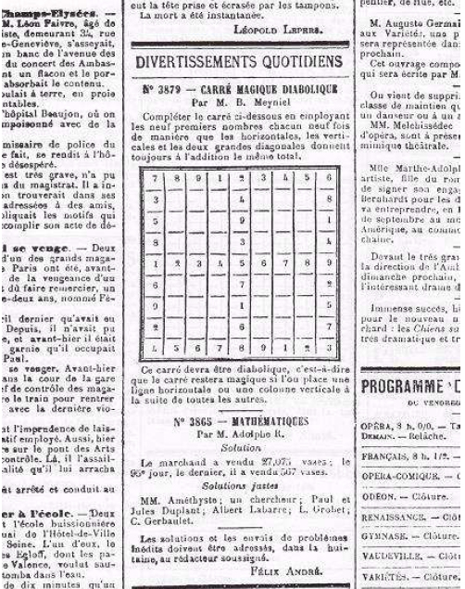




Sudoku
1
2
3
4
4
5
6
7
2
8
9
Jovanoski Bojan
Notes:
Igra potiče iz Japana gde se igra već 1000 godina, dok u modernom svetu postaje popularnija kad počinje da se štampa u Engleskom časopisu The Times 2004 godine.

Slide 3
Sudoku
1
5
2
3
4
6
7
8
9
4
7
3
1
9
8
2
5
6
6
8
9
5
2
7
1
3
4
2
4
1
6
5
3
8
9
7
3
6
8
9
7
2
4
1
5
5
9
7
4
8
1
6
2
3
7
1
4
8
3
5
9
6
2
9
3
6
2
1
4
5
7
8
8
2
5
7
6
9
3
4
1
Jovanoski Bojan

Slide 4
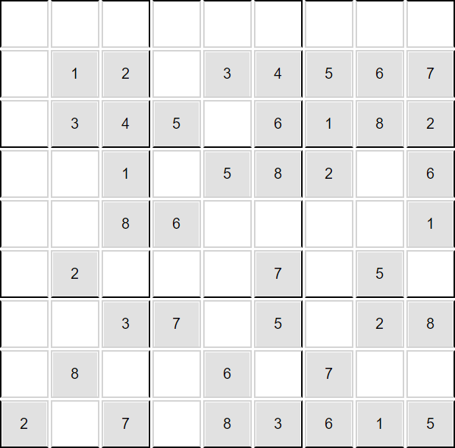
Sudoku
Jovanoski Bojan
Notes:
- Običan Sudoku
- Minimalnim Sudokom

Slide 5
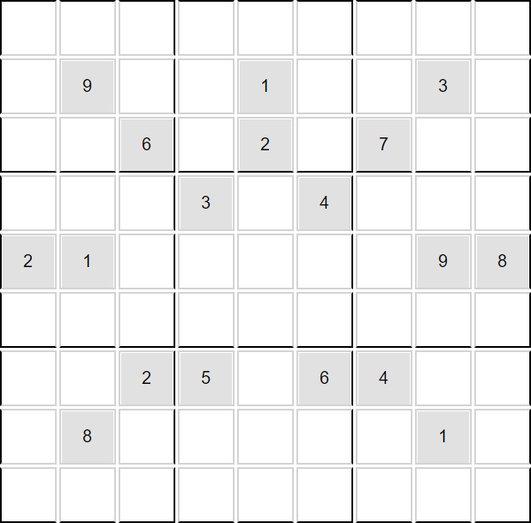
Sudoku
Jovanoski Bojan
Notes:
Težina igre
ortogonalnoj simetriji, diagonalnom simetrijom, automorfična

Slide 6
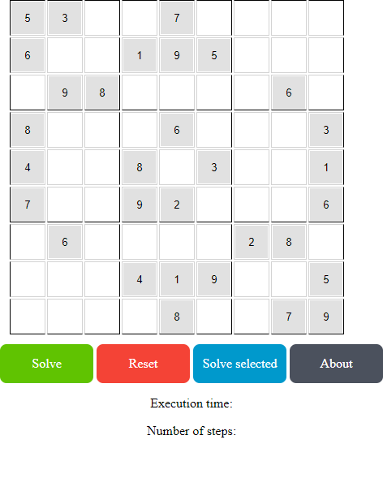
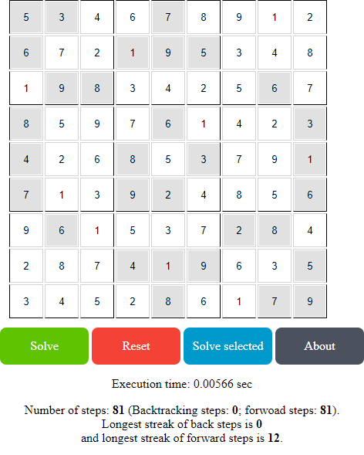
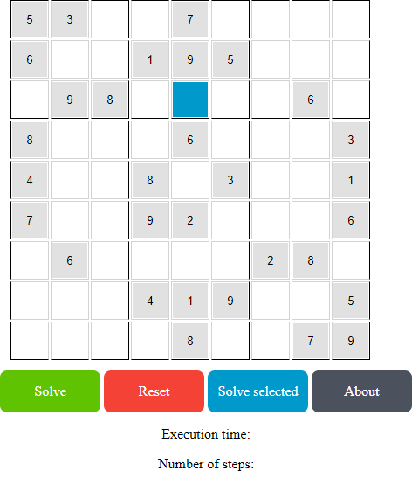
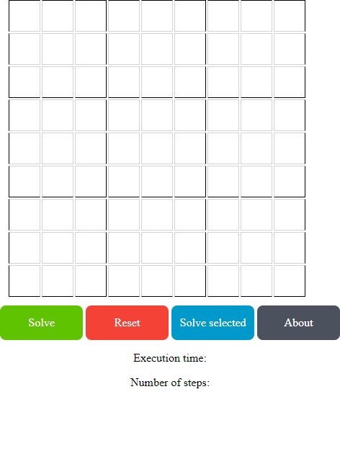

Aplikacija
ai.jovanoskibojan.com
Jovanoski Bojan
Notes:
Spomenuti korišćene tehnologije

Slide 7
Nizovi
[Milan, Viktor, Marko, Bojan, Vanja]
[[Milan, Viktor, Marko, Bojan, Vanja],
[1254, 7854, 4789, 1241, 4541 ],
[10.0, 9.78, 7.78, 6.75, 8.25 ],
[Inf., Elek., Meha., Elek., Inf. ]]
[[Maja, Ana, Andrej, Vuk, Vanja],
[7543, 7745, 4789, 1241, 4541 ],
[9.0, 10.78, 7.78, 6.75, 8.25 ],
[Inf., Elek., Meha., Elek., Inf. ]]
[[Pera, Miša, Žarko, Sanja, Sonja],
[7543, 7745, 4789, 1241, 4541 ],
[9.0, 10.78, 7.78, 6.75, 8.25 ],
[Inf., Elek., Meha., Elek., Inf. ]]
[[Žika, Marko, Darko, Bilja, Ana],
[7543, 7745, 4789, 1241, 4541 ],
[9.0, 10.00, 7.78, 8.88, 9.25 ],
[Inf., Elek., Meha., Elek., Inf. ]]
Jovanoski Bojan

Slide 8
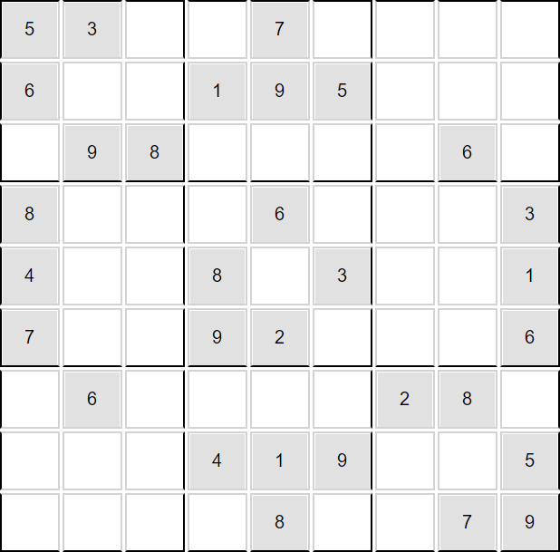
Backtracking
[[5, 3, 0, 0, 7, 0, 0, 0, 0],
[6, 0, 0, 1, 9, 5, 0, 0, 0],
[0, 9, 8, 0, 0, 0, 0, 6, 0],
[8, 0, 0, 0, 6, 0, 0, 0, 3],
[4, 0, 0, 8, 0, 3, 0, 0, 1],
[7, 0, 0, 9, 2, 0, 0, 0, 6],
[0, 6, 0, 0, 0, 0, 2, 8, 0],
[0, 0, 0, 4, 1, 9, 0, 0, 5],
[0, 0, 0, 0, 8, 0, 0, 7, 9]]
Jovanoski Bojan

Slide 9
Backtracking
[[0],
[0],
[1, 2, 4],
[2, 6],
[0],
[2, 4, 6, 8],
[1, 4, 8, 9],
[1, 2, 4, 9],
[2, 4, 8]]
[[0],
[2, 4, 7],
[2, 4, 7],
[0],
[0],
[0],
[3, 4, 7, 8],
[2, 3, 4],
[2, 4, 7, 8]]
[[1, 2],
[0],
[0],
[2, 3],
[3, 4],
[2, 4],
[1, 3, 4, 5, 7],
[0],
[2, 4, 7]]
[[0],
[1, 2, 5],
[1, 2, 5, 9],
[5, 7],
[0],
[1, 4, 7],
[4, 5, 7, 9],
[2, 4, 5, 9],
[0]]
Jovanoski Bojan

Slide 10
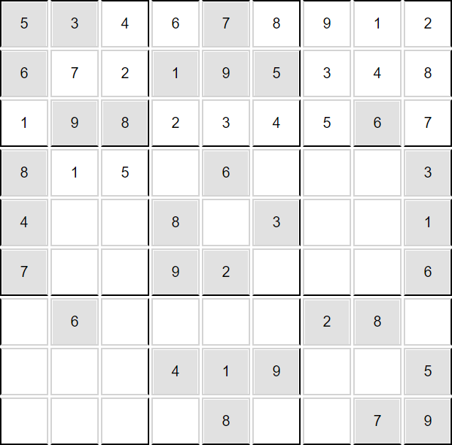
Backtracking
[[0],
[0],
[1, 2, 4],
[2, 6],
[0],
[2, 4, 6, 8],
[1, 4, 8, 9],
[1, 2, 4, 9],
[2, 4, 8]]
[[0],
[2, 4, 7],
[2, 4, 7],
[0],
[0],
[0],
[3, 4, 7, 8],
[2, 3, 4],
[2, 4, 7, 8]]
[[1, 2],
[0],
[0],
[2, 3],
[3, 4],
[2, 4],
[1, 3, 4, 5, 7],
[0],
[2, 4, 7]]
[[0],
[1, 2, 5],
[1, 2, 5, 9],
[5, 7],
[0],
[1, 4, 7],
[4, 5, 7, 9],
[2, 4, 5, 9],
[0]]
Jovanoski Bojan

Slide 11
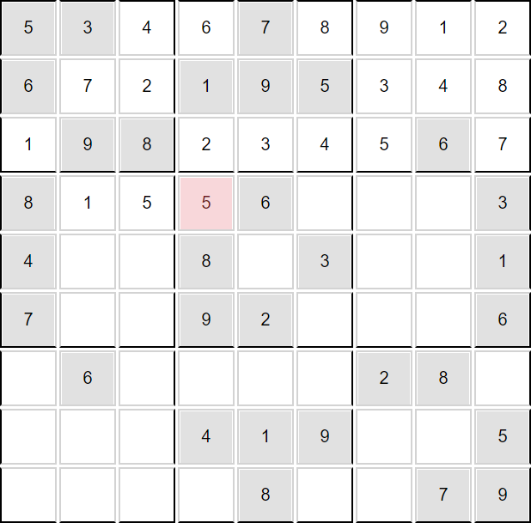
Backtracking
[[0],
[0],
[1, 2, 4],
[2, 6],
[0],
[2, 4, 6, 8],
[1, 4, 8, 9],
[1, 2, 4, 9],
[2, 4, 8]]
[[0],
[2, 4, 7],
[2, 4, 7],
[0],
[0],
[0],
[3, 4, 7, 8],
[2, 3, 4],
[2, 4, 7, 8]]
[[1, 2],
[0],
[0],
[2, 3],
[3, 4],
[2, 4],
[1, 3, 4, 5, 7],
[0],
[2, 4, 7]]
[[0],
[1, 2, 5],
[1, 2, 5, 9],
[5, 7],
[0],
[1, 4, 7],
[4, 5, 7, 9],
[2, 4, 5, 9],
[0]]
Jovanoski Bojan

Slide 12

Backtracking
[[0],
[0],
[1, 2, 4],
[2, 6],
[0],
[2, 4, 6, 8],
[1, 4, 8, 9],
[1, 2, 4, 9],
[2, 4, 8]]
[[0],
[2, 4, 7],
[2, 4, 7],
[0],
[0],
[0],
[3, 4, 7, 8],
[2, 3, 4],
[2, 4, 7, 8]]
[[1, 2],
[0],
[0],
[2, 3],
[3, 4],
[2, 4],
[1, 3, 4, 5, 7],
[0],
[2, 4, 7]]
[[0],
[1, 2, 5],
[1, 2, 5, 9],
[5, 7],
[0],
[1, 4, 7],
[4, 5, 7, 9],
[2, 4, 5, 9],
[0]]
Jovanoski Bojan

Slide 13
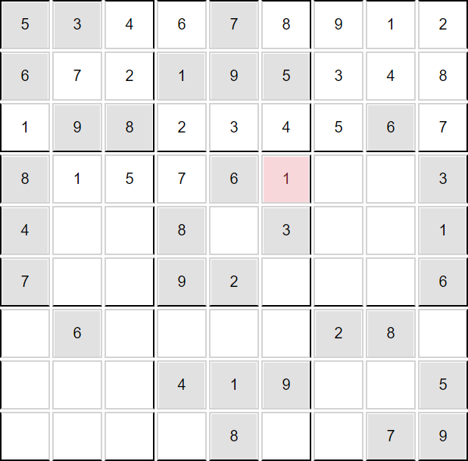
Backtracking
[[0],
[0],
[1, 2, 4],
[2, 6],
[0],
[2, 4, 6, 8],
[1, 4, 8, 9],
[1, 2, 4, 9],
[2, 4, 8]]
[[0],
[2, 4, 7],
[2, 4, 7],
[0],
[0],
[0],
[3, 4, 7, 8],
[2, 3, 4],
[2, 4, 7, 8]]
[[1, 2],
[0],
[0],
[2, 3],
[3, 4],
[2, 4],
[1, 3, 4, 5, 7],
[0],
[2, 4, 7]]
[[0],
[1, 2, 5],
[1, 2, 5, 9],
[5, 7],
[0],
[1, 4, 7],
[4, 5, 7, 9],
[2, 4, 5, 9],
[0]]
Jovanoski Bojan

Slide 14

Backtracking
[[0],
[0],
[1, 2, 4],
[2, 6],
[0],
[2, 4, 6, 8],
[1, 4, 8, 9],
[1, 2, 4, 9],
[2, 4, 8]]
[[0],
[2, 4, 7],
[2, 4, 7],
[0],
[0],
[0],
[3, 4, 7, 8],
[2, 3, 4],
[2, 4, 7, 8]]
[[1, 2],
[0],
[0],
[2, 3],
[3, 4],
[2, 4],
[1, 3, 4, 5, 7],
[0],
[2, 4, 7]]
[[0],
[1, 2, 5],
[1, 2, 5, 9],
[5, 7],
[0],
[1, 4, 7],
[4, 5, 7, 9],
[2, 4, 5, 9],
[0]]
Jovanoski Bojan

Slide 15

Backtracking
[[0],
[0],
[1, 2, 4],
[2, 6],
[0],
[2, 4, 6, 8],
[1, 4, 8, 9],
[1, 2, 4, 9],
[2, 4, 8]]
[[0],
[2, 4, 7],
[2, 4, 7],
[0],
[0],
[0],
[3, 4, 7, 8],
[2, 3, 4],
[2, 4, 7, 8]]
[[1, 2],
[0],
[0],
[2, 3],
[3, 4],
[2, 4],
[1, 3, 4, 5, 7],
[0],
[2, 4, 7]]
[[0],
[1, 2, 5],
[1, 2, 5, 9],
[5, 7],
[0],
[1, 4, 7],
[4, 5, 7, 9],
[2, 4, 5, 9],
[0]]
Jovanoski Bojan

Slide 16
Backtracking
[[0],
[0],
[1, 2, 4],
[2, 6],
[0],
[2, 4, 6, 8],
[1, 4, 8, 9],
[1, 2, 4, 9],
[2, 4, 8]]
[[0],
[2, 4, 7],
[2, 4, 7],
[0],
[0],
[0],
[3, 4, 7, 8],
[2, 3, 4],
[2, 4, 7, 8]]
[[1, 2],
[0],
[0],
[2, 3],
[3, 4],
[2, 4],
[1, 3, 4, 5, 7],
[0],
[2, 4, 7]]
[[0],
[1, 2, 5],
[1, 2, 5, 9],
[5, 7],
[0],
[1, 4, 7],
[4, 5, 7, 9],
[2, 4, 5, 9],
[0]]
Jovanoski Bojan

Slide 17
Backtracking
[[0],
[0],
[1, 2, 4],
[2, 6],
[0],
[2, 4, 6, 8],
[1, 4, 8, 9],
[1, 2, 4, 9],
[2, 4, 8]]
[[0],
[2, 4, 7],
[2, 4, 7],
[0],
[0],
[0],
[3, 4, 7, 8],
[2, 3, 4],
[2, 4, 7, 8]]
[[1, 2],
[0],
[0],
[2, 3],
[3, 4],
[2, 4],
[1, 3, 4, 5, 7],
[0],
[2, 4, 7]]
[[0],
[1, 2, 5],
[1, 2, 5, 9],
[5, 7],
[0],
[1, 4, 7],
[4, 5, 7, 9],
[2, 4, 5, 9],
[0]]
Jovanoski Bojan

Slide 18
Backtracking
[[0],
[0],
[1, 2, 4],
[2, 6],
[0],
[2, 4, 6, 8],
[1, 4, 8, 9],
[1, 2, 4, 9],
[2, 4, 8]]
[[0],
[2, 4, 7],
[2, 4, 7],
[0],
[0],
[0],
[3, 4, 7, 8],
[2, 3, 4],
[2, 4, 7, 8]]
[[1, 2],
[0],
[0],
[2, 3],
[3, 4],
[2, 4],
[1, 3, 4, 5, 7],
[0],
[2, 4, 7]]
[[0],
[1, 2, 5],
[1, 2, 5, 9],
[5, 7],
[0],
[1, 4, 7],
[4, 5, 7, 9],
[2, 4, 5, 9],
[0]]
Jovanoski Bojan

Slide 19
Backtracking
[[0],
[0],
[1, 2, 4],
[2, 6],
[0],
[2, 4, 6, 8],
[1, 4, 8, 9],
[1, 2, 4, 9],
[2, 4, 8]]
[[0],
[2, 4, 7],
[2, 4, 7],
[0],
[0],
[0],
[3, 4, 7, 8],
[2, 3, 4],
[2, 4, 7, 8]]
[[1, 2],
[0],
[0],
[2, 3],
[3, 4],
[2, 4],
[1, 3, 4, 5, 7],
[0],
[2, 4, 7]]
[[0],
[1, 2, 5],
[1, 2, 5, 9],
[5, 7],
[0],
[1, 4, 7],
[4, 5, 7, 9],
[2, 4, 5, 9],
[0]]
Jovanoski Bojan

Slide 20

Backtracking
[[0],
[0],
[1, 2, 4],
[2, 6],
[0],
[2, 4, 6, 8],
[1, 4, 8, 9],
[1, 2, 4, 9],
[2, 4, 8]]
[[0],
[2, 4, 7],
[2, 4, 7],
[0],
[0],
[0],
[3, 4, 7, 8],
[2, 3, 4],
[2, 4, 7, 8]]
[[1, 2],
[0],
[0],
[2, 3],
[3, 4],
[2, 4],
[1, 3, 4, 5, 7],
[0],
[2, 4, 7]]
[[0],
[1, 2, 5],
[1, 2, 5, 9],
[5, 7],
[0],
[1, 4, 7],
[4, 5, 7, 9],
[2, 4, 5, 9],
[0]]
Jovanoski Bojan

Slide 21
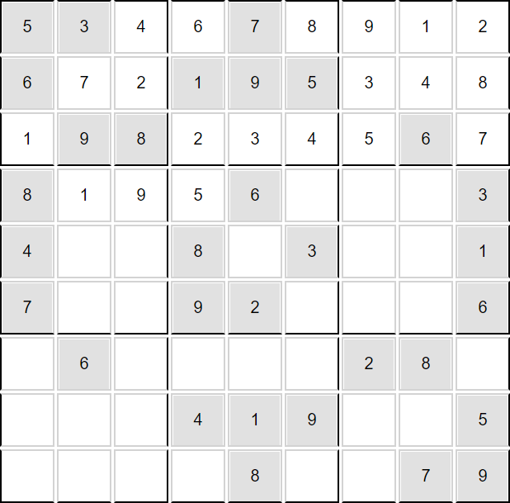
Backtracking
[[0],
[0],
[1, 2, 4],
[2, 6],
[0],
[2, 4, 6, 8],
[1, 4, 8, 9],
[1, 2, 4, 9],
[2, 4, 8]]
[[0],
[2, 4, 7],
[2, 4, 7],
[0],
[0],
[0],
[3, 4, 7, 8],
[2, 3, 4],
[2, 4, 7, 8]]
[[1, 2],
[0],
[0],
[2, 3],
[3, 4],
[2, 4],
[1, 3, 4, 5, 7],
[0],
[2, 4, 7]]
[[0],
[1, 2, 5],
[1, 2, 5, 9],
[5, 7],
[0],
[1, 4, 7],
[4, 5, 7, 9],
[2, 4, 5, 9],
[0]]
Jovanoski Bojan

Slide 22

Backtracking
[[0],
[0],
[1, 2, 4],
[2, 6],
[0],
[2, 4, 6, 8],
[1, 4, 8, 9],
[1, 2, 4, 9],
[2, 4, 8]]
[[0],
[2, 4, 7],
[2, 4, 7],
[0],
[0],
[0],
[3, 4, 7, 8],
[2, 3, 4],
[2, 4, 7, 8]]
[[1, 2],
[0],
[0],
[2, 3],
[3, 4],
[2, 4],
[1, 3, 4, 5, 7],
[0],
[2, 4, 7]]
[[0],
[1, 2, 5],
[1, 2, 5, 9],
[5, 7],
[0],
[1, 4, 7],
[4, 5, 7, 9],
[2, 4, 5, 9],
[0]]
Jovanoski Bojan

Slide 23

Backtracking
[[0],
[0],
[1, 2, 4],
[2, 6],
[0],
[2, 4, 6, 8],
[1, 4, 8, 9],
[1, 2, 4, 9],
[2, 4, 8]]
[[0],
[2, 4, 7],
[2, 4, 7],
[0],
[0],
[0],
[3, 4, 7, 8],
[2, 3, 4],
[2, 4, 7, 8]]
[[1, 2],
[0],
[0],
[2, 3],
[3, 4],
[2, 4],
[1, 3, 4, 5, 7],
[0],
[2, 4, 7]]
[[0],
[1, 2, 5],
[1, 2, 5, 9],
[5, 7],
[0],
[1, 4, 7],
[4, 5, 7, 9],
[2, 4, 5, 9],
[0]]
Jovanoski Bojan

Slide 24
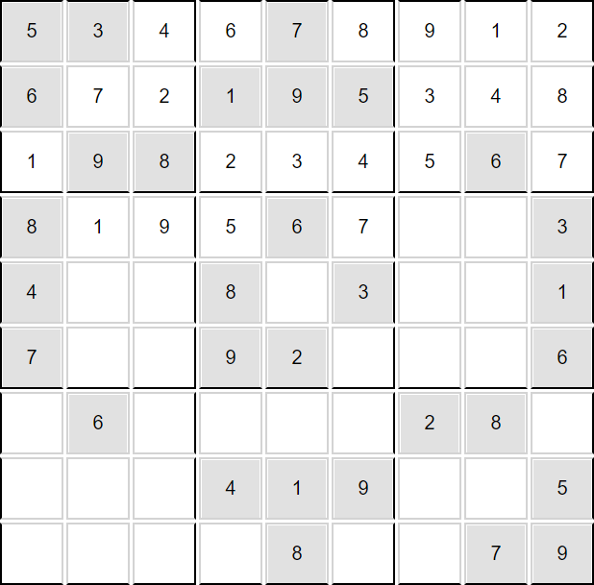
Backtracking
[[0],
[0],
[1, 2, 4],
[2, 6],
[0],
[2, 4, 6, 8],
[1, 4, 8, 9],
[1, 2, 4, 9],
[2, 4, 8]]
[[0],
[2, 4, 7],
[2, 4, 7],
[0],
[0],
[0],
[3, 4, 7, 8],
[2, 3, 4],
[2, 4, 7, 8]]
[[1, 2],
[0],
[0],
[2, 3],
[3, 4],
[2, 4],
[1, 3, 4, 5, 7],
[0],
[2, 4, 7]]
[[0],
[1, 2, 5],
[1, 2, 5, 9],
[5, 7],
[0],
[1, 4, 7],
[4, 5, 7, 9],
[2, 4, 5, 9],
[0]]
Jovanoski Bojan

Slide 25
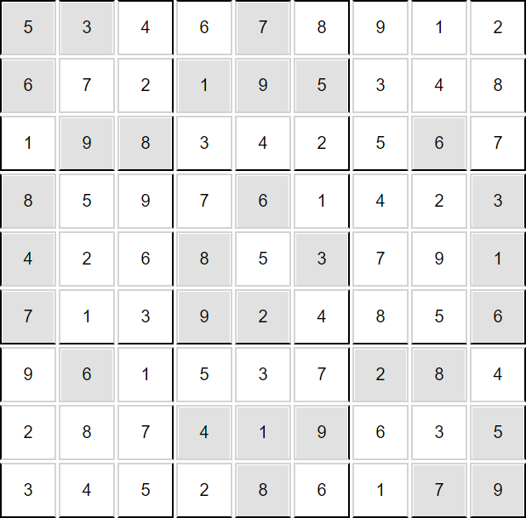
Backtracking
[[0],
[0],
[1, 2, 4],
[2, 6],
[0],
[2, 4, 6, 8],
[1, 4, 8, 9],
[1, 2, 4, 9],
[2, 4, 8]]
[[0],
[2, 4, 7],
[2, 4, 7],
[0],
[0],
[0],
[3, 4, 7, 8],
[2, 3, 4],
[2, 4, 7, 8]]
[[1, 2],
[0],
[0],
[2, 3],
[3, 4],
[2, 4],
[1, 3, 4, 5, 7],
[0],
[2, 4, 7]]
[[0],
[1, 2, 5],
[1, 2, 5, 9],
[5, 7],
[0],
[1, 4, 7],
[4, 5, 7, 9],
[2, 4, 5, 9],
[0]]
Jovanoski Bojan

Slide 26
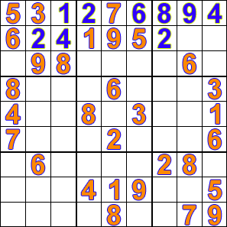
Backtracking
Jovanoski Bojan

Slide 27
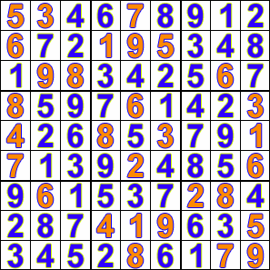
Backtracking
Jovanoski Bojan

Slide 28
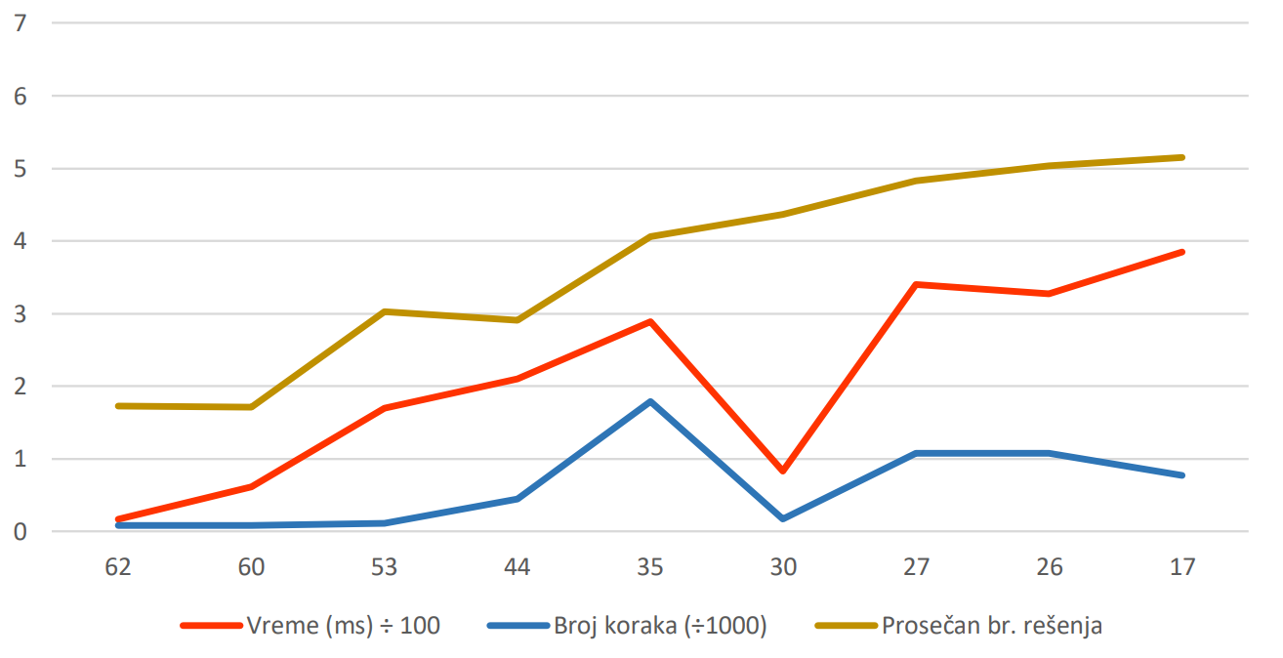
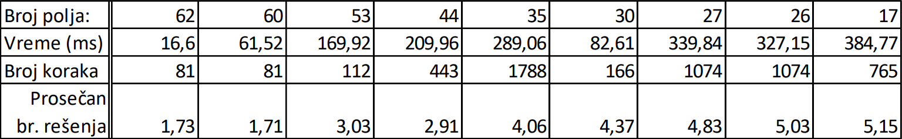
Vreme
Jovanoski Bojan

Slide 29
Hvala na pažnji!
Kandidat: Jovanoski Bojan
Mentor: Pot Mikloš

