Slide 1
Welcome

Slide 2

Oranges

Slide 3
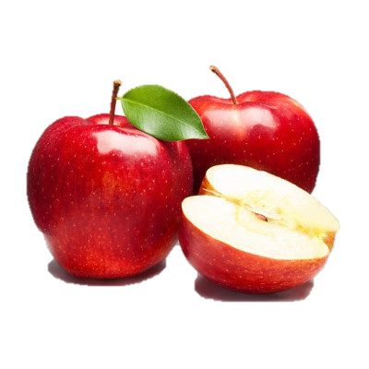
Apples

Slide 4
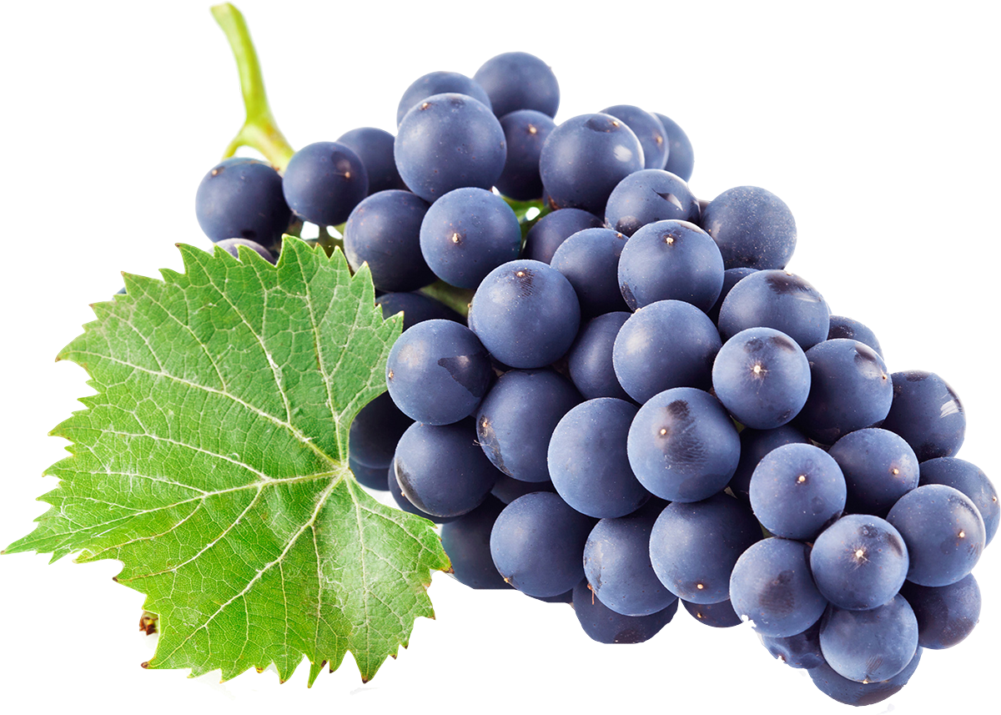
Grapes

