Slide 1
Single-Cell Analysis of Immune Response to Nanoplastic Particles

Slide 2
Context
Nanoplastics that enter the bloodstream interact directly with immune cells, and particle size appears to shape the response
We will use single-cell RNA sequencing (scRNA-seq) to investigate how nanoplastics of different sizes affect human peripheral blood immune cells

Slide 3
Dataset
Source: Zenodo (https://zenodo.org/records/15866724)
Four samples from one donor, exposed to PSNPs:
40 nm
200 nm
40+200 nm mixture
control (no exposure)

Slide 4
Tasks
QC and preprocessing
Integration and clustering
Cell type annotation
Marker genes
Azimuth Neural Network
Composition analysis
Differential expression
Size specific effects

Slide 5
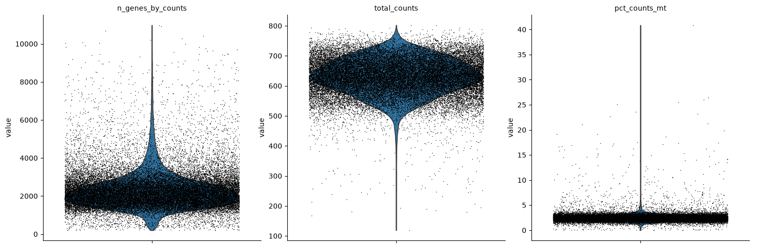
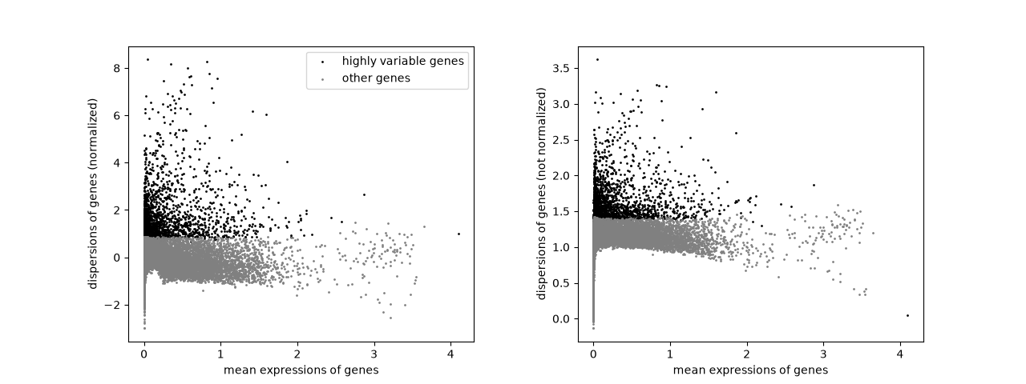
QC and preprocessing
Thresholds:
min_genes=500
max_genes=4000
max_mt_pct=5
Selected 2500 HVG
After excluding MT/Ribo: 2487 HVG

Slide 6
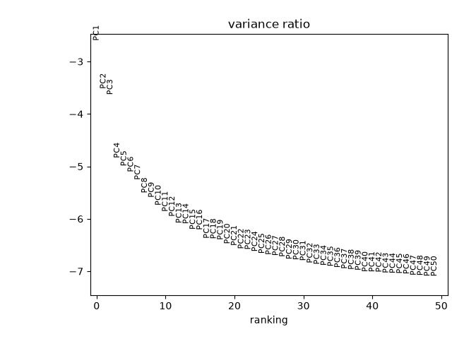
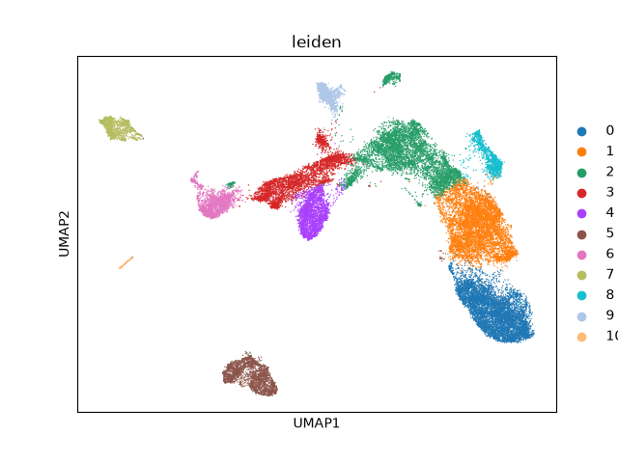
Integration and clustering
PCA with 50 PCs
BBKNN – Batch Balanced KNN
Forced to find NN within each sample
Used all 50 PCs to capture maximum variance
UMAP; Clusters - Leiden

Slide 7
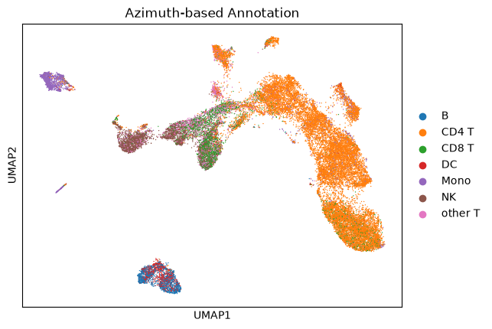
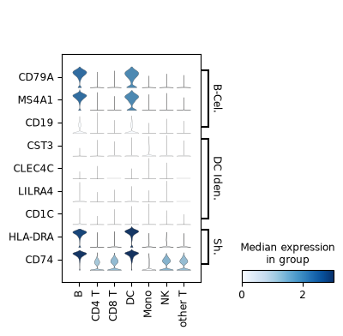
Cell type annotation – marker genes
Used marker genes from Azimuth
Annotated cell types with score_genes
Issues: overlapped annotations in UMAP
B and DC (DC is most likely B)
CD8T and NK

Slide 8
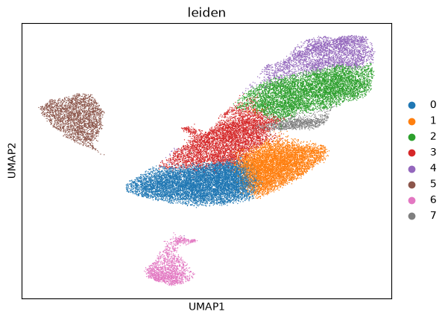
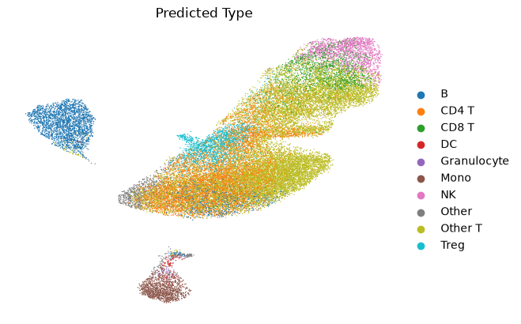
Cell type annotation - Azimuth Neural Network
Azimuth Neural Network for fine-grained annotation
Used NN embeddings instead of PCA for kNN
DC can be ignored (low number of annotations)
We will use this annotation

Slide 9
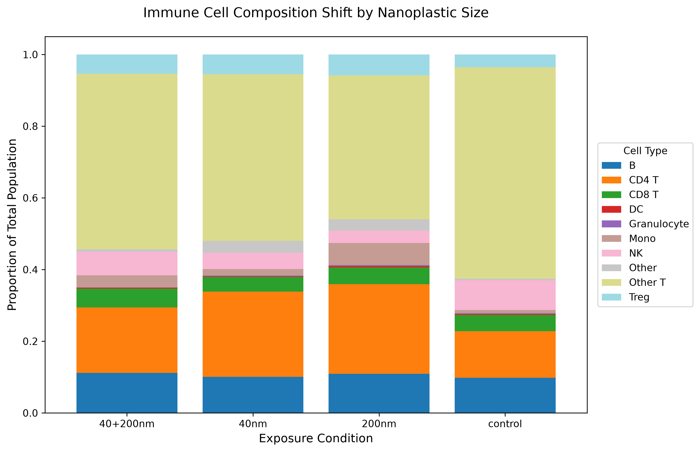
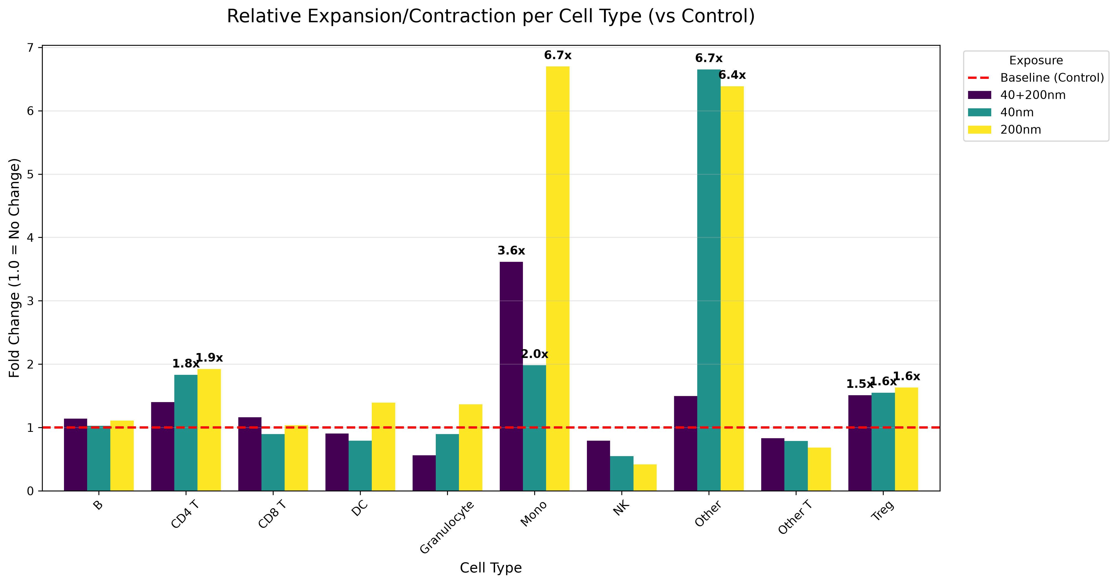
Composition analysis
Monocytes increase 2x in 40nm and 6.7x in 200nm
Inflammatory response from PSNPs
CD4 T cells increasing – helper cells activating
NK cells decreasing – potentially dying from toxicity
“Other” (unannotated, low confidence) cells increased – potentially deformation caused by PSNPs

Slide 10
Differential expression
All cell types and PSNP sizes – Response to LPS and bacteria
Immune system misidentifies PSNP and triggers inflammation
Size specific
200nm PSNPs force systemic recruitment of immune cells
40nm PSNPs cause internal damage to immune cells (oxidative stress)
40+200nm mixture forces “survival mode” for immune cells (halting growth, cells dying)

Slide 11
Differential expression
Treg – 200nm – trying to decrease inflammation, 40nm – cells are dying and causing inflammation
NK – causing inflammation and dying/losing function
Monocytes – 200nm – calling for backup and expanding (6.7x), 40nm – causing pain and inflammation
CD8 T cells – calling for backup instead of doing the job themselves
B cells – causing inflammation instead of producing antibodies

Slide 12
Size-specific effects
Shared – identification of PSNPs as pathogen-like threat
Unique to 40nm – Internal cell stress, likely cell penetration causing mechanical damage
Unique to 200nm – causing oxidative stress, probably 200nm PSNPs are too large for immune cells to process
Unique to mixture – stopping growth to save energy/stay alive, metabolic shutdown and cells dying

Slide 13
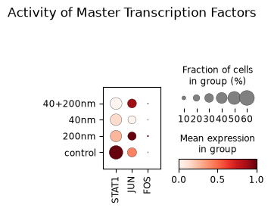
Additional insights – Transcription factor
STAT1 decreases in exposed samples
PSNPs supress body’s ability to fight viruses
JUN increases in 200nm and mixture samples
Cellular stress, damage, inflammation signal

Slide 14
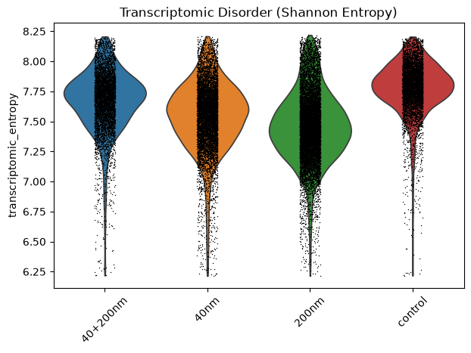
Additional insights – Transcriptomic Entropy
Control has the highest entropy – highest range of genes
Exposed samples all have lower entropies
200nm sample has the lowest entropy – immune system is producing specialized immune cells

Slide 15
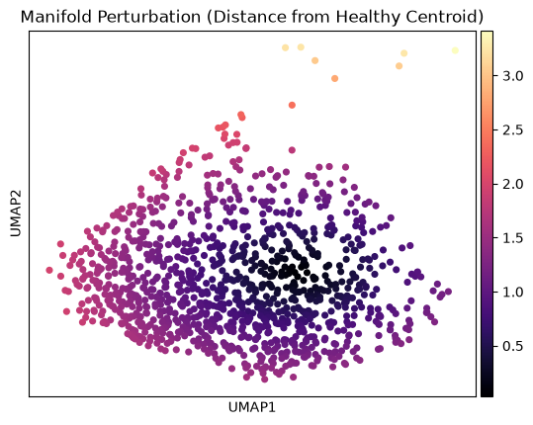
Additional insights - Transcriptomic State-Space Displacement
Comparing UMAP distances between monocyte centroid and monocyte cells by sample
Control – 0.87
40nm – 1.05, 200nm and mixture – 1.06
Conclusion – nanoplastic samples “pushed away” monocytes from a healthy state

Slide 16
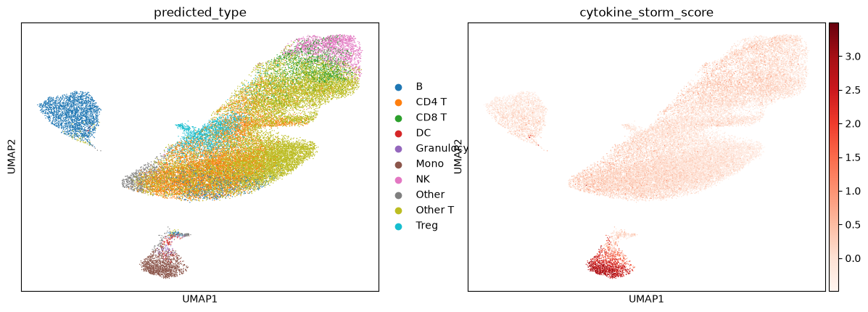
Additional insights – Proinflammatory genes
Monocytes have significantly higher score than other cell types
They act as inflammation epicenter
Monocytes are causing inflammation by “eating” PSNPs (phagocytes)

