Slide 1
IMAGE PROCESSING APPLICATION
IMAGE PROCESSING APPLICATION FOR DETECTING IF A PERSON IS NOT WEARING A MASK
Aleksandar Buljević, Jovan Simić, Vladimir Vukoman, Milan Jokanović
Novi Sad, 27-08-2021

Slide 2
Problem
Description
Create an application that will recognize and alert if someone is not wearing a mask within the office.
Requirements
Image upload functionality
Image/Live stream processing functionality
Sending SMS and email if a person is found not wearing a mask
Logging alert in DB
Live stream alerting

Slide 3
Application structure
Client application
Email/SNS service
RabbitMQ
Mask detector service
Alert Service
S3 storage
Postgress database

Slide 4
Technologies
Client application – Angular
Server – Spring boot
Image storage – AWS S3
Micro service communication – RabbitMQ
Database – PostgreSQL
Email and SNS service – AWS SNS and AWS SES

Slide 5

opencv
OpenCV (Open Source Computer Vision Library) is a library of programming functions mainly aimed at real-time computer vision.
It is used to detect and recognize faces, identify objects, classify human actions in videos, track camera movements

Slide 6

how it works

Slide 7
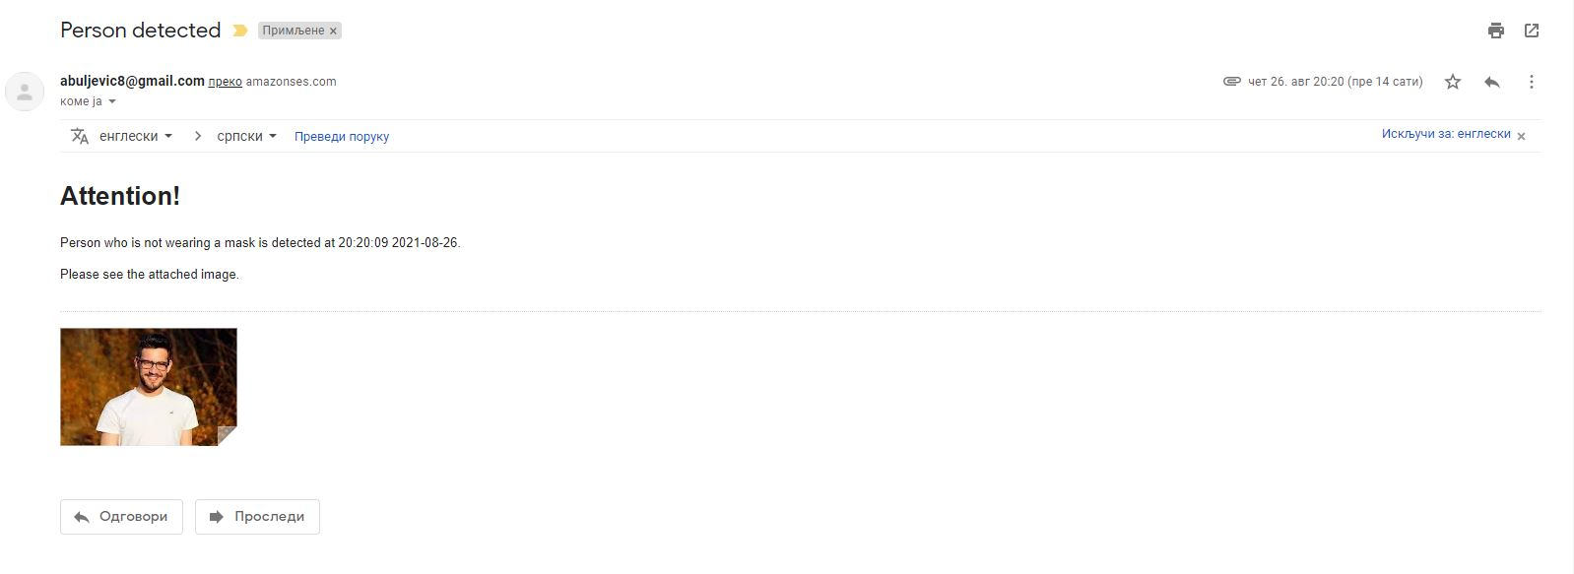
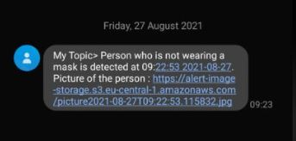
Alert notification

Slide 8
deployment
AWS services:
ECR
EKS
API Gateway
S3
...

Slide 9
Questions

Slide 10
Thank you
SERBIA / NOVI SAD
Levi9 Global Sourcing Balkan d.o.o.
Novi Sad Offices
Trifkovićev Trg 6
21000 Novi Sad, Serbia

