Slide 1

Heartbeat Classification Using Various Machine Learning and deep learning Models
Notes:
照片为学生拍摄的礼堂

Slide 2
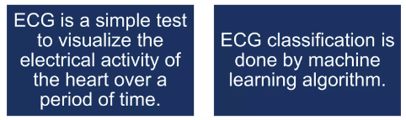
Introduction
Motivation
ECG data classification to assist in health monitoring
E.g. in the Emergency room
Cardio Vascular diseases are among the number one cause of death worldwide
Gain knowledge and work with machine learning
Create an effective and easier classifier
The machine learning algorithms are: XGBoost, RF, SVM, LR, KNN, NB, and DT

Slide 3
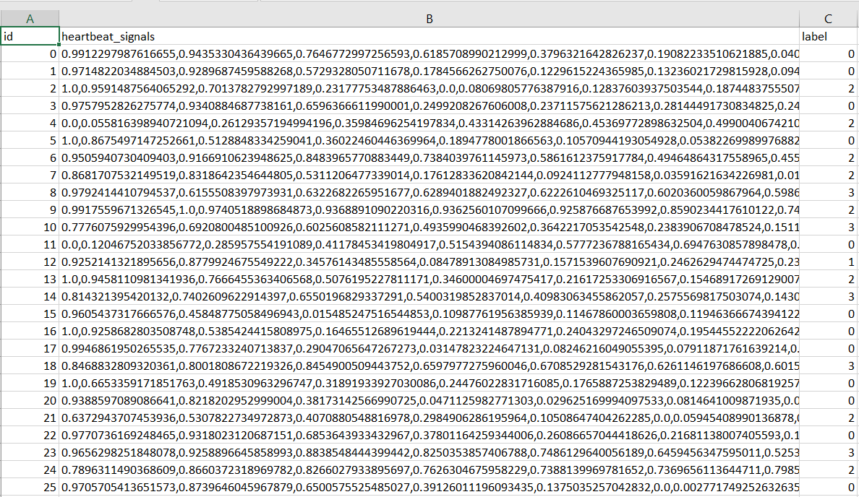
Data preparation for machine learning
I used the pandas library to split one heartbeat signals column into 205 columns using python

Slide 4
Data Pre-processing
I use annotations in this dataset to create four different beat categories (classes) in accordance with the Association for the Advancement of Medical Instrumentation EC57 standard
Label | Category | Annotation
0 | N | • Normal • Left/Right bundle branch block • Atrial escape • Nodal escape
1 | S | • Atrial premature • Aberrant atrial premature • Nodal premature • Supra-ventricular premature
2 | V | • Premature ventricular contraction • Ventricular escape
3 | F | • Fusion of ventricular and normal

Slide 5
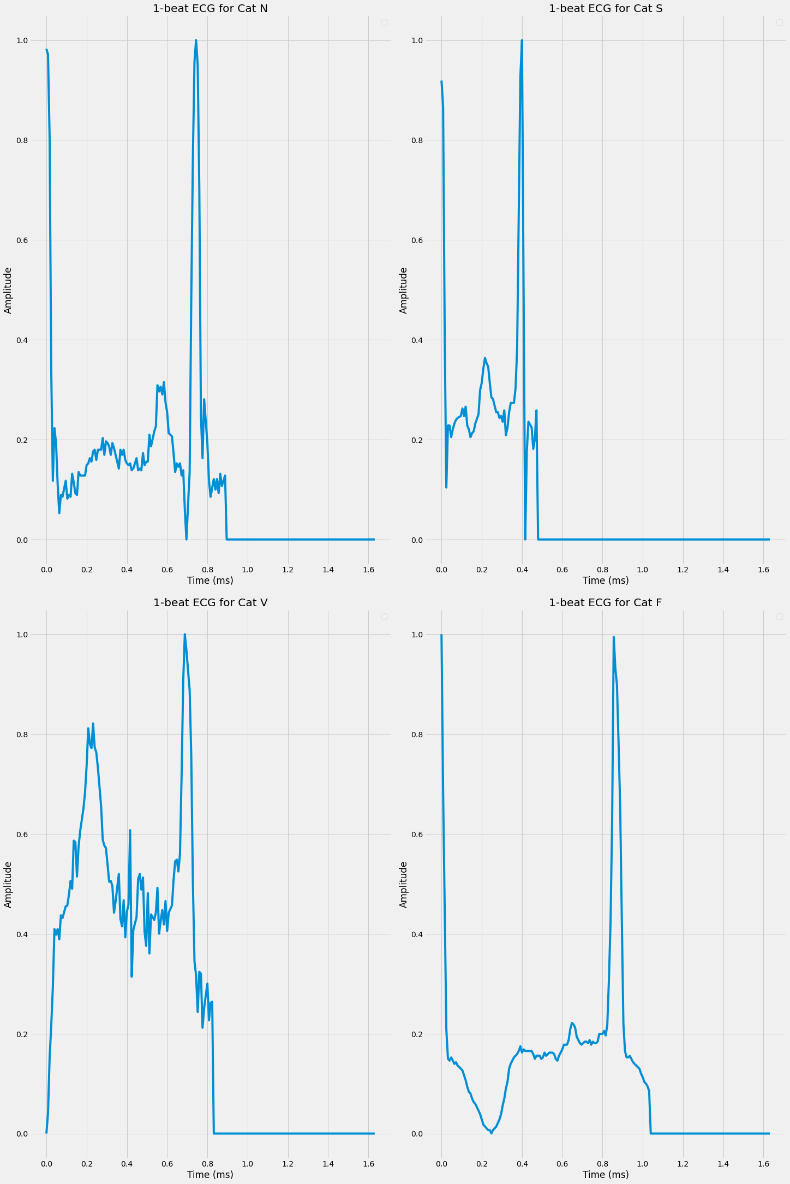
Normal vs abnormal heartbeat based on the given data
The X-axis in this figure corresponds to the time frame ranging from 0.0ms to 1.6ms,
The Y-axis is normalized and represents the normalized amplitude value of the heartbeat signals.

Slide 6
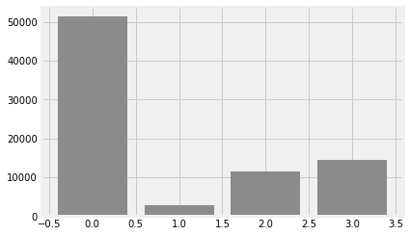
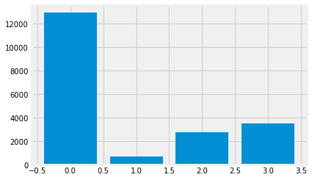


Distribution of train and test set
Train Target
Test Target

Slide 7
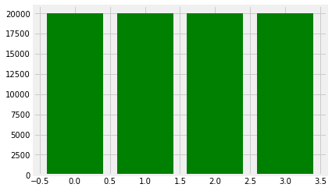
Balancing train and test set
Train Target
Test Target

Slide 8
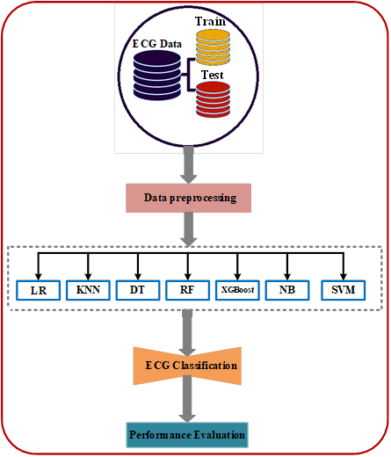
Methods used
Algorithms Used
K- Nearest Neighbor
Naïve Bayes
XGBoost
Random Forest
Decision Trees
SVM
Logistic Regression

Slide 9
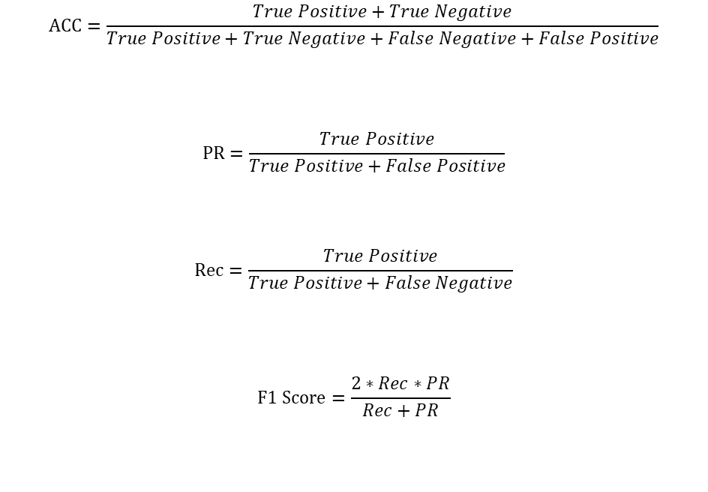
Performance evaluation
$$ACC=\frac{True Positive+True Negative}{True Positive+True Negative+False Negative+False Positive}$$
$$PR=\frac{True Positive}{True Positive+False Positive}$$
$$Rec=\frac{True Positive}{True Positive+False Negative}$$
$$F1 Score=\frac{2∗Rec∗PR}{Rec+PR}$$
Accuracy: The ratio of the correct predictions to the total of the input observations.
Precision is defined as the quotient of the true positive observations and the total predicted positive samples
Recall measures the fraction of correctly predicted positive samples among the true positive and false negative observations within the class.
F1-score is a crucial metric estimating the balance between the Recall and the Precision metrics.

Slide 10
Results analysis
Method | Training Accuracy (%) | Testing Accuracy (%) | Precision | Recall | F1-Score
Logistic Regression | 79.65 | 79.30 | 0.793 | 0.793 | 0.793
K-Nearest Neighbor | 98.74 | 96.57 | 0.965 | 0.965 | 0.965
Decision Trees | 100 | 91.32 | 0.913 | 0.913 | 0.913
Random Forest | 99.99 | 95.12 | 0.951 | 0.951 | 0.951
XGBoost | 99.96 | 95.68 | 0.956 | 0.956 | 0.956
Naïve Bayes | 34.77 | 35.21 | 0.352 | 0.352 | 0.352
Support Vector Machines | 95.55 | 94.48 | 0.944 | 0.944 | 0.944

Slide 11
Conclusion
The main purpose of this project is to propose a machine-learning model that can classify heartbeat
The given ECG dataset contains 80,000 samples used for training and 20,000 samples used for testing.
The class imbalance problem has been handled by performing random sampling so that each class has the same number of samples.
XGboost method outperformed other methods while Naïve Bayes has poor classification performance among the group

