Slide 1
Machine Learning Clustering

Slide 2
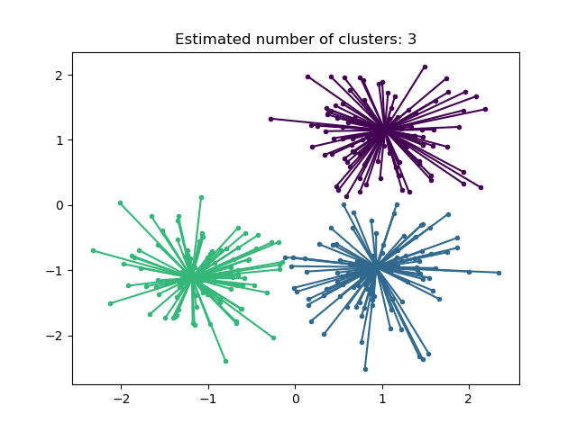

Affinity Propagation
Creates clusters by sending messages between pairs of samples until convergence.
A small number of exemplars, which are identified as those most representative of other samples.
The messages sent between pairs represent the suitability for one sample to be the exemplar of the other, which is updated in response to the values from other pairs.
This updating happens iteratively until convergence, at which point the final exemplars are chosen, and hence the final clustering is given.
It chooses the number of clusters based on the data provided.
The two important parameters are
preference, which controls how many exemplars are used
damping factor which damps the responsibility and availability messages to avoid numerical oscillations when updating these messages.
Useful for small to medium sized datasets because of memory &complexity complexity of
the order

Slide 3
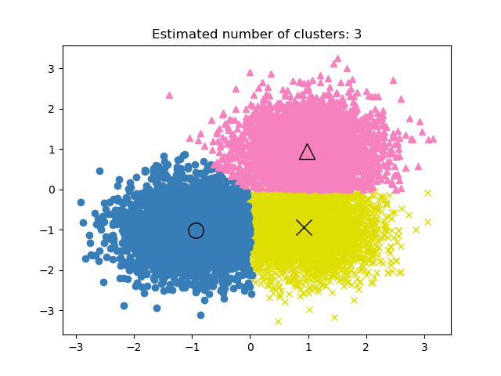

Mean Shift
Centroid based algorithm, which works by updating candidates for centroids to be the mean of the points within a given region.
Candidates are then filtered in a post-processing stage to eliminate near-duplicates to form the final set of centroids.
Automatically sets the number of clusters.
Bandwidth dictates the size of the region to search through.
It is not highly scalable, as it requires multiple nearest neighbor searches during the execution
It converges but this algorithm will stop iterating when the change in centroids is small.

Slide 4
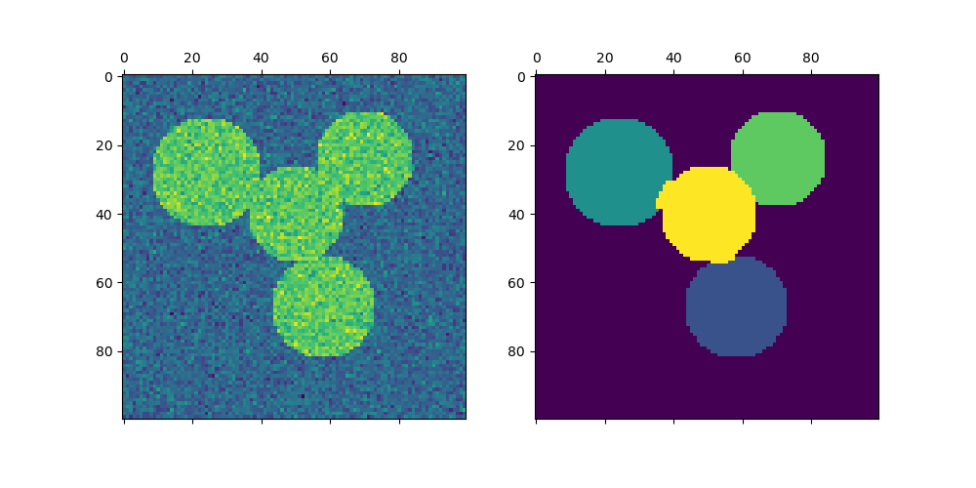
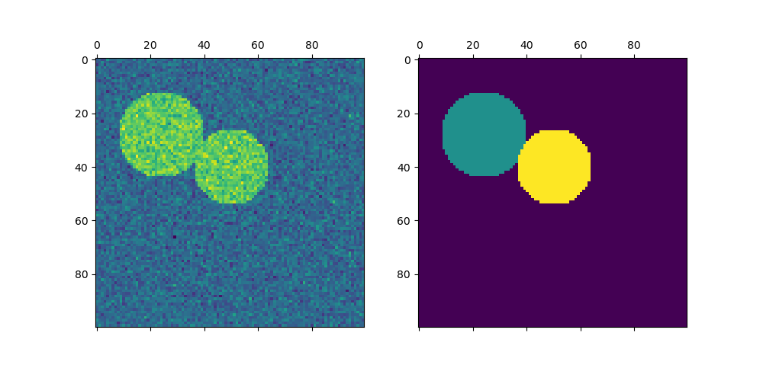
Spectral clustering
It performs a low-dimension embedding of the affinity matrix between samples, followed by clustering.
Spectral Clustering requires the number of clusters to be specified in advance.
It works well for a small number of clusters, but is not advised for many clusters.
For two clusters, Spectral Clustering solves a convex relaxation of the normalized cuts problem on the similarity graph. (cutting the graph in two so that the weight of the edges cut is small compared to the weights of the edges inside each cluster.)

Slide 5
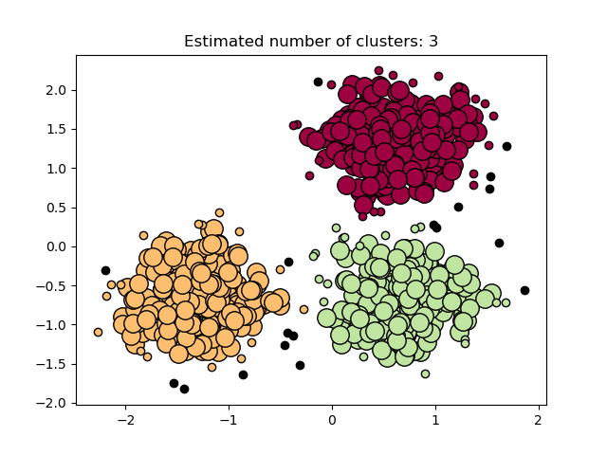

DBSCAN (Density-Based Spatial Clustering of Applications with Noise)
The DBSCAN algorithm views clusters as areas of high density separated by areas of low density.
Clusters found by DBSCAN can be any shape, as opposed to k-means which assumes that clusters are convex shaped.
The central component to the DBSCAN is the concept of core samples(samples in areas of high density). A cluster is therefore a set of core samples, each close to each other (measured by some distance measure) and a set of non-core samples that are close to a core sample (but are not themselves core samples).
Two important parameters are, min_samples and eps, which define formally what we mean when we say dense.
Higher min_samples or lower eps indicate higher density necessary to form a cluster.

Slide 6
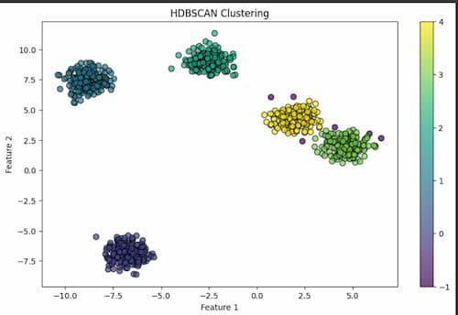

HDBSCAN (Hierarchical Density-Based Spatial Clustering of Applications with Noise)
The HDBSCAN algorithm can be seen as an extension of DBSCAN and OPTICS.
DBSCAN assumes that the clustering criterion (i.e. density requirement) is globally homogeneous. In other words, DBSCAN may struggle to successfully capture clusters with different densities.
HDBSCAN alleviates this assumption and explores all possible density scales by building an alternative representation of the clustering problem.
HDBSAN examines the density of the data points in the dataset. It starts by calculating a density-based clustering hierarchy, which creates clusters from densely connected data points. This hierarchical structure enables the recognition of clusters of various shapes and sizes.

Slide 7
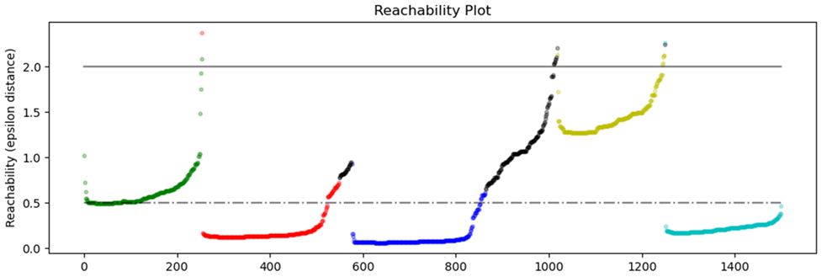
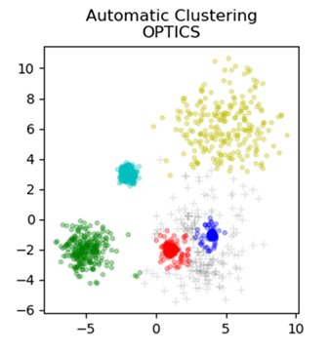

OPTICS (Ordering Points To Identify the Clustering Structure)
It is a generalization of DBSCAN that relaxes the eps requirement from a single value to a value range.
It also produces a cluster ordering that can be used to identify the density-based clusters at multiple levels of granularity.
OPTICS algorithm builds a reachability graph, which assigns each sample both a reachability_ distance, and a spot within the cluster ordering_ attribute.
The reachability distances generated by OPTICS allow for variable density extraction of clusters within a single data set. Setting max_eps to a lower value will result in shorter run times, and can be thought of as the maximum neighborhood radius from each point to find other potential reachable points.

Slide 8
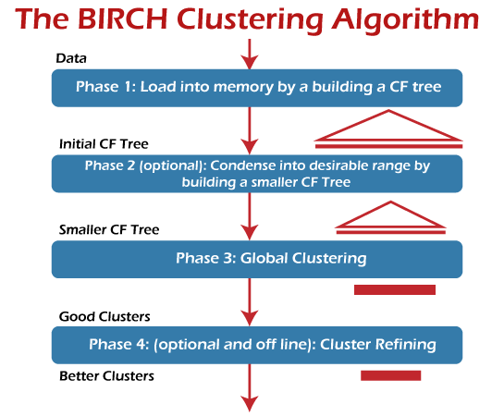
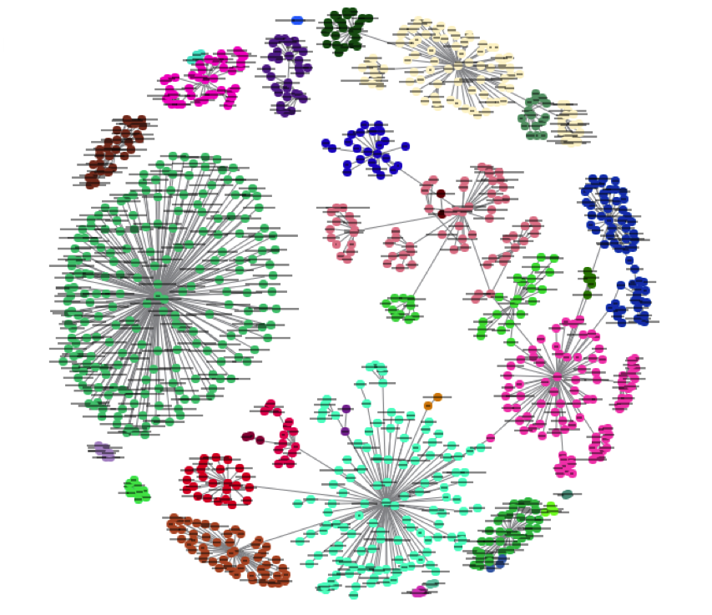

BIRCH (Balanced Iterative Reducing and Clustering using Hierarchies)
It builds a tree called the Clustering Feature Tree (CFT).
The data is essentially lossy compressed to a set of Clustering Feature nodes (CF Nodes). The CF Nodes have a number of subclusters called Clustering Feature subclusters (CF Subclusters) and these CF Subclusters located in the non-terminal CF Nodes can have CF Nodes as children.
The BIRCH algorithm has two parameters, the threshold and the branching factor.
The branching factor limits the number of subclusters in a node and the threshold limits the distance between the entering sample and the existing subclusters.

