Slide 1
Set Theory

Slide 2
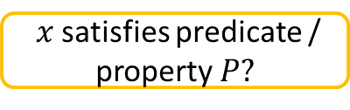
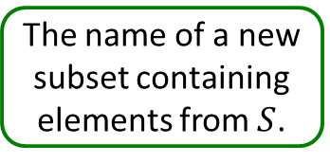
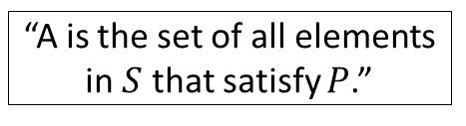
Some Vocabulary and Notation
In set theory, set and element are undefined terms (true, false, and sentence are undefined terms in logic).
Intuitive definition. A set $S$ can be thought of as a collection of separate objects. These objects are the elements of $S$.
“Collect all elements”
“such that”
\mid in LaTeX.
The name of a new subset containing elements from $S$.
$$A=\left\{x∈S∣P\left(x\right)\right\}$$
$x$ satisfies predicate / property $P?$
Curly braces indicate a set (this is true in Python as well).
“A is the set of all elements in $S$ that satisfy $P$.”

Slide 3

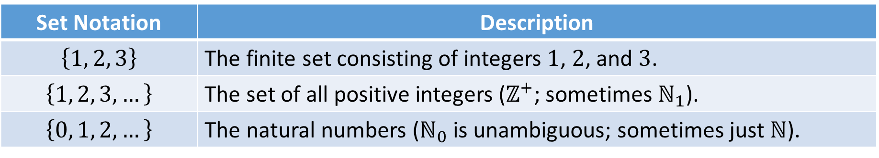

Some Examples
Set Notation | Description
$$\left\{1, 2, 3\right\}$$ | The finite set consisting of integers $1$, $2$, and $3$.
$$\left\{1, 2, 3,…\right\}$$ | The set of all positive integers ($ℤ^{+}$; sometimes $ℕ_{1}$).
$$\left\{0, 1, 2,…\right\}$$ | The natural numbers ($ℕ_{0}$ is unambiguous; sometimes just $ℕ$).
Problems.
Using set notation, represent the idea of all real numbers greater than 10.
Using set notation, represent the idea of all integers divisible by 10. Do not use a modulus operator.
$$\left\{x∣x∈ℝ and x>10\right\}$$
$$\left\{x∣x=10k and k∈ℤ\right\}$$

Slide 4







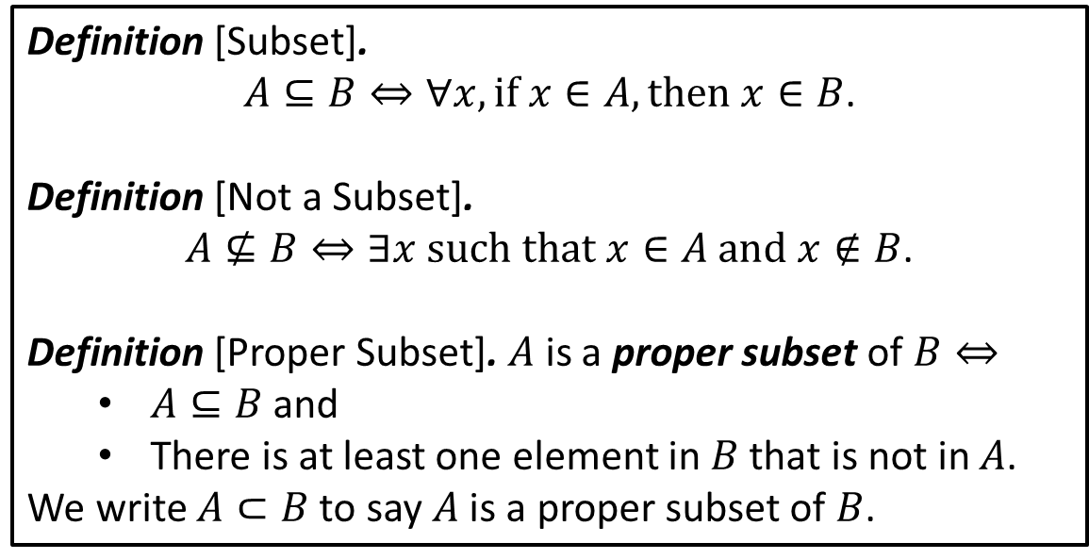









Subset Definitions
Definition [Subset].
$A⊆B⇔∀x,if x∈A, then x∈B$.
Definition [Not a Subset].
$A⊈B⇔∃x such that x∈A and x∉B$.
Definition [Proper Subset]. $A$ is a proper subset of $B⇔$
$A⊆B$ and
There is at least one element in $B$ that is not in $A$.
We write $A⊂B$ to say $A$ is a proper subset of $B$.
$$R$$
$$B$$
$$P$$
$$G$$
$$G⊆B$$
$$G⊆R$$
$$G⊂B$$
$$ℚ⊆ℝ$$
$$ℤ⊇ℕ$$
$$ℝ⊂ℤ$$
Problems. True or false?
true
false
true
true
true
false
$$P⊆R$$
$$P⊇B$$
$$G⊂G$$
$$ℕ_{1}⊆ℤ^{+}$$
$$ℤ^{+}⊆ℕ_{1}$$
$$ℕ_{1}=ℤ^{+}$$
true
false
false
true
true
true

Slide 5
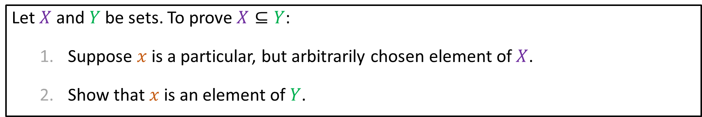


Method of Proving a Set is a Subset of Another Set
Let $X$ and $Y$ be sets. To prove $X⊆Y$:
Suppose $x$ is a particular, but arbitrarily chosen element of $X$.
Show that $x$ is an element of $Y$.
Prove $A⊆B$ where
$A=\left\{m∈ℤ∣m=6r+12 for some r∈ℤ\right\}$ and $B=\left\{n∈ℤ∣n=3s for some s∈ℤ\right\}$.
Proof.
Suppose $x∈A$. Then $x$ can be written as $x=6r+12$ for some $r∈ℤ$.
Then attempting to show $x$ is also an element of $B$:
$x=6r+12=3\left(2r+4\right)$.
Letting $s=2r+4$ and noting $s$ is an integer. We have $x=3s$.
It follows $x∈B$ and more generally $A⊆B$.
$$∎$$

Slide 6

Problem (continued)
Disprove $B⊆A$ where
$A=\left\{m∈ℤ∣m=6r+12 for some r∈ℤ\right\}$ and $B=\left\{n∈ℤ∣n=3s for some s∈ℤ\right\}$.
Proof.
To show the statement is false, we need to identify an element of $B$ that is not in $A$.
Through trial and error, we might identify such a value. “Guessing and checking” is not a precise algorithm and thus is not an ideal way to approach this problem.
Suppose $x∈B$. Hence, $x=3s$ for some $s∈ℤ$.
In order for $x$ to be a member of $A$, we require $3s=x=6r+12$ for some $r∈ℤ$.
Now $s=2r+4$.
$s=2r+4$ is a linear function. Can we find an integer for $s$ in which $r$ is not an integer? If so, we are done.
Consider $s=1$. Then, $1=2r+4$ and it follows $r=−\frac{3}{2}$. Hence, $3∈B$, but $3∉A$.
$$∎$$

Slide 7


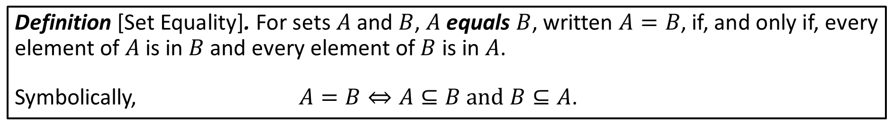



Set Equality
Definition [Set Equality]. For sets $A$ and $B$, $A$ equals $B$, written $A=B$, if, and only if, every element of $A$ is in $B$ and every element of $B$ is in $A$.
Symbolically, $A=B⇔A⊆B and B⊆A$.
Prove $A=B$ where
$A=\left\{m∈ℤ∣m=2a for some a∈ℤ\right\}$ and $B=\left\{n∈ℤ∣n=2b−2 for some b∈ℤ\right\}$.
Proof.
By definition, we must show both directions: double inclusion.
$A⊆B$:
Suppose $x∈A$. Then there exists $a∈ℤ$ such that $x=2a$.
For $x$ to be an element of $B$, we require
$2a=x=2b−2$.
Clearly, $a+1=b$ and b is an integer.
It follows $x=2b−2=2\left(a+1\right)−2=2a$ and thus $x∈B$ since it can be written in the desired form.
$B⊆A$:
Suppose $x∈B$. Then there exists $b∈ℤ$ such that $x=2b−2$.
Let $a+1=b$. Then $x=2\left(a+1\right)−2=2a∈A$.
$$∎$$

Slide 8


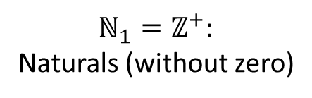




Venn Diagrams with Number Systems
$ℕ_{1}=ℤ^{+}$:
Naturals (without zero)
$ℤ$: Integers
$$ℕ_{0}$$
$ℚ$: Rationals
$ℝ$: Reals
$ℂ$: Complex
$ℍ$: Quaternions

Slide 9






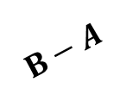



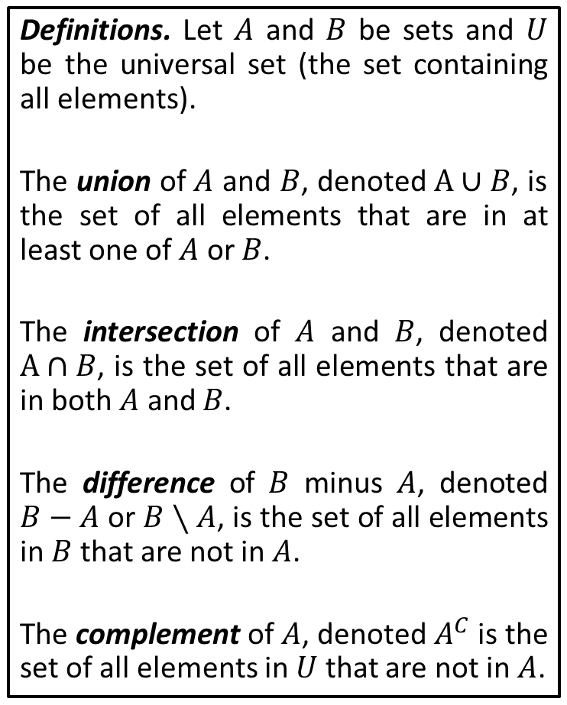


Set Operations
Definitions. Let $A$ and $B$ be sets and $U$ be the universal set (the set containing all elements).
The union of $A$ and $B$, denoted $A∪B$, is the set of all elements that are in at least one of $A$ or $B$.
The intersection of $A$ and $B$, denoted $A∩B$, is the set of all elements that are in both $A$ and $B$.
The difference of $B$ minus $A$, denoted $B−A$ or $B∖A$, is the set of all elements in $B$that are not in $A$.
The complement of $A$, denoted $A^{C}$ is the set of all elements in $U$ that are not in $A$.
$$A$$
$$A∪B$$
$$A∪B=\left\{x∈U∣x∈A or x∈B\right\}$$
$$B$$
$$A$$
$$A∩B$$
$$A∩B=\left\{x∈U∣x∈A and x∈B\right\}$$
$$B$$
$$A$$
$$B−A=\left\{x∈U∣x∈B and x∉A\right\}$$
$$B$$
$$B−A$$
$$A^{C}$$
$$A^{C}=\left\{x∈U∣x∉A\right\}$$
$$A$$

Slide 10






















Interval Notation
Let $a,b∈ℝ$ with $a≤b$.
Finite bounded intervals
$$\left(a,b\right)=\left\{x∈ℝ∣a<x<b\right\}$$
$$\left[a,b\right]=\left\{x∈ℝ∣a≤x≤b\right\}$$
open
closed
$$a$$
$$b$$
$$a$$
$$b$$
$$[a,b)=\left\{x∈ℝ∣a≤x<b\right\}$$
$$(a,b]=\left\{x∈ℝ∣a<x≤b\right\}$$
half-open
half-open
$$a$$
$$b$$
$$a$$
$$b$$
Infinite bounded intervals
$$\left(a,∞\right)=\left\{x∈ℝ∣x>a\right\}$$
$$[a,∞)=\left\{x∈ℝ∣x≥a\right\}$$
$$a$$
$$a$$
$$\left(−∞, b\right)=\left\{x∈ℝ∣x<b\right\}$$
$$(−∞,b]=\left\{x∈ℝ∣x≤b\right\}$$
$$b$$
$$b$$
$$\left(−∞,∞\right)=\left\{x∈ℝ\right\}$$

Slide 11





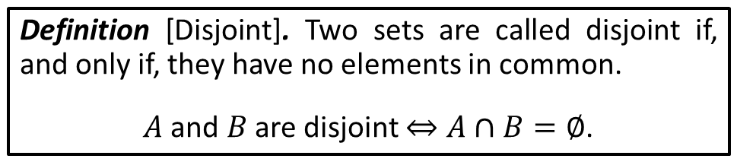



The Empty Set; Disjoint Sets
Is it possible for a list to be empty?
Of course.
This is also true for sets. It is possible to have a set that contains no elements.
Mathematical Notation
LaTeX
We call such a set, the empty set.
$$∅$$
\emptyset
\lcurly \rcurly
Note:
$$\left\{ \right\}≠\left\{∅\right\}$$
Definition [Disjoint]. Two sets are called disjoint if, and only if, they have no elements in common.
$A$ and $B$ are disjoint $⇔A∩B=∅$.
$$\left\{1,3,5\right\}∩\left\{2,4,6\right\}=∅$$
$$A$$
$$ℝ^{−}∩ℝ^{+}=∅$$
$$B$$
$$\left(−4,4\right)∩\left(4,5\right)=∅$$

Slide 12




$∅$-Related Proofs
[Emptyset is a Subset of Every Set] If $E$ is a set with no elements and $A$ is any set, then $E⊆A$.
Proof by contradiction.
Suppose there exists a set $E$ with no elements and a set $A$ such that $E⊈A$.
Then there exists an element $e∈E$, but $e∉A$.
This is a contradiction since $E$ contains no elements.
$$∎$$
[Uniqueness of the Empty Set] There is only one set with no elements.
Proof.
Suppose $E_{1}$ and $E_{2}$ are both sets with no elements.
By the previous result, $E_{1}⊆E_{2}$ and $E_{2}⊆E_{1}$.
Thus $E_{1}=E_{2}$ by the definition of set equality.
$$∎$$

Slide 13












Cardinality
We sometimes talk about the size of a set. Mathematically, we say that the number of elements in a set $S$ is called its cardinality and is denoted as $\left|S\right|$.
Since this is a computing-based course, we will generally focus on (1) the use of proper notation and (2) cardinalities of finite sets.
(While it is a reasonable mathematical exercise to consider cardinalities of infinite sets and correspondences among those sets, that will not be our focus. Yes, there are different sizes of infinity.)
Evaluate the expression.
$$\left|∅\right|$$
$$\left|\left\{1, 2, 3\right\}\right|$$
$$\left|\left\{2, 2, 2\right\}\right|$$
$$\left|ℕ_{0}−ℕ_{1}\right|$$
$$\left|\left\{∅\right\}\right|$$
$$\left|ℤ^{+}∩ℤ^{−}\right|$$
$$0$$
$$3$$
$$1$$
$$1$$
$$1$$
$$0$$
Recall, sets do not have redundant elements.

Slide 14
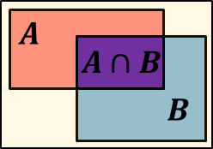


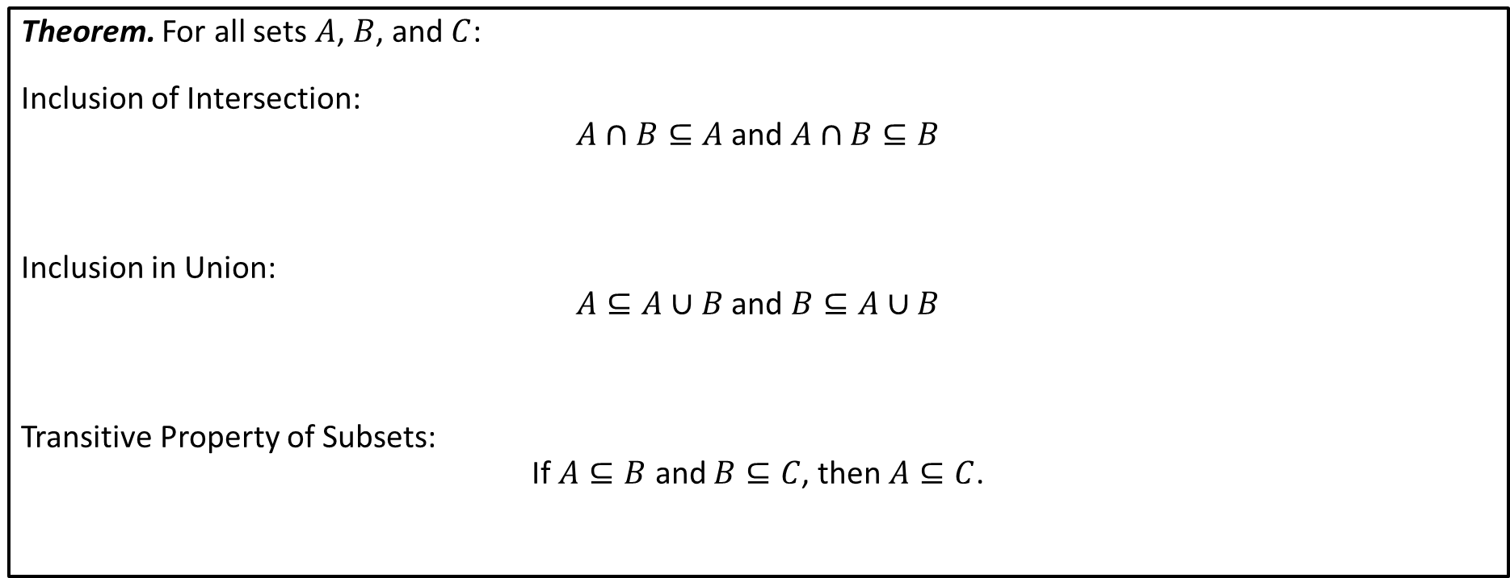

Properties of Sets
Theorem. For all sets $A$, $B$, and $C$:
Inclusion of Intersection:
$A∩B⊆A$ and $A∩B⊆B$
Inclusion in Union:
$A⊆A∪B$ and $B⊆A∪B$
Transitive Property of Subsets:
If $A⊆B$ and $B⊆C$, then $A⊆C$.
$$A$$
$$B$$
$$A∪B$$
$$C$$
$$B$$
$$A$$

Slide 15


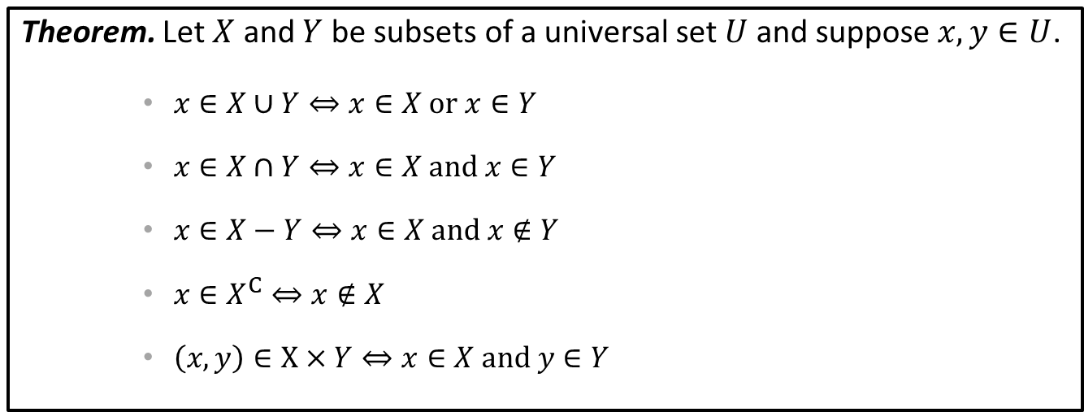

Element-Based Versions of Set Definitions
Theorem. Let $X$ and $Y$ be subsets of a universal set $U$ and suppose $x,y∈U$.
$x∈X∪Y⇔x∈X or x∈Y$
$x∈X∩Y⇔x∈X and x∈Y$
$x∈X−Y⇔x∈X and x∉Y$
$x∈X^{C}⇔x∉X$
$\left(x,y\right)∈X×Y⇔x∈X and y∈Y$
Problem. For sets $A$ and $B$, show $A∩B⊆A$.
Proof.
Suppose $x∈A∩B$.
By definition of intersection, $x∈A$ and $x∈B$.
Thus every element of $A∩B$ is in $A$ and it follows $A∩B⊆A$.
$$∎$$

Slide 16
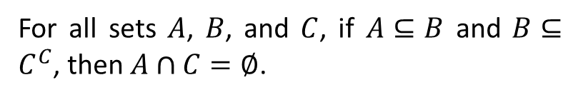






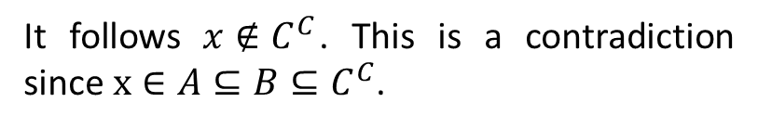



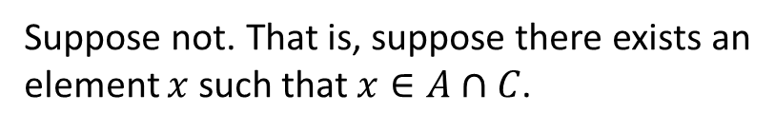
Exercise
For all sets $A$ and $B$, if $A⊆B$, then $B^{C}⊆A^{C}$.
For all sets $A$, $B$, and $C$, if $A⊆B$ and $B⊆C^{C}$, then $A∩C=∅$.
Proof.
Proof.
We use an element-based approach to our argument.
Suppose not. That is, suppose there exists an element $x$ such that $x∈A∩C$.
Suppose $x∈B^{C}$.
(We wish to show $x∈A^{C}$.)
Then both $x∈A$ and $x∈C$.
Then $x∉B$.
It follows $x∉C^{C}$. This is a contradiction since $x∈A⊆B⊆C^{C}$.
Since we assumed $A⊆B$, it follows that $x∉A$.
$$∎$$
We then conclude $x∈A^{C}$.
$$∎$$

Slide 17
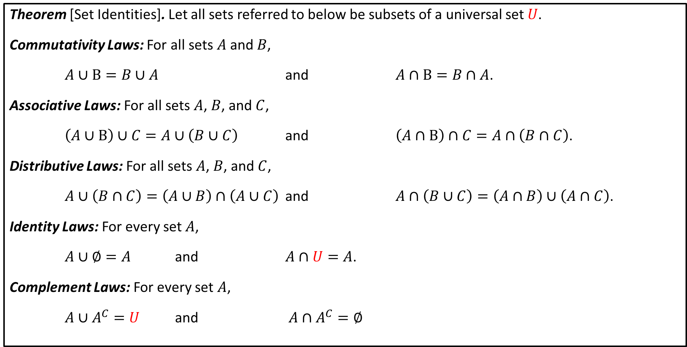
Set Identities I
Theorem [Set Identities]. Let all sets referred to below be subsets of a universal set $U$.
Commutativity Laws: For all sets $A$ and $B$,
$A∪B=B∪A$ and $A∩B=B∩A$.
Associative Laws: For all sets $A$, $B$, and $C$,
$\left(A∪B\right)∪C=A∪\left(B∪C\right)$ and $\left(A∩B\right)∩C=A∩\left(B∩C\right)$.
Distributive Laws: For all sets $A$, $B$, and $C$,
$A∪\left(B∩C\right)=\left(A∪B\right)∩\left(A∪C\right)$ and $A∩\left(B∪C\right)=\left(A∩B\right)∪\left(A∩C\right)$.
Identity Laws: For every set $A$,
$A∪∅=A$ and $A∩U=A$.
Complement Laws: For every set $A$,
$A∪A^{C}=U$ and $A∩A^{C}=∅$

Slide 18
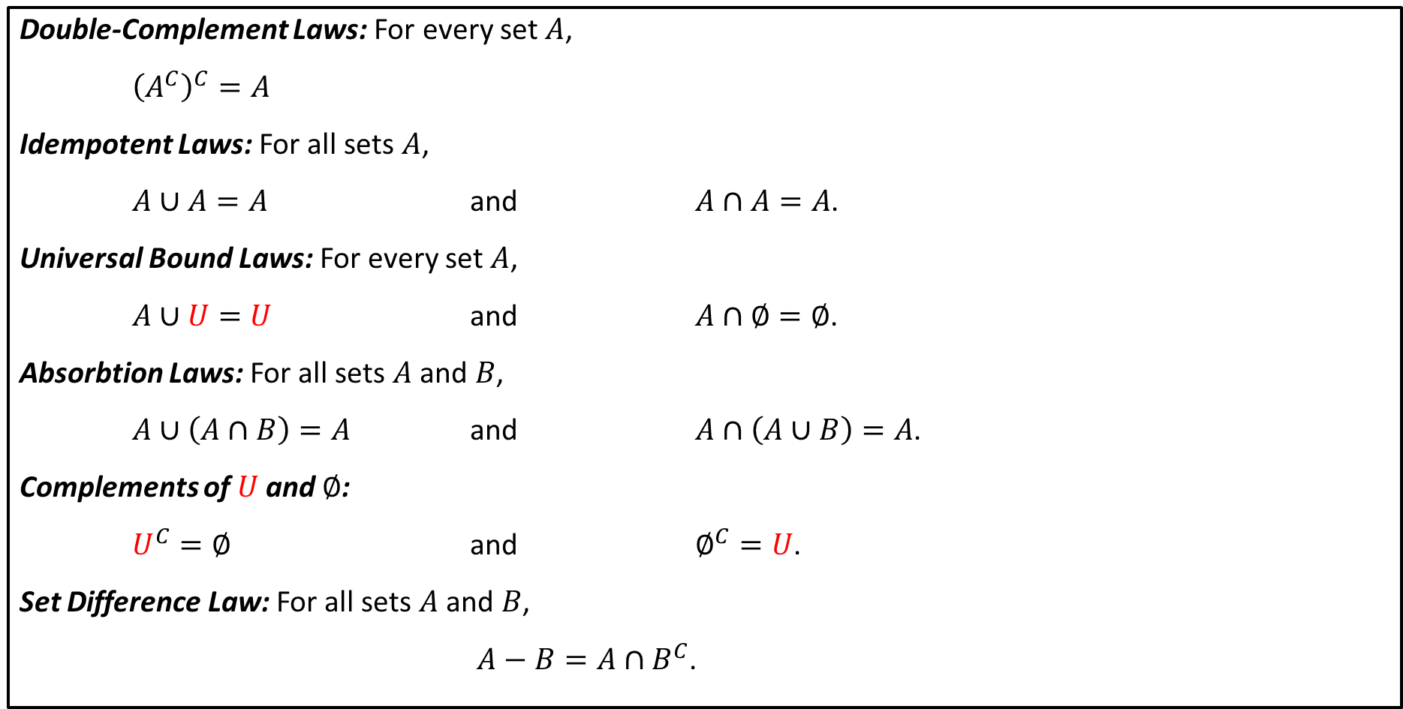
Set Identities II (continued)
Double-Complement Laws: For every set $A$,
${\left(A^{C}\right)}^{C}=A$
Idempotent Laws: For all sets $A$,
$A∪A=A$ and $A∩A=A$.
Universal Bound Laws: For every set $A$,
$A∪U=U$ and $A∩∅=∅$.
Absorbtion Laws: For all sets $A$ and $B$,
$A∪\left(A∩B\right)=A$ and $A∩\left(A∪B\right)=A$.
Complements of $U$ and $∅$:
$U^{C}=∅$ and $∅^{C}=U$.
Set Difference Law: For all sets $A$ and $B$,
$A−B=A∩B^{C}$.

Slide 19



Algebraic Proof Exercise I
For all sets $X$, $Y$ and $Z$, show $\left(X∪Y\right)−Z=\left(X−Z\right)∪\left(Y−Z\right)$.
Proof.
It suffices to show that the LHS of the equation can be reduced to the RHS using Set Identities.
Set Difference Law
$$\left(X∪Y\right)−Z$$
$$=\left(X∪Y\right)∩Z^{C}$$
Commutative Law for $∩$
$$=Z^{C}∩\left(X∪Y\right)$$
Distributive Law
$$=\left(Z^{C}∩X\right)∪\left(Z^{C}∩Y\right)$$
Commutative Law for $∩$
$$=\left(X∩Z^{C}\right)∪\left(Y∩Z^{C}\right)$$
$$=\left(X−Z\right)∪\left(Y−Z\right)$$
Set Difference Law

Slide 20




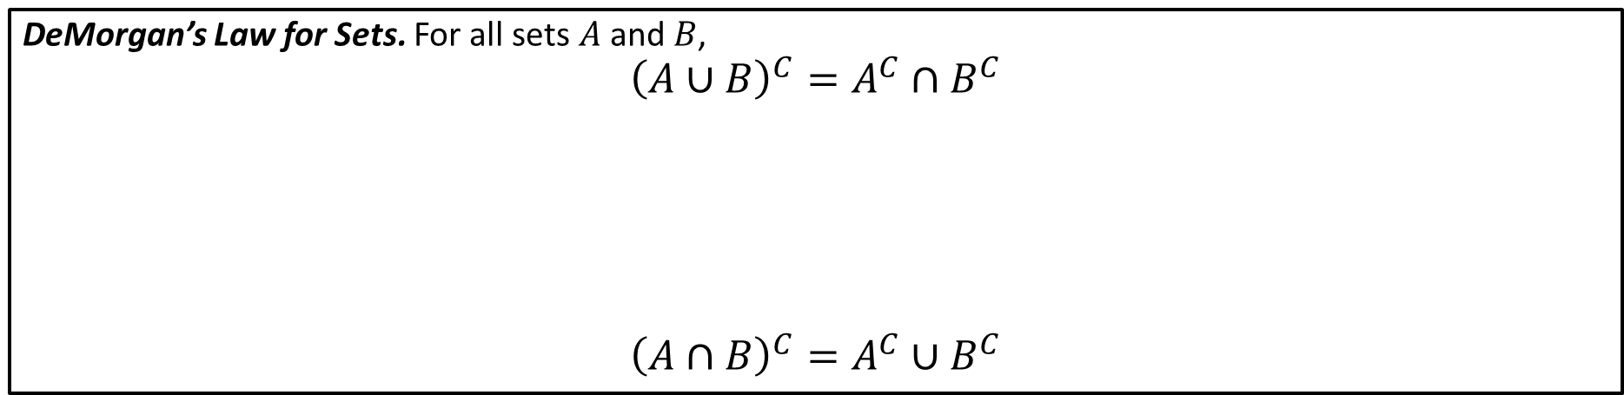










DeMorgan’s Law for Sets. For all sets $A$ and $B$,
$${\left(A∪B\right)}^{C}=A^{C}∩B^{C}$$
$${\left(A∩B\right)}^{C}=A^{C}∪B^{C}$$
$$A$$
$$A$$
$$B^{C}$$
$$A∪B$$
${\left(A∪B\right)}^{c}$
$$A^{C}∩B^{C}$$
$$B$$
$$B$$
$$A^{C}$$
For sets $A$ and $B$, prove $X−\left(X∩Y\right)=X−Y$.
Proof.
$$X−\left(X∩Y\right)$$
$$=X∩{\left(X∩Y\right)}^{C}$$
Set Difference Law
DeMorgan’s Law
$$=X∩\left(X^{C}∪Y^{C}\right)$$
Distributive Law
$$=\left(X∩X^{C}\right)∪\left(X∩Y^{C}\right)$$
Complement Law
$$=∅∪\left(X∩Y^{C}\right)$$
Commutativity of $∪$ followed by Identity Law
$$=X∩Y^{C}$$
Set Difference Law
$$=X−Y$$

