Slide 1
Biotechnology in the
21st Century
Learning goals: biotechnology products, food, health, and wider impacts.
Notes:
Introduce biotechnology as a way of working with living systems. The deck moves from tools and crops to ecosystems, vaccines, and clinical gene editing.
Learning goals from the textbook: explain modern biotechnology products, describe food and health applications, and weigh societal, environmental, and ethical implications. Present these as classroom examples, not settled conclusions for every case.

Slide 2
THE BIG SHIFT
Biology is becoming
an engineering discipline.
Modern biotechnology reads, edits, designs, and grows living systems to solve human problems. Examples span food, health, and environmental tools.
Notes:
Pause on the phrase “engineering discipline.” The point is not that biology becomes simple. It is that researchers can increasingly measure, alter, design, and build with living systems.
Textbook definition: modern biotechnology uses living systems, or their parts, to make products and solve problems. Use this to introduce the lesson objectives.ffffdffdd

Slide 3

COMPARE
Traditional biotechnology vs modern biotechnology
Traditional biotechnology
Modern biotechnology
Uses natural processes
Fermentation
Selective breeding
Ancient practices
Uses DNA and gene technology
Genetic engineering
Gene editing
Modern laboratory techniques
Key takeaway: Traditional biotechnology improves organisms using natural methods, while modern biotechnology uses science and technology to work directly with DNA and genes.
Notes:
Compare the two columns. Traditional biotechnology relies on natural processes such as fermentation and selective breeding. Modern biotechnology works directly with DNA and genes through genetic engineering, gene editing, and modern laboratory techniques.

Slide 4
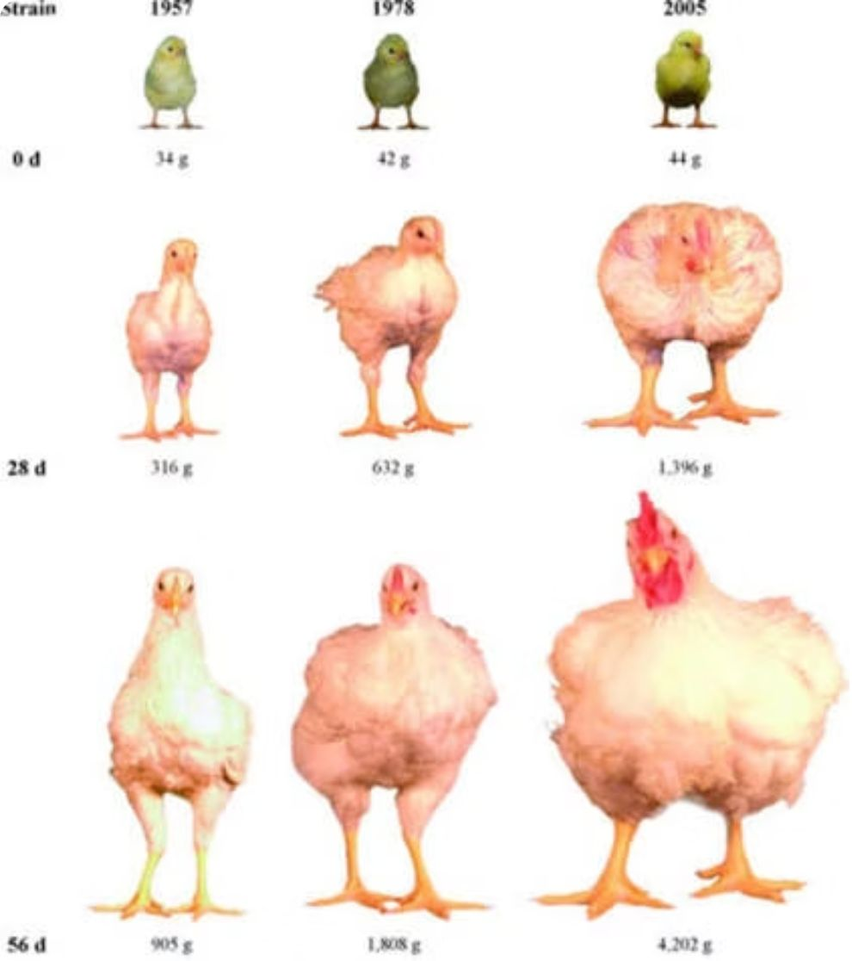
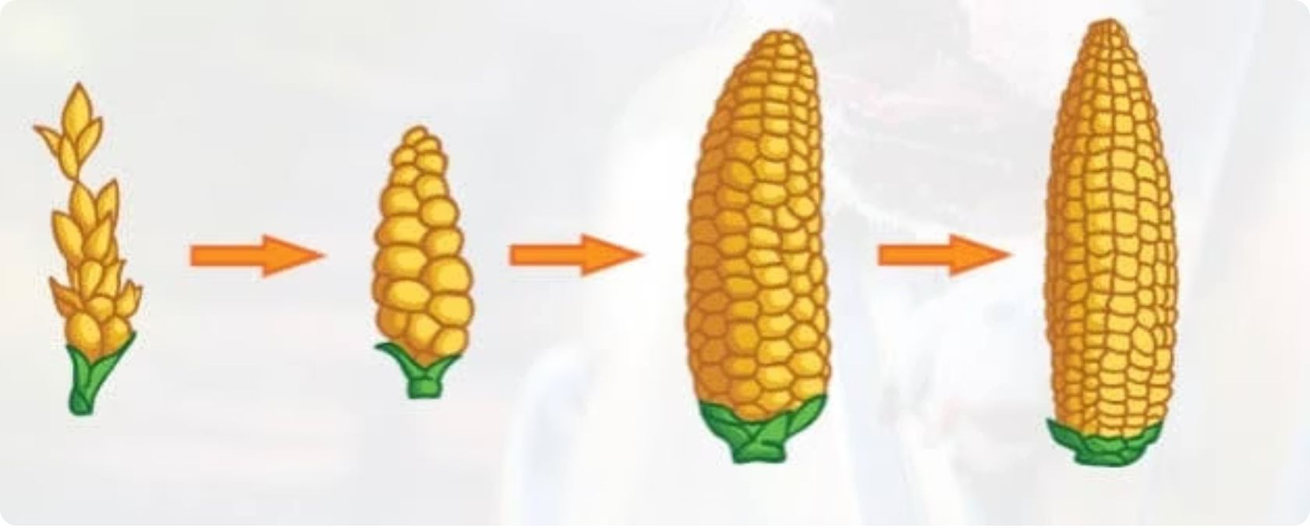

TRADITIONAL BIOTECHNOLOGY
Selective breeding: choosing traits over generations
Corn: each selected generation produces larger ears
Chicken lines: later strains grow larger birds
Selective breeding means choosing organisms with desired traits to be parents, so those traits become more common over generations.
It is a traditional biotechnology method: it works through reproduction and selection, not by directly editing DNA in a laboratory.
Takeaway: The breeder selects the parents; the next generations show more of the chosen trait.
Notes:
Selective breeding chooses parents with the traits we want, so those traits appear more often in later generations. The chicken strains and the corn ears show this over time. This is a traditional biotechnology method because it relies on reproduction and selection, not on editing DNA in a laboratory.

Slide 5
MODERN BIOTECHNOLOGY
Key building blocks of modern biotechnology
DNA
Gene
Stores hereditary information in living organisms.
Modern biotechnology can study, copy, transfer, or modify DNA.
A segment of DNA associated with a biological function or characteristic, like one instruction in the DNA book.
Genetic engineering
Recombinant DNA
The deliberate alteration of genetic material using biotechnology techniques.
DNA may be inserted, removed, or altered so a cell or organism expresses a desired trait.
DNA sequences combined in new arrangements that may not occur naturally.
Notes:
DNA stores hereditary information. A gene is one instruction in the DNA book. Genetic engineering deliberately alters genetic material so a cell or organism expresses a desired trait. Recombinant DNA combines DNA sequences in new arrangements that may not occur naturally.

Slide 6
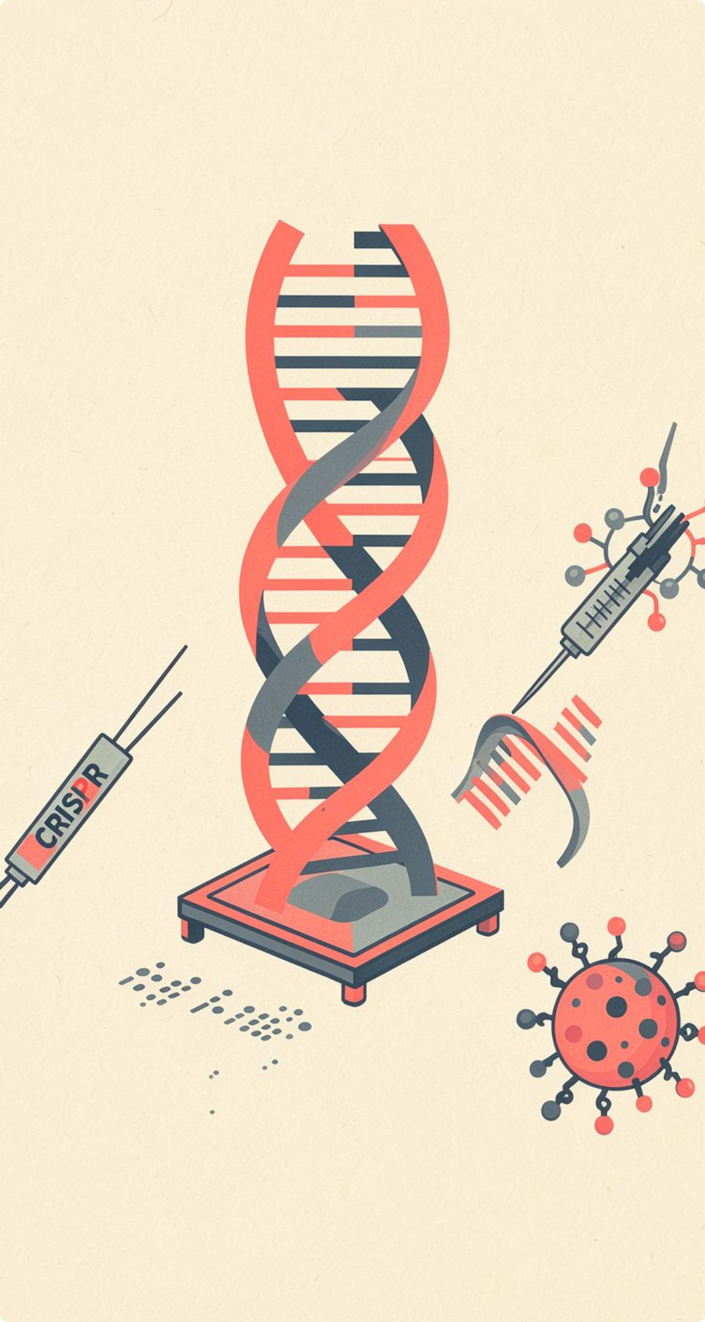




Four tools power the biotech revolution
Read
Edit
Read DNA faster through sequencing.
Edit genes with CRISPR and related tools.
Deliver
Design
Deliver instructions through RNA and engineered cells.
Design biological systems with synthetic biology.
Source: United Nations
Notes:
Use the four verbs as the organizing frame: read, edit, deliver, design. Each tool changes what scientists can do with biological information.
Textbook link: sequencing reads DNA, CRISPR edits genes, RNA and engineered cells deliver instructions, and synthetic biology designs biological circuits. Each tool expands what scientists can measure and build.

Slide 7
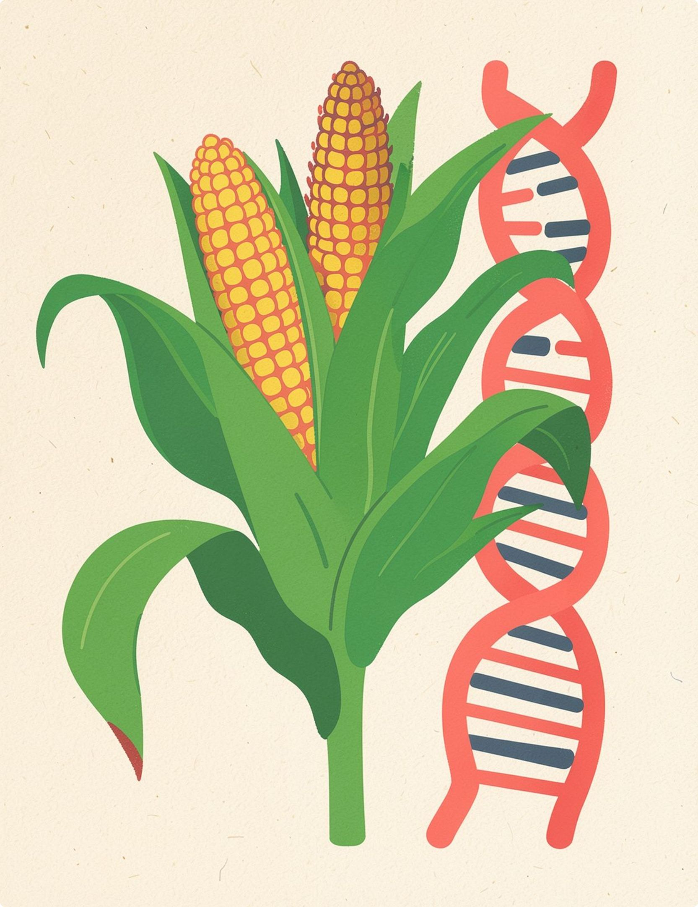
A DEFINITION
GMOs change an organism’s genetic instructions
A genetically modified organism has DNA altered in a way that does not occur through natural mating or recombination.
Examples include Bt corn, Bt eggplant, and golden rice.
Notes:
Emphasize the definition’s boundary: the change is genetic, and it is made in a way that natural mating or recombination would not produce.
Textbook examples: Bt corn, Bt eggplant, and golden rice. Bt corn carries a Bacillus thuringiensis gene so the plant produces a biopesticide that targets certain insects. Ask students to separate what the definition says from what each example does.

Slide 8

How a genetically modified organism is developed
A GMO is an organism whose genetic material has been deliberately altered using genetic engineering.
01
02
03
04
Identify the gene
Alter or insert
Select cells
Grow and study
Alter the gene or insert it into the new organism.
Select cells that contain the intended change.
Grow and study the organism to observe gene expression and the outcome.
Find the gene of interest linked to the desired trait.
Flow: gene of interest → altered DNA → selected cells → grown organism
The organism itself carries the genetic change. Selective breeding is not the same as genetic engineering.
Notes:
Walk through the four steps from left to right. Stress that the change is made deliberately in the DNA of the organism, which differs from selective breeding, where existing variation is chosen over generations.
Slide 6 gave the GMO definition and examples; this slide shows how one is built.

Slide 9
Why create genetically modified crops?
01
02
03
Protection
Better crops
Farm support
Genetically modified crops can protect plants from insects, viruses, and disease.
They can improve durability, nutrition, or price.
They help farmers manage weeds and crop loss.
Notes:
Explain the three main reasons for creating genetically modified crops: protection from insects, viruses, and disease; improved durability, nutrition, or price; and help managing weeds and crop loss.

Slide 10
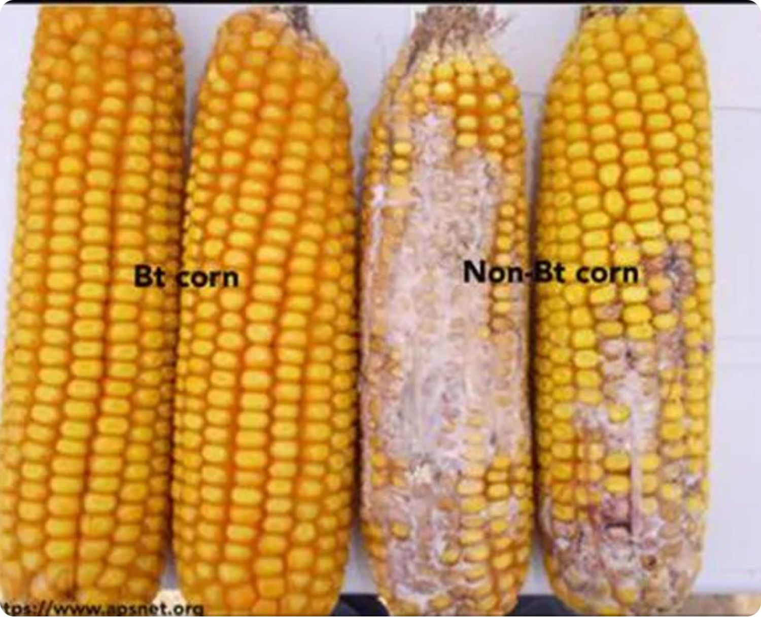
Bt corn
Bt corn carries a gene from Bacillus thuringiensis, a soil bacterium. The gene makes a protein that harms certain insect pests, so the plant resists them without extra spraying.
Purpose: fewer crop losses from insect damage.
Notes:
Bt corn is the first example in the textbook table. The bacterial gene makes a protein that is toxic to some insect pests but generally harmless to people.

Slide 11
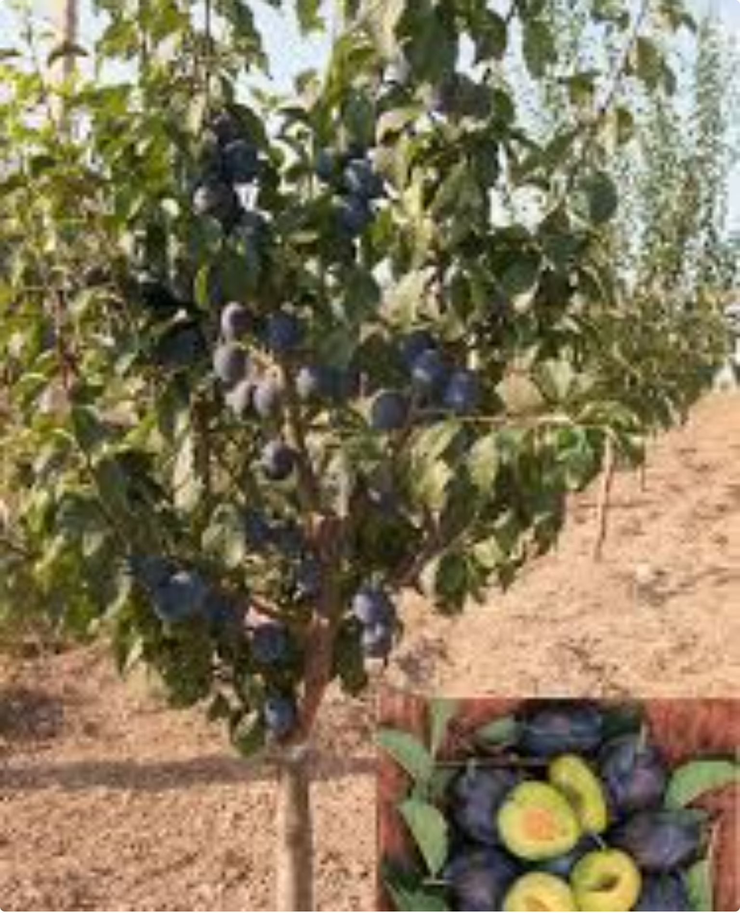
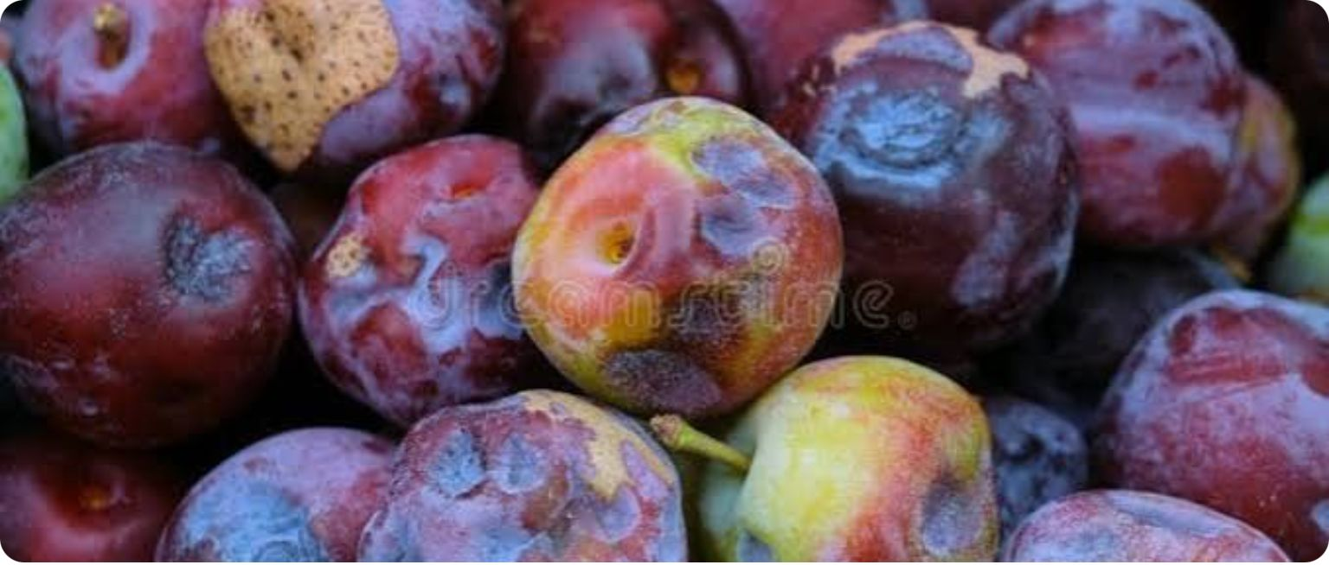
Virus-resistant plum
Scientists added a viral gene to this plum tree. The gene helps the tree resist plum pox virus, a disease that damages fruit and can destroy an orchard.
Purpose: protect the harvest from a viral disease.
Notes:
Virus resistance is a disease-control purpose. Plum pox virus is spread by aphids and has no cure once a tree is infected, so resistance protects both the fruit and the grower's investment.

Slide 12
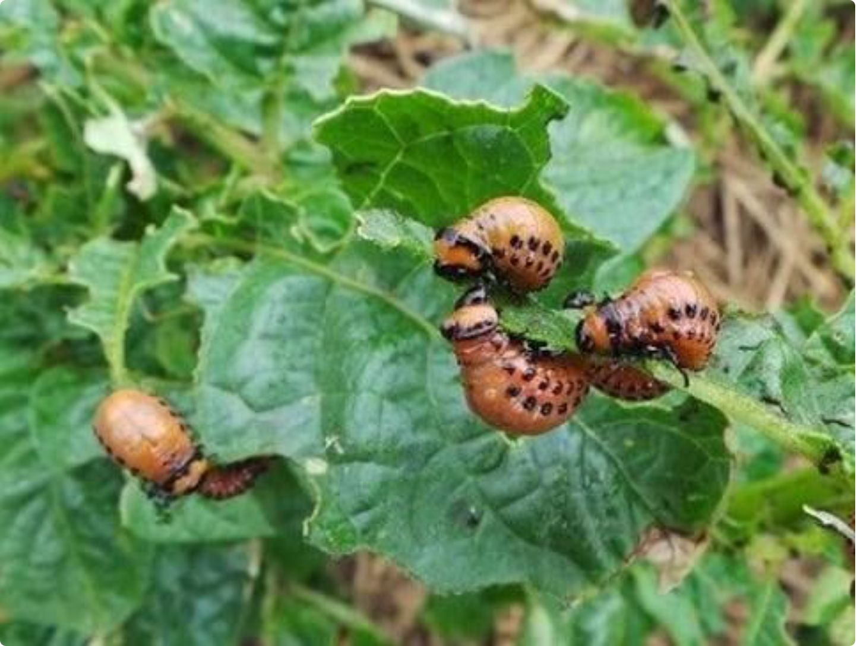
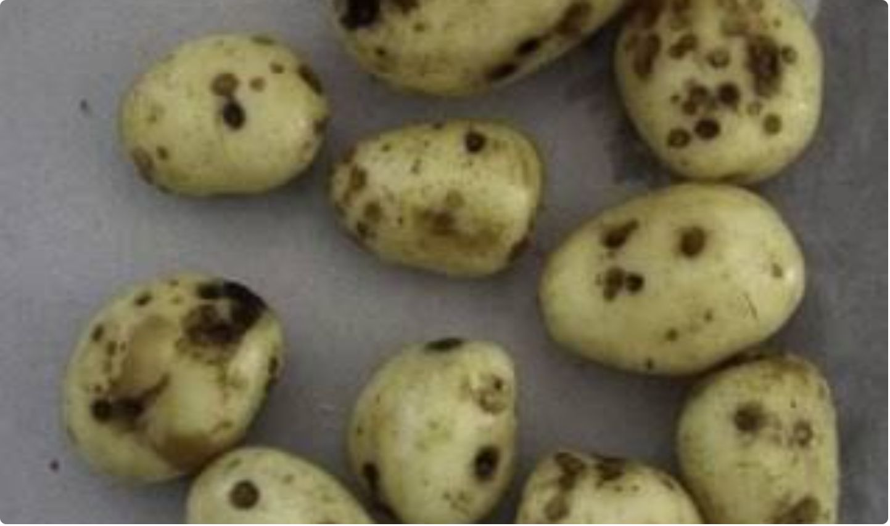
EXAMPLE 3 OF 5
Insect-resistant potatoes
Some potatoes carry a Bt gene. The plant makes a protein that is harmful to certain insects, such as the Colorado potato beetle, which eats leaves and reduces yield.
Purpose: reduce insect damage to the crop.
.
Notes:
Insect-resistant potatoes show the same Bt approach as Bt corn applied to another crop. Ask students why a plant that protects itself might need fewer chemical sprays.

Slide 13
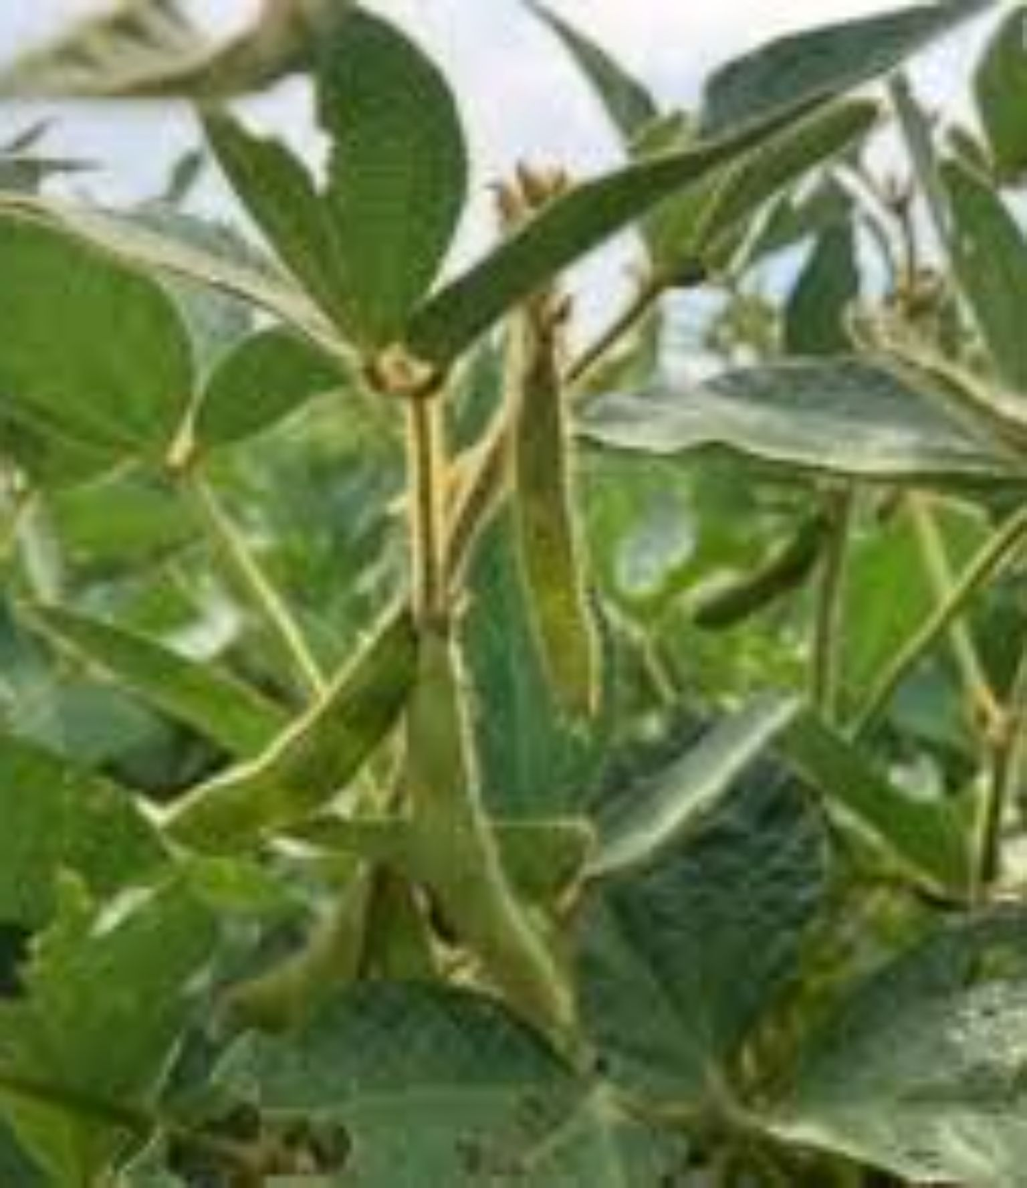
EXAMPLE 4 OF 5
Herbicide-tolerant soybeans
These soybeans can survive a herbicide that kills the weeds growing around them. Farmers can spray the field to control competing weeds while the crop keeps growing.
Purpose: help control weeds that compete with the crop.
Notes:
Herbicide tolerance is a management trait rather than a pest defense. Discuss why weed control matters for yield and why farmers may worry about weeds that become resistant to the herbicide.

Slide 14
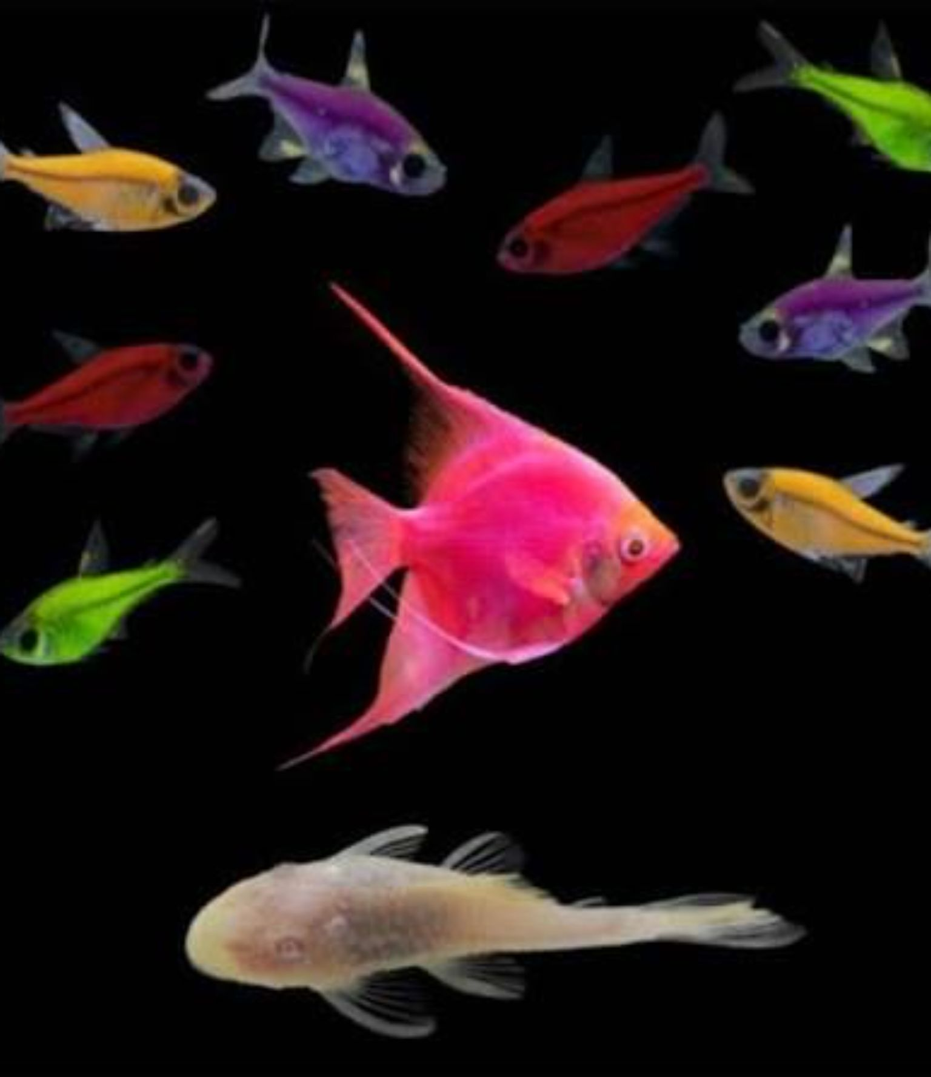
EXAMPLE 5 OF 5
Fluorescent GloFish
GloFish carry a gene from a fluorescent marine organism. The gene makes the fish glow under special light, a visible trait that is not related to food.
Purpose: show a genetically conferred trait that people can see directly.
Notes:
GloFish is a non-food example. Discuss its purpose as an ornamental pet and the ecosystem questions it raises if fish escape into the wild.

Slide 15

RECOMBINANT DNA
Recombinant DNA and recombinant insulin
1
2
3
4
Plasmid
Host bacterium
Insulin production
Purification
A circular DNA carrier receives the insulin gene.
The recombinant plasmid is placed into a bacterial cell.
Engineered bacteria act like biological factories and produce the desired insulin protein.
The insulin is filtered, separated, and polished into medicine.
Recombinant DNA is placed into a host cell, often bacteria using plasmids as carriers.
Engineered cells produce the desired protein.
Recombinant insulin is purified medicine.
The product is not the same as the GMO production system.
Notes:
Walk through the four steps in order: plasmid, host bacterium, insulin production, purification. Stress that the purified insulin is the medicine, while the engineered bacteria are only the production system.

Slide 16
RECOMBINANT DNA TECHNOLOGY
Recombinant DNA technology in plants
1
2
3
Build the recombinant plasmid
Introduce into plant cells
Regenerate the plant
Transfer the recombinant Ti plasmid into cultured plant cells.
Grow a whole plant from the cultured cells so it expresses the new trait.
Cut foreign DNA and the Ti plasmid from Agrobacterium tumefaciens with a restriction enzyme, then join them with DNA ligase.
Foreign DNA
Ti plasmid
Restriction-enzyme cut site
Inserted DNA carrying the new gene
Plant with a new trait
Notes:
Explain the three steps in order: build the recombinant Ti plasmid with a restriction enzyme and ligase, introduce it into cultured plant cells, then regenerate a whole plant that expresses the new trait.

Slide 17
HOW TRAITS ARE ADDED AND EXPRESSED
A borrowed gene gives the organism a new, visible trait
1
2
3
4
5
Source: Bacillus thuringiensis naturally makes an insect-damaging protein.
Copy: The Bt plasmid, a circular DNA, is copied.
Insert: The gene is inserted into corn embryo cells.
Grow: The plant grows and produces corn.
Result: Corn-borer pests feed, the Bt protein damages their gut, and the insect dies.
Genetically modified organism | Trait
Bt corn | Resistance to insect damage
Plum | Virus resistance
Golden rice | Beta-carotene, which the body converts to vitamin A
Bt eggplant | Resistance to insect damage
Potatoes | Resistance to insect damage
Soybeans | Control of dicot weeds
GloFish | Fluorescence
Genetically modified animals are used mainly to research diseases and treatments, and may support species conservation.
Notes:
Walk through the five Bt corn steps in order, then point to the table: each organism carries one introduced gene that produces a visible or useful trait.

Slide 18
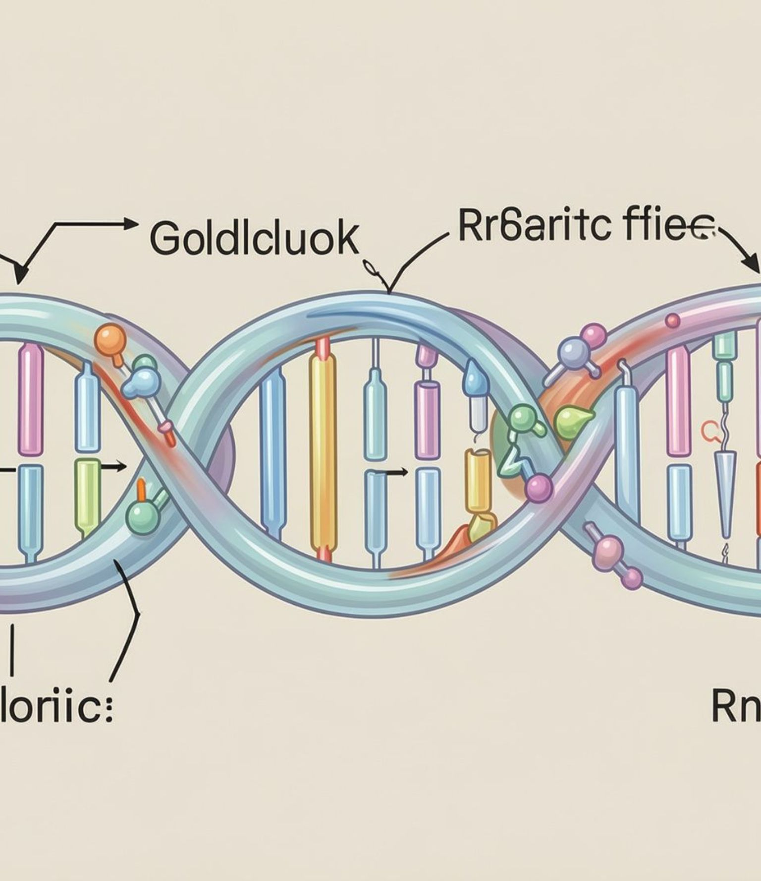
Gene editing: changing a specific DNA sequence
Gene editing is targeted alteration of DNA, often to disrupt a harmful gene or repair a mutation.
Example: CRISPR-based sickle-cell treatment edits a patient’s blood-forming cells to disable a disease-causing gene variant.
CRISPR (Clustered Regularly Interspaced Short Palindromic Repeats) is a powerful biotechnology tool that allows scientists to selectively and precisely modify the DNA of living organisms
Edit = change; Therapy = treat; Clone = copy.
Notes:
Definition sources: National Academies/NCBI explains genome editing and its relationship to gene therapy (ncbi-nlm-nih-gov-ec5c9045). Gene editing changes a specific DNA sequence. Ask students: what is being changed, and where does the tool find its target?

Slide 19
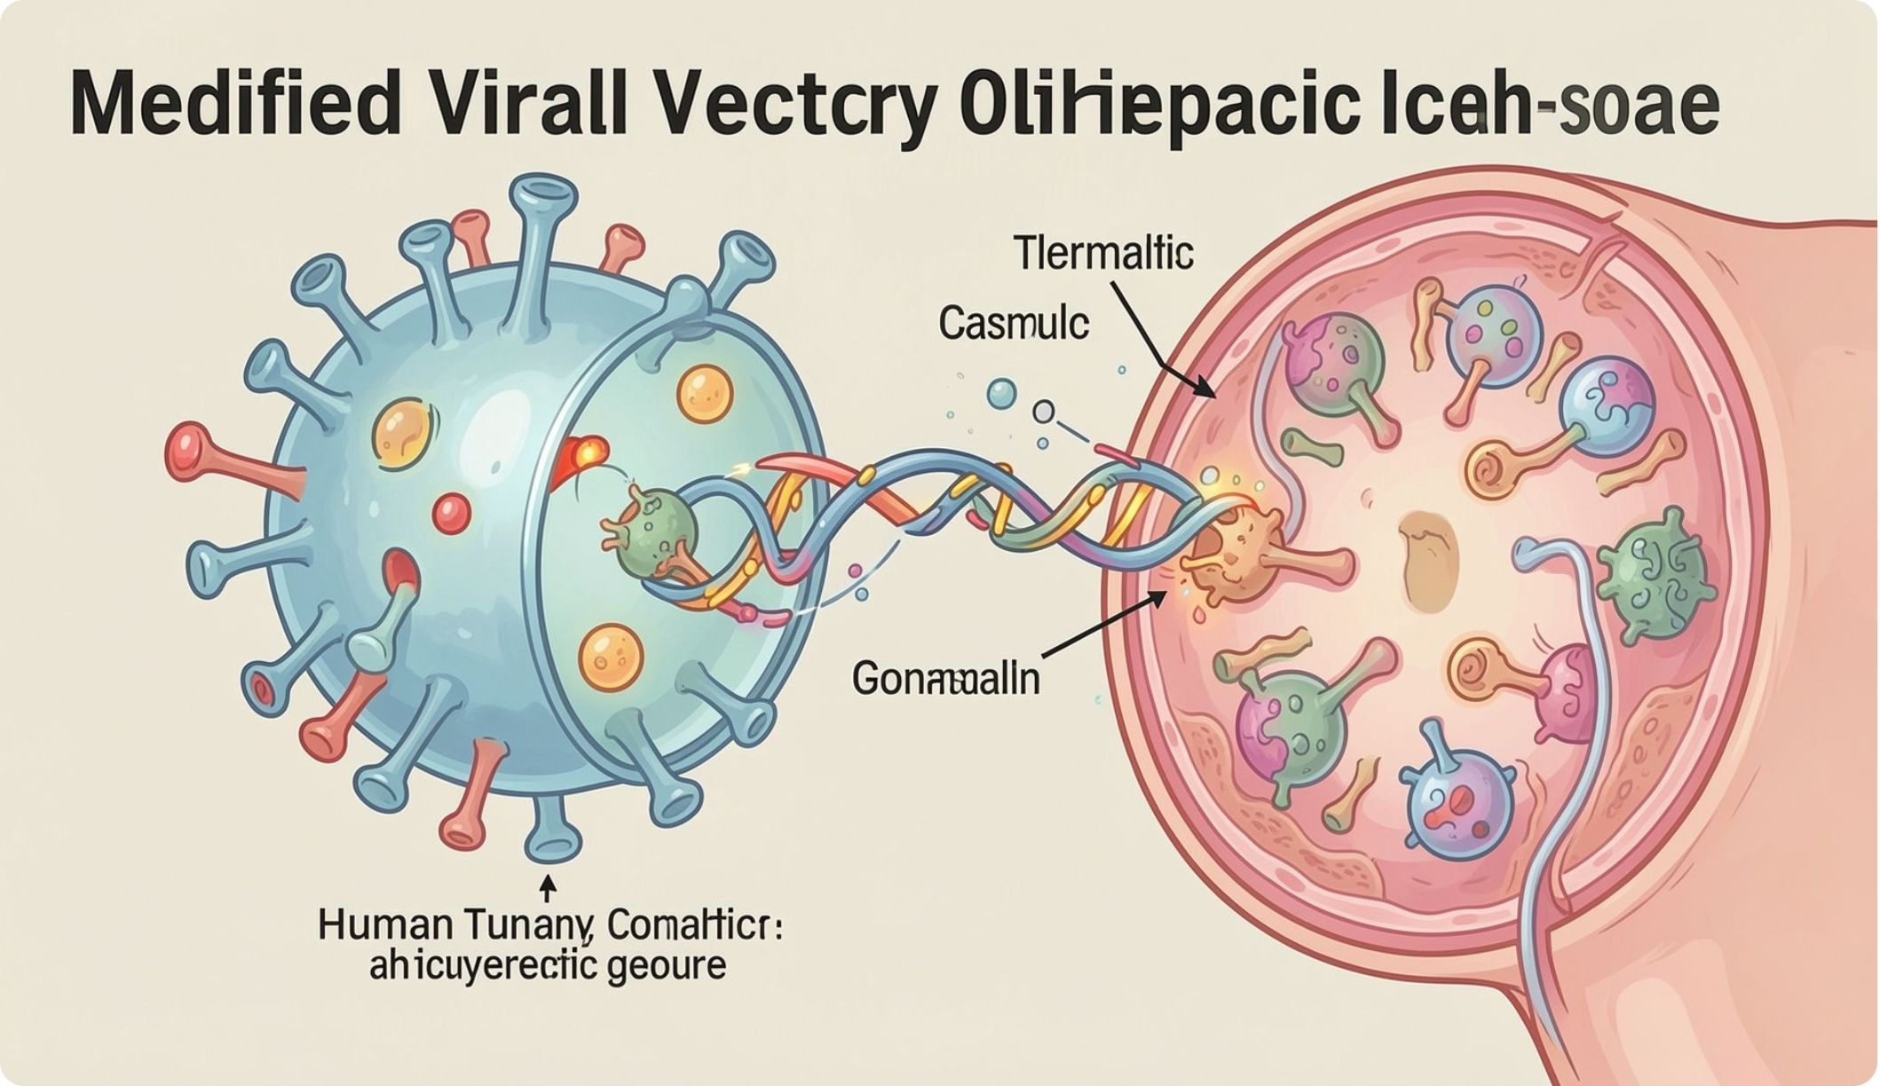
Gene therapy: delivering a treatment through genes
Gene therapy modifies gene activity, or adds, replaces, or inactivates genetic instructions, to treat or cure disease.
Example: a therapeutic gene is delivered into cells to restore a missing function, or a patient’s cells are modified outside the body and returned to the patient.
Edit = change; Therapy = treat; Clone = copy.
Notes:
Definition sources: FDA defines gene therapy as modifying genes to treat or cure disease, including replacing, inactivating, or introducing genes (fda-gov-947d7fa4). National Academies/NCBI relates genome editing to gene therapy (ncbi-nlm-nih-gov-ec5c9045). Ask students: how does the delivery vehicle get the gene into the right cell?

Slide 20
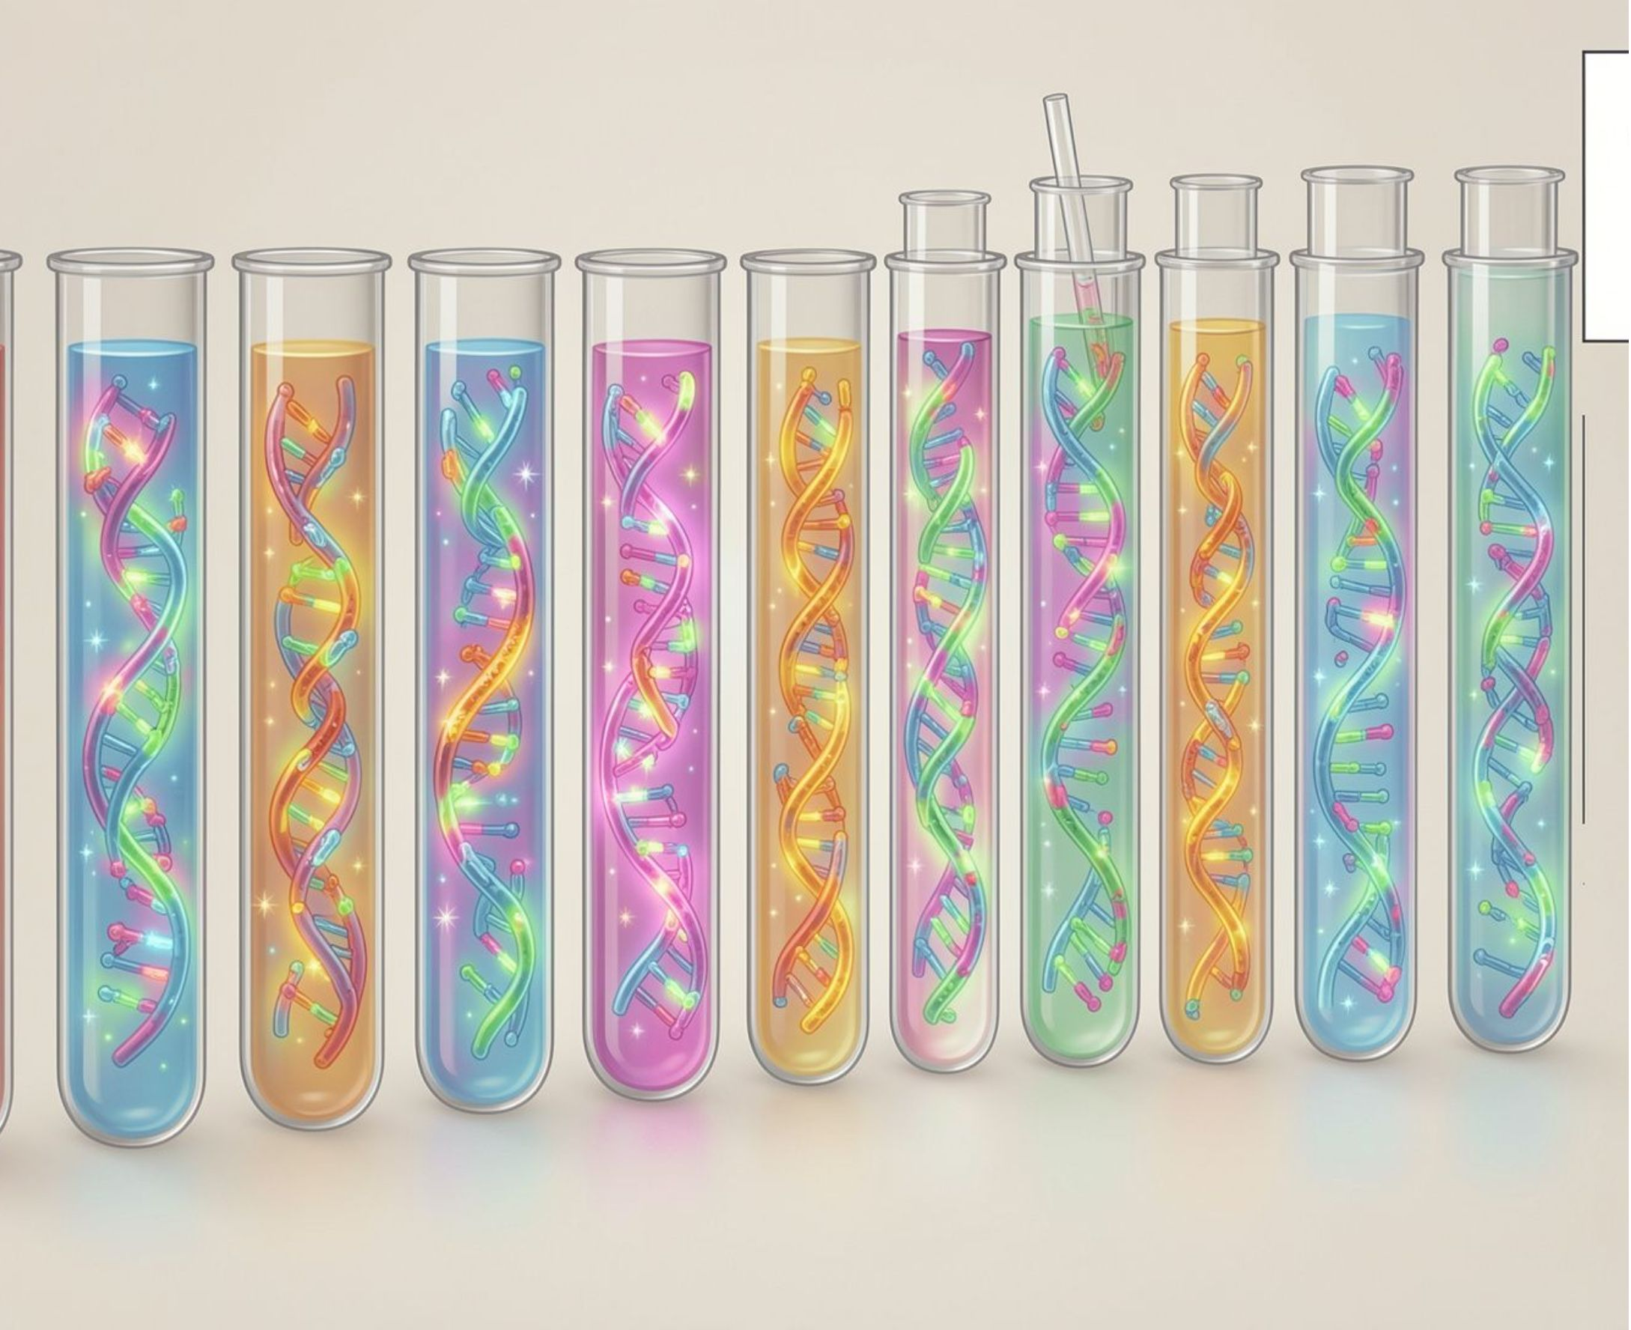
Gene cloning: making genetic copies
Cloning produces genetically identical copies of a gene, DNA segment, cell, tissue, or sometimes an organism.
Cloning copies genetic material.
Editing changes a sequence.
Therapy uses genetic change or delivery to treat disease.
Example: Dolly the sheep was a cloned animal, genetically identical to the adult it was copied from.
Edit = change; Therapy = treat; Clone = copy.
Notes:
Definition sources: NHGRI defines cloning as producing genetically identical copies, and distinguishes gene, reproductive, and therapeutic cloning (genome-gov-834c5e7a). Dolly the sheep is the classic example of reproductive cloning. Ask students: why is copying different from editing?

Slide 21
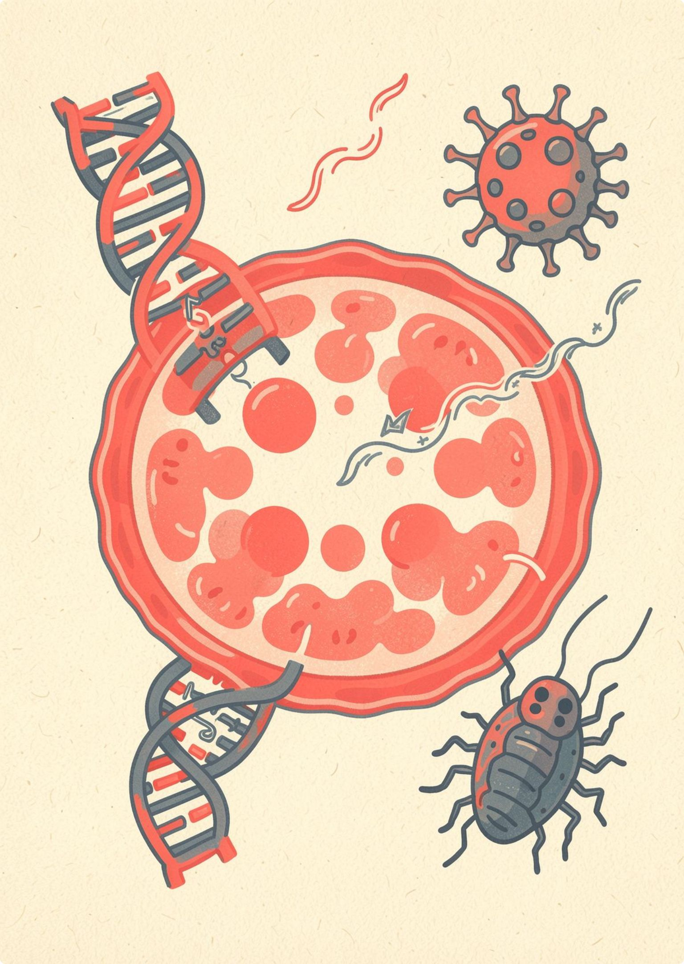
FROM CHEMISTRY TO INFORMATION
Medicine is moving from molecules to instructions
Biotechnology now works with DNA, RNA, viruses, bacteria, and human cells as potential tools for treatment and prevention. It include in vitro fertilization for infertility and stem-cell biotechnology for regenerative medicine and cancer-drug testing.
Source: National Academies of Sciences, Engineering, and Medicine
Notes:
Medicine still uses molecules, but the toolkit is expanding. DNA, RNA, viruses, bacteria, and human cells can each become part of a treatment strategy.
IVF steps in the textbook: check ovarian reserve and the uterus, evaluate sperm, fertilize the egg in a Petri dish, let the embryo develop, then transfer it. Stem cells are pluripotent, can support regenerative medicine, and can reduce animal testing in cancer-drug studies. Ethical questions include religious objections, the status of the embryo, and a person's right to know through GM-food labeling.

Slide 22
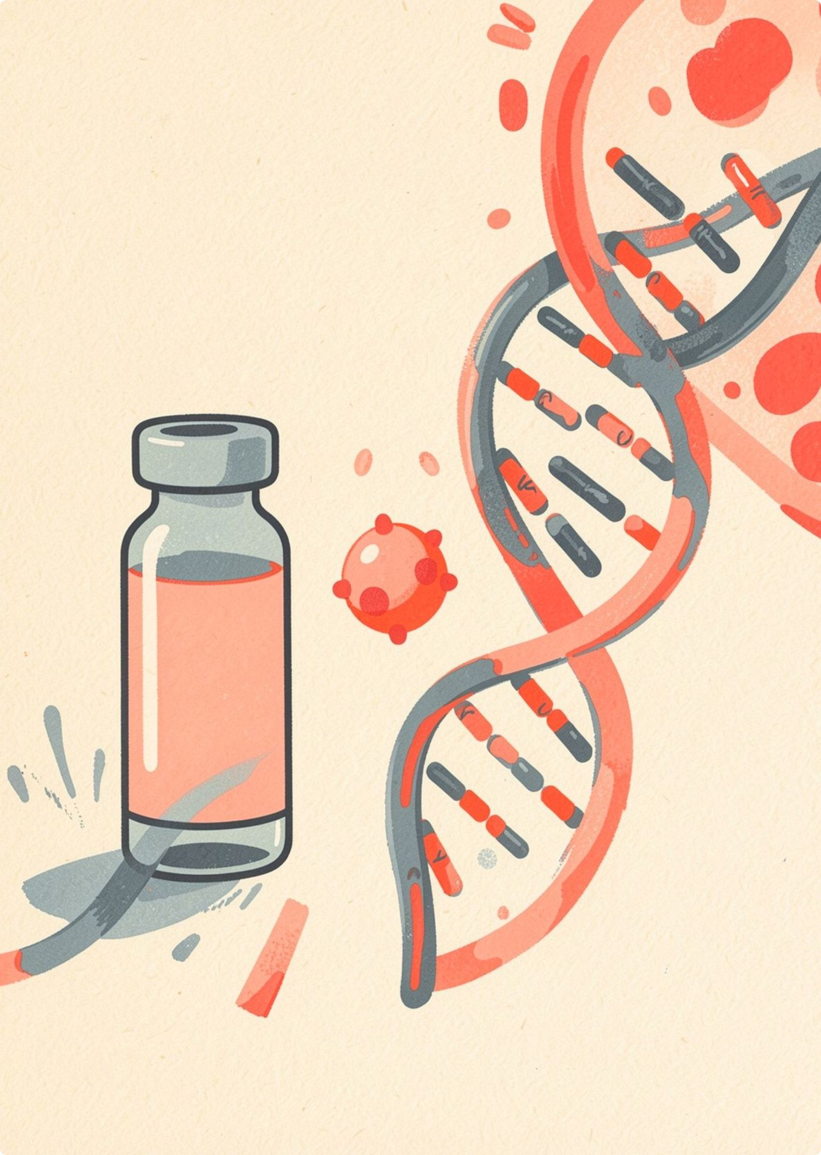
mRNA vaccines made a platform visible
Decades of work on messenger RNA and delivery systems enabled rapid vaccine development during COVID-19 and opened a broader therapeutic platform.
01
02
03
Message
Delivery
Response
mRNA carries temporary instructions.
A delivery system helps it reach cells.
Cells make a target that trains immunity.
Sources: National Academies; Cell
Notes:
Explain why mRNA is described as a platform. The same basic idea, with different instructions, can support different targets. The COVID-19 vaccines made that possibility visible to the public.
Connect this to the textbook's advantages of biotechnology: vaccine development and rapid response to disease. The platform idea can be explored for other targets, but each new use needs its own evidence.

Slide 23
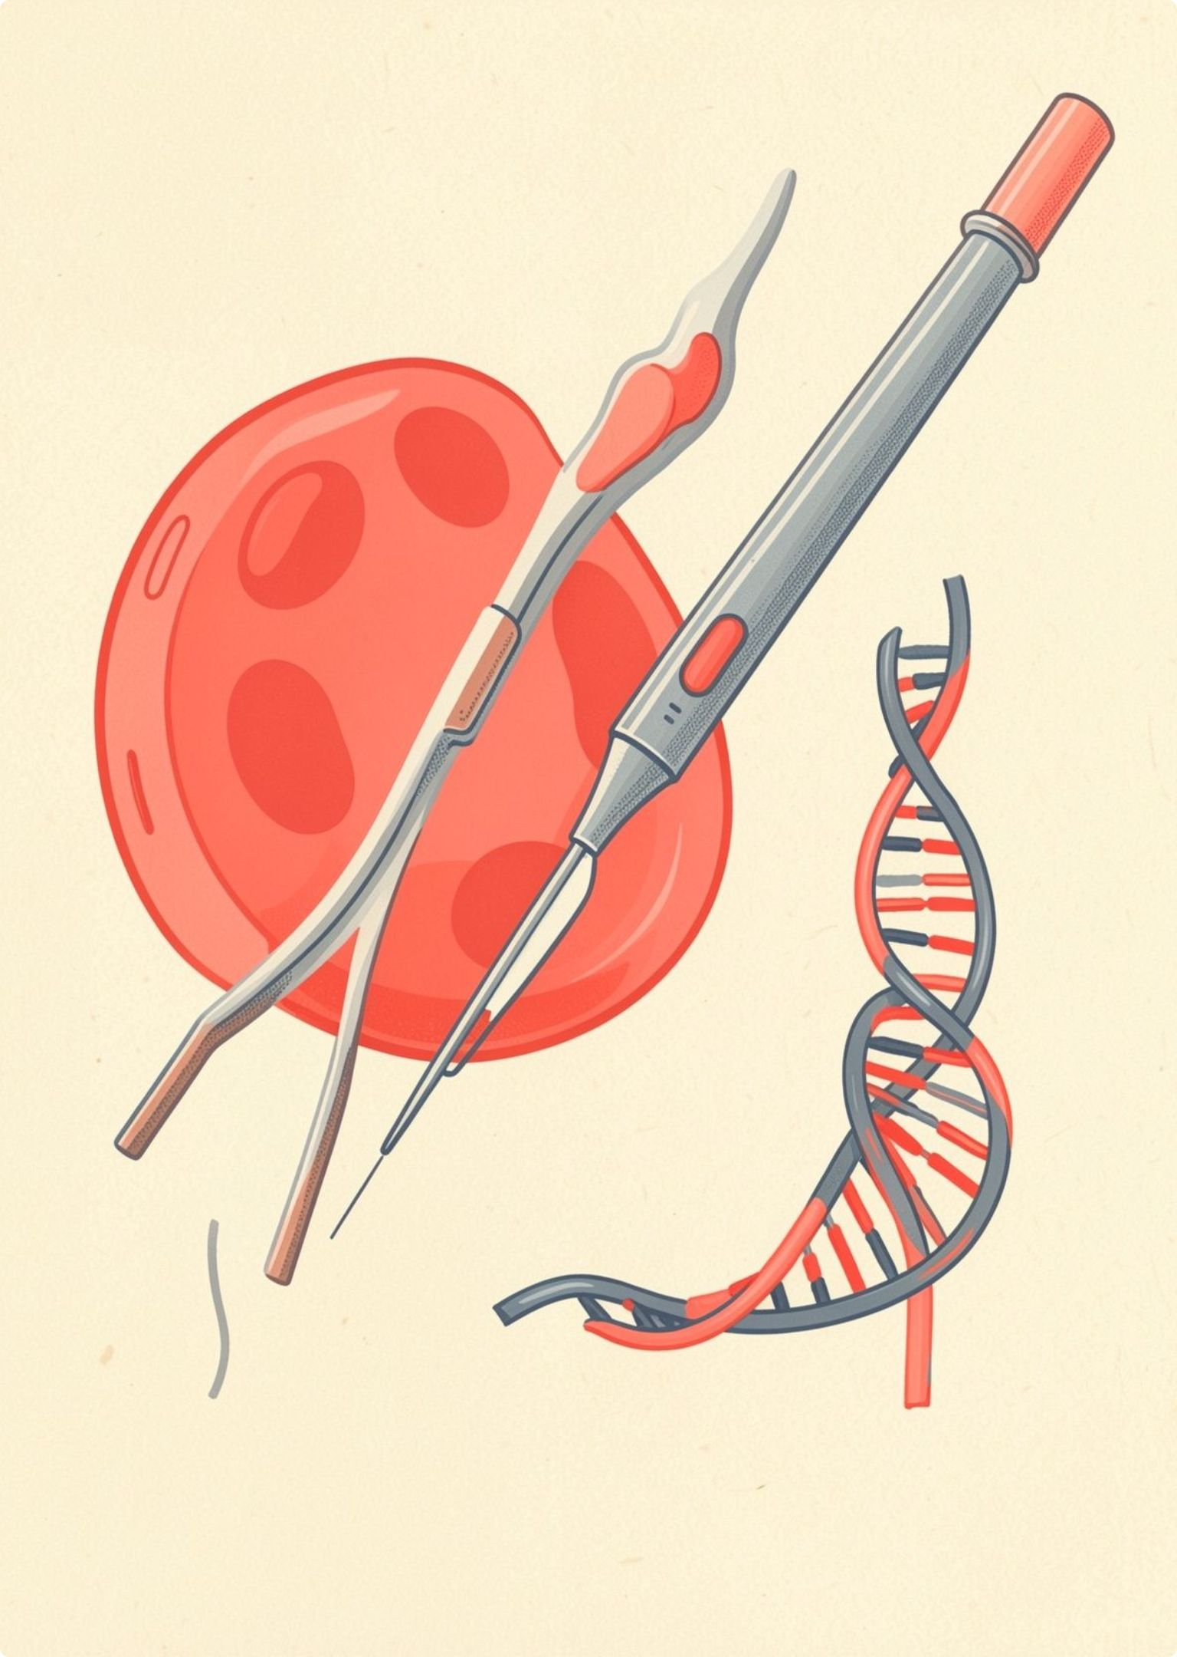
FROM TOOL TO TREATMENT
CRISPR turns gene editing into a clinical tool
Gene editing aims to correct, disable, or replace genetic instructions inside cells.
01
02
03
Find
Edit
Treat
Locate a chosen DNA sequence.
Change the instructions inside cells.
Return edited cells to address disease.
The first CRISPR-based treatment for sickle-cell disease was approved in the United States in 2023. Source: United Nations
Notes:
Close on the transition from laboratory capability to clinical use. CRISPR is not a magic repair button, but it has become part of an approved treatment pathway, including a treatment for sickle-cell disease approved in the United States in 2023.
Use the textbook's ethics questions as discussion prompts: who should decide how gene editing is used, and how should patients and the public be informed?

Slide 24
IVF helps fertilization happen outside the body.
In vitro fertilization (IVF) is a modern biotechnology treatment in which eggs and sperm meet in a laboratory, helping people with some fertility problems.
Used when fallopian tubes are damaged, ovulation is disrupted, endometriosis is present, or sperm production is impaired.
Before treatment, clinicians check ovarian reserve, uterine health, and sperm quality.
Sources: course textbook; HFEA IVF information; Guy's and St Thomas' NHS.
Notes:
IVF is a treatment that brings eggs and sperm together in a laboratory. The textbook lists damaged fallopian tubes, ovulation disorders, endometriosis, and impaired sperm production as reasons it may be used.
The textbook also describes checks before treatment: ovarian-reserve testing, uterine health checks, and sperm evaluation. Stress that treatment, risks, and outcomes vary by person.

Slide 25
THE IVF PROCESS
The IVF procedure: from assessment to embryo transfer
01
02
Assess
Stimulate
Check ovarian reserve and uterine health.
Use fertility medicines to produce several eggs.
03
04
Collect
Fertilise
Collect the eggs and prepare a sperm sample.
Combine eggs and sperm in a lab dish. ICSI injects one sperm into an egg.
05
06
Culture
Transfer
Grow embryos for about two to six days while the team assesses them.
Place a selected embryo in the uterus using a thin catheter.
07
Freeze
Freeze suitable remaining embryos when appropriate.
Treatment, risks, and outcomes vary by person. Discuss them with a qualified fertility clinician.
Notes:
The steps follow the textbook and official sources. HFEA confirms ovarian stimulation, egg collection, laboratory fertilisation, embryo development for two to six days, embryo selection, transfer, freezing, and ICSI.
Guy's and St Thomas' NHS describes the five-stage cycle of medicines, egg collection, sperm collection, fertilisation, and embryo transfer, and describes ICSI as injecting a single sperm into an egg. Remind students that outcomes vary and that a fertility clinician should guide any decision.

Slide 26
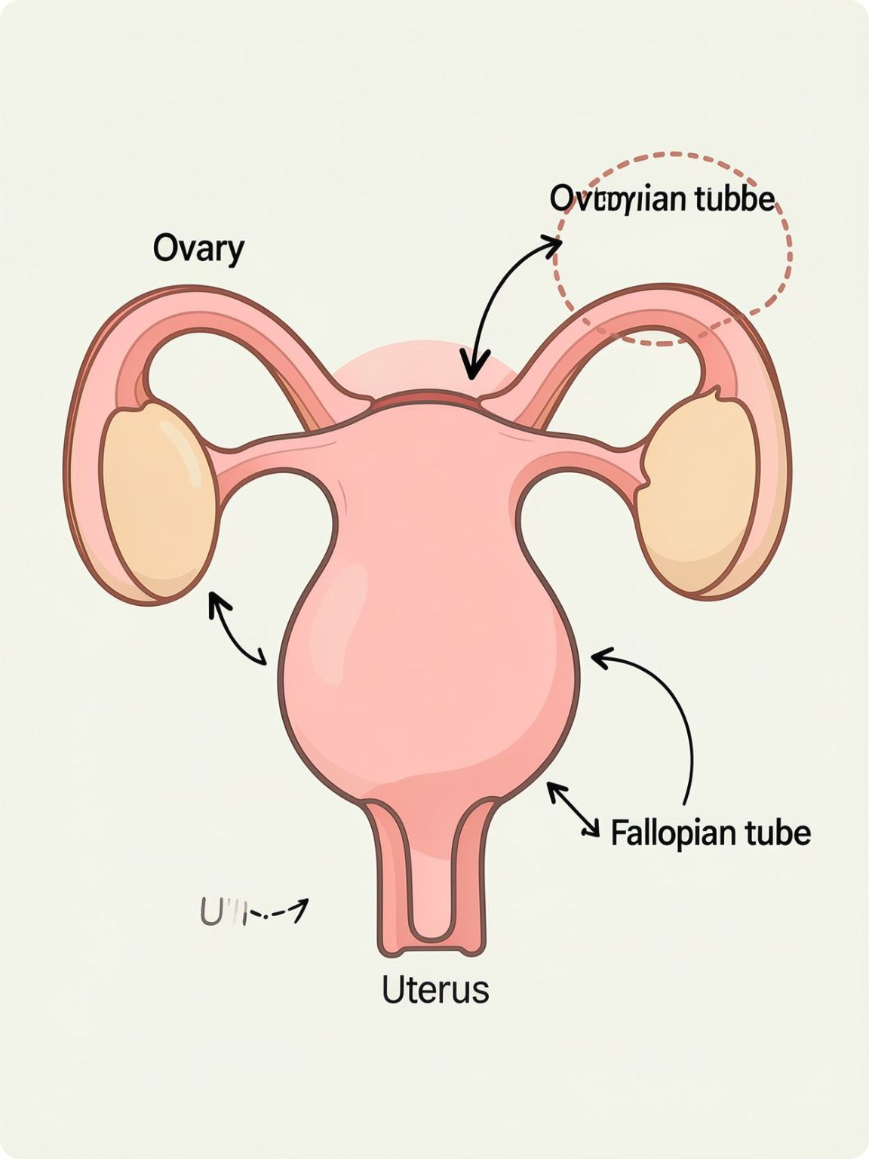
THE IVF PROCESS · PART 1
Before the laboratory work begins
01
02
Consult
Test ovarian reserve
Review fertility history and the treatment goal.
Measure how many eggs may be available.
03
04
Scan the uterus
Evaluate sperm
Use ultrasound to check the uterus.
Test the sperm sample for quality.
05
06
Agree the plan
Start medicines
Discuss the plan, possible risks, and consent.
Use medicines to control and stimulate the ovarian cycle.

Slide 27
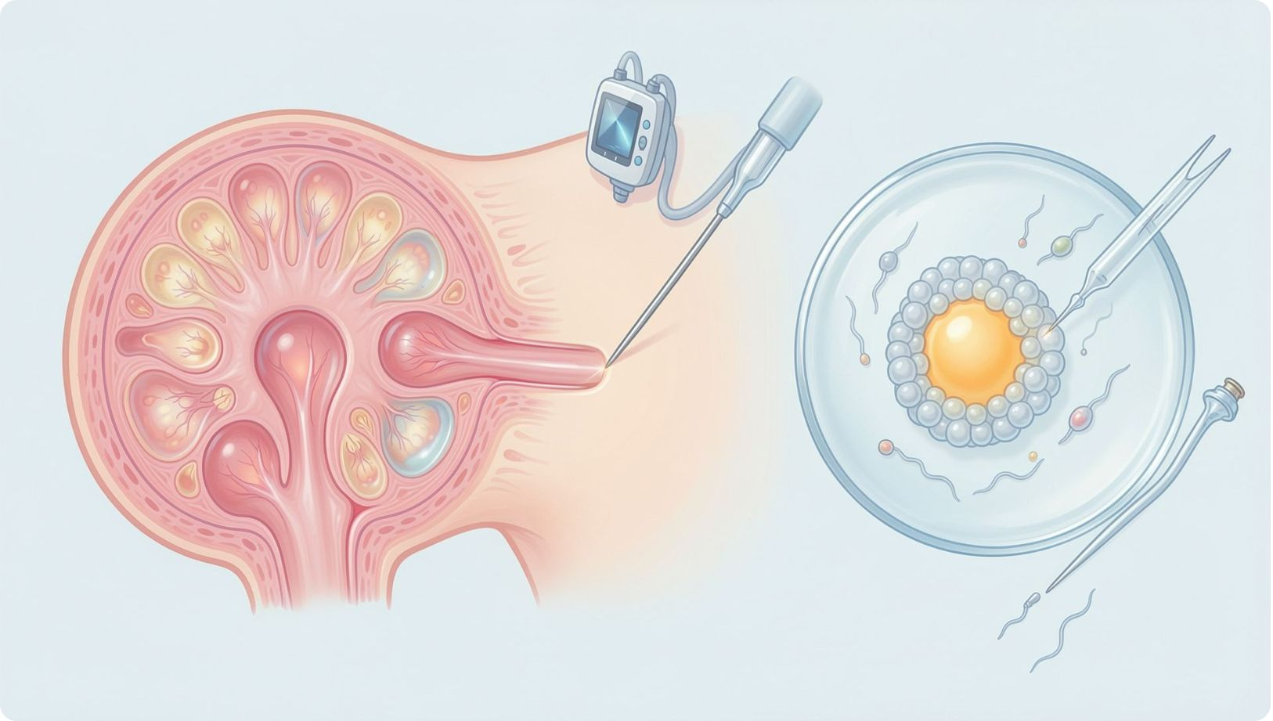
THE IVF PROCESS · PART 2
Egg retrieval and fertilization
Ovarian stimulation →
Follicle monitoring →
Egg retrieval →
Sperm preparation →
Fertilization in a dish →
Optional ICSI
01
02
03
04
Monitor
Trigger
Retrieve
Prepare sperm
Track follicle growth.
Give a trigger medicine when eggs are ready.
Collect eggs from the ovaries.
Collect and prepare a sperm sample.
05
06
07
Combine
ICSI, if needed
Check
Place eggs and sperm together in a laboratory dish.
Inject one sperm into an egg.
Check for fertilization.

Slide 28
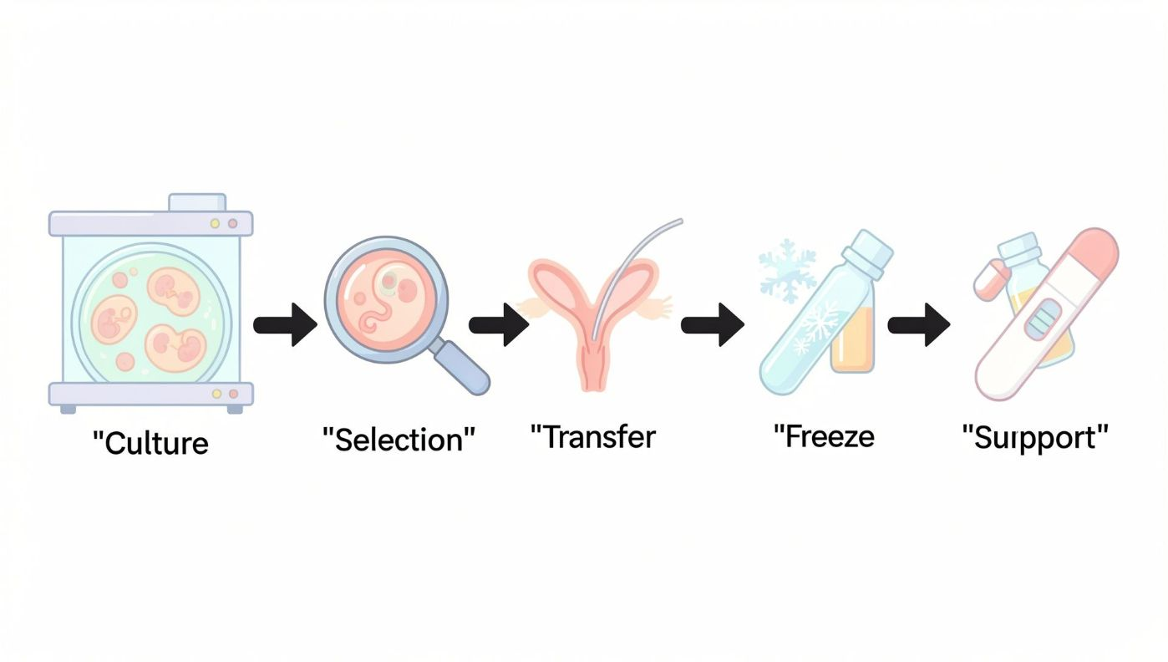
THE IVF PROCESS · PART 3
Embryo culture, transfer, and follow-up
01
02
Culture
Assess
Let embryos develop in the lab for two to six days.
Check embryo development and select one.
03
04
Transfer
Freeze
Use a thin catheter to place the embryo through the cervix into the uterus.
Freeze suitable remaining embryos when appropriate.
05
06
Support
Test
Continue prescribed hormonal support.
Take a pregnancy test after the transfer.
IVF outcomes and medical decisions vary by person. Work with a qualified fertility clinician.

Slide 29
ETHICAL IMPLICATIONS · 1 OF 3
Human health and safety come first
Altered foods may cause allergic reactions or unintended effects.
Contamination or laboratory leakage can spread risk beyond the lab.
Testing and long-term monitoring are needed before and after use.
Informed consent matters in IVF, gene therapy, and stem-cell research.
Risk triangle
Prevent: contain risks at the source
Test: check safety before use
Monitor: track effects over time
Classroom prompt: Which corner of the triangle is weakest today?
Notes:
Discuss how the textbook examples of contamination and mutation are prompts for thinking, not proven outcomes.

Slide 30
ETHICAL IMPLICATIONS · 2 OF 3
Ecosystems can change in ways we cannot easily reverse
Genes can flow to non-target organisms, including wild relatives.
Native populations and food chains may be disrupted.
Ecological imbalance can reduce biodiversity in unexpected ways.
Containment, long-term monitoring, and responsible management are essential.
Genetic material from microbes used in crops could combine with genes in non-target crops.
Unintended changes could favor more harmful microbes or affect human health.
GM crops may influence food chains and non-target species.
The textbook uses monarch butterflies as a classroom example of wildlife concerns.
Ecosystem network
Crop → insects and birds → wild plants → soil and water
A change at one node can ripple through the whole web.
Textbook prompt: the monarch butterfly example. Discuss what evidence would be needed to show a real effect.
These are potential impacts that need evidence, testing, and long-term monitoring, not universal outcomes.
Notes:
Frame these as questions for classroom discussion. Not every release produces these effects; the point is how to detect and manage them.

Slide 31
ETHICAL IMPLICATIONS · 3 OF 3
Who benefits, who decides, and who gets a voice?
Cost and unequal access to biotech foods and medical procedures.
Possible loss of traditional farming practices.
The right to know through GM-food labeling.
Religious and cultural objections, and the status of embryos in IVF.
Public participation and ethical oversight.
Student discussion
What level of risk is acceptable?
Who should make the decision?
How can benefits be shared fairly?
Stakeholders to weigh: farmers, consumers, scientists, patients, and communities.
Notes:
Balance the stakeholder views. Invite students to argue from more than one position.

Slide 32
ETHICAL IMPLICATIONS · STEM CELLS
Stem-cell biotechnology: promise and moral boundaries
Medical promise
Ethical questions
Stem cells are pluripotent, so they can become many cell types.
Regenerative medicine can repair damaged tissue and replace lost cells in degenerative disease.
Researchers grow and test treatments and study cancer.
Some animal testing may be reduced.
Some religious and cultural groups object to manipulating living organisms or using in-vitro embryos.
People may disagree about the moral status of embryos.
GM-food labeling supports the right to know what we buy and choose what we eat.
Discussion prompt
How should scientific potential be balanced with beliefs, consent, transparency, and respect for human life?
Notes:
Present both columns as perspectives, not conclusions. Invite students to weigh the medical promise against the ethical questions.

